Slide 1

Committee on Earth Observation Satellites
10 years of
COSMO-SkyMed
Italian Space Agency
CEOS Plenary 2017
Agenda Item 4.8
Rapid City, South Dakota, USA
19 – 20 October 2017

Slide 2
10 years of COSMO-SkyMed
https://drive.google.com/file/d/0B3raIQaN1eb-eG1GaHZRVURfM00/view

Slide 3
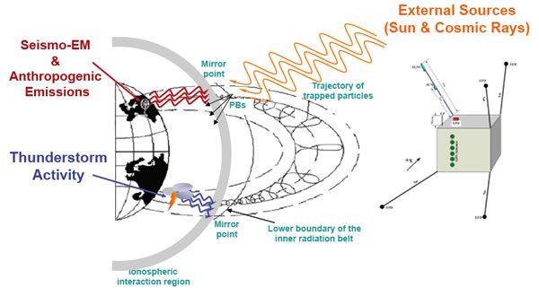
Forthcoming 2018
CSES - China Seismo-Electromagnetic Satellite
ASI-CNSA collaboration program
Italian High Energy Particle Detector (HEPD);
scientific mission: monitoring electromagnetic field and waves, plasma and particles perturbations of the atmosphere, ionosphere and magnetosphere induced by natural sources and anthropocentric emitters;
study their correlations with the occurrence of seismic events;
Launch date: February 1st, 2018;
PRISMA: PRecursore IperSpettrale della Missione Applicativa
Mission Objectives: pre-operational (improvements are on-going) and technology demonstrator, focus on space qualification of PAN/HYP payload and development and production of PAN/HYP products up to Level 2d
Program Highlights:
  National program
  Fully funded by ASI
  Mission includes System, interacting with Target and Users
  System B2/C/D/E1 contract running
  S-CDR
  Launch date: May 28th, 2018

