Slide 1

USGS Status
Committee on Earth Observation Satellites
Frank Kelly, USGS EROS
CEOS Plenary 2017
Agenda Item #4.14
Rapid City, South Dakota, USA
19 – 20 October 2017

Slide 2
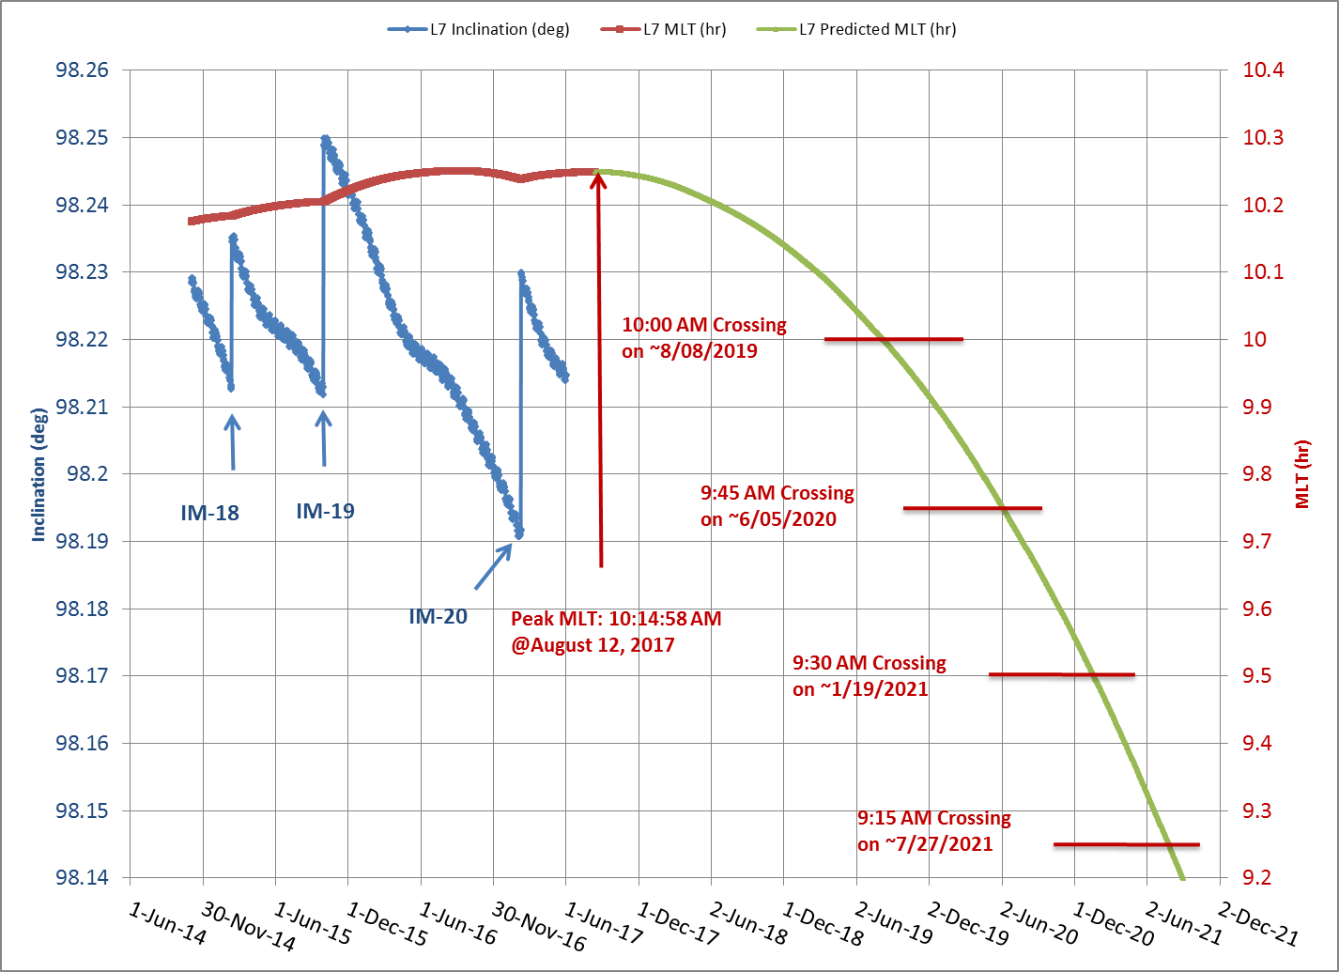
Landsat 7 End of Life
Landsat 7 achieved it peak MLT of 10:14:58 AM on 12 August 2017
No additional inclination maneuvers are possible
Landsat 7 science mission is no longer viable once MLT reaches 9:15:00 AM in July 2021

Slide 3
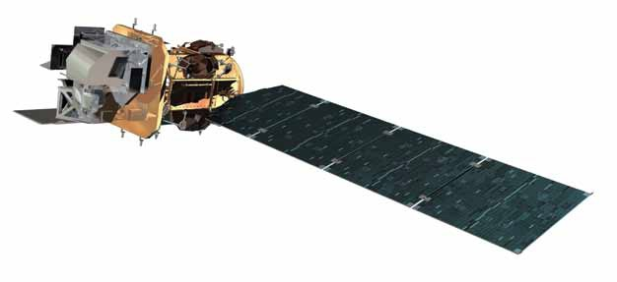
Landsat 8 Overview
Acquiring land surface data at a rate of ~740 scenes per day via a continental and seasonal acquisition strategy
  All land imaging
Acquiring numerous ascending (night imaging) data in support of Western Hemisphere fire season & disaster monitoring
Performing off-nadir imaging campaigns of Greenland and Antarctica regions
On-orbit performance of Landsat 8 observatory continues to be outstanding;
  Geometric and Radiometric performance continues to be highly stable
  TIRS alternative operations concept ensuring availability of TIRS instrument data for the long-term
  No spacecraft or instrument anomalies since September 2015
  On-board mission data management highly effective – Solid State Recorder averaging 70% margin
Landsat 8 Ground Network (LGN) robust – system averaging greater than 20% margin
  LGN comprised of diverse partnerships: LGS (USGS), GLC (NOAA), NSN (DLR), ASN (GA), and SGS (NSC/KSAT)
Highly engaged international community - 23 active International Cooperator stations
Notes:
Final

Slide 4
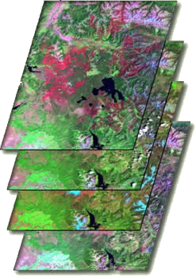
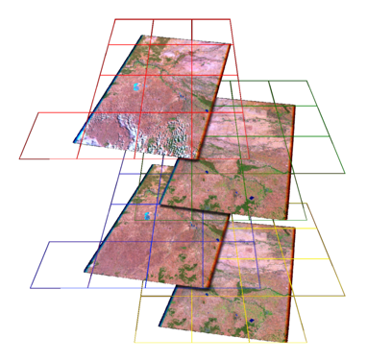

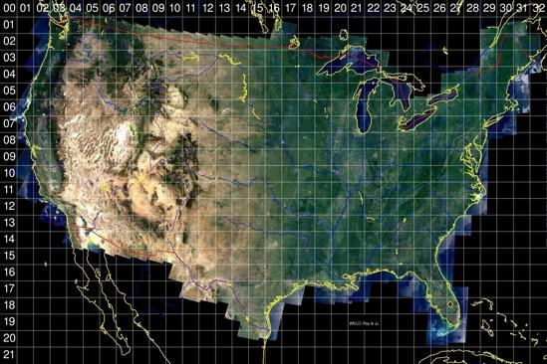
Landsat Analysis Ready Data (ARD)
Landsat ARD is data that is consistently processed, gridded to a common cartographic projection, and accompanied by appropriate metadata to enable further processing while retaining traceability of data provenance. It includes:
  Top of Atmosphere Reflectance
  Surface Reflectance
  Brightness Temperature
  General and Per-Pixel Quality Metadata
U.S. Landsat ARD has been created from the TM, ETM+, and OLI/TIRS record (1982 – present)
  Key input to USGS Land Change Monitoring, Assessments, and Projections (LCMAP)
  Will be available to the public in early November
Landsat Global ARD will be included with Collection 2 production early in 2019
Will maximize Landsat / Sentinel-2 Interoperability
Projection and product
format specifications in
work through a set of pilots
and community feedback
Notes:
LCMAP is founded on the principle that the use of all available Landsat data will enable the automated generation of accurate land cover and land change products. The Landsat archive, currently organized as path rows, is not sufficiently efficient for time series studies. Moving to a grid-based data cube approach with API’s that condition and serve data per user specification will reduce data preparation time.
Global ARD includes a major shift in the way Landsat data is used
Access through “grids” of information enabled at the area of interest level
Eliminates many of the complexities and time consuming processing activities to make data ready for applications
Includes access to pixel level metadata (quality bands) that enable efficient filtering of data (e.g. cloud filtering)
Includes efficient standardized APIs for data access
Includes advanced visualizations techniques
For Additional information see https://landsat.usgs.gov/ard

Slide 5
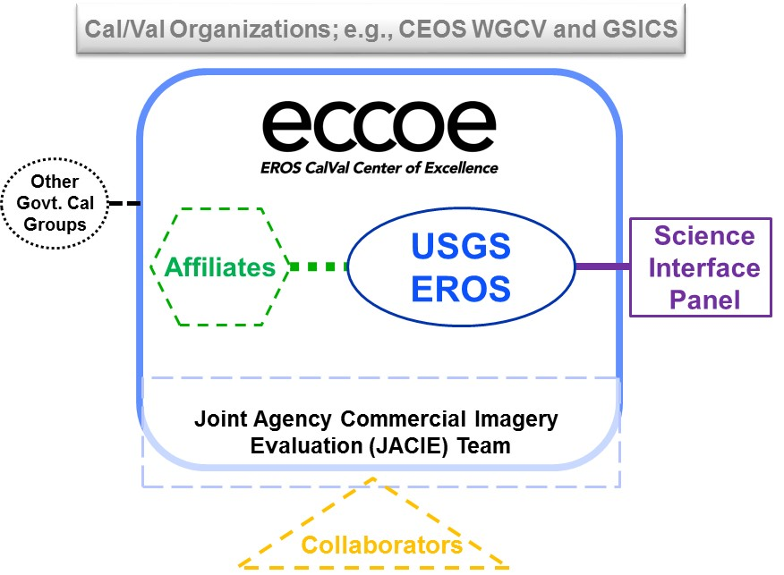
USGS EROS Calibration Center of Excellence (ECCOE)
A recognized nationally and internationally leading organization for effectively improving the accuracy, precision, and efficiency of radiometric, geometric, and spatial characterization, calibration, and cross-calibration of optical remote sensing systems to achieve the highest degree of interoperability of remote sensing data products.“
Objectives
  Develop advanced methods to perform radiometric/geometric/spatial characterization and calibration of optical remote sensing systems to improve the accuracy and precision of all derived data products.
  Develop new and improved methods for the cross-calibration of optical remote sensing systems for continuous improvement of the interoperability of data products.
  Provide the expertise and advocacy necessary for the acquisition of new measurements that continue to improve optical remote sensing data quality, coverage, and expanded usefulness for science applications.
  Develop mutually beneficial partnerships within USGS/DOI, across other government agencies, and throughout the industry.

Slide 6
Future Path for Landsat Products
USGS remains committed to high-quality Landsat data
Science needs more than Top of Atmosphere Reflectance
  Higher-order products needed – surface reflectance and beyond
  All require very stable, accurate inputs
Moving toward higher-order products
  Develop new calibration and validation methods for these products
  Establish, maintain interoperability with other large systems (for example, Landsat-Sentinel-2 cross-calibration)
  Collaborate with others in cross-sensor, cross-dataset comparisons
Work with government agencies, nations, universities, and industry
  Develop new methods, resources, collaborations
  Promote high-quality data and interoperability

