Slide 1
Copernicus Programme
Committee on Earth Observation Satellites
European Commission
CEOS Plenary 2017
Agenda Item # 4.9
Rapid City, South Dakota, USA
19 – 20 October 2017

Slide 2
Copernicus - current status
Major Milestones reached:
Budget of € 4.3 Bn for 2014-2020
Full, free and open access to data
2017: Successful launch of Sentinel 2B
Six services are operational delivering 24h/7d
Notes:
Following the entry into force of a new legal framework in early 2014, the Commsision has negotiated delegation agreements with entrusted entities to implement the programme. Agreements have been signed with ESA and EUMETSAT for the space infrastructure. A first satellite has been launched successfully in April 2014. Further agreements have been signed with ECMWF, Mercator Ocean and the European Environmental agency for the Copernicus core services.
This has now put a programme structure in place providing free of charge satellite images and geo-information to users world wide.
Our presentation today is giving the opportunity to see what types of products can be deliverd by Copernicus, on a free and open basis – encouraging the data sharing model also adopted internationally in the Group of Earth observation (GEO) context.

Slide 3
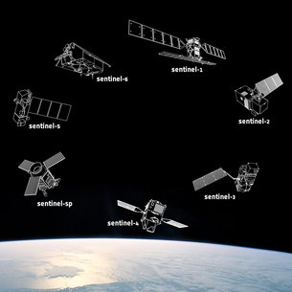
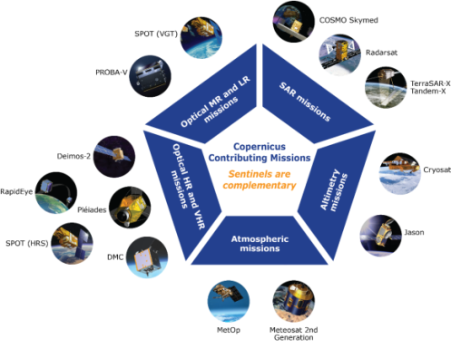
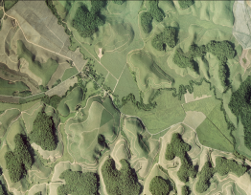
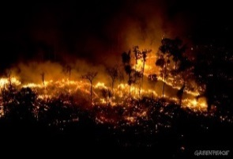
Copernicus Architecture
6 services use Earth Observation data to deliver …
Contributing missions
Sentinels
…added-value products

Slide 4
Space Component
Five dedicated Sentinel satellites are in orbit: Sentinel 1A, 1B, 2A, 2B, 3A
Two Sentinel constellations, Sentinel 1A and 1B and Sentinel 2A and 2B are now in orbit
By the end of 2020, 8 Sentinel satellites will be in orbit, providing most of the data needed by the Copernicus services
Notes:
Copernicus' operational phase starts now, building on the success and experience of the previous GIO (GMES Initial Operations) programme. User requirements and data-buy arrangements are in place, but our (EU-owned) Sentinels will deliver more and better data with unpredecented volume. => A quantum leap for EU Earth Observation. A key element of Copernicus is ensuring the smooth dissemination of this huge volume of data, making the EU as a major global player/owner in Earth Observation data.
External data-buy will continue, but decrease as Sentinels become operational in 2015-2016 ff. However, some gaps will remain (high-resolution imagery) as Copernicus was not (!) designed to fill them.

Slide 5
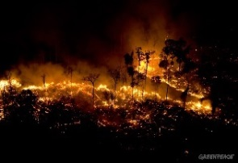
Service
Component
Notes:
Copernicus' operational phase starts now, building on the success and experience of the previous GIO (GMES Initial Operations) programme. User requirements and data-buy arrangements are in place, but our (EU-owned) Sentinels will deliver more and better data with unpredecented volume. => A quantum leap for EU Earth Observation. A key element of Copernicus is ensuring the smooth dissemination of this huge volume of data, making the EU as a major global player/owner in Earth Observation data.
External data-buy will continue, but decrease as Sentinels become operational in 2015-2016 ff. However, some gaps will remain (high-resolution imagery) as Copernicus was not (!) designed to fill them.

Slide 6
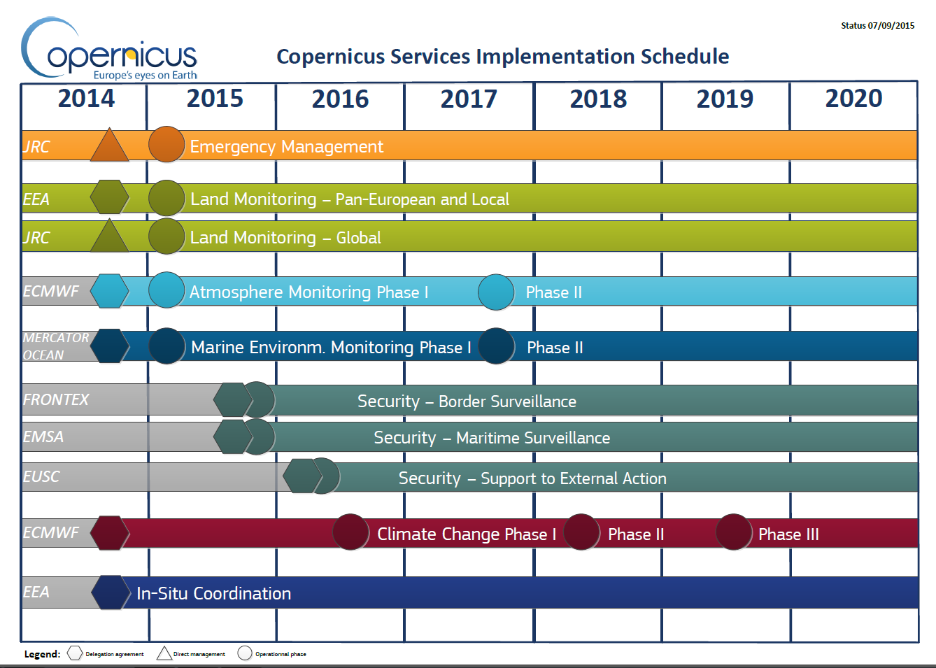
Copernicus Services Deployment
Notes:
In parallel to the satellite deployment, the services are ramping up their information production. Emergency management services and Land Monitoring services have been operational since 2012, and are now joined with round the clock forecasting by the Atmosphere and Marine Environment Monitoring services.

Slide 7
Example: Products
etc …
Notes:
Do

Slide 8
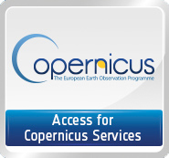
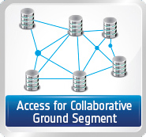
Copernicus data access
FULL, FREE AND OPEN
Restricted to the Copernicus Service Projects
Copernicus Space Component Data Access Portal*
Restricted to international partners
https://scihub.copernicus.eu/
Access to Copernicus Services Data and Information
FULL, FREE AND OPEN
Land-related data: http://land.copernicus.eu
Atmosphere-related data: http://atmosphere.copernicus.eu
Marine-related data: http://marine.copernicus.eu
Emergency-related data: http://emergency.copernicus.eu
Climate change-related data: http://climate.copernicus.eu (Beta version)

Slide 9
The Big data challenge
Massive amounts of data
Full, open and free-of-charge
Ease of access and use
Different types of dissemination infrastructures
Member States Collaborative GS
New technology developments
ICT and EO cross-fertilisation
Interoperability with non-EO datasets
Public programmes as enablers
Growth and jobs in downstream sector
Over 10 Petabyte/year of new data
with just Sentinels-1, -2 and -3 fully operational
(data are downloaded many times over)

Slide 10
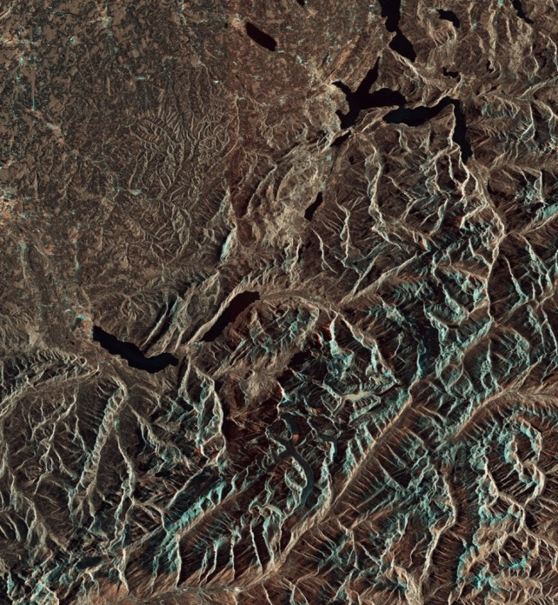
Copernicus big data approach
Setting up of Data Access and Information Services (DIAS):
Access to all Copernicus data and information virtually collocated with computing resources
Allowing Big Data analytics without the need to download the data and information
Allowing data fusion with non-EO data and information
Bring together all user communities (public authorities, research, commercial, ONG,…)

Slide 11
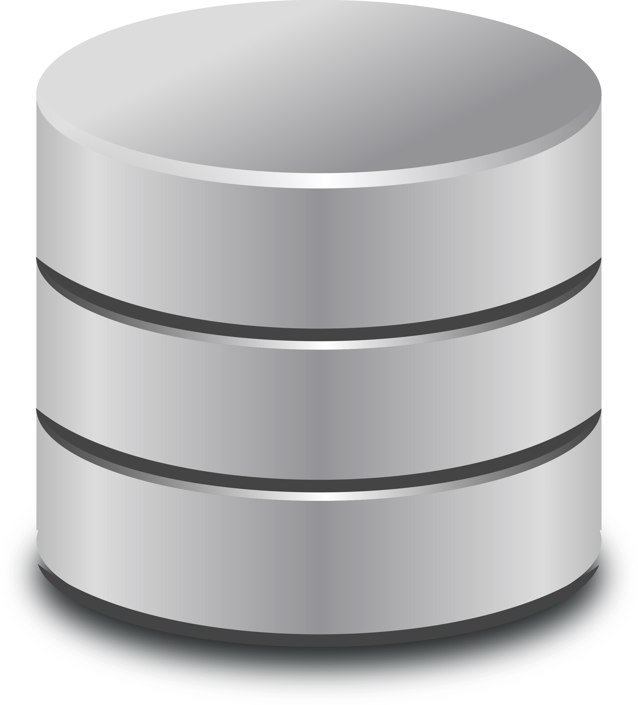
European EO Data ecosystem on DIAS
End user: User of the third-parties services
Front
office service
Front
office service
Front
office service
Front
office service
Front
office service
Front
office service
Front
office service
Funded by
third-parties
Front
office service
Front
office service
Front
office service
Front
office service
Third Party
Users
Copernicus DIAS interfaces
DIAS
funded
Copernicus DIAS Storage
Third-party
Users
Copernicus Services & user uptake
Commercial or research users or initiatives (e.g. EO Market place,..)
Pathfinder projects
EOEP-5 (“EO Science for Society”)
EU Member States & particpating countries
Copernicus Data & Information Access Services
SAF
Heritage Data (LTDP+), Earthnet
National/commercial missions data access
Research and Innovation Projects (H2020)
EarthWatch CCI, InCubed
Sentinel Collaborative Ground Segment
Open Science Cloud & GEOSS Infrastructure

Slide 12
Copernicus
Thank you for your attention
Mauro.Facchini@ec.europa.eu
Website: http://copernicus.eu
Facebook: CopernicusEU
Twitter: @Copernicus EU

