Slide 1
GFOI & SDCG
Committee on Earth Observation Satellites
CEOS Plenary 2017
Agenda Item 3.4
Rapid City, South Dakota, USA
19 – 20 October 2017

Slide 2
GFOI CEOS PLENARY 2017
CEOS Lead: Masanobu Shimada
Alternate: Stephen Ward
SDCG Co-Chairs: Frank Martin Seifert (ESA) and Gene Fosnight (USGS)

Slide 3
Issues
Brief report against 2017 CEOS Work Plan outcomes
Update on GFOI status & directions for CEOS understanding
Update on SDCG leadership and capacity

Slide 4
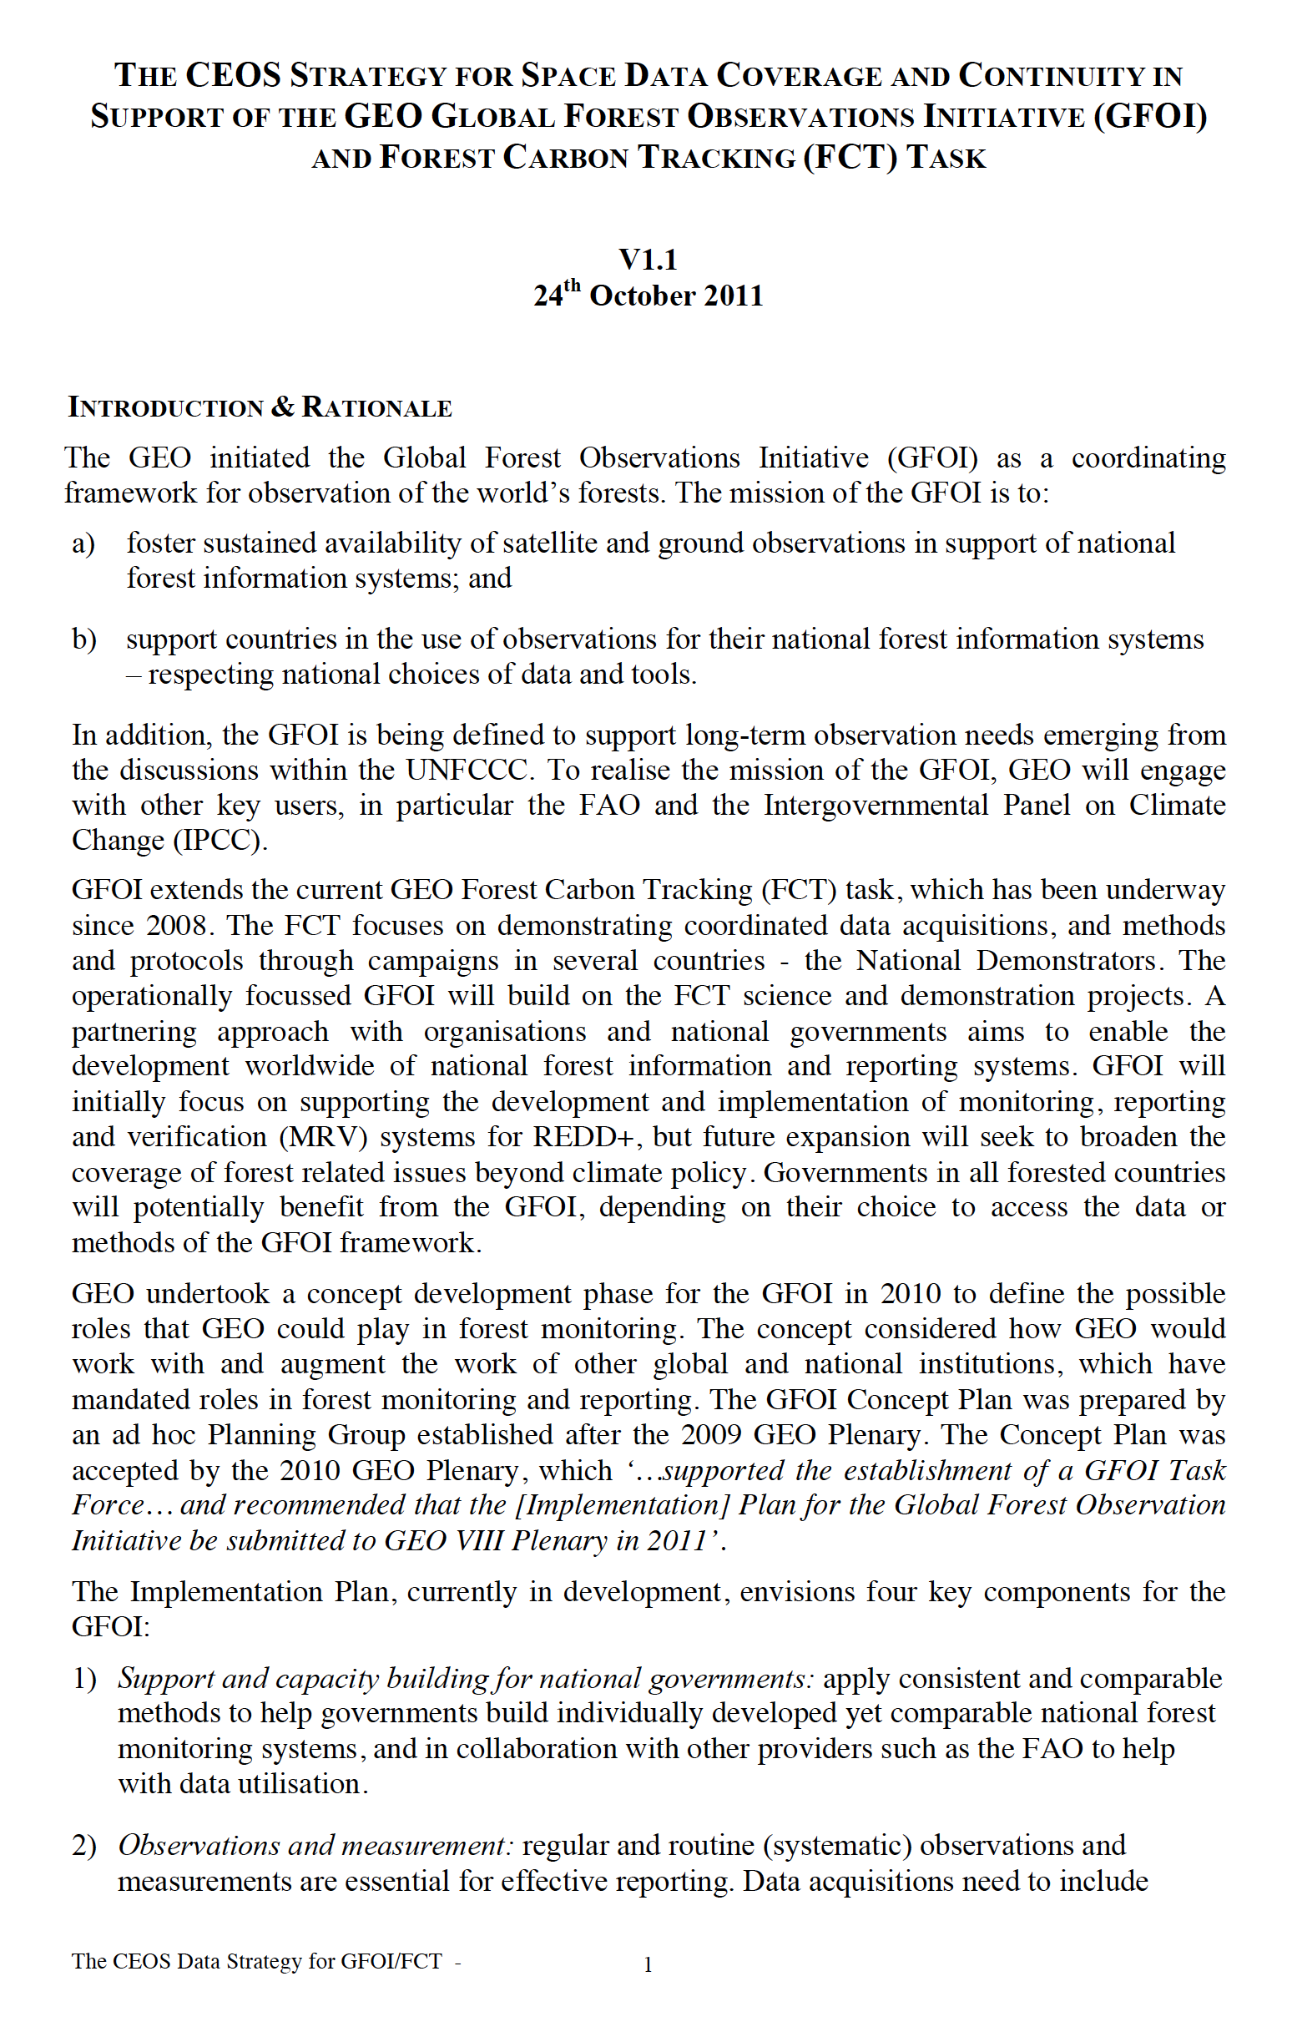
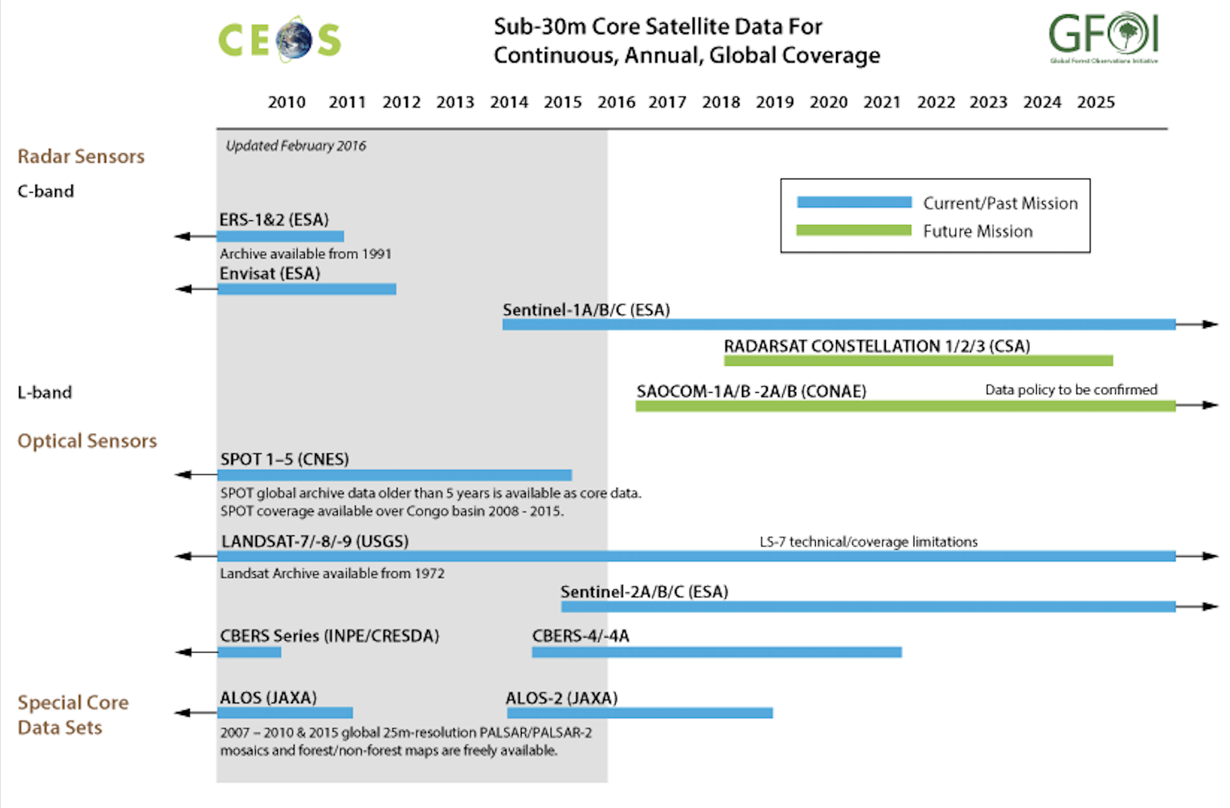
Recap
Space Data Strategy for GFOI in 2011:
Global baseline coverage based on core data streams
Space Data Services
Data for R&D

Slide 5
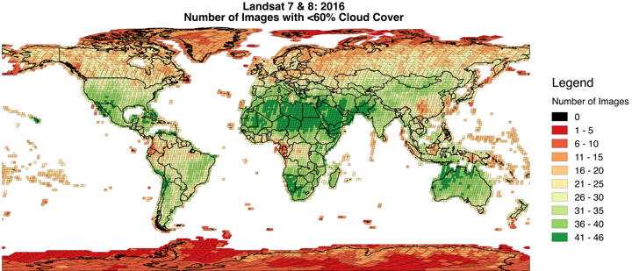
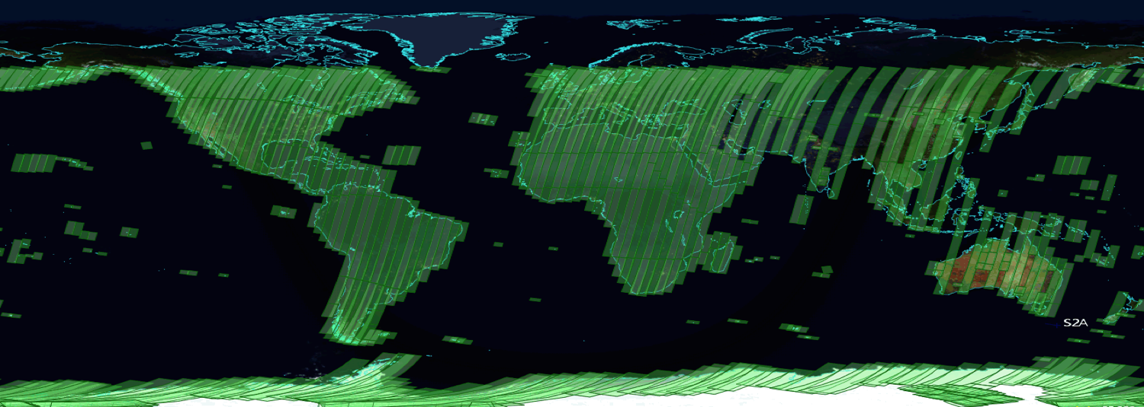
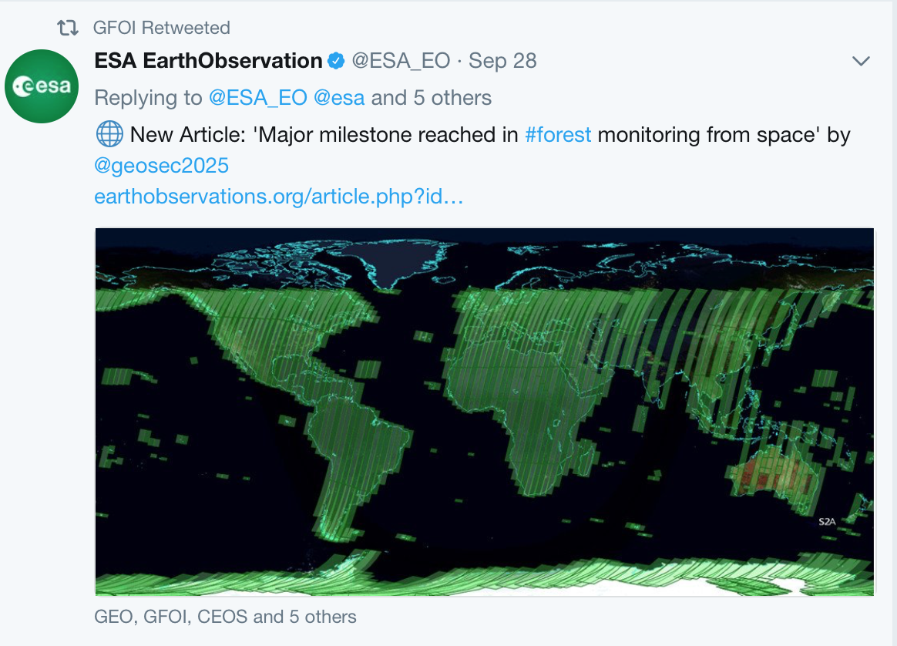
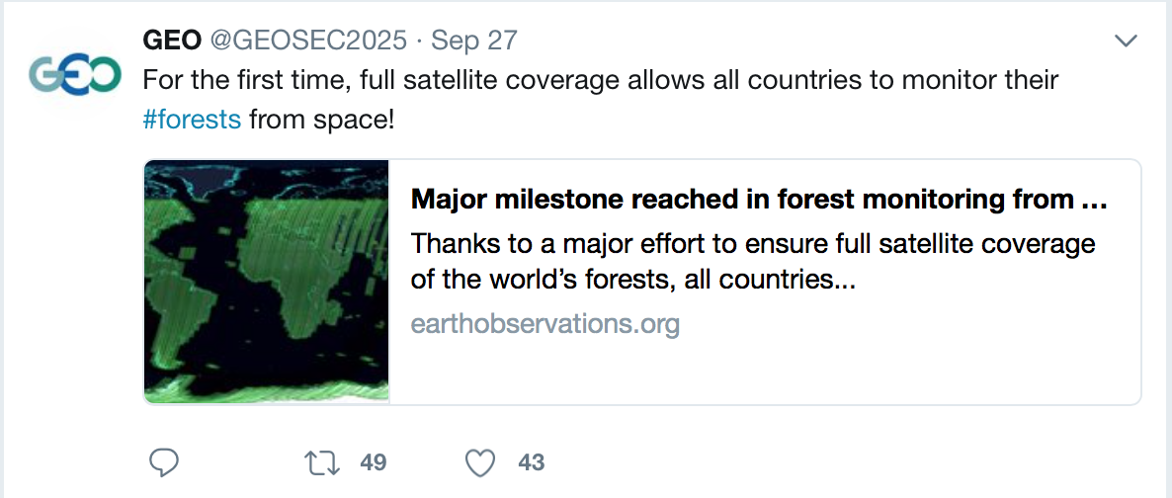
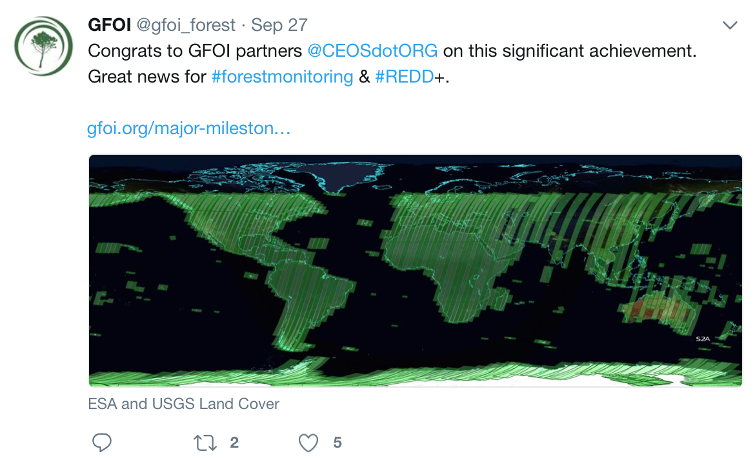
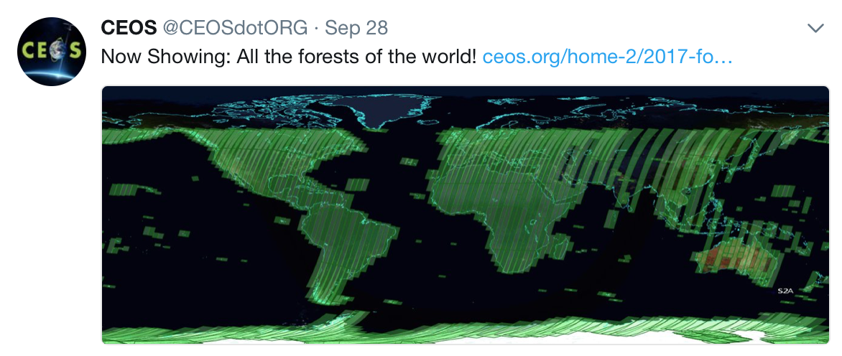
Claiming success on global baseline from 2017
Landsat data contributing to cloud free monitoring of forests
Significant milestone in support for all countries that wish to report on forest cover (eg for UNFCCC, REDD+, market incentives)
Confident in annual wall-to-wall coverage for all countries through next decade and beyond
CEOS/GEO/GFOI/agency PR timed to coincide with CEOS and GEO plenaries
One of SDCG major CEOS WP outcomes for 2017

Slide 6
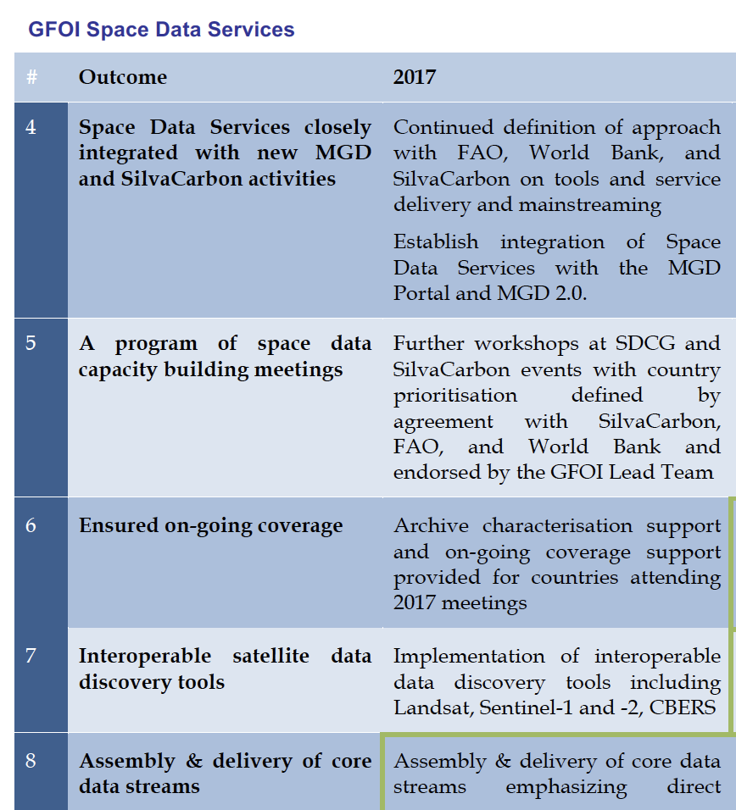
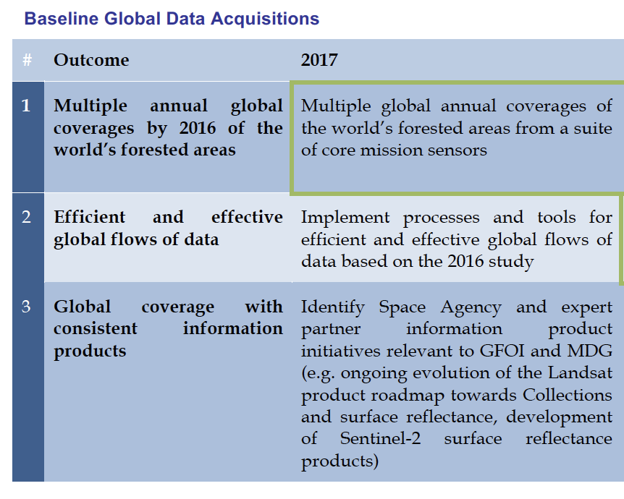
Other CEOS WP items from SDCG
CEOS WP features highlights of SDCG’s own 3-yr WP
Needs revisiting due to definition of Phase 2 of GFOI

Slide 7
GFOI Phase 2
Strong country emphasis – reflecting the development aid finance nature of funding
Improved mechanisms for coordination
gap analysis and needs assessments
joint work planning for priority needs/gaps
joint implementation of work plans
Proposal for Office to have budget to support some joint implementation that directly benefits countries.
ESA (R&D support), UK and German govts all invited to serve on expanded Leads group and all understood to be accepting

Slide 8
GFOI Phase 2
MGD:
Re-established the MGD Advisory Group
Ake Rosenqvist (JAXA) the CEOS technical rep
Role and use of REDDcompass continues to grow rapidly
University courses increasing
Capacity Building:
SilvaCarbon continuing to implement full work plan until September 30 2018. Assumption of same level USAid funding for next FY with significant uncertainty (broadly)
Hopeful that GIZ will continue to grow involvement
REDDcompass short courses being jointly delivered by CB Partners and the MGD Component
R&D:
ESA will finance GOFC GOLD office including GFOI R&D Coordination for the next 3 years (open ITT in autumn 2017)
Expert meetings and materials underway
Working closely with World Bank’s FCPF to help address technical issues that countries are facing in reporting to the Carbon Fund.

Slide 9
Space Data in Phase 2
Emphasis turns to data uptake and application – consistent with GFOI Phase 2
Pilot activities ongoing – Data Cube for Colombia and now Vietnam
SDCG EXEC pursuing inclusion of Early Warning as GFOI activity – possible basis for the long-promised cooperation with WRI/Global Forest Watch
All Element-3 agencies actively contributing to R&D activities
Awaiting further definition of a new Data User Advisory Group proposed by Leads to further narrow the gap between EO data suppliers and user country agencies
Significant opportunities to deepen the benefits that CEOS and agencies get from this thematic coordination initiative
Closer than ever to users and their implementing partners, inc IFI funding
Strong policy foundations (UNFCCC, IPCC, REDD, SDG methodologies..)
Proving ground for our FDA ambitions
But needs leadership and capacity!

Slide 10
SDCG – Leadership and capacity challenges
Significant changes for attention of Plenary and Principals:
USGS Co-Chair (Gene Fosnight) retiring and no prospect of replacement
GFOI Lead has appealed for new Co-Chairs
CEOS GFOI Lead proposed change from Masanobu Shimada to Osamu Ochiai with JAXA still willing to support
SDCG SEC funding from Australian Govt has ended
SDCG needs 1-2 Co-Chairs and SEC capacity
Results:
Co-Chair offered by UKSA
Some SDCG SEC capacity (~15%) offered by JAXA
Per the conclusions from the Joint LSI/GFOI/GEOGLAM mtg in Sept, SDCG notes the ongoing requirement for a CEOS group dedicated to the GFOI interface so long as CEOS is engaged in the flagships (GFOI, GEOGLAM…)

Slide 11
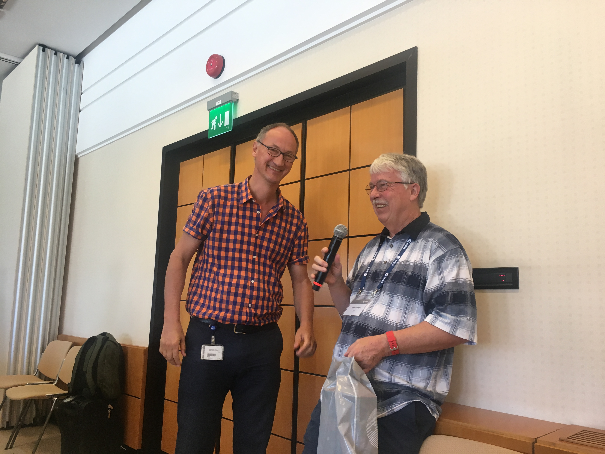
Thanks to Gene Fosnight!

Slide 12
Discussion
Questions?

