Slide 1
WGClimate Report
Joint CEOS CGMS Working Group on Climate
CEOS Plenary 2017
Agenda Item 2.1
Rapid City, South Dakota, USA
19 – 20 October 2017

Slide 2
Agenda topics
GCOS IP Space Agency Response (For Information)
SBSTA 47 Space Agency Statement (For Information)
COP23 CEOS/CGMS Presence (For Information/Discussion)
Essential Climate Variables (ECVs) Inventory
  Way forward on Gap Analysis Report and coordinated Action Plan (For Information/Discussion)
  Perspective for the next two years (For Information/Discussion)
WGClimate Vice-Chair Nomination (For Decision)

Slide 3
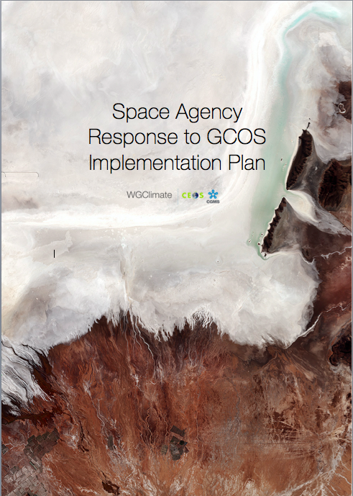
Space Agency Response to the GCOS IP
The Space Agency Response to the GCOS IP was sent on October 16th to:
  UNFCCC secretariat and to GCOS
  CEOS and CGMS secretariats
A big thank you for the Writing Team, all the contributors and all the reviewers
The document is bigger than expected (47 pages instead of the 30 pages as presented at the SIT Workshop.
A technical supplement will be produced by Spring 2018 to include detailed responses to the GCOS IP.

Slide 4
Outline as presented at CEOS SIT 32
Targeting a 20-30 pages document
Broad Context (10-15 pages)
  “Soft Actions” and Cross cutting actions
  Calibration , Validation, Assessment, Data integration and Intercomparison.
Detailed Implementation (6-9 pages)
  Terrestrial (2-3 pages - Grouped in meta-Actions)
  Oceanic (2-3 pages - Grouped in meta-Actions)
  Atmospheric (2-3 pages - Grouped in meta-Actions)
A Technical supplement
  detailed responses to GCOS Actions – Coordinated Action Plan

Slide 5
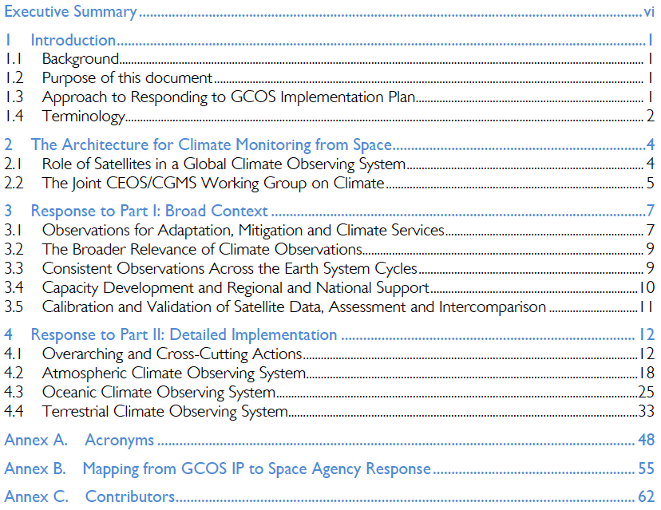

Document Structure
Table of Content

Slide 6
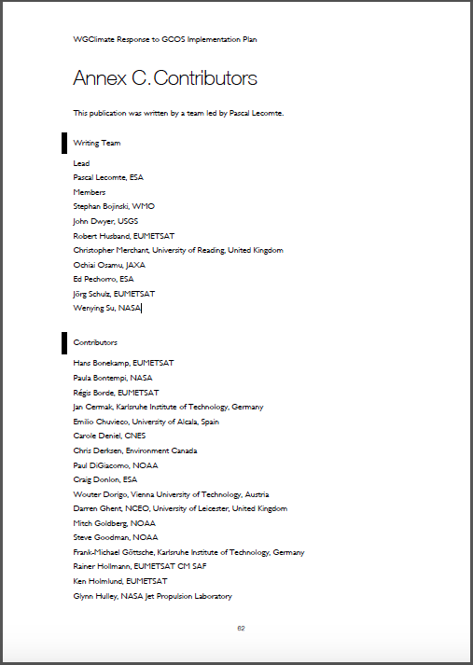
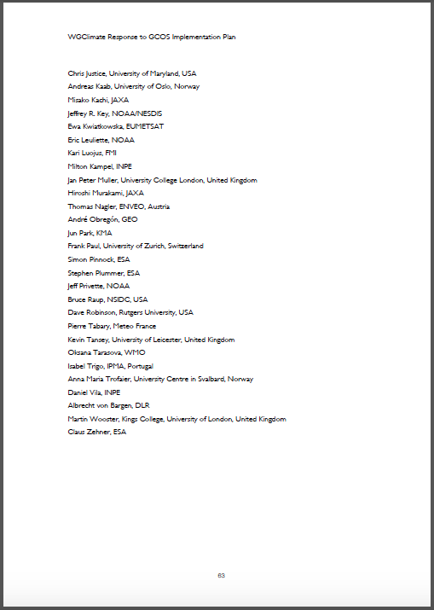
Writing Team
Core Writing Team
  ESA Pascal Lecomte
  WMO Stephan Bojinski
  EC Mark Dowell
  USGS John Dwyer
  EUMETSAT Robert Husband
  U. Reading Christopher Merchant
  JAXA Osamu Ochiai
  ESA Ed Pechorro
  EUMETSAT Jörg Schulz
  NASA Wenying Su
Atmospheric Chapter – Stephan Bojinski (WMO)
Oceanic Chapter – Chris Merchant (UKSA)
Terrestrial Chapter – John Dwyer (USGS)

Slide 7

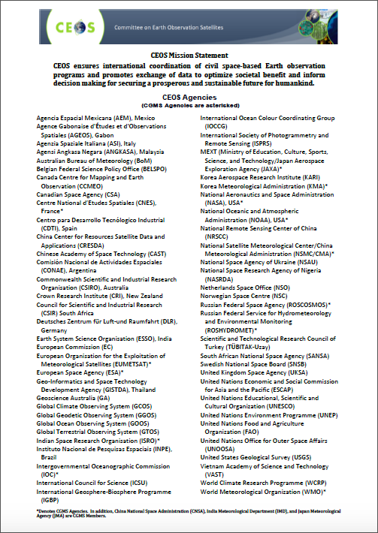
Space Agency Statement to SBSTA-47
The final text:
was sent to the CEOS sec,
is available on the CEOS web site and,
was sent to the UNFCCC secretariat

Slide 8
Space Agency Statement to SBSTA-47
STATEMENT TO THE UNITED NATIONS FRAMEWORK CONVENTION ON CLIMATE CHANGE SBSTA 47/COP 23 06-17/11/2017
“The consolidation of space agency and EO Programme owners efforts through the establishment of the joint CEOS/CGMS Working Group on Climate has resulted in a significant increase in efficiency in responding to the needs of Systematic Observations as required by the Convention. This is manifested in part by considerable increase in the quantity of climate data records (factor 3) submitted by agencies to the Essential Climate Variable (ECV) Inventory with respect to the first exercise implemented in 2015.”
“The synergistic relationship with the UN’s GCOS Programme continues to strengthen. Here, CEOS and CGMS present a response to the 2016 GCOS Implementation Plan reiterating their commitment to address the Actions required for the implementation of the global observation system for climate.”

Slide 9

COP-23
November 6th to 17th, 2017 (duration: 12 days)
Bonn, UN Campus
  Bula Zone
    blue: main entrance and conference rooms
    Bula is Welcome for Fiji
  Rheinaue (Bonn Zone)
    red: delegation pavilions, exhibits and side events

Slide 10
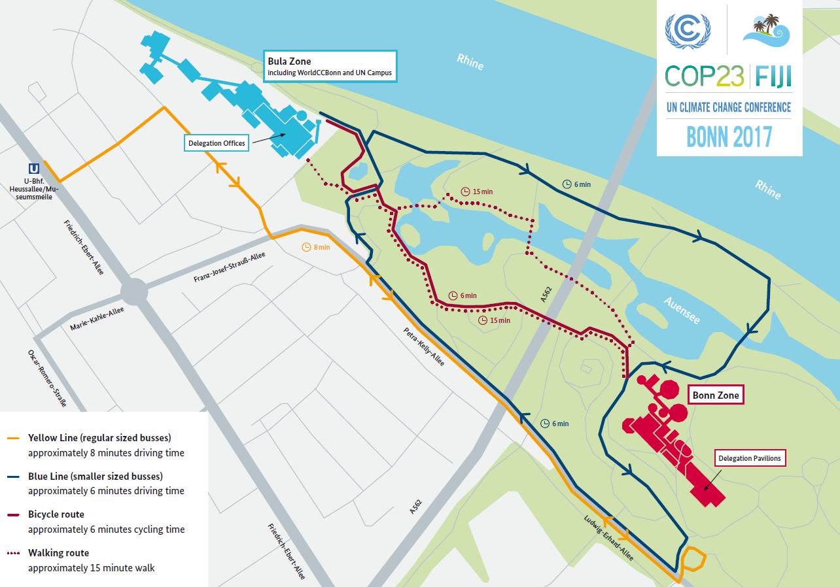
COP-23

Slide 11
GCOS Side Event
GEO Side Event proposed (see GEO presentation)
Two side events have been proposed by GCOS and WMO (have been merged into one event)
Received confirmation and logistics information from the UNFCCC secretariat (still some discussion there…)
An informal strategy meeting between the SBSTA Chair and the Earth observation community is organised on Friday 10th November, 8.00-10.00.
  GCOS, ESA, EC, EUMETSAT have been invited
WGClimate intend to present the Space Agency Response to the GCOS IP in the context of one of these side events in coordination with GCOS.
  we are in contact with GCOS and still trying to find the best way for WGClimate to report on the Space Agency Response to the GCOS IP. There is a high likelihood that a stage can be arranged.
GCOS also proposed a UN system wide side event (approved)
  It will be WMO, IPCC, GCOS and the World Food Program talking about their role as practitioner in applying science information.
  The GCOS IP is featured there including talking about climate indicators.
  No CEOS representative as originally planned.

Slide 12
Identified events
Date | Time | Event
Monday 6th November | pm | SBSTA-47 Plenary – CEOS Statement
Monday 6th November | 13:15-14:45 | Copernicus Climate Change Service. CREWS, EUM, ECMWF, DG-GROW
Tuesday 7th November | 11:00-11:30 | ECMWF (C3S/CAMS) Media Briefing
Tuesday 7th November | 15:30-16:30 | JAXA/MOE Space Agency Round Table in GHG/IPCC – Japanese Pavilion
Tuesday 7th November | throughout day | SBSTA Research and Systematic Observation – subgroup
Wednesday 8th November | 13:15-14:45 | Joint GEO-GCOS Side Session
Wednesday 8th November | throughout day | SBSTA Research and Systematic Observation – subgroup
Thursday 9th November | 16:00-17:30 | Global monitoring of GHG for a better understanding of our Climate (ESA, EUM, C3S, DG GROW)
Thursday 9th November | 16:45-18:15 | Land use monitoring in Pacific Islands together. UNFCCC with Australia (lead applicant);
Thursday 9th November | 18:00-19:30 | Sentinel for REDD+, ESA lead with support from DG GROW (EU Pavilion )
Friday 10th November | 08:00-10:00 | Informal strategy meeting between the SBSTA Chair and the EO community
Friday 10th November | 13:15-14:45 | Open data and local capacities to support the global response to climate change

Slide 13
ECV Inventory and Gap Analysis
ECV Inventory 2.0 published;
Fully describes current and planned implementation arrangements (ECV-by-ECV) within the Architecture;
More than 4 times more data records 913 versus ~210 compared to first version 2015;
Content for the first time fully verified;
Gap analysis capacity demonstrated:
  All ECV Products without CDRs identified
  Compliance of CDRs to GCOS requirements analysed
  Capability to analyse missing missions established (Inventory/MIM/OSCAR harmonisation on-going);
Financial support of the EC for the Inventory gratefully acknowledged.
Action Plan & Creation of conditions to deliver CDRs (CMRS-16)
ECV Inventory
(CMRS-14)
Gap Analysis & Recommendations
(CMRS-15)
✓
✓
http://climatemonitoring.info/ecvinventory
http://climatemonitoring.info/ecvinventory
http://climatemonitoring.info/ecvinventory

Slide 14
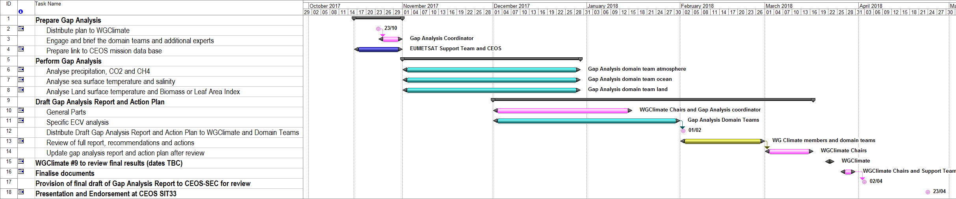
Planning for completion of gap analysis to baseline ECV Inventory 2.0
The bulk of the gap analysis activities have been performed (and documented)
The residual activities to be performed include a gap analysis on a limited number of ECV products including mission availability and suitability (with the selection of these ECV products based on the relevance of the variable to current discussions and/or known issues with past and future missions)
The finalisation of the Gap Analysis (and its documentation - including the coordinated action plan) is planned to be completed in time for SIT-33 in April 2018.

Slide 15
Lessons learnt during cycle#2
The EC Funding of the inventory activities made a big difference;
Engagement with agency focal points and data set experts was key to success;
Verification process absolute critical to ensure that the inventory is a reliable source of information (for both users and the gap analysis process);
Population and verification was a huge effort - need to keep the community involvement in the future and avoid drastic changes;
Commitment level for future component of the inventory needs to be reconsidered to get a more complete picture from agencies;
Global data record development is more dynamic than we thought. Biennial update of inventory should be replaced by incremental (annual) updates;
Volume of data records does not allow full analysis of Inventory every year => need to carefully track changes during inventory update process and perform limited gap analysis in affected areas;
General low use of FCDRs to derive ECV climate data records implies extra Inventory for the base data records.

Slide 16
Perspectives for the next two years
Major Objectives:
  Complete Cycle#2 activities by SIT-33 (finalisation of Gap Analysis);
  Change reference for Inventory and Gap Analysis to the 2016 GCOS-IP (and update the inventory as appropriate);
  Promote case studies and workshops supporting the Architecture and its Inventory;
Changes:
  The Inventory-gap analysis-action plan process shall move to a more incremental update with annual reporting and endorsement (potentially synchronised with UNFCCC/SBSTA reporting);
  Gap analysis addressing Inventory updates and high priority areas, e.g., carbon cycle;
Deliverables:
  First gap analysis report and action plan for endorsement at SIT-33;
  Update of Inventory baseline to GCOS IP 2016 by 31 Dec 2018;
  Second gap analysis and action plan for endorsement by 2019 Plenary;
  Continued reporting to SBSTA.

Slide 17
WGClimate Vice Chair Nomination
According to the Working Group ToR:
  A request for proposal was sent to all space agencies
  Nominations were received with a letter of support from the Agencies.
  John Dwyer from USGS was nominated by the WGClimate members at their 7th meeting in Sao Jose dos Campos (February 2017).
  The nomination was presented at the CGMS 45th plenary (Jeju-June 2017) and endorsed
  The nomination is now presented to the CEOS for endorsement.

Slide 18


Chairmanship Hand Over
November 2017 – November 2019
Chair: Jörg Schulz (EUMETSAT)
Vice Chair: John Dwyer (USGS)
November 2019 – November 2021
Chair: John Dwyer (USGS)
Vice Chair: asking for proposals by Agencies

Slide 19



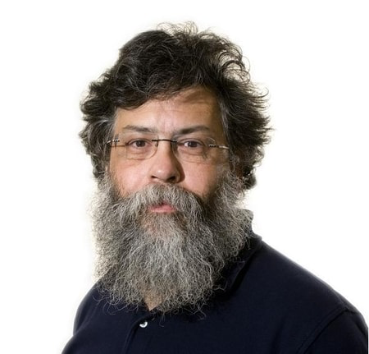
Schulze
Professor Cuthbert Calculus
Schultze
Capitaine Haddock

Slide 20


