Slide 1

2017-2019 SIT Chair Priorities IMPLEMENTATION
Committee on Earth Observation Satellites
Steve Volz, Incoming SIT Chair
National Oceanic and Atmospheric Administration (NOAA)
CEOS Plenary 2017
Agenda Item # 12.2
Rapid City, South Dakota, USA
19 – 20 October 2017

Slide 2
SIT Chair 2018-2019 Priorities
Ensure the efficient execution of existing SIT responsibilities as described in the SIT Terms of Reference, including addressing Working Group and Virtual Constellation (VC) continuity, sustainability, and outputs, including:
  Undertaking gap analyses for each VC, to support ongoing and likely upcoming strategic Agency observatory decisions;
  Seeking observations from VCs and WGs on best practices and possible modifications to existing practices; and
  Supporting the activities of the CEOS ad hoc Team on Sustainable Development Goals by identifying targets and indicators relevant to each VC.
Enhance the utility of new observations from next generation of geostationary satellites and exploring development of LEO/GEO combination products and data processing capabilities.
Presented at SIT-32 and 2017 SIT Technical Workshop

Slide 3
SIT Chair 2018-2019 Priorities
Improve and clarify CEOS relationships with CGMS, GEO, and to a lesser degree WMO, by identifying coordinated activities and, where appropriate, holistic interaction among CEOS, CGMS, GEO, and WMO, emphasizing the unique values of each.
  Identify and focus on areas of appropriate and productive collaboration.
  Take stock of trends and future directions so that CEOS can best serve the needs of its Agencies and execute its role most productively alongside CGMS, GEO, and WMO
  Identify appropriate and productive engagement approaches with commercial sector in the process.
Support initiatives undertaken by CEOS Chairs in 2018 and 2019.
Presented at SIT-32 and 2017 SIT Technical Workshop

Slide 4
How Will we Implement SIT Priorities
Questionnaire to Virtual Constellations and Working Groups
  VCs and WGs are the intellectual capacity of CEOS
  What is the value of the VC/WG to the community
  How do we reinvigorate and assure viability and usability
  What are the “must-haves” for the next generation of missions
  Do we need to update, or develop, roadmaps and gap analyses
  How can we address resource and leadership challenges
  Will be released mid-January 2018
SIT Chair and VC (and WG?) Bi-annual Tag-ups
  February/March 2018 & 2019
  July/August 2018 & 2019
Emphasis on Deliverables

Slide 5
Expectations and Challenges to CEOS Community
Realize the CEOS Work Plan
  This is our agencies’ commitments to working
  as members of CEOS
  Adjust VC and WG contributions based on results
  of questionnaire
Return to First Principles – CEOS Mission and Objectives
  Develop tactical approach to meeting expectations of international community and those of our own agencies
  What does an agency gain by participating in CEOS? By supporting personnel to fulfill key leadership roles within CEOS?

Slide 6

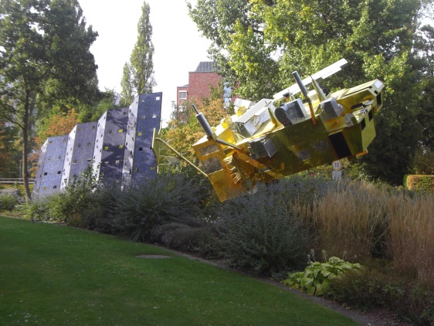
SIT Meetings – 2018
SIT-33
April 23-26, 2018
Location: Boulder, Colorado, USA
Topics:
  Results of VC/WG questionnaire
  Presentation on updates to Work Plan and …
  Water foci discussion and consolidation
  Anything related to COM objectives?
2018 SIT Technical Workshop
September 10-14, 2018
Location: Darmstadt, Germany (host - EUMETSAT)

Slide 7


SIT Meetings – 2019
SIT-34
March/April 2019
Location: National Water Center,
Tuscaloosa, Alabama (TBC)
2019 SIT Technical Workshop
September 2019
Location: TBD (we will consider offers to host)
National Center for Environmental Information (NCEI)
Asheville, NC

Slide 8
Meet the Strategic Implementation Team
SIT Chair – Steve Volz
SIT Chair Team – Kerry Sawyer, Chuck Wooldridge, Paul DiGiacomo, Paul Chang, Ken Casey, Jeff Privette, AJ DeGarmo…
SIT Contract Support – Symbios: Stephen Ward, George Dyke
SIT Support – YOU

Slide 9
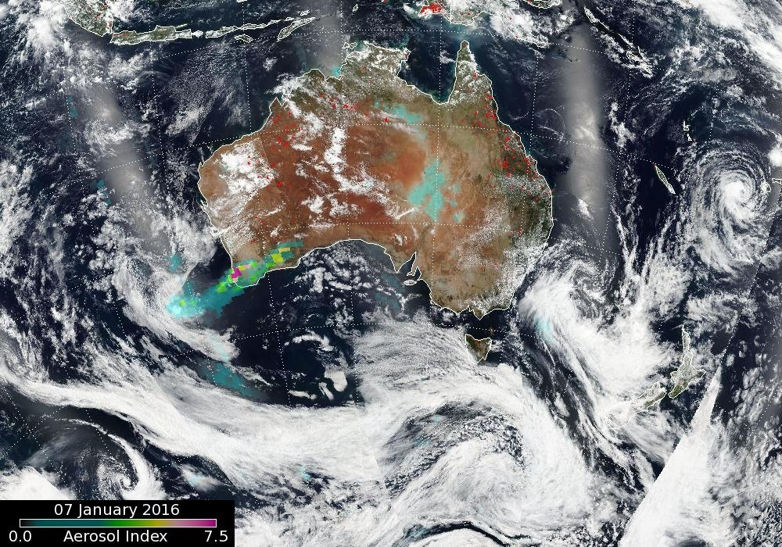
SIT Vice Chair Team
Notes:
The OMPS AI detected the resulting smoke plume nicely on the following 3 days (with VIIRS RGB imagery and hotspot detection as the background):

Slide 10
CEOS Technical Roles
GEO Programme Board (PB)
CEOS nominated as Participating Organization with three-year term, until 2019
SIT Chair is expected representative but because of unique situation, agreed to the following:
  Primary to the PB – Kerry Sawyer (SIT Chair Team)
  Alternate to the PB – Steven Hosford (CEO)
Observer to ExCom
CEOS selected by the PB to Observer for the GEO ExCom
SIT Chair is expected representative but because of unique situation, agreed to the following:
  Alex Held - SIT Vice Chair will be the Observer (Adam Lewis if Alex not available)
  With support/accompaniment from Kerry and/or Steven
GEO Blue Planet Advisory Board
SIT Vice Chair will be the CEOS Representative

Slide 11


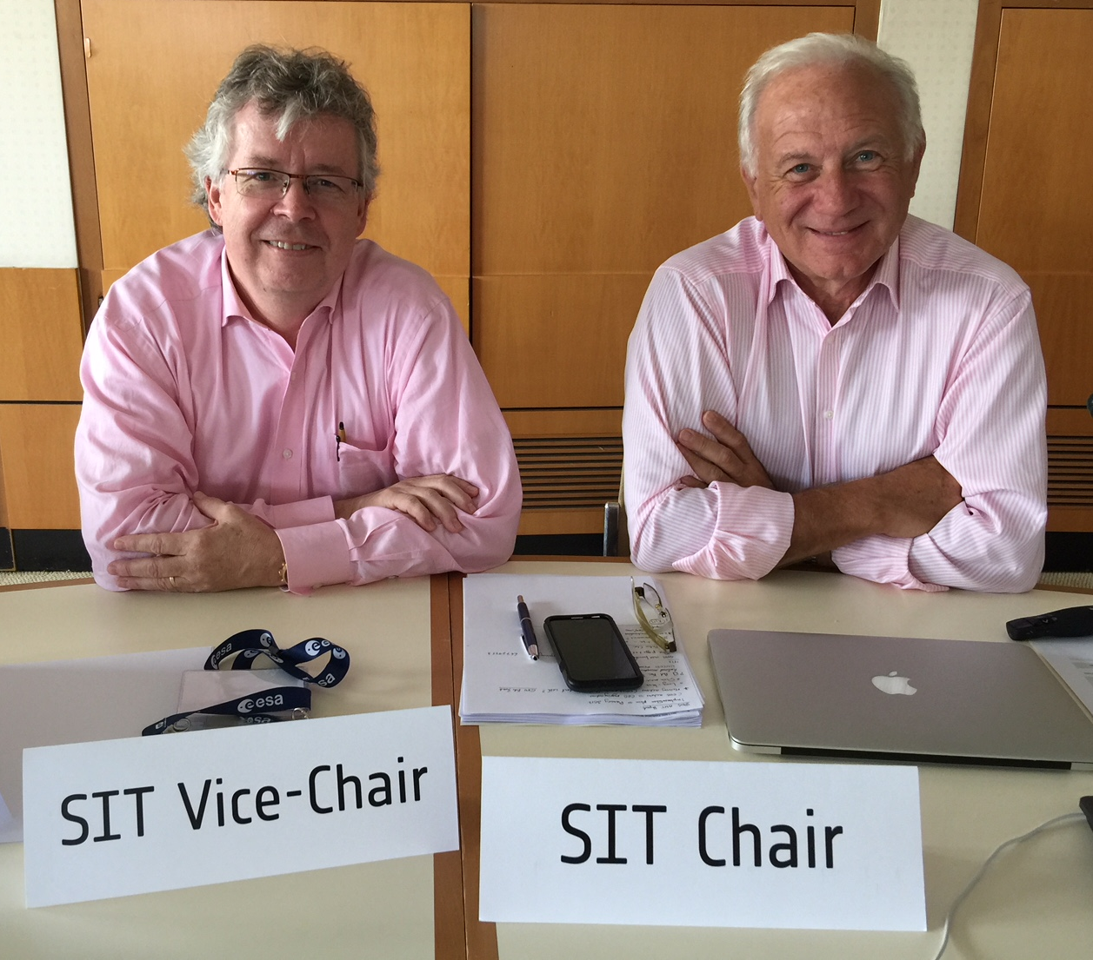
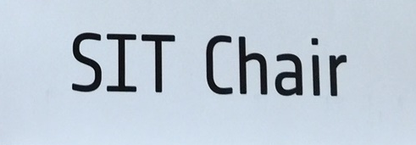
Transfer of SIT Chair Responsibilities
Gone Riding
“Yee-haw”

