Slide 1

Committee on Earth Observation Satellites
SEO Report
Brian Killough
NASA, CEOS Systems Engineering Office
CEOS Plenary 2017
Agenda Item 11.2
Rapid City, South Dakota, USA
19-20 October 2017

Slide 2
SEO Accomplishments in 2017
  SEO Technical Team ... The primary efforts have been focused on the Data Cube initiative, supporting the LSI-VC (ARD definition, gap analysis process), supporting SDCG for GFOI and GEOGLAM data acquisition planning and maintaining our existing tools (COVE, Data Policy Portal, CEOS website).
  Kim Holloway: Provided communications support to the SDG-AHT and WGCapD, managed CEOS web and social media content, continued producing the “Faces of CEOS” video series, provided meeting logistics support across many CEOS entities, developed new outreach materials, maintained the mailing lists.
  Special Thanks ... The SEO would like to thank Analytical Mechanics (AMA), Symbios (Stephen and George), Ake Rosenqvist, and Alyssa Whitcraft for their SEO support.
  Data Cubes ... The SEO is a member of the Open Data Cube “Partners Forum” and AMA participates in the technical “Steering Council”. The SEO has made a number of significant code contributions (e.g. user interface, applications, ingestion) to the Open Data Cube repository and led many of the country pilot projects. See Agenda Item 8.2 for more …

Slide 3
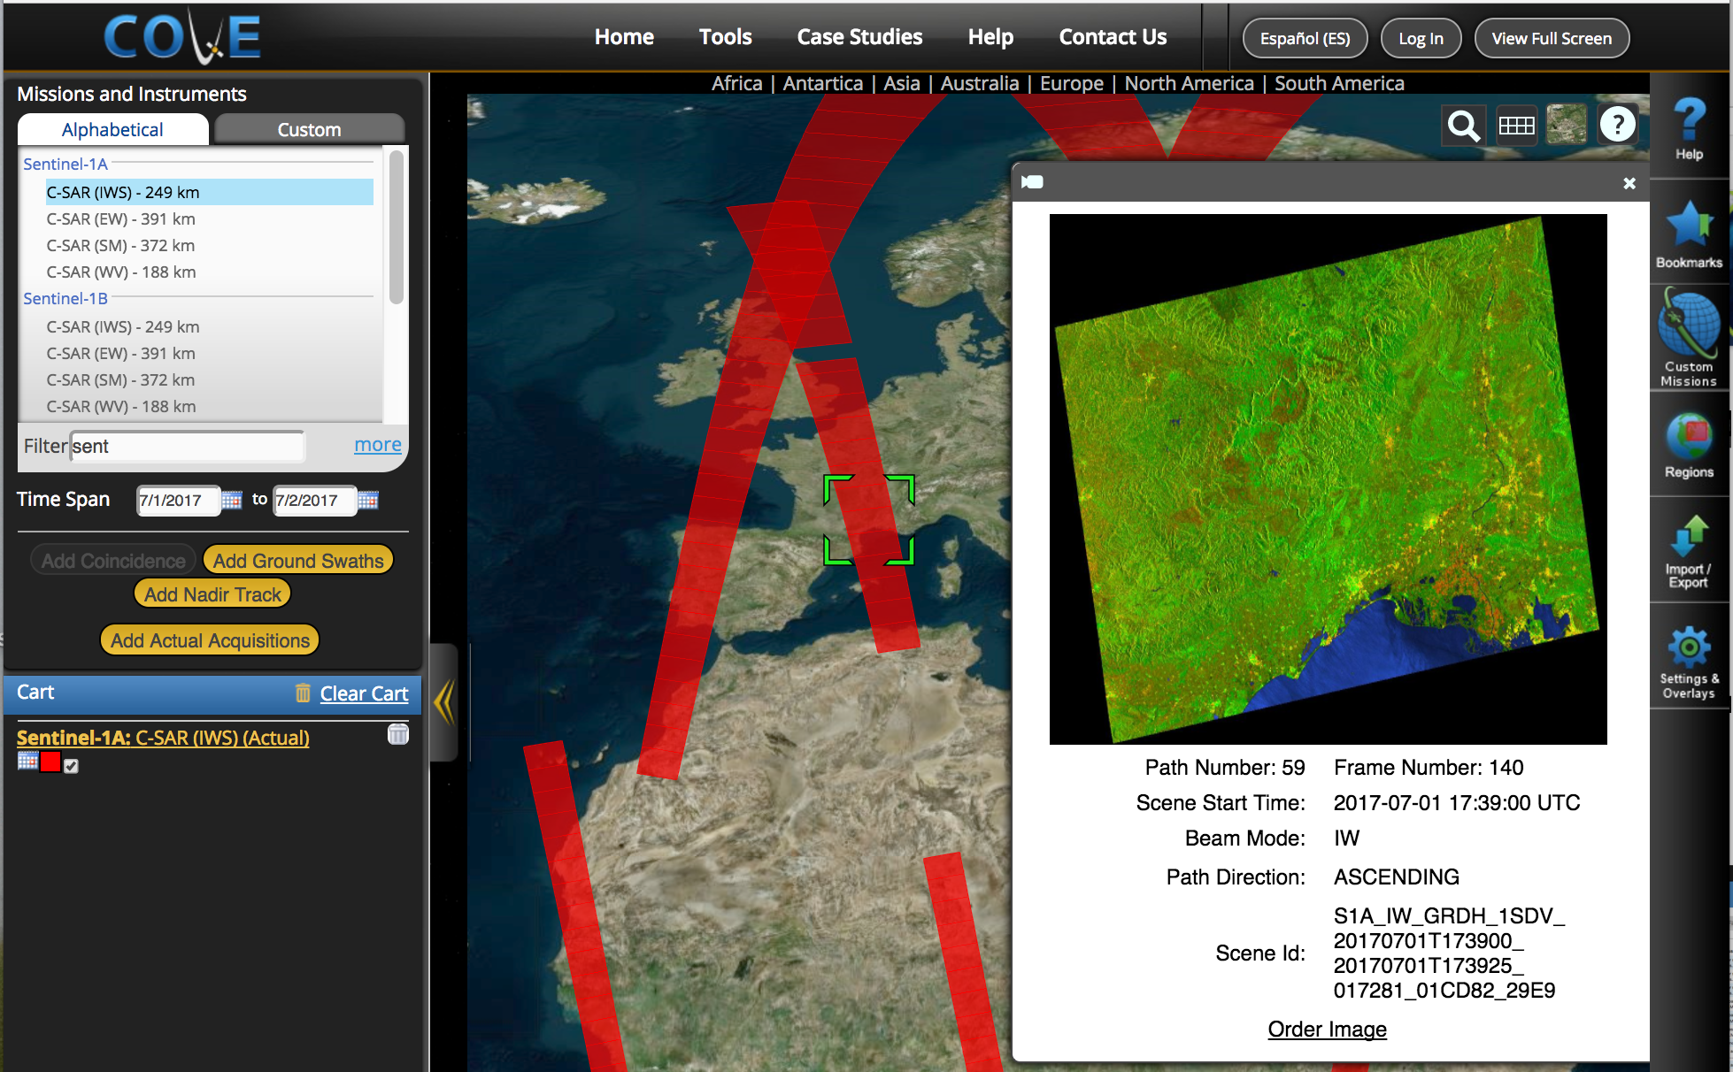
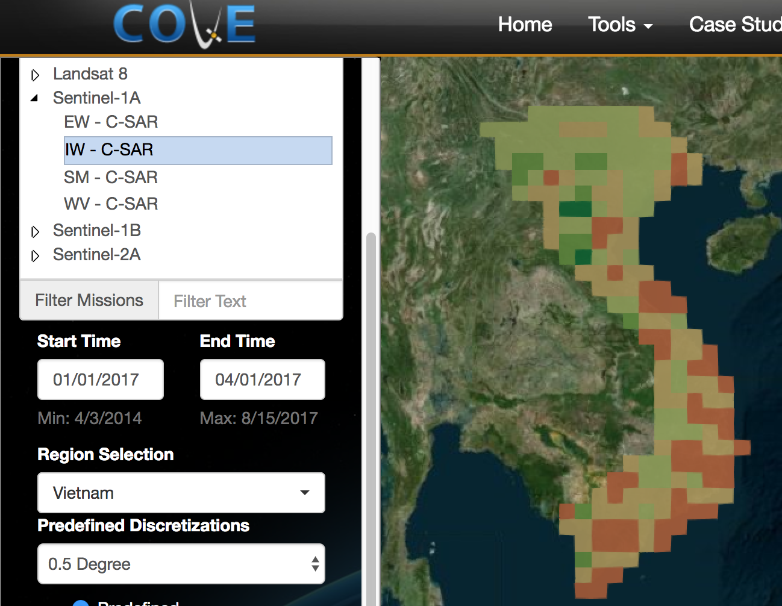
COVE Tool Updates
The CEOS Visualization Environment (COVE) is a browser-based suite of tools for searching, analyzing, and visualizing actual and potential satellite sensor coverage.
COVE is FREE and OPEN for anyone to use!
There is a large international user base with 4000+ users in 2017.
COVE includes 131 missions and is linked to several mission archives to get metadata and browse images for past acquired data: Landsat, SPOT, Pleaides, Radarsat-2, ALOS-1, TerraSAR-X, Sentinel-1, Sentinel-2, CBERS-4 and ResourceSAT-2.
Coverage Analyzer: New tool for acquisition reports and links to data ordering.
www.ceos-cove.org

Slide 4
SEO Plans for 2018
  Open Data Cube (ODC) and CEOS Data Cube (CDC):
  Continue significant support to this effort in 2018. Work with the
  multi-agency team to develop an end-to-end infrastructure release. Continue to progress country prototypes and capture “lessons learned”. Enhance the use of CEOS Agency satellite data through future data architectures, improved data interoperability, time series analyses, and solutions for developing countries.
  GEOGLAM, GFOI, LSI-VC, FDA, and UN-SDGs: Continued support for data acquisition planning, systems analyses, and ARD definition.
  COVE Tool: Complete enhancements to the Coverage Analyzer and Data Browsers tool in COVE. Add more links to mission data archives.
  Annual updates to the Data Policy Portal and the MIM Database.
  Outreach support for the IGARSS Conference and GEO. Continue to expand the impact of CEOS through social media.

Slide 5
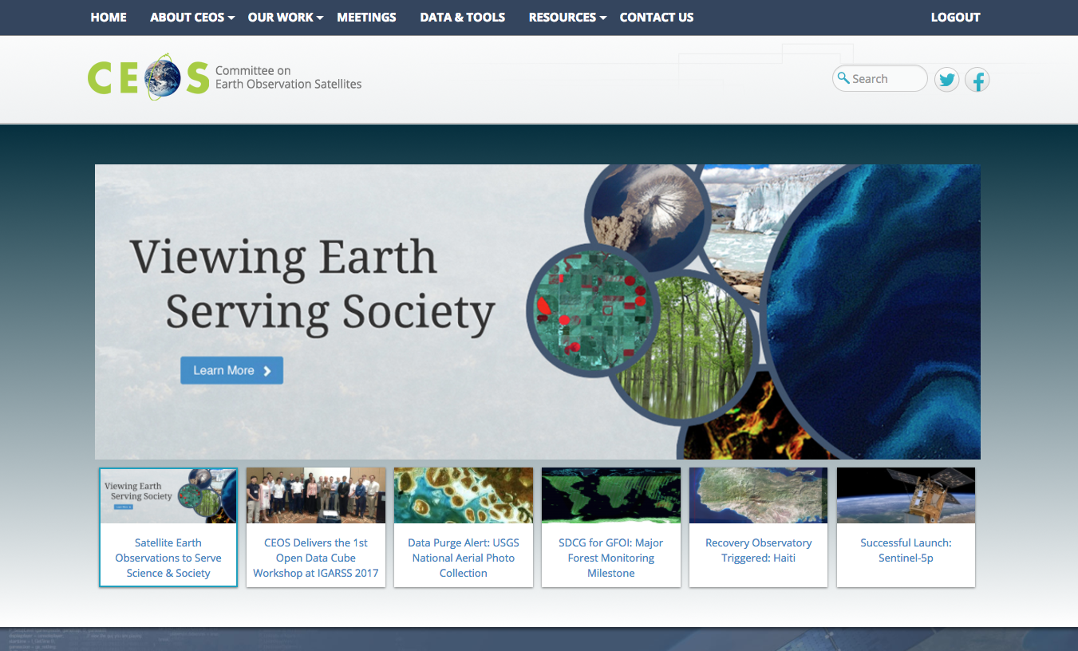
CEOS Communications
Over 47K Visits
in the Last Year,
More than 28K for the first time.
Most Popular Pages:
Home, Meetings, Data & Tools, Overview, Working Groups
5

Slide 6
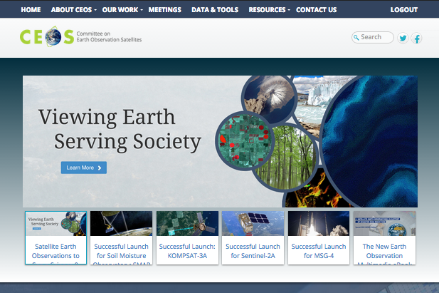
CEOS Communications
Requests to You:
CEOS Leadership, WG & VC Leads: Review Relevant Webpages & Send Updates.
All: Send Short Summaries of Newsworthy CEOS Activities/Accomplishments.
Remember: Meeting Registration Capabilities & Document Management System for You
6

Slide 7

CEOS Communications
CEOS Social Media:
Grew by about 600
Likes/ Followers Total
Post topics on Regular Rotation – Send Kim New Material or “Tag Us”
Twitter: @ceosdotorg
Facebook: @socialceos
7
751 Followers!
1304 Likes!

Slide 8
CEOS Communications
Outreach & Exhibits:
New “Data Cube”
Mousepad Coasters
Plans for IGARSS & GEO Exhibitions in 2018
Contact:
Kim.E.Holloway@nasa.gov
Brian.D.Killough@nasa.gov
8

