Slide 1
WGCapD Report
Committee on Earth Observation Satellites
Phila Sibandze, SANSA
CEOS Plenary 2017
Agenda Item # 10.3
Rapid City, South Dakota, USA
18th – 20th October 2017

Slide 2
Working Group for Capacity Building and Data Democracy (WGCapD)
Raise awareness of the value of EO data products and services to user communities, including
Support to locate and access data, products, and tools
Targeted training workshops
Support CEOS initiatives and help WGs and VCs undertake their own capacity building initiatives
E.g. guidance on best practices
Collaborate with GEO, UNOOSA, and other UN agencies
Bring out the benefits of EO tools and services
Help to collect, coordinate, and synergize capacity building resources
Provide expertise to support their efforts in workshops, symposia, and conferences

Slide 3
2016 - 2017 Activities
SAR Workshops
Lusaka, Zambia (Oct 2016)
Tshwane, South Africa (Jan 2017)
Libreville, Gabon (Feb 2017)
Tshwane, South Africa (May 2017)
Other Workshops:
Gift Workshop- Cape Town, S Africa (Aug 2016)
One Earth Health-Earth Observations (EO) to Public Health Practices, Canada (2017)
Trainings in support of GEO regional initiatives
AmeriGEOSS week in Colombia (Jun 2016)
AmeriGEOSS week in Costa Rica (Aug 2017)
AfriGEOSS Sentinel S1/S2/S3 and GEE applications training, Ghana (2017)
Online
- Webinar on SAR – 2017 (Total Participants: 252 from 53 Countries (Apr 17-Jun 9, 2017)
Languages: English and French
Estimated # of Participants Onsite & online > 240
Focus Areas: Disasters and Health
Regions: Africa, South Asia, Australia, Latin America and the Caribbean

Slide 4
Lessons Learned & Best Practices
Lessons Learned Reports from Capacity Building Initiatives are available on the site:
http://ceos.org/ourwork/workinggroups/wgcapd/e-learning/
http://ceos.org/ourwork/workinggroups/wgcapd/training-workshops/
Document compiled and in review: → Training: Methods & Best Practices
Training activities in general, using the five phases of the ADDIE (Analysis, Design, Development, Implementation, Evaluation)
General Tips
Webinar Tips
Summarized Steps for Creating Training Initiatives.

Slide 5
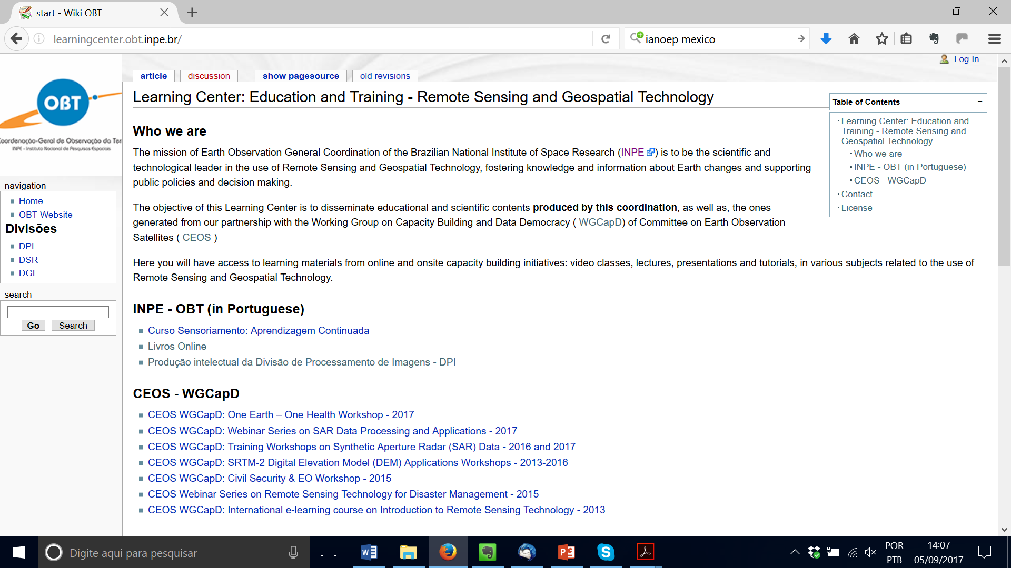
Access to Training Resources
Digital Knowledge Repository for record and archival of teaching material – Free and open (Creative Commons License) at: http://learningcenter.obt.inpe.br/

Slide 6
Collaborations with WGs
Collaborate on CB-1: Explore future options for providing portal-based access to capacity building and training resources. Conduct a study of existing and potential new approaches to collect, coordinate, and synergize available capacity building and training resources related to satellite Earth observations.
WGCapD and WGISS working to define our current practices for:
Hosting on demand recorded webinars – make discoverable, common metadata
Hosting capacity building resources - make discoverable, common metadata
Planning calendar into future – plan, and post as 2 separate steps

Slide 7
Collaborations with WGISS
WGCapD assist WGISS in sharing training best practices and in building awareness of WGISS planned webinars
Using WGCapD distribution list to those previously trained to announce WGISS training
Pointing to WGISS recorded webinars from WGCapD website page
Best practices document completed WGCapD review & will be sent to WGISS
WGISS and WGCapD collaborate on a study to improve standardization and interoperability of data system supporting documentation
Discussed, awaiting further WGISS definition

Slide 8
Collaborations with Future Data Architectures (FDA)
Share best practices to inform their training.
Plans to archive training with video and GoTo Meeting recordings.
Continued coordination with FDA along with WGISS and ODC.

Slide 9
Collaborations with WGCV
Current practice of new space operators approaching WGCV once satellite up for calibration help could be modified to include proactive engagement.

Slide 10
Collaborations with Open Data Cube (ODC)
Help promote awareness of data cube training, e.g. at IGARSS 2018.
Provide advice on how to best make YouTube video tutorials.

Slide 11
Collaborations with AHTs
Ad Hoc Teams
SDG
Promote awareness of SDG methodologies as are developed, along with GEO
Leverage existing efforts to develop materials
GEOGLAM
Joined our 2017 WGCapD annual meeting, exploring potential
Potential collaborations with other AHTs
Other WGs and VCs – potential collaborations

Slide 12
Summary
Raise awareness of the value of EO data products and services
Support CEOS initiatives
Collaborate with WGs, VCs, GEO, UNOOSA and other UN agencies in capacity building
Continue conducting training workshops and webinars (SRTM, SARS etc.)
Follow up on:
Explore future options for providing portal-based access to capacity building & training resources
Common Calendar of events
Advertisement of data cube initiatives

Slide 13
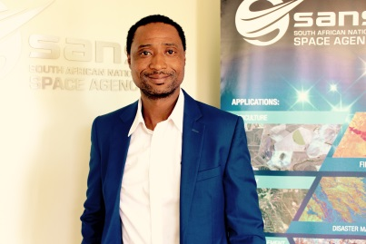
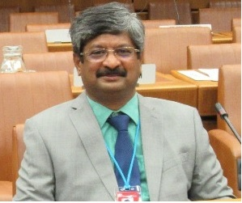
2018-2020 - Chairmanship

Slide 14
Vice Chair approval
Approve New Vice-Chair: NASA

Slide 15
Committee on Earth Observation Satellites
Thank you for your support

