Slide 1

CEOS 3-Year Work Plan Annual Update
Committee on Earth Observation Satellites
CEOS Executive Officer
CEOS Plenary 2017
Agenda Item #1.3
Rapid City, USA

Slide 2




Brought to you by …
I’m
Back!
The CEOS Minion(s)!

Slide 3



Work Plan 2017
“[Sets] forth near-term objectives and deliverables designed to achieve the goals outlined in the CEOS Strategic Guidance document”

Slide 4
Functions
Focus on objectives and deliverables associated with timescales and assigned responsibilities
Updated annually by the CEO under the guidance of the CEOS Chair
In consultation with:
the CEOS SIT Chair
CEOS Secretariat
CEOS Working Groups
Virtual Constellations
Ad Hoc Teams
CEOS membership at large
CEOS’s external stakeholders
Provide sound and shared basis for measuring our progress in a multiannual perspective
Shall be consistent with and mutually supporting of other CEOS guiding documents

Slide 5
The current 3-Year Work Plan
Eighty-seven (87) Objectives/Deliverables for 2017-2019
Main outcomes are described for the following thematic areas:
  Climate Monitoring, Research, and Services
  Carbon Observations, Including Forested Regions
  Observations for Agriculture
  Observations for Disasters
  Observations for Water
  Future Data Architectures
  Capacity Building
  Data Access, Availability and Quality
  Advancement of the CEOS Virtual Constellations
  Support to Other Key Stakeholder Initiatives
  Outreach to Key Stakeholders
  Organizational Issues

Slide 6
Putting the Work Plan
At the Centre of CEOS Plenary
All CEOS Entities asked to report latest updates using the website: ceos-deliverables.org
Remains a challenge
Summary table provided in hard-copy for reference during Plenary
CEO
Assessment
Presenters asked to reference relevant work plan items
Agenda has been cross-referenced to work plan items
Statistical summary coming up …

Slide 7
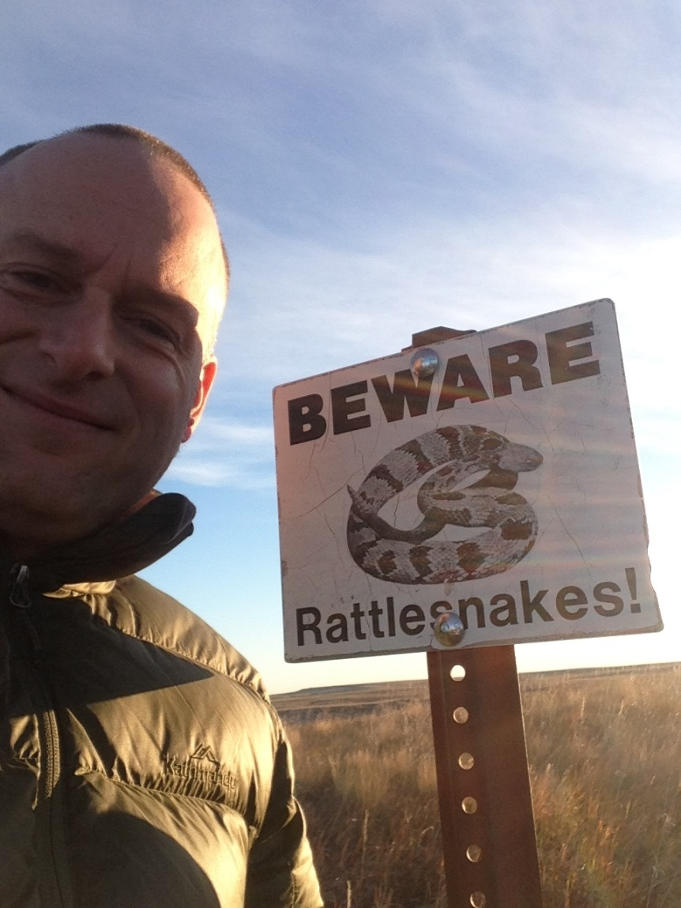

Slide 8
Delivery
Completed | 19
On track | 49
Material Delay | 14
Not started | 5

Slide 9
Development
Now
Late Nov 17
Late Jan 18
Mid Feb 18
End Feb 18
New
Initiatives
Updated Priorities
MilestoneChanges
Refinement
Concurrence
CEOS-31
v0
V0.5
Pre-V1
V1.0
Discontinued Objectables
Status
Updates
Add/Remove
Objectables
Validation
Major Slips
Plenary
Outcomes
Revise
Rationale
WGs/VCs/AHTs
CEO Team
SEC
CEO Team
Chair Team
WGs/VCs/AHTs
Stakeholders
Principals
(Virtual Endorsement)

Slide 10
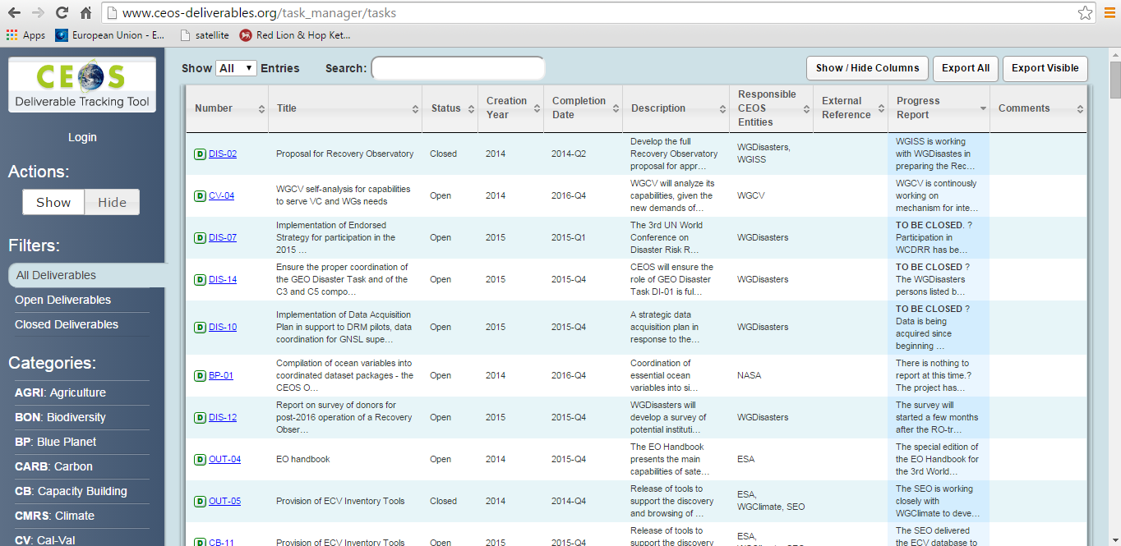
Challenge
Keeping this up-to-date …

