Slide 1

CEOS-30 Action Status
Agenda Item 1.2
CEOS Plenary 2017
Rapid City, United States
Jonathon W. Ross
Executive Officer

Slide 2
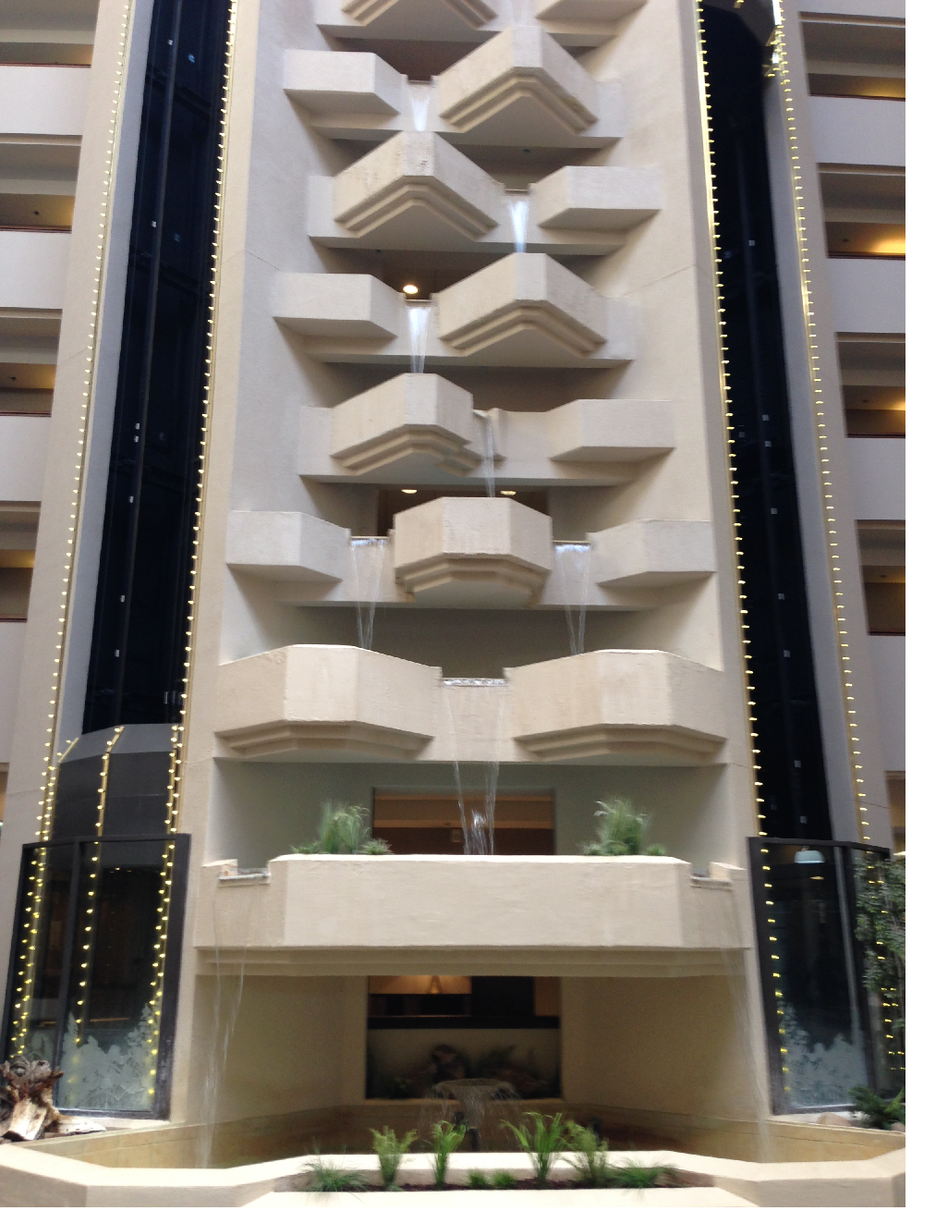








Health and Safety Alert
NO
BATHING
BATH/SHOWER
IN EACH
ROOM

Slide 3
No. | Action | Due Date | Status as at CEOS-31
30-1 | The CEOS Executive Officer (CEO) and SIT Chair Team to work with Paul Di Giacomo (NOAA) and Andy Steven (CSIRO) to understand potential CEOS contributions to the governance structure of GEO Blue Planet. | Present the way forward and roles at CEOS SIT-32. | Resolved.
30-2 | The CEOS ad hoc Working Group on GEOGLAM, in consultation with the CEOS Secretariat, to provide feedback on the GEOGLAM Secretariat paper on commercial engagement. The CEOS ad hoc Working Group on GEOGLAM and GEOGLAM Secretariat to discuss, and ensure the inclusion of a clear statement of the value proposition for each entity involved. | When the GEOGLAM paper is ready for comment. | Document not yet provide by GEOGLAM. Recommend close and consider at a future time.
30-3 | The CEOS Executive Officer (CEO), in coordination with the CEOS Chair Team, SIT Chair Team, and CSIRO, to prepare a statement of objectives for the new ad hoc team on the UN SDGs, and to seek approval of the statement by the CEOS Secretariat at CEOS SEC-219. Pending approval, the ad hoc team co-leads will seek members for the team (December 2016) and prepare terms of reference, to be confirmed to the CEOS Secretariat at CEOS SEC-220. | CEOS SEC-220 | SDG Team successfully established.
30-4 | CEOS Agencies to liaise with their national delegations to COP22 to encourage interventions in support of the CEOS Statement to SBSTA45. | COP22 | Completed.
30-5 | CEOS Agencies to provide any comments to Mark Dowell (EC/JRC) on the initial initiatives proposed as the next steps for implementation of the CEOS Strategy for Carbon Observations from Space – to identify major omissions and consider support capacity for the initiatives. | December 2016 | Completed – status reports now being provided to SIT.

Slide 4
No. | Action | Due Date | Status as at CEOS-31
30-6 | CEOS Chair to write (with the mandate outline attached) to the CGMS Chair advising of the CEOS Atmospheric Composition Virtual Constellation (AC-VC) task to develop a Satellite Carbon Report. CGMS should be invited to nominate additional contributors, if desired, for development of the Report. | November 2016 | Completed. Report is under development.
30-7 | CEOS Chair to provide the AC-VC Chairs with the outline mandate for the Satellite Carbon Report for comment. | November 2016 | Completed.
30-8 | CEOS Agencies to provide Pascale Ultré-Guérard (CNES) with feedback on the Marrakech Declaration: ‘Heads of Space Agencies Support Actions at COP22 for Water Management’ (individual agency comments; CEOS has already provided its input). | 11 November 2016 | Completed.
30-9 | CEOS Data Cube team to prepare a governance plan for the management of a consolidated open source repository, by CEOS SIT-32. | CEOS SIT-32 | Completed – Open Data Cube governance now in place through a Partners Forum and Steering Council. UK Catapult has also joined.

Slide 5
No. | Action | Due Date | Status as at CEOS-31
30-10 | CEOS Agencies to provide updates at the 31st CEOS Plenary on opportunities taken forward from the Non‐meteorological Applications for Next Generation Geostationary Satellites Study. | Updates to be provided at the 31st CEOS Plenary. | To be presented at CEOS-31. Also discussed at CGMS Plenary.
30-11 | EUMETSAT to provide the final Non‐meteorological Applications for Next Generation Geostationary Satellites Study to CGMS and provide any feedback from CGMS Agencies via the CEOS Secretariat and an update at the 31st CEOS Plenary. | Update to be provided at the 31st CEOS Plenary. | To be presented at CEOS-31.
30-12 | Given the risk to the current and future passive microwave constellation for sea surface temperature and the need for a redundant 7 GHz capability, CEOS to encourage its Agencies to ensure the continuity of existing capabilities and to coordinate efforts to ensure continuity and redundancy of these measurements in the future. The CEOS Sea Surface Temperature Virtual Constellation (SST-VC) to report a status update via the SIT Chair at the 31st CEOS Plenary. | 31st CEOS Plenary | To be presented at CEOS-31.

