Slide 1
GOES-R America’s Next-Generation Geostationary Weather Satellite
Committee on Earth Observation Satellites
Chuck Wooldridge
NOAA
CEOS Plenary 2016
Agenda Item #9.1
Brisbane, Australia
1st – 2nd November 2016

Slide 2
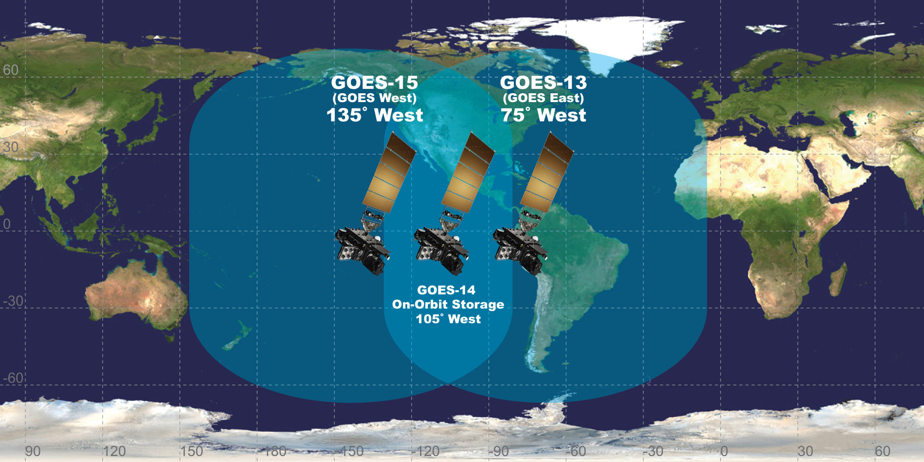
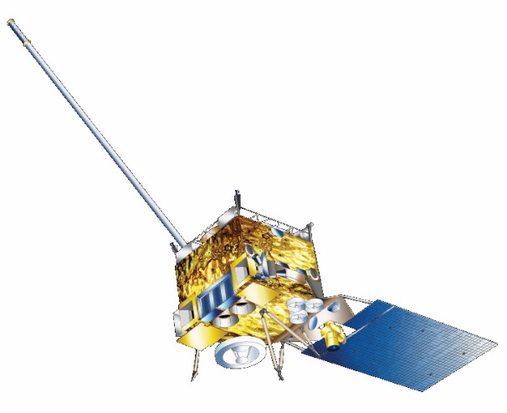
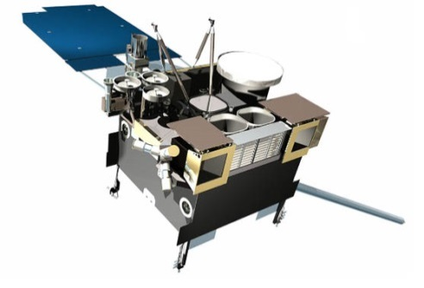
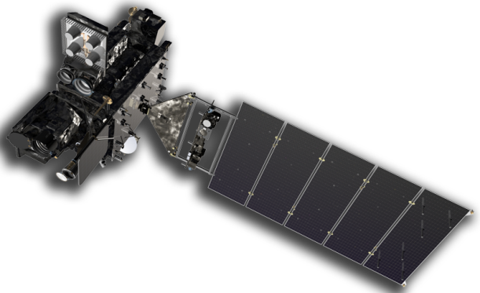
THE GOES FLEET CONFIGURATION
GOES-15
GOES-13
GOES-R
Notes:
The GOES satellites operate from two primary locations. GOES East is located at 75° W and provides most of the U.S. weather information. GOES West is located at 135°W over the Pacific Ocean. NOAA also maintains an on-orbit spare GOES satellite in the event of an anomaly or failure of GOES East or GOES West.
Once it reaches geostationary orbit, the satellite will be placed in the 89.5° checkout orbit where it will undergo an extended checkout and validation phase of approximately one year. The satellite will transition to operations immediately afterward. GOES-R’s operational orbit has not yet been determined. The final decision will be based on the health and performance of the GOES constellation.
The GOES-R ground system is located in two primary locations: the NOAA Satellite Operations Facility (NSOF) in Suitland, Maryland and the Wallops Command Data Acquisition Center (WCDAS) at Wallops, Virginia. A third operations facility in Fairmont, West Virginia, will serve as a backup location in the event of a communications issue at either NSOF or WCDAS.

Slide 3
The GOES-R Mission
GOES-R will provide:
Continuous imagery and atmospheric measurements of Earth’s Western Hemisphere in near real-time,
Total lightning data,
And space weather monitoring.
Notes:
The GOES-R series of satellite will provide significant enhancements for weather forecasters and give them the ability the observe the Western Hemisphere in near real-time.
GOES-R will provide continuous imagery and atmospheric measurements of Earth’s Western Hemisphere, total lightning data, and space weather monitoring to provide critical atmospheric, hydrologic, oceanic, climatic, solar and space data.
Compared to current GOES satellites, the GOES-R series will offer three times more spectral channels, four times better resolution, and provide five times faster scans of Earth.

Slide 4
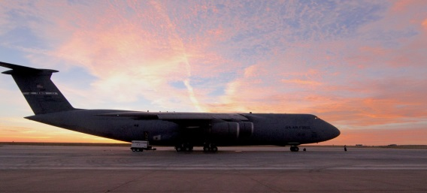
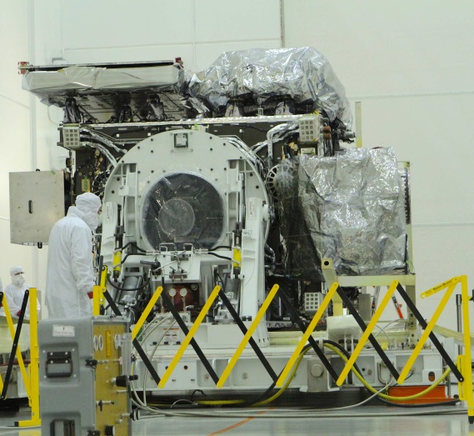
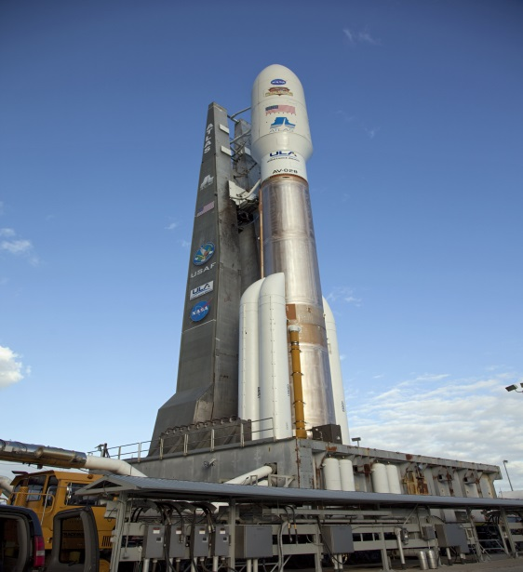
GOES-R Road to launch
Flown from Colorado to Florida, August 22, 2016
Currently in pre-launch preparations
Launching from Cape Canaveral Air Force Station, Florida
Lift-off is scheduled for NET 16 Nov 2016
Will be carried to space aboard a United Launch Alliance Atlas V 541 rocket
Will orbit 22,236 miles above Earth
Notes:
On August 23 of this year, NOAA's GOES-R satellite was officially unveiled after its journey from Littleton, Colorado (where it was built) to Cape Canaveral, Florida (where it will leave Earth). After landing, the satellite was moved to its storage facility at the Kennedy Space Center where technicians quickly began work to unpack and inspect the satellite. The successful shipment of GOES-R has brought the satellite another step closer to space and to revolutionizing weather forecasting across the United States.
Scheduled launch date and location: November 4, 2016 from Cape Canaveral, Florida at 5:40pm EDT (there is a two hour launch window)
Mission: NOAA mission, in collaboration with NASA
Spacecraft: 3-axis stabilized, 6,173 lbs (2,800kg) at launch, 6.1 meters tall
Launch vehicle: Atlas V 541 expendable launch vehicle provided by United Launch Alliance
Orbit: Geostationary orbit, 22,236 miles above Earth, East or West position is tbd
Primary measurements: Continuous imagery and atmospheric measurements of Earth’s Western Hemisphere, total lightning data, and space weather monitoring
Observational mitigation: Continues legacy GOES mission through 2036
NOAA’s GOES-R satellite is a next-generation NOAA weather satellite that will observe the Western Hemisphere in near real-time. The first satellite in the new series, GOES-R, will launch on November 4, 2016. Once in orbit, the satellite will be known as GOES-16.

Slide 5
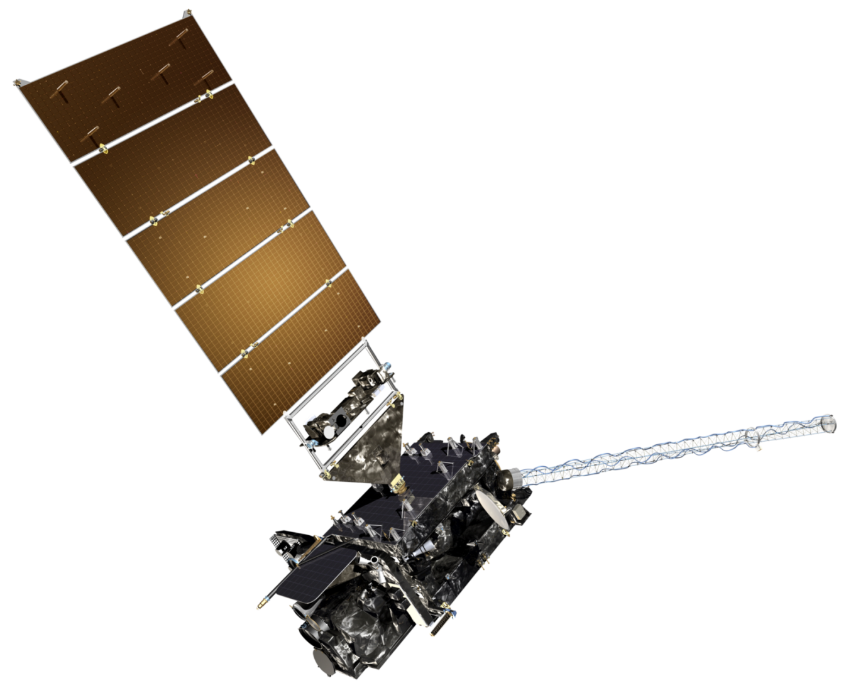
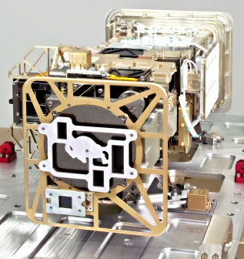
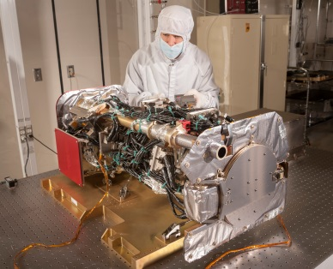
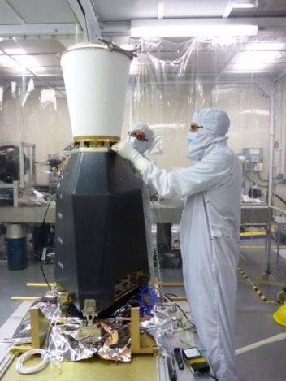
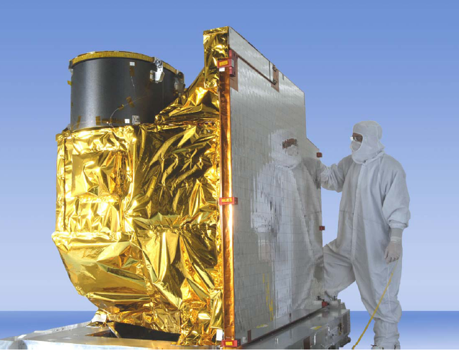
THE SPACECRAFT
Extreme Ultraviolet and X-Ray Irradiance Sensor (EXIS)
Solar Ultraviolet Imager (SUVI)
Space Environment In Situ Suite (SEISS)
Magnetometer
Geostationary Lightning Mapper (GLM)
Advanced Baseline Imager (ABI)
Notes:
Primary instruments:
Advanced Baseline Imager (ABI)
Geostationary Lightning Mapper (GLM)
Extreme Ultraviolet and X-ray Irradiance Sensors (EXIS)
Magnetometer (MAG)
Space Environment In-Situ Suite (SEISS)
Solar Ultraviolet Imager (SUVI)
Additional Payloads
Search and Rescue Satellite Aided Tracking (SARSAT)-GOES-R will be a proud part of the SARSAT network which saved 250 lives in 2015.
Relay distress signals from 406 MHz emergency beacons
Information Network (HRIT/EMWIN)
Emergency Managers Weather Information Network services
Delivers selected imagery, charts, data products, and text messages (NWS Watches and Warnings) to users throughout western hemisphere.
Data Collection System (DCS)
Relays data transmissions from over 20,000 in situ environmental data platforms from across the hemisphere
GOES-R Rebroadcast (GRB)
Data from each of the GOES-R series instruments is processed on the ground, then bounced back through GOES-R satellites to users throughout the hemisphere.

Slide 6
Why GOES-R is a game Changer for noaa:
Improved hurricane track and intensity forecasts
Increased thunderstorm and tornado warning lead time
Improved aviation flight route planning
Improved air quality warnings
Better data for long-term climate variability studies
Better fire detection and intensity estimation
Better detection of heavy rainfall and flash flooding risk
Better monitoring of space weather to improve geomagnetic storm forecasting
As well as, continued participation SARSAT rescues
And the list goes on!
Notes:
GOES-R can provide images of weather patterns and severe storms as frequently as every 30 seconds, which will contribute to more accurate and reliable weather forecasts and severe weather outlooks.
GOES-R’s environmental data products will support short-term weather forecasts (the one- to two-day outlooks we rely on), sever storm watches and warnings, maritime forecasts, season predictions, drought outlooks and space weather predictions.
GOES-R products will also improve hurricane tracking and intensity forecasts, increase thunderstorm and tornado warning lead time, improve aviation flight rout planning, provide data for long-term climate variability studies, improve solar flare warnings for communications and navigation disruptions and enhance space weather monitoring.
GOES-R will be a proud part of the SARSAT network which saved 250 lives in 2015.

Slide 7
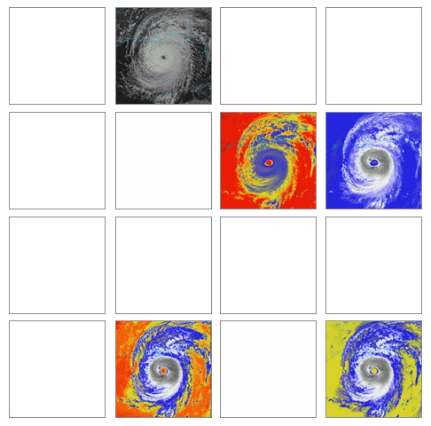
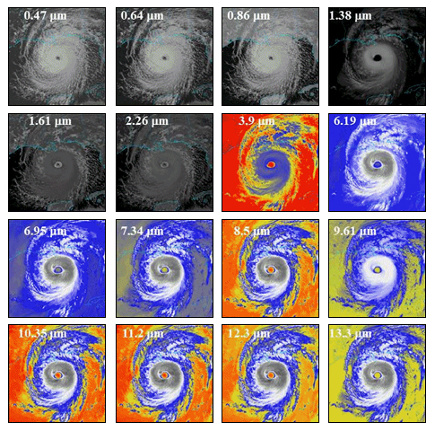
MORE DATA THAN EVER BEFORE
GOES-13/14/15 Spectral Bands
GOES-R Spectral Bands
Notes:
Primary instrument in GOES-R series is the ABI, a 16 channel imager that measures radiances in the visible and near-infrared wavelengths.
three times more spectral channels, four times better resolution, and provide five times faster scans of Earth.
GOES-R will offer 3x more data with 4x greater resolution, 5x faster than ever before. (Improves upon current capabilities in spectral information (3X), spatial coverage (4X), and temporal resolution (5X).

Slide 8
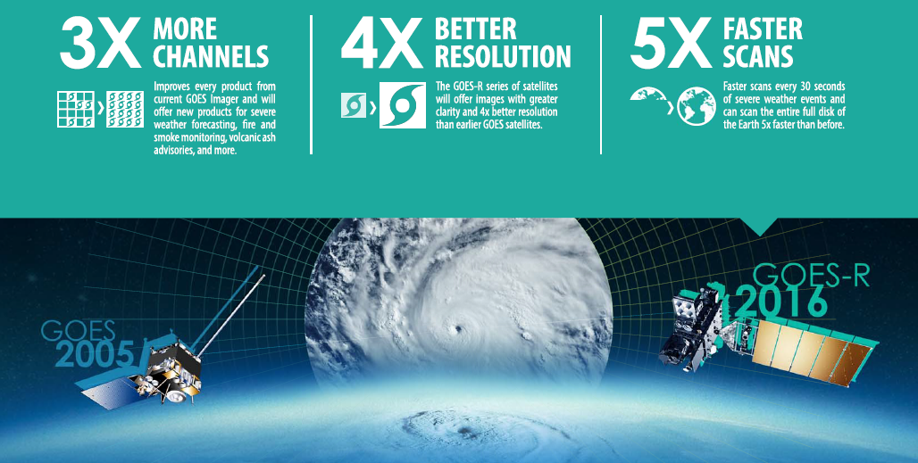
3 TIMES MORE DATA
4 TIMES GREATER CLARITY
5 TIMES FASTER
Notes:
Primary instrument in GOES-R series is the ABI, a 16 channel imager that measures radiances in the visible and near-infrared wavelengths.
three times more spectral channels, four times better resolution, and provide five times faster scans of Earth.
GOES-R will offer 3x more data with 4x greater resolution, 5x faster than ever before. (Improves upon current capabilities in spectral information (3X), spatial coverage (4X), and temporal resolution (5X).

Slide 9
GOES-14 RAPID SCAN 1-MIN IMAGERY
http://cimss.ssec.wisc.edu/goes/srsor2014/GOES-14_SRSOR.html
Notes:
(Click play on animation)
This three-panel animation shows visible imagery from GOES-14 and shows the difference between standard or routine 15-minute interval, 5-7 minute interval Rapid Scan Operations (RSO), and 1-minute interval Super Rapid Scan Operations Mode for GOES-R (SRSO) 0.63 µm visible channel images for the rapidly-developing convection that produced two separate tornadoes in southern Minnesota on May 8, 2014.
This example highlights the fact that the formation and evolution of the rapidly-developing convection was much more evident and easy to follow with the one-minute imagery.

Slide 10
TOTAL LIGHTNING DETECTION
1-min TRMM/LIS overpass, May 3, 1999 tornado outbreak
Notes:
(Click play on animation)
Diagnosing convective storm structure and evolution
Aviation and marine convective weather hazards
Tropical cyclone intensity change
Decadal changes of extreme weather – thunderstorms/ lightning intensity and distribution
GLM data latency only 20 sec
The Geostationary Lightning Mapper instrument on GOES-R will observe not only cloud to ground lightning strikes, but also in-cloud lightning activity. Scientists believe that an increase in lightning may be a precursor to the formation of tornadoes and GOES-R will offer new tools to observe lightning in near real-time.

Slide 11
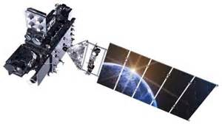
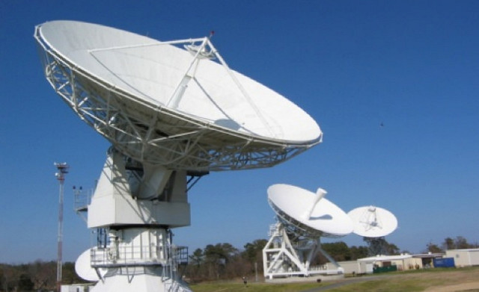
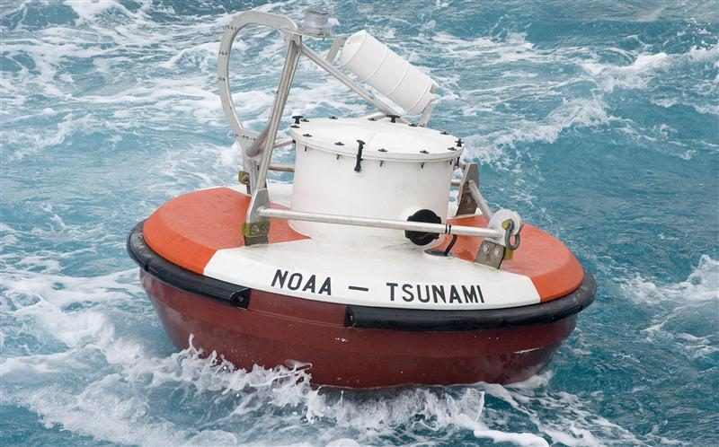
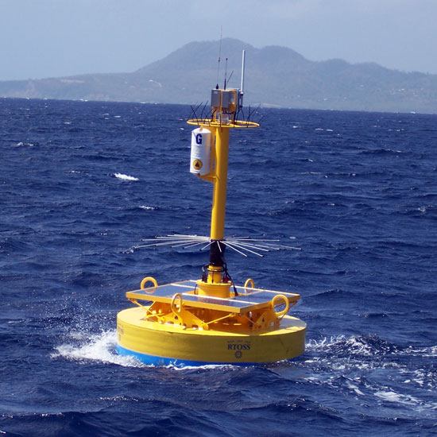
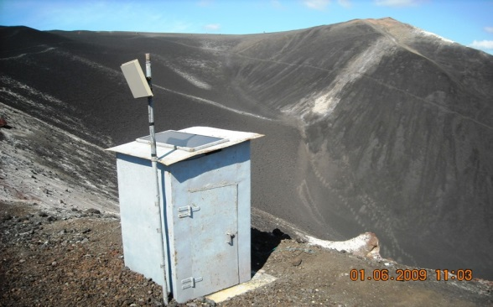
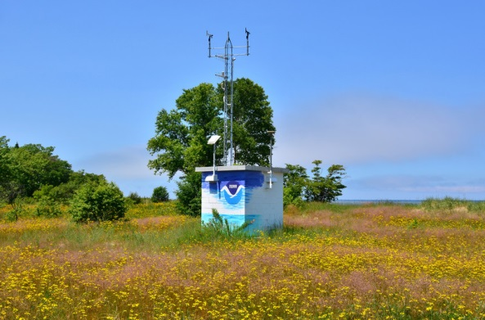
ENVIRONMENTAL DATA RE-BROADCAST
Notes:
GOES-R will support all of NOAA by providing the receiving and transmitting of data from approximately 27,000 terrestrial and remote systems, such as seismic stations, stream gauges, tsunami buoys, and weather stations to users around the world.

