Slide 1
Copernicus Programme
Committee on Earth Observation Satellites
European Commission
CEOS Plenary 2016
Agenda Item # 9.1
Brisbane, Australia
1st – 2nd November 2016

Slide 2
Copernicus - current status
Major Milestones reached:
Budget of € 4.3 Bn for 2014-2020
Full, free and open access to data
2016: Successful launches of Sentinel 1B & 3A
Five services are operational delivering 24h/7d
Notes:
Following the entry into force of a new legal framework in early 2014, the Commsision has negotiated delegation agreements with entrusted entities to implement the programme. Agreements have been signed with ESA and EUMETSAT for the space infrastructure. A first satellite has been launched successfully in April 2014. Further agreements have been signed with ECMWF, Mercator Ocean and the European Environmental agency for the Copernicus core services.
This has now put a programme structure in place providing free of charge satellite images and geo-information to users world wide.
Our presentation today is giving the opportunity to see what types of products can be deliverd by Copernicus, on a free and open basis – encouraging the data sharing model also adopted internationally in the Group of Earth observation (GEO) context.

Slide 3
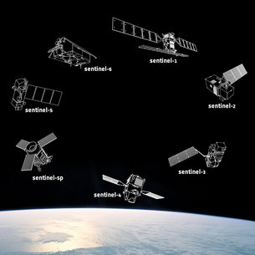
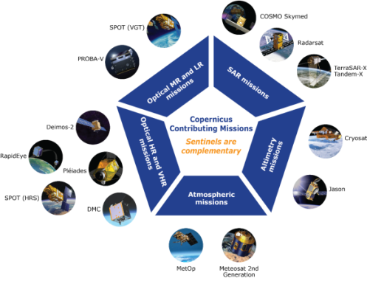
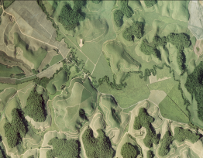
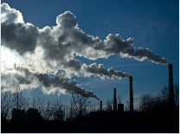
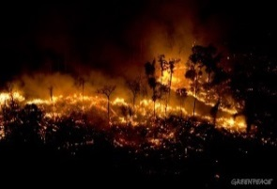
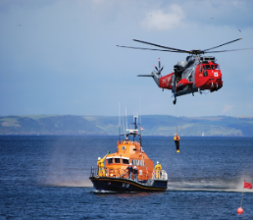
Copernicus Architecture
6 services use Earth Observation data to deliver …
Contributing missions
Sentinels
…added-value products

Slide 4
Space Component
Four dedicated Sentinel satellites are in orbit: Sentinel 1A, 1B, 2A, 3A
First Sentinel constellation, Sentinel 1A and 1B is now operational
By the end of 2020, 8 Sentinel satellites will be in orbit, providing most of the data needed by the Copernicus services
Notes:
Copernicus' operational phase starts now, building on the success and experience of the previous GIO (GMES Initial Operations) programme. User requirements and data-buy arrangements are in place, but our (EU-owned) Sentinels will deliver more and better data with unpredecented volume. => A quantum leap for EU Earth Observation. A key element of Copernicus is ensuring the smooth dissemination of this huge volume of data, making the EU as a major global player/owner in Earth Observation data.
External data-buy will continue, but decrease as Sentinels become operational in 2015-2016 ff. However, some gaps will remain (high-resolution imagery) as Copernicus was not (!) designed to fill them.

Slide 5
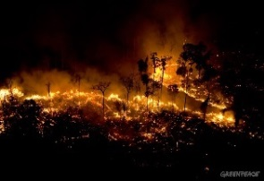
Service
Component
Notes:
Copernicus' operational phase starts now, building on the success and experience of the previous GIO (GMES Initial Operations) programme. User requirements and data-buy arrangements are in place, but our (EU-owned) Sentinels will deliver more and better data with unpredecented volume. => A quantum leap for EU Earth Observation. A key element of Copernicus is ensuring the smooth dissemination of this huge volume of data, making the EU as a major global player/owner in Earth Observation data.
External data-buy will continue, but decrease as Sentinels become operational in 2015-2016 ff. However, some gaps will remain (high-resolution imagery) as Copernicus was not (!) designed to fill them.

Slide 6
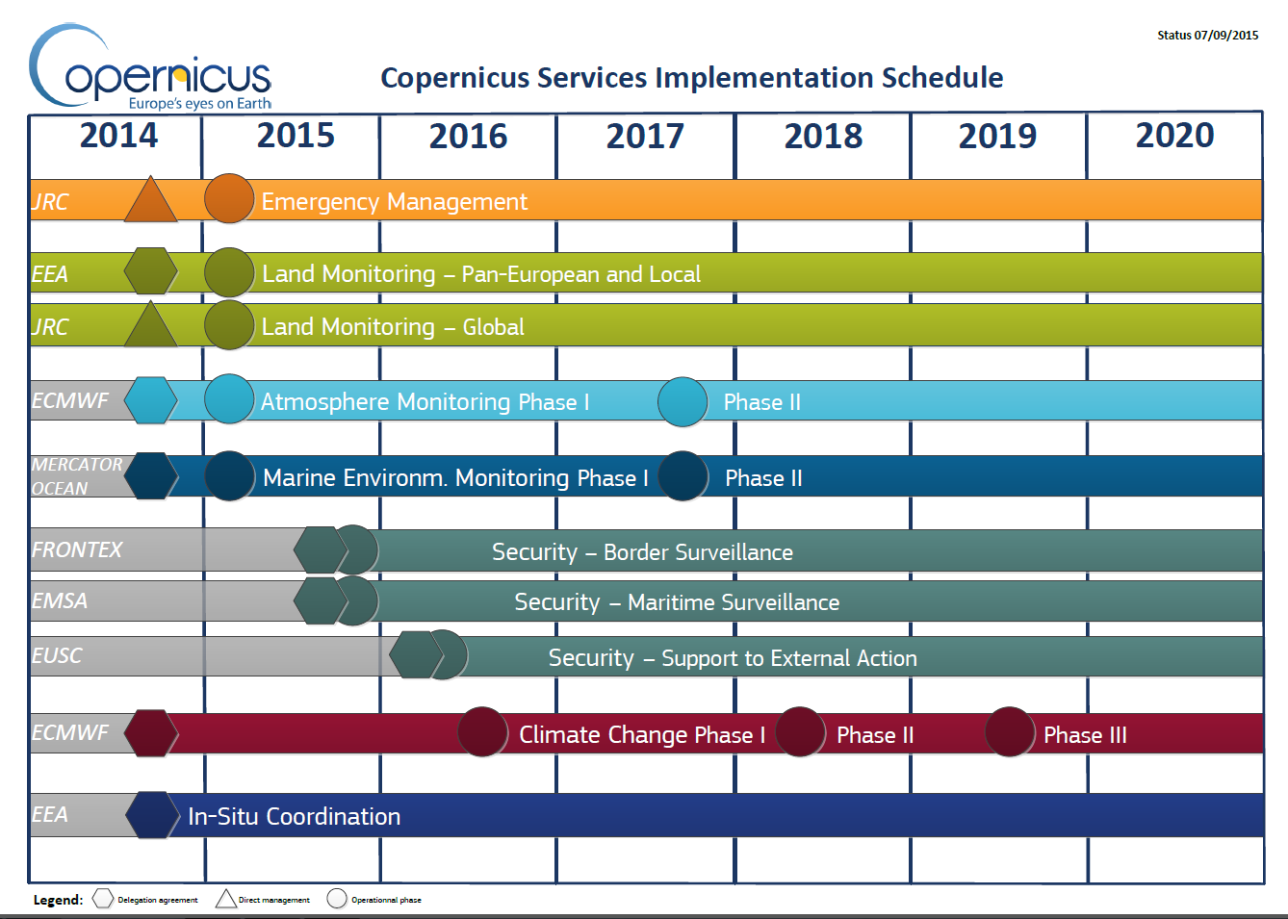
Copernicus Services Deployment
Notes:
In parallel to the satellite deployment, the services are ramping up their information production. Emergency management services and Land Monitoring services have been operational since 2012, and are now joined with round the clock forecasting by the Atmosphere and Marine Environment Monitoring services.

Slide 7
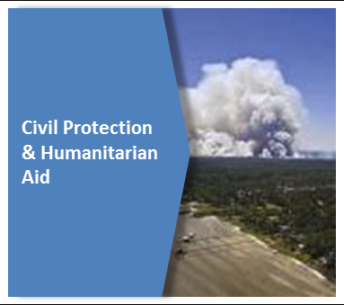
Example: Products
etc …
Notes:
Do

Slide 8
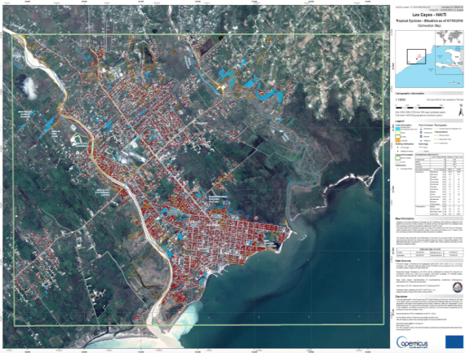
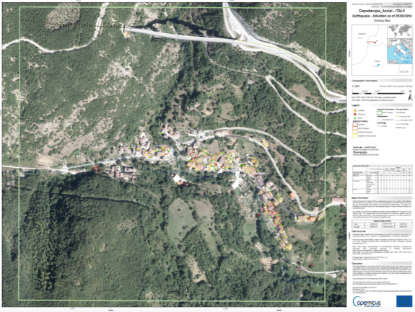
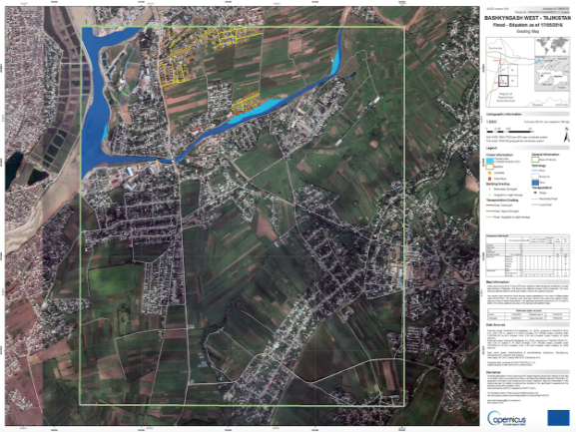
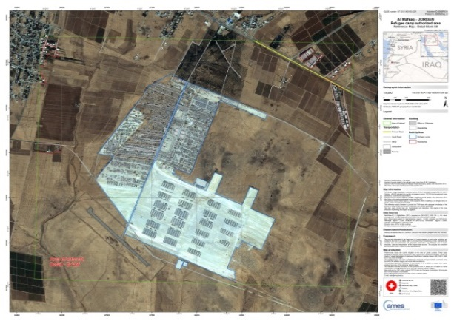
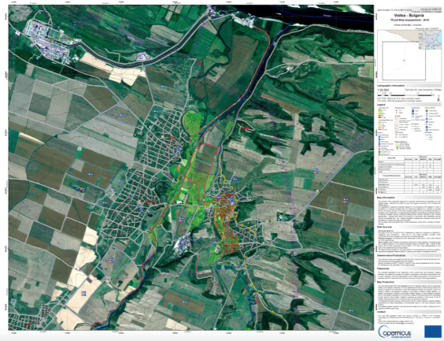
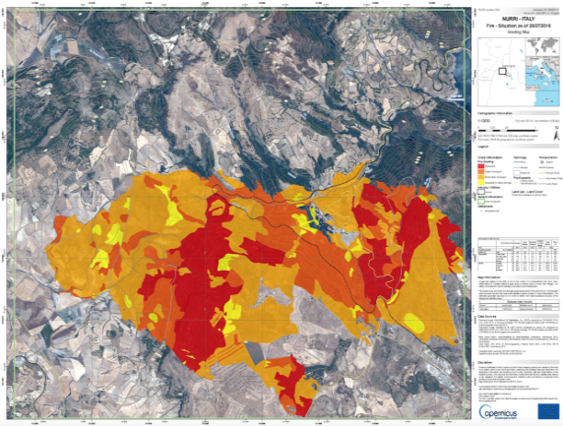
Example: Products on Emergency Mapping
Tropical Cyclone, Haiti
Earthquake,
Central Italy
Floods,
Tajikistan
Refugee Camp,
Al Mafraq Jordan
Flood Risk Assessment,
Bulgaria
Forest Fire, Sardinia,
Italy
Notes:
Diverse cover of events:
Tropical Cyclone, Vanuatu
Ebola epidemic, Guinea
Wind storm, Zakopane, Republic of Poland
Refugee Camp, Al Mafraq Jordan
Floods, Ostlandet Norway
Earthquake, San Felice sul Panaro Italy

Slide 9
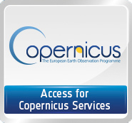
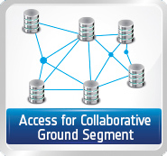
Copernicus data access
FULL, FREE AND OPEN
Restricted to the Copernicus Service Projects
Copernicus Space Component Data Access Portal*
Restricted to international partners
https://scihub.copernicus.eu/
Access to Copernicus Services Data and Information
FULL, FREE AND OPEN
Land-related data: http://land.copernicus.eu
Atmosphere-related data: http://atmosphere.copernicus.eu
Marine-related data: http://marine.copernicus.eu
Emergency-related data: http://emergency.copernicus.eu
Climate change-related data: http://climate.copernicus.eu (Beta version)

Slide 10
Copernicus data access

Slide 11
Copernicus
Thank you for your attention
Mauro.Facchini@ec.europa.eu
Website: http://copernicus.eu
Facebook: CopernicusEU
Twitter: @Copernicus EU

