Slide 1
ESA Status Report
30th CEOS Plenary, 1-2 November 2016

Slide 2
Overview - Planning of ESA satellite systems

Slide 3
Sentinels - Earliest Possible Launch Dates
SENTINEL | DATE | LAUNCHER
Sentinel-1A | Launched 3 April 2014 | Soyuz ST
Sentinel-2A | Launched 22 June 2015 | Vega
Sentinel-3A | Launched 16 Feb 2016 | Rockot
Sentinel-1B | Launched 25 April 2016 | Soyuz ST
Sentinel-5P | End March 2017 | Rockot
Sentinel-2B | 28 Feb 2017 | Vega(**)
Sentinel-3B | 30 Nov 2017^{(**)} | Rockot(**)
Sentinel-6A (*) | July 2020 | TBD
(*) = FAR ; (**) = Launcher swap with S2B/S3B being finalised
Notes:
To introduce the 3 next launches to come and launch swap

Slide 4
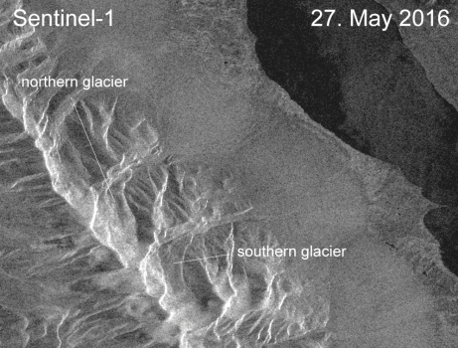
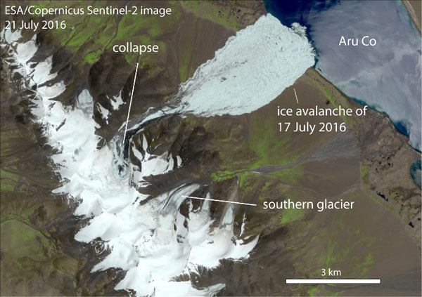
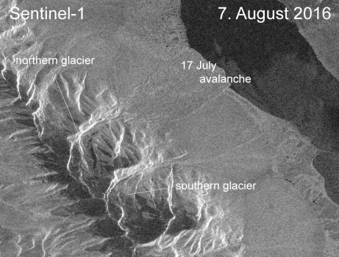
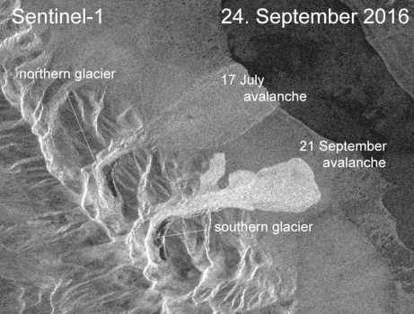
Tibetan ice avalanches: 17 Jul. and 21 Sep. 2016
Glacier dislocation … Two recent massive ice avalanches in western Tibet. Data from the Sentinel-1 and Sentinel-2 satellites turned out to be the most reliable source of information available worldwide.
Sentinel-1: 27 May 2016
Sentinel-2: 21 Jul. 2016
Sentinel-1: 7 Aug. 2016
Sentinel-1: 24 Sep. 2016
17 Jul. 2016, Northern glacier
60–70 million m3 (8.8 square kilometres) of ice and rocks cascaded down a narrow valley in Rutog County, killing nine people and hundreds of animals.
21 Sep. 2016: Southern glacier

Slide 5
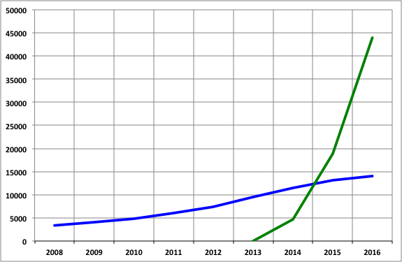
Sentinel data - Users Registration
A steady sharp increase of users as a consequence of Data Policy and Mission Operations Concept:
systematic observation, acquisition, processing and dissemination
Number of registered users
50,782 self-registered users on open access data hub
(status 24 October 2016)
ESA missions data users

Slide 6
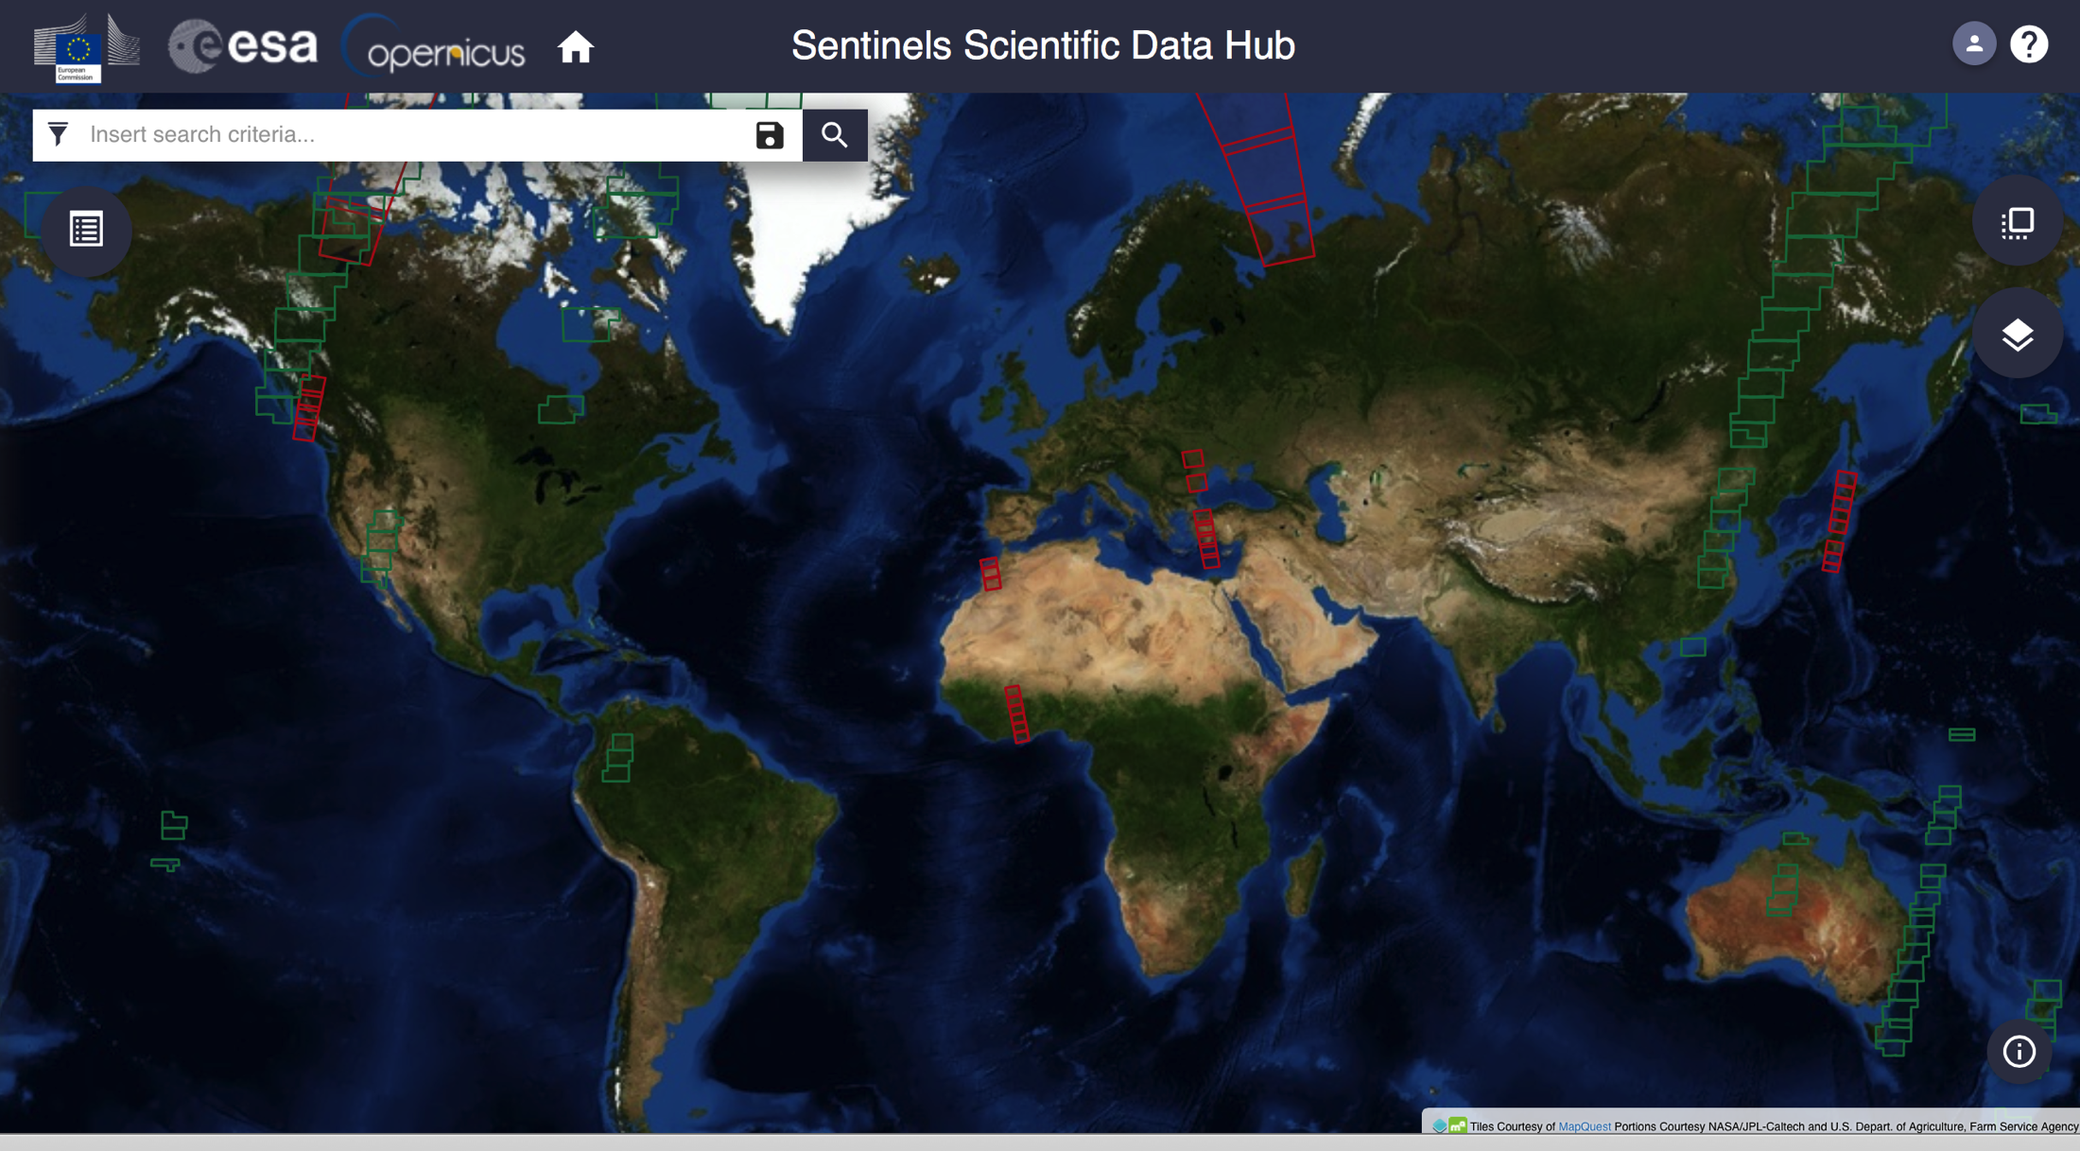
Sentinels Data Access Statistics - Open Access Data Hub
https://scihub.copernicus.eu
> 810,000 products available (1.35 PB)
~ 51,000
Registered users
> 8.2 Million
products downloaded
> 12 PB
Data volume
downloaded
Statistics: 30 Sept. 2016

Slide 7
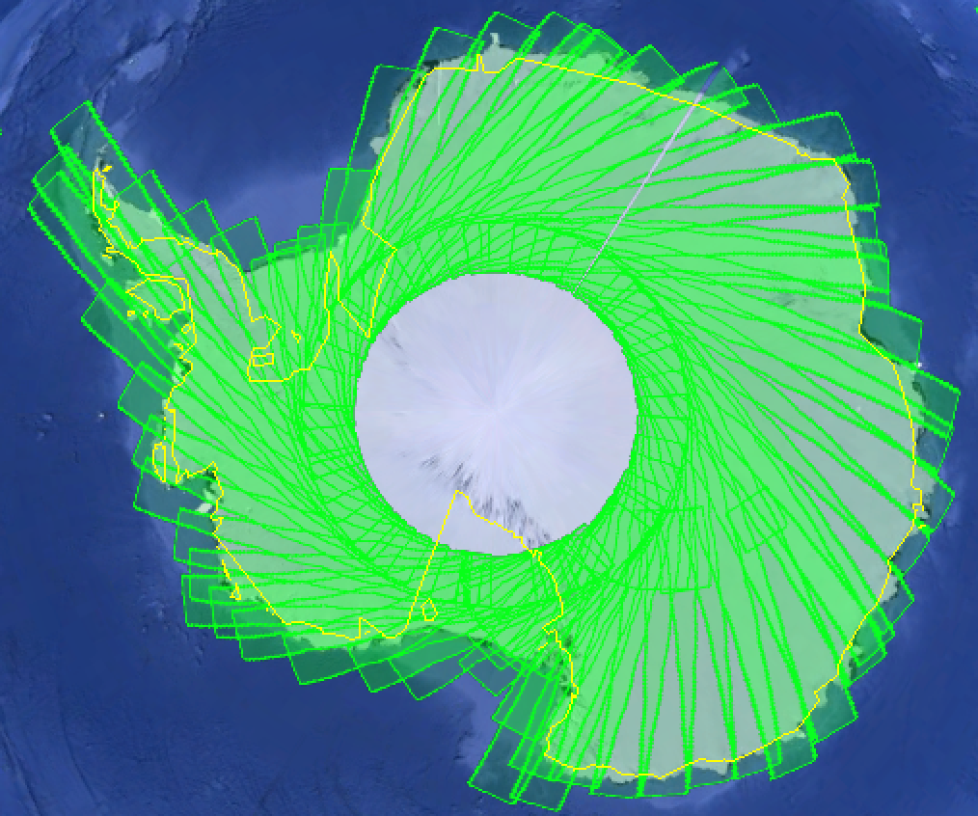
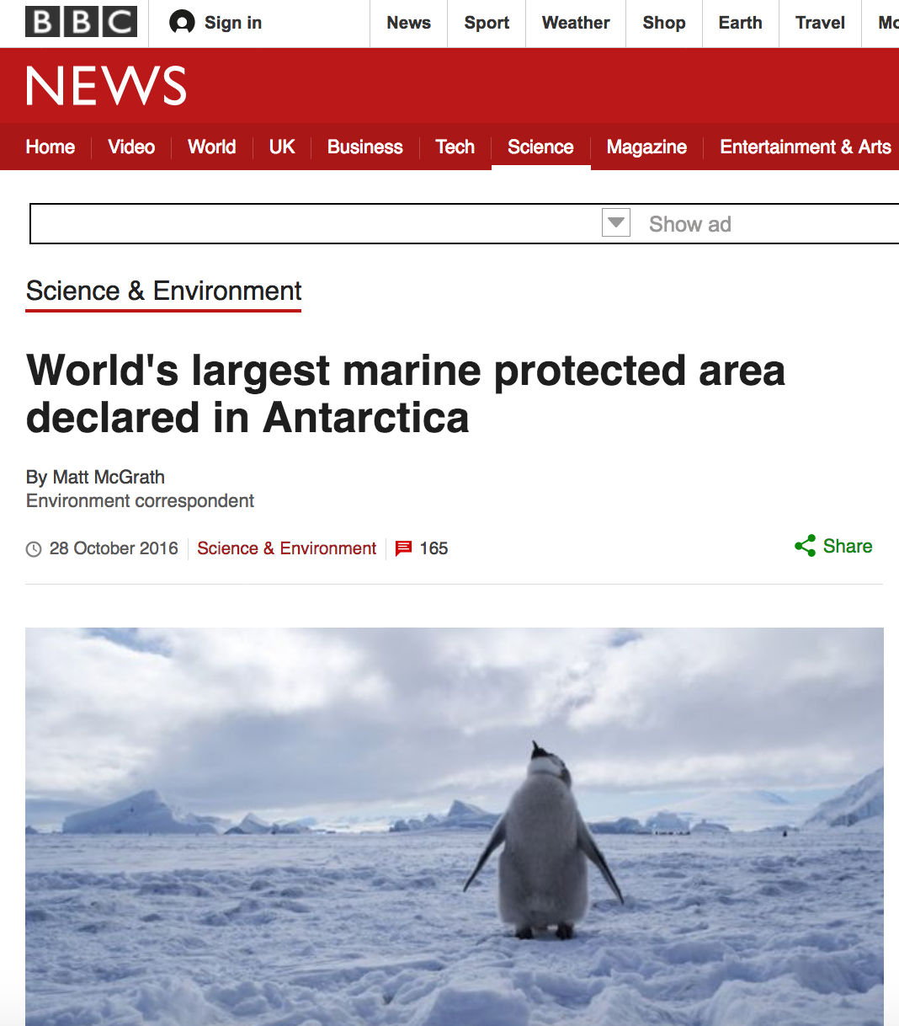
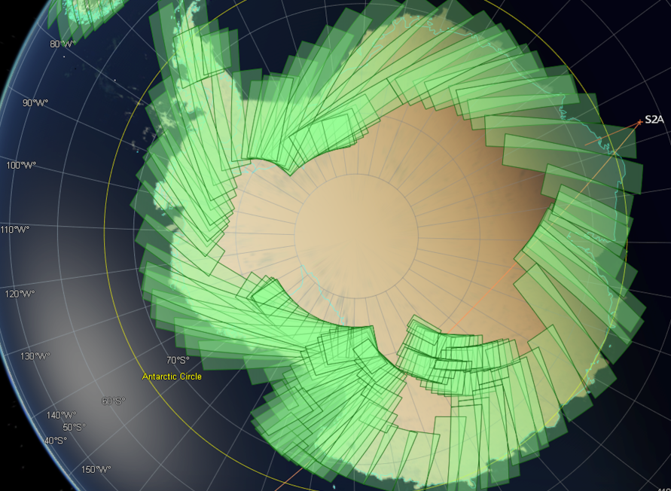
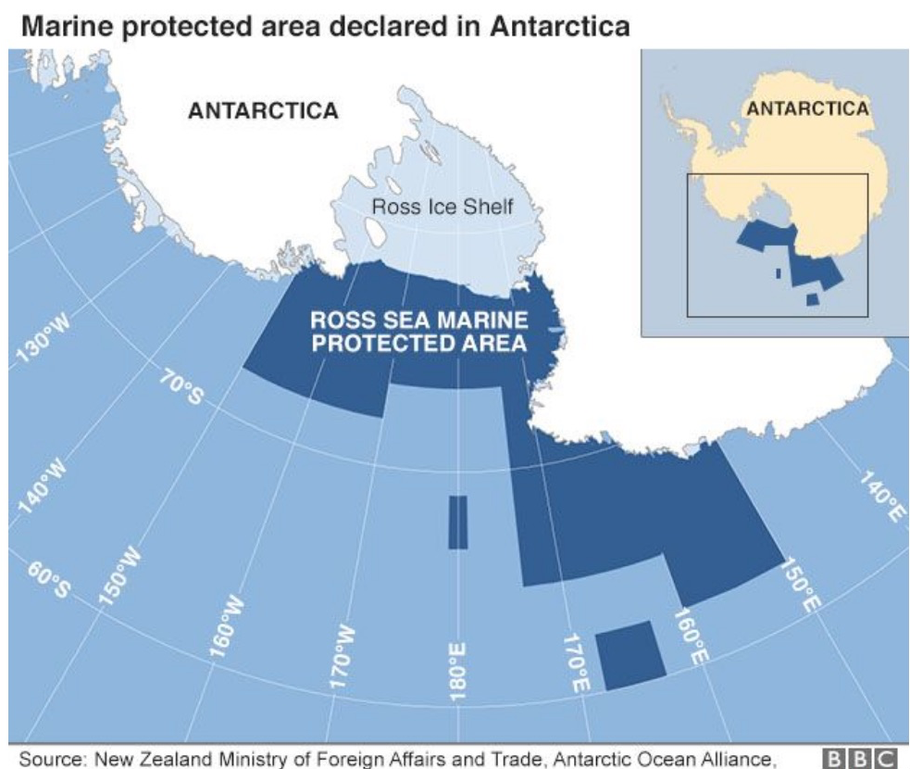
Use of S2 spare ‘Northern winter’ capacity: Antarctica campaigns
17-25 Oct
Antarctica Nov 2016 & possibly once/twice more, tbc
NEW!

Slide 8
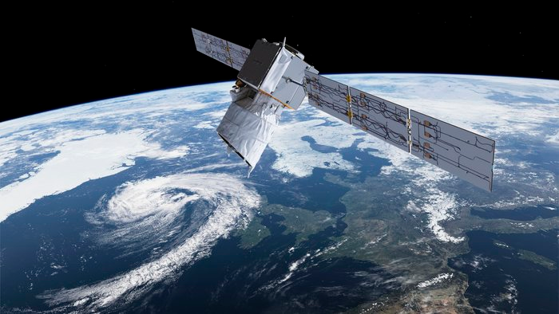
ADM-Aeolus : ESA’s Wind Mission
First space mission to acquire profiles of the wind on a global scale to:
Improve the accuracy of numerical weather and climate prediction and
Advance our understanding of tropical dynamics and processes relevant to climate variability.
Launch contract signed with Arianespace. Target launch date: November 2017

Slide 9
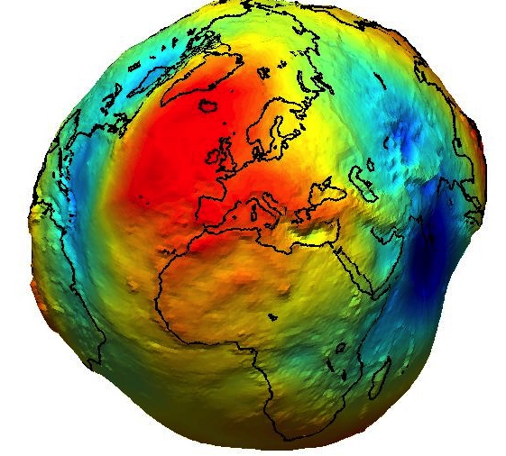
GOCE: mission accomplished
Measured most precise geoid to date
Notes:
Great scientific and engineering accomplishment.
Might also mention GOCE
use in lithospheric modeling
combinations with Grace for ice-mass balance studies
detection of earthquake signal
re-entry signals used to understand re-entry and improve accuracy of geoid further

Slide 10
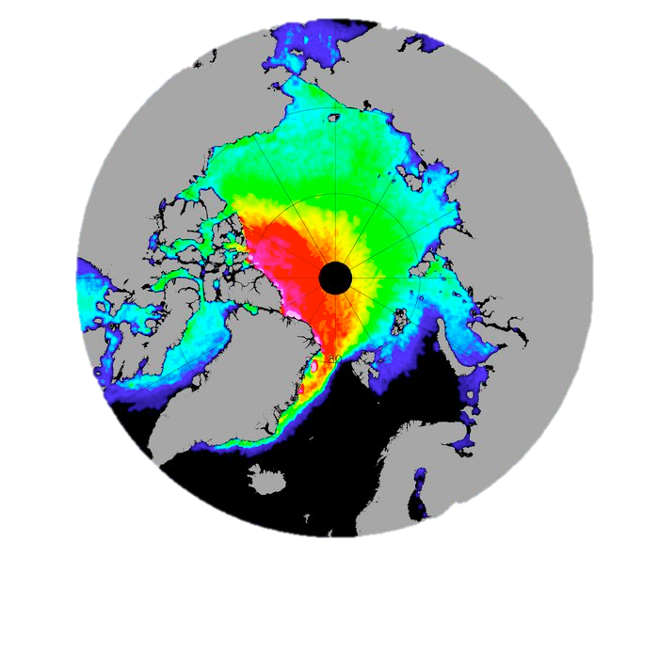
Cryosat: mission accomplished and ongoing
Surveyed sea ice thickness
Notes:
Relevance for Climate Change
Perspective for possible future in Copernicus (sustainability)

Slide 11
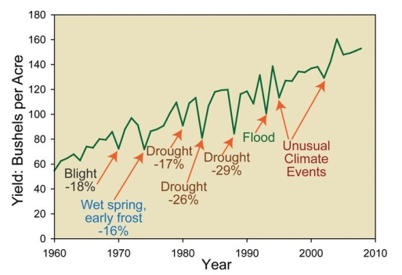
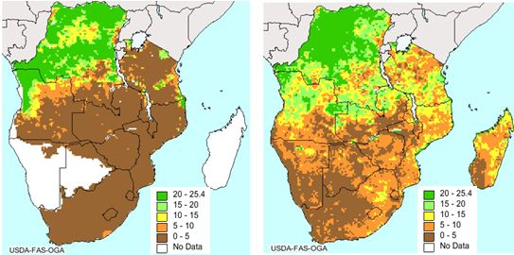
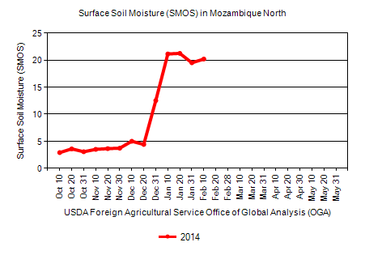
SMOS/SMAP: Soil Moisture for Drought
SMOS data used to predict drought and improve crop yield by US Department of Agriculture (USDA)
Crop Explorer website: http://www.pecad.fas.usda.gov/cropexplorer/
Credit: USDA FAS
Current Zambezi Flooding in SE Africa
Credit: USDA FAS, Soil moisture in southern Africa in mid-April 2014.
Notes:
FAS = Foreign Agricultural Service
SMOS data have been used to predict corn yield by USDA
Varying meteorological/hydrological conditions influence the corn yield
USDA uses SMOS data in their prediction of water being available in the growing seasons to plants as seen here in mid-April 2014 in Africa.
LEFT: only rain gauge data, RIGHT: including SMOS data → adding significant information for plant growth and food production
Units: mm of water in upper soil, 25.4 is the maximum value of the model. i.e. soil saturation
10 to 20 is ideal for growth.

Slide 12
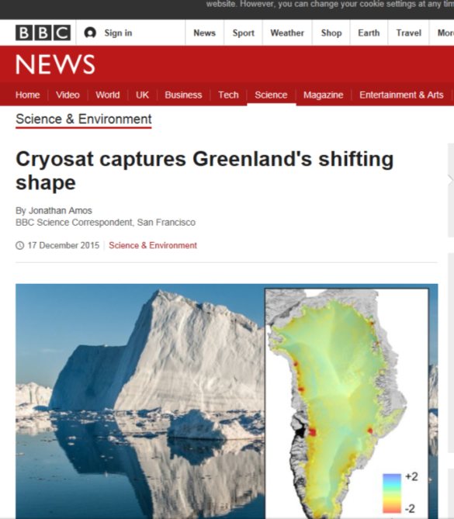
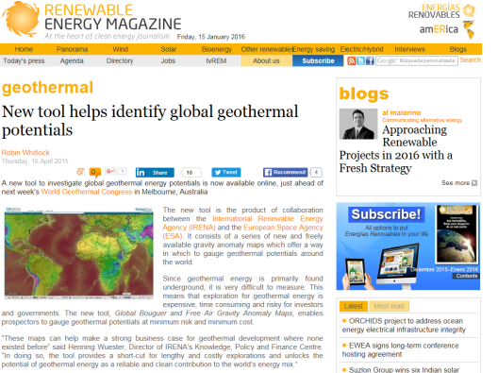
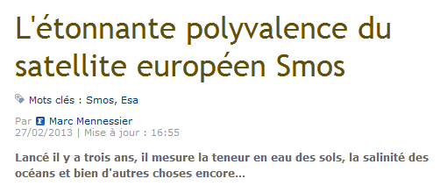
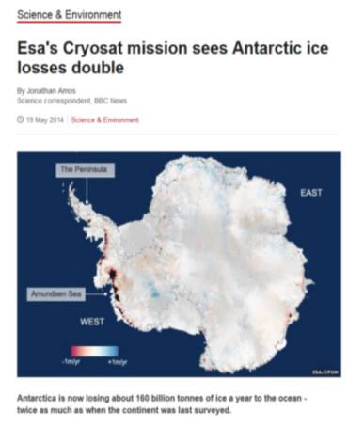
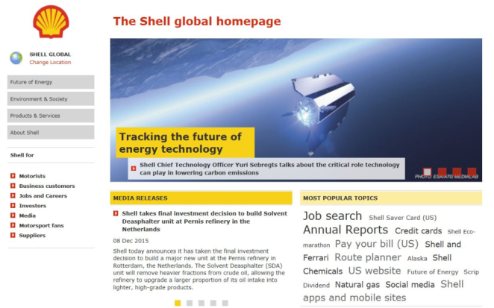
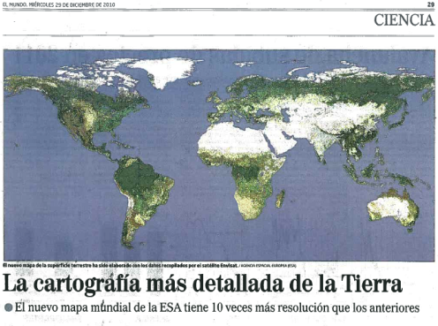
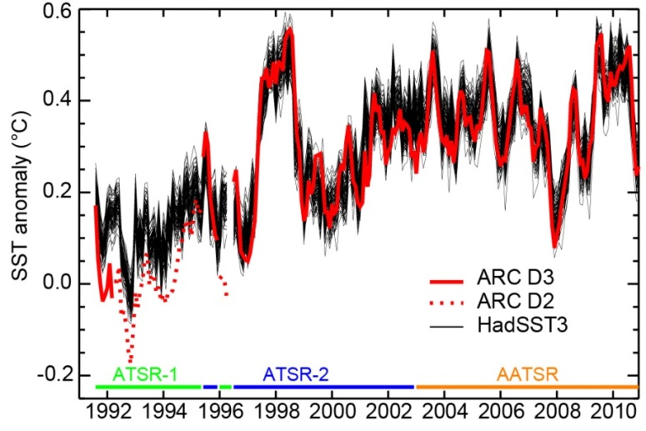
EOEP Outreach

Slide 13
EOP programmes at CM16

Slide 14
Thank you for your attention

