Slide 1

Key Updates on Existing Space Assets or Upcoming Launches - EUMETSAT
Committee on Earth Observation Satellites
EUMETSAT
CEOS Plenary 2016
Agenda Item 9.5.
Brisbane, Australia
1st – 2nd November 2016

Slide 2


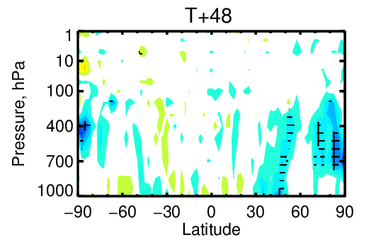
2016 : EUMETSAT is 30 years old …
… and MSG constellation in orbit was also 30 years
Meteosat-10/Full Earth Scan service at 0°
Meteosat-9/Rapid Scan Service over Europe
Meteosat-11 in-orbit storage
… and Metop-A was 10 years in orbit …
Flown in dual constellation with Metop-B
creating new benefits to users
Impact of dual Metop winds
on ECMWF Day 2 forecast

Slide 3
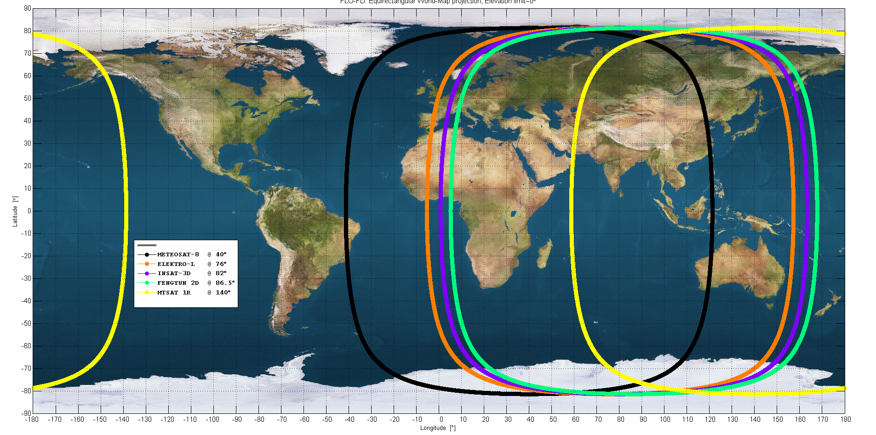




Meteosat-8 on its way to the Indian ocean
Meteosat-8 drifted from 0° to 41.5°E between 4 July and 21 September
Operational data dissemination started on 4 October
European contribution to an internationally coordinated effort with India, China and Japan providing

Slide 4
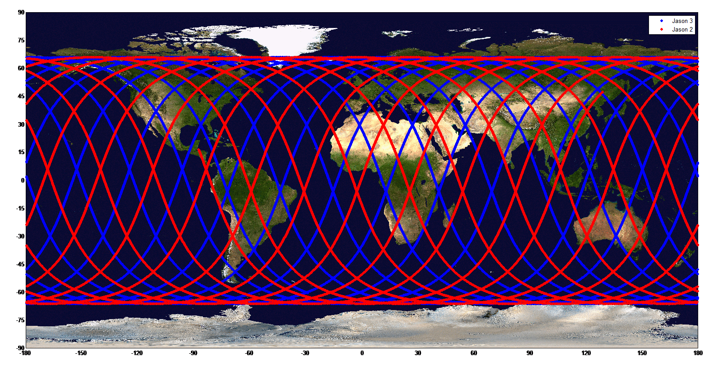




Jason-3
17/01 Launch
20/01 Start of Copernicus-funded operations
21/01 First data
12/02 Reached final orbit, 557 km behind Jason-2
02/02 Processing of NRT OGDR products started
08/03 Trial dissemination started
01/06 Satellite handed over from CNES to NOAA
01/07 Release of OGDR/ IGDRs to all users
12/09 Became the reference HPOA mission
14/10 Jason-2 manoeuvre towards “interleaved” orbit

Slide 5
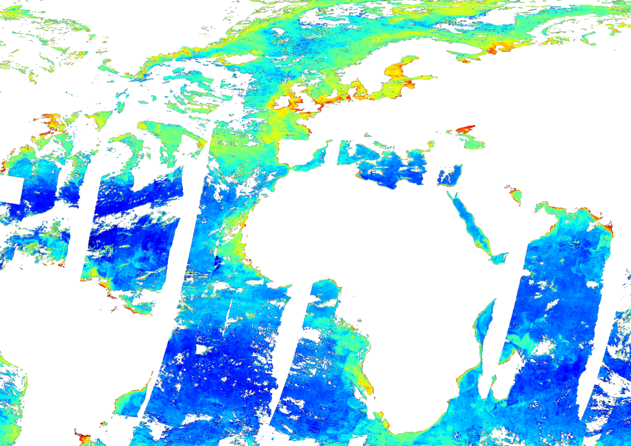
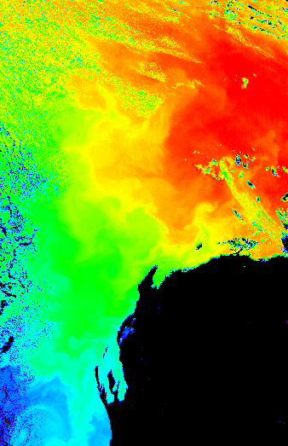


Sentinel-3
16/02 Launch
13/07 Handover of the operations of the satellite to EUMETSAT
13/10 Handover of the Marine Payload Data Ground Segment to EUMETSAT First data
Product release to users
20/10 OLCI L1 NRT full and reduced resolution
14/11 SLSTR L1 NRT products
05/12 SRAL L1A, L1B and L2 NRT and STC products
Technical Operations Arrangements “signed” with NOAA and GA

Slide 6
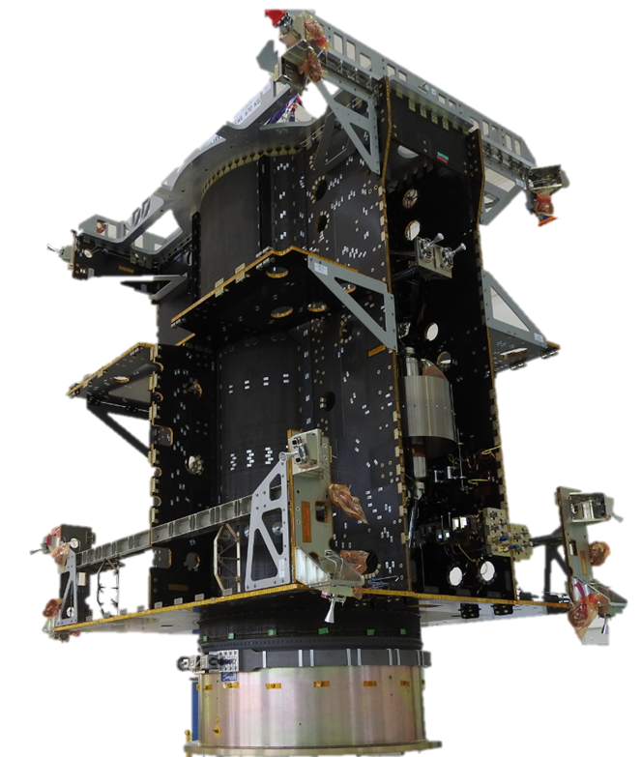
Metop-C, MTG, EPS-SG and JCS
Progress towards
Launch of Metop-C in 10/2018
MTG-I1 in Q1/2021, MTG-S1 in Q4/2022
Metop-SG-A1 in Q3/2021 and SG-B1 in Q4/2022
Jason-CS-A / Sentinel 6A in Q3/2020

Slide 7
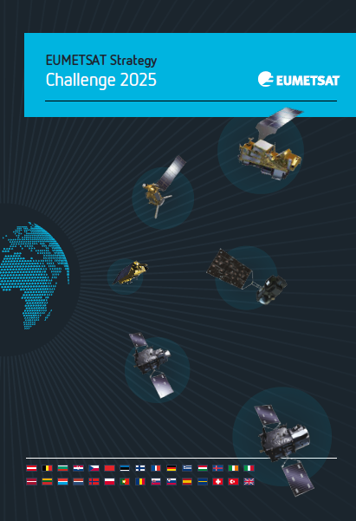
EUMETSAT Council approved updated strategy – Challenge 2025 years old …
http://www.eumetsat.int/website/home/AboutUs/Publications/Brochures/index.html

Slide 8
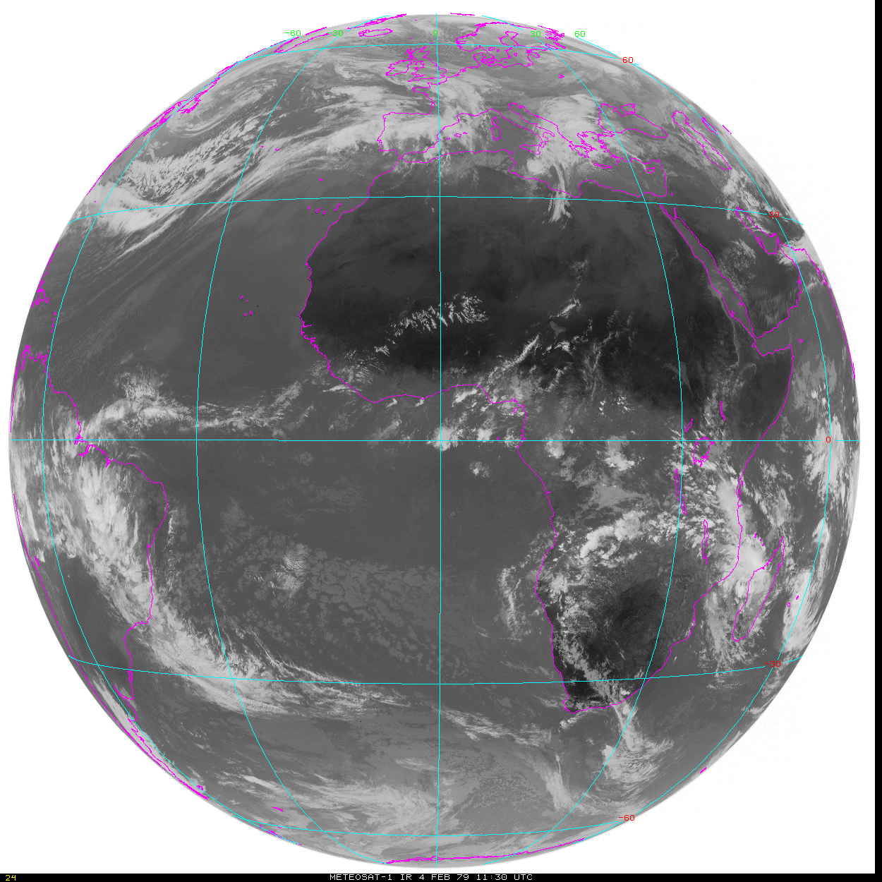
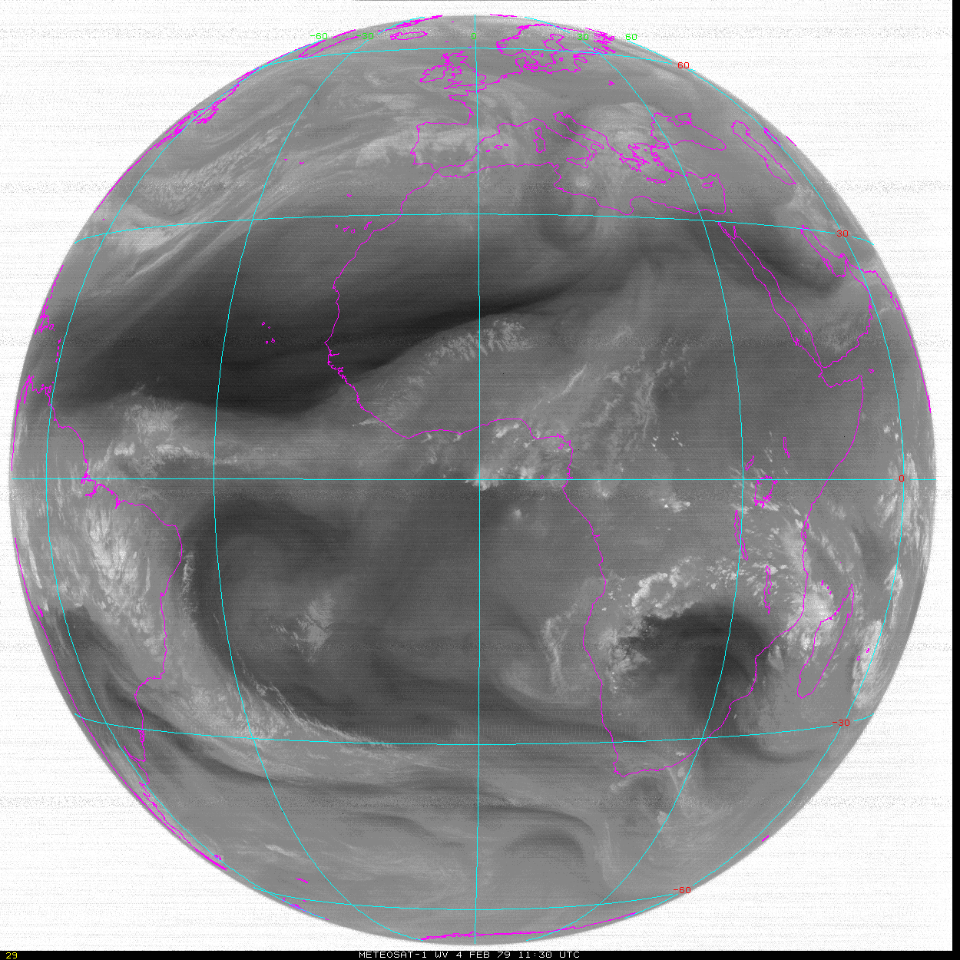
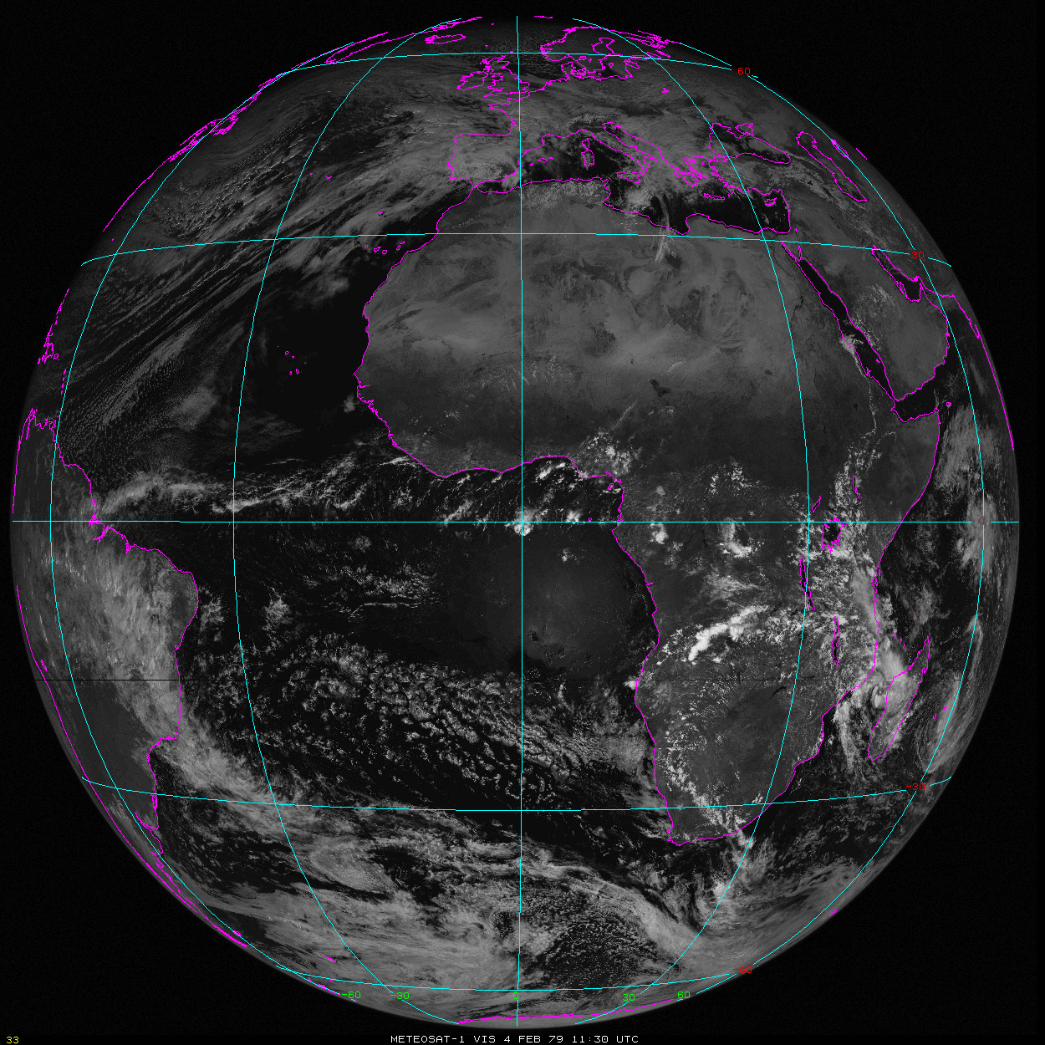
And finally a 30th birthday present ….
The University of Wisconsin retrieved 1 year of (lost) Meteosat data for the period: 2.12.1978 – 24.11.1979
4 February 1979 11:30 am, UTC

