Slide 1

NASA Flight Program Update
Committee on Earth Observation Satellites
NASA
CEOS Plenary 2016
Agenda Item 9.1
Brisbane, Australia
1st – 2nd November 2016

Slide 2
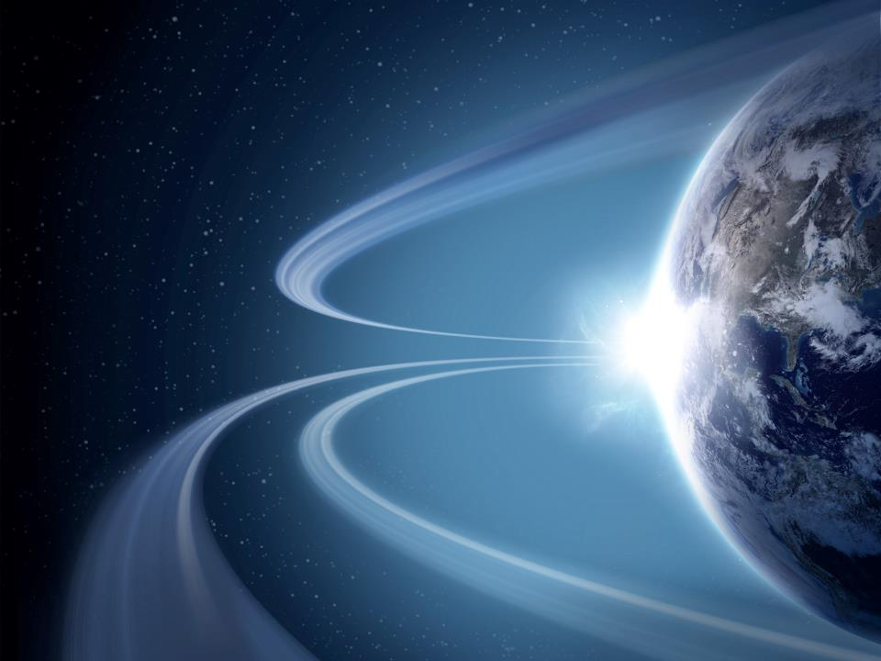


























(Pre)Formulation
Formulation
Implementation
Implementation
MAIA (~2021)
TROPICS (~2021)
EVM-2 (~2021)
Primary Ops
Landsat 9
(2020)
Primary Ops
Extended Ops
PACE (2022)
Extended Ops
NISAR (2022)
SWOT (2021)
TEMPO (2018)
JPSS-2 (NOAA)
RBI, OMPS-Limb (2018)
InVEST/Cubesats
MiRaTA (2017)
RAVAN (2016)
IceCube (2017)
HARP (2017)
TEMPEST-D (2018)
RainCube (2018*)
CubeRRT (2018*)
CIRiS (2018*)
CIRAS (2018*)
LMPC (----)
*Target date, not yet
manifested
Sentinel-6A/B (2020, 2025)
GRACE-FO (2) (2017)
Earth Science Instruments on ISS:
CATS, (2020)
LIS, (2017)
SAGE III, (2017)
TSIS-1, (2018)
ECOSTRESS, (2017)
GEDI, (2018)
OCO-3, (2018)
CLARREO-PF, (2020)
TSIS-2 (2020)
ICESat-2 (2017)
CYGNSS (2016)
ISS
SORCE, (2017)
TCTE (NOAA)
NISTAR, EPIC (2019)
(NOAA’S DSCOVR)
QuikSCAT (2017)
Landsat 7
(USGS)
(~2022)
EO-1 (2017)
SMAP (>2022)
Terra
(>2021)
Suomi NPP (NOAA) (>2022)
Aqua(>2022)
Landsat 8
(USGS) (>2022)
CloudSat (~2018)
CALIPSO (>2022)
GPM (>2022)
Aura (>2022)
GRACE (2)
(2018)
OSTM/Jason 2 (>2022)
(NOAA)
OCO-2 (>2022)
Notes:
EJD 10/20/16 changed dates of SAGE III and LIS to 2017
Fleet - Earth Science Division - Missions (with color key; editable)
Dec. 15, 2015
Credit: NASA/J. Mottar
------------------------------
SLIDE INFO
CORRECTION DENNING PER RIVERA Feb 18, 2016
Changed misspelling of “Sentinal” to “Sentinel”
UPDATE DENNING PER FREILICH DECISIONS FEB 12, 2016
Changed OCO-3 to Formulation color and moved lower in list
Changed RBI to Formulation color
Changed GEDI to Implementation color and moved to line above it
Added TSIS-2 in Formulation color
UPDATE DENNING PER FREILICH DECISIONS FEB 4, 2016
Changed “Altimetry FO (Formulation in FY16) to “Sentinal-6A/B”
On Landsat 9, removed comma and TIRFF
Change I was going to make – “NISTAR, EPIC (NOAA’s DSCOVR) to green primary ops was already corrected
Dec. 15, 2015 – Updated: TEMPO changed to Implementation phase; NISTAR, EPIC changed to Primary Ops phase; ; OCO-3 and ECOSTRESS changed to Implementation phase; Aquarius removed; slide now fully editable. JMottar
May 18, 2015 – Added to SMD Multimedia Library.
May 18, 2015 – Updated the outdated 2014 version: TRMM was removed; NISTAR, EPIC (NOAA's DSCOVR) were added; SMAP icon was updated; moon at top left was removed; color key moved to top left.-JMottar
ID: I-EA-15-0040 (image)
ID: SL-EA-15-0068 (slide)

Slide 3
(Pre)Formulation
Formulation
Implementation
Implementation
MAIA (~2021)
TROPICS (~2021)
EVM-2 (~2021)
Primary Ops
Landsat 9
(2020)
Primary Ops
Extended Ops
PACE (2022)
Extended Ops
NISAR (2022)
SWOT (2021)
TEMPO (2018)
JPSS-2 (NOAA)
RBI, OMPS-Limb (2018)
InVEST/Cubesats
MiRaTA (2017)
RAVAN (2016)
IceCube (2017)
HARP (2017)
TEMPEST-D (2018)
RainCube (2018*)
CubeRRT (2018*)
CIRiS (2018*)
CIRAS (2018*)
LMPC (----)
*Target date, not yet
manifested
Sentinel-6A/B (2020, 2025)
GRACE-FO (2) (2018)
Earth Science Instruments on ISS:
CATS, (2020)
LIS, (2017)
SAGE III, (2017)
TSIS-1, (2018)
ECOSTRESS, (2017)
GEDI, (2018)
OCO-3, (2018)
CLARREO-PF, (2020)
TSIS-2 (2020)
ICESat-2 (2018)
CYGNSS (2016)
ISS
SORCE, (2017)
TCTE (NOAA)
NISTAR, EPIC (2019)
(NOAA’S DSCOVR)
Near-Future Upcoming Launches
6 Nov.: RAVAN Cubesat
12 Dec.: CYGNSS constellation
15 Jan.: SAGE-III, LIS to ISS
EVM-2 selection announcement imminent
RapidScat-ISS mission has ended
Decadal Survey expected by Dec. 2017
QuikSCAT (2017)
Landsat 7
(USGS)
(~2022)
EO-1 (2017)
SMAP (>2022)
Terra
(>2021)
Suomi NPP (NOAA) (>2022)
Aqua(>2022)
Landsat 8
(USGS) (>2022)
CloudSat (~2018)
CALIPSO (>2022)
GPM (>2022)
Aura (>2022)
GRACE (2)
(2018)
OSTM/Jason 2 (>2022)
(NOAA)
OCO-2 (>2022)
Notes:
EJD 10/20/16 changed dates of SAGE III and LIS to 2017
Fleet - Earth Science Division - Missions (with color key; editable)
Dec. 15, 2015
Credit: NASA/J. Mottar
------------------------------
SLIDE INFO
CORRECTION DENNING PER RIVERA Feb 18, 2016
Changed misspelling of “Sentinal” to “Sentinel”
UPDATE DENNING PER FREILICH DECISIONS FEB 12, 2016
Changed OCO-3 to Formulation color and moved lower in list
Changed RBI to Formulation color
Changed GEDI to Implementation color and moved to line above it
Added TSIS-2 in Formulation color
UPDATE DENNING PER FREILICH DECISIONS FEB 4, 2016
Changed “Altimetry FO (Formulation in FY16) to “Sentinal-6A/B”
On Landsat 9, removed comma and TIRFF
Change I was going to make – “NISTAR, EPIC (NOAA’s DSCOVR) to green primary ops was already corrected
Dec. 15, 2015 – Updated: TEMPO changed to Implementation phase; NISTAR, EPIC changed to Primary Ops phase; ; OCO-3 and ECOSTRESS changed to Implementation phase; Aquarius removed; slide now fully editable. JMottar
May 18, 2015 – Added to SMD Multimedia Library.
May 18, 2015 – Updated the outdated 2014 version: TRMM was removed; NISTAR, EPIC (NOAA's DSCOVR) were added; SMAP icon was updated; moon at top left was removed; color key moved to top left.-JMottar
ID: I-EA-15-0040 (image)
ID: SL-EA-15-0068 (slide)

Slide 4
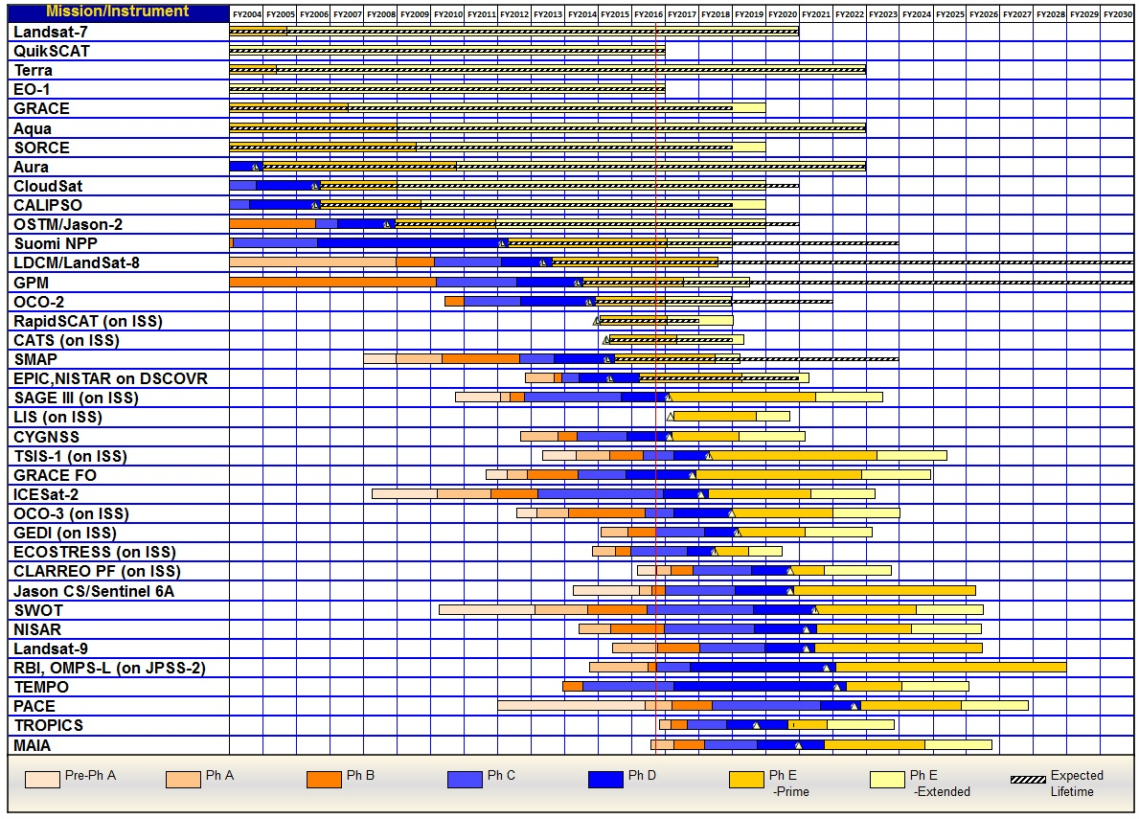
Mission Schedules (Pre-Phase A through Phase E)
Preliminary – Under Review
Note. Continuity for Jason CS/Sentinel 6A and Landsat-9 are planned through Jason CS/Sentinel 6B and Landsat-10, respectively.

Slide 5

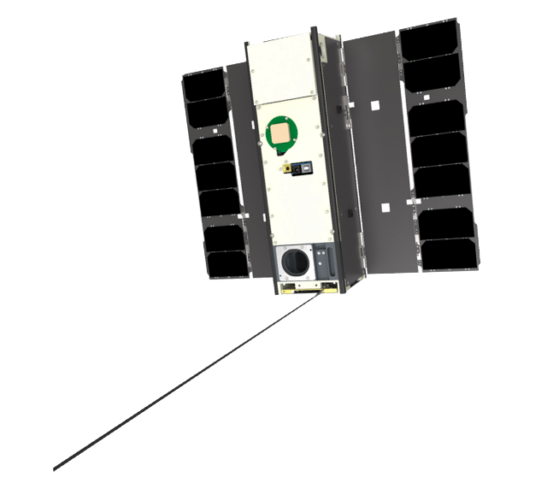
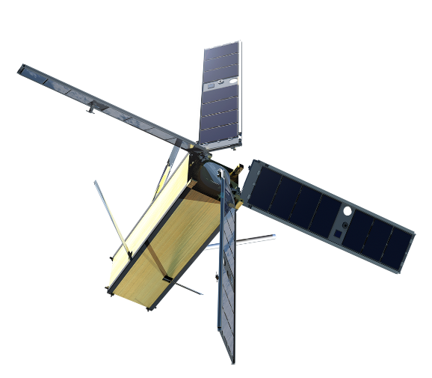
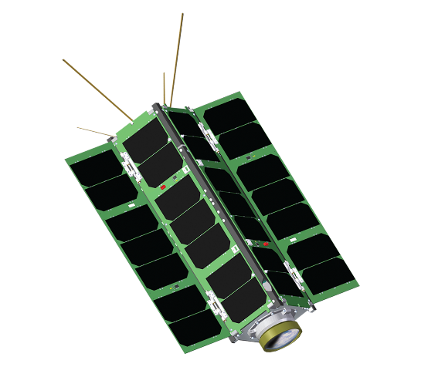
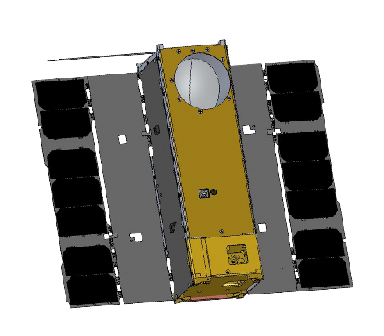
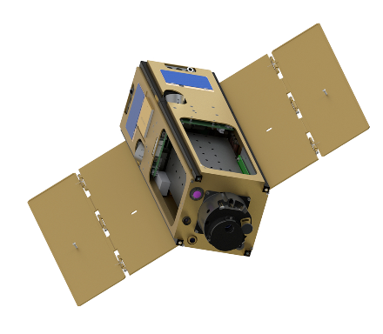

ESTO InVEST 2012 Program
U-Class Satellites Advancing TRLs for Future Earth Science Measurements
MiRaTA
MIT / MIT-LL
RAVAN
APL
IceCube
GSFC
HARP
UMBC
LMPC
The Aerospace Corporation
3 Frequency Radiometer and GPSRO
Validate new microwave radiometer and GPSRO technology for all-weather sounding
Vertically Aligned Carbon Nanotubes (VACNTs)
Demonstrate VACNTs as radiometer absorbing material and calibration standard for total outgoing radiation
874 GHz submm-Wave radiometer
Validate sub-mm radiometer for spaceborne cloud ice remote sensing
Wide FOV Rainbow Polarimeter
Demonstrate 2-4 km wide FOV hyperangular polarimeter for cloud & aerosol characterization
Photon Counting InfraRed Detector
Demonstrate linear mode single photon detector at 1, 1.5, and 2 microns in space environment

Slide 6
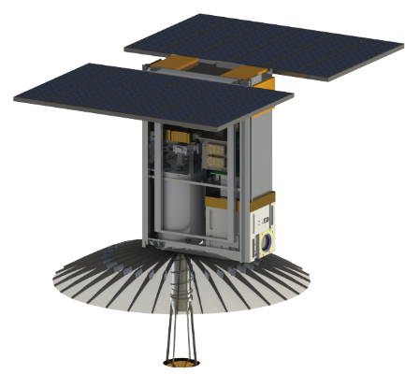
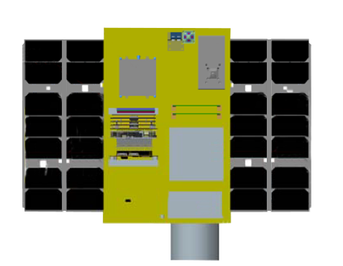
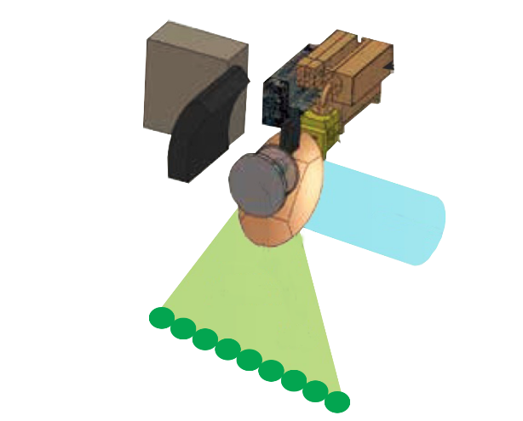
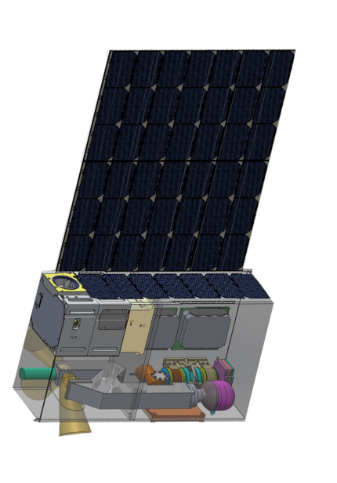
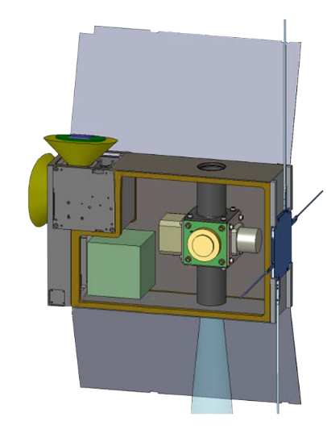
U-Class Candidate Development Satellites
ESTO Technology Developments for Future Earth Science Measurements
Venture Tech
ESTO InVEST 2015 Program
TEMPEST-D
Colorado State University
RainCube
Jet Propulsion Lab
CubeRRT
Ohio State University
Precipitation Radar
Validate a new architecture for Ka-band radars on CubeSat platform and
an ultra-compact deployable Ka-band antenna
Radiometer RFI
Demonstrate
wideband RFI mitigating backend technologies vital for future space-borne microwave radiometers
CIRiS
Ball Aerospace
CIRAS
Jet Propulsion Lab
5 Frequency mm-Wave Radiometer
Technology demonstrator measuring the transition of clouds to precipitation
Infrared Radiometer
Validate an uncooled imaging infrared (7.5 um to 13 um) radiometer designed for high
radiometric performance from LEO
Infrared Atmospheric Sounder
Demonstrate ability to measure spectrum of upwelling infrared radiation and validate 2D infrared detector material, a micro pulse tube cryocooler, and a grating spectrometer

Slide 7
Venture Class Selections/Solicitations
EVS-1: CARVE, ATTREX, DISCOVER-AQ, AirMOSS, HS-3
EVM-1: CYGNSS (21 Nov 2016 LRD)
EVI-1: TEMPO (2019-; 2017 instrument delivery) – hosted payload on
GEO comm sat
EVI-2: GEDI (2019; 2018 del.); ECOSTRESS (10/2017; 5/2017 del.)
EVS-2: ATom, NAAMES, OMG, ORACLES, ACT-America, CORAL
EVI-3: MAIA, TROPICS
EVM-2: Selection(s) in Q4 CY2016
Notes:
TJF 3/27/15: removed second page number.

Slide 8

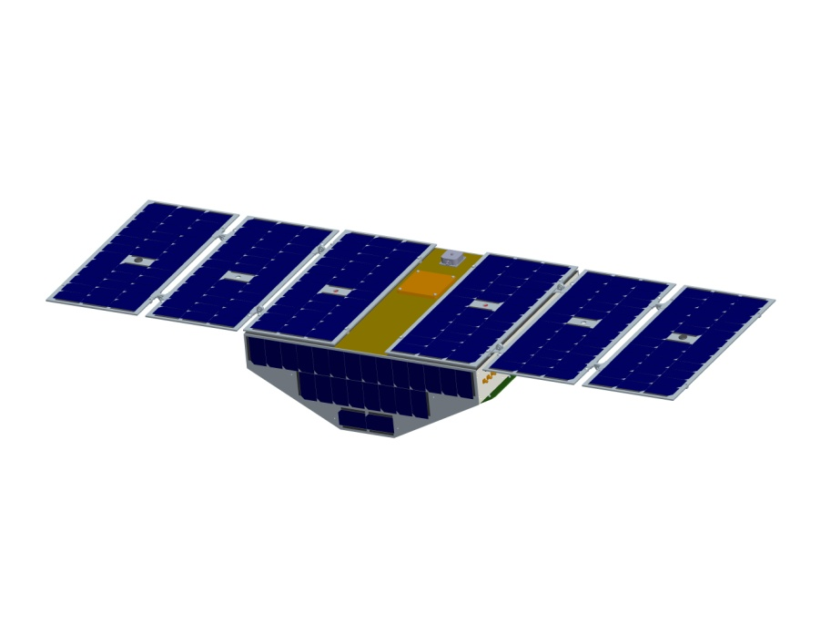
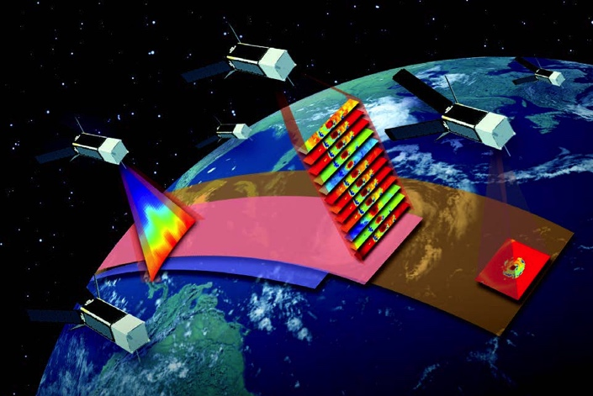
Small Satellite CONSTELLATIONS
Cyclone Global Navigation Satellite System
(CYGNSS)
  Selected under Earth Venture Mission-1 AO
  8-satellite Microsat Constellation to measure winds
  and air-sea interactions in tropical storms, using
  reflected GPS
  Ready for launch scheduled for 12 Dec 2016
  PI-led (C. Ruf, U. Michigan, plus SWRI)
Time-Resolved Observations of Precipitation structure and storm Intensity with a Constellation of Smallsats (TROPICS)
  Selected under Earth Venture Instrument-3 AO
  12-satellite Cubesat Constellation
  First science-focused cubesat constellation
  Targeted for launch in 2020, may use VCLS
  vehicle
  PI-led (W. Blackwell, MIT, plus Lincoln Labs
  and WFF)

