Slide 1

Committee on Earth Observation Satellites
SEO Report
Brian Killough and Kim Holloway
CEOS SEO
30th CEOS Plenary
Brisbane, Australia
2 November 2016

Slide 2
SEO Accomplishments in 2016
  SEO Technical Team ... The primary efforts have been focused on the Data Cube initiative (more below), supporting the new LSI-VC (ARD definition, gap analysis process), supporting SDCG for GFOI and GEOGLAM data acquisition planning and maintaining our existing tools (COVE, Data Policy Portal, CEOS website).
  Special Thanks ... The SEO would like to thank Analytical Mechanics (AMA), Symbios (Stephen and George), Ake Rosenqvist, and Alyssa Whitcraft for their SEO support.
  Kim Holloway: Managed website and news content for CEOS, managed the CEOS social media presence, continued production of the Faces of CEOS video series, provided CEOS SIT/Plenary meeting logistics support, hosted and coordinated the WGCapD annual meeting in Hampton, VA, provided user testing/analysis for SEO’s information systems and tools, developed outreach materials including three new CEOS banners in support of STEMx Day (Brisbane on Thursday), and maintained CEOS mailing lists.
  Data Cubes ... Developed a new 3-Year Work Plan, coordinated work with a distributed team (GA, CSIRO, USGS), developed new architecture elements (cloud-based user interface, demo cubes, sample application algorithms, and software enhancements.
  COVE Tool ... Continue to add missions and connections to mission archives. adding new missions, tool to improve support of GFOI and GEOGLAM.
  Completed annual mission updates to the Data Policy Portal and supported annual updates and enhancements to the MIM Database.

Slide 3
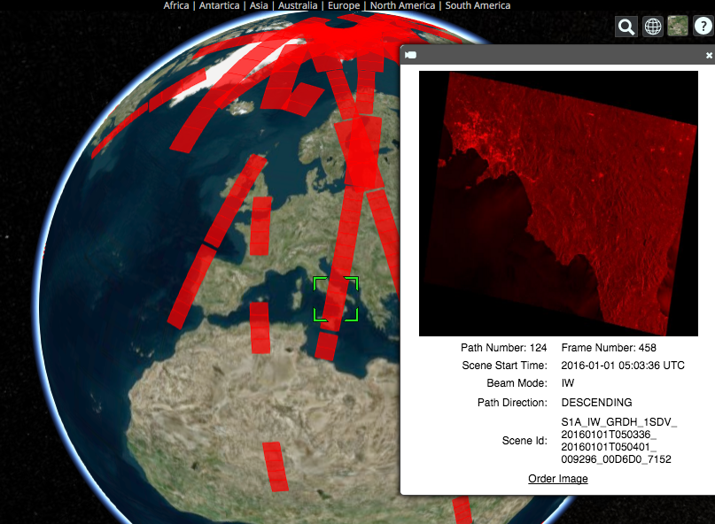
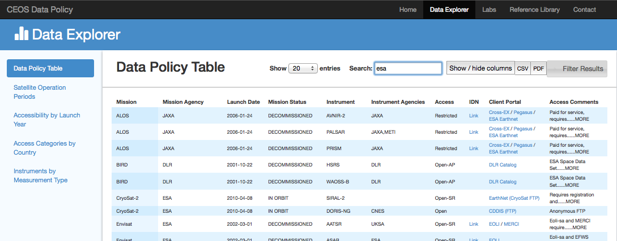
Systems Engineering Tools
COVE Tool
3700+ unique users in 2016. Free and Open
Over 130 missions in the database. Upgraded user interface in October 2016.
New archive link to Sentinel-1 through ASF mirror hub. Plans to add Sentinel-2 archive link through the USGS mirror hub by Dec-2016.
Data Policy Portal
141 current CEOS missions in orbit as of
October 2016.
74% of instruments are OPEN data access.
Entire database (past and current) includes
651 mission/instrument combinations from
28 countries.
Updated annually, including links to client data portals. Linked to MIM Database and COVE.
www.ceos-cove.org
www.ceos-datapolicy.org

Slide 4
SEO Plans for 2017
  GeoCube (Data Cube): Continue significant support to this effort in 2017. Work with multi-agency team to develop a governance plan and to advance the infrastructure. Continue to progress several prototypes and develop new prototypes. Enhance the use of CEOS satellite data through improved data interoperability, time series analyses, and solutions for developing countries.
  GEOGLAM, GFOI and LSI-VC: Continued support for data acquisition planning, systems analyses and ARD definition.
  COVE Tool: Add enhancements to the Coverage Analyzer sub-tool to improve support of GFOI and GEOGLAM. Add more missions and links to data archives (Sentinel-2 priority).
  Annual updates to the Data Policy Portal and the MIM Database.
  Outreach support for SilvaCarbon, IGARSS Conference, and GEO. Develop new outreach materials and continue to expand the impact of CEOS through social media. More from Kim ...

Slide 5

CEOS Communications
Over 48K Visits
in the Last Year:
More than 30.5K from New Users
Most Popular Pages:
Home, Meetings, Data & Tools, Working Groups
5

Slide 6
CEOS Communications
Requests to You:
CEOS Leadership, WG & VC Leads: Review Relevant Webpages & Send Updates.
All: Send Short Summaries of Newsworthy CEOS Activities/Accomplishments.
Remember: Meeting Registration Capabilities & Document Management System for You
6

Slide 7

CEOS Communications
CEOS Social Media:
COP-21 TweetChats
Grew by about 600 Likes/ Followers Total
Post topics on Regular Rotation – Send Me Cool Stuff or Tag Us
T: @ceosdotorg
F: @socialceos
7
502 Followers!
1076 Likes!

Slide 8
CEOS Communications
Outreach & Exhibits:
3 New CEOS Banners
Microfiber cloths
3x5 CEOS Info Cards
STEMx Brisbane (Thursday)
Plans for IGARSS & GEO in 2017
8

Slide 9
CEOS Communications
Contact:
Kim.E.Holloway@nasa.gov
Brian.D.Killough@nasa.gov
9

