Slide 1
MIM Database and CEOS Info Systems
Committee on Earth Observation Satellites
I. Petiteville, ESA
CEOS Plenary 2016
Agenda Item #8.1
Brisbane, Australia
1st – 2nd November 2016

Slide 2
2016 Activity Summary
CEOS MIM Database – agency update survey
Maintenance and update of online portal
database.eohandbook.com
Conducted CEOS Information Systems Survey
EO Handbook, CEOS DB, COVE, Data Policy Portal
No EO Handbook in 2016
Major international agreements in 2015: WCDRR and COP21
2017 to be considered if EOHB can be an added value to promote the use of EO satellite data and the coordination role of CEOS Agencies in relation to a specific framework / event e.g. “CEOS Support to SDGs”

Slide 3
CEOS MIM Database Update
Annual update cycle completed and available online:
database.eohandbook.com
Responses received from 30 CEOS agencies
32 new mission records added, 250 existing records updated
14 new instrument records added, 144 existing records updated
Currently features operating or planned for launch in next 15 years:
322 Earth observing satellite missions
916 instruments

Slide 4
Website Usage
Website traffic largely stable year-on-year
~10% decrease in 2016 owing to 2015 uptick with two EO Handbooks in support to Climate and Disasters Risk Reduction.
Slight move towards mobile platforms but desktop still > 90%
Top content
Mission/instrument discovery: ~65% of page views
Landing page: ~12.1%
Measurements: ~11.7%
Timelines: ~6.8%
Climate: ~3.4%
 | CEOS DB | EO HB | Total
Visitors | 9,806 | 6,515 | 16,321
New users | 62% | 72%
Technology: Desktop | 93.6% | 90.8%

Slide 5
CEOS Information Systems Survey
Conducted as part of ongoing efforts to improve the services offered by several core CEOS information services
EO Handbook: http://www.eohandbook.com/
CEOS Database: http://database.eohandbook.com/
COVE: http://www.ceos-cove.org/
CEOS Data Policy Portal: http://www.ceos-datapolicy.org/
Form a better understand how these resources are used, and to study possible future enhancements
Collaboration between the ESA CEOS Database / EO Handbook and SEO teams

Slide 6
Results Summary
29 responses received
45% from space agencies
21% government other than space agency
21% university
10% NGO and International Organisation
None identified from industry
Preliminary results assessment underway
Features and enhancements highlighted by respondents
API; direct link between CEOS DB and COVE coverage
Links to instrument data stores / data access
Custom mission/instrument timelines

Slide 7
2017 Activities
Complete assessment of survey responses by end of 2016. Presentation at SIT-32.
Implement a cycle of website and information system enhancements based on survey response.
Conduct usual agency update survey (~Q2 kick-off)
2017 EO handbook – to be considered for H2 if opportune wrt CEOS strategic objectives

Slide 8
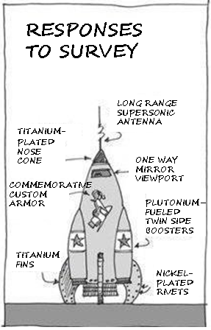
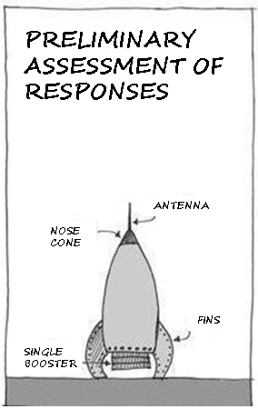
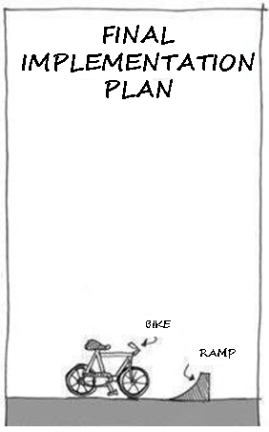
Next Steps …

Slide 9
Questions or Comments?
Online resources
www.eohandbook.com
database.eohandbook.com
Contact the team:
ceosmim@gmail.com

