Slide 1

Report from WG Disasters
Committee on Earth Observation Satellites
Stéphane Chalifoux, CSA
Chair, Working Group on Disasters
CEOS Plenary 2016
Agenda Item # 7.4
Brisbane, Australia
1st – 2nd November 2016

Slide 2
Overview of the Presentation
Floods, Seismic Hazards, Volcanoes Pilots and Recovery Observatory (RO)
- Status and Key Successes
New Landslide Pilot
- Landslide pilot EO implementation plan, including strategic data acquisition plan
GEO Geohazard Supersites and National Laboratories (GSNL)
- Supersite biennial report
Vesuvius/Campi Flegrei
Etna
Marmara
- Greek Supersite

Slide 3
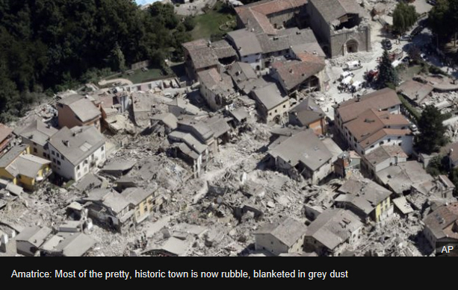
Recent CEOS Activities in Support of DRM: Amatrice Earthquake Response
On Wednesday August 14, 2016, a 6.0 magnitude earthquake struck central Italy, near Amatrice.
The earthquake has left more than 280 people dead.
Seismic pilot Obj. C has been triggered to generate rapid science products to support response.
The EQ is of moderate magnitude but caused strong impact in some villages due to site amplification effects.
The national Civil Protection and other local bodies are the final end users using scientific support products provided by the pilot.
CEOS Space Agencies support the pilot by providing imagery throughout the crisis.
Photo credit: http://www.bbc.com/news/world-europe-37181933

Slide 4
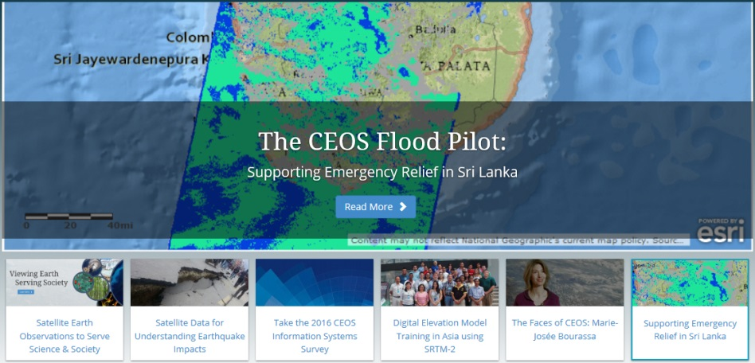
Status of Disaster Risk Management (DRM) Pilots
Flood, Seismic Hazards, Volcano, and RO pilots are progressing very well with positive feedback from end users:
Series of on-going end-to end projects (end in 2017) to demonstrate benefits of satellite EO to ALL DRM phases, with strong user involvement.
CEOS Agencies have provided imagery and very good value-adding support from non-CEOS partners (practitioners, end users, major stakeholders).
Excellent collaboration with the International Charter Space & Major Disasters.
Initial discussion begun on pilot evaluation and on sustainability strategy.
CEOS Web story:
  Earthquake struck island of Cephalonia
  (Jan. 26, 2014), Greece.
  Supporting flood emergency relief
  (May, 2016), Sri Lanka.

Slide 5
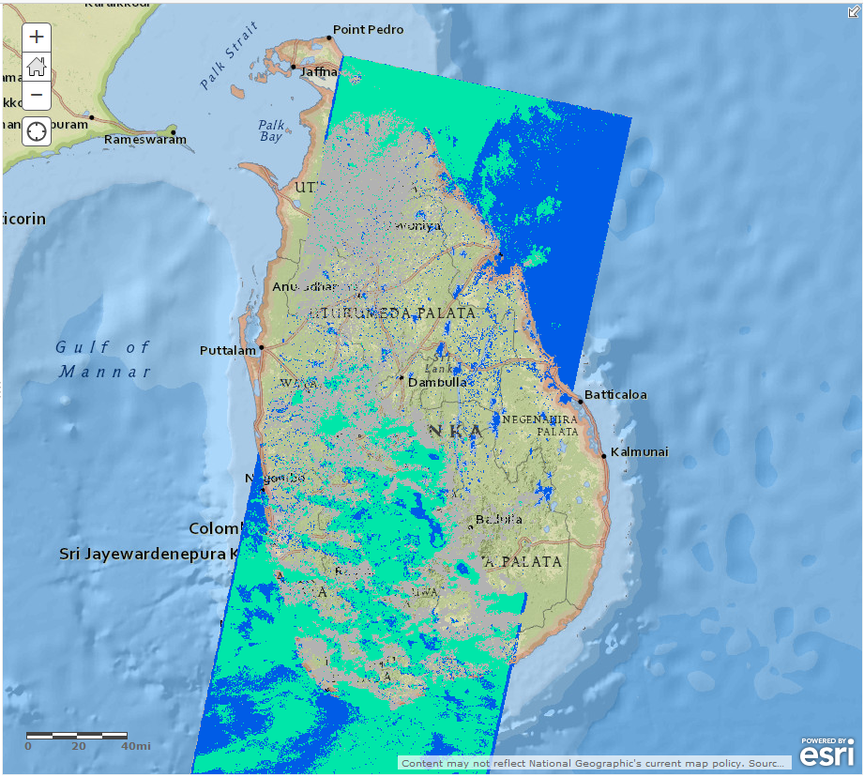
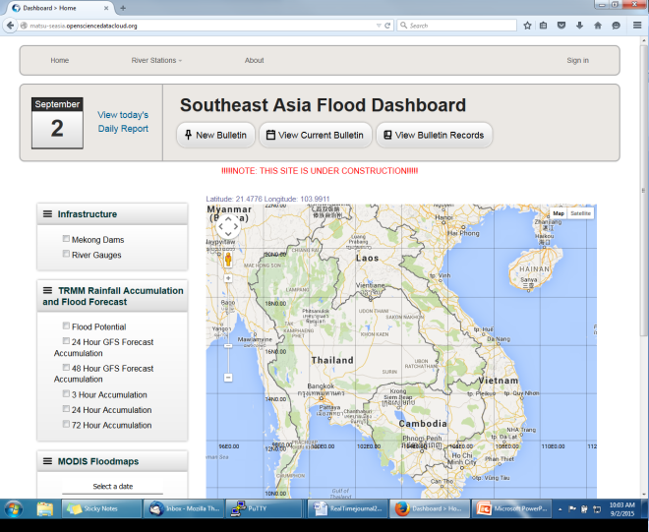
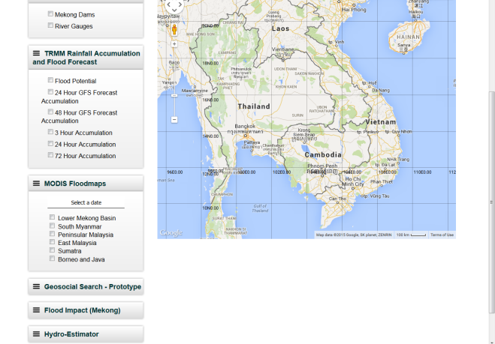
Flood Pilot Overview
Demonstrate effective application of EO to the full cycle of flood management at all scales
Global Flood Dashboard (single access for multiple existing systems)
Three regional pilots showcasing end user benefit of frequent high spatial resolution observations (Caribbean, Southern Africa, Mekong/Java)
Encouraging at least base-level in-country capacity to access EO data and integrate into operational systems and flood management practices.
Flood coverage map for Sri Lanka
On 8 May 2016 derived from
Landsat-8 OLI

Slide 6
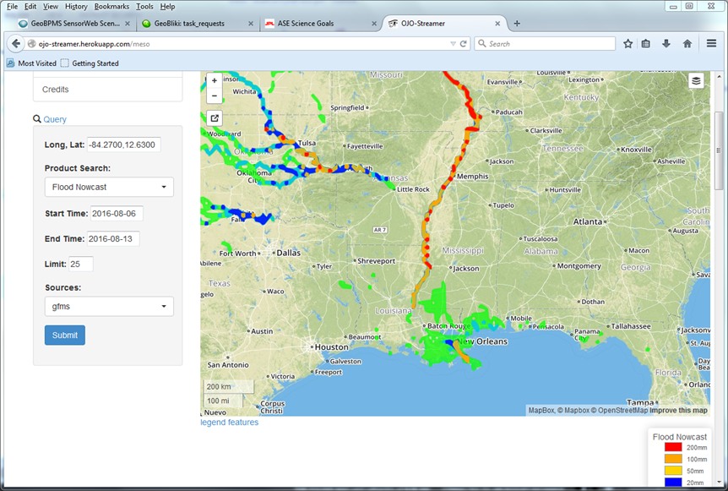
Flood Pilot: Global Component Highlight
Global Flood Monitoring System (GFMS) flood products converted to GIS layers and distributed via application programming interface (API)
C. Vaughan of FEMA's flood hazard mapping program: “This is absolutely the direction we want to head.”

Slide 7
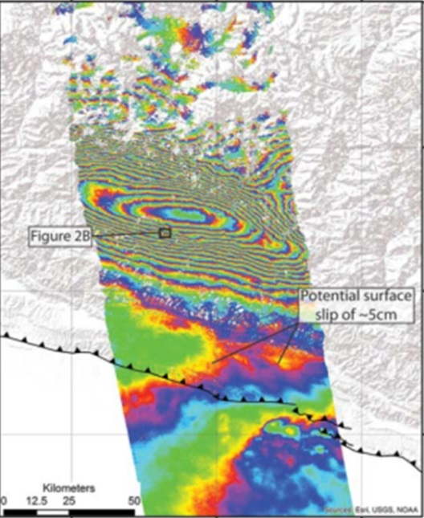
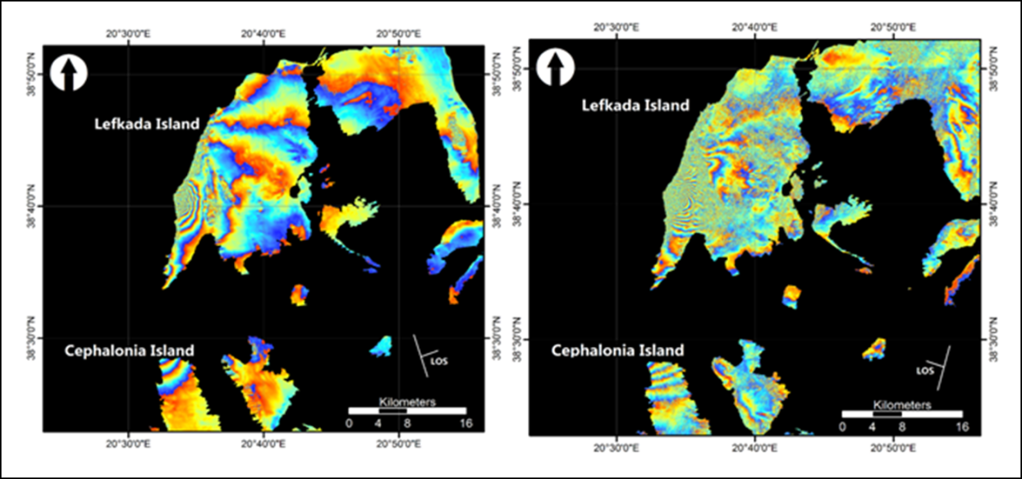
Seismic Risks Pilot Overview
Demonstrate how satellite EO can be used to improve seismic monitoring and response to seismic events
Demonstrator for EO-based global strain map (main focus on Turkey, Himalayas and Andes)
Exploitation platform for large data set analysis (strain map, supersites)
Rapid scientific products for 4 to 6 earthquakes per year (>M5.8)
Lefkada earthquake : Study of the surface deformation caused by the November 2015 seismic event.
Sentinel-1A differential interferograms of the ascending pair (left) and descending (right)

Slide 8
Seismic Risks Pilot: Highlight on the GEP
“The main benefit of technologies such as GEP is that they give users the possibility to perform complex processing of SAR data in a very user-friendly way. The user has immediate access to vast data archives, and the processors available need very little user interaction. In the case of the Kumamoto earthquake, the interferogram was processed on GEP within hours after the availability of the first post-event acquisition.”
Patrick Ordoqui, TRE ALTAMIRA
“One of the more useful tool in a web-platform such as GEP is the possibility to run multi-temporal interferometric processing, implementing different algorithms such as SBAS or other Persistent Scatterer Inteferometric chains, and exploiting the large computing power and storage capabilities present in GEP.”
Cristiano Tolomei, EO expert, INGV

Slide 9
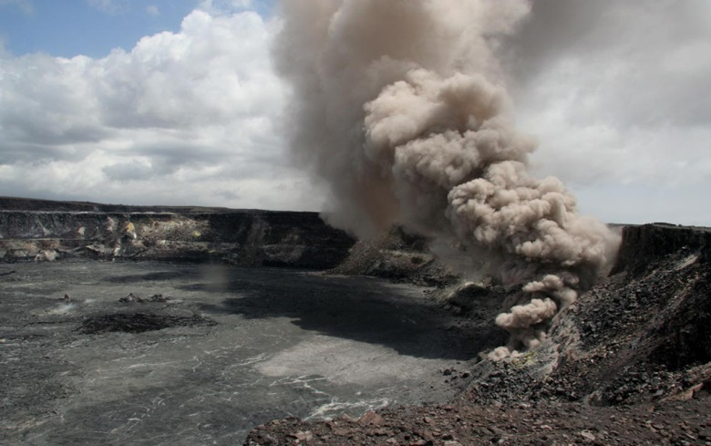

Volcano Pilot Overview
Improve coordination of satellite data acquisition over volcanoes, demonstrate efficiency of EO-based monitoring methodologies as a complement to in-situ measurements, and support and continue the GSNL initiative
Demonstrate feasibility of systematic global monitoring in regional arc (Latin America)
Develop new EO-based monitoring products at supersites
Real-time in-depth monitoring of one ‘100-year’ category major eruption
Cosmo-SkyMed

Slide 10
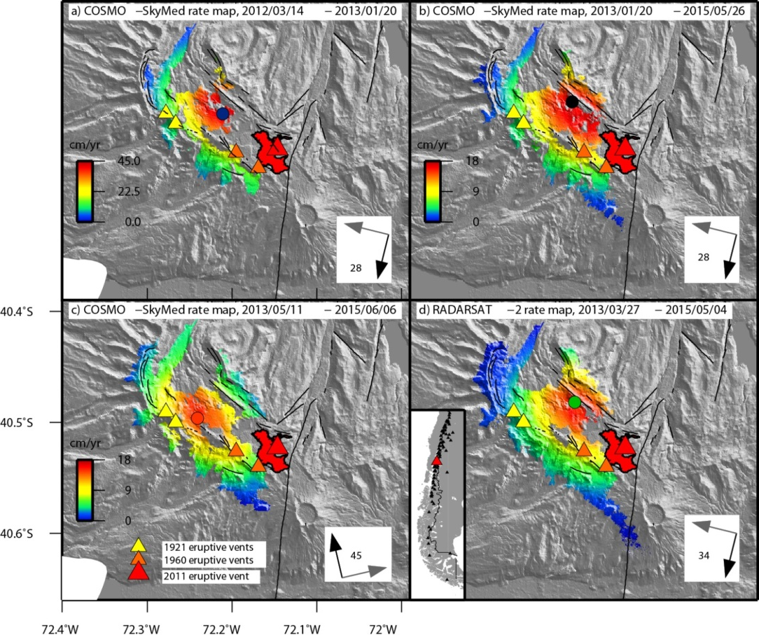
Volcano Pilot: Volcano Observatory in Latin America Highlight
“These InSAR results surprised OVDAS, as the volcano does not have geodetic instrumentation, and will lead to the deployment of the first continuous GPS stations over the volcano.”
Luis Lara, Director, OVDAS
Observatorio Volcanológico de los Andes del Sur (OVDAS) installed 3 continuous GPS stations in response to interferograms showing inflation of Cordón Caulle
Monitored volcanoes with no ground networks and
motivated installation of new sensors

Slide 11
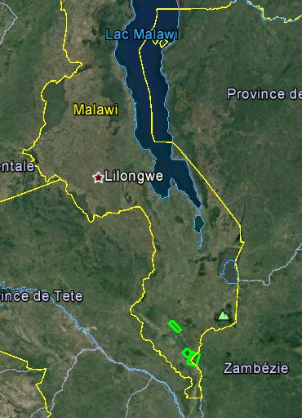
Recovery Observatory
CEOS Agencies continue to ensure readiness to activate the Disaster Recovery Observatory (RO) for a one-time demonstration in the 2016–2017 period.
Working with GFDRR/World Bank and the Government of Malawi, a Malawi Demonstrator is being implemented in order to validate applications relevant to recovery needs, including development of specific tools tailored to provide easy access to data over affected areas (pre-event data, response data and coordinated post event acquisitions).
Other demonstration activities being pursued in Nepal (housing reconstruction) and possibly Syria (agricultural monitoring to determine ability to support livelihoods)
A sub-group is working on an overarching Data Licensing document for Disasters.
Triggering the RO in evaluation: Summary Event Report: Hurricane Matthew

Slide 12
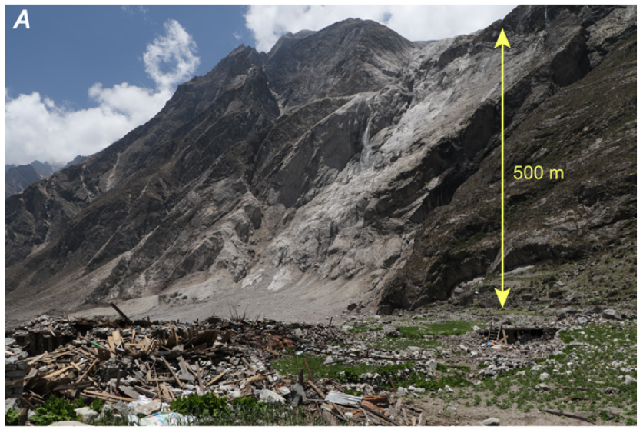
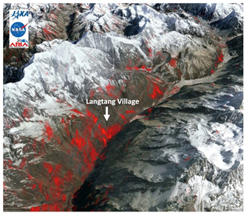
New Landslide Pilot
Plenary endorsed creation of multi-hazard landslide pilot team at the 29th CEOS Plenary in 2016
Main Goals of the landslide pilot:
  To demonstrate the effective exploitation of Earth observations (EO) data and technologies to detect, map and monitor landslides, in different physiographic and climatic regions.
  To apply satellite EO across the cycle of landslide disaster risk management, including preparedness, situational awareness, response and recovery with a distinct multi-hazard focus on cascading impacts and risks.
View from the ground (Photo credit USGS)
Damage Proxy Map (DPM) from ALOS-2 Data

Slide 13
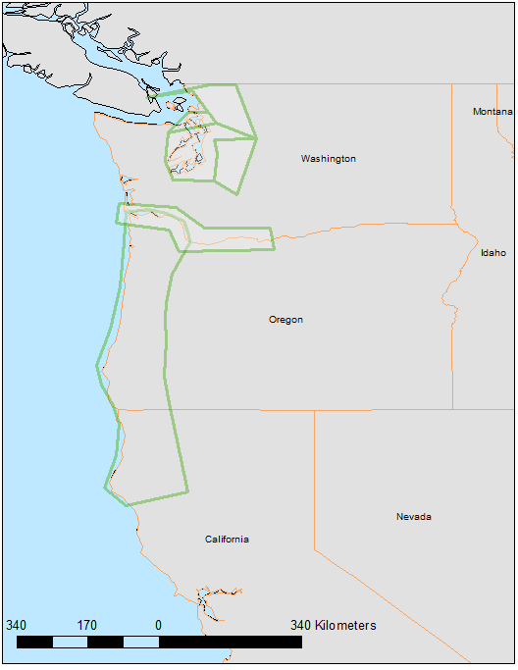
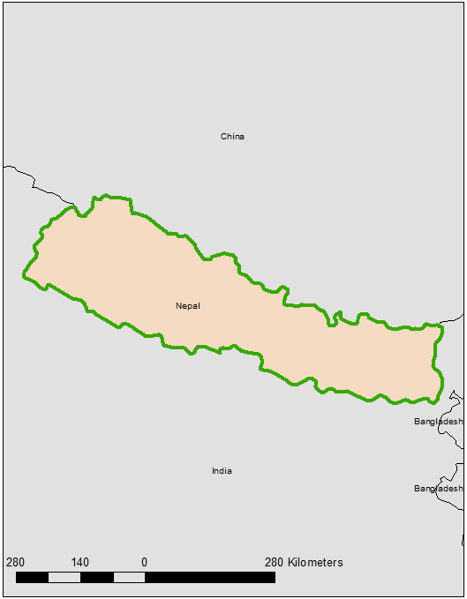
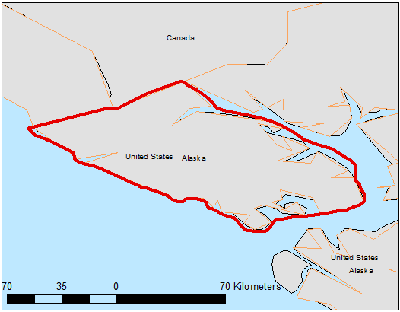
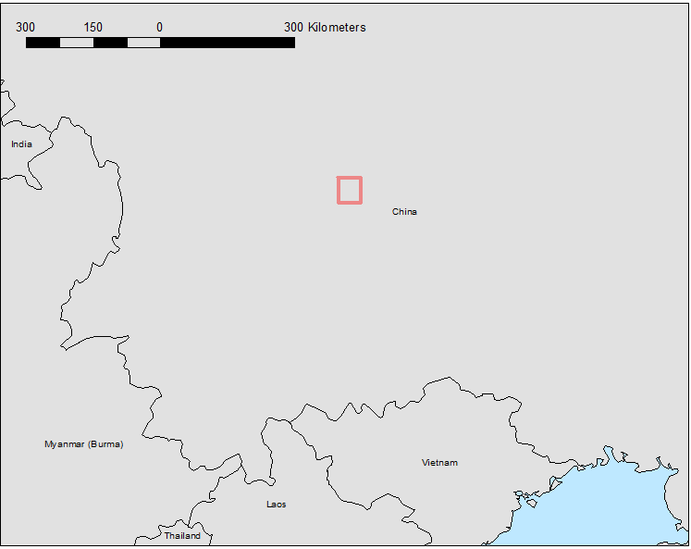
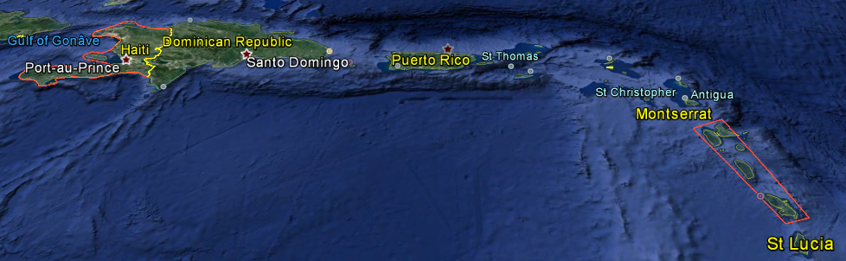
Target areas for the Landslide Pilot
The Landslide Pilot will focus on two primary regions (Nepal and the Pacific Northwest in North America) and five experimental regions (Southeast Alaska, China, Caribbean, Peru, Indonesia).
Pacific Northwest, USA
Nepal
Experimental Regions
Southeast Alaska
China
Caribbean

Slide 14
Data Contributions from CEOS Agencies
Mission/Instrument | Agency | New | Archived | Total | Comments
Sentinel-2A / MSI | ESA |  |  |  | Available
EO-1 / ALI | NASA |  |  |  | Use Archived Imagery
Landsat-8 / OLI | USGS |  |  |  | Available
SPOT (archive only) | CNES | 20 | 170 | 190
Pleiades | CNES | 50 | 50 | 100
ALOS-2 / PALSAR-2 | JAXA | TBD | TBD | TBD
Sentinel-1A / SAR | ESA |  |  |  | Available
Sentinel-1B / SAR | ESA |  |  |  | Available
Radarsat-2 / SAR-C | CSA | 105 | 155 | 260
Cosmo Sky-Med / SAR-2000 | ASI | 400 | 225 | 625
TerraSAR-X | DLR | 460 | 100 | 560

Slide 15
How data will be exploited
Geographic Area | Products | Value Added Partners
Nepal | Landslide monitoring and deformation analysis, multi-temporal landslide inventories, magnitude-frequency analysis of landslide occurrence, multi-temporal landslide hazard analysis | ICIMOD, Nepal Govt. Ministries, World Bank, Red Cross, US Army Corp of Engineers
Pacific Northwest, US | Landslide monitoring and deformation mapping, historical analysis and multi-temporal mapping | Washington and Oregon Departments of Transportation, National Parks Service, National Forest Service, FEMA, USGS
SE Alaska | Identify timing of rock avalanches and detection of precursory deformation | USGS and U.S. National Park Service
China | Technologies of spatial-temporal detection of landslides; Spatial-temporal mapping of earthquake-induced landslides | IMHE/CAS (Institute of Mountain Hazards and Environment, Chinese Academy of Sciences).
Haiti and Lesser Antilles | Multi-temporal landslide maps, Landslide monitoring and deformation mapping Methodological developments for automated processing of time series (GEP platform, other calculation). Frequency-magnitude relationships with triggers. Haiti and Lesser Volcanic Arc | CNES (Kal-Haiti), CNIGS, CIAT and UEH (Haiti) Permanent Risk Observatory of Guadeloupe and Martinique
Peru | In development
Indonesia | In development

Slide 16
Response to Landslide Pilot
Majority of contributions (open & free data) confirmed by Agencies. Some options still being worked (e.g. review against data policies constraints and commercial conflict).
Main issue: data contributions are for R&D activity; should some activities become operational after 2019, funding is required to ensure sustainability.
Consolidated response from space agencies very positive; volume of EO data & products confirmed is similar or greater to what was initially provided to other pilots.
Main objectives of each pilot can be reached with the firm contributions announced.

Slide 17
Landslide Pilot Data Plan: For Decision
Decision @ Plenary
CEOS Plenary Action to WGDisasters: Prepare for approval the implementation plan including the strategic data acquisition plan in response to the landslide pilot EO requirements.
Accept: CEOS Principals are asked to endorse the strategic data acquisition plan prepared by the relevant CEOS Agencies, in response to the landslide pilot EO requirements.

Slide 18
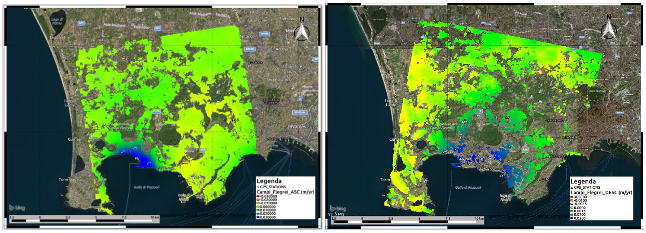
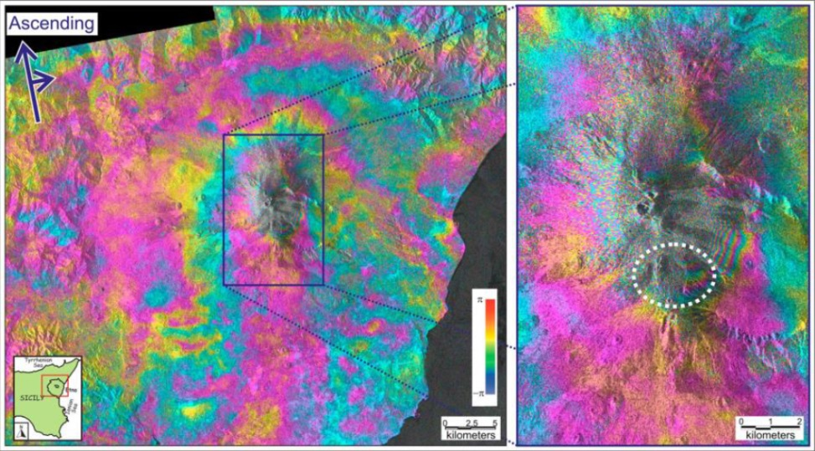
GEO Geohazard Supersites and Natural Laboratories (GSNL)
Supersite Periodic Review Process: Biennial report
Etna, Campi Flegrei and Marmara supersites endorsed at the CEOS SIT-29 Meeting 2014
Vesuvius/Campi Flegrei Supersite
Left: CSK mean deformation velocity map (01/2011-10/2015, Ascending)
Right: CSK mean deformation velocity map (01/2011-03/2015, Descending)
Credits INGV-CNT
Quick facts:
Outreach: More than 16 peer reviewed journal articles and
69 conference presentations/proceedings in 2015-16
Dara used: ERS, ENVISAT, Sentinel, TerraSAR-X, Cosmo-SkyMed, RADARSAT, ALOS, ASTER, Landsat, MODIS, AVHRR, Pleiades
Etna Supersite
December 2014 to 12 January 2015 Sentinel-1A ascending interferogram
Credit: Bonforte and Guglielmino, 2015

Slide 19
Supersite Periodic Review Process: For Decision
Decision @ Plenary
Biennial report
Positive evaluations from Agencies with comments and remarks clarified by Supersite coordinators: Sustainability, in-situ data policy and science team.
Accept Vesuvius/Campi Flegrei Supersite Report (Permanent Supersite)
Accept Etna Supersite Report (Permanent Supersite)
Accept Marmara Supersite Report (Permanent Supersite)

Slide 20
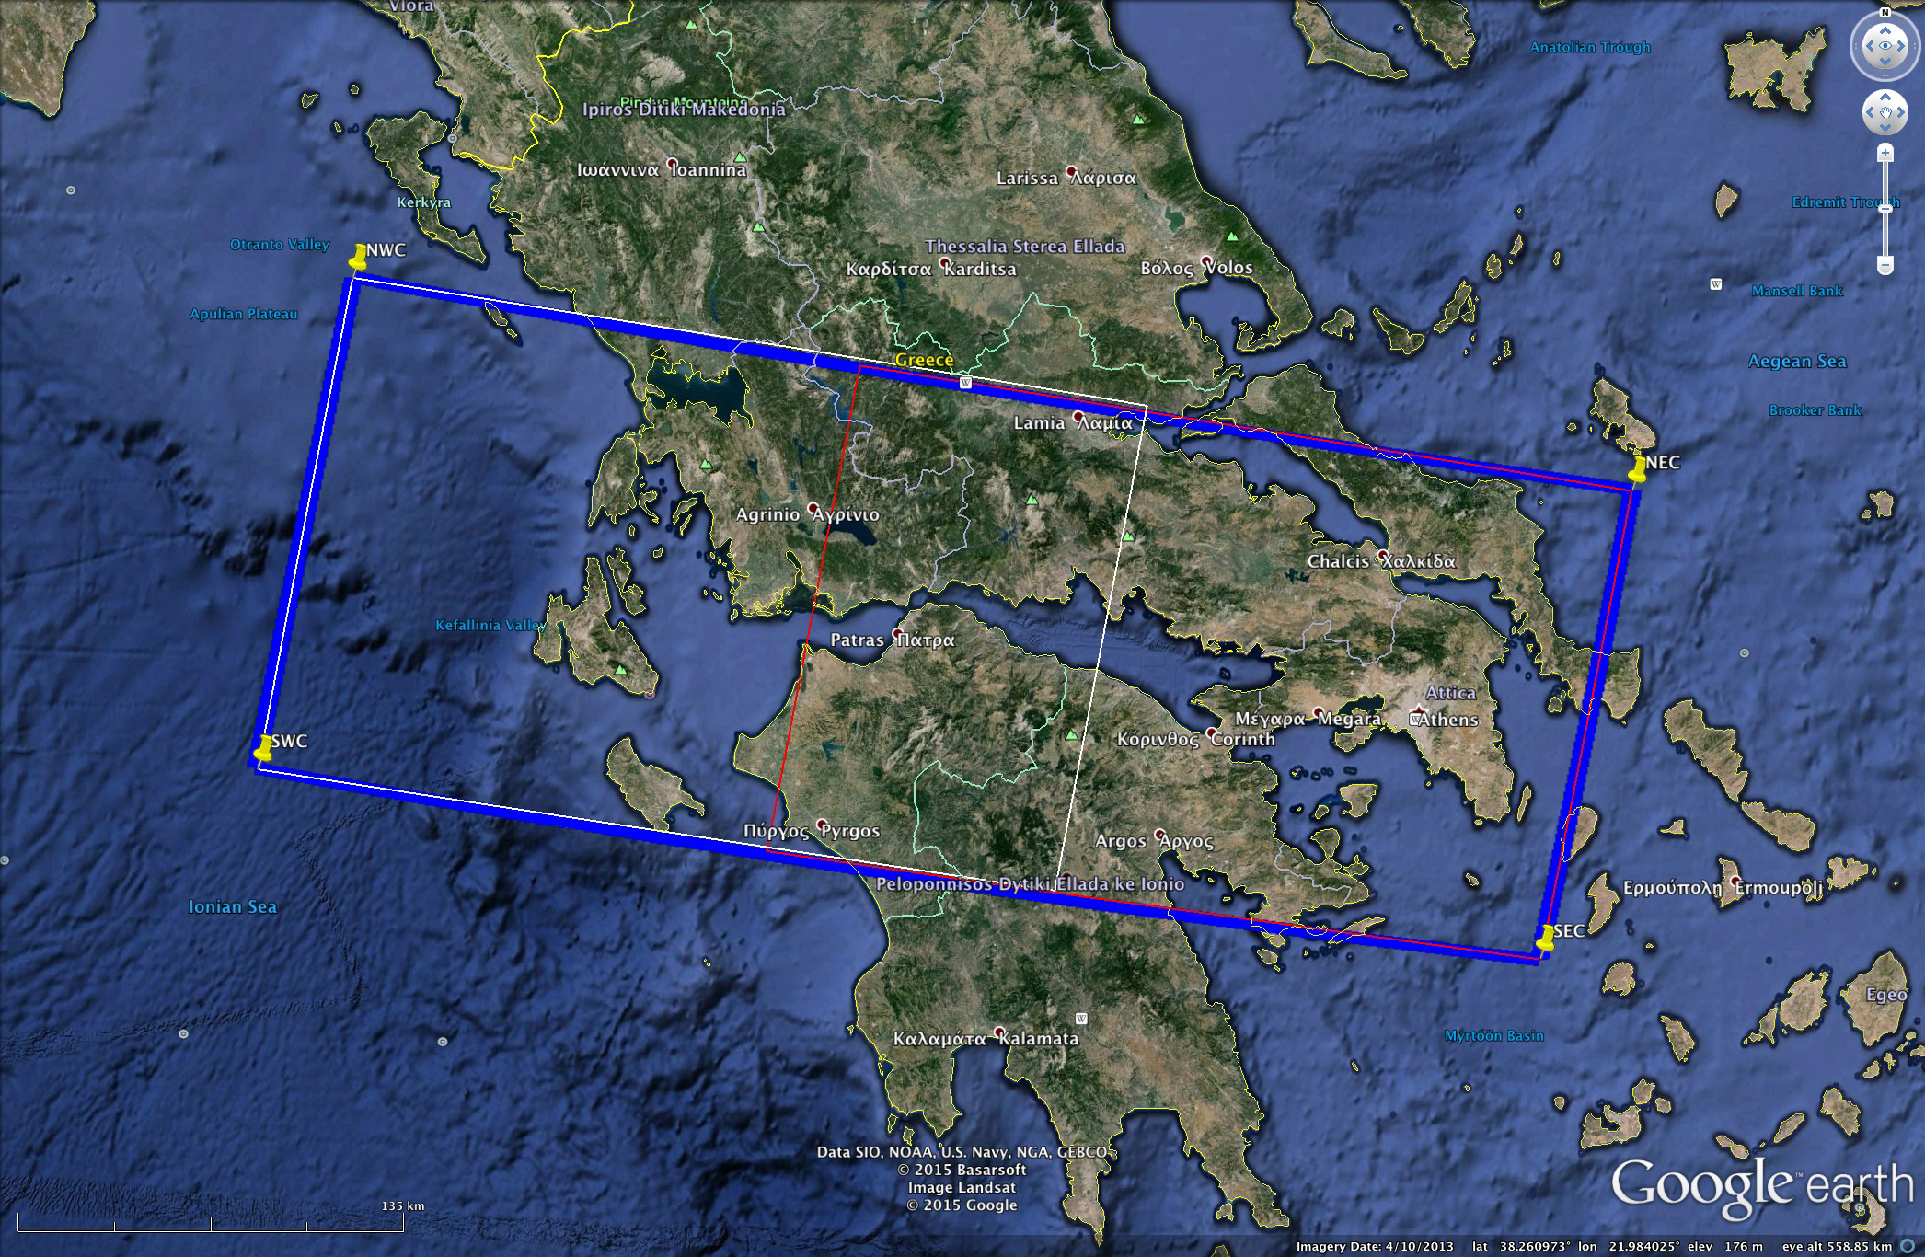
Greek Supersite Proposal

Slide 21
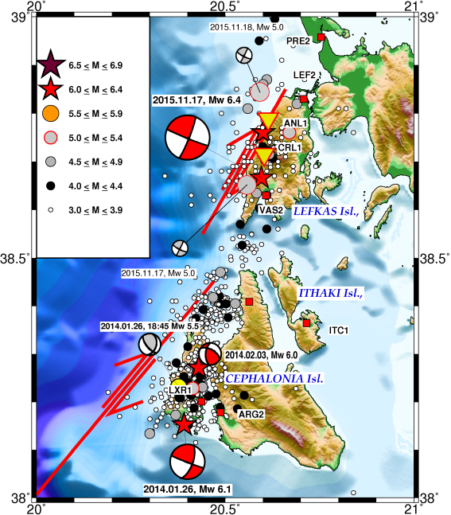
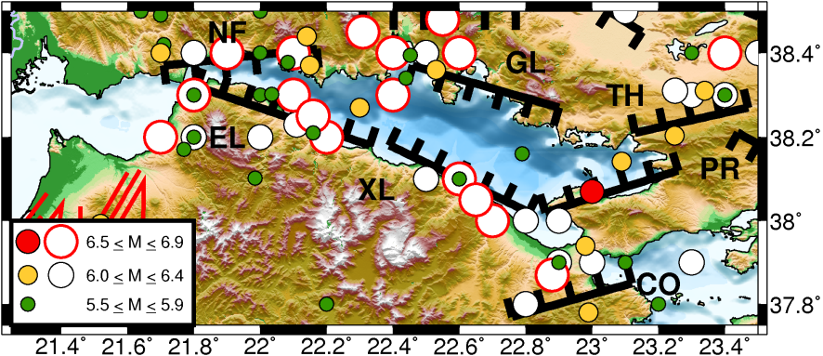
Greek Supersite Major Seismic Hazard Area
GULF OF CORINTH
Epicenters of strong historical (open circles) and instrumental earthquakes (colored circles).
CEPHALONIA TRANSFORM FAULT ZONE
Epicenters of strong (M≥6.0) main events for the period 2004-2015, their associated after-shocks and focal mechanisms.

Slide 22
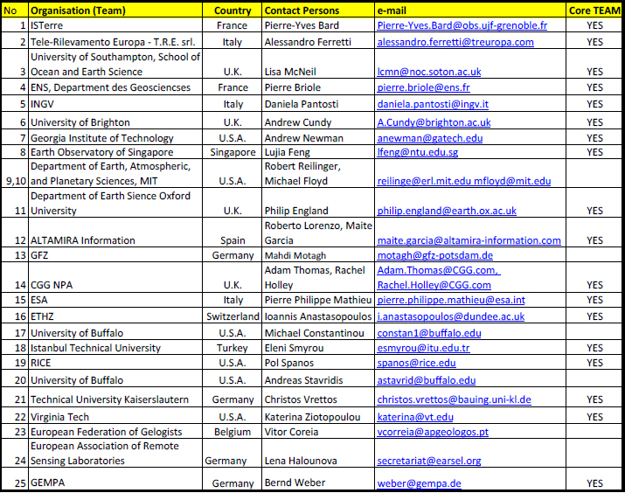
Greek Supersite Team
Supersite Point-of-Contact: A. Savvaidis, Institute of Engineering Seismology and Earthquake Engineering (ITSAK), Greece
Core Team: Organized between several Greek Academia - Institutes, gives a strong statement of current and future collaborative work (NKUA, NTUA, HUA, AUTh, UPatras, HCMR, CERTH and FORTH)
International Scientific Community:

Slide 23
Greek Supersite Available In-Situ Data
Broadband and short-period seismic stations (Seismograph)
Accelerometers (Accelerograph)
Campaign and continuous GPS (GNSS)
Digital elevation models
A permanent accelerometer network of 43 sensors was installed on the Evripos bridge in 1994 by the Institute of Engineering Seismology and Earthquake Engineering (ITSAK).

Slide 24
CEOS support to the Greek Supersite
Indicative data resources committed
CEOS intends to support this Supersite with the following resources:
CSA | 120 products for a period of 2 years | RADARSAT-2
CNES | 20 standard 20x20km Pleiades scenes for the first year, reappraisal for any additional years | Pleiades, SPOT-5
DLR | 60 new scenes per year + a few archive images | TerraSAR-X
ASI | 120 products for a period of 2 years | COSMO-SkyMed
USGS | no quota as the data is freely accessible | Landsat
ESA | no quota as the data is freely accessible | Sentinel-1, -2, -3
JAXA | TBD | ALOS-2

Slide 25
Greek Supersite: For Decision
Decision @ Plenary
Plenary accepts the Supersite Proposal and agrees to support it by making available data according to the request in the proposal and up to the limits listed below.
Plenary requests that the Data Coordination Team (DCT) inform the PoC for the Supersite of this decision and the procedures of ordering and accessing the data

Slide 26
Decision @ CEOS Plenary
Required decisions by Plenary:
New Landslide Pilot
1. Endorsement: Landslide pilot EO implementation plan, including strategic data acquisition plan
GEO Geohazard Supersites and National Laboratories (GSNL)
2. Endorsement: Vesuvius/Campi Flegrei Supersite biennial report
3. Endorsement: Etna Supersite biennial report
4. Endorsement: Marmara Supersite biennial report
5. Endorsement: Greek Supersite

Slide 27
Thank You !!
Landslide affecting houses in a village of central China’s Hunan Province.
Published on July 19, 2016
https://www.youtube.com/watch?v=gXNdV9_8kCk/

