Slide 1

WGCapD Report
Committee on Earth Observation Satellites
SANSA
CEOS Plenary 2016
Agenda Item 7.3
Brisbane, Australia
1st – 2nd November 2016

Slide 2

Progress on 2016 Activities Summary
Activity | Progress
CB-2: Build awareness and demonstrating the value and applications of EO targeting teachers, students and practitioners in major conferences. The first of these is an event during the Living Planet Symposium (ESA and DLR) in 2016 and SANSA at ISRSE (2017) (ESA, DL and SANSA)
CB-4: Continue exploration and providing of appropriate E-learning courses in relevant applications (ISRO, INPE, NOAA and NASA)
CB-7: Survey of CEOS Capacity Building activities and a task report on capacity Building in CEOS + Document on best practices in Capacity building (SEO, NASA, SANSA and USGS)
CB-9: SAR Training Workshops. Two planned SAR data access and basic processing training workshops. (SANSA, ESA, DLR)
CB-16: SRTM- Training Workshops (USGS, NASA and SANSA)
CB-14: Create a planning document for the release of newsletters and mail-outs (SEO, SANSA, NASA, USGS and ISRO)
CB-4: Contribute to Capacity Building Portal (GeoCab Portal) ; Populate the Capacity Building Portal. Joint Project with GEO (NASA, GEO, USGS )
No Progress
Progress

Slide 3
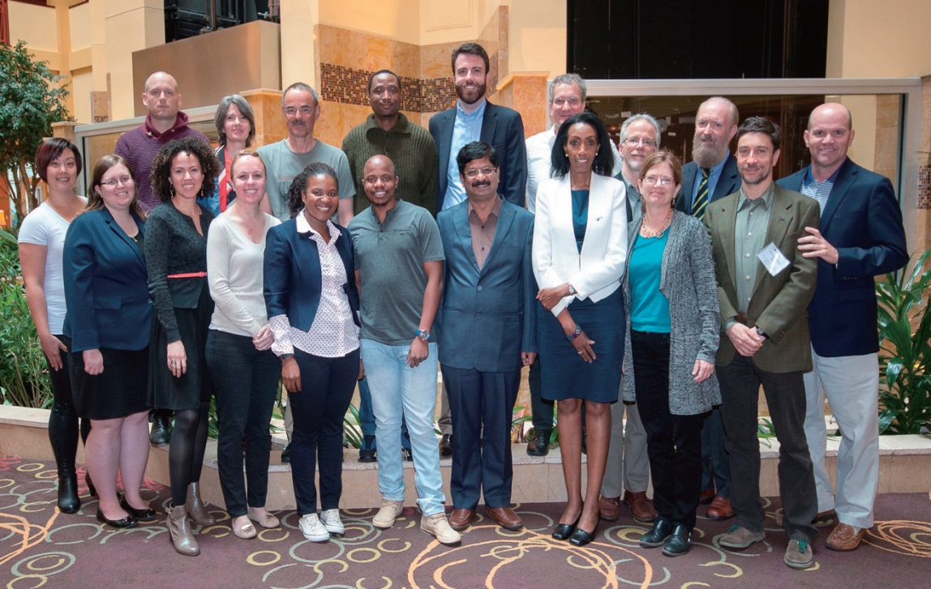
Achievements / Highlights
Activity | Progress
WGCapD 5th Annual Meeting hosted by the CEOS Systems Engineering Office (SEO) in Hampton, Virginia, USA from Wednesday, March 30, 2016 to Friday, April 1, 2016. Thanks to Brian and Kim

Slide 4
CB-2: Build awareness and demonstrating the value and applications of EO targeting teachers, students and practitioners in major conferences.
Activity | Progress
CB-2: Build awareness and demonstrating the value and applications of EO targeting teachers, students and practitioners in major conferences. The Living Planet Symposium (ESA and DLR) and Gift Workshop in Cape Town in 2016 and at ISRSE-37 (2017) Pretoria | The Working group was represented at the Living Planet Symposium by ESA and DLR. Chris Stuart from ESA indicated that the event was a success with about 3000 participants in attendance. WGCapD members (ESA and DLR) provided training activities in addition to Czech space office, and UK Space Academy. A teacher course was also conducted at the stand, and a positive response was obtained through the evaluation forms. Great appreciation to DLR for sending trainers and ESA for financing most of the symposium.

Slide 5

CB-9 SAR Training Progress
Activity | Progress
CB-9 :SAR Training Workshops in Bogota (Columbia, South America) with GEOGLAM SAR Training Workshop Zambia October (10-14) | Two of the four courses were SAR related (1) GEOGLAM, (50 students) and 2) sponsored by CEOS DCEO(CSA)and (NOAA) provided translation. Introduction to the use of aperture radar (SAR) data for monitoring agriculture, - available systems, Pre-processing and general view of the application of SAR and its use in the monitoring of agriculture. The second session of SAR (25 students) focused on applications in the areas of seismology and volcanology

Slide 6
Zambia SAR Training Workshop 10-14 October: Objectives
Contribute in bridging the skills gap of SAR technology in the region and to provide awareness on how and where to access freely available SAR data and processing software such as the Sentinel Application Platform, commonly known as SNAP.
The working group’s contribution to the “Training the Trainer” initiative, about 95% of the workshop participants were lecturers at universities. Such an approach ensures that the knowledge and material acquired can be shared with students.
Title | Name | Surname | Organization | Country | Responsibility
Mr | Phila | Sibandze | SANSA | South Africa | Course Coordinator
Prof | Christy | Hansen | Delft University of Technology | Netherlands | Course Coordinator
Prof | Chris | Schmullius | Friedrich-Schiller-University Jena | Germany | Course Coordinator
Prof | Chris | Stewart | European Space Agency | Italy | Course Coordinator
Prof | Mikhail | Urbazaev | Friedrich-Schiller-University Jena | Germany | Course Coordinator
Mrs | Joalane | Marunye | National University of Lesotho | Lesotho | Participant
Mr | Aniceto | Chauque | Universidade Eduardo Mondlane | Mozambique | Participant
Ms | Hilma | Nghiyalwa | University of Namibia | Namibia | Participant
Ms | Zodwa | Ndlela | University of Swaziland | Swaziland | Participant
Dr | Fadzai | Zengeya | University of Zimbabwe | Zimbabwe | Participant
Dr | Cosmo | Ngongondo | University of Malawi (UNIMA) | Malawi | Participant
Dr | Proches | Msigula | Sokoine University of Agriculture | Tanzania | Participant
Dr | George | Chirima | Agricultural Research Council | South Africa | Participant
Mr | Moses | Chisola | University of Zambia | Zambia | Participant
Dr | Douty | Chibamba | University of Zambia | Zambia | Participant
Mr | Michael | Phiri | National Remote Sensing Centre | Zambia | Participant
Ms | Phoebe | Odour | RCMRD | Kenya | Participant

Slide 7
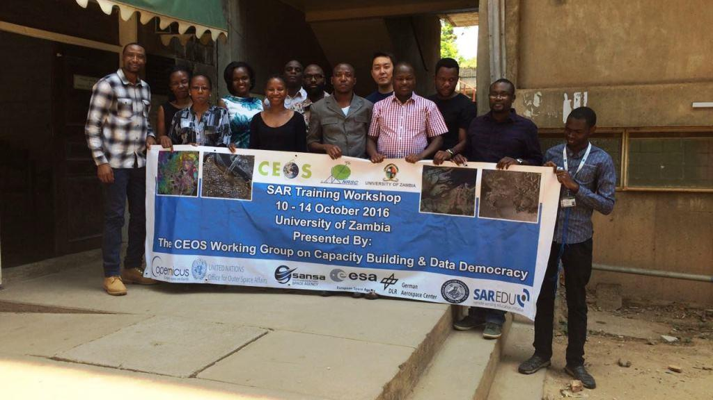
Zambia SAR Training Workshop
(10-14) October: Participants
Big Question: What is the future plan for these SAR Workshops??
Collating all available SAR tutorials, tools and online courses and provide access to those that have participated in face-to- face SAR training workshops. (ESA, DLR , NASA and SANSA). WGISS– CEOS Data Discovery Webinar **

Slide 8
SRTM- Training Workshops
19-22 Sept- 2016
A four-day Regional Training on Shuttle Radar Topography Mission (SRTM-2) took place from 19 – 22 September 2016 at the International Centre for Integrated Mountain Development (ICIMOD) Headquarters, Kathmandu, Nepal.
The training focused on the use of 30-meter elevation SRTM-2 datasets, which are freely and publicly available, and are extremely valuable for addressing critical issues impacted by the Earth’s topography, including water flow, heavy rainfall, river plain flooding, coastal storm surges, agricultural stresses; and public health challenges.
Participants were from relevant Government Ministries and agencies in Hindu Kush Himalaya (HKH) and Mekong regional countries, the training was facilitated by experts from NASA SERVIR hubs
Expected outcomes: The ability to describe the availability, applications, and limitations of satellite DEMs at varying spatial scales in different thematic areas
Ability to use DEM data for demarcation of river basins, flood inundation mapping, and hydrological modeling
Understanding of the accuracies of DEM derived products at various spatial scales.
The US Government (NASA, USAID, NOAA and USGS) and CEOS (WGCapD), and the Secure World Foundation (SWF) were partners and collaborators with ICIMOD to organize the training.

Slide 9
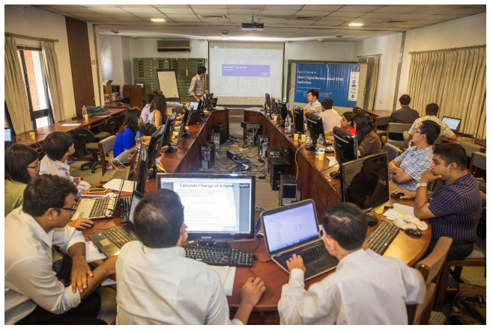
SRTM- Training Workshop. Participants

Slide 10
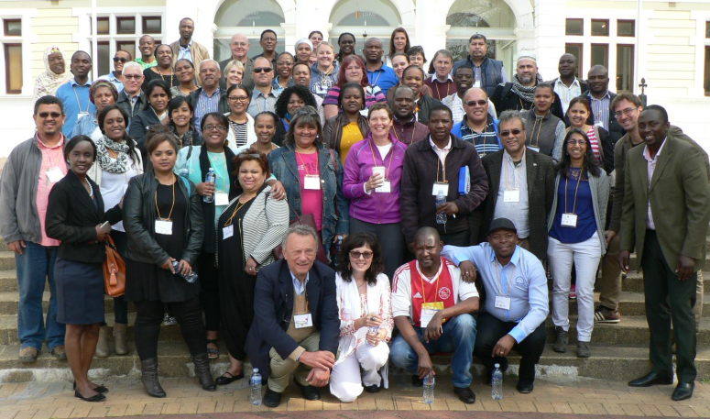
Gift Workshop for Teachers
Activity | Progress
Gift Workshop in Cape Town 27-28 August 201, Iziko Museum WGCapD represented by ESA and SANSA Also distributed: ESA School Atlas, SANSA School Atlas, SANSA FUNDISA Disc and access to the its Portal

Slide 11
New Strategic Initiatives
Activity | Progress
Capacity Building in support of UN Sustainable Development Goals Data Cubes GEOGLAM Engagement with GEO AmeriGEOSS/AfriGEOSS | The Working Group’s future plan is to re-structure in order to support CEO strategic objectives –Example SDGs and Data cubes The most important enabler is resource availability in terms of people and funds. Discussion underway to implement a capacity Building activity in support of GEOGLAM USGS and NASA are our representatives on GEO Capacity Building Task team . Discussions are underway to bring more coordination in GEO capacity building tasks and other teams

Slide 12
Coming soon
2nd SAR Training Workshop (Pretoria) 23-25th January 2017 Funded by JICA in support of RESTEC and JAXA
3rd SAR Training Workshop (Gabon) (Date?? February 2017) Funded by ESA Copernicus Office
WGCapD 6th Annual Meeting: To be hosted by DLR (March 27-29)
Still seeking for the next Vice-Chair

Slide 13
Committee on Earth Observation Satellites
Thank you for your support

