Slide 1
WGISS Report
Committee on Earth Observation Satellites
Andrew Mitchell - NASA
CEOS Plenary 2016
Agenda Item # 7.1
Brisbane, Australia
1st – 2nd November 2016

Slide 2
Summary
Technology Exploration Interest Group
Interoperability Interest Group
Data Stewardship Interest Group
GEO Interactions

Slide 3
Technology Exploration Interest Group
Purpose: to serve as a forum for exchange of technical information and lessons-learned experience about current and trending software technologies, services and other WWW / Internet related software technologies.

Slide 4
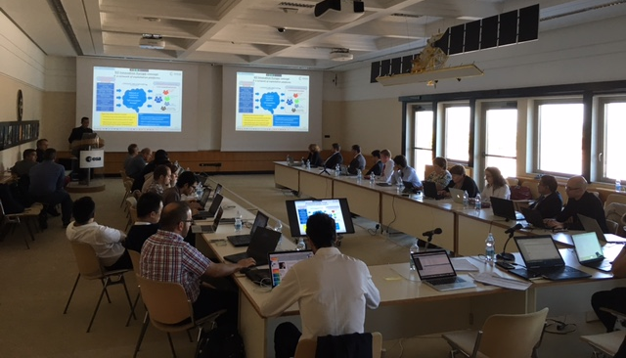
Cloud Computing Workshop
ESA GS evolution and EO Innovation Europe and Thematic Exploitation Platforms and Cloud Computing Activities
CNES Cloud Computing and Security
JAXA Approach on Virtualization and Cloud Computing
ISRO EO Data Processing Cloud: Requirements and Research Issues
Computing in the Cloud at Geoscience Australia
Leveraging the Value of Data with Industry at NOAA
USGS Cloud Hosting
Assessing Applications of Cloud Computing to NASA EOSDIS
CEOS Data Cube use of Cloud Computing
Held a successful Cloud Computing Workshop on September 20, 2016.
Creating a summary report of the Cloud Computing Workshop tailored for input to the FDA report.
Source Image: http://icfailureanalysis.com/sample-reports/

Slide 5
Cloud Computing Workshop
#1 Finding:
Due to the increase in EO measurements, there is a strong need to move Users closer to the Data and not move large volumes of data.
Questions WGISS will be addressing next:
Will cloud save us money?
What interoperability issues will cloud solve/create?
How best to make ARD discoverable/accessible via cloud?
What are/can we going to do with the data in the cloud? (cloud enabled applications)
Image Source: http://gncdcny.org/credit-smart-education/educational-workshops/

Slide 6
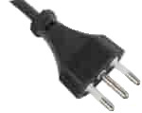
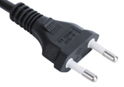
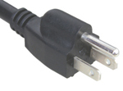
Interoperability Interest Group
Architecture
CWIC
FedEO
IDN
Connected Data Assets
System Level Team
Carbon Strategy

Slide 7
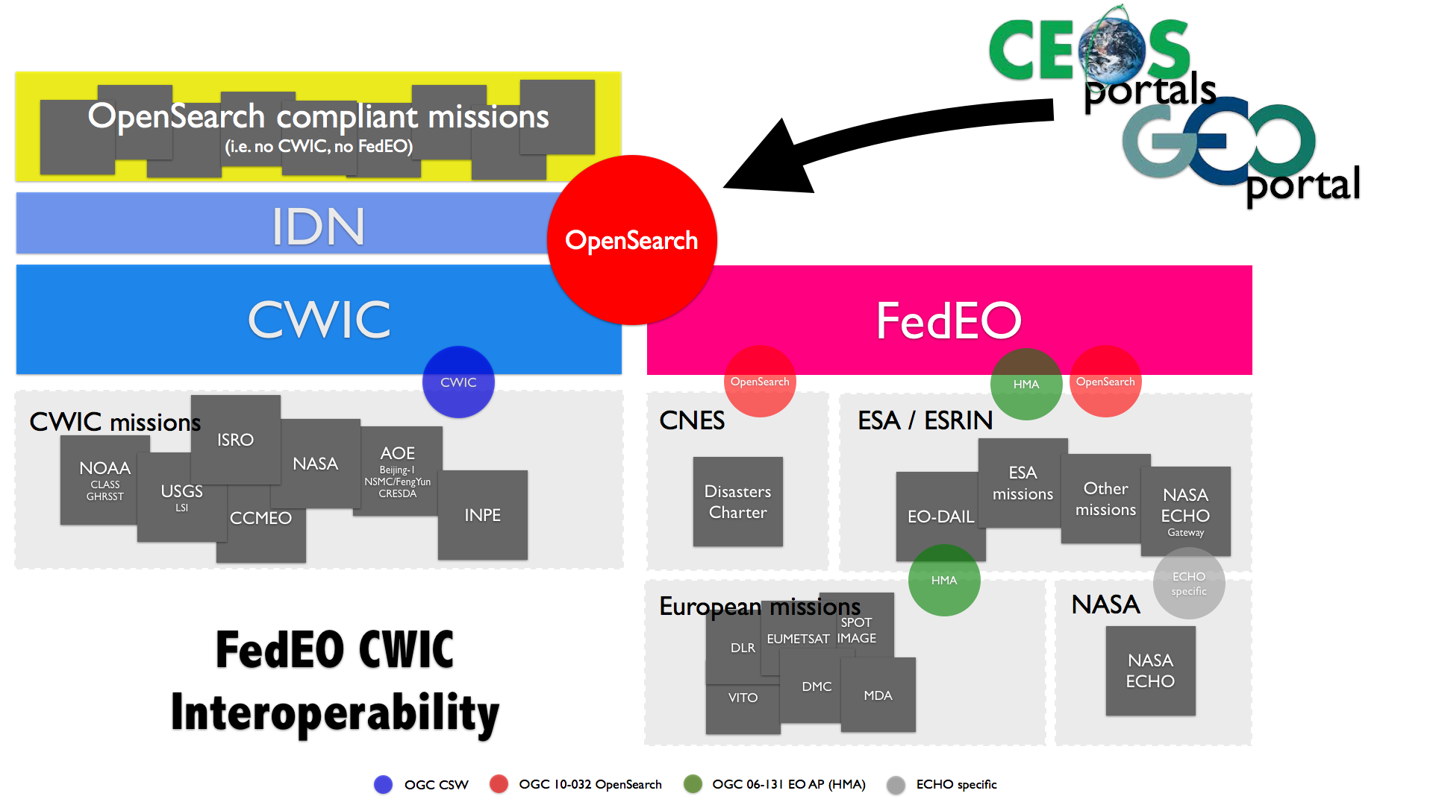
WGISS Interoperability Standards Architecture
WGISS has adopted the CEOS OpenSearch Best Practices in addition to the Open Geospatial Consortium (OGC) Catalog Services for the Web (CSW) v2.0.2 standards for searching remote sensing catalogs, both for collection and inventory information.
The FedEO, CWIC and IDN systems have implemented the WGISS supported standards are providing access to over:
4900+ collections and 260+ millions granules of EO mission data.
The IDN provides descriptions of data sets (collection level) of relevance to global change research. Both the CWIC and the FedEO systems offer search of inventory data (granule level) and access to the data records. A WGISS system level team will provide technical support to register data collections in the IDN and to on-board new data providers to connect their inventory systems to CWIC or FedEO.

Slide 8
Current Architecture Consolidation Approach
PHASE 1: Consolidation of current CWIC/FedEO/IDN overall architecture to quickly address some of the identified open issues
CLIENTS
FedEO Node
CWIC Node
Collection
Directory
(FedEO, CWIC)
Collection metadata population & harvesting
Search (1st step)
IDN
Collection
Directory
(CWIC, FedEO, Others)
Non-European Partners
product catalogues:
USGS, NASA, ISRO, NOAA, NOAA/GHRSST, INPE, AOE, CCMEO
European Partner product catalogues:
ESA, EU Copernicus, DLR, CNES, ROSCOSMOS, VITO, EUMETSAT, ASI, UKSA

Slide 9
Connected Data Assets

Slide 10
System Level Team
Created an integrated system team to coordinate and oversee the WGISS integrated system and standards:
Coordinate operations, maintenance and evolution activities (e.g. for infrastructure, standards adoption, etc).
On-board new data partners
Provide technical support for client partners
Monitor the health of the federated system and report outages and errors etc. to the partners
Test all the components of the federated system, including end to end search and data access
Work with data and client partners to identify and resolve system and component bugs
Provide support for metrics collection
Image Source: http://professionbiz.com/archives/7347

Slide 11
ECVs/CDRs Discovery and Access through WGISS Systems
Objective: facilitate discoverability and accessibility of ECV Products and space-born CDRs relevant for the CEOS Carbon Action via WGISS Interoperability Systems & Standards (FedEO/CWIC/IDN, OpenSearch).
Approach: start from results of WGClimate Questionnaire for ECV Inventory population; tailoring for Carbon Action and gaps identification wrt data records already discoverable/accessible through WGISS systems (Q1/Q2 2017); feasibility analysis, priorities setting and liaising with relevant organizations (Q2/Q3 2017); start technical activities (Q3/Q4 2017).
Additional Resources: support from WGClimate and experts for priorities setting; activities at data providers’ side to be carried out by relevant entities.
Image Source: http://www.onlygfx.com/5-red-green-approved-stamp-png-transparent/
Notes:
Carbon Portal prototype

Slide 12
WGISS Carbon Portal
Objective: development as WGISS project of a CEOS WGISS Carbon Portal prototype similar to the Water portal (http://waterportal.ceos.org/) to allow displaying Carbon datasets and providing assistance to scientists and general users in the development of related services & tools.
Approach: collection of needs from Carbon (or WGClimate) experts on what needs to be in the portal (Q1/Q2 2017); Carbon Portal requirements definition and system design (Q2/Q3 2017); start development (Q3/Q4 2017).
Additional Resources: requirements definition and development resources provided by NOAA; support from WGClimate and experts for requirements definition.
Image Source: http://www.onlygfx.com/5-red-green-approved-stamp-png-transparent/
Notes:
Carbon Portal prototype

Slide 13
CEOS Work Plan 2016-2018
DATA-2: Full representation of CEOS Agency datasets in the IDN and accessible via WGISS Interoperable Standards
Status: WGISS began discussions with ISRO and the following Australian centers in order to get their data accessible via WGISS interoperable standards (i.e. IDN, CWIC). (Geosciences Australia / CSIRO / Bureau of Meteorology /Australian National University &National Computational Infrastructure). New entries were added to the IDN from ESA, EUMETSAT, and JAXA datasets.
VC-1: List of Relevant Datasets from VCs
Status: WGISS is requesting updated list from the VCs.
QUESTIONS FOR VC/WGs
Which products do your VC/WG have difficulty discovering or accessing?
Is there a need from your VC/WG to have science discipline focused data access portals?
Are there technologies that WGISS should prioritize in our Technology Exploration webinars?
What are your overall data access, data discovery, technology pain points?

Slide 14
Data Stewardship Interest Group
WGISS accomplishes its Data Preservation and Curation efforts through the Data Stewardship Interest Group (DSIG)

Slide 15
Data Stewardship Best Practices Document Tree
Policy Documents
Individual organizations' policies (stewardship, access, ...)
EO Data Stewardship Cooperative Framework
Applied to
CEOS EO Space Data Sets
Data Purge Alert Procedure & White Paper
High level framework documents
Applied to
Technical Documents
Preservation Workflow
Glossary of Acronyms and Terms
General guidelines and best practices
Support
Guidelines and best practices on specific topics
Persistent Identifiers Best Practice
EO Data Preservation Guidelines
Preserved Data
Set Content
Associated Knowledge Preservation
CEOS Maturity Matrix
…
EO Data Set Consolidation Process
…
Technical implementation procedures
Image Source: http://eastenders.wikia.com/wiki/File:Under-construction.png

Slide 16
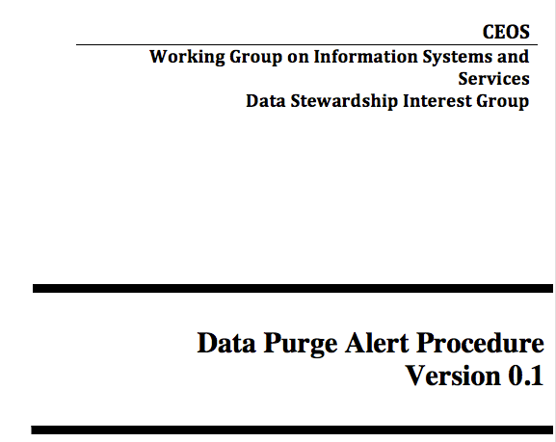
Data Purge Alert Procedure Status
The U.S. Geological Survey intends to dispose of its
Landsat Multispectral Scanner (MSS) and Thematic Mapper (TM) satellite film
Purge Alert Procedure endorsement at CEOS Plenary in Nov 2015
Finalization of Purge Alert White Paper and material needed to ensure visibility of Purge Alert Procedure on CEOS and WGISS Web Sites
Define approach to inform Commercial Data Owners of the existence of the procedure (data at highest risk, in particular old ones). Possibility for them to use the procedure.
Image source: https://en.wikinews.org/wiki/Template:Breaking_news_overlay
Image Source: http://eastenders.wikia.com/wiki/File:Under-construction.png
Image Source: http://www.clipartkid.com/thumbs-up-thumbs-down-cliparts/

Slide 17
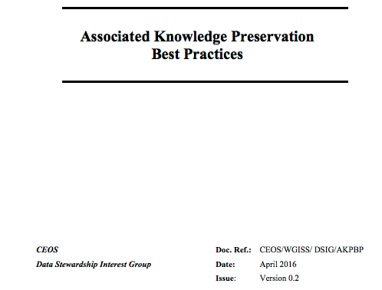
Documents “Working in Progress” Associated Knowledge Preservations
How to manage the preservation of Data Associated Knowledge?
Discussion, collection of information and survey performed on approaches at CEOS &
Long Term Data Preservation (LTDP) WG Agencies and in other domains
Need for an harmonized approach
Drafting of CEOS Best Practice on recommended approaches for Associated Knowledge (i.e. information and SW tools) preservation
Information
Documents
Images
Videos
Metadata
Etc.
Software/Tools

Slide 18
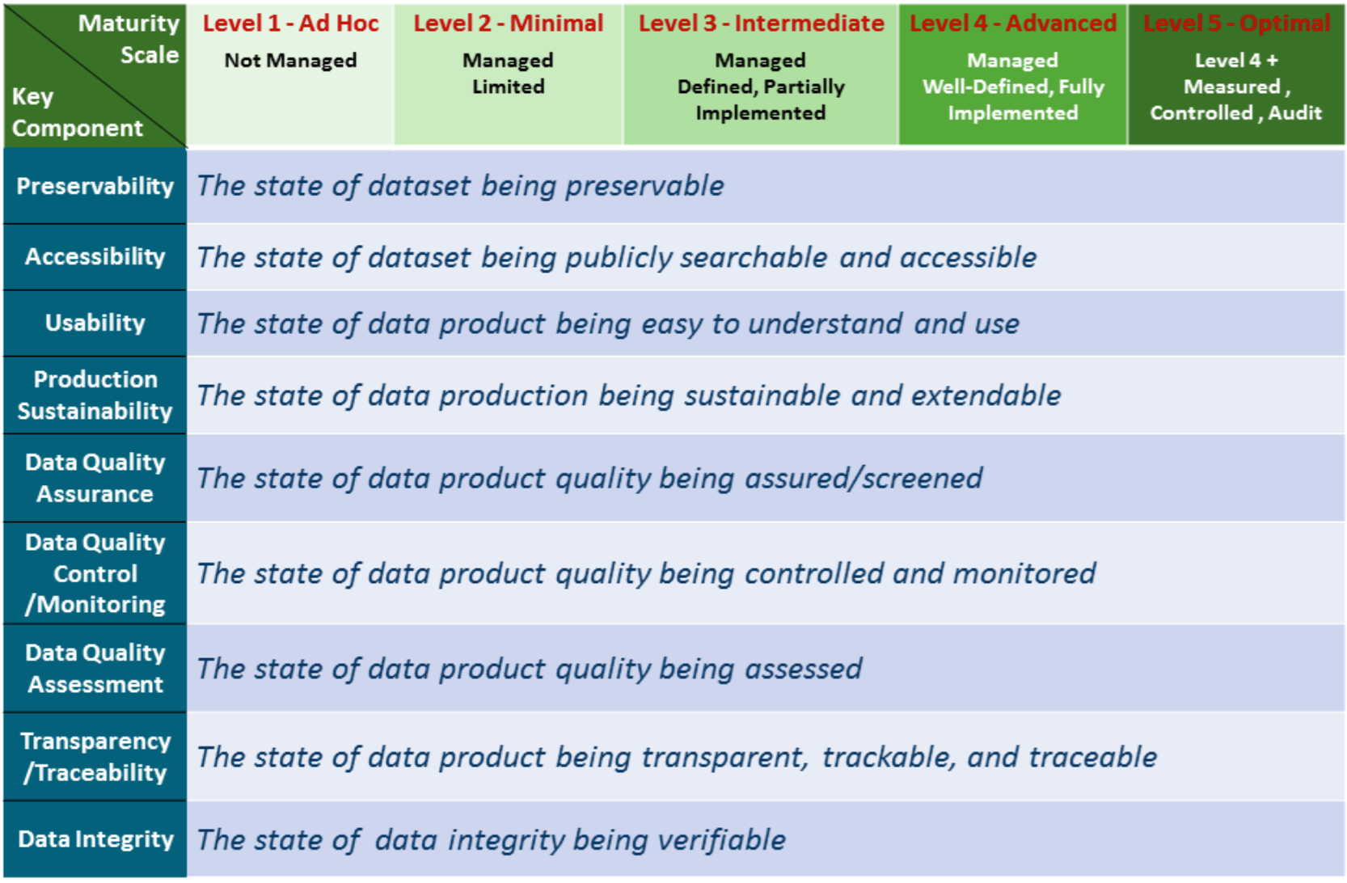
Documents “Working in Progress” Maturity Matrix/Model
A reference model for data stewardship planning and resource allocation
Gives a technical evaluation of the level of preservation and helps with self assessment of preservation;
Provides detailed guideline and recommendations for preservation;
Creates a roadmap for scientific data stewardship improvement;
Provides data quality, usability information to users, stakeholders, and decision makers;
Different Mission Datasets might have different targets and different Maturity level ratings.

Slide 19
GEO Interactions
WGISS has been added as a contributor to the Foundational Task GD-7 Subtask 2 ‘GCI Development’ and GD-2 ‘GCI Operations’.

Slide 20
GEO Interactions
As a GEOSS Clearinghouse Infrastructure (GCI) provider of CEOS data, presented WGISS activities related to CWIC, FedEO and the IDN at the GCI Workshop on May 5th and 6th in Switzerland.
Initiated a review of the draft GCI User Requirements.
Representing CEOS by presenting methods of data discovery and access during the Data Providers Side event in the GEO-XIII Plenary – Nov 7th.
GEO Secretariat request: “CEOS WGISS to identify a PoC to discuss further for improving CEOS agencies assets discoverable and accessible through IDN, CWIC and FedEO”
WGISS response: WGISS identified the NEW System Level Team

Slide 21
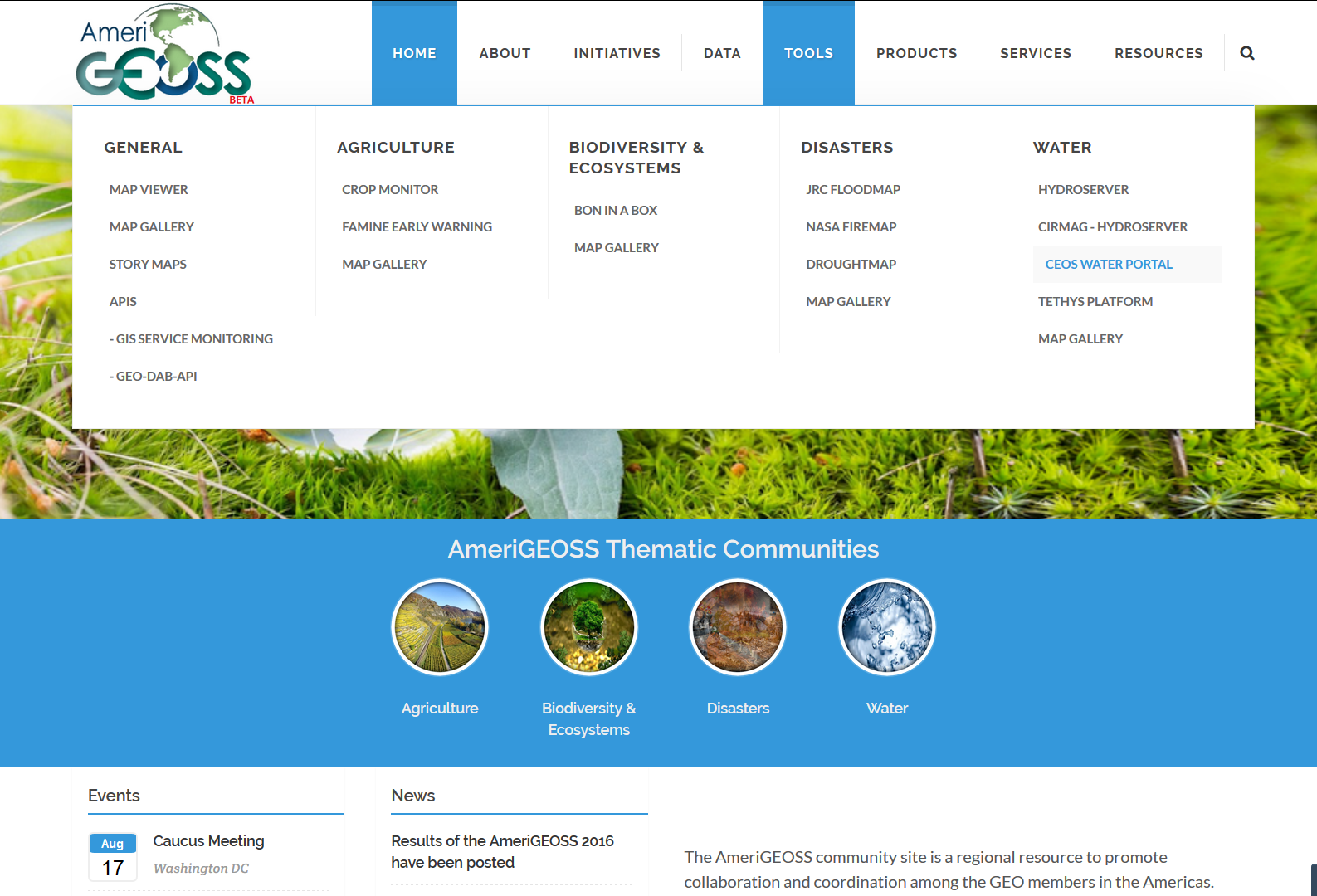
AmeriGEOSS Pilot

Slide 22
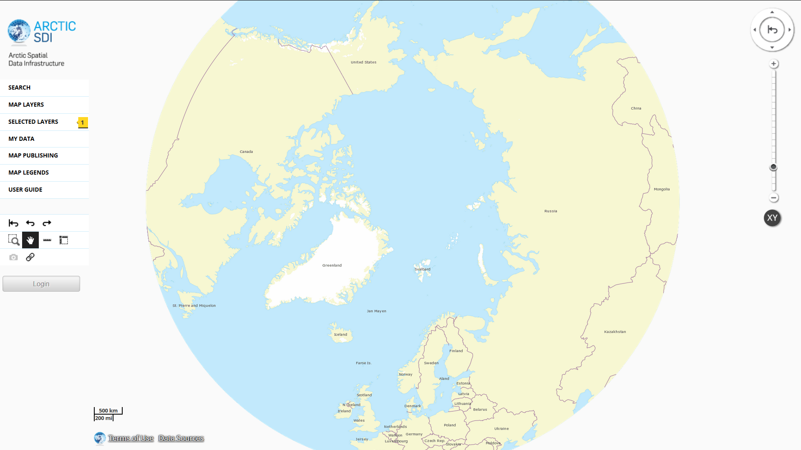
GEO Portal Updates
CWIC is being integrated in the GeoSUR Portal (regional initiative led by spatial data producers in Latin America and the Caribbean), GeoPlatform community and the ArticSDI community

Slide 23
WGISS Leadership Succession
WGISS Vice Chair Nomination
A CEOS agency has expressed interest in putting forward a nominee and, at the moment, it is still considering the four-year commitment which would begin in Nov 2017.
Image Source: http://www.metsoc.org/awards-nomination-procedure/

Slide 24
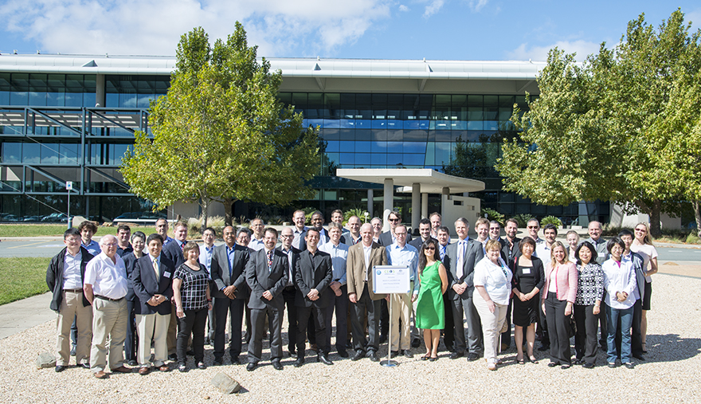
Committee on Earth Observation Satellites

Slide 25
Upcoming 2017 Meetings
Technology Exploration Webinar - January 2017
CEOS Data Discovery Webinar (along with WGCapD)
CWIC Meeting - February 2017 Greenbelt, Maryland US
WGISS 43 – April 2017 Annapolis, Maryland US
Technology Exploration Workshop
WGISS 44 – September 2017 …
Image Source: http://www.accidentalcreative.com/teams/guide-to-insanely-productive-meetings/

Slide 26
Image Source: http://www.badassteacher.org/badass-gratitude/

