Slide 1
Committee on Earth Observation Satellites
Non-meteorological Applications (NMA) for Next Generation Geostationary Satellites Study
Ad-hoc Team Report
Thomas Schroeder (CSIRO)
On behalf of the NMA Ad-hoc Team
CEOS Plenary 2016
Agenda Item 6.1
Brisbane, Australia
1st – 2nd November 2016

Slide 2
Introduction
One year study initiative to assess the potential and new opportunities arising from next generation geostationary satellites and GEO-LEO synergies
NMA Ad-hoc Team established in January 2016
Co-chaired by CSIRO (Thomas Schroeder), ABoM (Ian Grant), EUMETSAT (Kenneth Holmlund) and NOAA (Satya Kalluri)
Supported by 14 other CEOS Agencies:
CNES, CSA, DLR, EC, ESA, GA, JAXA, JMA, KARI, NASA, NSMC-CMA, UKSA, USGS, WMO
Consulted with CGMS – side event at CGMS-44 Plenary (Biot, France)
Study report delivered by a smaller focus-team, NMA co-leads supported by Albrecht von Bargen (DLR), Robert Husband (EUMETSAT) and in the early phase by Tom Cecere (USGS) and shared with CEOS WGs and CGMS for review

Slide 3
Clarifying the scope
What is meant by non-meteorological?
What is meant by next-generation geostationary satellites?

Slide 4
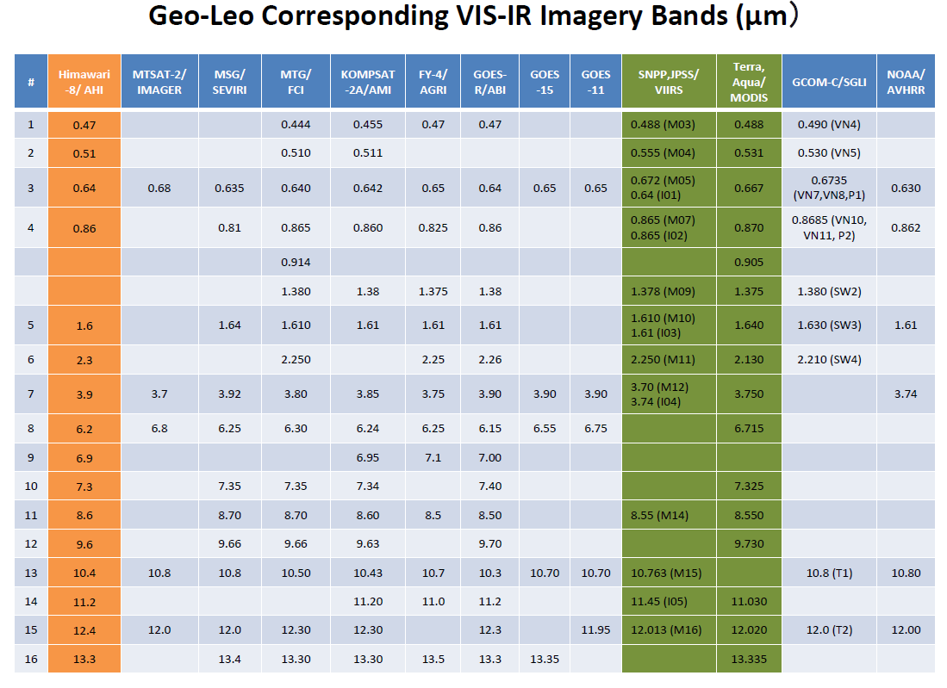
GEO
LEO
Oct 2014
2020
2018
2016
2016
(Credits: T. Kurino, JMA)

Slide 5
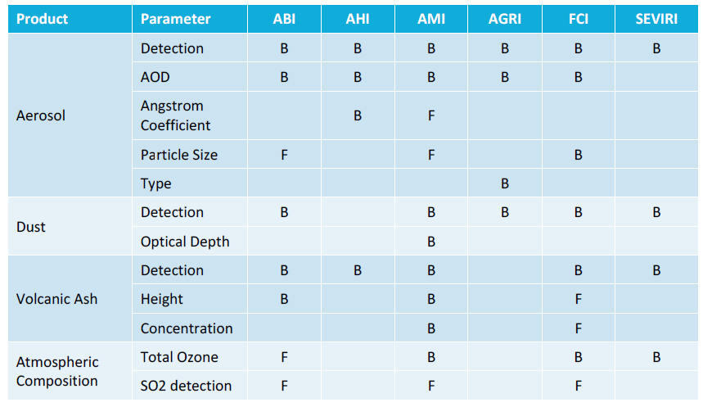
Non-meteorological applications
Atmosphere
B=Baseline, F=Future capability/potential

Slide 6
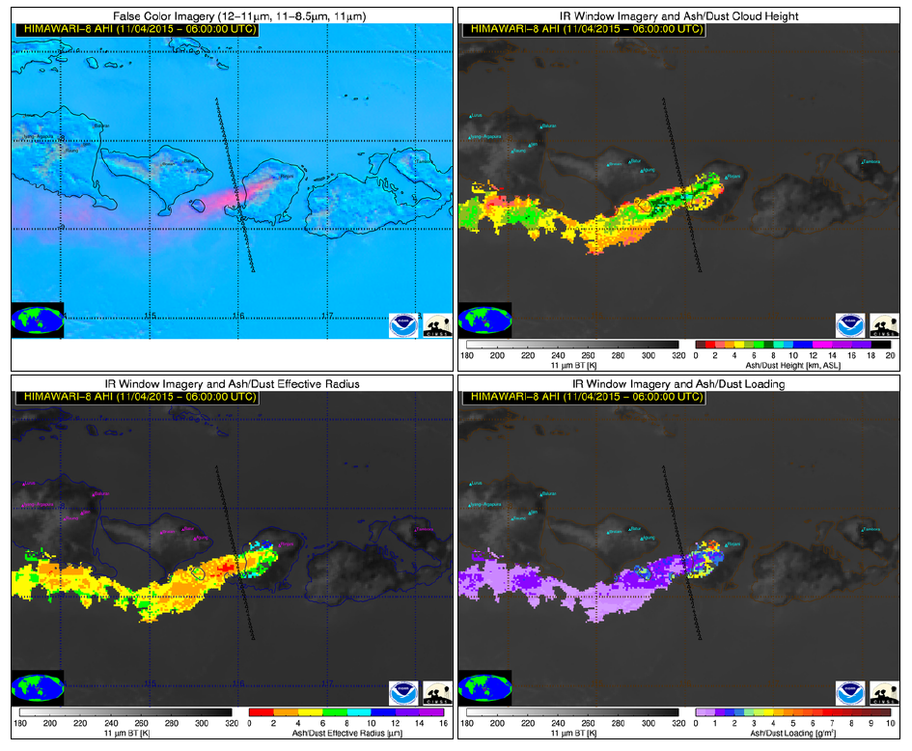
Example NMA - Atmosphere
Volcanic ash plume detection (Mt Rinjani Indonesia)
False Colour
Ash/Dust Height
Ash/Dust Effective Radius
Ash/Dust Loading
(Courtesy M. Pavolonis NOAA NESDIS STAR)

Slide 7
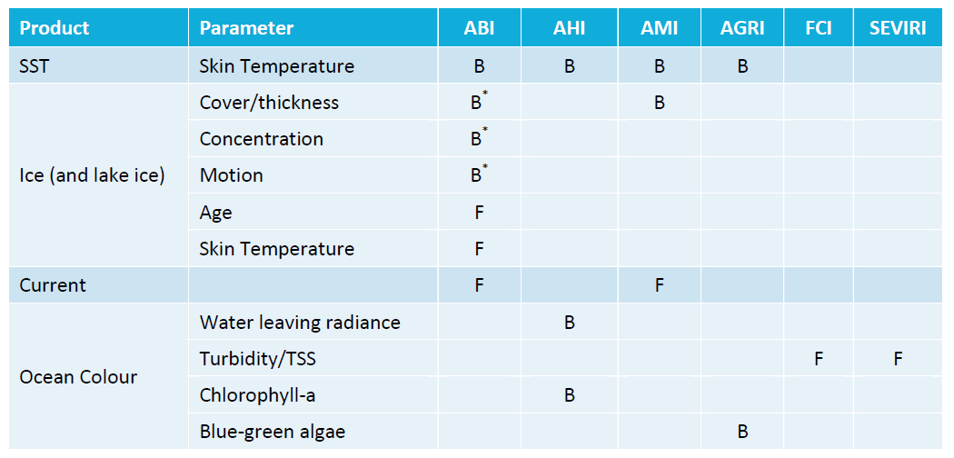
Non-meteorological applications
Ocean
B=Baseline, F=Future capability/potential
B*= Operational late 2017

Slide 8
Example NMA - Ocean
Chlorophyll-a retrieval using Himawari-8, Asia-Pacific
(Murakami, 2016)
High radiometric requirements (SNR) for Ocean Colour applications!

Slide 9
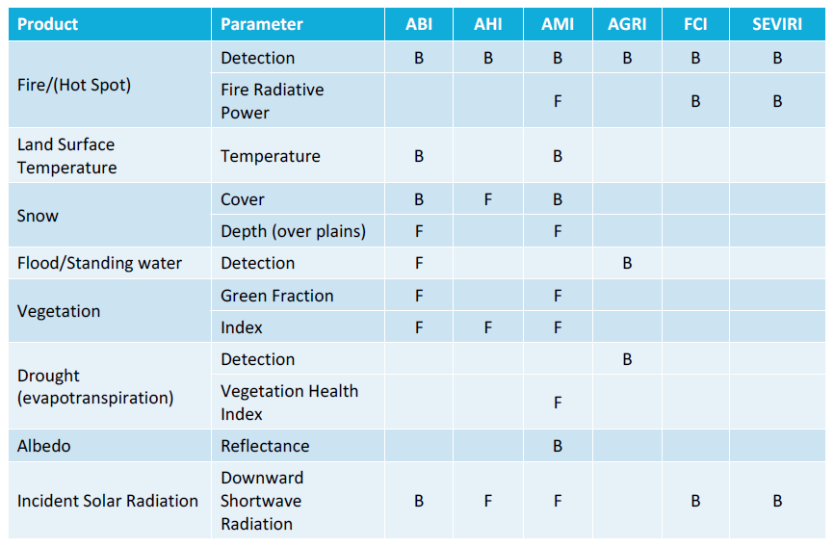
Non-meteorological applications
Land
B=Baseline, F=Future capability/potential

Slide 10
Example NMA - Land
Flood mapping using VIIRS and Himawari-8, China
Floods are the most frequent of natural disasters.
Global techniques for flood detection are required.
VIIRS – 3-day composite
Himawari-8 – 1 day
(Goldberg, 2016)
Himawari-8 provided a more complete overview of this flooding event.

Slide 11
NMA report …
Provided a comprehensive survey of NMA across atmosphere, land and ocean incl. concept of operations for key next generation imagers
A discussion on the synergistic use of GEO and LEO systems
GEO and LEO Level 1 data input to a single algorithm
Merging GEO and LEO Level 2 and higher-level data
GEO product input to LEO production or vice-versa
An overview of CGMS and other agency initiatives relevant to the further coordination and progression NMA from GEO orbit
User engagement - SATURN, EUMETRAIN, WMO-CGMS-Vlab
GSICS activities
EUMETSAT Satellite Application Facilities
Bilateral collaboration Japan-Australia
Identified a series of opportunities to achieve better integration and uptake of non-meteorological GEO observations

Slide 12
User engagement
Opportunities
The determination of user requirements and priorities would benefit from developing strong links with the relevant non-weather communities.

Slide 13
User engagement
Opportunities
The determination of user requirements and priorities would benefit from developing strong links with the relevant non-weather communities.
Study in detail the suitability of GEO observations to contribute to
United Nations Sustainable Development Goals (UNSDG).
…

Slide 14
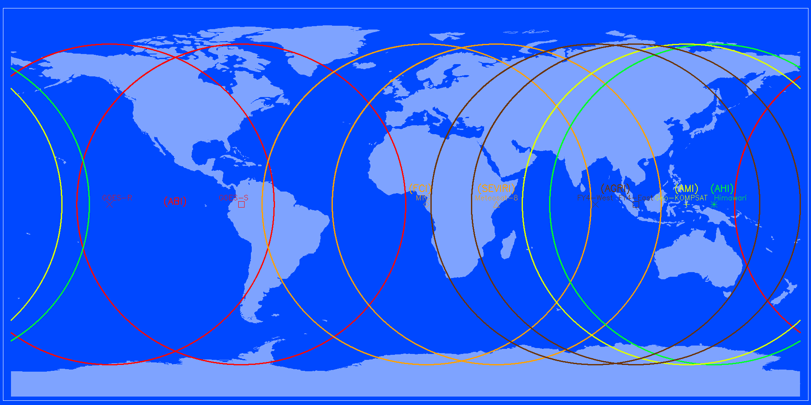
Application development
Opportunities
Support collaborative efforts for algorithm development and inter-comparison activities to achieve consistent GEO-ring products.

Slide 15
Application development
Opportunities
Support collaborative efforts for algorithm development and inter-comparison activities to achieve consistent GEO-ring products.
A broad engagement with the EO community and LEO science teams to foster collaborative developments of advanced algorithms, and identify potential non-meteorological applications for coordinated GEO-ring implementation.

Slide 16
Application development
Opportunities
Support collaborative efforts for algorithm development and inter-comparison activities to achieve consistent GEO-ring products.
A broad engagement with the EO community and LEO science teams to foster collaborative developments of advanced algorithms, and identify potential non-meteorological applications for coordinated GEO-ring implementation.
Continue working towards the operational delivery of NMA geophysical products to achieve quasi-global consistent coverage, particularly radiometric products that underpin downstream products.

Slide 17
Application development
Opportunities
Support collaborative efforts for algorithm development and inter-comparison activities to achieve consistent GEO-ring products.
A broad engagement with the EO community and LEO science teams to foster collaborative developments of advanced algorithms, and identify potential non-meteorological applications for coordinated GEO-ring implementation.
Continue working towards the operational delivery of NMA geophysical products to achieve quasi-global consistent coverage, particularly radiometric products that underpin downstream products.
Consider identifying a suitable pilot project for a new GEO-ring product within existing coordination activities.

Slide 18
Application development
Opportunities
Support collaborative efforts for algorithm development and inter-comparison activities to achieve consistent GEO-ring products.
A broad engagement with the EO community and LEO science teams to foster collaborative developments of advanced algorithms, and identify potential non-meteorological applications for coordinated GEO-ring implementation.
Continue working towards the operational delivery of NMA geophysical products to achieve quasi-global consistent coverage, particularly radiometric products that underpin downstream products.
Consider identifying a suitable pilot project for a new GEO-ring product within existing coordination activities.
Synergistic use of data from GEO and LEO imagers is encouraged.

Slide 19
Application development
Opportunities
Support collaborative efforts for algorithm development and inter-comparison activities to achieve consistent GEO-ring products.
A broad engagement with the EO community and LEO science teams to foster collaborative developments of advanced algorithms, and identify potential non-meteorological applications for coordinated GEO-ring implementation.
Continue working towards the operational delivery of NMA geophysical products to achieve quasi-global consistent coverage, particularly radiometric products that underpin downstream products.
Consider identifying a suitable pilot project for a new GEO-ring product within existing coordination activities.
Synergistic use of data from GEO and LEO imagers is encouraged.
Study in detail the suitability of GEOs to contribute to the climate monitoring framework.

Slide 20
Data calibration, validation, harmonization
Opportunities
Promote consistency of products and algorithms between platforms.

Slide 21
Data calibration, validation, harmonization
Opportunities
Promote consistency of products and algorithms between platforms.
To achieve consistent products continued strong inter-agency coordination and engagement in various calibration and validation initiatives, like GSICS and CEOS WGCV, is encouraged.

Slide 22
Data calibration, validation, harmonization
Opportunities
Promote consistency of products and algorithms between platforms.
To achieve consistent products continued strong inter-agency coordination and engagement in various calibration and validation initiatives, like GSICS and CEOS WGCV, is encouraged.
Algorithm development and validation benefits from openly shared in-situ validation data and simulated test data sets. Coordination of validation data acquisition such as from field campaigns, which are often resource intensive, would be highly beneficial.

Slide 23
Data calibration, validation, harmonization
Opportunities
Promote consistency of products and algorithms between platforms.
To achieve consistent products continued strong inter-agency coordination and engagement in various calibration and validation initiatives, like GSICS and CEOS WGCV, is encouraged.
Algorithm development and validation benefits from openly shared in-situ validation data and simulated test data sets. Coordination of validation data acquisition such as from field campaigns, which are often resource intensive, would be highly beneficial.
Support to cal/val infrastructure for validation of radiometric products such as the RadCalNet or AERONET(-OC) networks including system vicarious calibration sites, fosters interactions with the user community in support of validation and accuracy assessments.

Slide 24
Data management
Opportunities
Promote uniform data and metadata formats across missions.

Slide 25
Data management
Opportunities
Promote uniform data and metadata formats across missions.
Take advantage of modern data approaches such as those identified by the CEOS Ad Hoc Team on Future Data Architectures.

Slide 26
Data management
Opportunities
Promote uniform data and metadata formats across missions.
Take advantage of modern data approaches such as those identified by the CEOS Ad Hoc Team on Future Data Architectures.
Emphasise the generation of information rather than product files.

Slide 27
Data management
Opportunities
Promote uniform data and metadata formats across missions.
Take advantage of modern data approaches such as those identified by the CEOS Ad Hoc Team on Future Data Architectures.
Emphasise the generation of information rather than product files.
Consider how the “Analysis-Ready Data” concept would apply to GEO-ring products and GEO-LEO integration.

Slide 28
Data management
Opportunities
Promote uniform data and metadata formats across missions.
Take advantage of modern data approaches such as those identified by the CEOS Ad Hoc Team on Future Data Architectures.
Emphasise the generation of information rather than product files.
Consider how the “Analysis-Ready Data” concept would apply to GEO-ring products and GEO-LEO integration.
Create data that is readable by non-meteorological application software such as GIS to broaden the user base.

Slide 29
Data management
Opportunities
Promote uniform data and metadata formats across missions.
Take advantage of modern data approaches such as those identified by the CEOS Ad Hoc Team on Future Data Architectures.
Emphasise the generation of information rather than product files.
Consider how the “Analysis-Ready Data” concept would apply to GEO-ring products and GEO-LEO integration.
Create data that is readable by non-meteorological application software such as GIS to broaden the user base.
Develop common tools so that GEO data and applications can be integrated into commercial or open source software.

Slide 30
Outreach
Opportunities
Explore opportunities to promote non-met GEO products widely.

Slide 31
Outreach
Opportunities
Explore opportunities to promote non-met GEO products widely.
Consider including appropriate non-meteorological products and applications into training activities such as SATURN, EUMETRAIN and WMO-CGMS Vlab.

Slide 32
Conclusions
Meteorological geostationary satellites provide for many applications a distinct advantage of medium-resolution LEO satellites particularly wrt to temporal sampling that enables:
Early detection of rapidly changing phenomena
Better description of diurnal cycles
Increase opportunities of cloud free observations over limited time-period (e.g. one day)
Study highlighted the value of NMA from GEO orbit and identified a series of opportunities to achieve better integration and uptake of NMA GEO observations
Many opportunities for improved products though synergistic (LEO+GEO) use of data exist

Slide 33
Conclusions
Agencies can enhance their return on their existing substantial investment in GEO and LEO infrastructure and applications, by applying their infrastructure and expertise to non-meteorological GEO applications
This will strengthen the science and environmental monitoring as well as the associated impact on the various SBA
The geostationary NMA have a potential to have a positive impact on all associated SBAs
Significant development activities are already taking place within the satellite agencies to derive NMA products from meteorological geostationary satellites
Plenary discussion to identify potential opportunities going forward and appropriate course of action for CEOS

