Slide 1

Analysis ready data: definition document
Committee on Earth Observation Satellites
Organization
CEOS Plenary 2016
Agenda Item 5.4
Brisbane, Australia
1st – 2nd November 2016

Slide 2
Analysis ready data
The Land Surface Imaging Virtual Constellation (LSI-VC) was tasked (Nov 2015) to “Define intercomparable Analysis-Ready Data (ARD) products within the context of land surface imaging”.
This presentation:
  Seeks endorsement of the definition, and;
  Provides additional context to inform discussion, including the steps that will follow, pending endorsement
The presentation progresses through:
  Why analysis ready data is a valuable concept for CEOS
  What the definition is saying
  How the definition will be progressed to help CEOS achieve its objectives (next steps)
Notes:
This presentation will take about 10 minutes following which there is time for discussion
LSI-VC

Slide 3
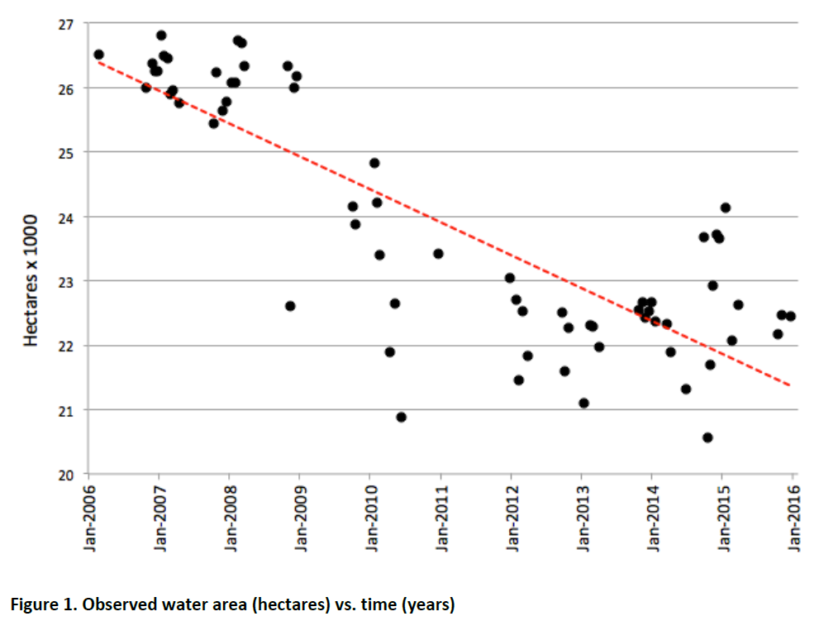
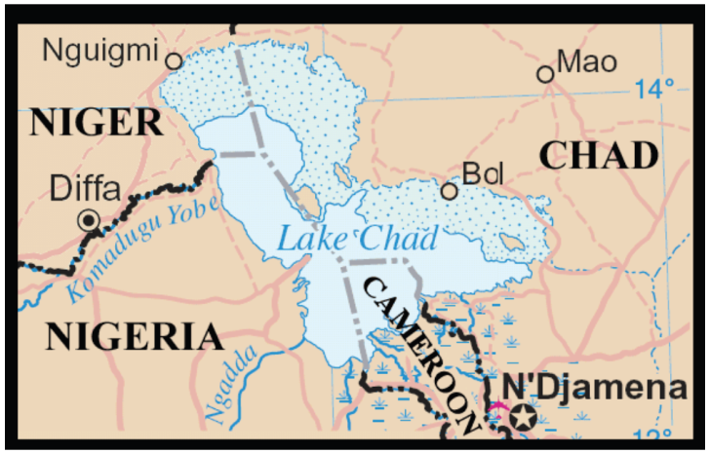
Benefits of analysis ready data
CEOS’ users need information to support decision making
‘Analysis-ready’ data removes the burden of pre-processing from the user, allowing them to focus on the problem of interest
Surface area of water observed over (part of) Lake Chad
2006 to 2016
Courtesy of CEOS SEO

Slide 4
Benefits of analysis ready data
Mission:
CEOS … promotes exchange of data to optimize societal benefit and inform decision making …”
(CEOS Strategic Guidance, Nov 2013)
The context for CEOS activities:
The number of Earth-observing satellites has vastly increased
New types of data in ever-growing volumes
Expanded and more diverse user community and new applications
(CEOS Overview: www.ceos.org)
‘Analysis-ready’ data removes the burden of pre-processing from the user, allowing them to focus on the problem of interest
Notes:
Both GEOGLAM and GFOI have identified with the need for ARD during their presentations to Plenary.

Slide 5
The definition – CARD4L
CEOS Analysis Ready Data for Land (CARD4L), are satellite data that have been processed to a minimum set of requirements and organized into a form that allows immediate analysis with a minimum of additional user effort, and, interoperability both through time and with other datasets

Slide 6
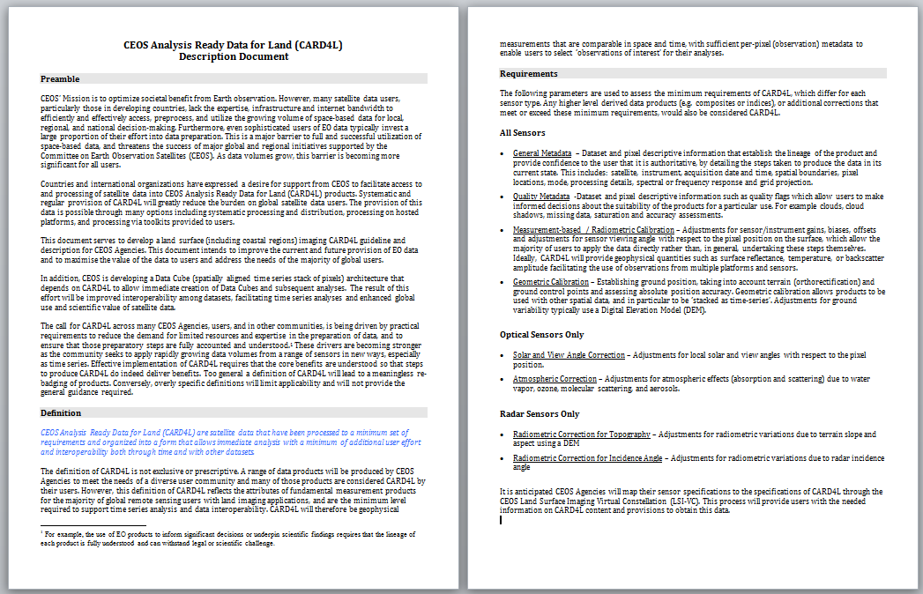
CARD4L – Description document
CEOS Analysis Ready Data for Land (CARD4L) is defined in the ‘description document’

Slide 7
CARD4L – Description document
Preamble
(1) Data preparation is a major barrier
(2) There is a call for analysis ready data
(3) The need is growing:
data volumes are increasing;
time series analyses are needed;
constellations must be supported

Slide 8
CARD4L – Description document
Definition paragraph
CEOS Analysis Ready Data for Land
(CARD4L), are satellite data that have
been processed to a minimum set of
requirements and organized into a form
that allows immediate analysis with a
minimum of additional user effort, and,
interoperability both through time and with other datasets
Caveats: Agencies will also produce other products for their users.

Slide 9
CARD4L – Description document
Requirements (minimum)
General metadata
lineage; authoritative data
Quality metadata
quality flags; suitability for a particular use
Corrections
allow the users to use the data directly; geophysical measurement of the land surface
Geometric correction
accurate location; data can be ‘stacked as time-series’

Slide 10
CARD4L – Description document
Requirements (optical and radar)
Optical : atmospheric and
solar view angle corrections
Radar: radiometric corrections for
topography and incidence angle

Slide 11
Next steps – CARD4L specifications
Following endorsement of the definition, Technical Specifications will also be needed. These will be the subject of further work with oversight by the LSI-VC
General Description
minimum characteristics
For endorsement by plenary
Technical Specifications
specifically, what is needed
for optical, radar or other
datasets to be CARD4L?
E.g. what is CARD4L
surface reflectance?
Specifications are to follow
Ongoing work, continuing development
Specifications will not change the
General Description

Slide 12
CARD4L – Specifications
Developing specifications (next steps / future work)
Materials will be developed that map CEOS agency products to the high level requirements for CARD4L
  Work with CEOS agencies to generate prototype CARD4L format data for
    CEOS data cube and Future Data Architecture pilots
    Other CEOS pilots, e.g., European Platforms approach
    GEOGLAM, GFOI and other user communities
  This work will be one focus for LSI-VC-3, scheduled for March 2017
Several groups have been considering specifications for analysis ready Radar data.
  A working team will be formed to focus on this. Nominations have already been received from key agencies.
Notes:
This table illustrates the type of structure that we are thinking of
Update the table.
Link the spreadsheet to the requirements process that LSI-VC.
We have responses from JAXA, CSA, ESA and NASA indicating willingness to participate in a SAR team to progress ARD for SAR, a call will go out including through WGCV.
The work on ARD is likely to feed into further work on FDAs: There is a demand for implementations of ARD and demonstration datasets for use in FDA.

Slide 13
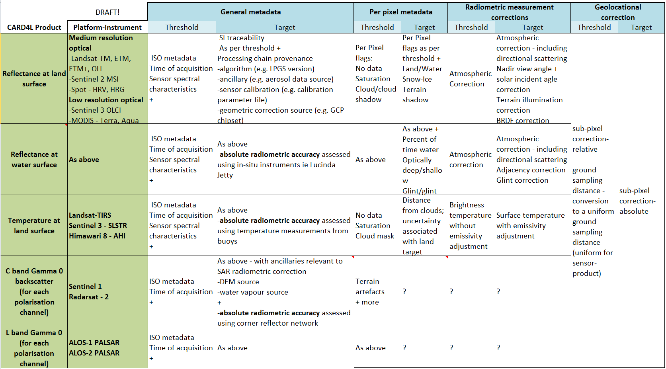
CARD4L – Specifications
Developing specifications (next steps / future work)
Materials will be developed that map CEOS agency products to the high level requirements for CARD4L.
An area of focus for LSI-VC-3, March 2017
A RADAR working team will be formed to focus on ARD for radar
Notes:
This table illustrates the type of structure that we are thinking of
Update the table.
Link the spreadsheet to the requirements process that LSI-VC.
We have responses from JAXA, CSA, ESA and NASA indicating willingness to participate in a SAR team to progress ARD for SAR, a call will go out including through WGCV.
The work on ARD is likely to feed into further work on FDAs: There is a demand for implementations of ARD and demonstration datasets for use in FDA.

