Slide 1
CEOS Data Cube Initiative
Committee on Earth Observation Satellites
Brian Killough NASA, CEOS Systems Engineering Office
CEOS Plenary 2016
Agenda Item 5.3
Brisbane, Australia
1-2 November 2016

Slide 2
The Latest Trends
Free and open data
Growing data volumes
Improved computing technologies
Open source software
Pre-processed products

Slide 3
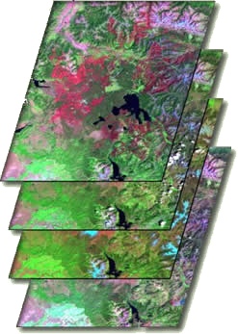
What are Data Cubes?
Data Cube = Time-series multi-dimensional (space, time, data type) stack of spatially aligned pixels ready for analysis
Proven concept by Geoscience Australia (GA) and the Australian Space Agency (CSIRO) and planned for the future USGS Landsat archive.
Analysis Ready Data (ARD) ... Dependent on processed products to reduce processing burden on users
Open source software approach allows free access, promotes expanded capabilities, and increases data usage.
Unique features: exploits time series, increases data interoperability, and supports many new applications.
TIME
Data Cubes are one example of a Future Data Architecture

Slide 4
Data Cube Work Plan
Provides a reference for internal and external Data Cube activities as there is great interest in Data Cubes and Future Data Architectures (FDA)
Provides a reference for CEOS agency contributions and discussion by CEOS leadership regarding coordination to ensure outcomes
The majority of the work is managed and funded by the SEO and GA with significant contributions by CSIRO.
The plan utilizes elements of the Australian AGDC development and is consistent with the USGS LCMAP plans.
The document captures expected outcomes and planned tasks.
Version 1.0 released at SIT-WS (Sept 2016) Version 1.1 released at Plenary (Oct 2016)

Slide 5
Work Plan Tasks
The Work Plan includes a new task summary that summarizes the responsible groups and the status and schedule for each task.
The tasks are grouped into 5 major categories ... (1) Core Technology, (2) Data Preparation and Formatting, (3) Prototypes, (4) User Requirements and Engagement, and (5) Capacity Building. Here are some highlights ...
Core Technology ... Amazon demo (next charts), GIS integration (ArcGIS, QGIS), Change Detection (CCDC, BFAST)
Data Preparation ... Working on Data Cube ingestors for Sentinels, SRTM/ASTER, SPOT-5, ALOS-PALSAR and climate data
Prototypes ... Colombia and Switzerland in progress. Others proposed or in planning: FDA pilot, Asia Cube, Balkans, Disasters Landslide Pilot
User Engagement ... FAO Forest Division and SEPAL tool integration
Capacity Building ... ALOS-PALSAR training manual completed, World Bank (Lake Chad, Tonga, Togo), SERVIR training in Jan 2017

Slide 6
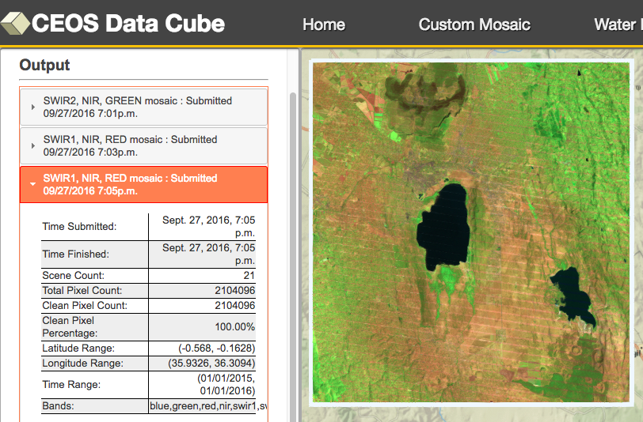
Amazon Cloud Demo
Data Cubes
5 total cubes with 10+ years each
Colombia: La Paya National Park and Meta River (RAPP region)
Kenya: Western region (forests) and Lake Baringo
Cameroon: Southern Lake Chad
User Interface Features
User-selected spatial region and time
Analysis capability for custom cloud-free mosaics, WOFS water detection, Total Suspended Matter (TSM) water quality, and Fractional Cover (coming soon).
Outputs in GEOTIFF and time series GIF animations
This is the first “hands-on” global demo of the Data Cube to show its potential for rapid time series data applications

Slide 7
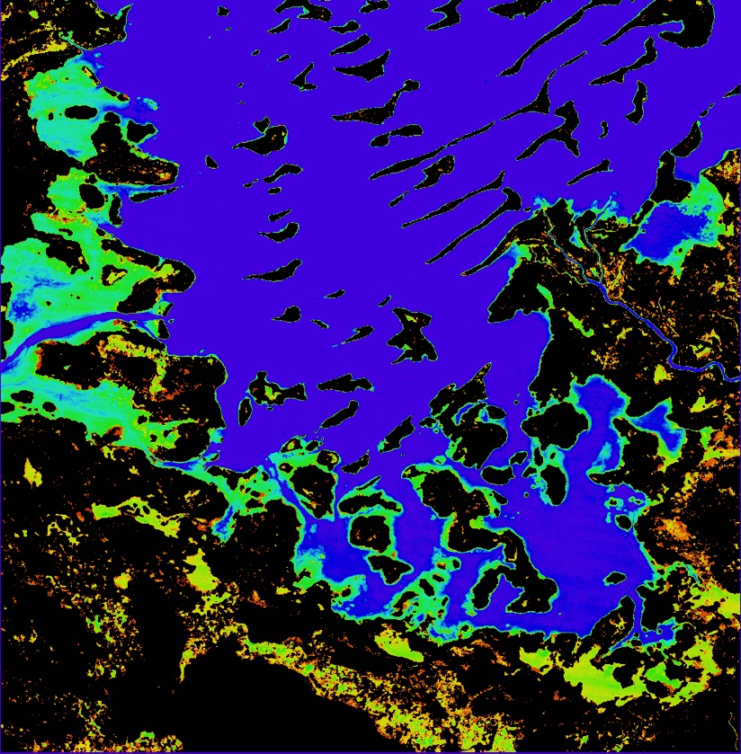
Lake Chad, Cameroon, Africa 10-year Time Series Results
The WOFS product shows the percent of observations detected as water over the full time series
Purple/Blue: Frequent water
Green/Yellow: Infrequent water and/or flood events
World Bank has shown extreme interest in these results as they have a large water management project in that region. An expansion of the dataset to the full lake is planned.

Slide 8
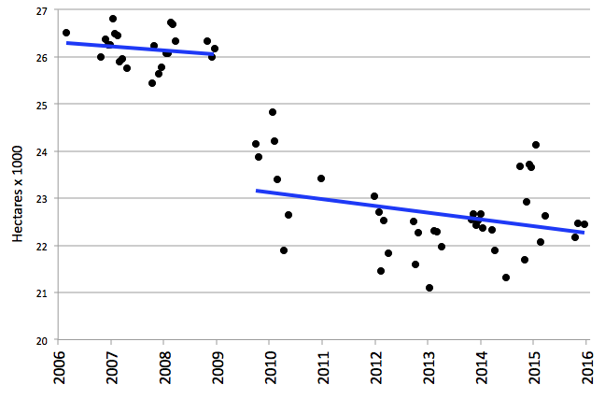
Lake Chad, Cameroon, Africa 10-year Time Series Results
The severe drought in 2008 is evident in the Lake Chad time series results. The overall 10-year trend is a loss of 1.4 hectares per day for this analysis region
Notes:
Lake Chad is a source of livelihood to 30 million people. The shrinking lake has had a substantial impact on the local populations, as entire communities have switched from a fishing-lifestyle to one of farming and agriculture. Local communities that once ringed the shores of the lake are now isolated villages — miles from water — and these populations have literally begun farming the now-dry lake bottom. As of 2015, there are plans are in the works to divert water from the Congo River to the River Chari, which flows into Lake Chad, and revitalize the lake.

Slide 9
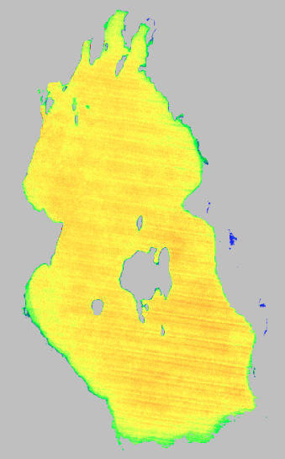
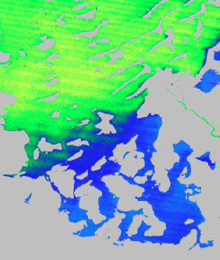
Water Quality
Total Suspended Matter (TSM)
Lake Baringo, Kenya 2006 to 2015 (10 years)
Lake Chad, Cameroon, Africa 2006 to 2015 (10 years)
The results show the average TSM (mg/L) over the time series for persistant water. TSM is closely related to turbidity which is an indicator of water condition for drinking or fisheries
Purple/Blue: Lower levels of suspended matter
Red/Yellow/Green: Higher levels of suspended matter
Lake Baringo (left) is commonly turbid with high sediment and high average TSM levels. Lake Chad (right) has higher TSM in the central portion of the lake but lower levels in the southern portion.

Slide 10
Lake Baringo, Kenya Time Series Animation
Sedimentation is considered to be the main environmental threat to Lake Baringo. It is reducing the depth and surface area of the lake and destroying aquatic life.
Rain does not always increase turbidity and TSM. Erosion from rainfall commonly causes higher TSM with more suspended matter, but increased rain may lead to lower water temperature and increased volume sufficient to dillute sediment and reduce algal growth. This effect is seen with increased rains and lake volume in 2013 and 2014
Notes:
Sedimentation is considered to be the main environmental threat to Lake Baringo. It is reducing the depth and surface area of the lake and destroying aquatic life. Rain does not always increase turbidity and TSM. Commonly, erosion from rainfall causes higher TSM with more suspended matter, but increased rain may lead to lower water temperature and increased volume sufficient to dillute sediment and reduce algal growth. TSM animation (2006 to 2015): Higher TSM before 2013, then rains in 2013 lower the TSM before rising again in 2014-2015.

Slide 11
Plenary Decisions
CEOS Plenary Decisions
NONE ... The 3-year CEOS Data Cube Work Plan is provided “for information only”. This plan will continue to evolve. Updated released are expected at SIT-32 and the 2017 CEOS Plenary.
Other Information
The CEOS Data Cube initiative was endorsed at the recent CEOS SIT Workshop. The activity is led by the SEO, GA, and CSIRO and will continue as a “Future Data Architecture” task through 2017.
Proposed Action: CEOS Data Cube team to prepare a governance plan for management of a consolidated open source repository by SIT-32. This will lay the foundation for fostering and growing a larger community of contributors to the CEOS Data Cube effort.

