Slide 1
WGClimate
Committee on Earth Observation Satellites
Pascal Lecomte, Jörg Schulz (ESA, EUMETSAT)
CEOS Plenary 2016
Agenda Item 4.5
Brisbane, Australia
1st – 2nd November 2016

Slide 2
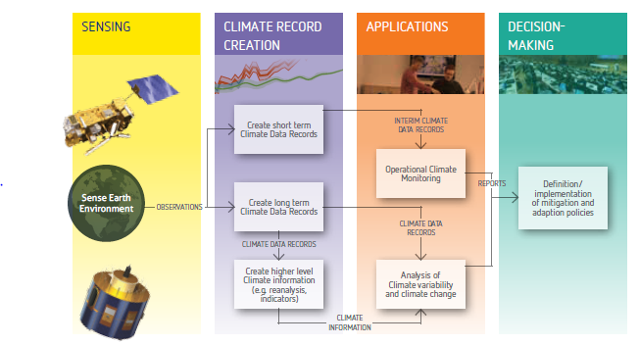
The Architecture for Climate Monitoring from Space
Implementation coordinated by
Joint CEOS – CGMS Working Group on Climate (WGClimate)

Slide 3
Importance of the ECV Inventory
Based on a questionnaire it describes the current and planned monitoring capability on an ECV basis;
Provides specific information per data record (some being not part of meta data);
Establishes traceability with respect to GCOS principles, requirements and guidelines;
Directly supports gap analysis by its structure.
ECV Inventory
Reference Assessment Process
Gap Analysis & Recommendation
Action Plan
Creation of conditions to deliver CDRs

Slide 4
Usage of the ECV Inventory by WG Climate
Description of current and future monitoring capability on an ECV basis allows easier response to e.g. GCOS IP (may suffer from mismatch after update but discussion on ECV list in GCOS not finished);
Combined perspective of the logical and physical views of the architecture should enable the definition of an optimum “macroscale” space system configuration and its components;
Used at the ECV/product level to identify gaps and shortfalls as well as to provide recommendations for action;
Formulation of a coordinated action plan to address recommendations;
Trigger for the medium‐term activities that need to be undertaken to sustain the long‐term implementation of the architecture.

Slide 5
Potential Usages of the ECV Inventory beyond the WGClimate
Can inform data record users with a public repository of verified information on what is available and how to access the data;
Can inform climate services on what to use;
Can inform data providers on competitive situations;
Can inform developers with whom to collaborate;
Can inform reviewers of proposals for new CDRs if it is worth investing ...

Slide 6
ECV Inventory Status
Total number of entries: 318 (219 current + 99 future)
Submitted entries: 64, of which 18 are verified – please note that many entries have been un-submitted after a first round of verification, and are now being edited/corrected by the responders.
As for the Domains, so far we have:
Atmosphere 171 (111C + 60F)
Land 37 (18C + 19F)
Ocean 33 (17C + 16F)
Still undefined 77 (mainly entries that have been copied from ECV Inventory #1 and have not been completed)

Slide 7
Agencies contributions
Responders: 125 registered, 43 really active
NASA 103 (some may end up as dummies; many responders have given no input so far)
EUMETSAT+SAF 98 (ROM SAF still missing)
NOAA 25 (some activity and interaction ongoing; 2 entries have been completed and re-submitted)
ESA-CCI: 38 +* (still no response at all from ESA-CCI Ozone, and still no input from Ocean Colour, Sea Ice, Ice Sheets Greenland; Glaciers gave offline input but no input into the web interface)
UKSA: 33 -* (* there is some overlap between UKSA and ESA-CCI responders, so only after verification of entries the numbers can be final)
USGS 10
CNES 6 (still no feedback from Thierry Guinle)
EC 2 (C3S, awaiting signing of contracts but input of ‘future’ CDRs sure to come; no response from JRC)
JAXA 0 (help sent, awaiting activity)
UK Met Office 0 (small input announced on SST)
CSA, ISRO, KMA (status unknown, e-mail contact but no input)
NSC, CMA, INPE, DLR (FPs stated there would be no input)
ASI, Roshydromet, JMA (no feedback at all)
Comment: For some agencies such as ASI and Rshydromet we do not have expectations. However, no response from JMA and some ESA projects is a disappointment.

Slide 8
ECV Inventory Population Close out
Deadline was extended from 30 Sep to 31 October;
We expect that we will complete and verify data record entries that were started;
We provide agencies who have not reacted so far a 2 weeks grace period after the CEOS Plenary to provide inputs;
We will start closing down the population phase on 21 November, i.e., no new entries after that date

Slide 9
General Issues
We observe huge diversity of “quality” of inputs – mainly regarding supporting documentation
QC is progressing very slow, in parallel with all the remaining support to delayed responders
We know some cases where the agencies arms are too short, e.g., for Remote Sensing Systems in the USA that hold one of the best know MSU data sets. We will get in contact directly and try to include.
Some inputs of CDRs addressing ECVs/ECV Products/Physical quantities not yet listed in GCOS-154 (2011) or have been redefined in the new IP because of existing data records. We propose to include all those for which quantitative requirements for satellite products exist in the new IP to stay up to date. This mostly applies to (groundwater storage, air-sea turbulent fluxes, grounding line location and thickness (ice sheets and ice shelves)

Slide 10
Gap Analysis
We suffer from not having a gap analysis coordinator yet.
Gap analysis teams per ECV domain have partly been established but not formalised yet.
Have started gap analysis tool development at EUMETSAT.
Gap analysis most likely to start in January 2017 after finalising the verification phase.
Test cases (single ECVs) may be tried earlier.

Slide 11
Schedule
Objectif/Deliverable | Background Information | Target Date
Cycle #2 – Stage #1 | Collection of New and Updated Information from Data Providers | Sep. 2016
Cycle #2 – Stage #2 | Data Incorporation and Quality Control | Nov. 2016
Cycle #2 – Stage #3 | Gap Analysis | Feb. 2017
Cycle #2 – Stage #4 | Action Plan | Jun. 2017
Comp. Activity #1 | Hosting of the ECV Inventory | Dec. 2016
Comp. Activity #2 | Development of Further ECV Inventory Capabilities | Feb.2019
Comp. Activity #3 | Development / Promotion of Case Studies | Sep 2017
Comp. Activity #4 | Development and Maintenance of a WGClimate Web Site | Sep 2017

