Slide 1
3rd GCOS Implementation Plan
Mark Dowell
European Commission – Joint Research Centre
mark.dowell@jrc.ec.europa.eu
On behalf of Carolin Richter & GCOS IP writing team

Slide 2
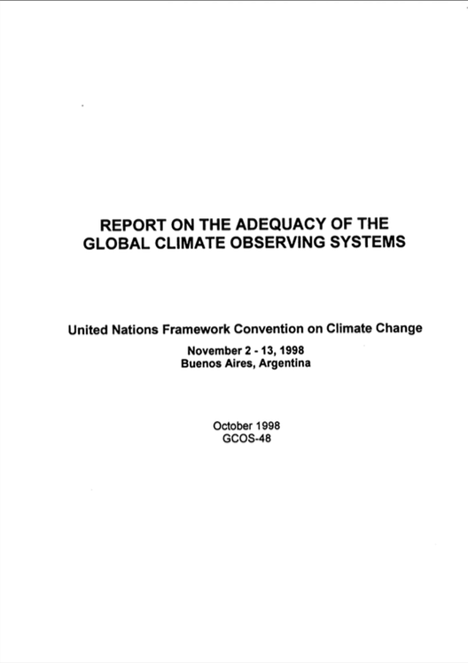
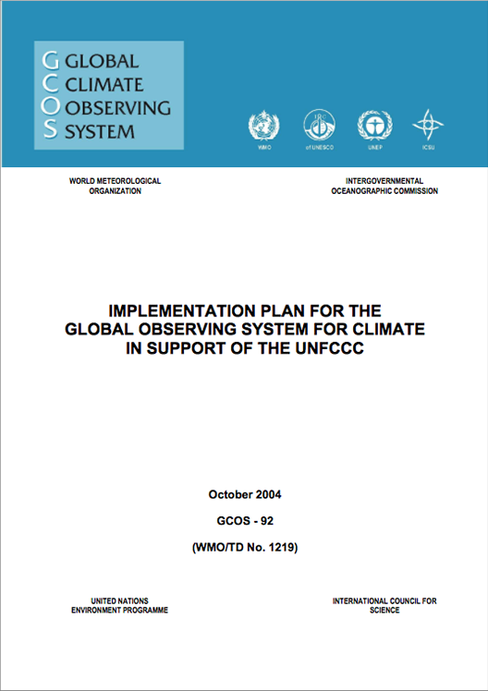
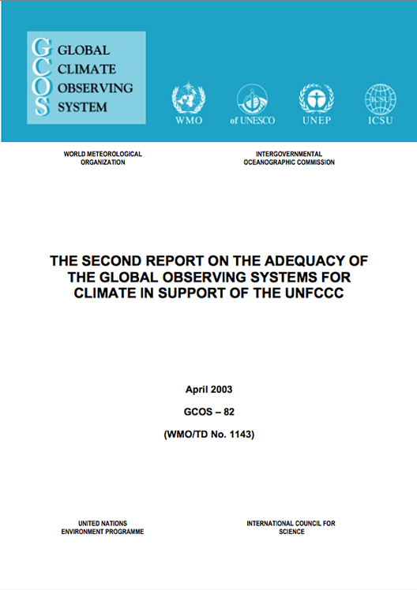
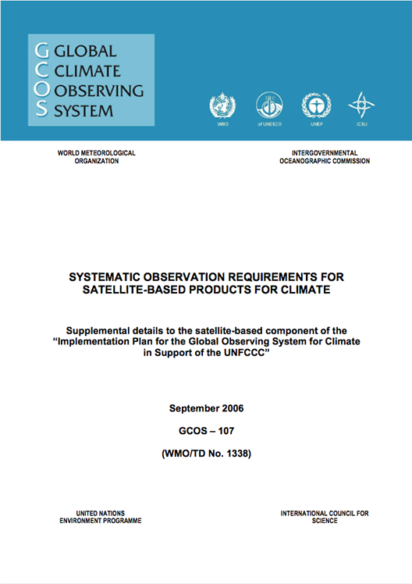
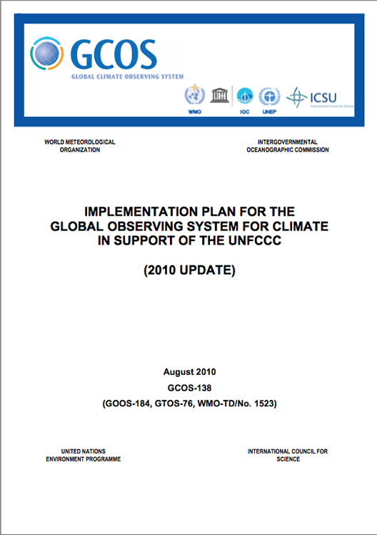
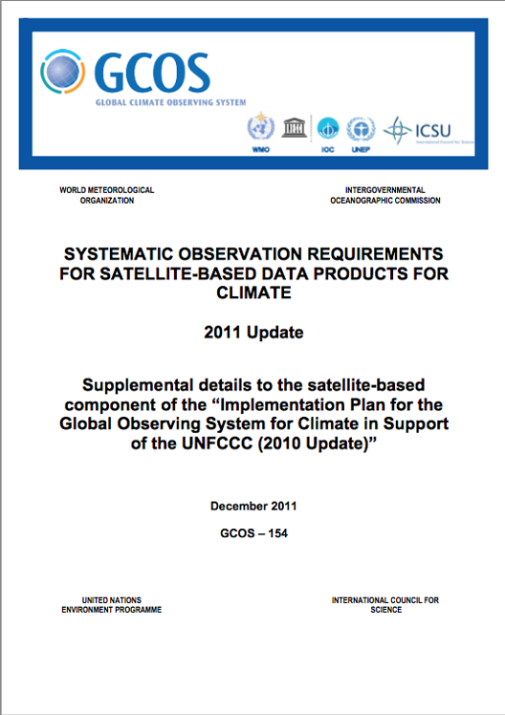
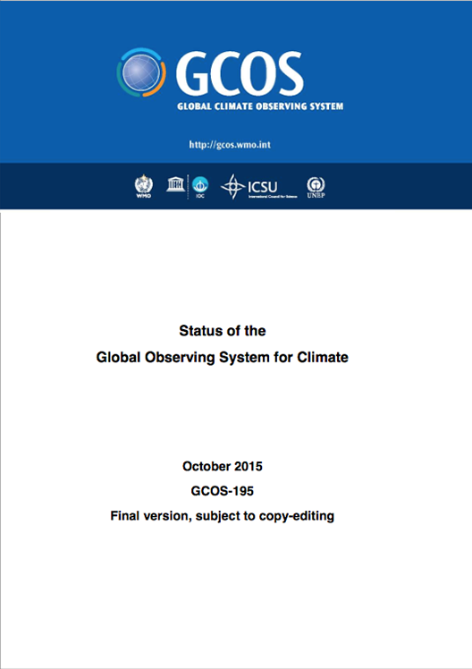
1998
2004
2003
2010
2015
Notes:
request by the UNFCCC COP 3 in 1997 addressed to SBSTA, for a report produced in consultation with the IPCC
Second Adequacy Report in 2003
‒ under the endorsement by SBSTA of its preparation ‒ addressed to the Parties to the UNFCCC ‒ introducing the “Essential Climate Variables” (ECVs)
5/CP5. Invites the secretariat of the Global Climate Observing System to continue to assist and facilitate the establishment of an appropriate intergovernmental process to identify the priorities for action to improve global observing systems for climate and options for their financial support
11/cp9 Essential Climate Variables as concept... Requests the Global Climate Observing System secretariat, under the guidance of the Global Climate Observing System steering committee, taking into account international and intergovernmental mechanisms, to coordinate the development of a phased 5- to 10-year implementation plan also asks for co-ordination with GEO.
5/CP10 Encourages Parties to enhance their work and collaboration on observation of the essential climate variables and on development of climate products to support the needs of the Convention, including through participation in the Global Climate Observing System cooperation mechanism; Invites Parties that support space agencies involved in global observations to request these agencies to provide a coordinated response to the needs expressed in the implementation plan;
SBSTA 25 CP12The SBSTA encouraged Parties to further promote their national activities related to GCOS and the Global Earth Observation System of Systems, and to note the close relationship among those activities
11/CP13 Parties should describe the status of their programmes for contributing observations of the essential climate variables (ECVs)
9/CP15 Invites the Global Climate Observing System secretariat, under the guidance of the Global Climate Observing System Steering Committee, to update, by the thirty-third session of the Subsidiary Body for Scientific and Technological Advice, the Global Climate Observing System implementation plan, taking into account emerging needs in climate observation, in particular those relating to adaptation activities

Slide 3
COP-21: Paris Agreement Article 7 (7c)
Strengthening scientific knowledge on climate, including research, systematic observation of the climate system and early warning systems, in a manner that informs climate services and supports decision- making
Developing the Transparency Framework (the need to promote transparency, accuracy, completeness, consistency, and comparability, and environmental integrity). Preparing for first Global Stock take
SBSTA Conclusions:
Noted with appreciation the [Status] report by GCOS
Encouraged GCOS to consider the outcomes of the twenty-first session of the Conference of the Parties when preparing the GCOS IP 2016
Invited GCOS to collaborate with relevant partners to continue enhancing access to, and understanding and interpretation of, data products and information to support decision-making on adaptation and mitigation at national, regional and global scales
@
Notes:
Paris agreement not prescription on how but provides process
Transparency Framework will substitute MRV

Slide 4
The writing team
Alan Belward
Mark Dowell
Roger Saunders
Han Dolman
Michel Verstraete
Bernadette Sloyan
Toste Tanhua
Konrad Steffen
Shaun Quegan
Pascal Lecomte
Stephen Briggs
Pierluigi Sivestrin
Carolin Richter
Simon Eggleston
Katy Hill
Caterina Tassone
Robert Husband
Detlef Stammer
Adrian Simmons
Mark Bourassa
Kenneth Holmlund
2000+ comments
over two review cycles
+
+

Slide 5
Time-line
Structure and approach outlined by IP lead GCOS Director and GCOS SC Chair (March 2015)
Discussion and input from Science Panels (March / April 2015)
Finalization of draft structure and appointment of writing team (July 2015)
Outline submitted to SBSTA/COP21 (December 2015)
First writing team meeting (February 2016)
Scientific community views at GCOS Science Conference (March 2016)
GCOS Science Panel development, review and input (March – April 2016)
Second writing team meeting (May 2016)
V0.1 submitted for Friendly-Fire review to 10th July 2016
Public review of V0.2 (following ff review) to 5th September 2016
V1.0 prepared in light of comments on V0.2
V1.0 submitted to GCOS SC September 2016
Final version to be submitted to UNFCCC Secretariat (14th October 2016)

Slide 6
IP 2016 Table of Contents THE GLOBAL OBSERVING SYSTEM FOR CLIMATE: IMPLEMENTATION NEEDS
EXECUTIVE SUMMARY
Part 1: MEETING THE NEEDS
INTRODUCTION
IMPLEMENTATION
OBSERVATIONS FOR ADAPTATION, MITIGATION AND CLIMATE INDICATORS
THE BROADER RELEVANCE OF CLIMATE OBSERVATIONS
CONSISTENT OBSERVATIONS ACROSS THE EARTH SYSTEM CYCLES
CAPACITY DEVELOPMENT , REGIONAL AND NATIONAL SUPPORT
Part 2: DETAILED IMPLEMENTATION
INTRODUCTION
OVER-ARCHING & CROSS-CUTTING ACTIONS
ATMOSPHERIC CLIMATE OBSERVING SYSTEM
OCEANIC CLIMATE OBSERVING SYSTEM
TERRESTRIAL CLIMATE OBSERVING SYSTEM
LIST OF ACTIONS
APPENDICES
APPENDIX 1: CONTRIBUTORS
APPENDIX 3: GLOSSARY OF ACRONYMNS
Annexes:
ECV PRODUCT REQUIREMENTS
Basic Terminology for Data Records Related to Climate
Notes:
13 page exec summary
38 page pt 1
183 page pt 2
330 page in total.

Slide 7
2. Implementation will
Ensure that the climate system continues to be monitored
Improve global, regional and local long-term climate forecasts by; Filling gaps in network coverage; Refining ECV Requirements; Improving techniques; Addressing Global Cycles
Support adaptation
Improve the provision of useful information to users
Observe additional parameters
Improve the communication of the state of the climate
Improve collaboration

Slide 8
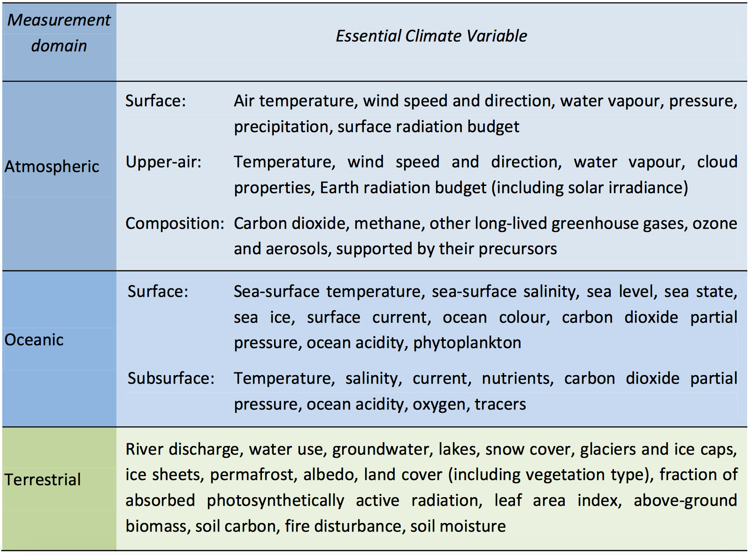
Status report version
2. Implementation provides continuity

Slide 9
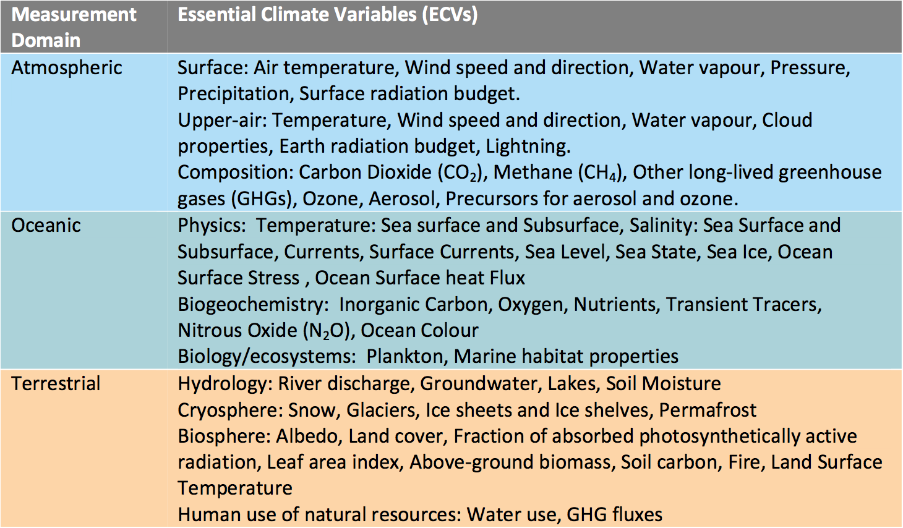
NIP version
2. Implementation drives progress
Section 3.2.1
Table 12
Table 14
+Lightning, Ocean surface stress, Ocean surface heat flux, Marine habitat properties, Land surface temperature, GHG Fluxes

Slide 10
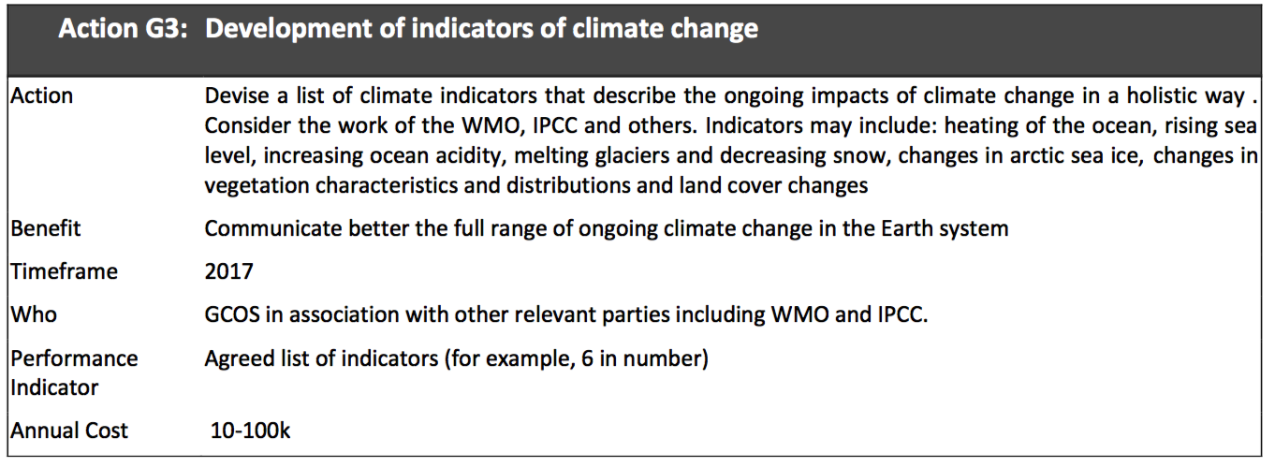
3. Observations for adaptation, mitigation and climate indicators
Indicators

Slide 11
4. The broader relevance of climate observations
UNFCCC
CBD
UNCCD
Sendai
Ramsar Convention: framework for national action and international cooperation for the conservation and wise use of wetlands and their resources
Notes:
2012 CBD COP11/3: Ad Hoc Technical Expert Group on Indicators for the Strategic Plan for Biodiversity 2011–2020, and GEOBON are establishing the Essential Biodiversity Variables
2013 UNCCD COP 11/22: Ad-hoc Advisory Group of Technical Experts (AGTE) are developing a Progress Indicator framework

Slide 12
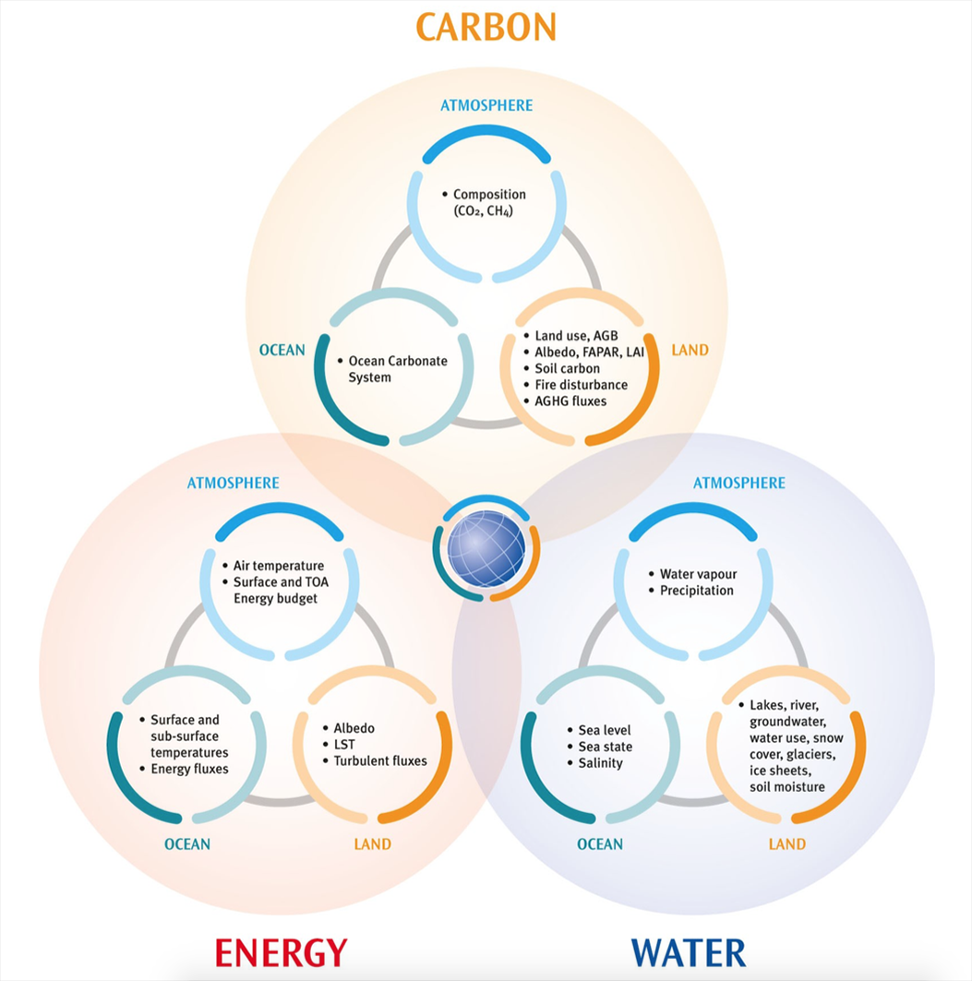
5. Consistent observations across the Earth System Cycles
Notes:
Earth System Cycles the Glue for cross convention ECV

Slide 13
PART II: Detailed Implementation
Introduction
Overarching and cross-cutting actions
Requirements for Climate Observations
Planning, Review and Oversight
Data management, stewardship and access
Production of Integrated ECV Products
Ancillary and additional observations
183 pages

Slide 14
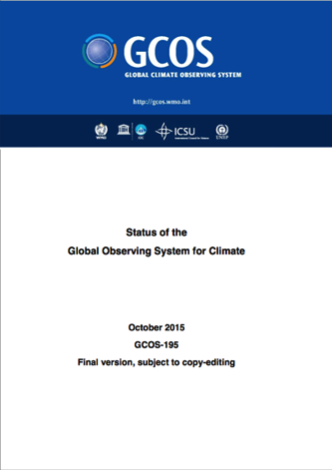
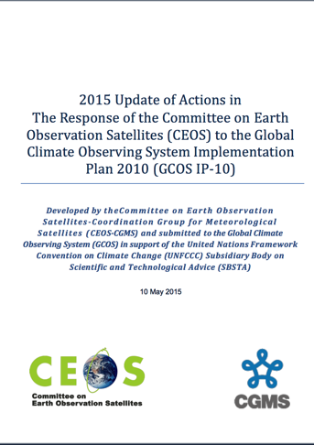
ECV Product Requirements and the Satellite Supplement
Maximise GCOS - CEOS / CGMS synergy
Reduce time-lag between IP and Satellite Supplement release
Align requested reporting of both GCOS and the Space Agencies to SBSTA
Provide Satellite Supplement as an Appendix to this Implementation Plan
Extend ECV product requirements provided in satellite supplement to all observations (incl. those based primarily on in-situ observations)
Action to define review process in 2017 and provide periodic updates
Notes:
space agency response by November 2017

