Slide 1

Carbon Strategy Implementation
Committee on Earth Observation Satellites
Mark Dowell
European Commission – JRC
CEOS Plenary 2016
Agenda Item # 4.2
Brisbane, Australia
1st – 2nd November 2016

Slide 2

CEOS Carbon activity - history and Background
GEO Carbon Report developed in June 2010 by team led by Ciais et al. (GCP).
CEOS Strategy for Carbon Observations from Space – written in response to above, completed in March 2014 – Wickland et al.
42 Actions identified in the report for specific response– first discussed at SIT Technical Workshop in September 2013
April 2014:Proposed establishment of a study team to take forward the Actions and also identify formal CEOS mechanism to manage Actions.

Slide 3


COP-21: Paris Agreement Article 7 (7c)
Strengthening scientific knowledge on climate, including research, systematic observation of the climate system and early warning systems, in a manner that informs climate services and supports decision- making
Developing the Transparency Framework (the need to promote transparency, accuracy, completeness, consistency, and comparability, and environmental integrity) & Global Stock-take
SBSTA Conclusions:
Noted with appreciation the [Status] report by GCOS
Encouraged GCOS to consider the outcomes of the twenty-first session of the Conference of the Parties when preparing the GCOS IP 2016
Invited GCOS to collaborate with relevant partners to continue enhancing access to, and understanding and interpretation of, data products and information to support decision-making on adaptation and mitigation at national, regional and global scales
@
Notes:
These requirement on Carbon are not going away – if anything they will become greater
Paris agreement not prescription on how but provides process
Transparency Framework will substitute MRV

Slide 4
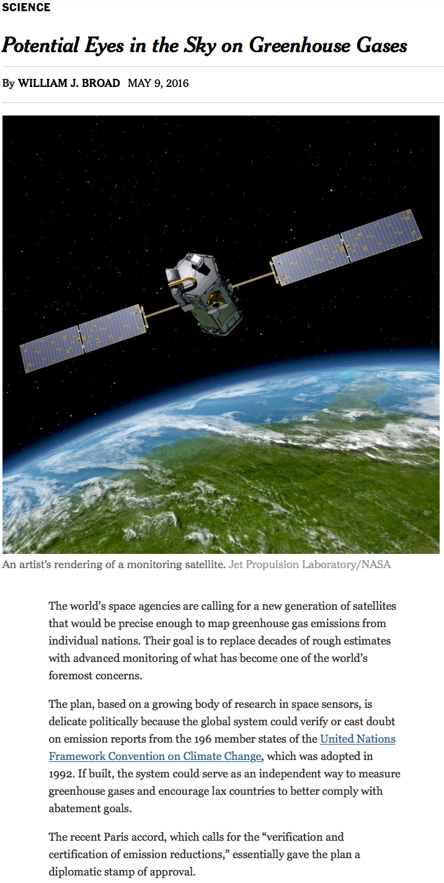
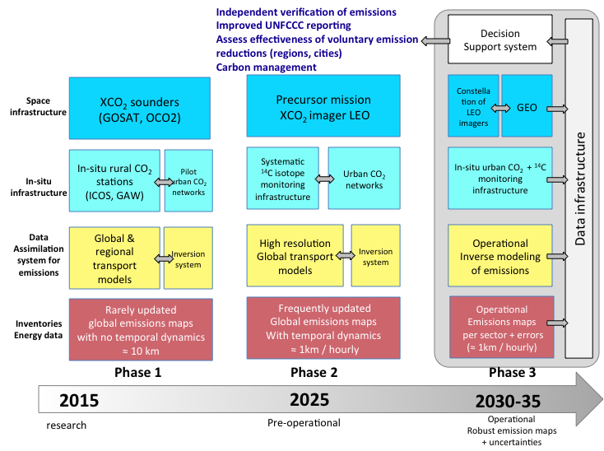
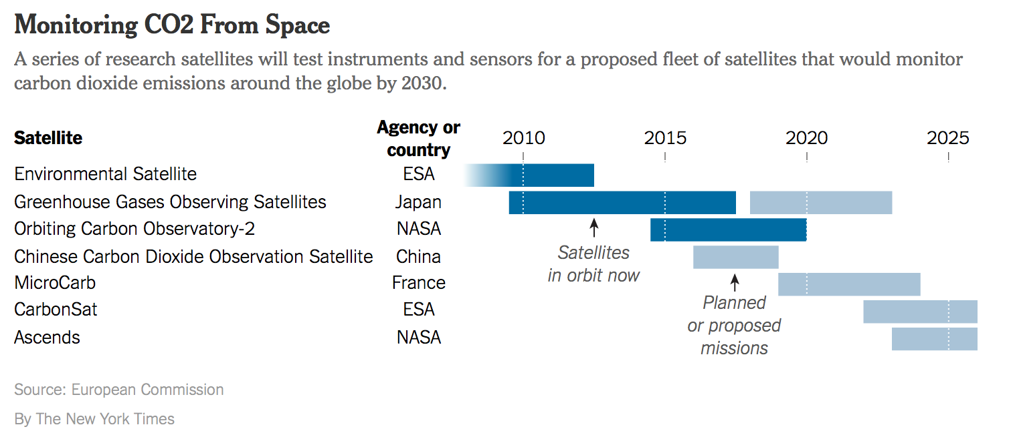
Systems Approach
International effort and coordination

Slide 5
Truly cross-cutting within CEOS
Spreadsheet identified lead CEOS “Entity” as:
    Atmospheric Chemistry-VC: 6 Actions
    Land Surface Imaging-VC: 4 Actions
    Working Group Climate: 7 Actions
    Working Group Calibration/Validation: 11 Actions
    Strategic Implementation Team: 7 Actions
    N/A: 2 Actions
    Other WGs and VCs named as contributing

Slide 6
Plenary 2015
Way Forward
VCs and WGs were reassured that Principals understand that ‘finishing’ many of the actions is a long-term effort and that an ‘agile’ approach is appropriate.
Noting the need to build momentum the SIT Vice Chair suggested that:
VCs and WGs focus specific near-term (1 year) steps that are achievable and will show progress.
Principals be engaged to determine their support for these proposed ‘next steps’; with this helping give VCs and WGs confidence in their direction.

Slide 7
CEOS WP 2016-2018
Birth of the Carbon Strategy meta-Action
CARB-8: Implementation of agreed actions in response to CEOS Strategy for Carbon Observations from Space
And dedicated Action on support to GEO Carbon Flagship
CARB-12: Support for definition of a potential GEO Carbon Flagship

Slide 8
Some Actions have been undertaken…(from LSI-VC)
CARB-08-03: CEOS Agencies with historical moderate-resolution (~250 m - 1 km) satellite data records will strive to ensure these data are publicly available …
CARB-08-04: CEOS Agencies with historical medium-resolution (~30 m -100 m) satellite data records will strive to ensure these data are publicly available …

Slide 9
3rd Carbon from Space Workshop
3rd Carbon from Space Workshop (26-28th January 2016, Exeter)
>80 experts, to review and discuss the existing scientific knowledge gaps and research priorities areas for the carbon cycle. Objectives:
  Implementation of recommendations of the CEOS Strategy for Carbon Observations from Space.
  The development of the GEO Flagship on Carbon and Greenhouse Gas and the other coordination projects related to carbon cycle (e.g., IG3IS, the North American Carbon Programme).
  The review and refocusing of the Global Carbon Project on its move from ESSP and IGBP to Future Earth.
CEOS member agencies to identify with the carbon cycle community the priorities in terms of measurements in the context of time (2015-2020-2025) and space (increasing resolution of needs) (e.g. Carbon from Space meeting) …

Slide 10
Proposed Process
Forego the “traffic light” approach to monitoring and review Carbon Action for some time [Although we will internally keep an overview of overall progress]
Identify a number (~ 5) of WG and VC proposed initiatives
These will also act as “prototypes” for number of crosscutting aspects related to the Carbon Action implementation i.e.:
  Initiatives addressing multiple Actions
  Initiatives across multiple CEOS entities VCs & WGs
  Initiatives addressing multiple thematic examples from the same Carbon Action
  Initiatives which “CEOSize” efforts previously undertaken within a specific CEOS Agency or through bilateral efforts
In parallel we would continue several shorter–term and supporting activities: GEO Carbon & GHG Inititaive engagement, mapping Agency level projects onto Carbon Actions, 2 yr CEOS Carbon Workshop

Slide 11
Shorter term outputs: WGCV
By end March 2017: Carbon Action #8 - related to LPV subgroup - identifying priorities of land data products to validate
LPV document its current list of validated land data products and candidate land data products to be validated. The list of land products will be compared to the Carbon Task Force report to identify possible gaps and resources that would be needed to assess those gaps.
Also by end of March 2017, document a set of best practice validation protocols with documented methods and an online platform for intercomparison of terrestrial carbon products. This is part of closing out Carbon Action #8 as well as making significant progress on Carbon Action #34 when coupled with identifying the best mechanism for making WGCV intercomparisons of carbon products available.

Slide 12
Initial Proposed Initiatives
ACC: aiming for a white paper on a Carbon constellation;
LSI-VC: adopt GEOGLAM gap analysis
WGClimate: focusing their gap analysis work on carbon-specific ECVs;
WGISS: on a carbon data portal to facilitate the discoverability and accessibility of ECV products and space-borne CDRs relevant for the carbon actions.;
NASA-ESA: on cal/val and production of biomass products from CEOS missions – based on previous bi-lateral NASA/ESA initiative
WGCV [Shorter term activities described before] + process for mapping across WGCV subgroups
JAXA: on the opportunity to engage with IPCC Inventories and promote satellite EO
These address a good cross-section of Actions across the Carbon Strategy

Slide 13
ACC Initiatives
  Deliveries:
  Merged CARB AI 16+18: ACC to support the organisation of yearly IWGGMS (International Workshop on Greenhouse Gas Measurements from Space): next planned at FMI (Helsinki, Finland) on 6-8 June 2017
  Merged CARB AI 17+19+23: ACC will prepare a white paper within 2 years (?)
  CARB AI 20: ACC will write a Technical Note within 2 years
  People involved:
  ACC GHG activities lead: D. Crisp (NASA)
  M. Nakajima, K. Shiomi (JAXA) – GOSAT, GOSAT2; D. Crisp (NASA) – OCO2, OCO3;
  Y. Liu (CAS) – TanSat; C. Zehner, Y. Meijer (ESA) – S5P, S5, future GHG Sentinel; A. Friker (DLR) – MERLIN - tbc; C. Deniel (CNES) - MERLIN, MicroCarb, R. Munro (EUMETSAT) – IASI, IRS; D. Edwards (NCAR) – GEO CH4; A. Butz - (DLR) GEO CO2; B. Pinty (EC) - tbc; – expecting updates follwing recent ACC-12 meeting, Seoul, 13-14 Oct 2016

Slide 14
LSI-VC Initiative
Perform an assessment of Terrestrial Carbon Strategy variables using GEOGLAM requirements ”matrix” process as a framework
Propose first review of approach by SIT-32 – full version of analysis by SIT Technical Workshop - September 2017

Slide 15
WGClimate Initiative
For consistent ECV Carbon products take advantage of Inventory output to produce subset of ECV Products contributing to Carbon Strategy
Space Based GCOS ECVs in Inventory
      Products requested in Carbon Strategy

Slide 16
Actions assigned to WGClimate
Encourage the production and availability of high-quality, consistent long time series data products based on multiple sensors and missions for carbon and climate science and for model-data and data-data intercomparison exercises. | WGCV AC-VC LSI-VC OCR-VC
Make publicly available all information necessary to document the accuracy, clarity, and traceability of the satellite data and data products they produce. | WGCV VCs
Coordinate efforts to develop compatible (e.g., temporal and spatial resolution, grids, data formats, common auxiliary data, units) carbon data products from multiple missions | OCR-VC AC-VC LSI-VC WGCV
Ensure the long-term accessibility of satellite data and data products for carbon cycle science and policy. This must include arrangement for secure archives, documentation, and metadata as well as for provisions for easy discovery and access | WGISS
Serve as a point-of-contact for appropriate satellite products for major model-data intercomparison exercises related to the carbon cycle. | WGClimate chair membership on WDAC
Notes:
Activation highlighted in red consistent with WGClimate Inventory-Gap Analysis process

Slide 17
ECVs/CDRs Discovery and Access through WGISS Systems
Objective: facilitate discoverability and accessibility of ECV Products and space-born CDRs relevant for the CEOS Carbon Action via WGISS Interoperability Systems & Standards (FedEO/CWIC/IDN, OpenSearch).
Approach: start from results of WGClimate Questionnaire for ECV Inventory population; tailoring for Carbon Action and gaps identification wrt data records already discoverable/accessible through WGISS systems (Q1/Q2 2017); feasibility analysis, priorities setting and liaising with relevant organizations (Q2/Q3 2017); start technical activities (Q3/Q4 2017).
Additional Resources: support from WGClimate and experts for priorities setting; activities at data providers’ side to be carried out by relevant entities.
Notes:
Carbon Portal prototype

Slide 18
WGISS Carbon Portal
Objective: development as WGISS project of a CEOS WGISS Carbon Portal prototype similar to the Water portal (http://waterportal.ceos.org/) to allow displaying Carbon datasets and providing assistance to scientists and general users in the development of related services & tools.
Approach: collection of needs from Carbon (or WGClimate) experts on what needs to be in the portal (Q1/Q2 2017); Carbon Portal requirements definition and system design (Q2/Q3 2017); start development (Q3/Q4 2017).
Additional Resources: requirements definition and development resources provided by NOAA; support from WGClimate and experts for requirements definition.
Notes:
Carbon Portal prototype

Slide 19
NASA-ESA Initiative
Follow-up to NASA-ESA initiative on Biomass
Recommended Actions
  Need to identify people who have the mandate to coordinate across missions;
  Develop network-level agreements for data sharing rather than each mission making agreements with each individual project
  Meetings to check the status of cal/val as the missions progress
  Coordinated supersite selection and data collection using all remote sensing techniques
  Develop a common data portal or network of data portals to archive and distribute biomass data
Near-Term Deliverables
  Report on the synergy of cal/val objectives across satellite missions
  Report on the detailed suggested approach for selecting key locations globally and what is needed at those locations

Slide 20
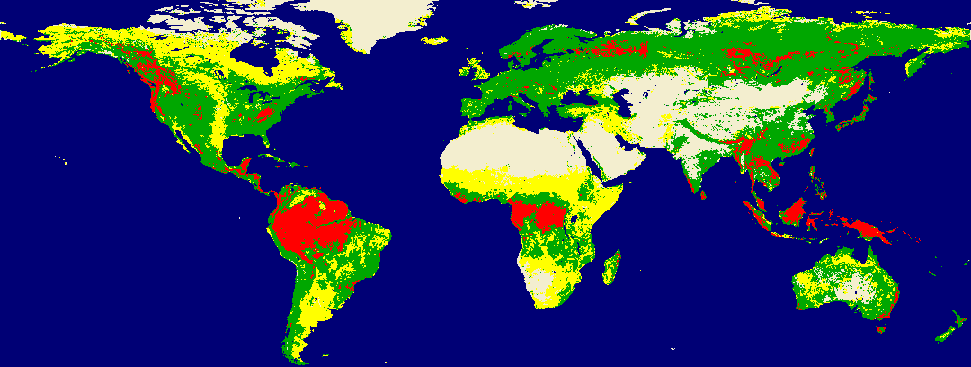
NASA-ESA Initiative
Need to develop a coordinated plan to establish cal/val sites that can be used by all biomass missions
GEDI Coverage
> 100 Mg/ha
< 100 Mg/ha
< 20 Mg/ha
BIOMASS Coverage
No Woody Biomass

Slide 21
GEO Carbon and GHG Initiative
Accepted as a GEO Initiative at 3rd GEO Programme Board 2016
The GEO C and GHG initiative provides cross integration and coordination of the interfaces (between: atmosphere, ocean and terrestrial domains; space-based, air-borne and in-situ monitoring systems;). It builds on existing strategies, initiatives, networks and infrastructures, and integrates them with the missing pieces to obtain a comprehensive globally coordinated GHG observation and analysis system.
Key Elements
  Task 1: User needs and policy interface (policy and science requirements)
  Task 2: Data access and availability (CEOS esp WGISS)
  Task 3: Optimization of observational networks (CEOS)
  Task 4: Budget calculation consistency (Global, Regional, sub-Regional, National, Local) (CEOS Carbon Strategy)
CEOS POC: Stephen Plummer, ESA – member of Executive Committee

Slide 22
Summary
Plenary to agree on overall approach i.e. a smaller number of dedicated activity addressing multiple Actions
  Update would be provided at Plenary added at Plenary 2017, process to be reviewed at Plenary 2018
  Additional initiatives could be added if critical mass and resources available
Plenary to comment on initial Initiatives proposed
  Identify major omissions we should follow-up on
  “Generous” offers of dedicated resources welcome
Additional comments welcome on:
  Organisation of dedicated CEOS Carbon Workshop (across WGs and VCs) first one Q2-Q3 2017 – then every 2 yrs
  GEO Carbon and GHG Initiative engagement and involvement with other external stakeholders (e.g. IG3IS)

Slide 23
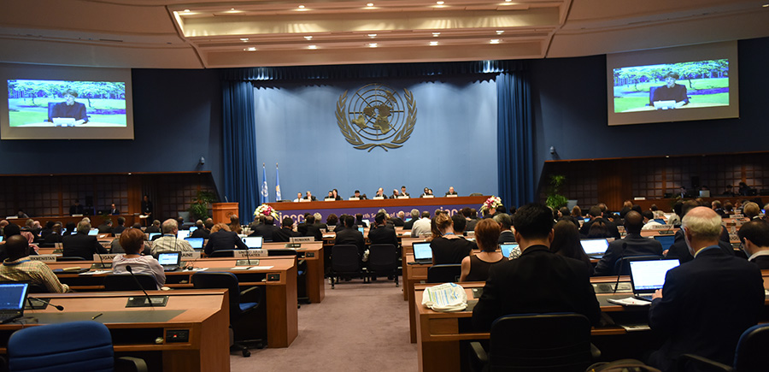
Engagement with UNFCCC and IPCC
IPCC Task Force on National Greenhouse Gas Inventories (TFI) developed “2006 IPCC Guidelines for National Greenhouse Gas Inventories” which will be updated and released in 2019.
  The current guidelines 2006 indicates that each country preferably use independent data to verify GHG inventories, and also indicates that satellite data has limitations in spatial, vertical and temporal resolution.
  Discussion for updating the guidelines is underway and its outline was defined at the IPCC plenary in October. Update of verification guidance is expected, expecially the guidance with atmospheric measurement and new datasets.
  Republic of Korea, supported by Belgium and Japan, proposed to include direct measurement of GHG emissions from sources, noting that they help to improve accuracy of estimates.

Slide 24
Engagement with UNFCCC and IPCC
CEOS has accumulated GHG scientific data by satellites such as GOSAT and OCO-2 for this decade and more satellites will follow.
  There are opportunities to collaborate with frameworks and activities outside CEOS such as GCOS IP 2016, CGMS, GEO GHG initiative plan and WMO IG3IS.
Therefore, CEOS engagement with IPCC by taking account of the various opportunities and efforts to resolve the limitations of satellite data are important. The guidelines to be complete in 2019 will be one of the targets.

Slide 25
Draft Mandate for Satellite Carbon report content, undertaken by ACC-VC (i)
Based on existing requirements. define the key characteristics of a global architecture for carbon (CO₂, CH₃) measurements from space.
Consider observational needs for both composition and fluxes, natural and anthropogenic
Include known plans and considerations from space agencies worldwide in overall system architecture to ensure global consistency of design
Incorporate potential observations from both GEO and LEO potential missions in an optimal system, and consider optimal acquisition strategies across the system including orbits, equator crossing times, sensor characteristics etc.
Include instrument on-orbit calibration and geophysical validation aspects
Build on work already undertaken by ACC-VC in response to the CEOS Carbon Strategy
Provide a reference architecture against which individual agencies can develop their plans to optimise joint implementation.
Report at Plenary 2017, with interim report SIT (April 2017)

