Slide 1
Progress on Building GEOSS 30th CEOS Plenary Barbara Ryan Director, GEO Secretariat 01 November 2016 Brisbane, Australia

Slide 2
2016 Progress
Reinforcing GEO’s ‘convening power’ – Members, POs, Development Banks, Foundations, emerging Commercial Sector;
Continued evolution & recognition of Policy Mandates;
Transition year for GEO’s Programme;
Implementation of new programmatic mechanisms – Community Activities, Initiatives and Foundational Tasks.

Slide 3
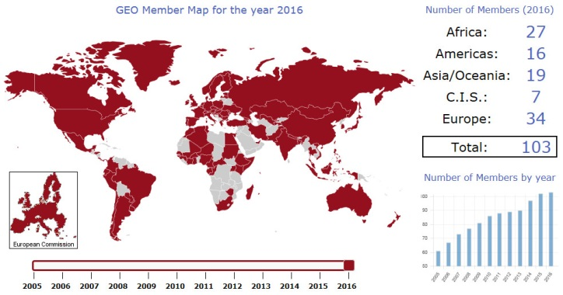
103 GEO Members

Slide 4
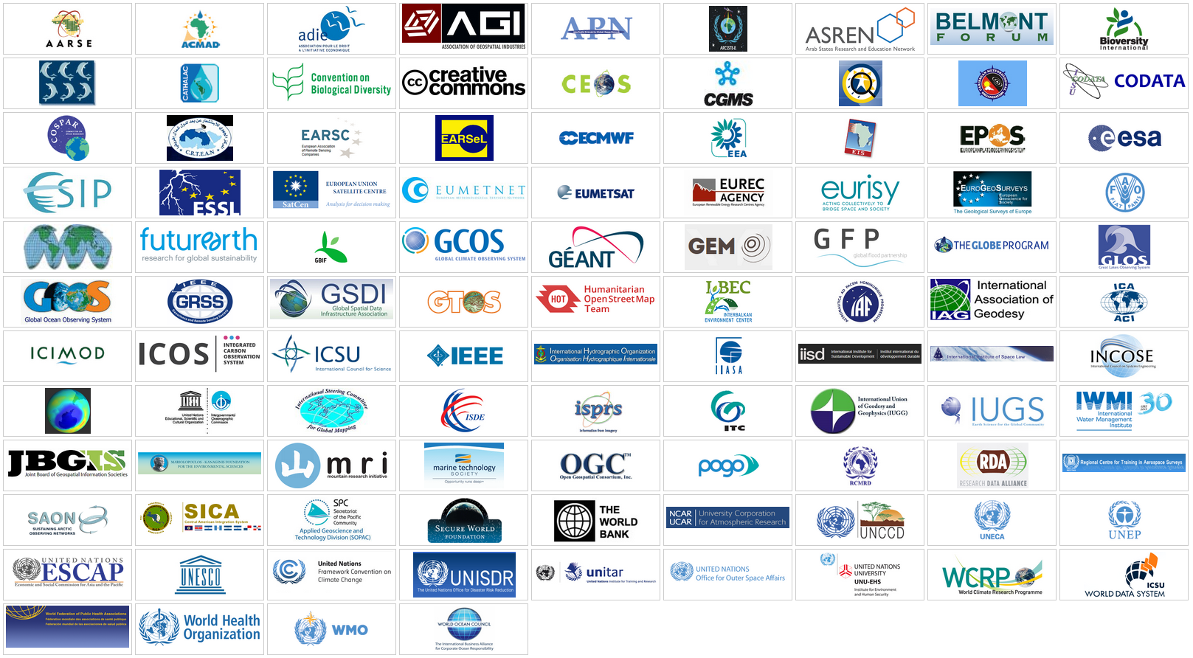
103 Participating Organizations

Slide 5
Governance Structure
GEO Plenary
103 Member Governments, 103 Participating Organizations, 12 Observers
GEO Executive Committee
Africa: Egypt, Senegal, South Africa
Americas: Colombia, Mexico, United States
CIS: Armenia, Russian Federation
Asia/Oceania: Australia, China, Japan, Korea
Europe: EC, Finland, France, Germany
Observers from Programme Board: CEOS, GOOS, WMO
GEO Programme Board
42 members from GEO Members and Participating Organizations

Slide 6
A Global Earth Observation System of Systems
Integrating Earth Observations Across Many Platforms and Disciplines to Benefit Society

Slide 7
8 Societal Benefit Areas

Slide 8
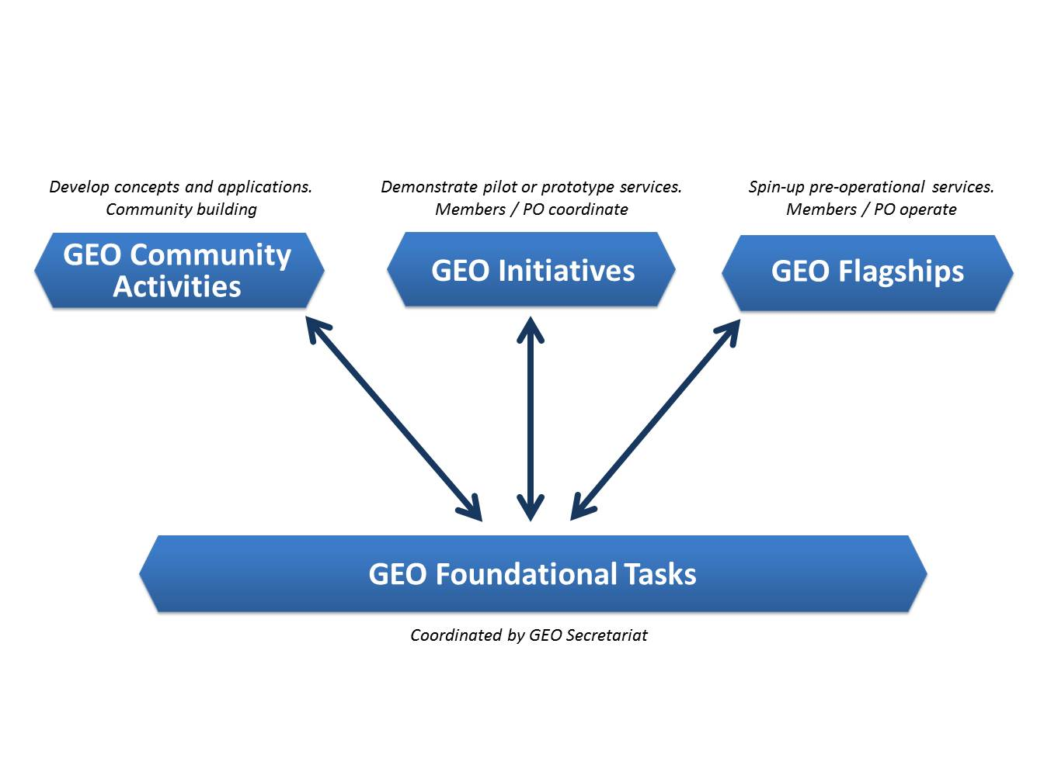
Implementation Mechanisms

Slide 9
2017-2019 Work Programme
SBA | GEO Flagships and Initiatives | Community Activities
 | GEO Biodiversity Observation Network (GEO BON) | Harmful Algal Bloom (HAB) Early Warning System
 | Global Forest Observation Initiative (GFOI)
 | GEO Global Ecosystem Initiative (GEO ECO)
 | GEO Global Network for Observation and Information in Mountain Environments (GEO-GNOME) | Global Mangrove Monitoring
 | Earth Observations for Ecosystem Accounting (EO4EA)
 | GEO Wetlands Initiative
 | Geohazard Supersites and Natural Laboratories (GSNL) | Space and Security
 |  | Chinese Tsunami Mitigation System
 | Global Wildfire Information System (GWIS) | Earth Observations for Disaster Risk Management
 |  | Global Flood Risk Monitoring
 |  | Earth Observations for Geohazards, Land Degradation and Environmental Monitoring
 | Data Access for Risk Management (GEO-DARMA)
 |  | Global Flood Awareness System (GloFAS)
 | GEO Vision for Energy (GEO VENER) | Earth Observations for Managing Mineral Resources

Slide 10
2017-2019 Work Programme
SBA | GEO Flagships and Initiatives | Community Activities
 | GEO Global Agricultural Monitoring (GEO-GLAM) | Global Agricultural Drought Monitoring
 | Global Observation System for Mercury (GOS4M) | AIRNOW International: Expanding Networks and Integrating Methods for Air Quality and Health Data
 | Global Observation System for Persistent Organic Pollutants (GOS4POPS)
 | Global Urban Observation and Information
 | GEO Human Planet Initiative: Spatial Modeling of Impact, Exposure And Access to Resources
 | GDIS (Global Drought Information System) | In Situ Observations For Water Cycle
 |  | Aquawatch
 | GEOCRI (Information Systems for Cold Regions) | DIAS
 |  | EARTH2OBSERVE
 | GEOGLOWS (GEO Global Water Sustainability)
 |  | Water-Energy-Food Nexus

Slide 11
GEO Initiatives not Easily Associated with One SBA
GEO Carbon and Greenhouse Gas Initiative | Climate
Climate Change Impact Observation On Africa's Coastal Zones (GEO-CCIOACZ)
AfriGEOSS: Reinforcing Regional African Engagement | Regional Coordination
AmeriGEOSS
Asia-Oceania GEOSS (AOGEOSS)
Oceans and Society: BLUE PLANET | Ocean
Earth Observations in Service of the 2030 Agenda For Sustainable Development | SDGs
GEOSS-EVOLVE | Support GEOSS

Slide 12
Community Activities not Associated with ne SBA
GFCS - GEO Collaboration | Climate
TIGGE (THORPEX Interactive Grand Global Ensemble) Evolution into a Global Interactive Forecast System (GIFS)
Research Data Science Summer Schools | Capacity Building
Forest Biodiversity in Asia and the Pacific Region: Capacity Building Phase
Advancing Communications Network | Support to GEOSS
Land Cover and Land Cover Change
Land Cover for Africa
Copernicus Atmospheric Monitoring Service (CAMS)
Copernicus Climate Change Service (C3S)
Digital GEOMEUSIUM
Earth Observations for Cultural Heritage Documentation
African Geochemical Baselines
Himalayan GEOSS
Socio-Economic Benefits from Earth Observations

Slide 13
Foundational Tasks
GEOSS Development and GCI Operations
Advancing GEOSS Data Sharing Principles
GEOSS Common Infrastructure (GCI) Operations
GEOSS In Situ Earth Observation Resources
GEOSS Satellite Earth Observation Resources
GEONETCast Development and Operations
User Needs and Gaps Analysis
Community Development
Capacity Building coordination
Secretariat Operations
Management and Support
Communication and Engagement
Monitoring and Evaluation

Slide 14
GEOSS Implementation Requires: Data Sharing Principles
Full and Open Exchange of Data
Data and Products at Minimum Time delay and Minimum Cost
Free of Charge or Cost of Reproduction
Notes:
See slide text

Slide 15
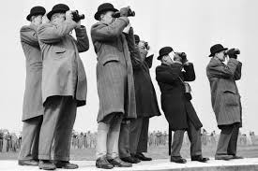
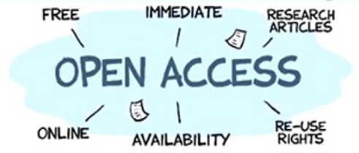
Data Management Principles
DISCOVERABILITY
DMP-1: Data and metadata will be discoverable
ACCESSIBILITY
DMP-2: Data will be accessible via online services
USABILITY
DMP-3: Encoding DMP-4: Documentation
DMP-5: Traceability DMP-6: Quality
PRESERVATION
DMP-7: Preservation DMP-8: Verification
CURATION
DMP 9: Review and reprocessing
DMP 10: Persistent and resolvable identifiers

Slide 16
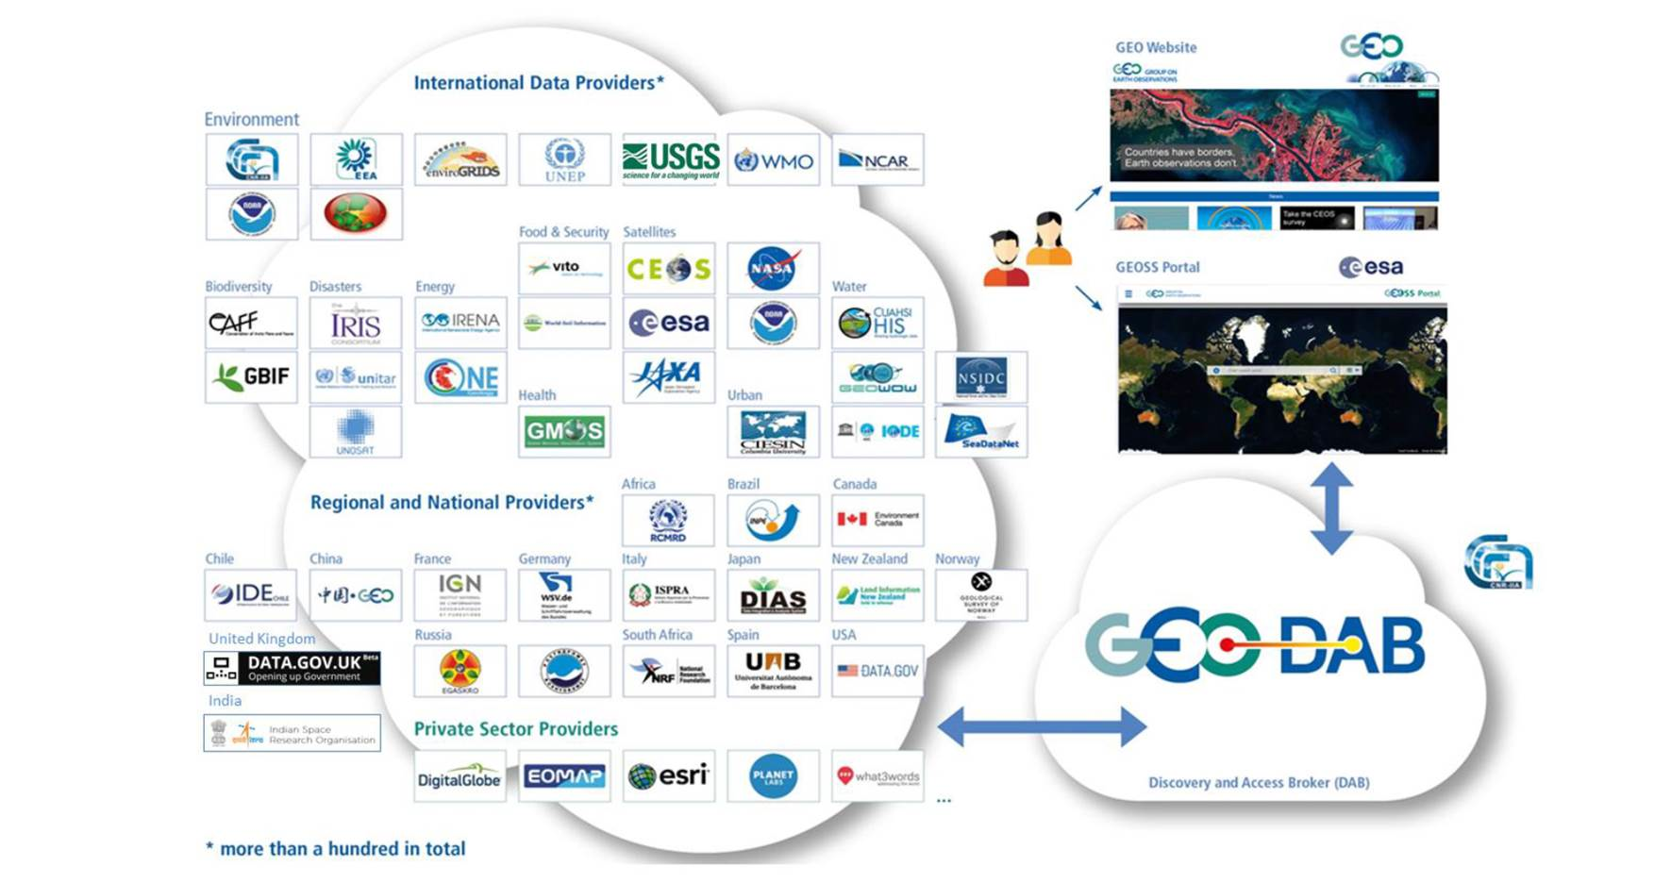
Enabling the ‘System of Systems’

Slide 17
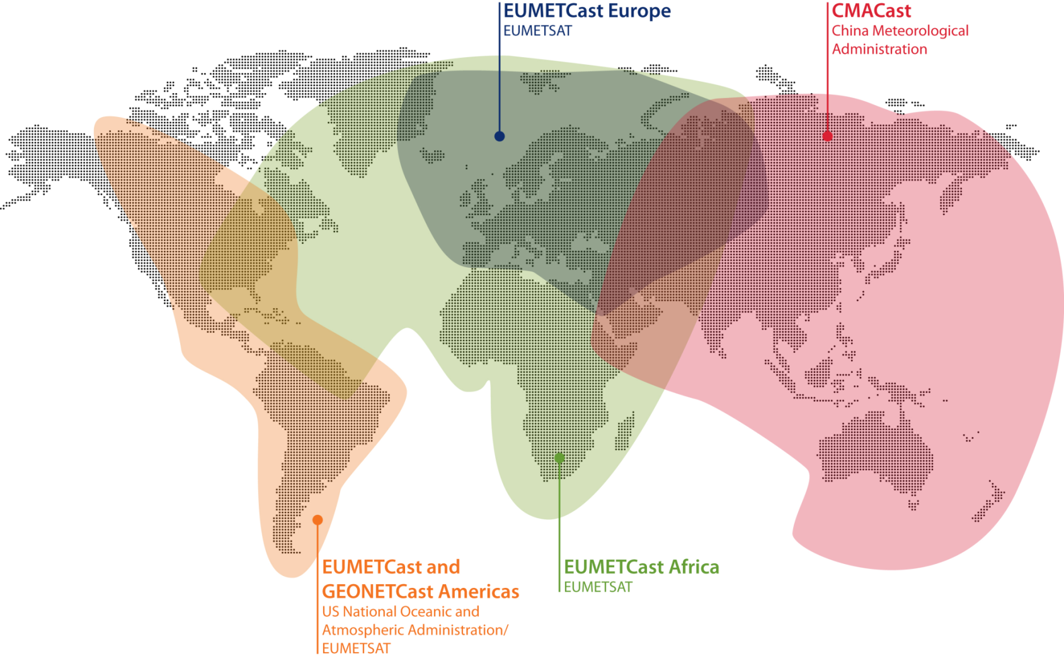
3054 users
2713 users
301 users
150 users
New stations deployed throughout the system (20 per month);
EUMETCast & CMACast shared management for users of exchanged data; and
Bandwidth increased in Europe (DVB-S2 service) to accommodate new products
Notes:
Added a bullet on NOAA/INPE agreement

Slide 18
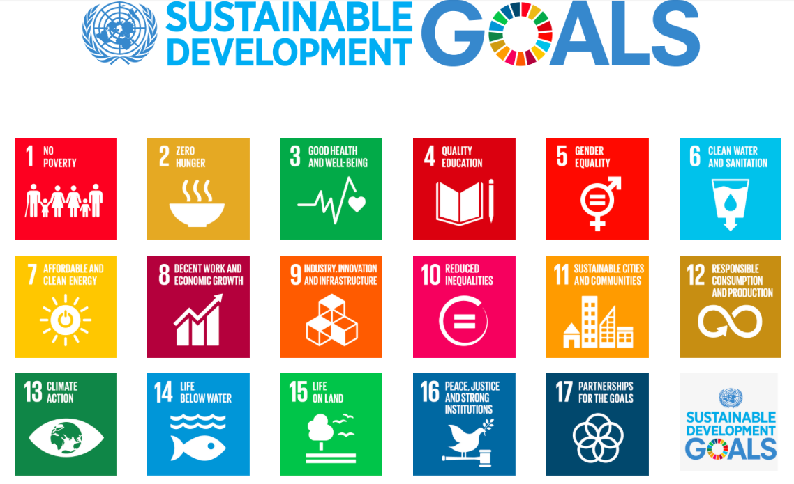
Transforming Our World: The 2030 Plan for Global Action - Article 76: “We will promote transparent and accountable scaling-up of appropriate public-private cooperation to exploit the contribution to be made by a wide range of data, including Earth observation and geo-spatial information, while ensuring national ownership in supporting and tracking progress.”

Slide 19
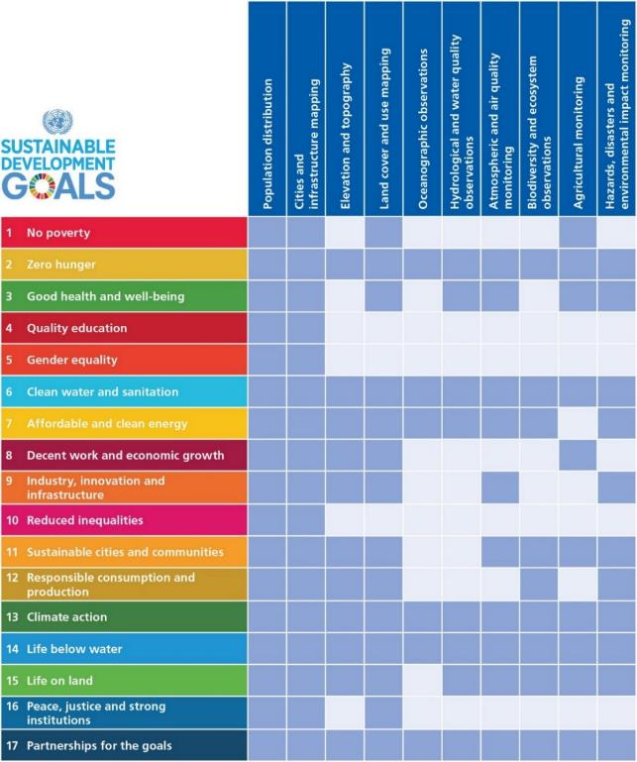
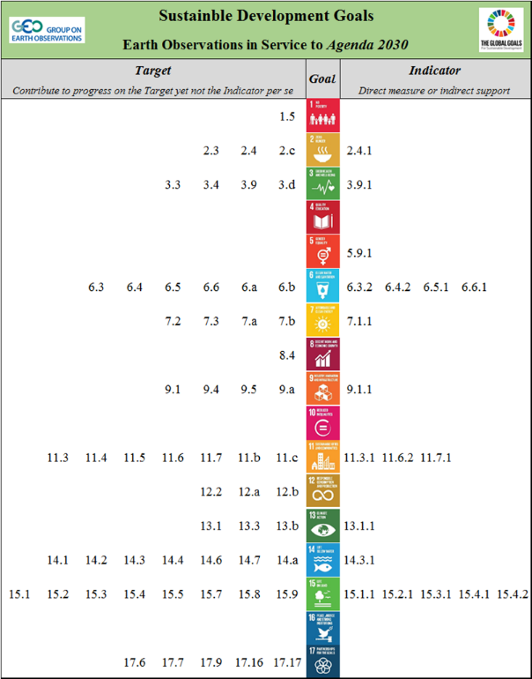
Earth Observations for SDGs
Notes:
This can be included in the Extra Slides (or at the end of this session)

Slide 20
Next Steps
Work with statistical agencies to ensure the methods are sound for use with Indicators and Targets;
Ensure the methods and solutions are available for all to use; and
Support countries and stakeholders to use the methods and build capacity.
others . . .
Notes:
Global Partnership for Sustainable Development Data
strengthen the inclusivity, trust, and innovation in the way that data is used to address the world’s sustainable development efforts.
Sustainable Development Solutions Network (SDSN)
Develops research themes around various “solutions” topics globally.
Reports on the SDG framework as well as the associated monitoring indicators, and it seeks to play a significant role in their implementation and in the associated processes.
International Institute for Sustainable Development (IISD)
Provides practical solutions to the challenge of integrating environmental and social priorities with economic development.

Slide 21
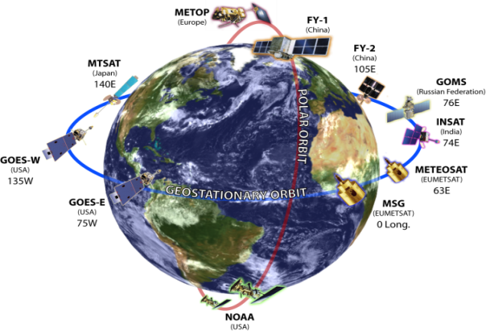
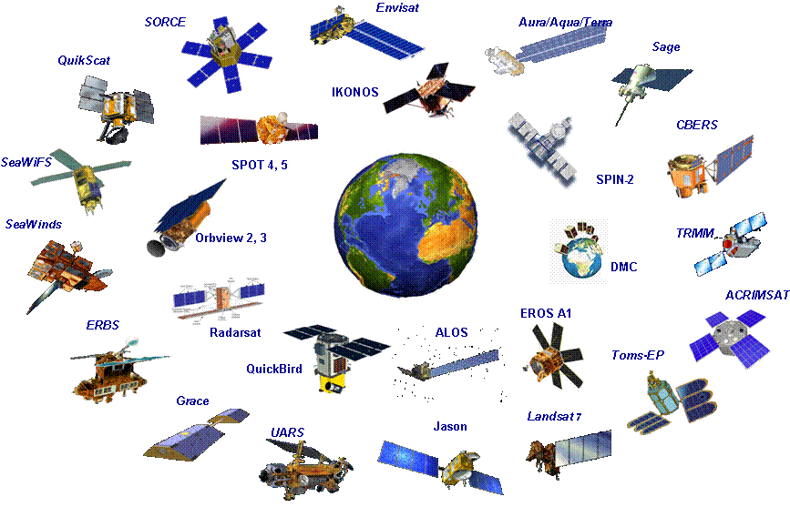
Strengtheninig Space-based Coordination
Climate Change

Slide 22
Countries have borders;
Earth observations don’t.
Barbara J. Ryan
Director, GEO Secretariat
Adapted from NY Times
September 2015

Slide 23
GEO-XIII Plenary
St. Petersburg, Russia
9-10 November 2016
Osamu Ochiai: oochiai@geosec.org
http://www.earthobservations.org
Twitter: @geosec2025 @barbararyangeo
Facebook: Group on Earth Observations

