Slide 1
CEOS Response to the Sendai Framework
Committee on Earth Observation Satellites
Stéphane Chalifoux, CSA, Chair of the WG on Disasters
Ivan Petiteville, ESA, GEO-DARMA Leader
CEOS Plenary 2016
Agenda Item # 2.6
Brisbane, Australia
1st – 2nd November 2016

Slide 2
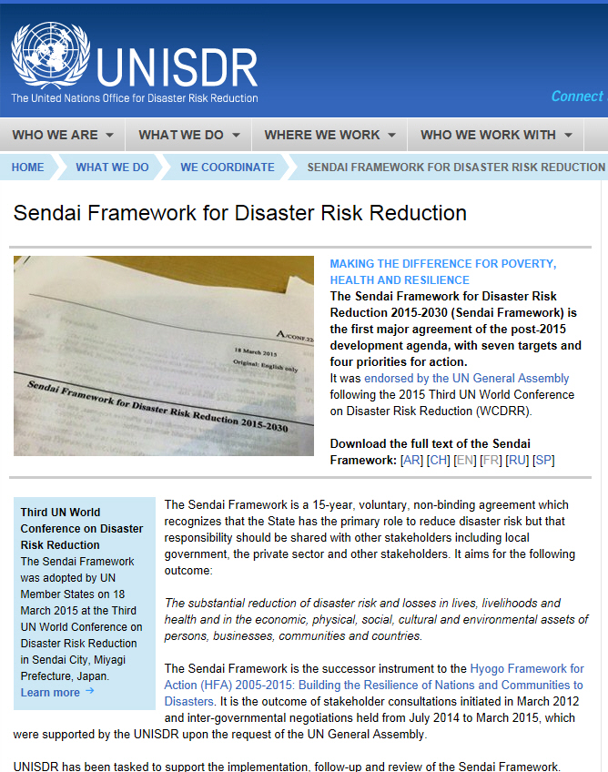
World Conference on Disaster Reduction and Recovery (WCDRR) – Sendai, Japan
Sendai Framework (SF) – adopted for 2015-2030 period; explicit references to satellite EO and several articles relying on the use of remote sensing data:
to produce regular up-to-date risk maps;
strong emphasis on monitoring risk reduction progress;
to outreach disaster risk information to decision maker, the general public and communities.
http://www.unisdr.org/we/coordinate/sendai-framework

Slide 3
Extracts from the Sendai Framework
Priority 1: Understanding disaster risk
National and local levels
Paragraph 24. To achieve this, it is important:
(c) To develop, periodically update and disseminate, as appropriate, location-based disaster risk information, including risk maps, to decision makers, the general public and communities at risk of exposure to disaster in an appropriate format by using, as applicable, geospatial information technology;
Global and regional levels
Paragraph 25. To achieve this, it is important:
(c) To promote and enhance, through international cooperation, including technology transfer, access to and the sharing and use of non-sensitive data and information, as appropriate, communications and geospatial and space-based technologies and related services; maintain and strengthen in situ and remotely-sensed earth and climate observations; and strengthen the utilization of media, including social media, traditional media, big data and mobile phone networks, to support national measures for successful disaster risk communication, as appropriate and in accordance with national laws;
(g) To enhance the scientific and technical work on disaster risk reduction and its mobilization through the coordination of existing networks and scientific research institutions at all levels and in all regions, with the support of the United Nations Office for Disaster Risk Reduction Scientific and Technical Advisory Group, in order to strengthen the evidence-base in support of the implementation of the present Framework […]; disseminate risk information with the best use of geospatial information technology; provide guidance on methodologies and standards for risk assessments, disaster risk modelling and the use of data; identify research and technology gaps and set recommendations for research priority areas in disaster risk reduction; promote and support the availability and application of science and technology to decision-making […]

Slide 4
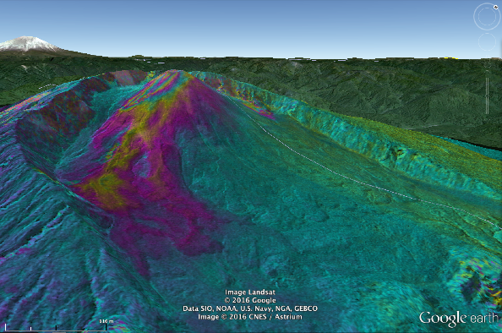
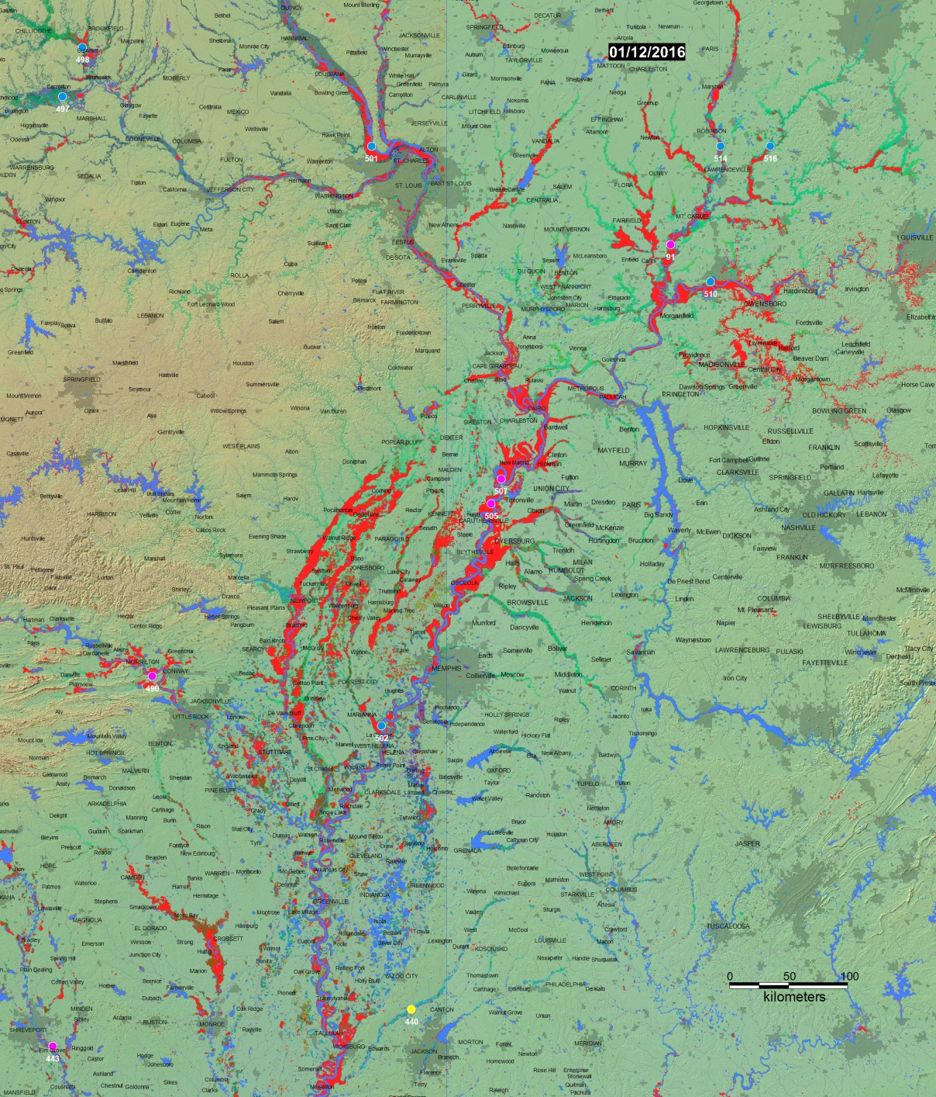
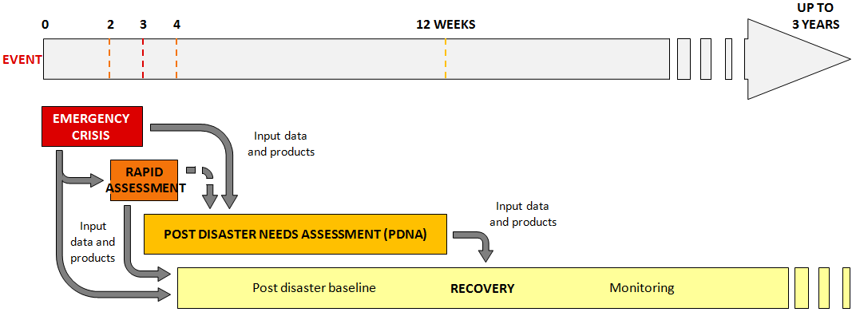
CEOS Disaster Risk Management Pilots
Three thematic pilots (floods, seismic hazards, volcanoes) approved April 2014 to run until end 2017.
Recovery Observatory approved November 2014 – demonstrator with World Bank/GFDRR and Government of Malawi began March 2016.
Fourth thematic pilot on landslides approved November 2015.
Pilots and RO meaningfully demonstrate how satellite EO contributes to all DRM phases, with strong user involvement.
Photos: Brackenridge Mississippi Floods (DFO), TSX data on Reventador, ISTerre (visco-elasticity in Tibet) ,

Slide 5
CEOS Flood Pilot
Leads: NASA, NOAA
Key users/stakeholders: National disaster management agencies, hydrological departments, river commissions, regional and national met organisations.
Achievements: Regional flood “dashboards” in Caribbean, Southern Africa and Mekong; capacity development in Southern Africa.
SF linkage: Floods most prevalent disaster globally; Demonstrates effective application of EO to the full cycle of flood management at all scale; flood products converted to GIS layers and distributed via application programming interface (API); Several outreach activities.

Slide 6
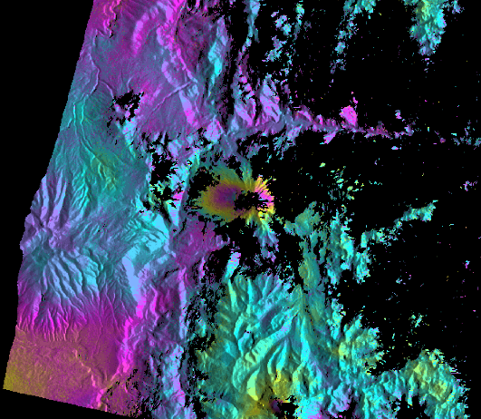
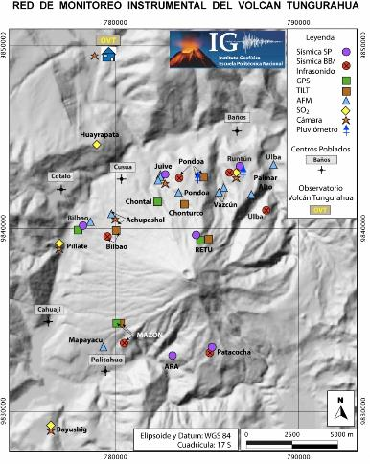
CEOS Volcano Pilot
Leads: USGS, ASI
Key users/stakeholders: National volcano observatories, national civil protection agencies, Washington and Buenos Aires VAACs.
Achievements: Demonstrated value of on-going SAR monitoring and integration of various satellite observations to achieve a complete integrated picture.
SF linkage: Pilot demonstrates clear, measurable ability to reduce risk; Demonstrates efficiency of EO-based monitoring methodologies as a complement to in situ measurements; Capacity building for use of EO data in volcanic observatories in Latina America.
RADARSAT-2 observations lead to new monitoring stations being installed

Slide 7
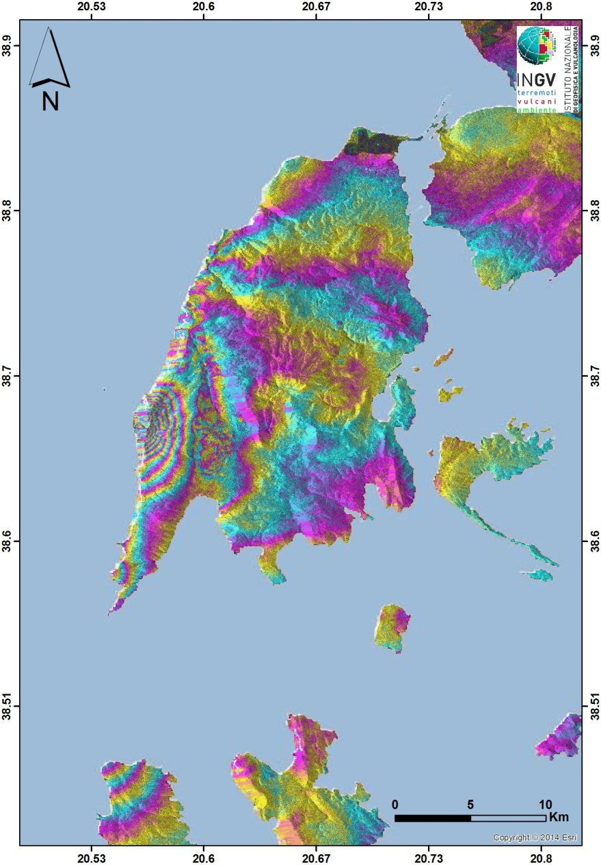
CEOS Seismic Hazards Pilot
Leads: ESA, INGV (Italy)
Key users/stakeholders: National civil protection agencies, science/geohazard agencies in affected countries.
Achievements: Global EO-based strain map; demonstrated value of rapid satellite-based science products after events for improved fault mapping and hazard understanding; integrated CEOS satellite data in Geohazards Exploitation Platform (GEP).
SF linkage: Pilot shows science products can improve hazard understanding, monitoring and support response; GEP is a tool for the geohazards community for accessing and sharing EO data and products including product generation though Cloud based hosted processing.

Slide 8
CEOS Recovery Observatory (RO)
Leads: CNES, GFDRR
Key users/stakeholders: National government of recovery area (demonstrator – Malawi); World Bank, GFDRR, UNDP, UNOSAT.
Achievements: Working partnership developed with GFDRR to deliver framework for satellite-based recovery planning and assessment; demonstrator Malawi 2016.
SF linkage: RO strong tool to promote resilient recovery; Validate applications, including development of specific tools tailored to provide easy access to data over affected areas; Work with the recovery community to define a sustainable vision for increased use of satellite Earth observations in support of recovery.

Slide 9
Follow-on Actions After Sendai
“Sendai Framework for Disaster Risk Reduction 2015-2030”:
Explicit references to satellite EO.
UN ISDR requested concrete follow-on actions to both CEOS & GEO.
Ongoing space agencies’ disaster-related activities (CEOS or non-CEOS) address several recommendations from the Sendai Framework.
CEOS & GEO SEC developed a new GEO initiative GEO-DARMA, endorsed with whole GEO 2016 WP (GEO Plenary, end 2015).
GEO-DARMA based on cooperation between international organisations incl. UN agencies
Participation of international / regional organisations during GEO-DARMA Concept Phase is absolutely necessary.
Past experience shows the importance to discuss the participation of stakeholders via individual / personal contacts.
Note: GEO-DARMA (Data Access for Risk Management

Slide 10
GEO-DARMA Way Forward
WG members expressed interest to join the GEO-DARMA Sub-Group: Ivan Petiteville Chair-ESA, NASA, NOAA, DLR, CNES and JAXA. (Sep. 2016).
GEO Programme Board has recommended GEO-DARMA as a GEO Flagship initiative for the GEO 2017-2019 Work Programme (Sep. 2016).
Contractual support to GEO-DARMA PoC (ESA) kicked-off (mid-Oct. 2016).
Partnership for Sendai implementation: In Sendai 2015 several partners launched the “Global Partnership on Earth observation” to support implementation of the Sendai framework. Expert meeting for the partnership in December. GEO-DARMA would be an essential building block of this partnership (Dec. 2016).
Global Platform for Disaster Risk Reduction (May 2017, México): Possible contribution to a special session (May 2017).

Slide 11
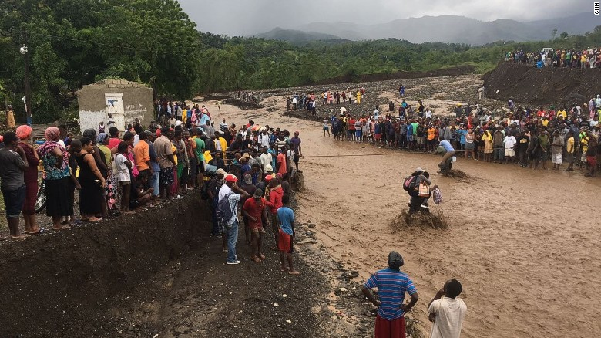
Thank You !!
Any questions?
The bridge collapse in Petit Goave, Haiti, after hurricane Matthew cut responders off from road access, October 7, 2016. CNN/Ryan Browne, Elizabeth Roberts, Ray Sanchez, Deborah Bloom and Nick Thompson
http://www.cnn.com/2016/10/07/americas/haiti-hurricane-matthew/

