Slide 1
CEOS Ad Hoc WG for GEOGLAM
Committee on Earth Observation Satellites
Selma Cherchali, CNES
Brad Doorn, NASA
CEOS Plenary 2016
Agenda Item #2.5
Brisbane, Australia
1st – 2nd November 2016

Slide 2
Status of GEO Coordination
SBA = “Food Security and Sustainable Development”
GI-01: GEOGLAM-Global Agricultural Monitoring and Early Warning
GEOGLAM Secretariat is composed of 1 full time + 2 part-time individuals
GEO Lead on Agriculture SBA / GEOGLAM Program Coordinator
Brazilian (INPE) and now French (MinAg) contribution – 2011-Present, on a full-time basis
Program Scientist/Crop Monitors Coordinator
US (NASA) contribution – 2015-Present, on a part-time basis
Program Scientist/EO Data Coordination Lead [Alyssa Whitcraft]
US (NASA) contribution – 2015-Present, on a part-time basis
Active on CEOS Ad Hoc WG
Participates in LSI-VC to help coordinate around agricultural requirements
Efforts to connect with CEOS WGCapD
GEOGLAM Secretariat is still below “critical mass” – working on concept paper with specific requests and necessary budget
Notes:
Overview of GI-01
The task comprises 7 components:
Monthly production of a Global Crop Monitor bulletin (for wheat, maize, rice and soya) and delivery to AMIS Secretariat (Agricultural Market Information System);
Development of a Global Rangelands and Grasslands Monitoring System (RAPP, Rangeland and Pasture Productivity)
Development of an Crop Monitor for Early Warning in charge of monitoring crops in countries subject to periodic food security crises
Coordination of Capacity Building activities to enable new countries to develop EO-based crop monitoring activities
Coordination of the international Joint Experiment for Crop Assessment & Monitoring (JECAM), to coordinate R&D activities to improve crop monitoring methods
Keeping close links with Committee of Earth Observations Satellite (CEOS) to maintain an efficient access to EO imageries
Ensure delivery of EO-based information for agricultural monitoring in developing countries through the GeoNetCast network
Activities for 2016
The plans for 2016 and onwards include dedicated additional efforts addressing components 2, 3 and 4, namely:
The RAPP (Rangeland and Pasture Productivity) Activity, through accurate forecasts of pasture and rangelands productivity and variability, aims at an improved global understanding of risk across all pastoral landscapes as impacted by climate and land use change.
The Early Warning Crop Monitor (EWCM) intends to coordinate an open, timely and accurate monitoring of agricultural production in chronically food deficit countries to better anticipate food crises (users: FAO, WFP, UN-HLTF, aid agencies…)
Capacity Building activities in new countries will allow these countries to benefit from EO-based information to better monitor their agricultural production, and therefore make better decisions in their agricultural planning.

Slide 3
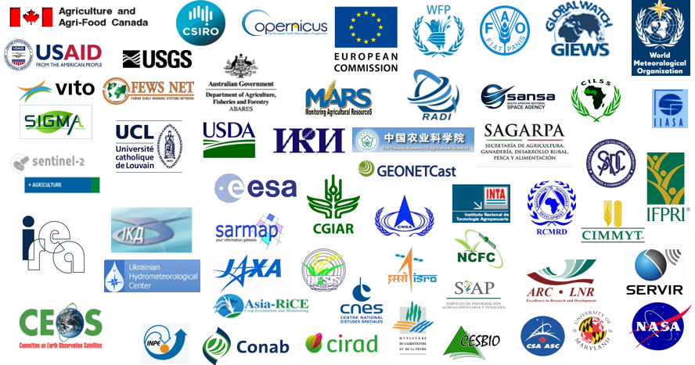
Users of EO Data Coordinated and Derived Information
Primary Users of EO Data | Secondary Users of Derived Information
GEOGLAM Community of Practice Crop Monitor participants (countries & major early warning entities (e.g. WFP, FAO GIEWS, USAID FEWS NET, JRC MARS)) National Monitoring Agencies | Agricultural Market Information System (AMIS) Food policy and food aid agencies National Ministries of Agriculture Commodities marketeers

Slide 4
New Draft
Organizational
Framework for
GEOGLAM

Slide 5
Main GEOGLAM News
(Q2/Q3 2017)
G20 Ag Ministers Communique
GEOGLAM’s important contribution to AMIS acknowledged via unanimous vote of GEOGLAM to AMIS Steering Committee & Secretariat
2nd Advisory Committee Meeting – June 2016
Relevant to CEOS: data coordination at core (CEOS data as key input, among others) – reflected in new framework [previous slide]
Notes:
- This is from the G20 ag ministers… the final G20 language is pending the November meeting.

Slide 6
Main GEOGLAM News (2/3)
(Q2/Q3 2017)
Interaction with LSI-VC – application of GEOGLAM’s EO Data Requirements Development and Evaluation Framework for other land applications
GEOGLAM Latinoamérica: launched at GEO Plenary 2015
training event in June 2016 in Bogota spurring interest for new usership of EO for agricultural monitoring
GEOGLAM launched “AfriGAM” – Kampala, Uganda (October 2016)
Discussions with CEOS WG CapD

Slide 7
Main GEOGLAM News (3/3)
(Q2/Q3 2017)
CNES supports Asia-RiCE activities in GEOGLAM (Thuy LeToan, CESBIO)
Securing EO observations and data access (Sentinels, ALOS, SPOT, Pléiades, VENUS)
Coordinating experiments across sites (SAR and optical EO for rice monitoring and yield estimation)
Coordinating in-situ data collection and for cross validation
Capacity building on the effective use of SAR data through training and joint workshop
Contribution to the workshop/meeting in Ho Chi Minh 17-19 Oct 2016 .
Helping establish JECAM site(s) for Asia-RiCE
JAXA proposes to set up the super site in Mekong delta for Asia-RiCE, in cooperation with CNES, VNSC, and other partners and the site should also be a JECAM site

Slide 8
Key Priorities for 2016-17 (1/4)
Upcoming “reboot” of GEOGLAM EO Data Requirements
Led by GEOGLAM Secretariat
Refining the table to account for evolution of “best practices” and new data streams; RAPP data requirements;
Incorporating in situ and agro-met with space-based EO req’s toward “Methods & Guidance” type documentation for GEOGLAM
Including community effort to define “analysis ready data” for agricultural monitoring applications
Began at JECAM meeting (Kiev, Oct 2016), culminating circa Q3 2017
CEOS Ad Hoc WG on GEOGLAM and LSI-VC to participate in the re-evaluation of GEOGLAM EO data requirements including RAPP requirements (post GEOGLAM Secretariat’s mature draft)
CEOS Ad-Hoc WG to review the outcomes at the next Plenary (2017).

Slide 9
Key Priorities for 2016-17 (2/4)
Commercial engagement – also a priority from the GEOGLAM AC
Three basic types of private/commercial entities for GEOGLAM:
Data providers
IT/computational industry
agricultural industry “value-added”
Action: CEOS (via the Ad Hoc WG for GEOGLAM) to provide feedback on the GEOGLAM Secretariat paper on commercial engagement once a mature draft is available. CEOS Ad Hoc WG & GEOGLAM to iteratively discuss, and ensure the inclusion of a clear statement of the value proposition for each entity involved.
CEOS engagement
points of entry

Slide 10
Key Priorities for 2016-17 (3/4)
Continued and sustained support for regional GEOGLAM initiatives:
Asia-RiCE
GEOGLAM Latinoamerica
AfriGAM
Support for RAPP (Rangeland and Pasture Productivity)
EO data requirements
Data Cube
Support for both test-site AND national scale monitoring efforts, as coordinated by GEOGLAM Secretariat + CEOS Ad Hoc WG for GEOGLAM

Slide 11
Key Priorities for 2016-17 (4/4)
Continued effort needed around issues of accessing and implementing EO data
Expanding usership of EO data
First prototype of Data Cube in progress for GEOGLAM RAPP
GEOGLAM to continue working with LSI-VC & CEOS SEO on data dissemination and access issues relevant to agricultural monitoring
Action: Request for continued support from CEOS Plenary for these efforts through the CEOS Ad Hoc WG for GEOGLAM.

Slide 12
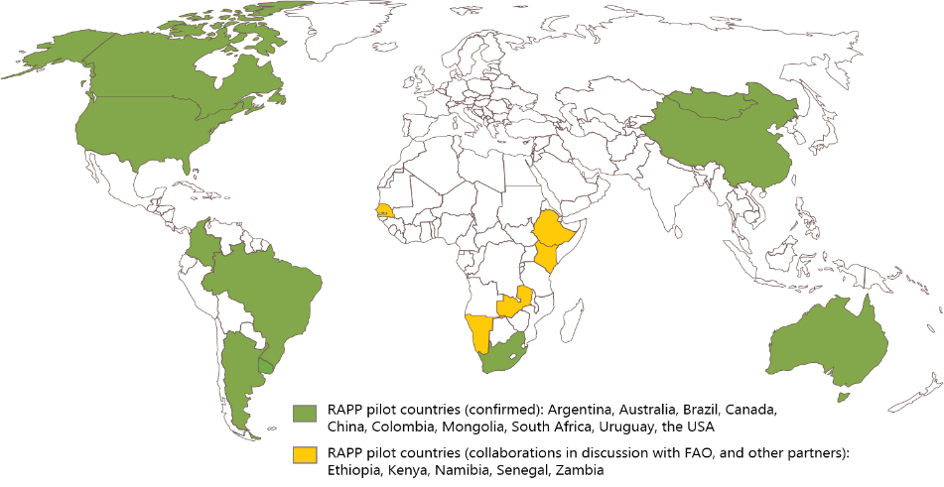
GEOGLAM RAPP (Rangeland and Pasture Productivity):
Steve Mann/ILRI
Juan Pablo Guerschman, Flora Kerblat and Alex Held
AGRICULTURE - LAND&WATER Business units

