Slide 1

GEOGLOWS-GEO GLObal Water Sustainability
Committee on Earth Observation Satellites
GEOGLOWS
CEOS Plenary 2016
Agenda Item #2.3
Brisbane, Australia
1st – 2nd November 2016

Slide 2
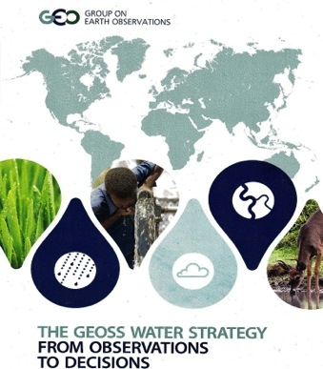

GEOGLOWS and the GEOSS Water Strategy
The GEOSS Water Strategy was prepared in 2014 to communicate the capabilities and needs of the GEO Water community to GEO members and the broader community as plans are made for the next phase of GEO.
GEOGLOWS is a new GEO initiative which received approval from the GEO Programme Board in August, 2016.
It is a voluntary, international program that currently encompasses experts and projects in North America, South America and Europe and is exploring linkages in Asia and Africa.
GEOGLOWS provides a framework for enabling GEO Members to address many of the Water Strategy’s 58 recommendations.

Slide 3
OBJECTIVES
Strengthen capacity to understand water data needs and develop user-driven applications products from EO data and applications
Engage end users and boundary organizations to understand needs by region and decision making process and prioritize activities based on vulnerability analyses
Coordinate and leverage GEOGLOWS partners to more effectively provide information and expertise to international stakeholders and end user communities
Strengthen global capacity to use water EO and science effectively across spatial and temporal scales
Contribute to the assessments of impacts of climate change with population and economic growth on water resources and their availability, and to inform planning and adaptation activities

Slide 4
GEOSS WATER STRATEGY IMPACTS
The GEOSS Water Strategy identified areas that need to be strengthened in its implementation. GEOGLOWS supports the following issues:
1. Commitments for GEO Members and GEO POs are needed to address specific recommendations
GEOGLOWS provides a framework within which GEO members can coordinate their responses to the GEOSS Water Strategy.
2. Strengthen User Engagement through relationships
with users and product co-design.
As an example for other GEO Members, AmeriGEOSS members will develop mechanisms for user interaction.

Slide 5
GEO Global Water Sustainability (GEOGLOWS)
1. Enhancing Global Water Sustainable Development Water and the SDGs Scarcity and Access Climate Change Cold Regions Ecosystems and Biodiversity | 2. Minimizing Basin and Regional Risk Integrated Water Prediction Floods Droughts Transboundary Issues (IWRM) Land Use Change Water-Energy-Food-Environment-Health Nexus Climate Change Adaptation | 3. Understanding Essential Water Variables (EWV) Water Quality Water Use Water Cycle Variables (Precipitation, Soil Moisture, Groundwater, Evapotranspiration, Stream Flow, Surface Water Storage (Includes Snow Pack))
4. Earth Observations, Integrated Data Products and Applications, and Tool Development 5. Data Sharing, Dissemination of Data, Information, Products, and Knowledge 6. User Engagement, Capacity Building and AmeriGEOSS
Notes:
2016 Community Activities that will become part of the 2017-2019 GEOGloWS initiative work plan – Bradley Doorn, Angelica Gutierrez, Jerad Bales:
CA-07 - Integrated Water-cycle products and services (Merge with GEOGLOWS) - Rick Lawford
CA-08 - Water Vapour and Clouds – Ralph Ferraro
CA -09 - Precipitation - George Huffman
CA-10 - Evapotranspiration - Forrest Melton
CA-15 - Capacity Building in the Americas- Angelica Gutierrez
CA -17 - GEO Great Lakes - Norman Grannemann and Gail Faveri
CA -21 - Integrated Water Prediction – Angelica Gutierrez

Slide 6
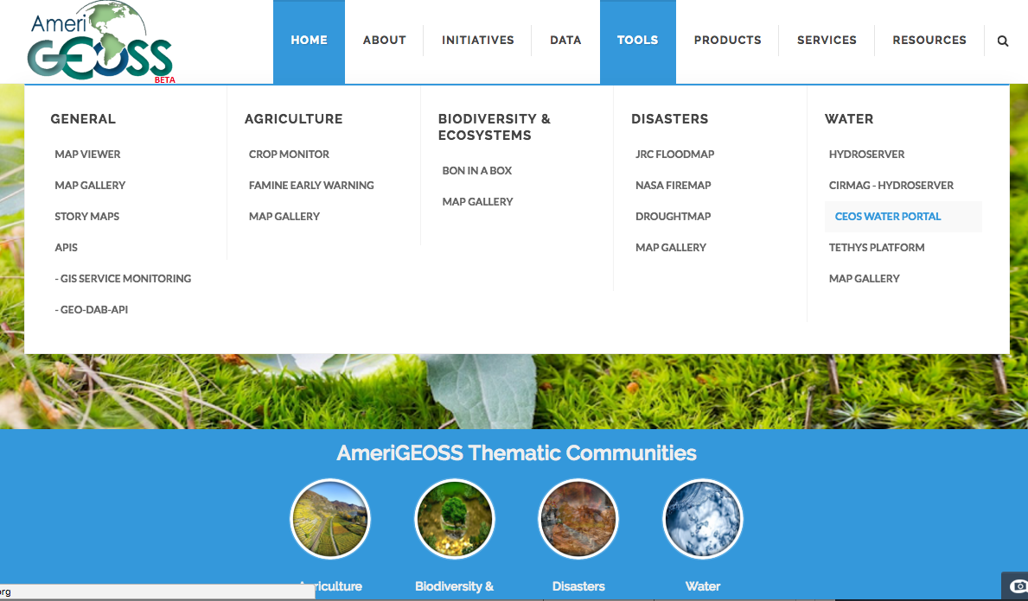
Coordination Effort
GEO - CEOS
https://www.fgdc.gov/amerigeoss/index.html#
Notes:
GEOGLOWS through the Water Working Group in AmeriGEOSS, has added the CEOS WATER PORTAL to the AmeriGEOSS platform so that the data can be accessed by the AmeriGEOSS community.
Through Google analytics we will be able to collect metrics on the use of the platform such as what is trending, country from which data is the most requested, etc.
We plan to extend these analyses to be more specific and capture user information requesting data.

Slide 7
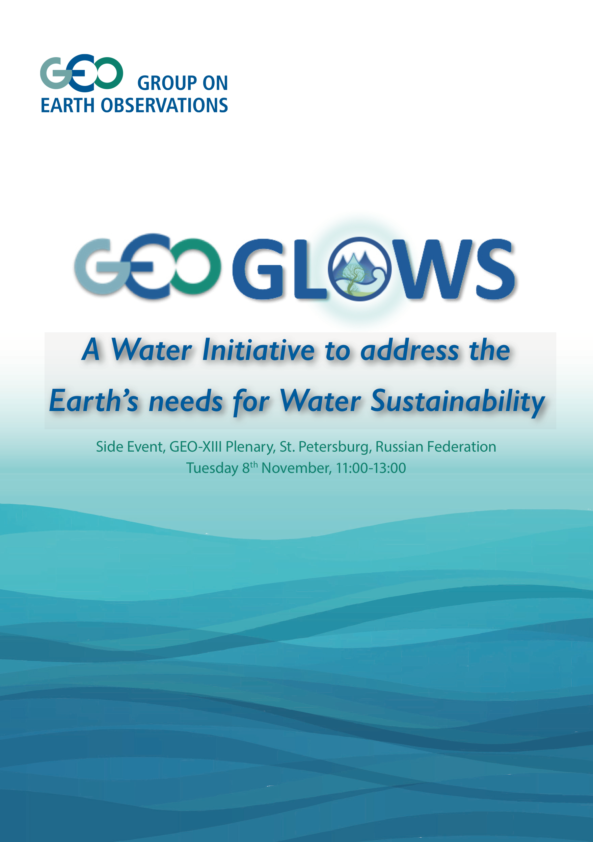
2016 GEO Plenary
GEOGLOWS Side Meeting

Slide 8
GEO INITIATIVE
Vanessa Aellen, GEO-SEC
Organizations which are currently leading GEOGLOWS include:
NOAA (National Oceanic and Atmospheric Administration) – USA
NASA (National Aeronautics and Space Administration) – USA
USGS (United States Geological Survey) – USA
IDEAM (Instituto de Desarrollo del Ambiente) – Colombia
JRC (Directorate-General JRC, European Commission, Europe
Collaborating organizations include:
CIMH (Caribbean Institute for Meteorology and Hydrology) - Barbados
CIRMAG (Centro de Investigación Científica del Rio Magdalena) – Colombia
Deltares – the Netherlands
EC (Environment Canada) – Canada
ENAP (Escuela Naval Almirante Padilla) – Colombia
Federal Institute of Hydrology - Germany
IMN (Instituto Meteorológico Nacional) – Costa Rica
INPE (Instituto Nacional de Pesquisas Espaciais) - Brazil
MARN (Ministerio de Medio Ambiente y Recursos Naturales) – El Salvador
SENARA (Costa Rica’s National Service of Underground Water, Irrigation and Drainage)– Costa Rica
SEMARNAT (Mexican Secretariat of the Environment and Natural Resources) - Mexico
UBY (University of Brigham Young) – USA
UNAL (Universidad Nacional de Colombia)
Questions

