Slide 1

Committee on Earth Observation Satellites
Feasibility Study for an Aquatic Ecosystems Imaging Spectrometer
Ad-Hoc Working Group CEOS
Presented by A.G. Dekker
CEOS Plenary
Brisbane, Australia, 1st November 2016

Slide 2
Scope of the Feasibility Study
Imaging Spectrometer for Aquatic Ecosystems
(excluding ocean colour)
The CEOS response to (GEOSS) Water Strategy developed under the auspices of the Water Strategy Implementation Study Team (WSIST) was endorsed by CEOS at the 2015 Plenary.
One Water Strategy recommendation is C.10 : A feasibility assessment to determine the benefits and technological difficulties of designing a hyperspectral satellite mission focused on water quality measurements:
The GEO Water Quality community (AquaWatch) proposed that alternative approaches, involving augmenting designs of spaceborne sensors for terrestrial and ocean colour applications to allow improved inland, near coastal waters and benthic applications, could offer a cost-effective alternative pathway to addressing the same science and societal benefit aplications. Accordingly, this CEOS study will also analyse the benefits and technological difficulties of this option

Slide 3
Scope of the Feasibility Study
Imaging Spectrometer for Aquatic ecosystems
Three activities defined in this feasibility study:
A feasibility assessment of the benefits and technological difficulties of designing a hyperspectral satellite mission focused on inland, estuarine, deltaic and near coastal waters - as well as mapping macrophytes, macro-algae, seagrasses and coral reefs and shallow water bathymetry- at significantly higher spatial resolution than 250m.
To examine threshold and baseline observation requirements for sensors suitable for aquatic ecosystem to inform CEOS Agencies when considering the potential to add this application area to their mission designs.
That the GEO Water community define inland and near-coastal water quality and benthic habitat essential variables, including an assessment of relative priority, linked to defined economic, social and environmental benefits. This information would be of great value in informing investment decisions.

Slide 4
CEOS Team
“Feasibility Study imaging Spectrometer”:
Lead: CSIRO - Arnold Dekker; Coordinator: DLR - Nicole Pinnel
Members: (for non-CEOS organisations the country is given)
CNES Marie-Jose Lefevre & Xavier Briottet
DLR Peter Gege, Harald Krawczyk, Bingfried Pflug, Birgit Gerasch
HZG Hajo Krasemann (Germany)
EOMAP Thomas Heege (Germany)
CNR Federica Braga, Claudia Giardino & Vittorio Brando (Italy)
NASA Kevin Turpie
CSA Martin Bergeron & Maycira Costa
USGS Thomas Cecere
WaterInsight Steef Peters (Netherlands)
TNO Andy Court (Netherlands)
(NSO) Mark Loos & Joost Carpaaij
(EC) Astrid-Christine Koch & Catharina Bamps

Slide 5
CEOS Report Contents
“Feasibility Study imaging Spectrometer”:
Table of Contents: Feasibility Study for an Imaging Spectrometer for Water Quality vs 2.0 1st Nov 2016
1. Background
1.1. Overview
1.2. Strategic direction for studying inland waters, coastal waters, benthos and shallow water bathymetry
  1.2.1. Inland waters and wetlands
    1.2.1.1.Remote sensing of inland waters and wetlands
    1.2.1.3. Theoretical basis of remote sensing of inland water quality
    1.2.1.4. Past, present, and planned sensor availability for Inland waters and wetlands
  1.2.2. Coastal waters, benthos and shallow water bathymetry
1.3 Benefits to society / societal impacts
1.4. Current situation: sensors used (designed for either land or ocean observations)
1.5. What we propose to do

Slide 6
CEOS Report Contents
“Feasibility Study imaging Spectrometer”:
2. Science and Applications Traceability Matrix
2.1. Introduction to the science questions
2.2. Science question per application
  2.2.1. Inland waters and wetlands
    2.2.1.1.Mapping inland aquatic macrophytes
  2.2.2. Estuarine, deltaic and lagoon waters
  2.2.3. Seagrass, coral reefs, kelp
  2.2.4. Shallow water bathymetry
  2.2.5. Atmospheric correction and air-water interface
2.3. Science and applications traceability matrix (inland waters & wetlands, estuarine, delta's and lagoons, seagrassess and coral reef, kelp, shallow water bathymetry)
2.4. Measurement Requirements (making use of bio-optical or RTF based forward models)

Slide 7
CEOS Report Contents
“Feasibility Study imaging Spectrometer”:
2.4. Measurement Requirements (making use of bio-optical or RTF based forward models)
  2.4.1. Spectral range and resolution requirements (includes spectral simulations)
  2.4.2. Radiometric Sensitivity requirements (includes simulations on radiometry)
  2.4.3. Spatial resolution requirements
  2.4.4. Temporal requirements incl time of day
  2.4.6. Geometric requirements& geolocational accuracy
  2.4.7. Sun glint avoidance requirement
  2.4.8. Polarisation requirements
2.5. Platform requirements
2.6 Ancillary data requirements
2.7 Summary (science traceability matrix with sensor requirements)

Slide 8
CEOS Report Contents
“Feasibility Study imaging Spectrometer”:
3. Instrument Requirements and Mission Design
3.1. LEO imaging spectrometer
  3.1.1 Review of past, present and (known) future instruments and the science traceability matrix
  3.1.2 Review of past, present and (known) future instruments and the measurement requirements
  3.1.3 Instrument concepts
3.2. Geostationary imaging spectrometer
3.3. Adaptations to near future planned land focused imagers to make them more suitable for aquatic ecosystem assessments
3.4. Adaptations to near future planned ocean focused imagers to make them more suitable for aquatic ecosystem assessments
3.5. End-to-end simulation

Slide 9
CEOS Report Contents
“Feasibility Study imaging Spectrometer”:
3.6. Calibration
  3.6.1 Pre-launch calibration and characterization.
    3.6.1.1. Radiometric and spectral pre-flight calibration
    3.6.1.2. Geometric pre-flight calibration
  3.6.2. Post-launch Calibration
    3.6.2.1. Spectral and radiometric calibration
3.7. Conclusions, Recommendations

Slide 10
CEOS Report Contents
“Feasibility Study imaging Spectrometer”:
4. Aquatic Ecosystem Earth Observation Enabling Activities
4.1. Studies for algorithm development
    4.1.1. Atmospheric characterisation
      4.1.1.1. Water vapour
      4.1.1.2. Aerosols
      4.1.1.3. Ozone and NO2
    4.1.2. Atmospheric correction
    4.2.2. Air-water interface correction
    4.2.3. In water algorithms
      4.2.3.1. Optically deep waters
      4.2.3.2. Optically shallow waters

Slide 11
CEOS Report Contents
“Feasibility Study imaging Spectrometer”:
4.2. Evolution and development of (optical) In situ Instruments
  4.2.1. Spectroradiometers (AOP sensors) above and underwater
  4.2.2. Inherent optical properties (IOP) sensors
  4.2.3. Biogeochemical sensors
4.3. Sources of uncertainties
4.4. Field campaigns and priorities for calibration/validation research
4.5. Summary and conclusions
5. References

Slide 12
Current Status:
April 2016: Team created
May 2016: Contents established
June 2016: Self nomination process chapter leads and co-authors
Sept. 2016 Summary presented at (CEOS-SIT) Oxford UK
Nov 2016 CEOS Plenary: Full draft approximately 80 % ready
By January 2017 final draft.
By April 2017 SIT final report

Slide 13
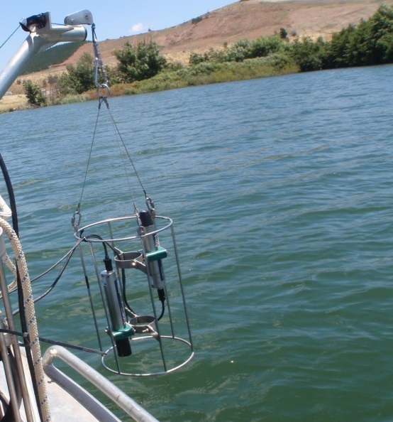
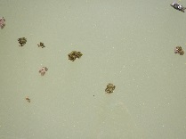

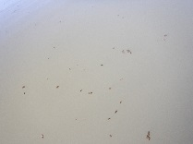
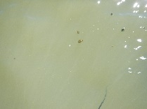
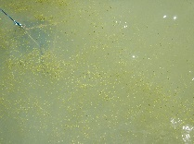
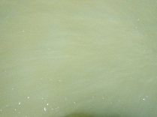
Inland waters: not so simple: land-water boundaries; lake at 600 m Altitude
Reflectance

Slide 14
Spectral simulations example of high CDOM (&variable S) and medium CHl
Some interesting thoughts: how to determine a representative set of concentration ranges for inland waters and coastal waters globally?

Slide 15
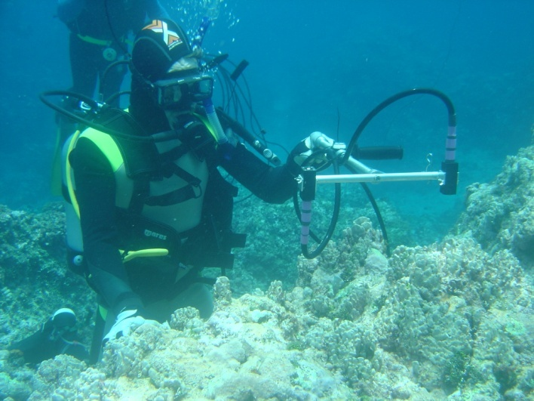
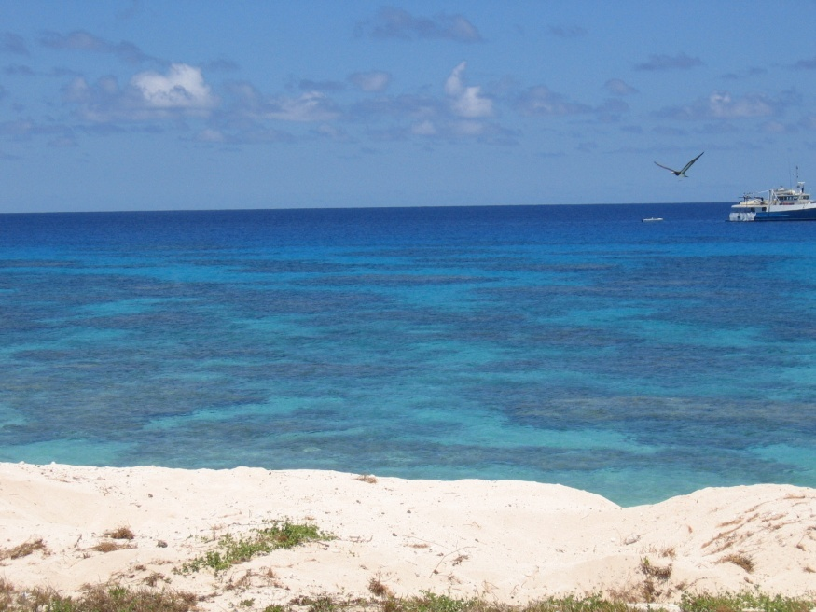
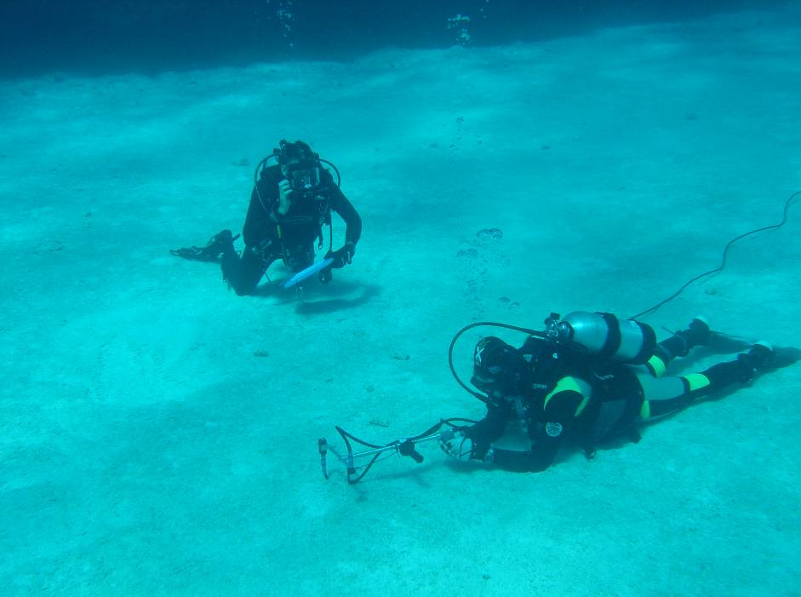
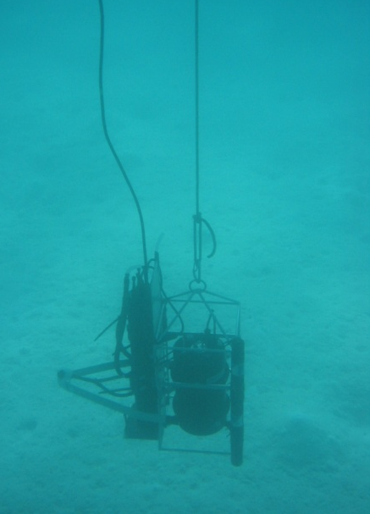
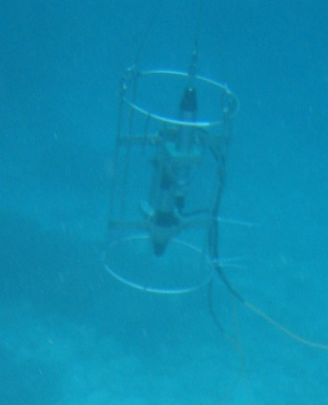
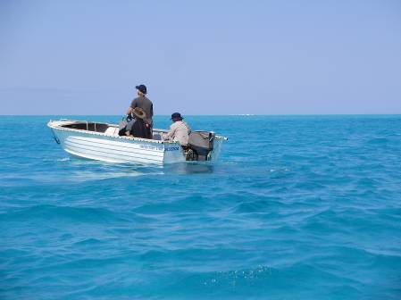
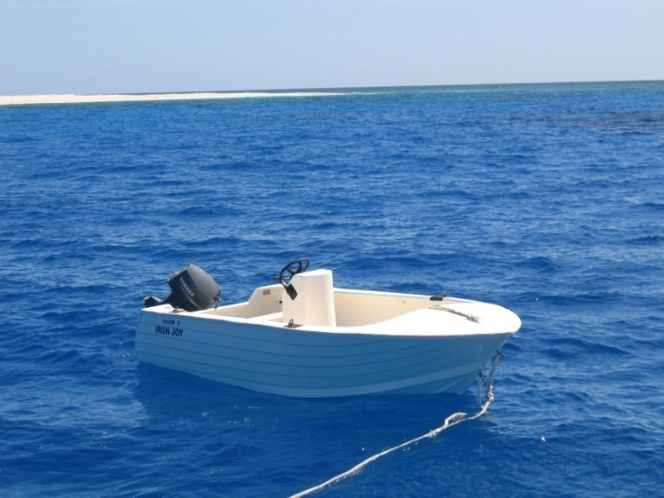
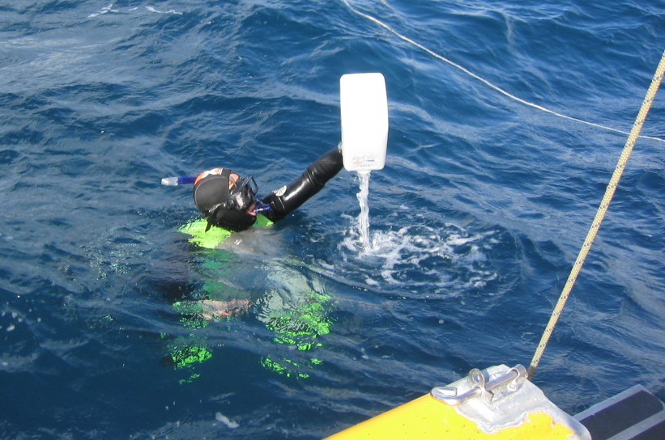
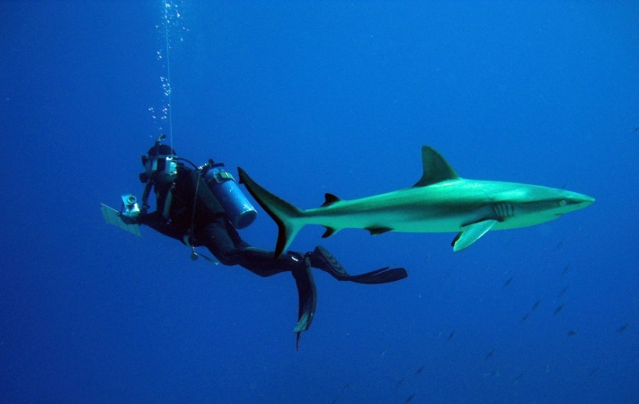
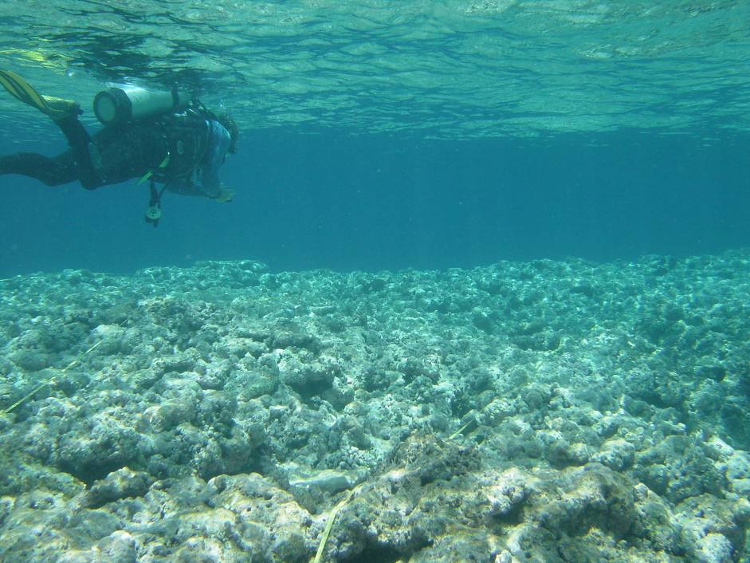
In situ substrate reflectance measurements (RAMSES)

Slide 16
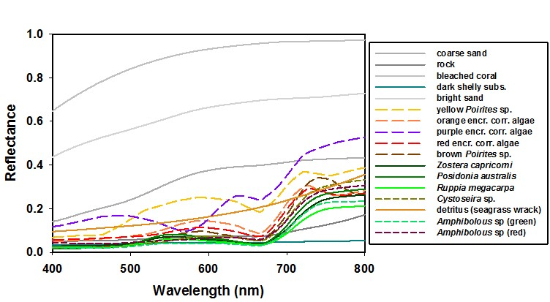
Substratum spectra: seagrass
& coral reef environments

Slide 17
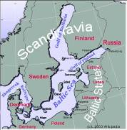
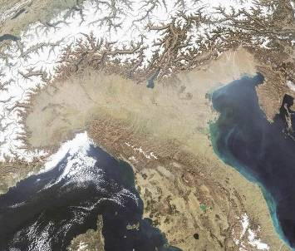
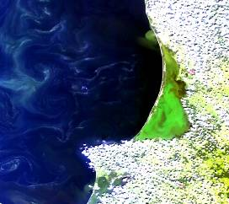
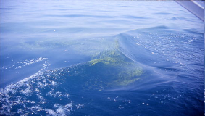
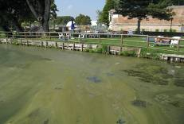
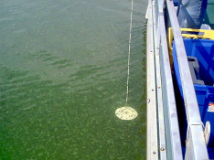
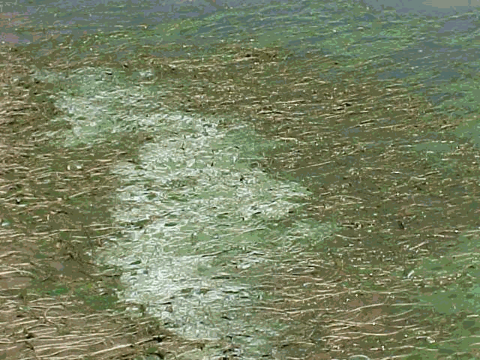
Study areas and potentially Harmful Algal Bloom types (courtesy C. Giardino CNR
Curonian lagoon
Como
Idro
Garda
Italian lakes
Mantova
Trasimeno
Sporadic homogeneous blooms with vertical migration in oligo-meso trophic lakes
Frequent and intense heterogeneous bloom in hypertrophic lakes
Frequent homogeneous bloom in meso-eurtrophic lakes without scums
Frequent and intense homogeneous bloom in hypertrophic lakes with scums

Slide 18
Table 6.2.
Spatial resolution for inland waters
Ground sampling distance requirements showing resolvable size class and total cumulative number and area coverage of the world’s lakes (based on assumptions using Verpoorter et al. (2014) dataset).
(Courtesy E.L. Hestir. North Carolina State University)
Size Class | Required GSD* | % Total Area | Total number
≥ 10 km² | 1054 m | 44 | 25,976
≥ 1 km² | 333 m | 60 | 353,552
≥ 0.1 km² | 105 m | 80 | 4,123,552
≥ 0.01 km² | 33 m | 90 | 27,523,552
≥ 0.002 km² | 15 m | 100 | 117,423,552
*Calculated using a box of 3 x 3 pixels sufficient to resolve the specified lake size

Slide 19
CEOS Report
“Feasibility Study imaging Spectrometer”:
Society needs detection, assessment and monitoring of aquatic ecosystems (multiple UN SDG’s contain aquatic ecosystem variables SDG 6, 14 and 15 specifically).
Coral reefs, seagrasses, macro-algae, macrophytes (freshwater) could all likely be measured with a fixed set of multispectral bands for each application
HOWEVER…..
When measuring optically active water constituents over large ranges (optically deep water case) and needing to measure the substratum spectra through a water column (optical shallow water case), there is not one specific multispectral band set that will be able to do it all- strong indication imaging spectrometry will be required.
HOWEVER…..
By augmenting planned land or ocean sensors spectrally or spatially cost-effective solutions for observing aquatic ecosystems could be achieved.

