Slide 1
SBA status in GEO 30th CEOS Plenary Osamu Ochiai GEO Secretariat 31 Oct - 2 Nov, 2016 Brisbane, Australia

Slide 2
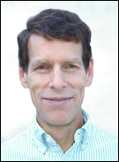
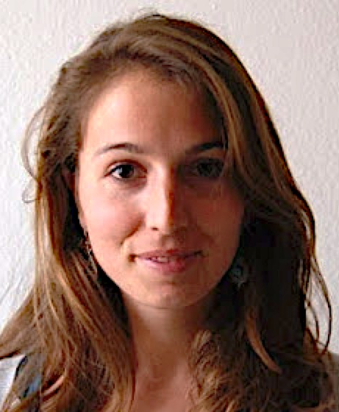
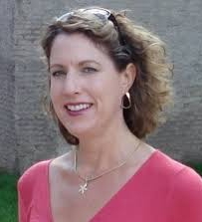
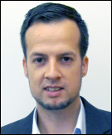
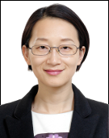
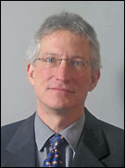
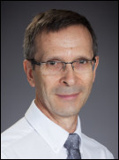
SBA experts in GEO Secretariat
Gary Geller
Vanessa
Aellen
Vanessa
Aellen
Climate
Kerry
Sawyer
André
Obregon
André
Obregon
Wenbo
Chu
Douglas
Cripe
Michel
Deshayes

Slide 3
GEO Water tasks restructuring
 | 2016 WP | 2017-2019 WP
 | Former structure and former leads | New strucure
Community activities | CA-11: Soil Moisture - P. Van Oevelen / C. Rudiger | (New) In-situ observations for Water Cycle ð Wolfgang Grab
 | CA-12: River Discharge - W. Grabs / D. Berod
 | CA-13: Groundwater - N. Kukuric
 | CA-14: GEO Water Quality – S. Greb | AquaWatch ð Steven Greb
 | CA-15 (part of): Water Cycle Capacity Building - A. Gutierrez | (New) DIAS (including WCI, AWCI, AfWCCI) ð Toshio Koike
 | CA-18: Water Cycle Integrator (WCI) - T. Koike
 | CA-20: EarthH2Observe - J. Schnellekens | EartH2Observe ðJaap Schellekens
 | CA-19: E2E Water Indicators - C. Vörösmarty | (New) Water-Energy-Food Nexus ðR. Lawford / C. J. Vörösmarty / R. Hossain
 | CA-22: Linking water tasks with wider SBA & the post-2015 global development framework - R. Lawford / A. Strauch
Initiatives | CA-16: global drought information system (GDIS) – W. Pozzi | (New) GDIS (Global Drought Information System) ðWill Pozzi
 | GI-11: Information Services for Cold Region (GEOCRI) - Y. Qiu | GEOCRI (Information Services for Cold Region) ðYubao Qiu
 | CA-07: integrated water-cycle products and services - R. Lawford | Included in ↓
 | Ca-08: water vapor and clouds (and aerosol and precipitation) - R. R. Ferraro
 | Ca-09: precipitation - G. J. Huffman
 | Ca-10: evapotranspiration - F. S. Melton
 | Ca-15: water cycle capacity building - A. Gutierrez
 | Ca-17: geo great lakes activity - G. Faveri
 | GI-20 GEO Global Water Sustainability (GEOGLOWS) | GEOGLOWS (GEO Global Water Sustainability) ð Angelica Gutierrez / Bradley Doorn / Nate Booth
Notes:
In blue: Affiliated with GEOGLOWS

Slide 4
Communities of Practice - Aquawatch & IGWCO
IGWCO (Integrated Global Water Cycle Observations Community of Practice)
Providing a framework for guiding decisions
Promoting strategies
Coordinating & facilitating the inputs
Fostering the development of tools, applications & systems
Supports the plans of the International Groundwater Resource Assessment Centre (IGRAC) & its Global Groundwater Monitoring Network (GGMN)
AquaWatch
In response to the need for an international operational water quality information system
Support water resource management & decision making
Transforming data to information based on user needs
Deliver water quality data products & information
Produce a global water quality monitoring & forecasting service
http://www.geo-water-quality.org/home

Slide 5
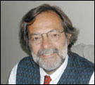
GD-08: SBAs process: Systematic determination of user needs / observational gaps “Task Description”
General description
Undertake regular, systematic analysis of global observational requirements
Societal Benefit Areas will provide the framework to perform this analysis
Other key outputs such as contributing to user engagement and to knowledge development.
Implementation approach and respective responsibilities
The GEO Secretariat will activate this SBA-related process
The GEO Secretariat will coordinate the participation of key stakeholders to the agreed activities and create the relevant linkages to GEO activities (Community, Initiatives and Flagships) and other ongoing global and regional processes.
Planned activities and outputs in 2016
The 2016 will be used to activate this process, starting from the SBAs already active and ensuring participation Expected outputs:
Issue a document describing the process and how it will be run (planned by end October)
Define initial plans for each SBA
Activate of the process for at least three SBAs by 2016

Slide 6
GD-08: SBAs process: Systematic determination of user needs / observational gaps “Phased approach”
Phase 1: June 2016 – Dec 2017 Process validation and interim results (light central coordination, no synthesis, just SBA by SBA)
June 2016 – Nov 2016
Run the SBA process for two SBAs and present reports to GEO-XIII Plenary
Food Security and Sustainable Agriculture
Sustainable Urban Development
January 2017 – Nov 2017
Refine the SBA process (if necessary), implementing Plenary recommendations and lessons learned
Revise the two SBA reports accordingly
Run the SBA process for two additional SBAs
Present the four reports to GEO-XIV Plenary
Phase 2: January 2018 - onwards
By 2019, run the process for the remaining SBAs, revise the first four and produce the first Summary Report "User needs and observations/information gaps for an extended use of EOs in decision making”.
Continue the rolling process and update all the reports in 2021, 2023 and 2025.
From DRAFT WG Report

Slide 7
Thank you!

