Slide 1
CEOS 3-Year Work Plan Annual Update
Committee on Earth Observation Satellites
CEOS Executive Officer Team
CEOS Plenary 2016
Agenda Item #1.4
Brisbane, Australia
1st – 2nd November 2016

Slide 2
Brought to you by …
The CEOS Minions!

Slide 3
Work Plan 2016
“[Sets] forth near-term objectives and deliverables designed to achieve the goals outlined in the CEOS Strategic Guidance document”

Slide 4
Functions
Focus on objectives and deliverables associated with timescales and assigned responsibilities
Updated annually by the CEO under the guidance of the CEOS Chair
In consultation with:
the CEOS SIT Chair
CEOS Secretariat
CEOS Working Groups
Virtual Constellations
Ad Hoc Teams
CEOS membership at large
CEOS’s external stakeholders
Provide sound and shared basis for measuring our progress in a multiannual perspective
Shall be consistent with and mutually supporting of other CEOS guiding documents

Slide 5
The current 3-Year Work Plan
Seventy-seven (77) Objectives/Deliverables for 2016-2018
Main outcomes are described for the following thematic areas:
Climate Monitoring, Research, and Services
Carbon Observations, Including Forested Regions
Observations for Agriculture
Observations for Disasters
Observations for Water
Capacity Building
Data Access, Availability and Quality
Advancement of the CEOS Virtual Constellations
Support to Other Key Stakeholder Initiatives
Outreach to Key Stakeholders
Organizational Issues

Slide 6
Phasing
Notes:
Unsurprisingly the majority are scheduled for delivery by the next Plenary. The lack of concrete milestones in the out years indicates a need for more considered long-term planning by CEOS Entities if CEOS is to gain maximum benefit from a rolling 3-year work plan.

Slide 7
Evolution
Notes:
The primary category where there has been a major drop is DATA. This may be as a result of WGISS waiting for strategic guidance from the CEOS Chair Initiative and other activities, having made major progress over the last years on the issue of metadata access. There has been a drop-off in activities within disasters, following the success at the WCDRR in Sendai and the focus shifting to implementation. The increase in CB activities should be monitored closely in line with the new strategy being developed by WGCapD.

Slide 8
Delivery
 |  | Ongoing | Due by Q4 2016 | Due by Q4 2017
 | Completed or on track | 9 | 31 | 13
 | Material delays | - | 6 | 2
 | Not started / other issues | - | 1 | 6
 | No update | - | 5 | -
* As at 24 October. Subject to review.

Slide 9
Development
Now
Late Nov 16
Late Jan 17
Mid Feb 17
End Feb 17
New
Initiatives
Updated Priorities
MilestoneChanges
Refinement
Concurrence
CEOS-30
v0
V0.5
Pre-V1
V1.0
Discontinued Objectables
Status
Updates
Add/Remove
Objectables
Validation
Major Slips
Plenary
Outcomes
Revise
Rationale
WGs/VCs/AHTs
CEO Team
SEC
CEO Team
Chair Team
WGs/VCs/AHTs
Stakeholders
Principals
(Virtual Endorsement)

Slide 10
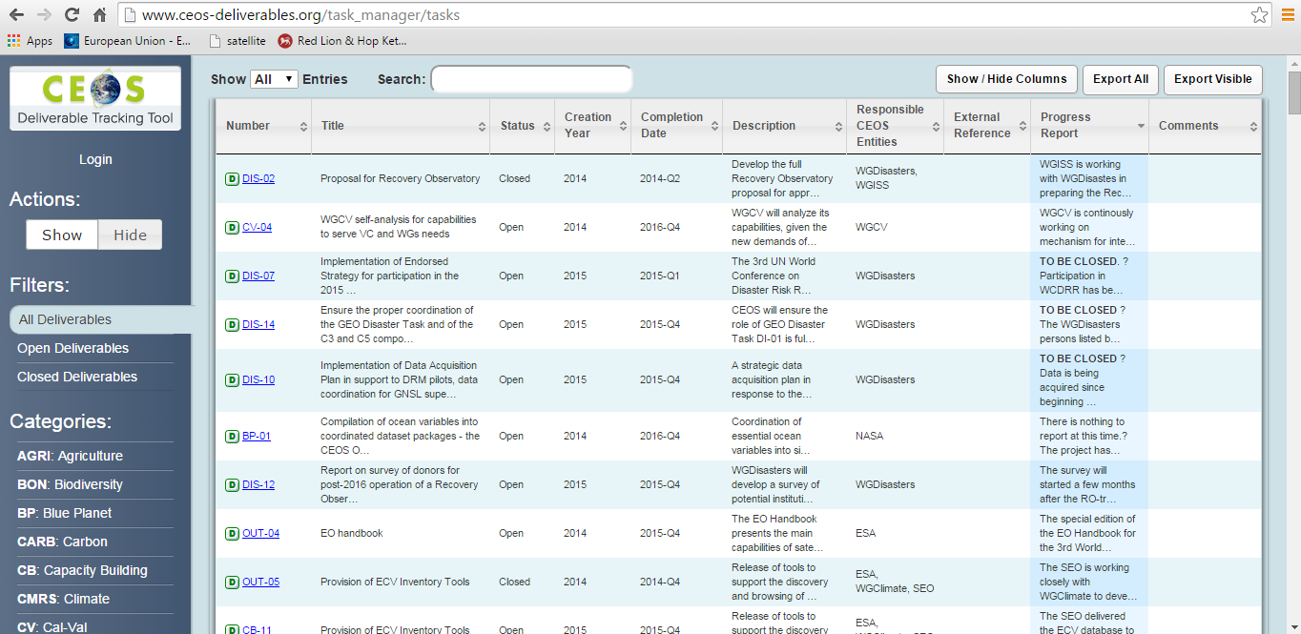
Challenge
Keeping this up-to-date …
Notes:
SIT Chair TagUps a useful forum to capture a status, but delays in getting reports out, and ensuring participation, are challenges. For example, have not yet had the time to fully update to reflect last round of TagUps.

