Slide 1

KMA Satellite Applications
Committee on Earth Observation Satellites
Geun-Hyeok Ryu
Korea Meteorological Administration
CEOS Plenary 2016
Agenda Item 1.2
Brisbane, Australia
1st – 2nd November 2016

Slide 2
KMA Organization
Administrator
Spokesperson
Deputy Administrator
Audit and Inspection Officer
Planning & Coordination
Forecast
Observation Infrastructure
Climate Science
Met. Service Promotion
4 divisions
8 divisions
4 divisions
4 divisions
4 divisions
General Services
Division
Earthquake & Volcano
2 divisions
National
Institute
of Met. Sciences
Regional
Met. Offices (9)
Korea
Aviation
Met. Agency
National
Met.
Satellite Center
Weather
Radar
Center
      NMSC : 3 divisions & 1 Team (Satellite Planning, Satellite Operation, Satellite Analysis division + Satellite Development team) with more than 120 staffs and researchers
NWP dept.

Slide 3


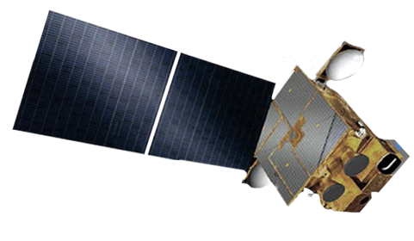

KMA Current Satellite
COMS program
  COMS is the first multi-purpose geostationary satellite for Korea in the application of Meteorology, Ocean and Communication
  Meteorological Mission Continuous observation to support weather forecasting and
  early detection of severe weather phenomena
  Development Period 2003 ~ 2010 (8 years)
  Orbit Location 128.2° E over equator (36,000km)
  Designed Life 7 years
  Operation Period April 2011 ~ 2018 (or more)
Ka-band
Antenna
Meteoro
-logical
Imager
Communication
Ocean and
Meteorological
Satellite
GOCI
Notes:
COMS is the first multi-purpose geostationary satellite for Korea in the application of Meteorology, Ocean and Communication. COMS has meteorological Mission for Continuous Meteorological Observation to support weather forecasting and early detection of severe weather phenomena, and developed from 2003 to 2010.
COMS settled in longitude 128.2 east degrees and has been operational since April 2011 with lifetime of 7 years.

Slide 4

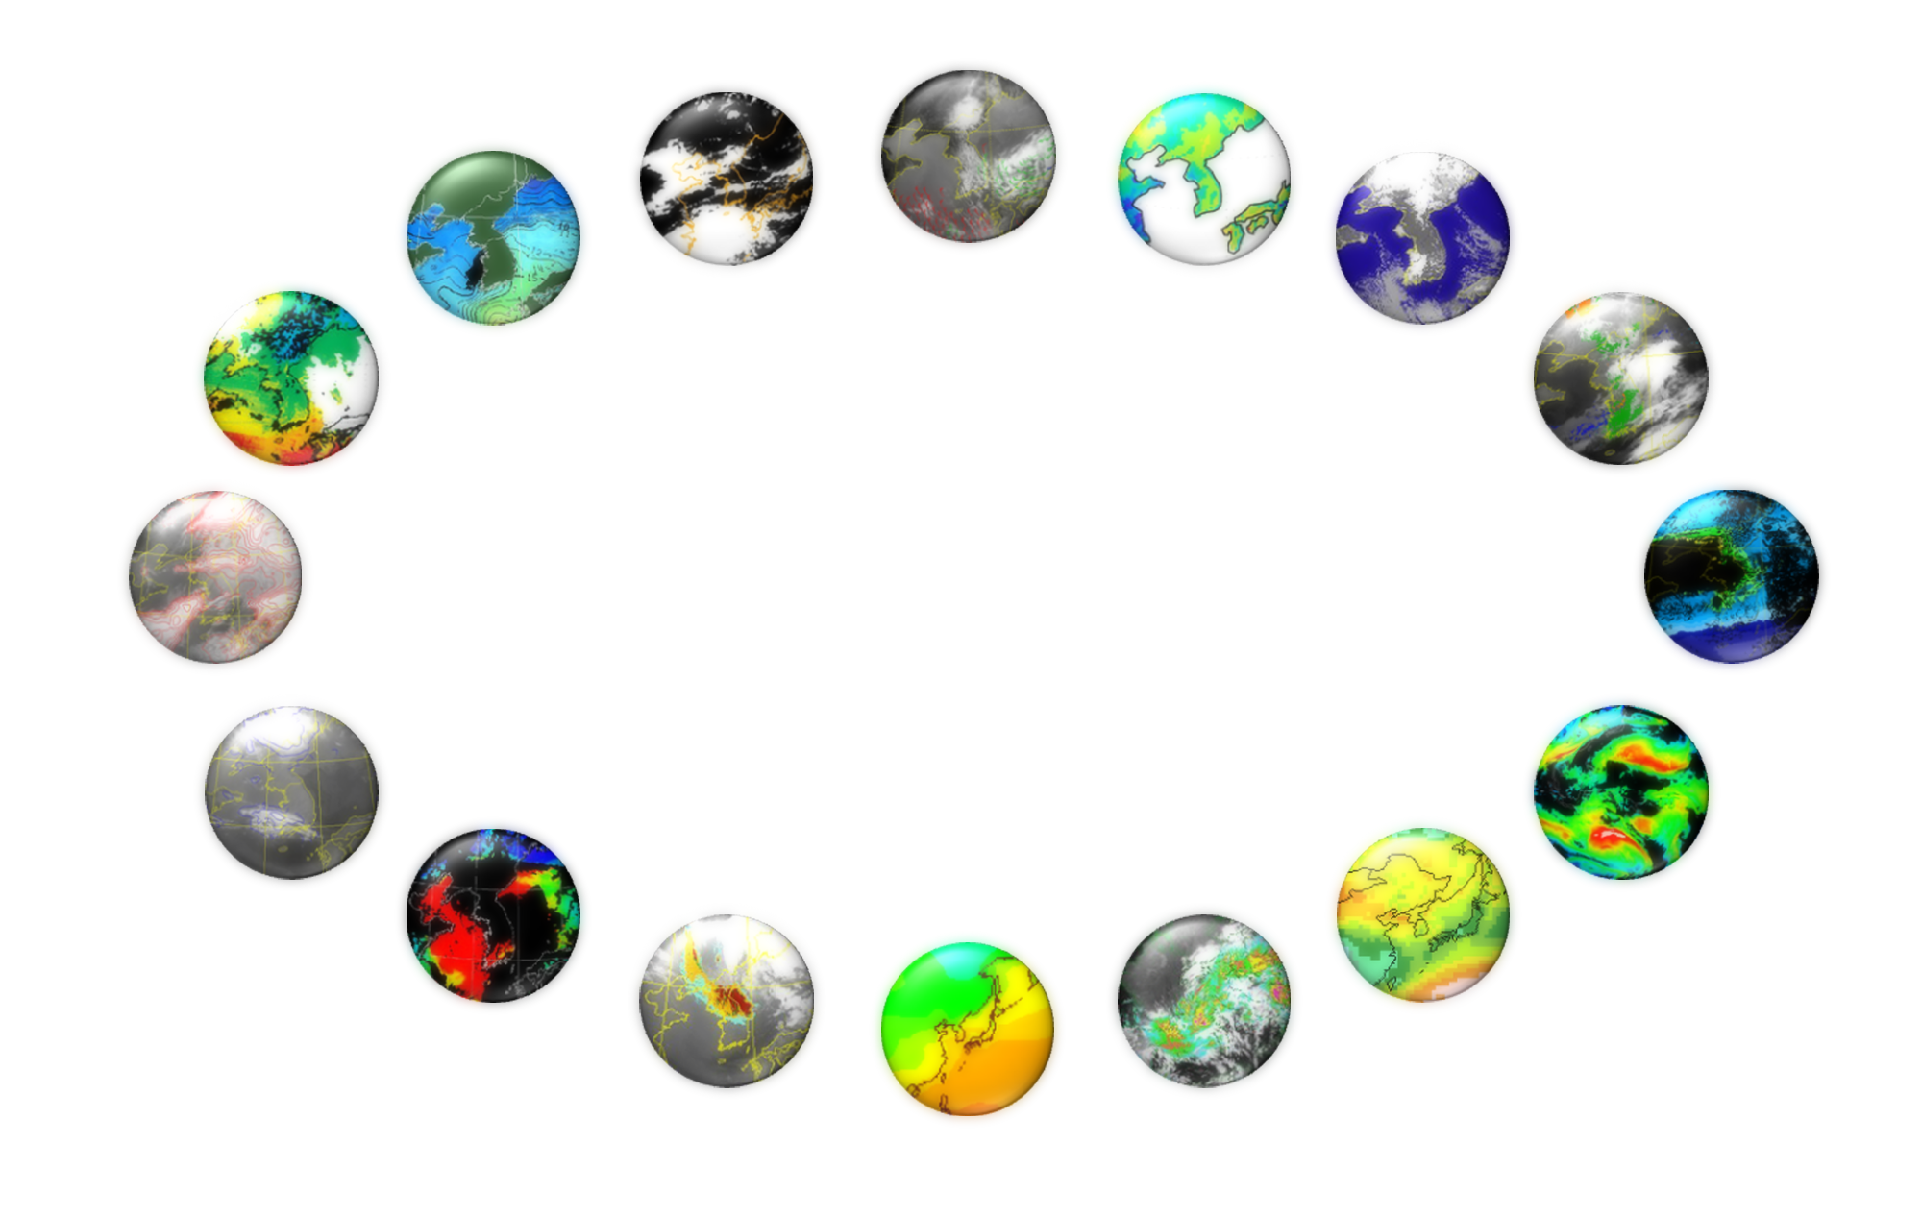
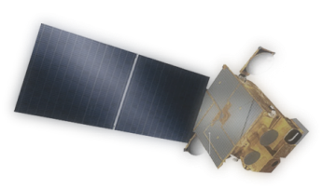
COMS Products
16 Baseline Products : Development (2003-2010) and operation (2011~)
AMV
(Atmospheric Motion Vector)
CLD
(Cloud Detection)
LST
(Land Surface Temperature)
SST
(Sea Surface Temperature)
SSI
(Snow/Sea Ice)
TPW
(Total Precipitable Water)
Fog
CTT/CTH
(Cloud Top Temperature/Height)
UTH
(Upper Tropospheric Humidity)
COMS
CA
(Cloud Analysis)
CSR
(Clear Sky Radiance)
AOD
(Aerosol Optical Depth)
INS
(Insolation)
AI
(Aerosol Index)
OLR
(Outgoing Longwave Radiation)
RI
(Rain Intensity)
Notes:
KMA developed CMDPS (COMS Meteorological Data Processing System), which produces 16 level-2 meteorological products.

Slide 5


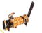
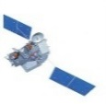

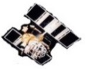


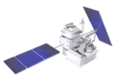


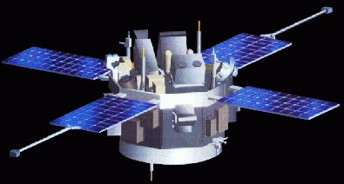

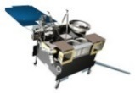
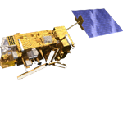


Satellite Data Utilization
To operate timely COMS, to gather reliable satellite data on weather and climate and to deliver them to other Agencies and countries
Himawari-8
COMS(GOCI)
COMS (MI)
DMSP(SSM/I)
TRMM
S-NPP
Windsat
FY-2E
GCOM-W1
GPM
Terra/Aqua
National Meteorological Satellite Center
DSCOVR
NOAA-15/18/19
Direct Receiving
FTP
GOES
Metop-A/B
Receive directly : 8~ Satellites
Land-Line : 15~ Satellites
SOHO
STEREO
Space Weather
Daily volume of satellite data received/produced by NMSC is about 2.2 TB
- GEO 2,136 GB (COMS 906GB, Himawari-8 1229 GB, FY-2E 0.9 GB) / LEO 74 GB
- Direct 919 GB / Indirect 1,291 GB

Slide 6
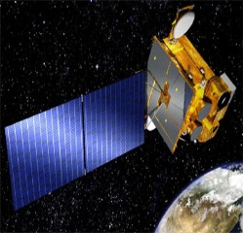
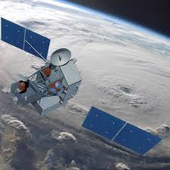
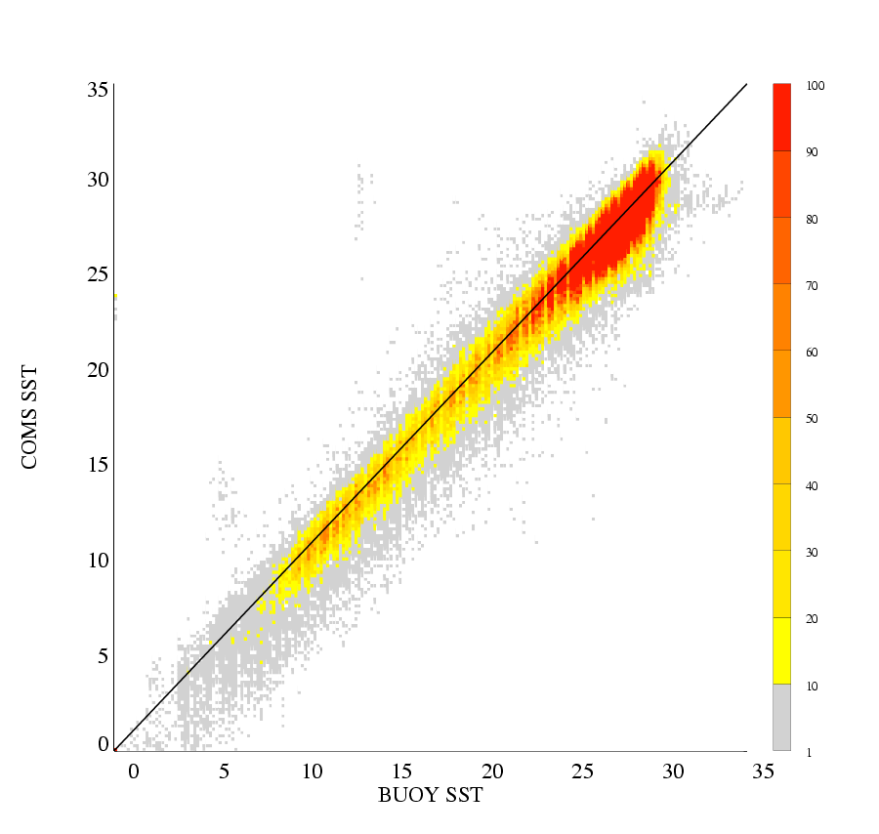
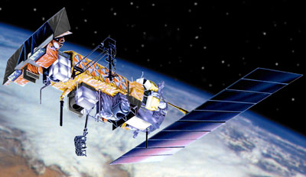
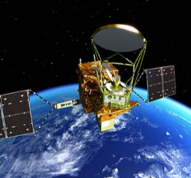
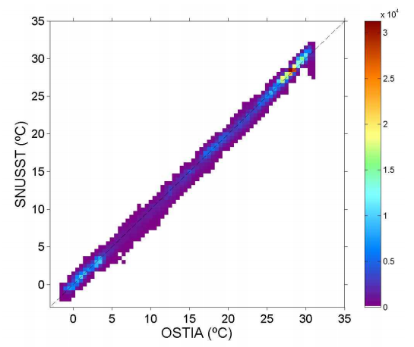
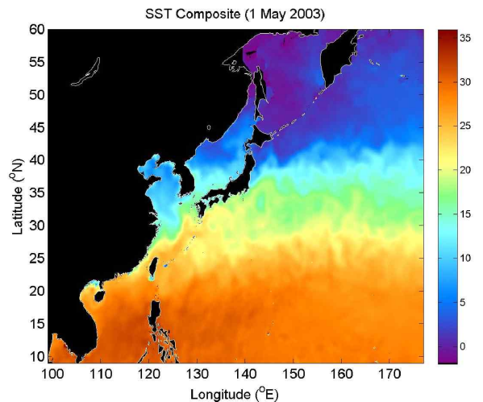
Observation of SST (4km)
Regional COMS SST(4km)
NMSC/KMA Composite SST
Operational Monthly COMS SST compared with buoy at April 2011 to January 2012(Unit: ℃)
COMS
TRMM TMI ➔ GPM
NOAA 18, 19
AVHRR
GCOM-W1
AMSR2
R = 0.98
BIAS = -0.52
RMSE = 1.25
OI
KMA/NMSC SST Composite
R = 0.997
BIAS = -0.025
RMSE = 0.807
OSTIA
OSTIA~5km/daily ➔ Composite SST(4km) with 6hr interval ➔ High resolution model(1.5km)
(Potential linkage with SST-VC)
Notes:
High resolution model is tested in 2016

Slide 7
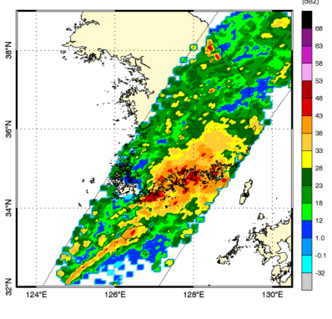
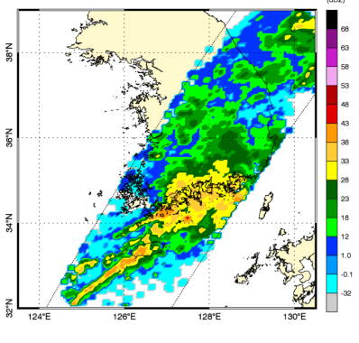
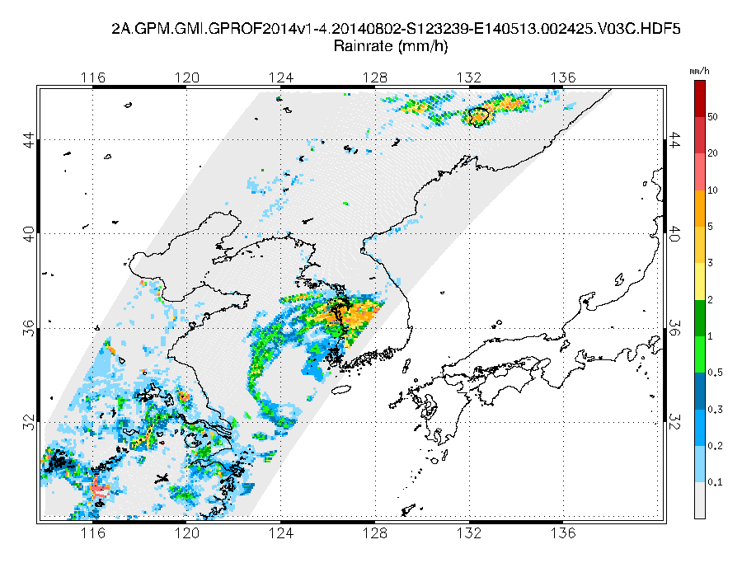
Observation of Precipitation
Development of Korean PMW rainfall retrieval algorithm for GPM (2012~2016)
GPM
GR
Collaboration with JAXA
Collaboration with NASA
Investigation of Precipitation mechanism and process over EA
GPM GV over the Korean Peninsula
Land surface working group
Ground Validation(GV)
Cloud microphysics over Korea
Ocean
Algorithm
Land
Algorithm
Radiation, rain, SST DB
- Build up radiation-rain database
- 1d-VAR + EOF optimization
Land surface emissivity
- Emissivity classification for Land
- Characterize scattering signal
Produce GPM rainfall over East Asia (2016~)
- Synergy on hydrometeorology/climatology
(Potential linkage with P-VC)

Slide 8

Improvement of
Earth Observation:
GK-2A
Notes:
Currently, KMA is operating the geostationary satellite COMS and has a plan to launch COMS follow-on in 2018 and 2019 which consists of GEO-KOMPSAT-2A and GEO-KOMPSAT-2B.
GEO-KOMPSAT-2A will succeed meteorological mission through the 16 channel meteorological instrument AMI. In addition to AMI, GEO-KOMPSAT-2A will have the space weather instruments.
GEO-KOMPSAT-2B will load two instruments. One is ocean color imager GOCI-II, and the other is environmental monitoring spectrometer GEMS.
The both of GEO-KOMPSAT-2A and GEO-KOMPSAT-2B will be operated for 10 years.
*KSEM: 경희대학교 개발중
*GOCI-II 13 bands 300m 10 times/day Local Area + Full Disk
*GEMS: O3, SO2, NO2, HCHO

Slide 9
GEO-KOMSAT-2A AMI
Information (CGMS SATURN web page, https://www.wmo-sat.info/satellite-user-readiness)
  Multi-channel capacity: 16 channels
  Temporal resolution: within 10 minutes for Full Disk observation
  Flexibility for the regional area selection and scheduling
  Lifetime of meteorological mission: 10years
Bands |  | Center Wavelength |  | Band Width (Max, um) | Resolution (km) | GOES-R (ABI) | Himawari-8 (AHI)
 |  | Min(um) | Max(um)
VNIR | VIS0.4 | 0.431 | 0.479 | 0.075 | 1 | 0.47 | 0.46
 | VIS0.5 | 0.5025 | 0.5175 | 0.0625 | 1 |  | 0.51
 | VIS0.6 | 0.625 | 0.66 | 0.125 | 0.5 | 0.64 | 0.64
 | VIS0.8 | 0.8495 | 0.8705 | 0.0875 | 1 | 0.865 | 0.86
 | NIR1.3 | 1.373 | 1.383 | 0.03 | 2 | 1.378
 | NIR1.6 | 1.601 | 1.619 | 0.075 | 2 | 1.61 | 1.6
 | NIR2.2 |  |  |  | 2 | 3.35 | 2.3
MWIR | IR3.8 | 3.74 | 3.96 | 0.5 | 2 | 3.90 | 3.9
 | IR6.3 | 6.061 | 6.425 | 1.038 | 2 | 6.185 | 6.2
 | IR6.9 | 6.89 | 7.01 | 0.5 | 2 | 6.95 | 7.0
 | IR7.3 | 7.258 | 7.433 | 0.688 | 2 | 7.34 | 7.3
 | IR8.7 | 8.44 | 8.76 | 0.5 | 2 | 8.50 | 8.6
LWIR | IR9.6 | 9.543 | 9.717 | 0.475 | 2 | 9.61 | 9.6
 | IR10.5 | 10.25 | 10.61 | 0.875 | 2 | 10.35 | 10.4
 | IR11.2 | 11.08 | 11.32 | 1.0 | 2 | 11.2 | 11.2
 | IR12.3 | 12.15 | 12.45 | 1.25 | 2 | 12.3 | 12.3
 | IR13.3 | 13.21 | 13.39 | 0.75 | 2 | 13.3 | 13.3
Notes:
Advanced Meteorological Imager AMI of GEO-KOMPSAT-2A is comparable to those of the ABI and AHI imager on board Himawari-8/9 and GOES-R.
The detailed specification of AMI are listed on the table
Full Disk observation time is within 10 minutes. There are flexibility for the regional area selection and scheduling.
*VIS 3개(AHI와 유사, but ABI는 그린 없음)/중층을 잘 보기 위해서 NIR1.3 선택(ABI와 유사, AHI와 다름)

Slide 10
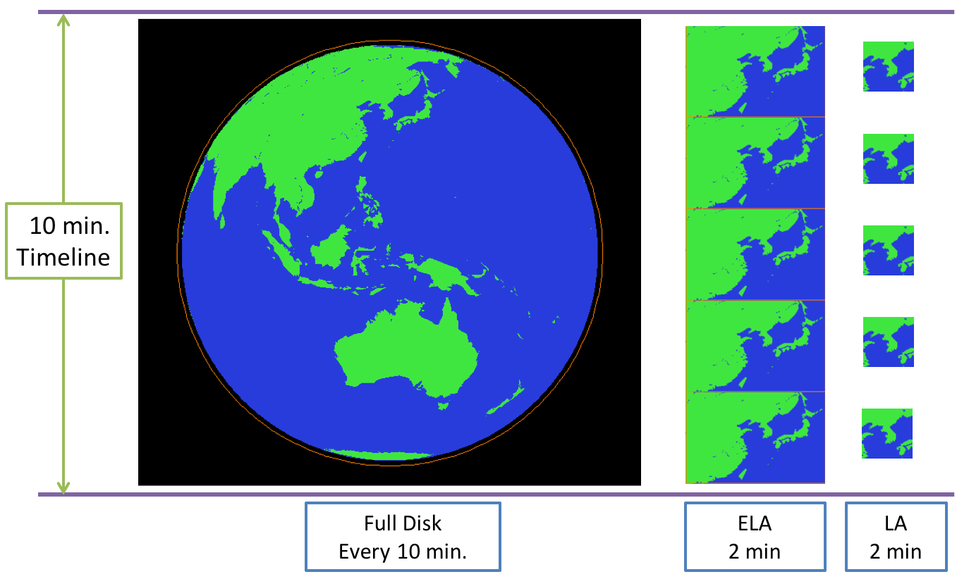
GEO-KOMSAT-2A AMI
Observation Area and Schedule
  Full Disk
  Extended Local Area: 3,800 X 2,400 km (EW X NS)
  Local Area: 1,000 X 1,000 km
Notes:
For the meteorological observation, 10 minutes of observation mode is under consideration, that consists of one full disk and 4 extended local area with 3,800 by 2,900 km². 3 observation area are defined with full disk, extended local area and local area with 1000 by 1000 km².

Slide 11
Data Service Plan: GK-2A
GK-2A broadcast
  Broadcast all 16 channels data (UHRIT) of meteorological observations
  Maintain L/HRIT broadcast corresponding to COMS five channels
Landline
  Cloud service similar to Himawari-cloud is under development (completed in 2018)
  Renovated web-based service system is under development (completed in 2018)
  GK-2A data also will be available in DCPC-NMSC (http://dcpc.nmsc.kma.go.kr)
Categories | UHRIT | COMS-like H/LRIT
 |  | HRIT |  | LRIT
Service
Data Rate | < 31 Mbps | 3 Mbps |  | ~512 Kbps
Frequencies | Uplink : S-band Downlink : X-band | Uplink : S-band , Downlink : L-band * Same Frequencies band with COMS
Data Type | AMI Image(16 Ch.) Alphanumeric text Encryption Key Message * Additional info could be added in the future | AMI Image(5 Ch.) Alphanumeric text Encryption Key Message GOCI-II products(TBD) | AMI Image (5 Ch.) Alphanumeric text Encryption Key Message Lv2 products GOCI-II image file
Mode | FD | FD, ENH | FD, ENH
Station | LDUS | MDUS | SDUS

Slide 12
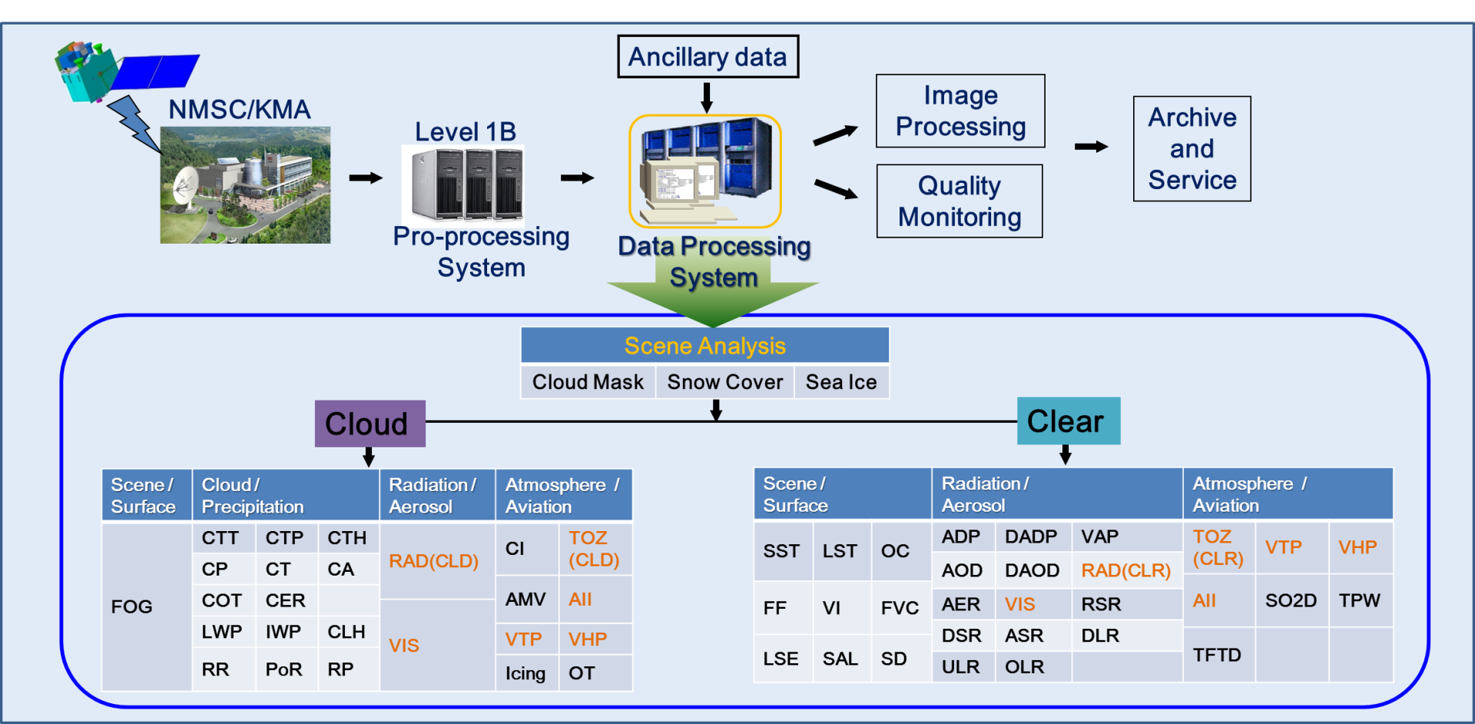
Meteorological Products
The algorithm prototype of 23 (primary) products have developed by 4 algorithm groups and 29 (secondary) products will be developed by the end of 2016
MODIS, SEVIERI, COMS, and AHI data are used as proxies to evaluate each algorithm
Non-Meteorological Application for the Next Generation
Geostationary Satellite
Notes:
Next, I want to explain the meteorological products from GK-2A measurements.
The algorithm prototype of 23 primary products have developed and 29 secondary products will be developed by the end of 2016.
MODIS, SEVIRI, COMS, and Himawari-8(AHI) data will be used as proxies to evaluate each algorithm.
This figure shows the sequential process of the meteorological products from preprocessing raw data to producing fifty-two level-2 data.

Slide 13
Utilization of Satellite Products
To be designed to maximize the utilization of the satellite products for forecasters and NWP
Areas | Contents
Nowcasting | Cloud analysis Heavy rainfall and snowfall analysis QPF
Typhoon & Ocean | Typhoon analysis system based on Satellite SST, red tide, freezing over the ocean 3D Winds analysis
NWP | Satellite data preprocess for NWP data assimilation
Hydrology & SFC | Soil moisture, Drought and Floods, Fire detection Fine Dust analysis Verification, grid and image composite technique
Climate & Environmental Monitoring NMA for the Next Generation Geostationary Satellite | Aerosol concentration, height, vertical distribution, Greenhouse gases, atmospheric composition, Energy budget, Air Quality model applications, Volcanic Ash
Atmospheric Trace Gas and Ocean Color data from GK2B will also be used.

Slide 14
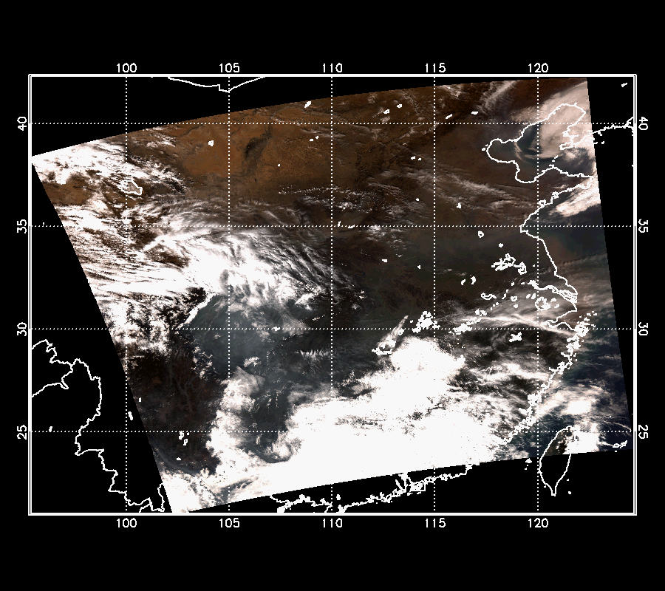
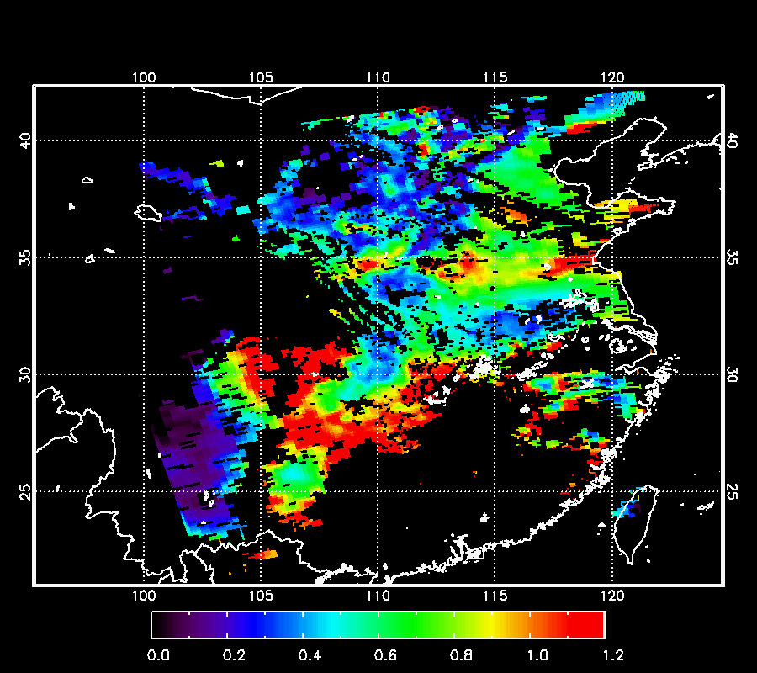
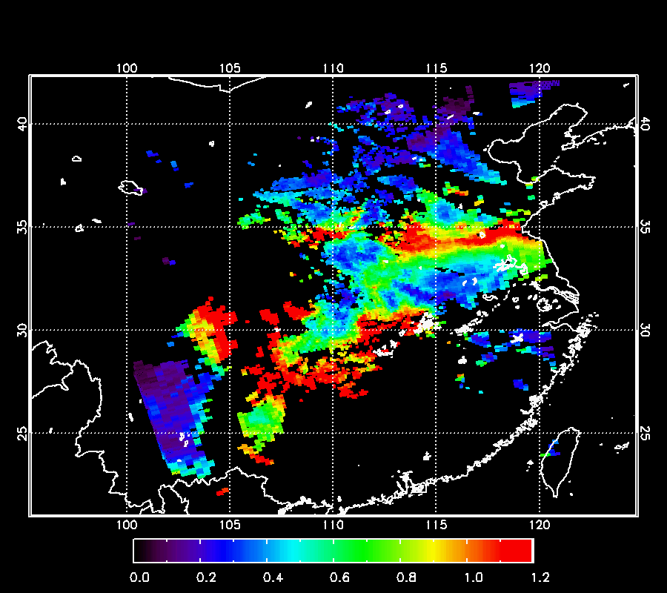
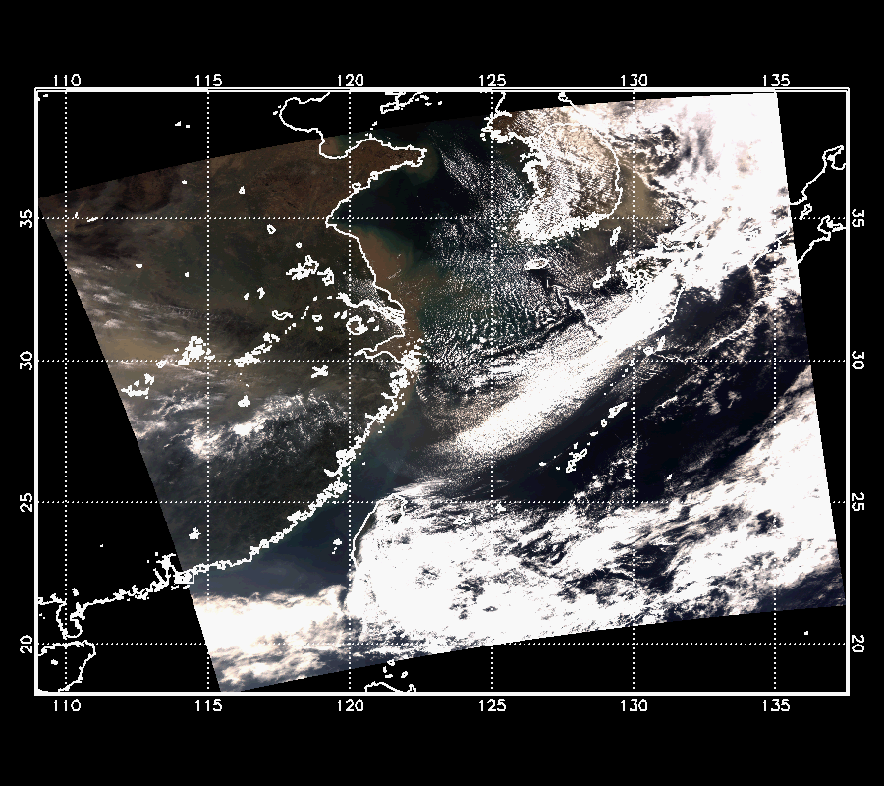
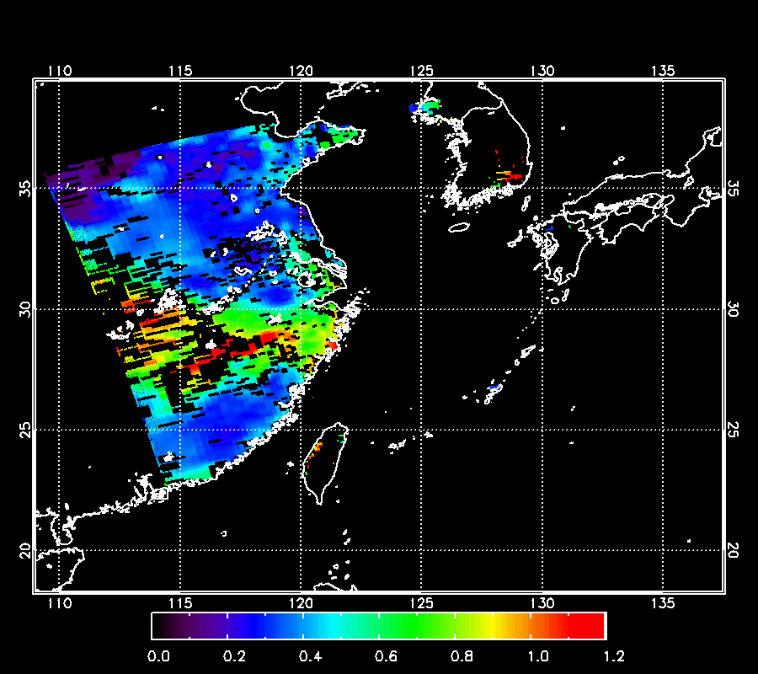
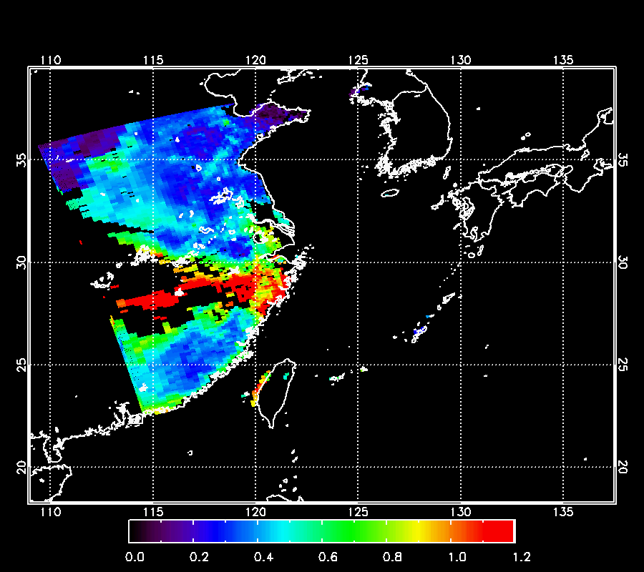
Non-Meteorological Applications:
Aerosol
Aerosol density and height
Procedure
  Aerosol height estimated by statistical regression equation model using aerosol optical depth, surface observation, other metrological element
  Aerosol height algorithm based O4 AMF(air mass factor)
RGB Image
GK-2A Algor. AOD (550nm)
MODIS DT AOD (550nm)
Smoke/Haze Episode
RGB Image
GK-2A Algor. AOD (550nm)
MODIS DT AOD (550nm)
Dust Episode
Potential linkage with AC-VC
Notes:
We have plan to generate Aerosol density and height by blending GK-2A and GK-2B data which will be very helpful to analyse the Yellow dust event.
*artificial fine aerosol case:
*Asian dust case:

Slide 15
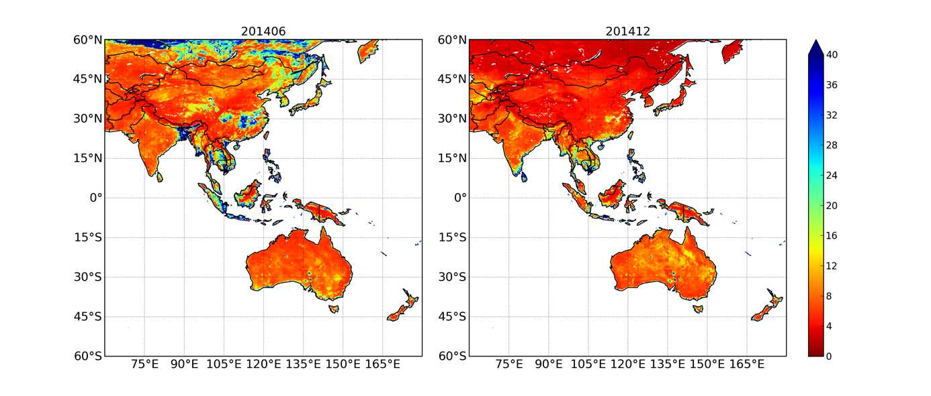
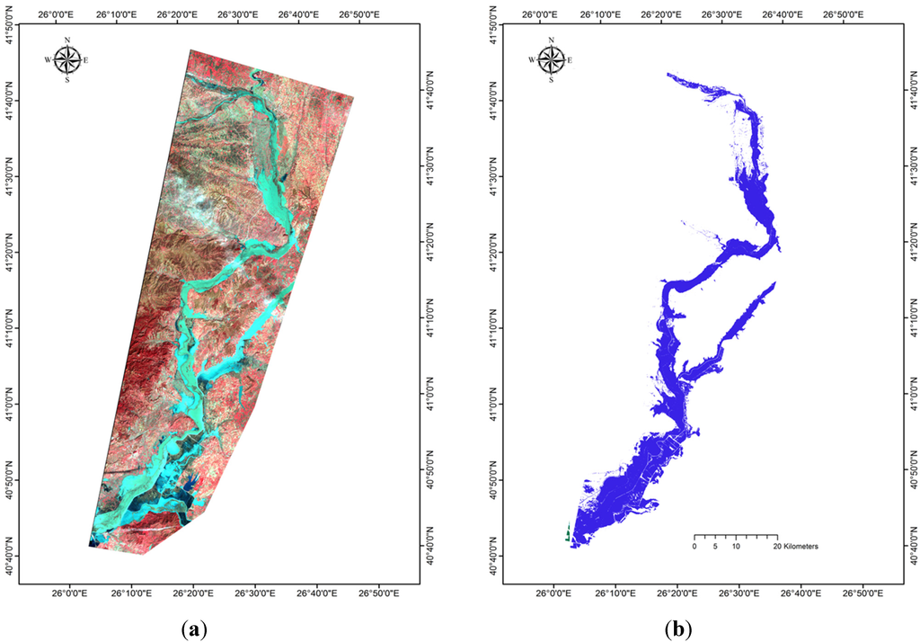
Non-Meteorological Applications:
Drought and Flooding
Near real-time monitoring of Drought and Flooding
  Drought : VHI (Vegetation Health Index)
  Procedure
    Improvement of sensitive variable in order to explain vegetation stress by VHI
    Considering seasonal and individual vegetation difference with respect to change weight of VHI and TCI (Temperature Condition Index)
  Flooding
  Procedure
    Using analysis technique development of GK-2A RGB and Reflection
Support Comprehensive Drought information systems of KMA
(Left) RGB composite, (right) detection of flooding region on Feb. 19, 2010 from Ireland et al., 2015
Potential linkage with WGDisasters
Notes:
As one of applications, NMSC will provide satellite based drought information based on Vegetation Health Index to KMA’s drought information system.
For doing this, optimal weight of VHI and TCI is being investigated considering vegetation types and seasonal variation.
*토양수분과 modified NDVI로 계산(from MODIS)
For the real-time flood monitoring, we will use high-resolution false color composite, refractive indices, vegetation indices and soil moisture, as well as GK-2A RGB images.

Slide 16
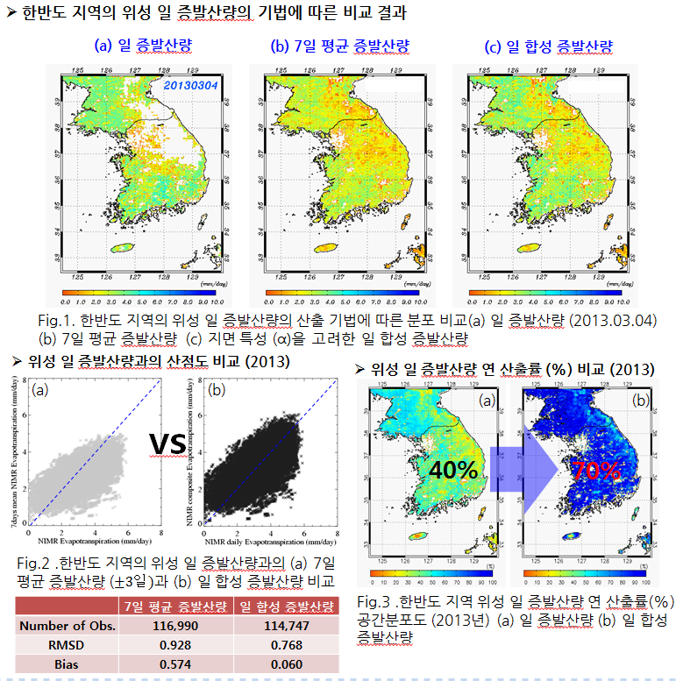
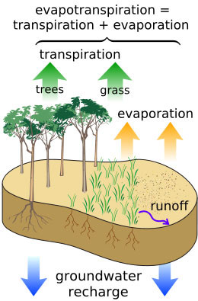
Non-Meteorological Applications:
Evapotranspiration
Comparison of evapotranspiration
a) Daily b) 7days(±3) average c) Synthetic daily
Scatter plot (2013.3.4)
Annual output rate
a) 7days(±3) average
b) Synthetic daily
a) daily
b) Synthetic daily
Rn = LE + H + G
➔ LE = Rn - H
 | 7days(±3) average | Synthetic daily
RMSD | 0.928 | 0.768
Bias | 0.574 | 0.060
Improve the Algorithm with coefficients and input data
H =
Potential linkage with LSI-VC
Notes:
Next item is Evapotranspiration which is important factor for climate monitoring and hydrology as well.
We are adopting the normal method which calculate evapotranspiration by difference between Net radiation flux(Rn) and Sensible heat(H) and generate daily, weekly and annual outputs.
We will keep trying to improve the evapotranspiration product algorithm.

Slide 17
Non-Meteorological Applications:
Essential Climate Variables (ECVs)
COMS-based ECVs long-term development plan(2011 yr)
  Content: International trend analysis, COMS-based ECVs definition, selection variables in the second step
COMS meteorological variables(L2) production
  Polar orbiting satellites(MetOp/IASI, Aqua/AIRS) verification system(GSICS), quality control
  COMs Level2 Production and regular service(Since April, 2011)
Domestic and international satellite-based ECVs data sharing and utilization system
  Objective: long-term securing of donsistent data
  (2015 yr) Primary ECVs (SST, INS, OLR) L3 unified system development
  (2016 yr) Second ECVs (Albedo, Precipitation, cloud fraction) Algorithm Improvement
ECVs Integrated System
COMS DN
Calibration
Level 1
COMS channel DATA
CMDPS Retrieval
Level 2
Products
Level 3
Products
GSICS
correction
CMDPS_CM Retrieval
Level 3 : reprocessed through the rough footage, the details check in the calibration process, including spatial
information grid-type satellite (composite) output
Potential linkage with WGClimate
Notes:
Finally, I’d like to talk about the ECVs related activities. We have been carrying out research to produce a satellite-based Essential Climate Variables (ECVs) since 2011. The research have contents of International trend analysis, COMS-based ECVs definition, and selection variables in the second step.
We also produce COMS level 2 data for ECVs and we also establishing ECVs integrated system for generating consistent long-term data.
*INS: Insolation/ OLR: outgoing longwave radiation

Slide 18
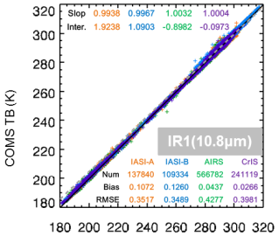
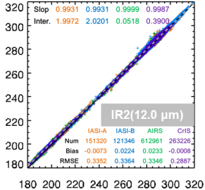
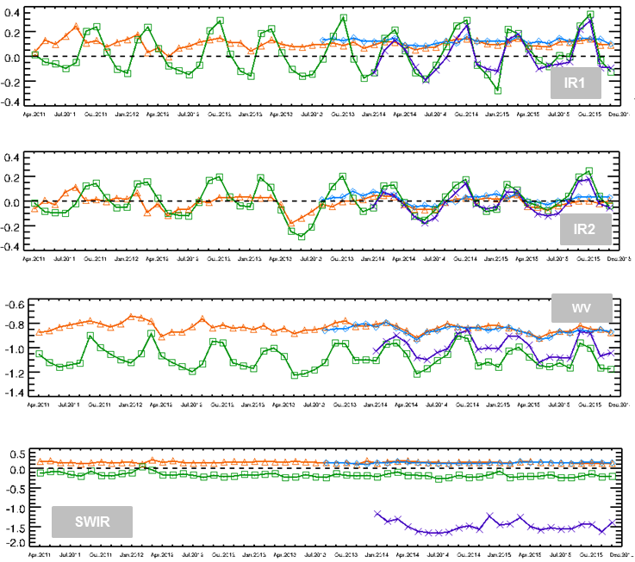
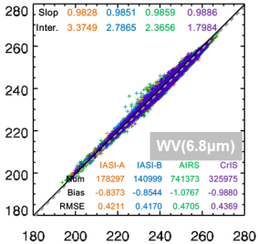
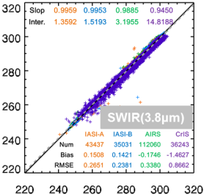
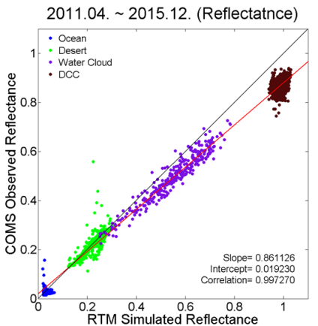
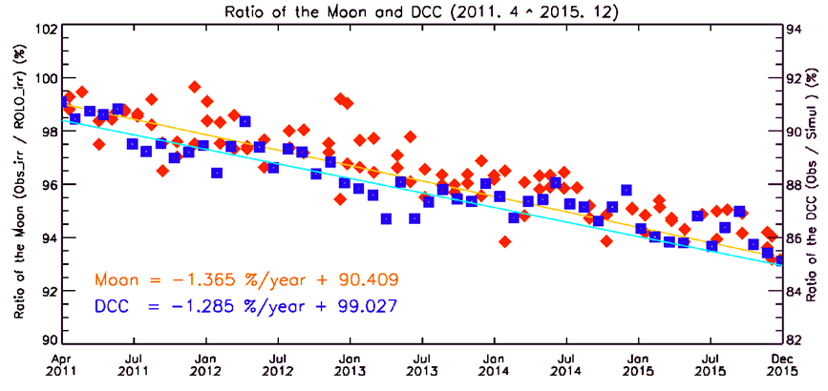
GSCIS Operational Calibration
check the TB bias for each IR channels
monthly variation of TB bias
COMS/MI has been monitored following GSICS
IR channel :
  use four well-calibrated hyper-spectral instruments on LEO satellites(MetOp-A,B/IASI, Aqua/AIRS, and SNPP/CrIS)
Visible channel:
  installed vicarious calibration system for visible channel using 5targets.(Ocean, Desert, Water Cloud, DCC, and Moon)
Long-term monitoring
COMS TB (K)
COMS TB (K)
LEO TB (K)
LEO TB (K)
Scatter plot
using ocean/desert/WC/DCC
Results of Moon and DCC (RTM)
Potential linkage with WGCV

Slide 19
Expansion of
Earth Observation:
LEO program
Notes:
In order to expand earth observation sustainably, Currently, KMA makes a plan to launch

Slide 20
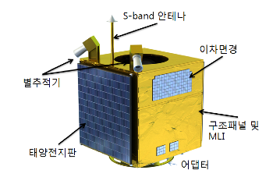
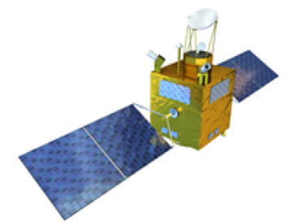
LEO Satellite Program
Development (plan) : ~ 2022 (or later)
Altitude/orbit : 500~900km / Sun-synchronous (TBD), dawn-dusk orbit
Satellite : ~500kg(CAS 500), instrument : ~150kg
Possible Instrument : MW Sounder such as ATMS, AMSU, SSMIS
: CRIS with limited channels
: GPM
~ one or two instrument due to the weight of payloads(~150kg)
~ instrument type will be decided for feasibility test
International cooperation / joint development for payload and sensors
Standard Bus System~ 500kg (Mid size sat.)
Meteorological Observation
Notes:
Now KMA in coordination with other government organization is under Phase 0 to design meteorological mission on LEO orbit using CAS 500 platform.
We also discuss about adopting MW sounder for LEO sensor.

Slide 21
LEO Satellite Program
Plan research
2015-16
User requirement of LEO satellite
- Prepare report for feasibility test
- two projects are undergoing.
Secure
a budget
2017
Feasibility test for LEO satellite (Nov 2016 ~)
- Execute the feasibility test for securing budget for LEO satellite
including technical and economical validity
Development of the LEO satellite
- Kick-off development of LEO satellite program
- Satellite bus, system integration and developing testing technique
- Ground segments development and secure a image quality technique
Satellite
development
2018-
Launch
/Utilization
2022-
Application of data Utilization plan
- Apply to weather, climate, earthquake, volcano, disaster, etc.
- Data utilization research for global water/climate, etc.
- Supply standard input data of numerical model
Notes:
In parallel with GEO-KOMPSAT program, KMA has plan to launch a LEO meteorological satellite program.
1st phase of the Korean CAS-500 LEO program started on this year.
And Korea government is preparing for the feasibility study of 2nd phase of this program in this year.
The KMA’s meteorological mission will be the part of this 2nd phase of LEO satellite program.
The progress has been delayed a little bit as KMA reported last year, but KMA tries to keep the launch in 2022.

Slide 22


THANK YOU!

Slide 23
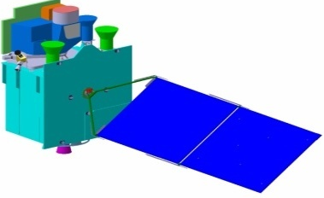
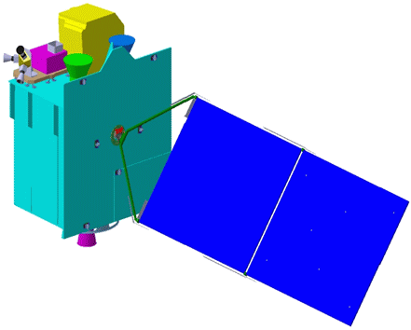

Geo-KOMSAT-2 Program
GK-2A with the next generation Imager and SWx monitoring sensors
  continuing and enhancing COMS’ mission of sever weather monitoring and supporting other KMA’s application
Meteorological Sensor
Space weather Sensor
Geo-KOMPSAT-2A
Geo-KOMPSAT-2B
Ocean / Trace Gas
Ground Segment
Data Processing System
Notes:
Ministry of Environment (ME), Korea, is developing the Geostationary Environmental Monitoring Spectrometer (GEMS) for atmospheric composition measurements in the Asia-Pacific region.

Slide 24
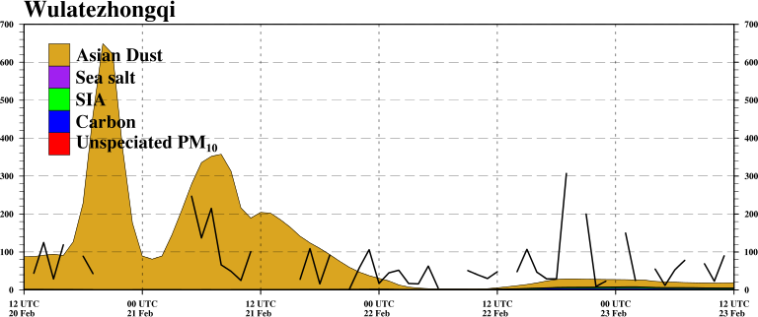
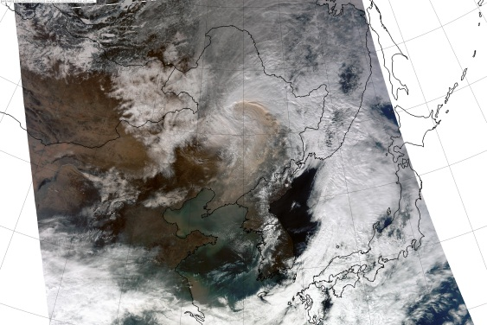
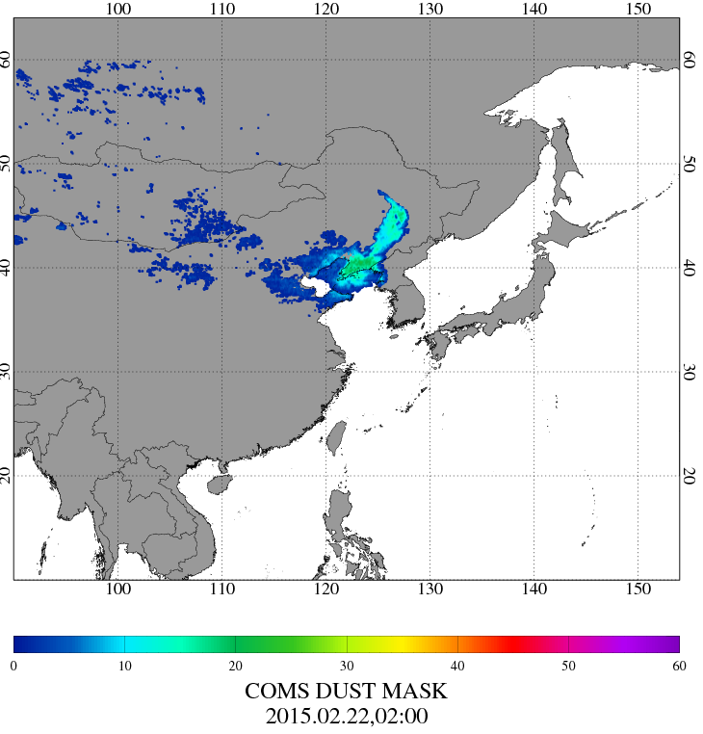
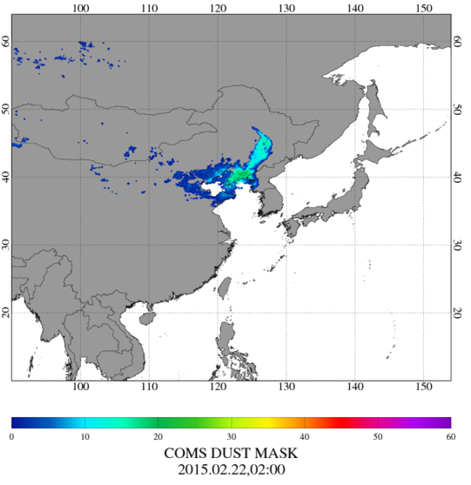
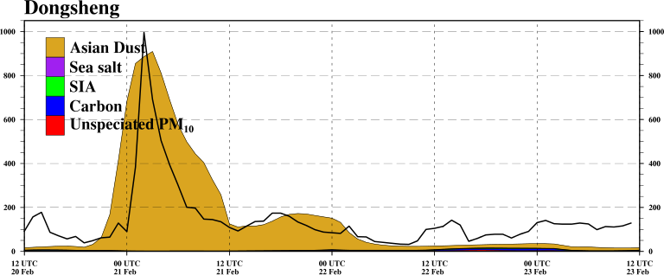
Detect Asian Dust
(Potential linkage with AC-VC)
Read COMS L1B data at the given time
Cloud Screening
(BTD > 0.5K)
For dynamic BTV
Extract Maximum BT_{11㎛} during 15 days
Calculate BTV at time with Maximum BT_{11㎛}
BTV = 11㎛ – 12㎛
Dust if BTD – BTV < -0.5
With the application of dynamic BTV,
we can get the reduction of false signal of dust over China region
02:00UTC Feb 22. 2015
Notes:
황사탐지 : BTD(11-12) – BTV < -0.5 이하 일 때 황사로 탐지
BTV는 황사가 발생하지 않을 때의 배경장값을 의미함.
- 개선사항 : 황사탐지 배경장(BTV) 개선
o. 기존 : 2011년 4월 한달의 자료를 이용하여 BTV 생산, 모든 계절에 적용
o. 문제점 : 중국 내륙 황사 발원지부근 오탐지 및 과대탐지 발생
o. 방향 : 매 시간 탐지시 15일 동안의 자료를 이용하여 BTV 생산, 적용
o. 결과 : 오탐지 감소

Slide 25
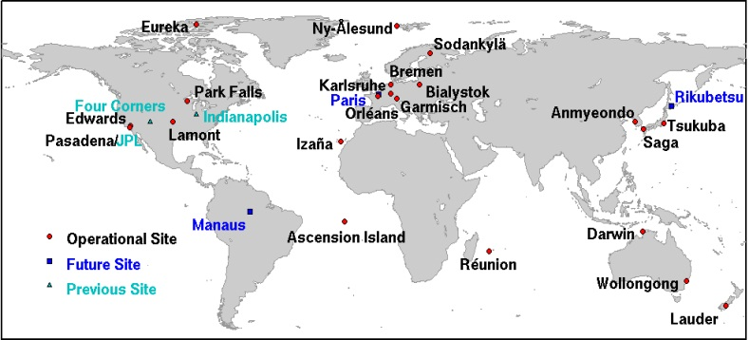
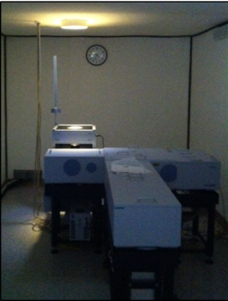



XCO2 Retrieval and Validation
(Potential linkage with AC-VC)
Research background
- Inaccurate aerosol optical information can lead to significant XCO₂ retrieval error up to 2.5 ppm (Jung et al., 2016).
Objectives
- Ground validation to the satellite-based XCO2 retrievals against those retrieved from the Fourier Transform Spectrometer (FTS) at Anmyeondo, Korea that is one of the operational sites in TCCON (Total Carbon Column Observing Network)
Objectives
The developments of XCO₂ retrieval algorithm using SWIR from TANSO-FTS with accurate aerosol information retrieved from TANSO-CAI
Yonsei
CArbon
Retrieval
– CAI
(YCAR-CAI)
Preliminary results of 2015
- Period: Jan ~ Dec, 2015
- Data: Hourly-mean XCO2 from the ground-based FTS
Spatially-averaged XCO2 from the GOSAT and OCO-2
The Validation
with ground-based FTS
over East-Asia
 | YCAR – CAI | NIES
N. Collocation (N_{total} = 2554 ) | 297 (11.6 %) | 205 ( 8.0%)
N. Daily | 57 | 46
Slope | 1.04 | 0.79
Bias [ppm] | -0.39 | 1.42
Standard deviation [ppm] | 50.71 | 57.53
RMSE [ppm] | 2.09 | 1.83
R | 0.818 | 0.778
Notes:
CO2 산출에 있어서 에어러솔의 정보는 가장 중요한 요소이며,
부정확한 에어러솔 정보를 가정할 시 최대 2.5 ppm의 에러를 발생시킨다고 보고된 바 있다 (Jung et al., 2016)
이에, 본 연구에서는 TANSO-FTS의 SWIR 채널을 이용한 XCO2 산출 알고리즘을 개발하였으며,
TANSO-CAI를 이용한 에어러솔 산출 알고리즘으로부터 제공된 에어러솔 광학정보를 활용하며,
에어러솔에 의한 CO2 산출 에러를 감소시키고자 하였다.
YCAR-CAI 알고리즘으로 명명하였으며,
이는 크게 전처리 및 구름 제거 단계, 산출 단계 및 후처리 단계로 나뉠수 있다.
(Flow chart)
산출 단계는 위성으로부터 얻은 geometry와 대기 및 지표 정보로부터 CO2 Profiles, 온도, 압력 및 지표면 알베도 등을 설정하고,
설정된 기체 정보에 대한 Absorption coefficients를 이용하여 Forward model을 이용하여 복사 휘도 및 각 상태변수의 자코비안을 모의한다.
Inverse model에서는 설정된 상태변수의 사전정보(a priori)와 공분산 행렬등을 이용하여 반복수행을 통해
모의된 복사 휘도와 위성 관측된 복사휘도의 차이를 줄여가는 Optimal estimation 방법을 이용하였다.
이때 에어러솔 정보로 TANSO-CAI 을 이용한 에어러솔 산출 알고리즘의 산출값을 활용하였다.
(validation)
YCAR-CAI 산출물은 TCCON 지상 관측 자료와 비교하였으며, 동아시아 지역 TCCON 관측망인 Saga와 Tsukuba 지역에서 실시하였다.
그림과 표 에서 보는 바와 같이 YCAR-CAI 산출물은 GOSAT 현업 산출물(NIES)에 비해 Bias가 적고, 높은 상관계수를 나타내고 있으며,
특히 현업 산출물에 비해 약 40% 증가된 산출률을 나타내었다.

Slide 26


Observation of Soil Moisture
Procedure
To develop composited soil moisture(weekly) using bias corrected SMOS, AMSR2 SM
Downscaling soil moisture(25km) to 4km using OI correlated with landuse
SSMIS Soil moisture
AMSR2+SMOS Synthetic high-resolution soil moisture
2014.12.25~31
Improvement
Supporting Drought information systems

