Slide 1
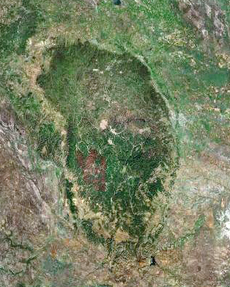
Committee on Earth Observation Satellites
31st CEOS Plenary
Black Hills National Forest
Rapid City, South Dakota
October 2017

Slide 2
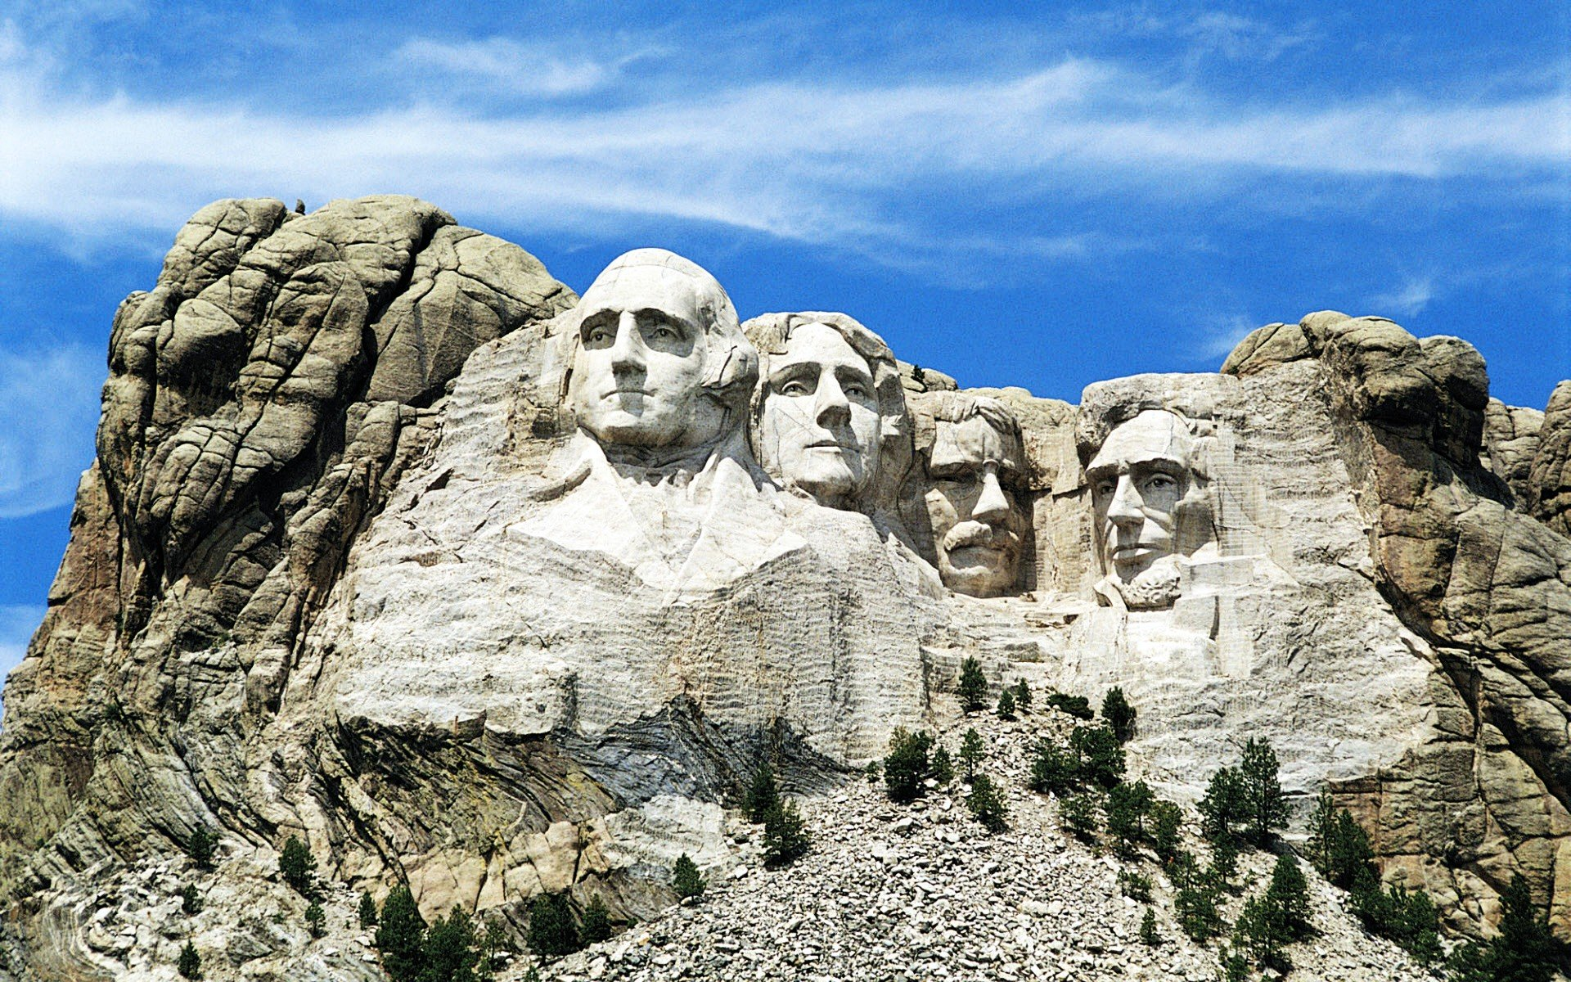
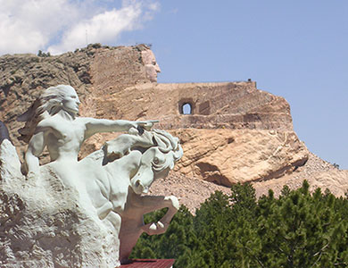
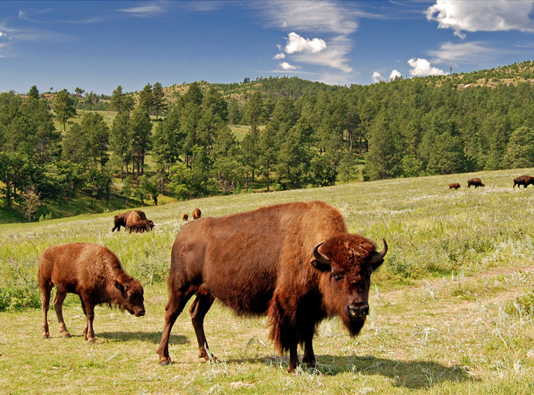
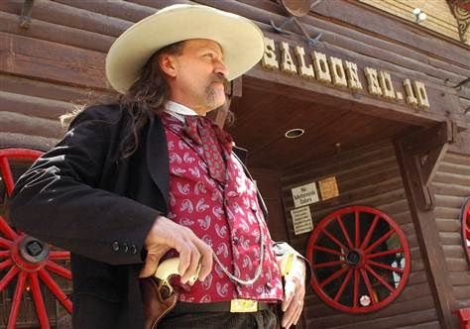
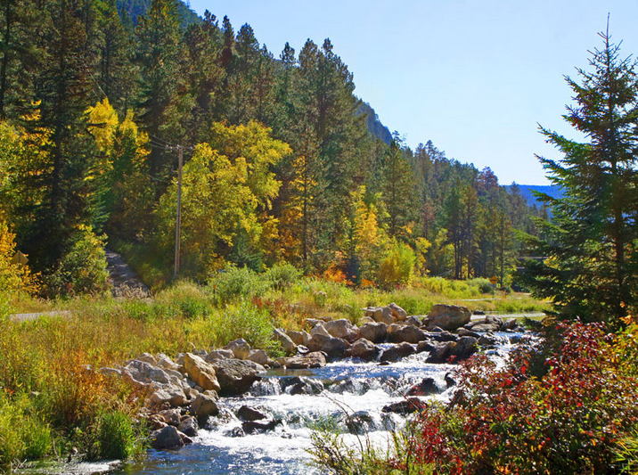
CEOS 31 – Rapid City, South Dakota Black Hills National Forest

