Slide 1
Committee on Earth Observation Satellites
Introduction of UNISPACE +50
JAXA
Plenary Agenda Item # 30
29th CEOS Plenary
Kyoto International Conference Center
Kyoto, Japan
5 – 6 November 2015

Slide 2
CEOS Pkenary @ Kyoto
30_Horikawa_v0.ppt
UNISPACE+50 toward 2018
Nvember 6, 2015
Yasushi Horikawa
Former Chair of the UNCOPUOS
Technical Counselor, JAXA

Slide 3
2018 “UNISPACE+50” THEME OF STSC, LSC and COPUOS
UNISPACE conferences I in 1968
II in 1982
III in 1999
2018 marks the 50th anniversary of UNISPACE I.
The 50th anniversary is an opportunity to consider the current status and chart the future role of COPUOS at a time when more actors, both governmental and non-governmental, are increasingly involved in ventures to explore space and carry out space activities.
The post-2015 development agenda was adopted in 2015 at GA with the establishment of new Sustainable Development Goals. This major target argues for stronger space governance and supporting structures in the future at all levels, including improved spatial data infrastructure.

Slide 4
Towards 2018,
joint GA First Committee and Fourth Committee session on TCBM last month and COPUOS action to the safety of space operations and the long-term sustainability of outer space activities in 2016
10th anniversary of International Cordination on GNSS (ICG) in 2015
10th anniversary of UN-SPIDER in 2016
50th anniversary of the Outer Space Treaty in 2017
LTS guidelines to be adopted in 2016
LSC on international mechanisms on international cooperatin to be concluded in 2017
NEO coordination mechanisms of SMPAG and IAWN being established
work plan for the socioeconomic and sustainable development of STSC and COPUOS to be concluded in 2018
new working mechanisms for considering space weather and global health at STSC
next International Space Exploration Forum (ISEF) planned in 2016/17

Slide 5
UNISPACE+50 Thematic priorities and synergies
Thematic priorities of STSC, LSC and COPUOS building upon the cross-cutting topics of:
Governance
Capacity-building
Resiliency
Interoperability
Space for sustainable development
Considerations on governance structure such as national spatial data structures, regional and inter-regional coordination mechanisms, potential new mechanisms for resiliency and interoperability such as in the field of DRR and NEO, TCBM and LTS within the broader concept of space security
Accommodation on the results of;
UN summit in Sep. 2015 to adopt post -2015 development
agenda, including SDGs,
Third UN World Conference of Disaster Risk reduction and its
outcome on a framework for disaster risk reduction for 2015-2030, and
COP-21 in Paris Nov.-Dec. 2015

Slide 6
Structure of UNISPACE+50
The Group of Bureau Members (G-15), including Working Group chairs of COPUOS, STSC and LSC and the Director of UNOOSA, serves as the steering committee for the preparations of 2018.
Each intergovernmental body should address the overarching theme of “UNISPACE+50” under their respective agendas, and States members of the Committee and permanent observers would be encouraged to address certain thematic priorities under this overall framework, to be agreed in the preparatory years 2015-2017.
All Member States of the United Nations and the broader space community, including UN entities, other intergovernmental and non-governmental organizations such as CEOS and the private sector, should be invited to participate in a dedicated commemorative segment of COPUOS in June 2018.
This month steering committe will be held together with a seminar.

Slide 7
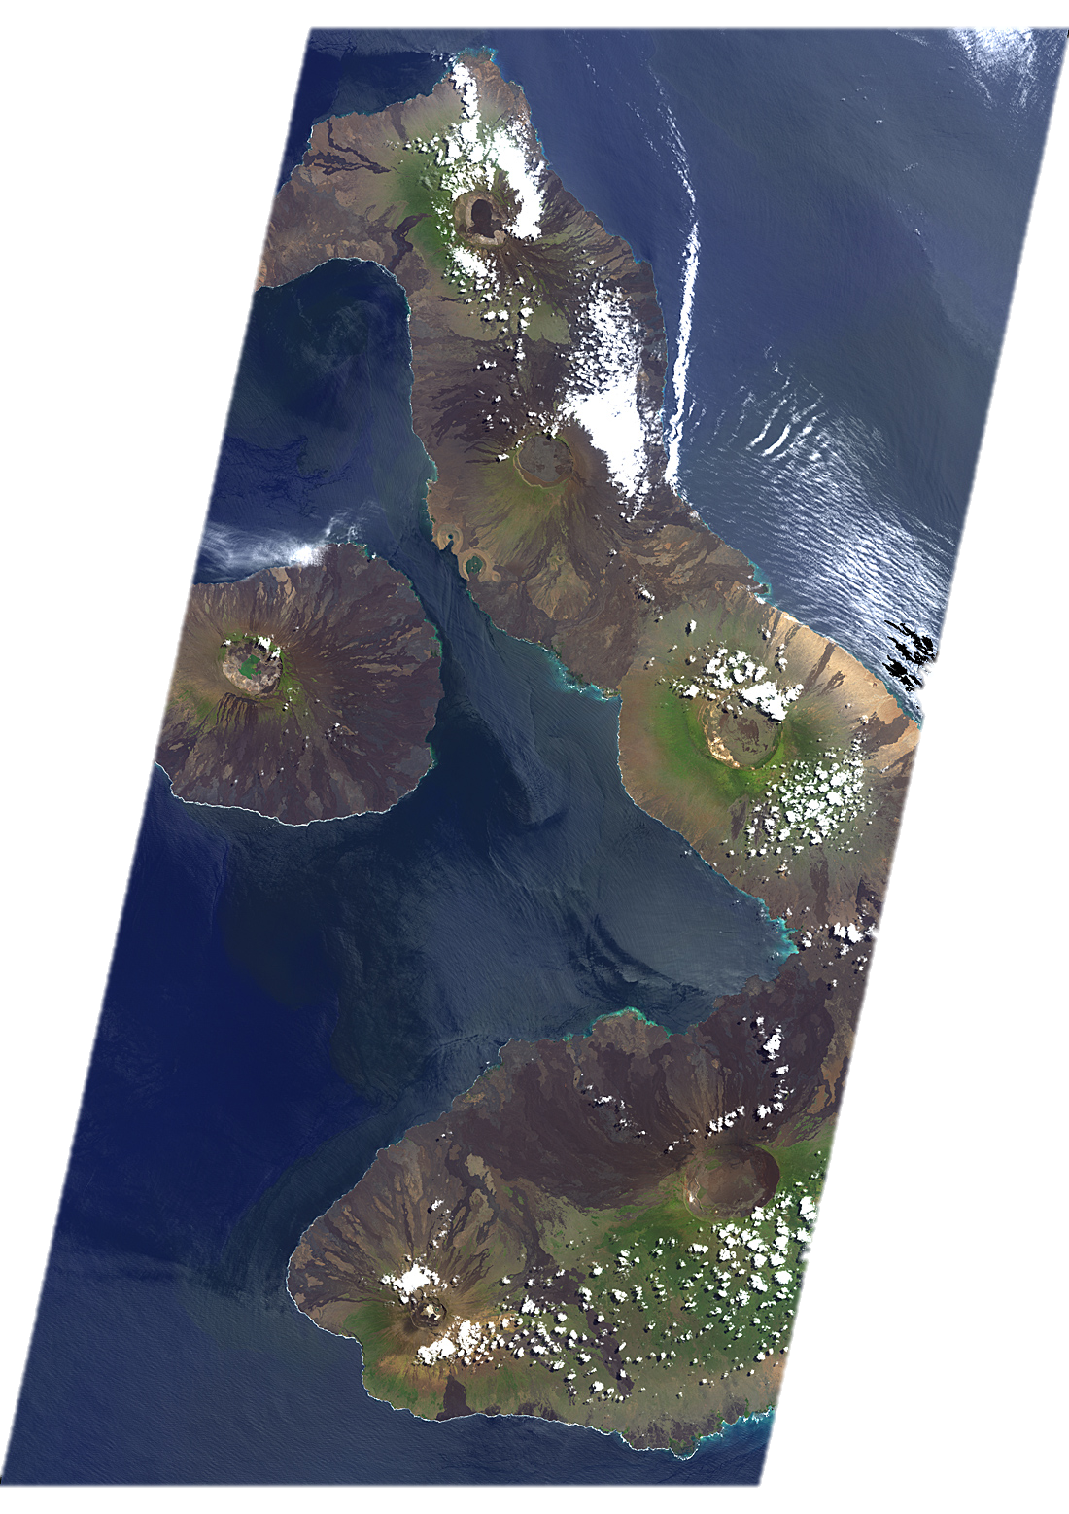
Please visit web sites !
http://www.oosa.unvienna.org/oosa/COPUOS/copuos.html
Thank you for your attention

