Slide 1
NOAA Satellite and Information Service Overview
Dr. Stephen Volz, Assistant Administrator
NOAA
Plenary Agenda Item 30
29th CEOS Plenary
Kyoto International Conference Center
Kyoto, Japan
5 – 6 November 2015

Slide 2
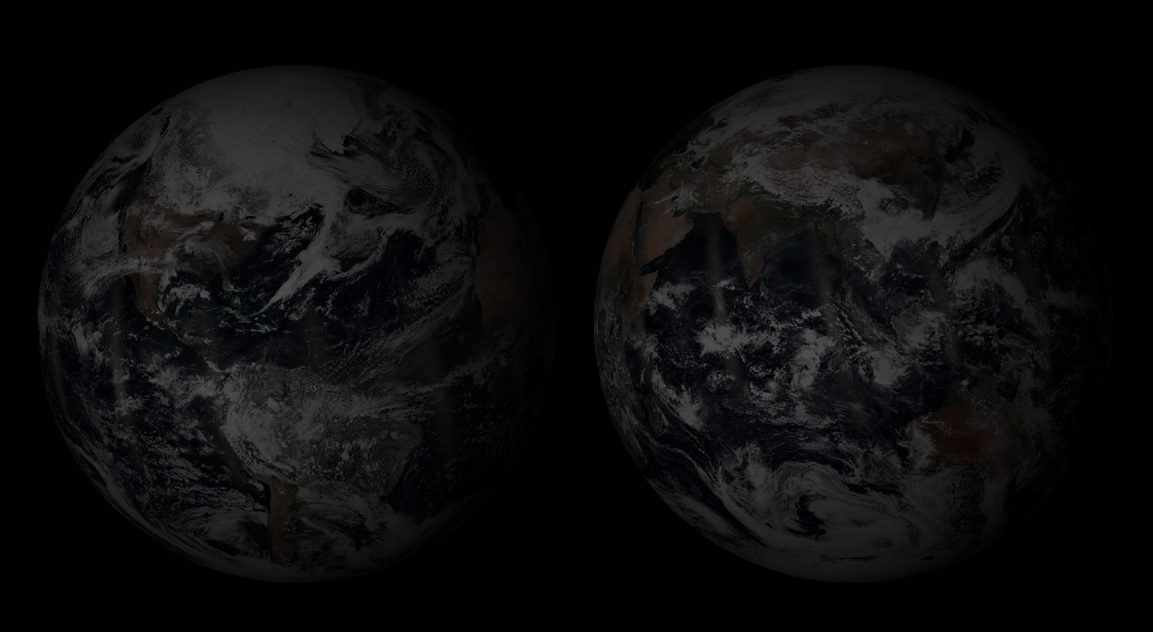
NOAA-NESDIS Mission & Challenge
Our mission is to deliver accurate, timely, and reliable satellite observations and integrated products and to provide long-term stewardship for global environmental information in support of our Earth observation mission.
Our challenge is to provide these observations and products reliably while improving the information content and evolving to stay current with the expanding complexity of the Earth observing contributors.
Notes:
Our mission is to deliver accurate, timely, and reliable satellite observations and integrated products and to provide long-term stewardship for global environmental information in support of our Earth observation mission.
This is includes supporting NOAA’s mission – and National Weather Service forecasts, as well as global efforts such as the Global Framework for Climate Services.
Our challenge is to provide these observations and products reliably while improving the information content and evolving to stay current with the expanding complexity of the Earth observing contributors.

Slide 3
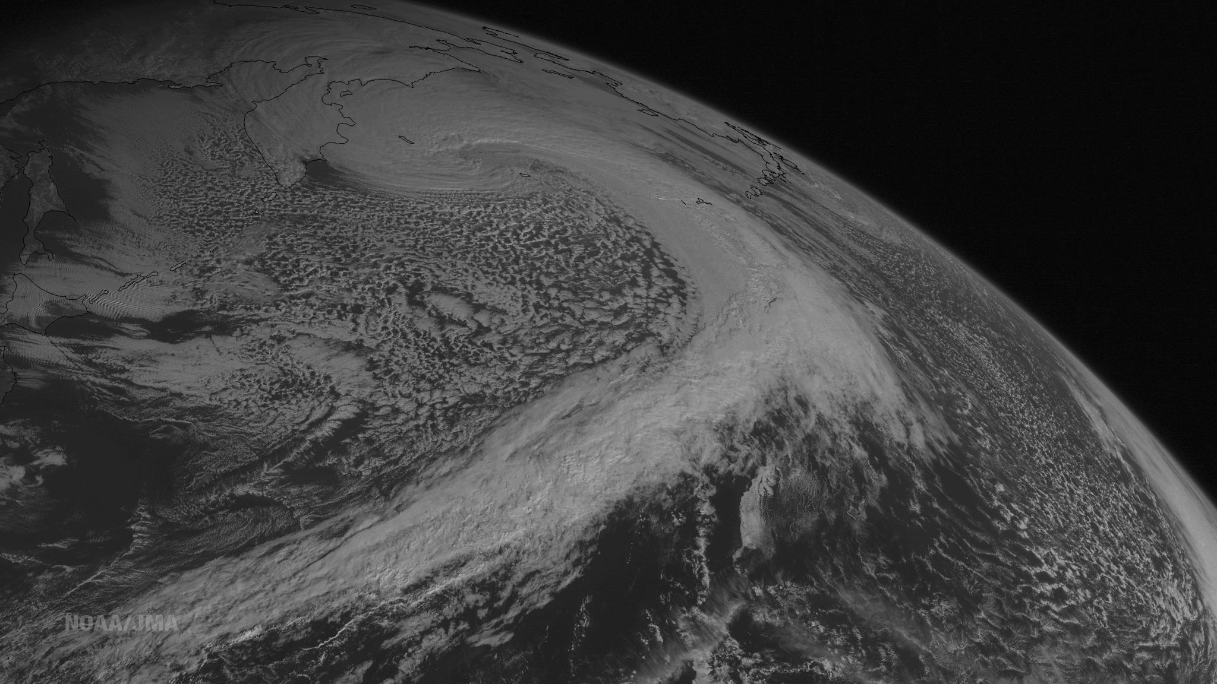
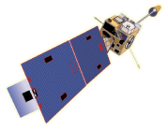
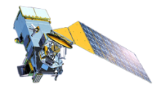
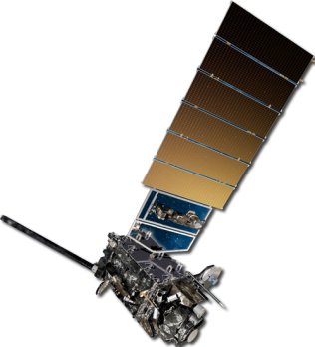
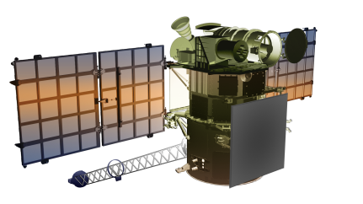
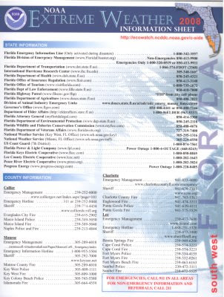
NESDIS Principal Activities
Currently Providing 24/7 On-Orbit Satellite Operations
Geostationary satellites (GOES)
Polar-orbiting satellites (POES)
Defense Meteorological Satellite Program (DMSP)
Jason-2 Altimetry Satellite
Suomi National Polar-orbiting Partnership (S-NPP)
DSCOVR (Space Weather Continuity)
Acquiring Next Generation Satellites
Jason-3 Altimetry Satellite – Launch NET December 15, 2015
COSMIC-2 Radio Occultation – Launch NET September 2016
GOES–R Satellite Series – Launch N Hemisphere Fall 2016
Joint Polar Satellite System – Launch N Hemisphere Winter 2016/2017
Providing Long Term Data Stewardship
Conducting Research and Developing Operations
POES
GOES
JPSS
GOES-R
DSCOVR
NCEI
Notes:
NOTES FOR Operational status and issues with DSCOVR
DSCOVR “handed-over” from NASA on October 27th
Have experienced anomalies with Faraday Cup – data bias successfully mitigated, commissioning activities continue to determine final operational level
Believe that we can provide full suite of reliable products by March 2016
NOTES FOR Jason-3:
SpaceX delivered their launch failure investigation report on XXX (Need to update when released)
Jason-3 partners working to preserve Jason-3 December launch date in the event SpsaceX can be certified for launch
Western Range closed for about 6 months in 2016 – lead to 2017 launch of Jason if December 2015 launch is postponed
Spacecraft currently in storage at SpaceX facility at Vandenberg Air Force Base

Slide 4
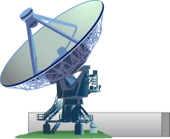
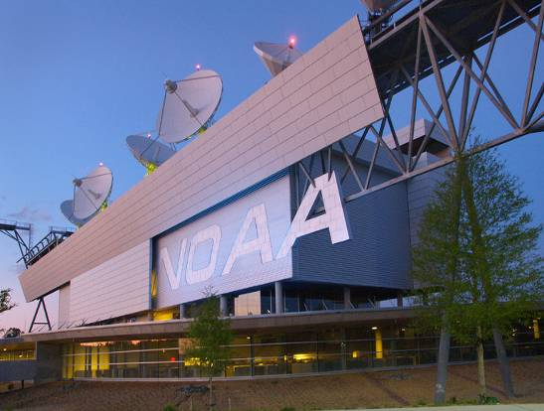
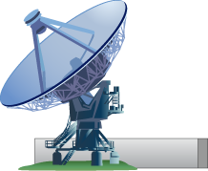
NESDIS Architecture
METOP
Meteosat
MTSAT
NASA EOS
Sentinel
Other Agencies
Commercial Data
GOES
POES
Suomi NPP
JASON-2
DMSP
COSMIC
DSCOVR
NOAA Satellite Operations Facility
Wallops, VA
Ground Station
Fairbanks, AK
Ground Station
Svalbard, Norway
Ground Station
Environmental Satellite Processing Center
McMurdo, Antarctica
Ground Station
Satellite Applications
Direct Services
NWS NCEP
NWS WFOs
USAF
USN
Others
Data & Products
SmallSats
Single & Merged
Data & Products
Cubesats
Hosted Payloads
Archive
Notes:
Our current data flow supports NOAA’s objectives - from raw satellite data to useful, operational, transparent products and services to users. But, are looking at how future data flows may change as both the NOAA and global constellations evolve.
For our new architecture we are focused on developing a space-based observing enterprise that is flexible, responsive to evolving technologies, and economically sustainable.
We seek an End-to-End Solution, considering all elements of the Earth Observing System
Focus the space observation constellation to achieve flexibility, leverage technology, and achieve greater efficiencies;
Establish Enterprise Ground to maximize efficiencies, minimize complexity, and reduce cost both in the ground system and in the development of operational data products;
Establish program management and integration structures to minimize overhead, simplify interfaces, and enable flexibility in execution and acquisitions;
Establish Enterprise Architecture and Enterprise Systems Engineering and Integration as a core competency of NESDIS; and
Partner with NASA, other Labs, Industry, and Academia to leverage investments in science and technology to enable more frequent and predictable refresh opportunities.
NOTES FOR NOAA Commercial Space Policy
NOAA policy reviewed under open public comment period. Comments being addressed.
NESDIS Commercial Process under development. Release TBD for open public comment period.
NESDIS is planning a workshop during open comment period to interact with interested parties.

Slide 5
Environmental Information
Maximize the Return on Investment of the Nation’s Earth Observing Satellites Systems
National
Climatic Data Center
National Ocean Data Center
National Geophysical Data Center
Ensure a high scientific quality satellite data stream
Develop science to maximize the utilization of the different satellite data
Analyze and interpret data for decision making purposes
https://www.ncei.noaa.gov/
Notes:
We are looking at ways to improve our product development and distribution.
Recently, we integrated the three National Data Centers into the new National Center for Environmental Information - NCEI – structure.
By using consistent data stewardship tools and practices across all science disciplines and by forging an improved data management team, users will see an improvement in the overall value of our environmental data archives.
The transition to NCEI will take time, with the final integration anticipated beyond 2020.
An overriding principle throughout the formation of NCEI is transparency to our users and commitment to continuing to provide the geophysical, oceans, coastal, weather and climate data users have come to rely on.
In addition, we are working to integrate STAR and the Centers with the rest of NESDIS for product development and distribution.
We are also exploring some non-traditional models for distributing our data.

Slide 6
Summary
Maintain planned satellite launch schedules
Maintain 24x7 satellite operations, product development, processing and distribution
Operate and maintain NOAA’s long-term archival storage capacity and provide access to preserved climatological, oceanographic and geophysical data
Developing commercial satellite policy and process
Evolve a space-based observing enterprise
Increased responsiveness to evolving technologies
Notes:
Later this year, in addition to continuing to ramp up to the Jason-3 launch, we’re working on these activities. I’ll note that are working to cooperate more closely with the private sector through a variety of mechanisms, and are also working to plan the follow-on mission to DSCOVR.

