Slide 1

Committee on Earth Observation Satellites
Agency Report (JAXA)
JAXA (Japan aerospace Exploration Agency)
Plenary Agenda Item 30
29th CEOS Plenary
Kyoto International Conference Center
Kyoto, Japan
5 – 6 November 2015

Slide 2
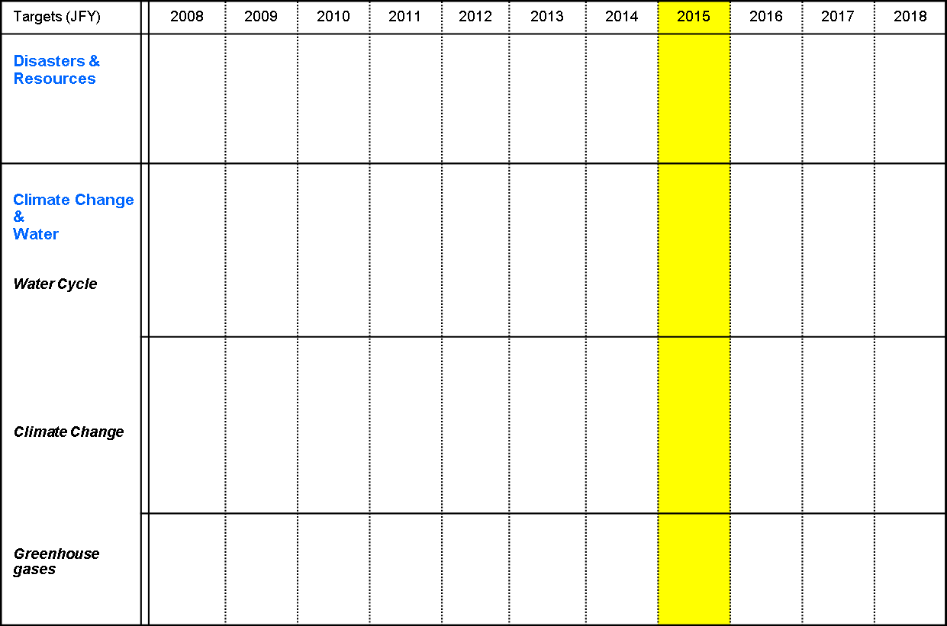
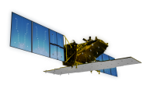







JAXA Earth Observation Satellites
[Land and Disaster monitoring]
ALOS/PALSAR
ALOS-2 PALSAR-2
ALOS
ALOS/PRISM AVNIR2
TRMM/PR
[Precipitation]
TRMM
GPM / DPR
Aqua/AMSR-E
Aqua
GCOM-W / AMSR2
[Wind, SST , Water vapor]
[Vegetation, aerosol, cloud, SST, ocean color]
250m, multi-angle, polarization
GCOM-C / SGLI
[Cloud and Aerosol 3D structure]
EarthCARE / CPR
[CO_{2,} Methane]
[CO_{2,} Methane, CO]
GOSAT
GOSAT-2
Mission status
On orbit
Phase C/D
Under Development

Slide 3
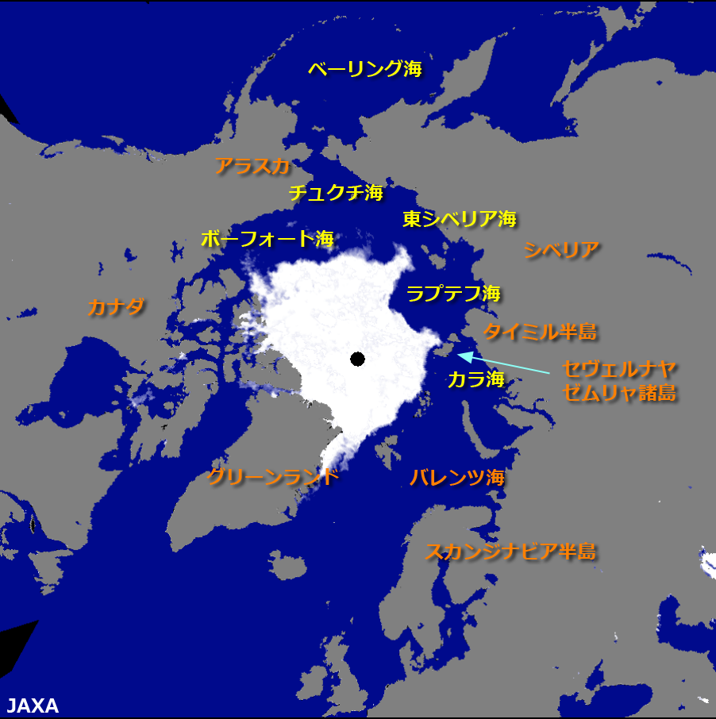
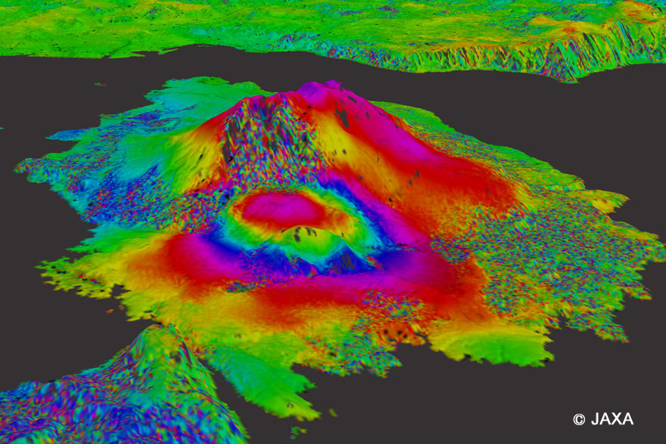
Recent Products.
Environment Natural Disaster
Sea ice around North pole by AMSR2
2015/September/14th 426km²
Sakurajima Active volcano by ALOS-2 In-SAR
2015/ Jan. 4ht – Aug. 16th

