Slide 1

Committee on Earth Observation Satellites
Status of EUMETSAT programmes
Alain Ratier, Director-General
Plenary Agenda Item #30
29th CEOS Plenary
Kyoto International Conference Center
Kyoto, Japan
5 – 6 November 2015

Slide 2
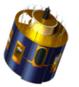
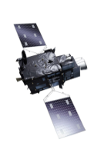
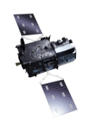
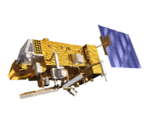

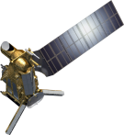
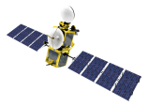
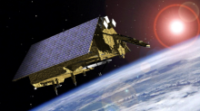
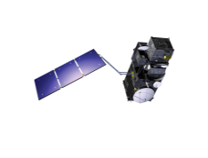
EUMETSAT mission planning
YEAR...
03
04
05
06
07
08
09
10
11
12
13
14
15
16
17
18
19
20
21
22
23
24
25
26
27
28
29
30
31
32
33
34
35
36
37
38
39
40
METEOSAT SECOND GENERATION
METEOSAT-8
METEOSAT-9
MSG-3/METEOSAT-10
MSG-4/METEOSAT-11*
METEOSAT THIRD GENERATION
Mandatory Programmes
MTG-I-1 : IMAGERY
MTG-S-1: SOUNDING
MTG-I-2: IMAGERY
MTG-I-3: IMAGERY
EUMETSAT POLAR SYSTEM (EPS)
MTG-S-2: SOUNDING
METOP-A
MTG-I-4: IMAGERY
METOP-B
METOP-C
EUMETSAT POLAR SYSTEM SECOND GENERATION (EPS-SG)
METOP-SG A: SOUNDING AND IMAGERY
METOP-SG B: MICROWAVE IMAGERY
JASON (HIGH PRECISION OCEAN ALTIMETRY)
JASON-2
Optional Programmes
JASON-3
SENTINEL 6 (JASON-CS)
COPERNICUS
Third Party Programmes
SENTINEL-3 A/B/C/D
SENTINEL-4 ON MTG-S
YEAR...
SENTINEL-5 ON METOP-SG A
03
04
05
06
07
08
09
10
11
12
13
14
15
16
17
18
19
20
21
22
23
24
25
26
27
28
29
30
31
32
33
34
35
36
37
38
39
40

Slide 3

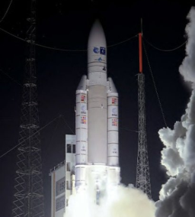
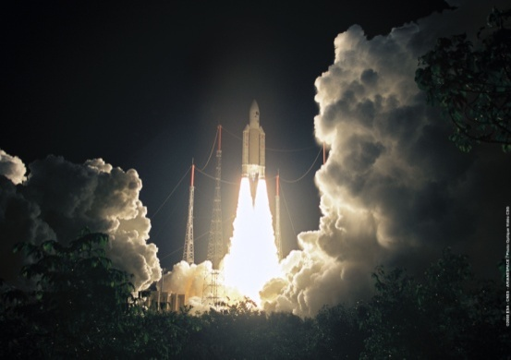
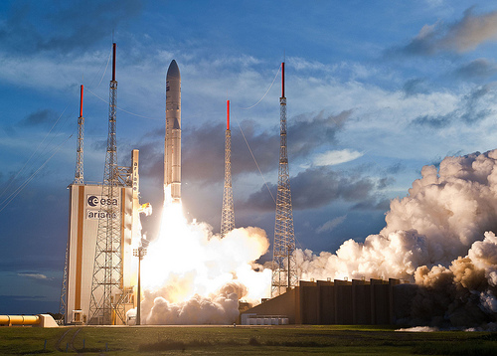
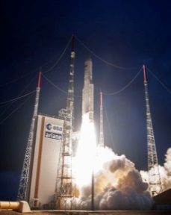
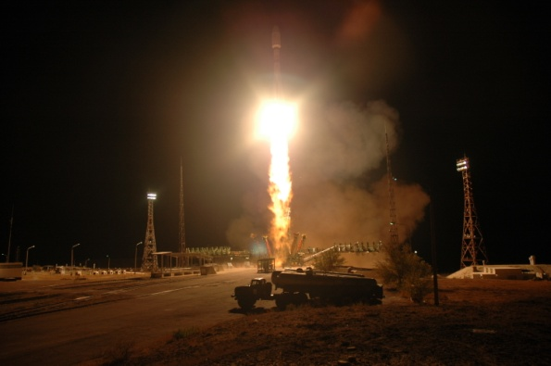
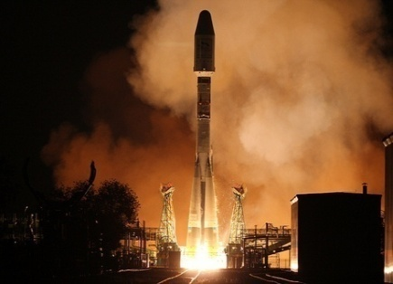
Deployment of current generation satellite
MSG-1
(Meteosat-8) launch
28 August 2002
MSG-2
(Meteosat-9) launch
21 December 2005
MSG-3
(Meteosat-10) launch
5 July 2012
MSG-4 launch
15 July 2015
METEOSAT SECOND GENERATION
METEOSAT-8
METEOSAT-9
MSG-3/METEOSAT-10
MSG-4/METEOSAT-11*
YEAR...
2002
2003
2004
2005
2006
2007
2008
2009
2010
2011
2012
2013
2014
2015
2016
2017
2018
2019
2020
2021
2022
2023
2024
2025
EUMETSAT POLAR SYSTEM (EPS)
METOP-A
METOP-B
METOP-C
Metop-A launch
19 October 2006
Metop-B launch
17 September 2012

Slide 4

Next relevant launches
Jason-3
15 December 2015 (cooperation with NOAA, NASA, CNES and the EU, with ESA contribution)
Sentinel-3A
23 December 2015 (EU Copernicus mission, developed by ESA, marine mission operated by EUMETSAT
Sentinel-3

Slide 5
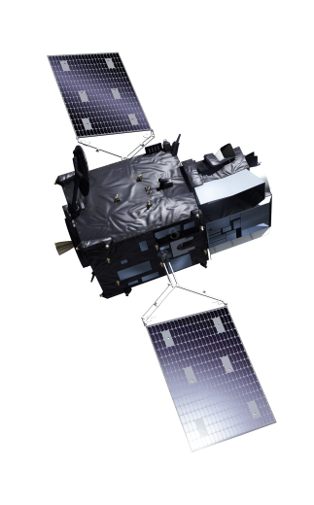
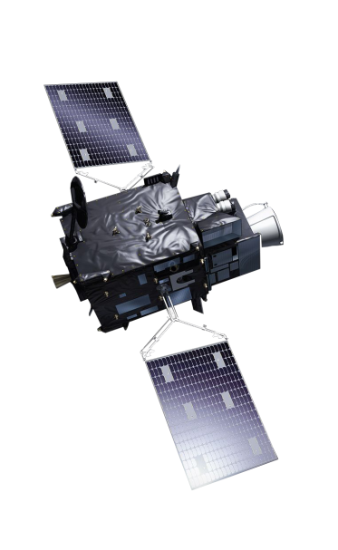
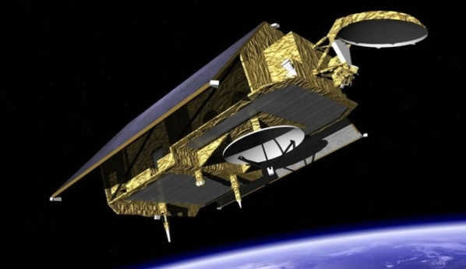
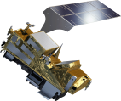
EUMETSAT future programmes
MTG: Approved, under development
Sentinel-4 approved (2 instruments funded by ESA)
Contribution to Jason-CS/Sentinel-6 :
Approved in September 2015
Collaborative mission with EU, ESA and NASA/NOAA
EPS-SG : Approved in June 2015
Sentinel-5 development approved at CMIN14
Recurrent Sentinel-5 instruments funded by EU/Copernicus

Slide 6

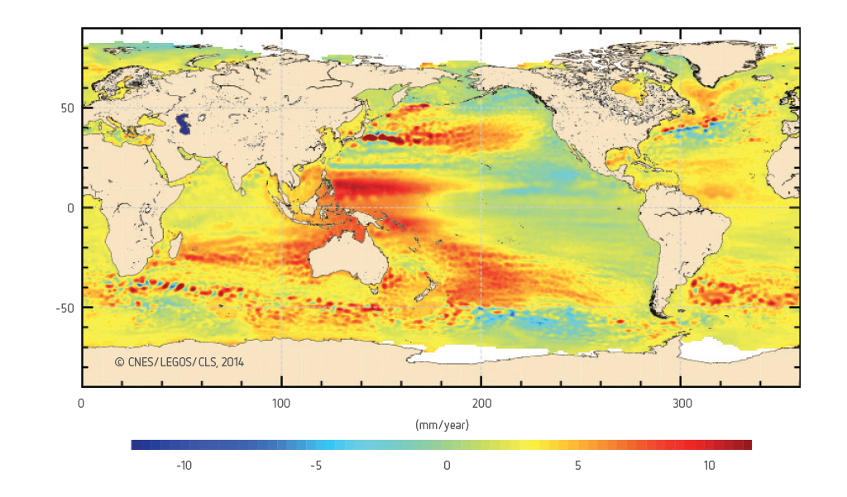
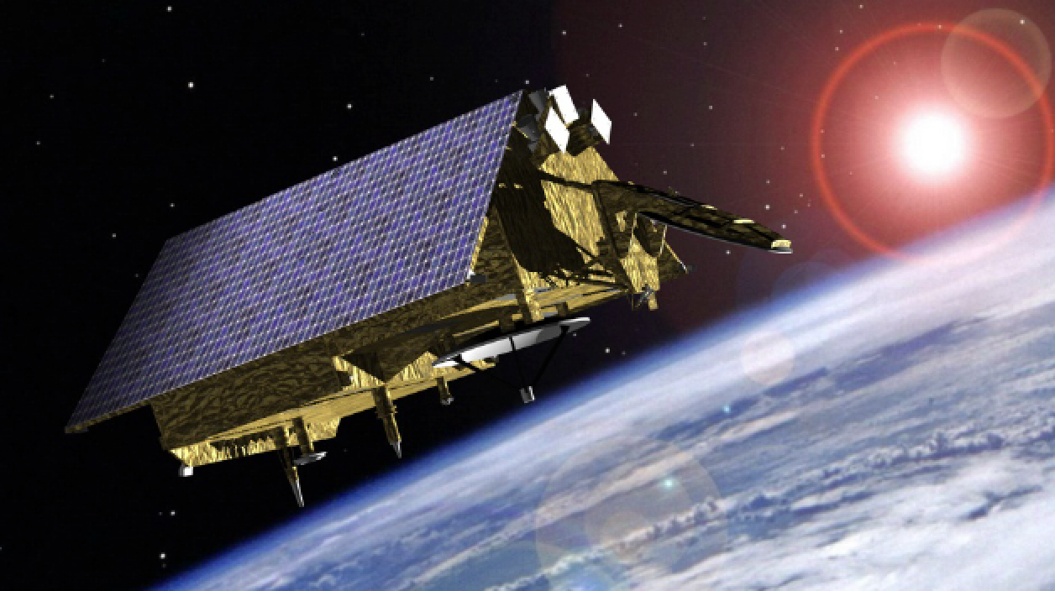






Continued commitment to collaborative high precision ocean altimetry missions: Jason-CS/Sentinel-6
Source CNES/LEGOS/CLS 2014
Launch of Jason-CS/Sentinel 6 planned in 2021

Slide 7
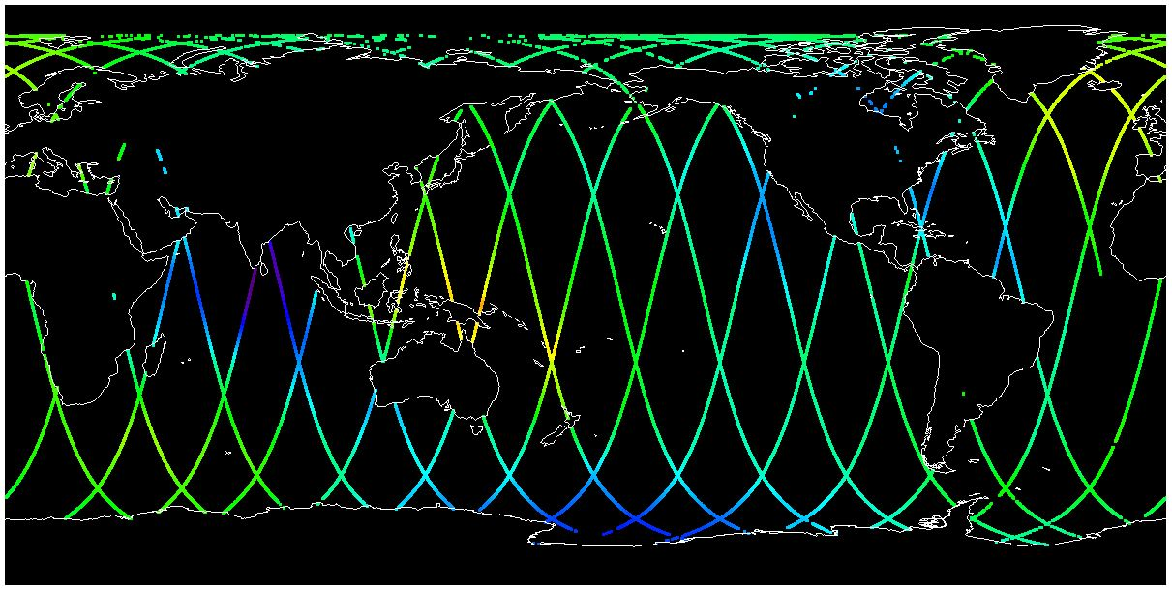
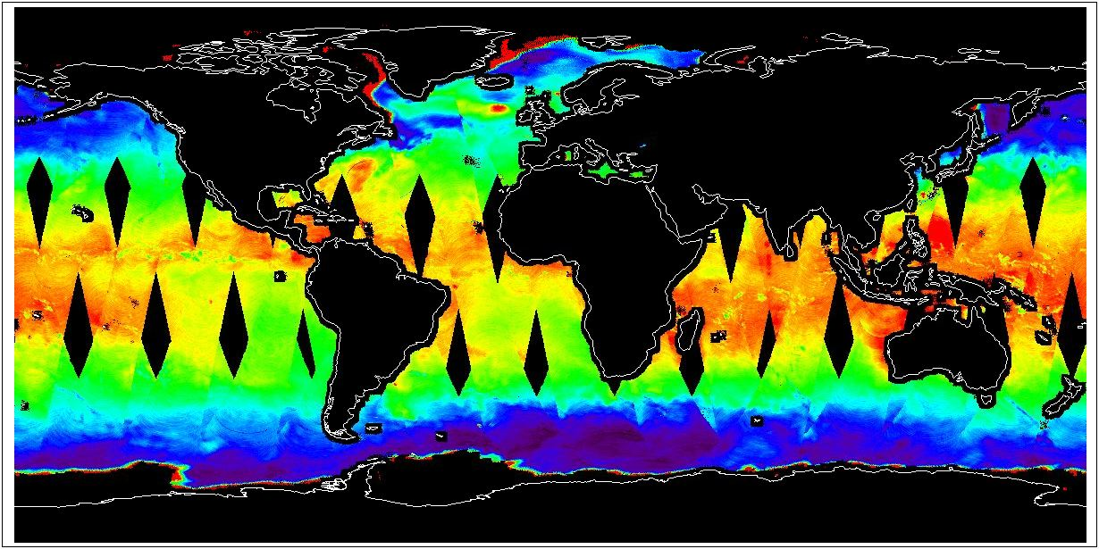
Third-party data services:
HY-2A (CSOA, China)
HY-2A:marine mission operated by SOA/NSOAS
Data redistributed to EUMETSAT Member States and ECMWF after reformatting

Slide 8
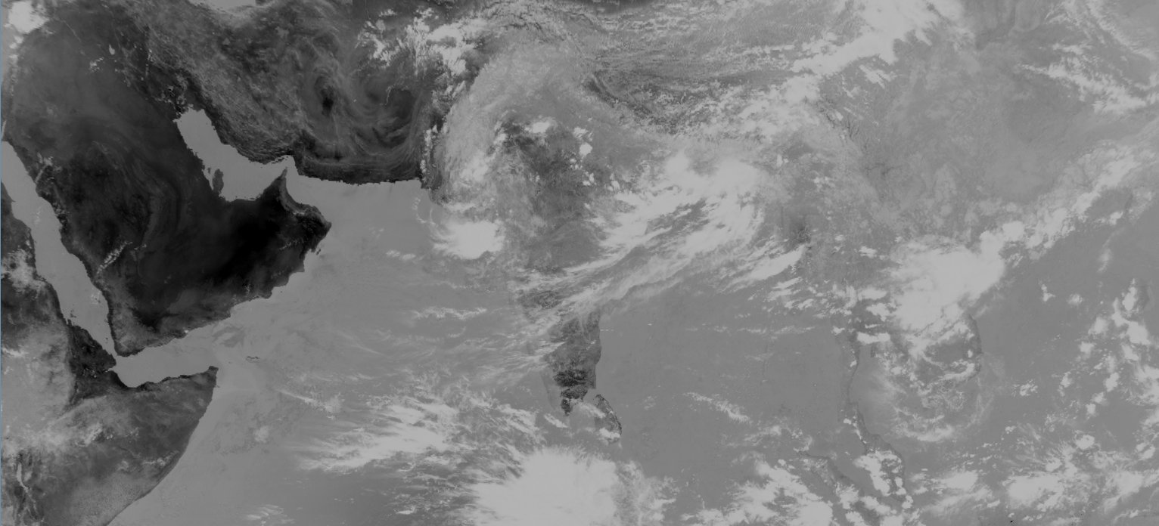
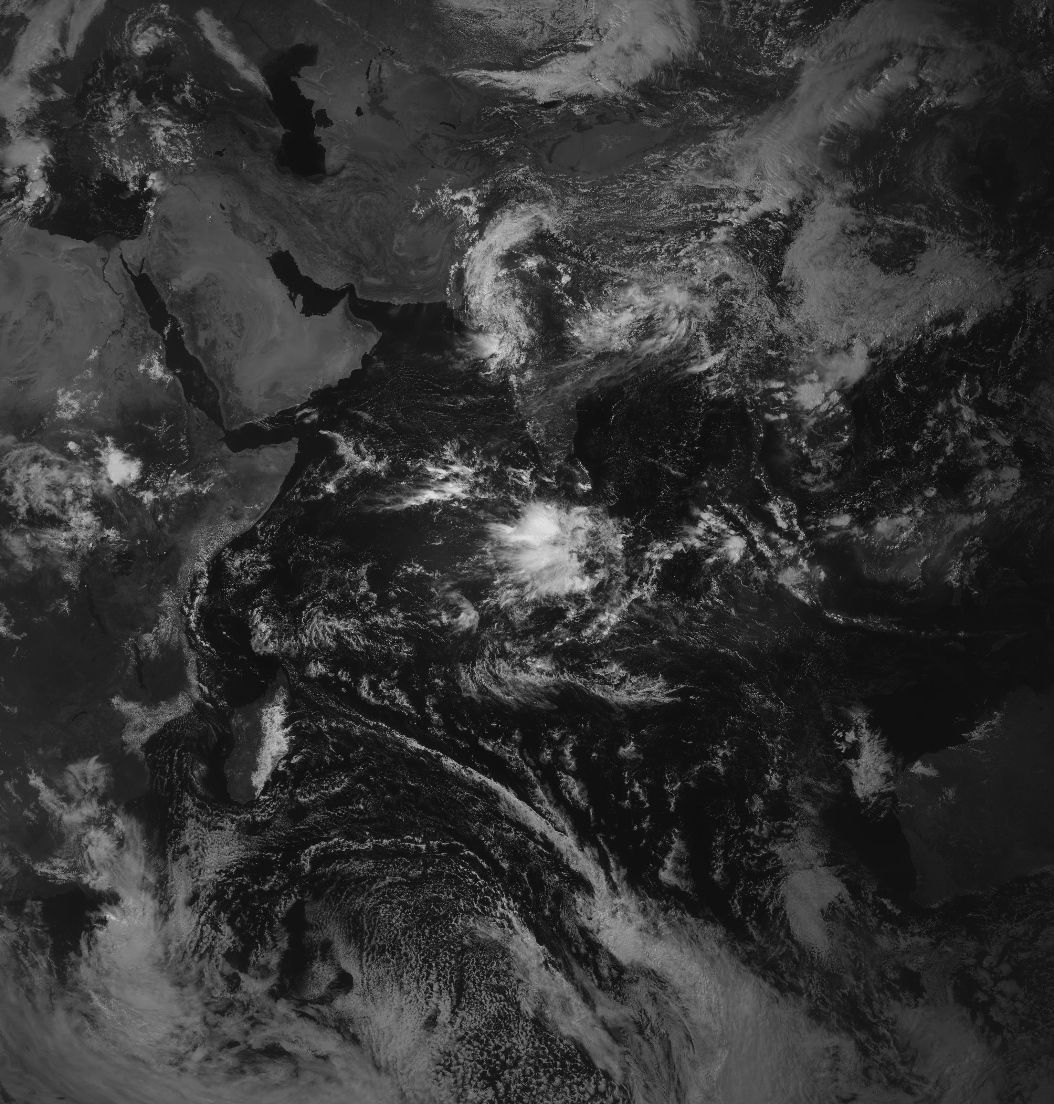
Third-party data services:
INSAT-3D (IMD/ISRO, India)
Dissemination of image data and SST products started on 22 September (30 min, 6 channels)

Slide 9
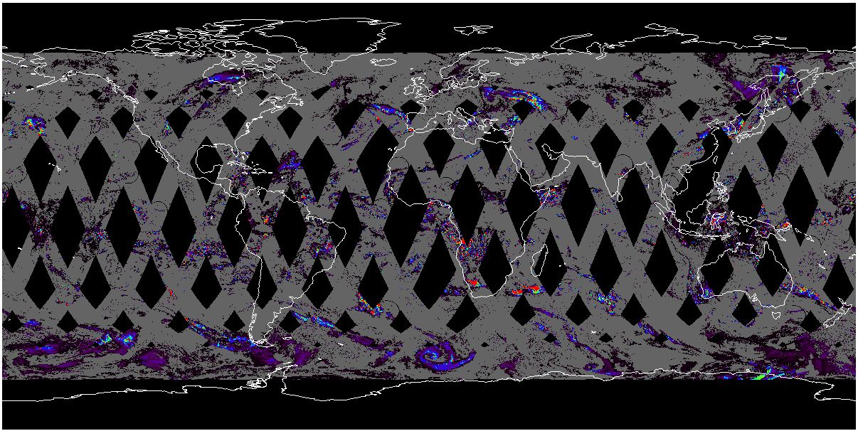
Third-party data services:
GPM-Core (NASA/JAXA)
GMI L2 daily rain
rate composite
(24/03/2015)
GMI L1C and L2 data redistributed after some reformatting

Slide 10
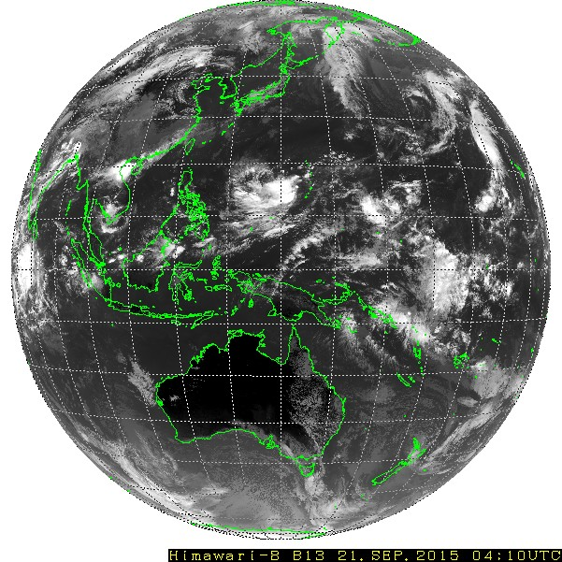
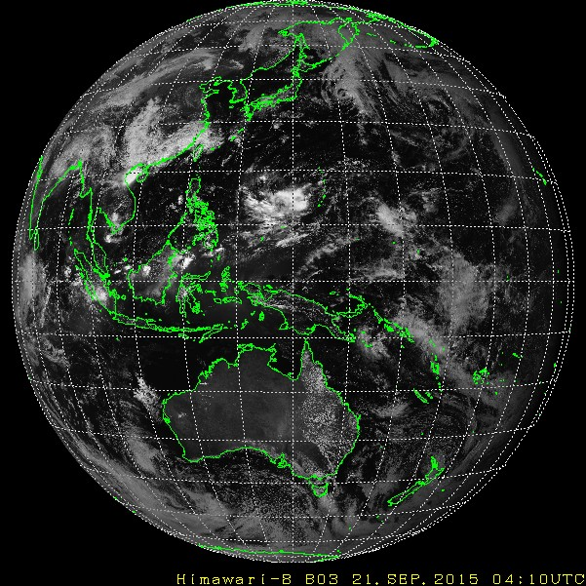
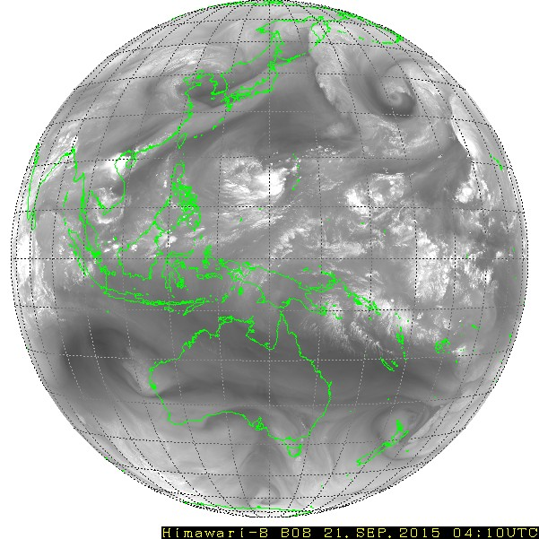
New third-party data services:
Himawari-8 (JMA, Japan)
Band 13, 10.4μm
Band 03, 0.64 μm
Band 08, 6.2 μm
Dissemination of Himawari-8 image data started on 9 September (30 min, 11 channels at 2 km resolution)

Slide 11
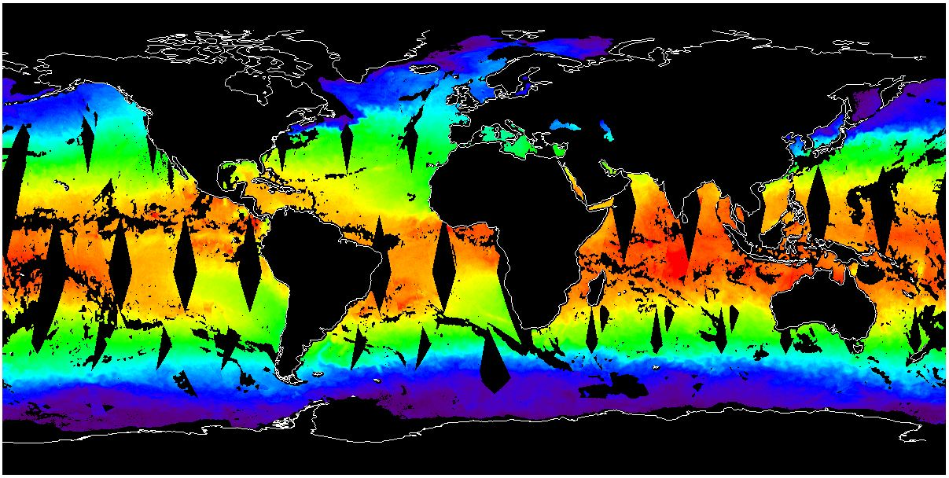
Third-party data services:
GCOM-W1 (JAXA, Japan)
AMSR-2 GHRSST SST (15/03/2015)
EUMETSAT redistributes the data to Member State NMHSs via EUMETCast L1C (BUFR) and L2 (GHRSST) data

Slide 12
5. Global NWP Impact Assessments
Season | Trial duration | Bias correction | NWP score
Jun-Jul 2014 | 28 days | static | +0.10
Dec 2014 – Jan 2015 | 34 days | VarBC | +0.32
Assimilation of AMSR-2 observations was trialled alongside the introduction of variational bias correction (VarBC) for satellite radiances
A positive “NWP score” shows improvements in forecast performance relative to a baseline control

