Slide 1

Committee on Earth Observation Satellites
Copernicus –
Current Status
European Commission
Plenary Agenda Item # 30
29th CEOS Plenary
Kyoto International Conference Center
Kyoto, Japan
5 – 6 November 2015

Slide 2
Copernicus - current status
Major Milestones reached:
Budget of € 4.3 Bn for 2014-2020
Full, free and open access to data
Successful launch of Sentinel 1A & 2A
Programme Regulation adopted
First images presented
Funds delegated to ESA/EUMETSAT
Four services are operational delivering 24h/7d
Notes:
Following the entry into force of a new legal framework in early 2014, the Commsision has negotiated delegation agreements with entrusted entities to implement the programme. Agreements have been signed with ESA and EUMETSAT for the space infrastructure. A first satellite has been launched successfully in April 2014. Further agreements have been signed with ECMWF, Mercator Ocean and the European Environmental agency for the Copernicus core services.
This has now put a programme structure in place providing free of charge satellite images and geo-information to users world wide.
Our presentation today is giving the opportunity to see what types of products can be deliverd by Copernicus, on a free and open basis – encouraging the data sharing model also adopted internationally in the Group of Earth observation (GEO) context.

Slide 3
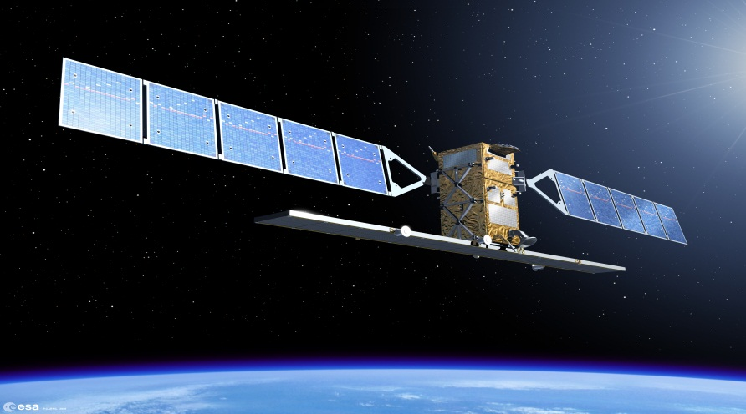

Space Segment
First Sentinel satellite, Sentinel 1A, was launched on 3 April 2014; operational since Oct 2014
Sentinel 2A was put in orbit on 23 June 2015; the commissioning phase has recently ended.
Notes:
Copernicus' operational phase starts now, building on the success and experience of the previous GIO (GMES Initial Operations) programme. User requirements and data-buy arrangements are in place, but our (EU-owned) Sentinels will deliver more and better data with unpredecented volume. => A quantum leap for EU Earth Observation. A key element of Copernicus is ensuring the smooth dissemination of this huge volume of data, making the EU as a major global player/owner in Earth Observation data.
External data-buy will continue, but decrease as Sentinels become operational in 2015-2016 ff. However, some gaps will remain (high-resolution imagery) as Copernicus was not (!) designed to fill them.

Slide 4
Space Segment
By the end of 2020, 8 Sentinel satellites will be in orbit, providing most of the data needed by the Copernicus services
Where no Sentinel data are available, the programme buys Earth observation data from other satellite data providers
Notes:
Copernicus' operational phase starts now, building on the success and experience of the previous GIO (GMES Initial Operations) programme. User requirements and data-buy arrangements are in place, but our (EU-owned) Sentinels will deliver more and better data with unpredecented volume. => A quantum leap for EU Earth Observation. A key element of Copernicus is ensuring the smooth dissemination of this huge volume of data, making the EU as a major global player/owner in Earth Observation data.
External data-buy will continue, but decrease as Sentinels become operational in 2015-2016 ff. However, some gaps will remain (high-resolution imagery) as Copernicus was not (!) designed to fill them.

Slide 5
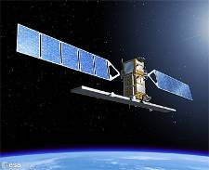
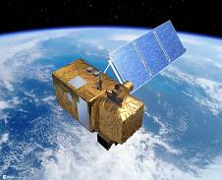
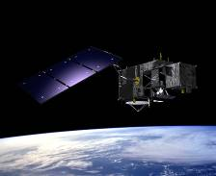
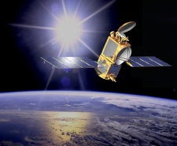
Sentinels
Each Sentinel is technically different to meet the needs of the 6 services
Sentinel 1 – radar imaging
All weather, day/night applications
Sentinel 2 – Optical imaging
Land applications: urban, forest, agriculture,..
Sentinel 3+6 – Ocean and global land monitoring, high precision ocean altimetry, OLCI, SLSTR
Sentinel 4+5 – Atmosphere composition monitoring, from a geostationary (-4) and a polar orbit (-5)
Notes:
Important to underline that Copernicus is :
A custom-built, comprehensive, cutting-edge Earth Observation system, that puts EU in class of its own (in many aspects even better-performing than civilian US satellites…)
Satellites and types of images are mutually reinforcing, idem for space- and in-situ data.
A key difference between different Sentinels is their orbits, allowing for different types of observations and revisit times of an inidividual spot on the globe.

Slide 6
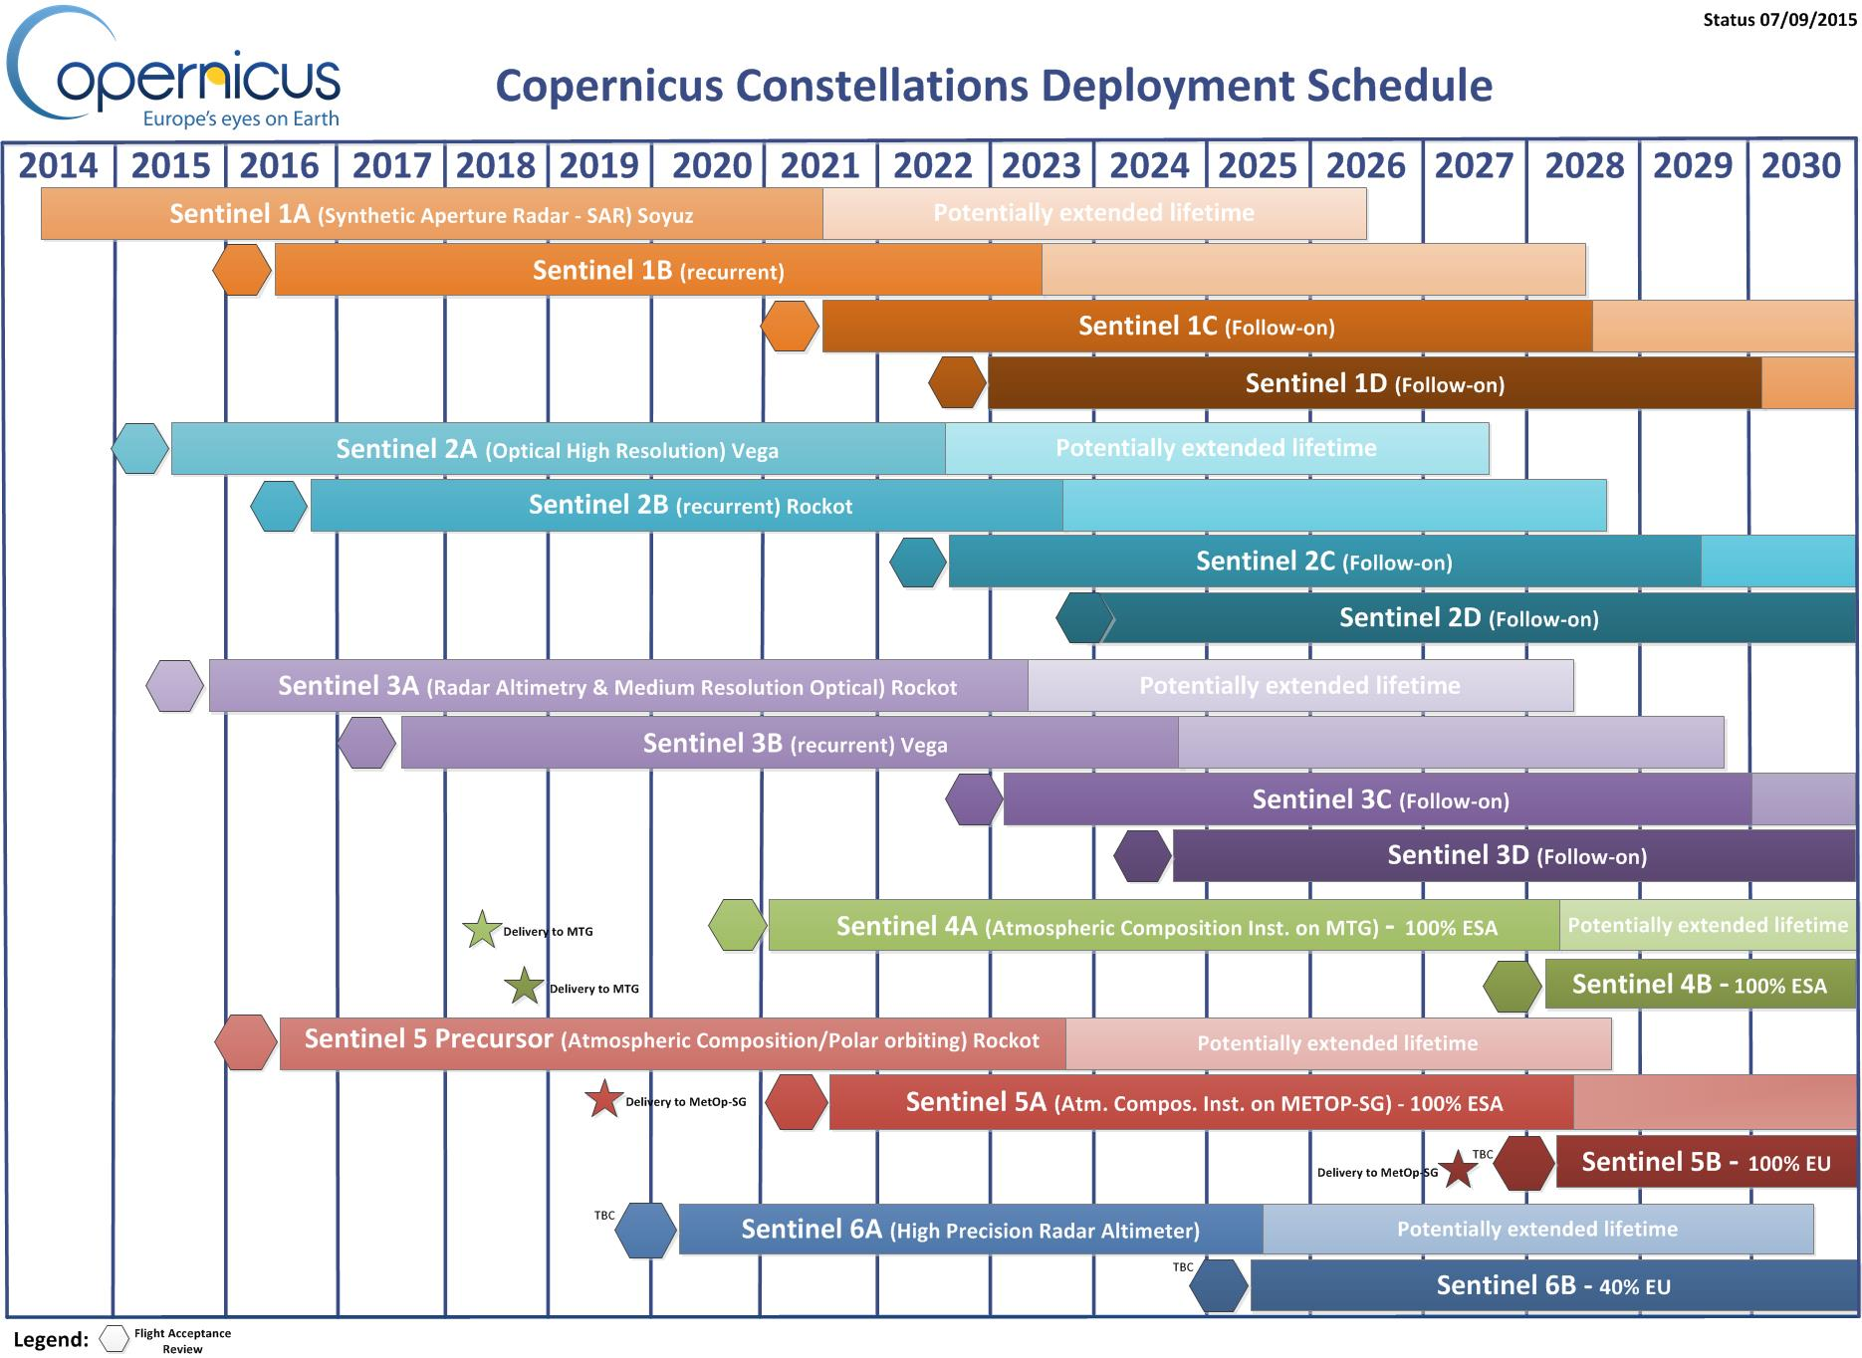
Sentinel Deployment Schedule

Slide 7










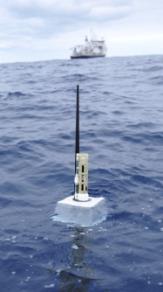

Copernicus services
6 services use Earth Observation data to deliver …
Sentinels
Contributing missions
…added-value products
in-situ

Slide 8


Data Dissemination
Two complementary approaches:
  Bringing the data to the user: web portal, mirroring of the data – high bandwidth connection needed (e.g. Geant)
  Bringing the user to the data: cloud computing ('hosted computing‘) – upgrade of the Copernicus core ground segment needed

Slide 9
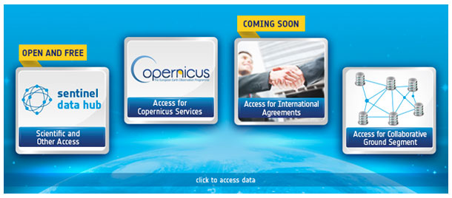
Data Dissemination
https://sentinels.copernicus.eu
https://sentinels.copernicus.eu/web/sentinel/sentinel-data-access

Slide 10
Copernicus
Thank you for your attention
Mauro.Facchini@ec.europa.eu
Website: http://copernicus.eu
Facebook: CopernicusEU
Twitter: @Copernicus EU

