Slide 1
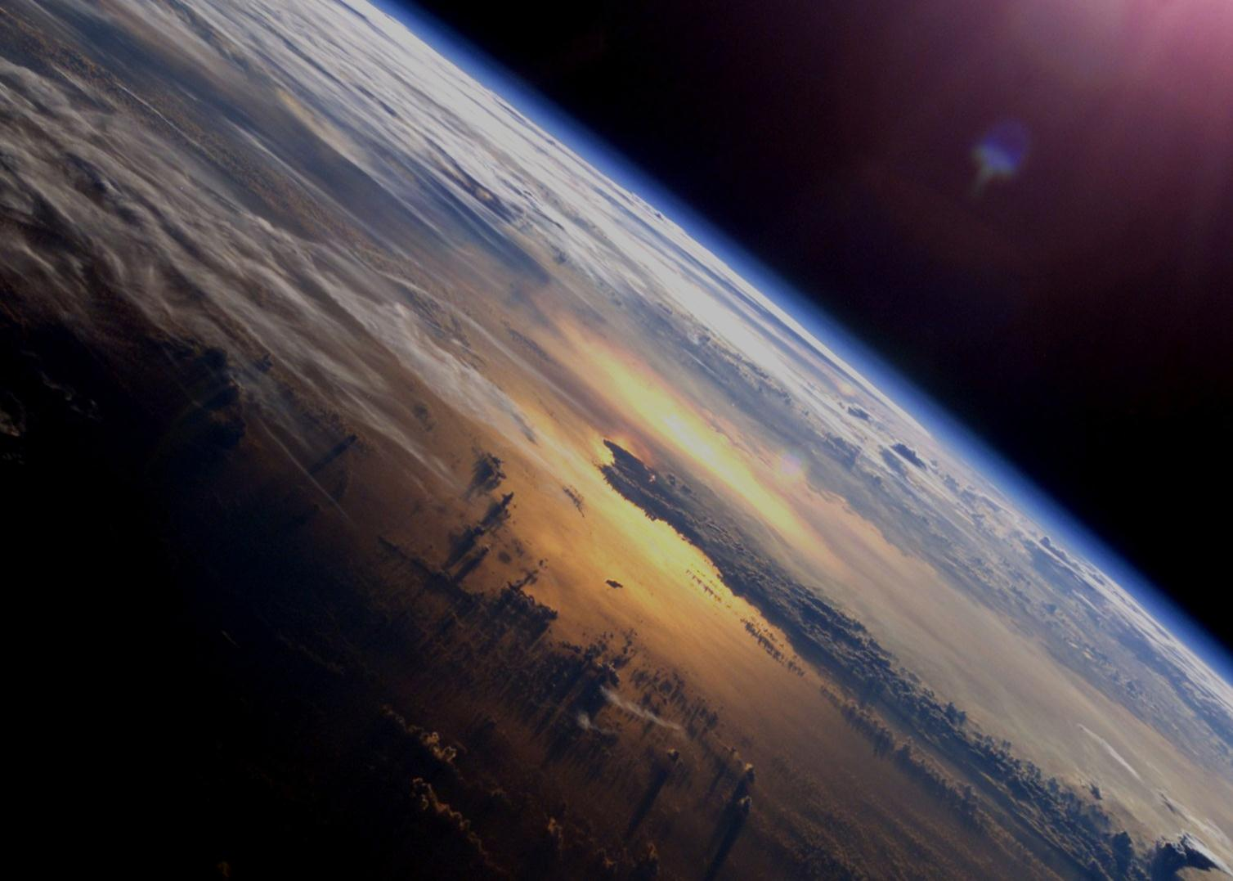

ESA’s Future Earth Observation Missions
CEOS Plenary
Tokyo, 6 November 2015
Volker Liebig, ESA
Director of Earth Observation Programmes

Slide 2
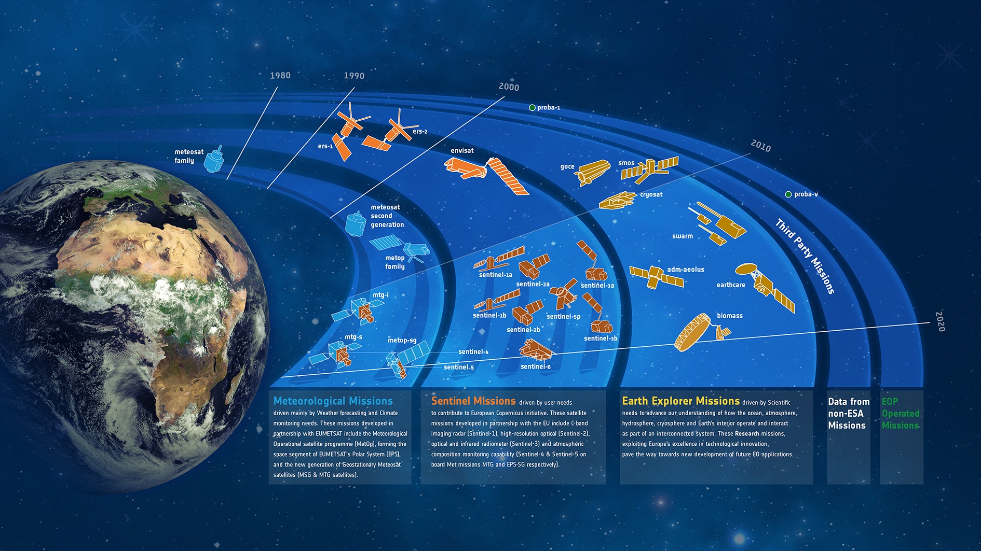
ESA Earth Observation Programmes

Slide 3
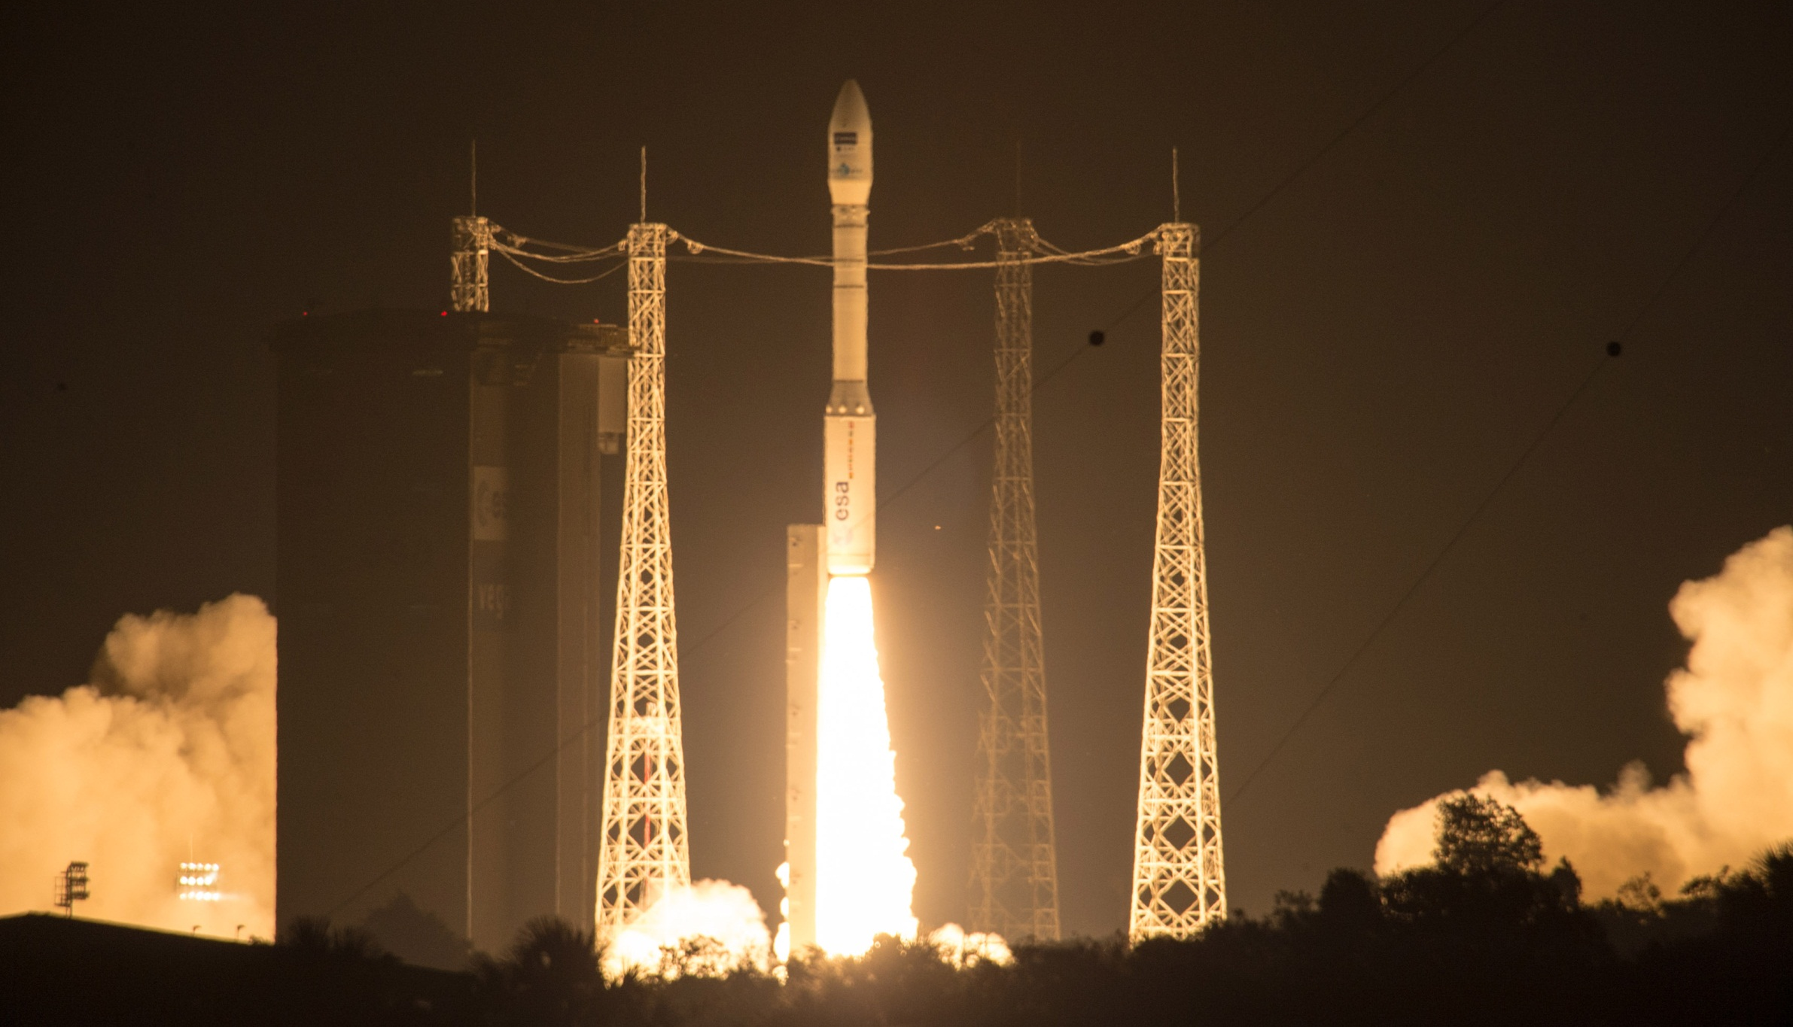
Sentinel-2A launch
launched 22 June 2015
commissioning phase
of 3.5 months concluded
15 Oct 2015
free and open data policy (as for any Sentinel)
data access to open soon

Slide 4
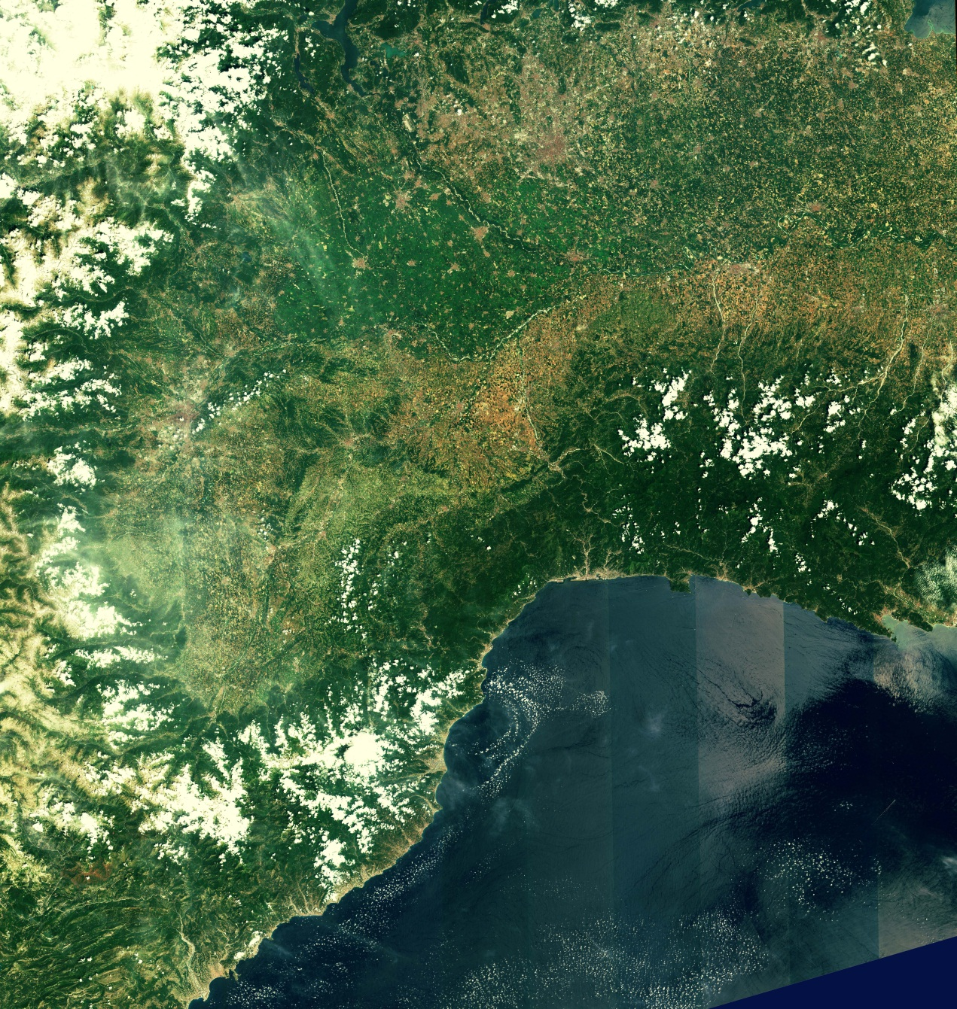
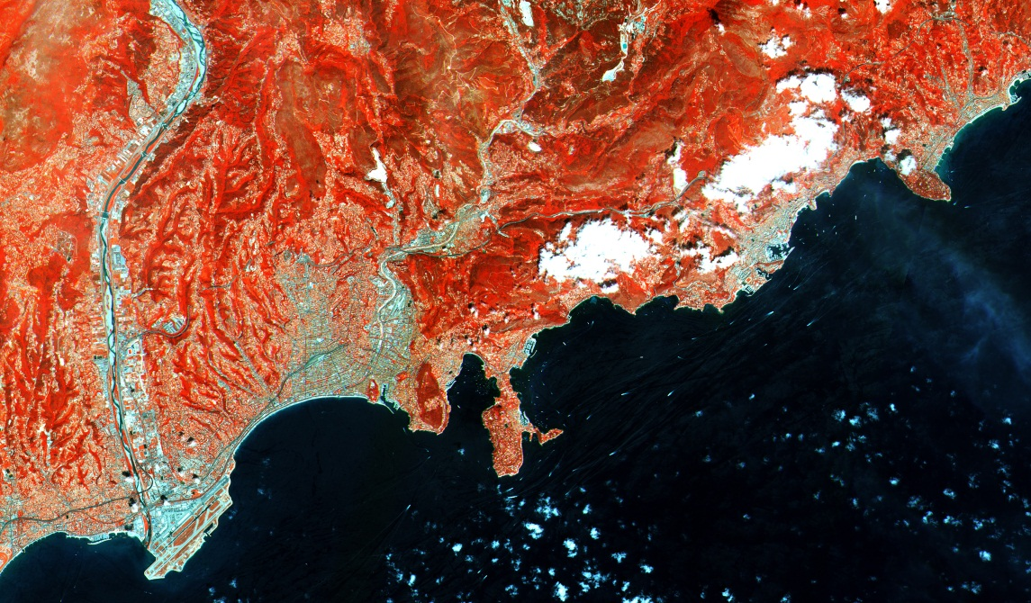
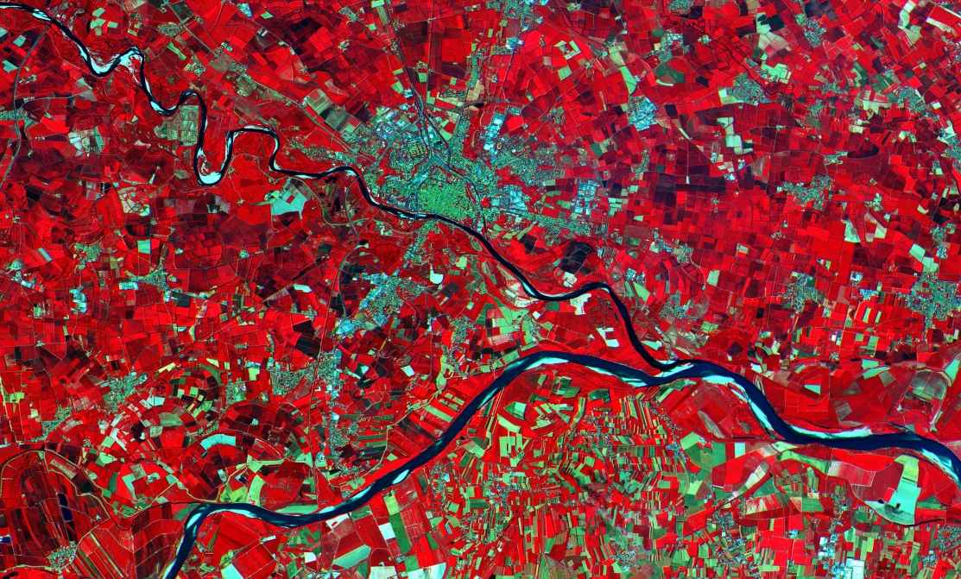
Sentinel-2A: First images
French Riviera
Northwest Italy and Southern France
Po Valley

Slide 5
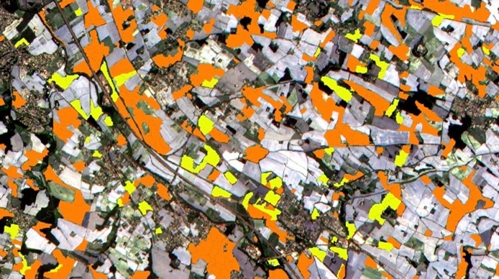
Sentinel-2A: Agricultural Monitoring
Notes:
Sentinel-2 is the first optical Earth observation mission of its kind to include three bands in the ‘red edge’, which provide key information on the state of vegetation. In this image from 6 July 2015 acquired near Toulouse, France, the satellite’s multispectral instrument was able to discriminate between two types of crops: sunflower (in organge) and maize (in yellow).

Slide 6
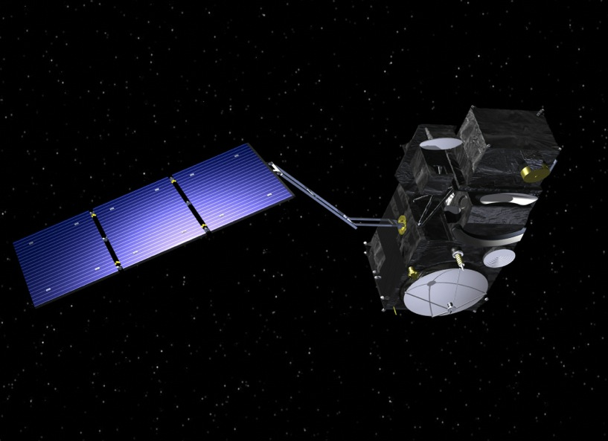
Sentinel-3: General Features
Main satellite characteristics
1250 kg maximal mass, 1100 W average power consumption
volume 3.89 m x 2.202 m x 2.207 m
4 instruments supporting Optical (OLCI, SLSTR)
and Altimetry (SRAL, MWR) missions
POD System (GPS, DORIS, LRR)
sun synchronous orbit at 814.5 km mean altitude
7.5 years lifetime (fuel for 5 add. years)
Launch S3A late 2015
Launch S3B 18 months later
Microwave
Radiometer
Ocean and Land Colour Instrument
Sea and Land Surface Temperature Radiometer
GPS
DORIS Antenna
SAR Radar Altimeter
Notes:
POD: This is Precise Orbit Determination and includes the on-board GPS units, the Laser Retroreflector and the CNES DORIS system.

Slide 7
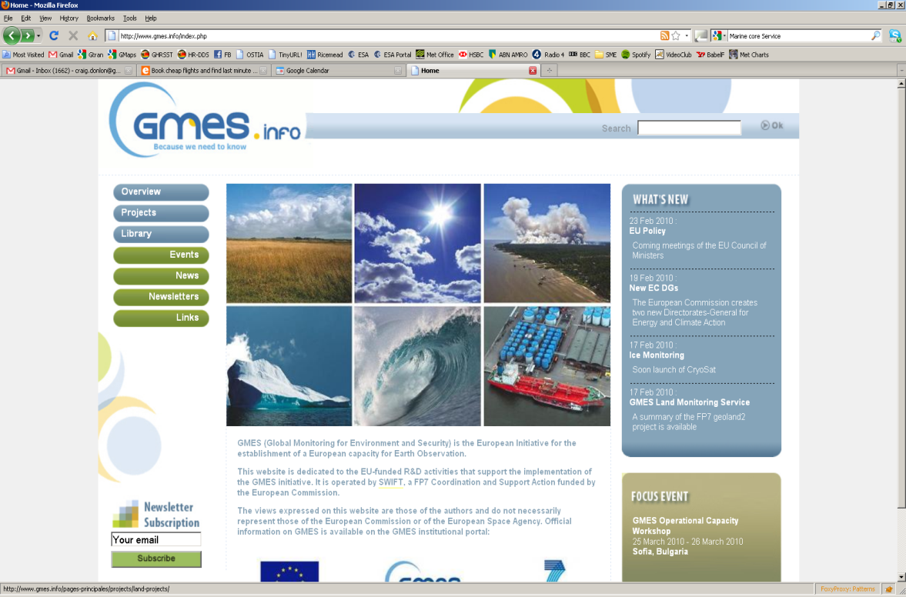





Sentinel-3: Mission Objectives
Primary
Secondary
Sentinel-3 shall provide continuity of an ENVISAT type measurement capability for Copernicus Services, including:
Continuity of ocean colour as good as ENVISAT MERIS or better
Continuity of SST as good as ENVISAT AATSR or better
Continuity of SSH as good as ENVISAT RA-2 or better with SAR capability derived from CryoSat-2
Continuity of land products (reflectance's, temperature) as good as ENVISAT MERIS and AATSR or better
Provide consistent quality L1 and L2 optical and topography products in a timely manner for Copernicus services
Continuity of SPOT VGT-P like products
Fire, River and lake height, atmospheric products…for Copernicus services
Notes:
MERIS Accuracy: 2-5% full range
Surface reflectance (ocean) <2 x 10 -4
Surface reflectance (Land) < 5%
Chlorophyll retrieval < 15 %
Yellow substance < 30 %
Suspended matter < 15 %
Water vapour < 20%
Cloud albedo < 2 %
Cloud optical thickness ~ 10%
Cloud top pressure ~ 40 hPa
MERIS Vegetation Index:-N/A
Water vapour < 20%
Cloud optical thickness ~ 10%
AATSR Sea surface temperature: <0.5K over 0.5 deg x 0.5 deg (lat/long) area with 80% cloud cover Land surface temperature: 0.1K (relative)
AATSR LST: <1K
RA-2 Altitude: better than 4.5cm,
RA-2 Wave height: better than 5% or 0.25m

Slide 8
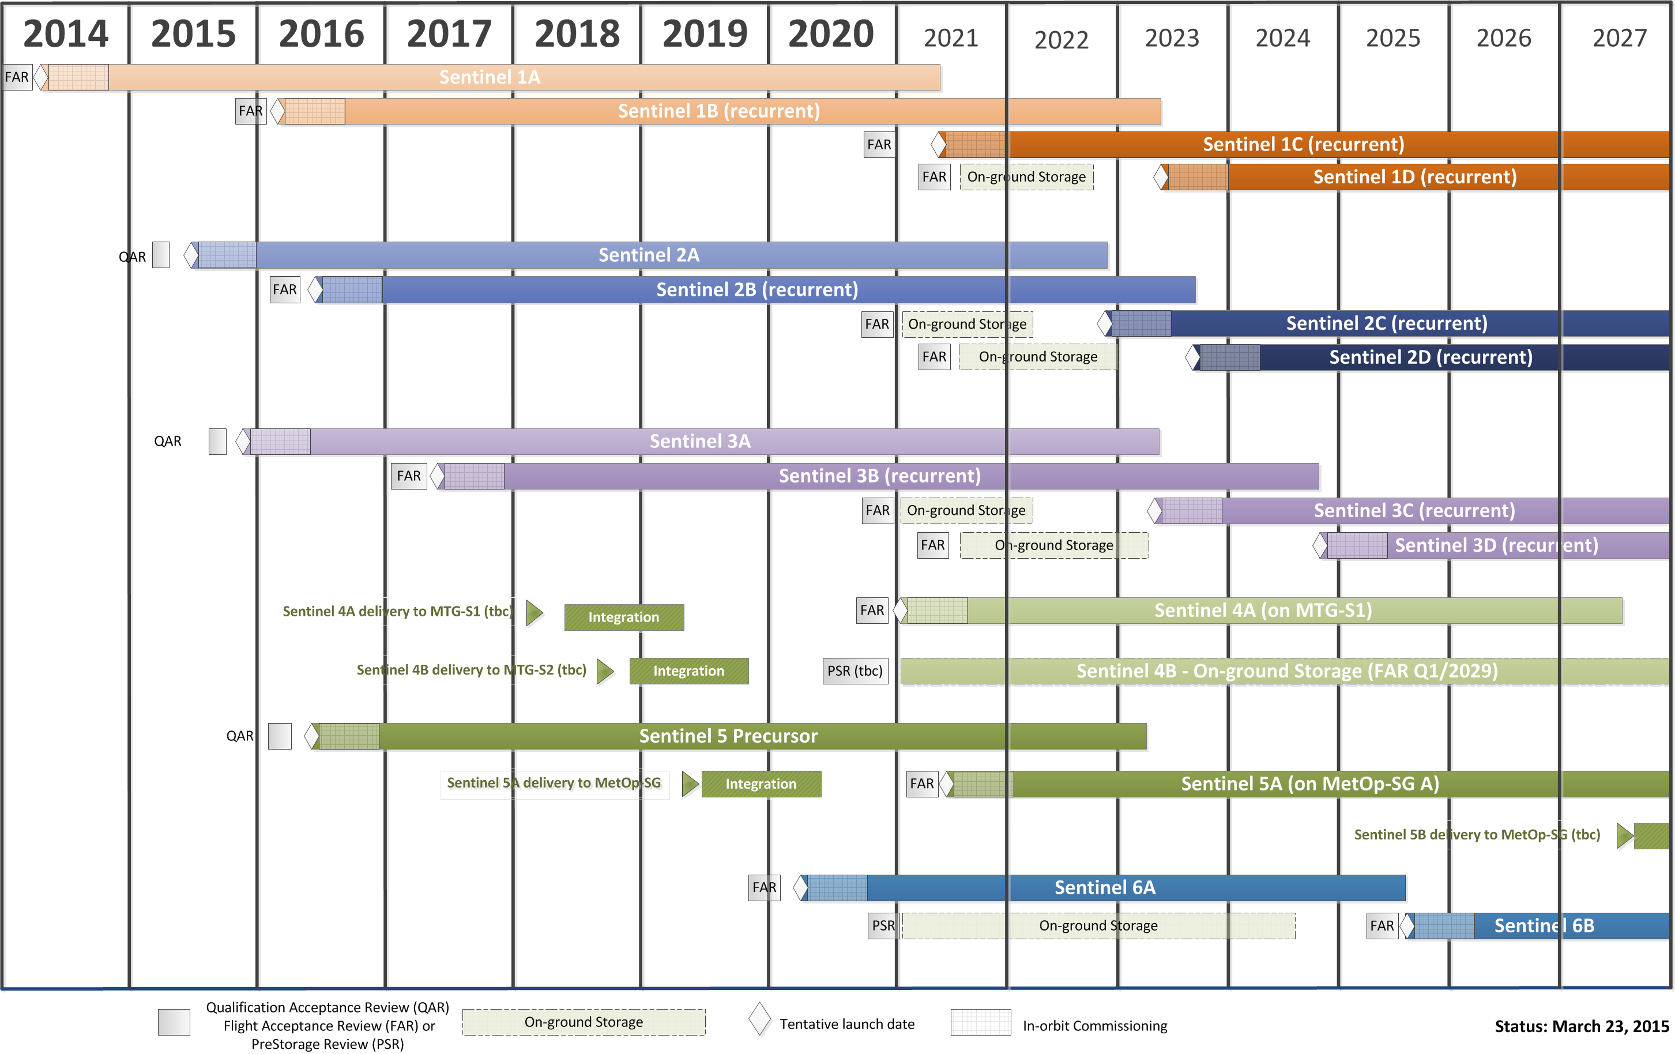
Tentative Sentinel Schedule

Slide 9
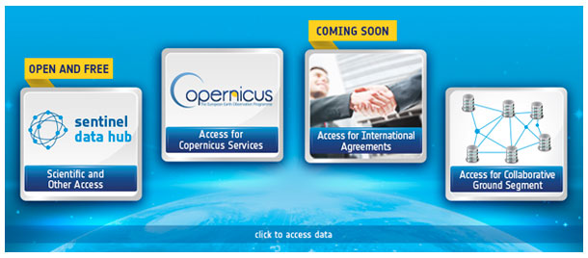
Sentinel Data Access
https://sentinels.copernicus.eu/web/sentinel/sentinel-data-access
Recent as well as archived data can be retrieved from the above link
Sentinel long term archive will be gradually opened to all users as of December 2015
Notes:
Clarification regarding the Rolling Archive:
==========================
The S-1 Rolling Archive has a capacity of 3 months; that means that the last 3 months of data / products are available on line but after that period the oldest data & products are moved to the long-term archive but they can be retrieved and distriuted at any time if requested by users.

Slide 10
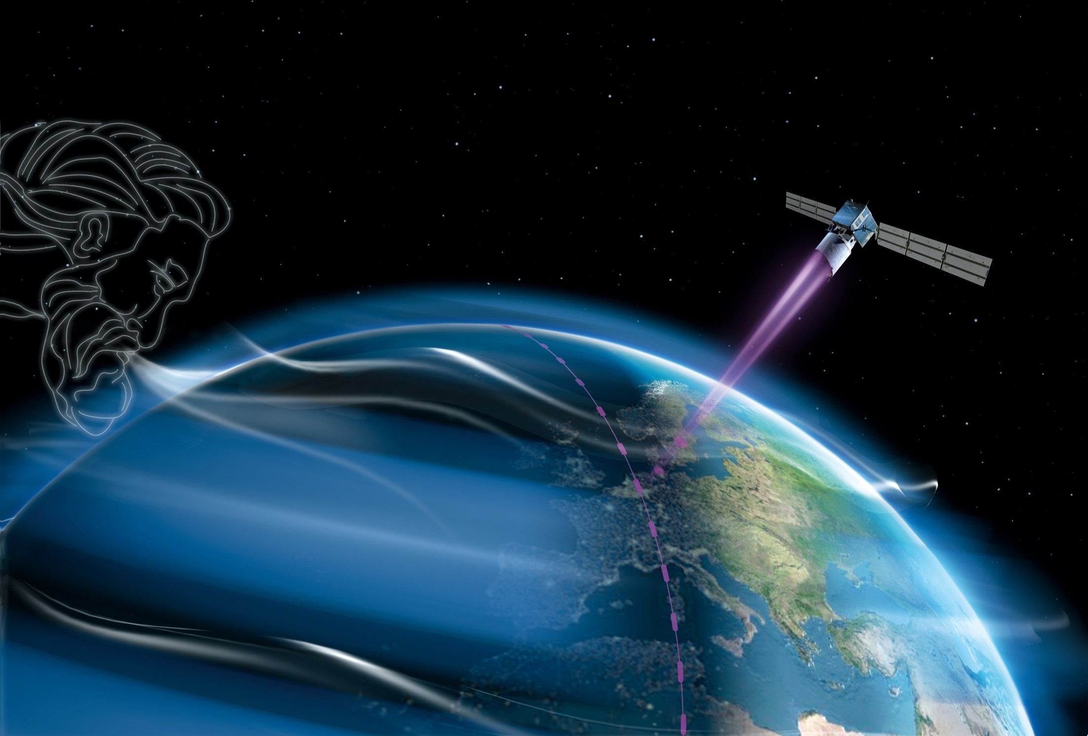
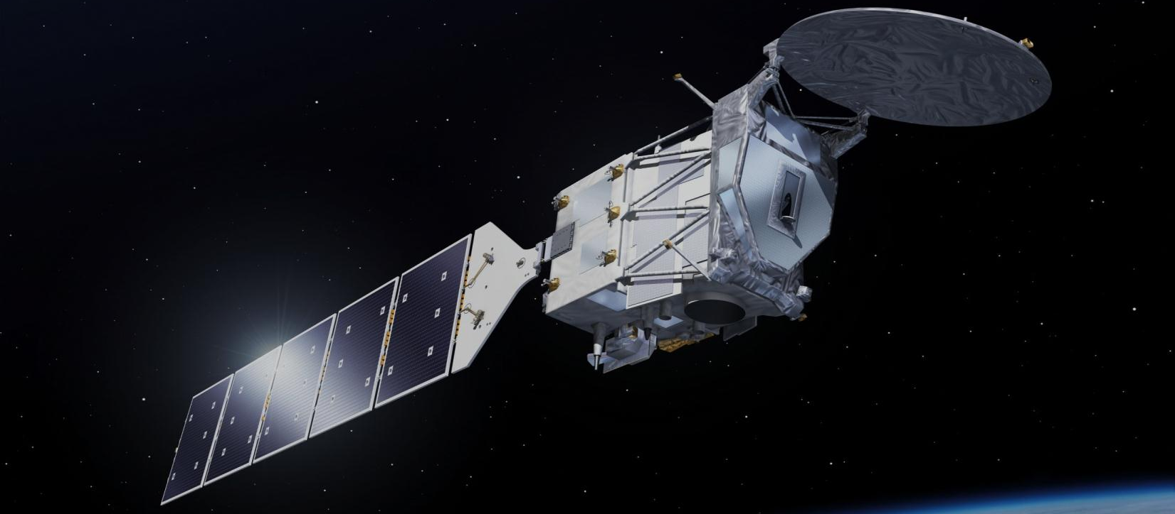
ADM-Aeolus and EarthCARE
ADM-Aeolus
Global observations of wind profiles for analysis of global 3D wind field
Launch planned for 2017
EarthCARE
Global observations of clouds, aerosols and radiation
Launch planned for 2018
Notes:
Two independent science studies have confirmed significant weather forecast impact using the Aeolus anticipated data, especially ECMWF has confirmed a decadal leap in mid-term forecasts thanks to Aeolus (Note: the scientific director of ECMWF, also the chairman of the Aeolus MAG, Professor Kallen, confirmed in front of DOSTAG that the impact of Aeolus in the ECMWF weather forecast will be significant, in particular for mid-term forecasts. He also reported on the importance of Aeolus wind data in the tropical regions since the latest climate research results indicate that these winds have a strong contribution to the global warming of the ocean water temperature at 500 - 2000m depth)

Slide 11
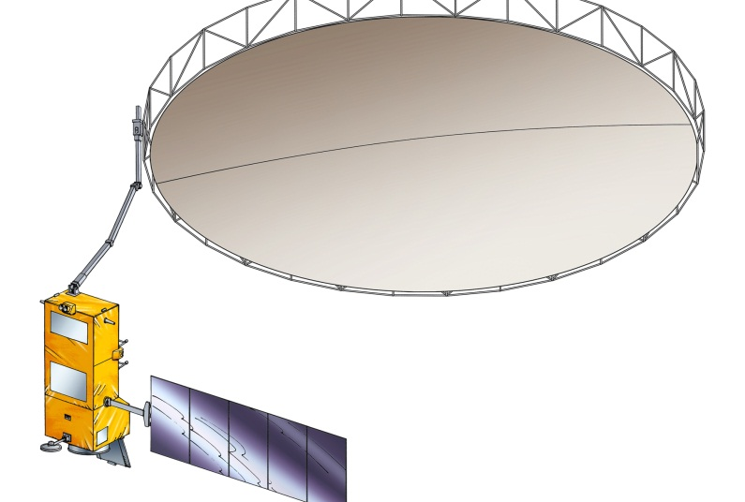
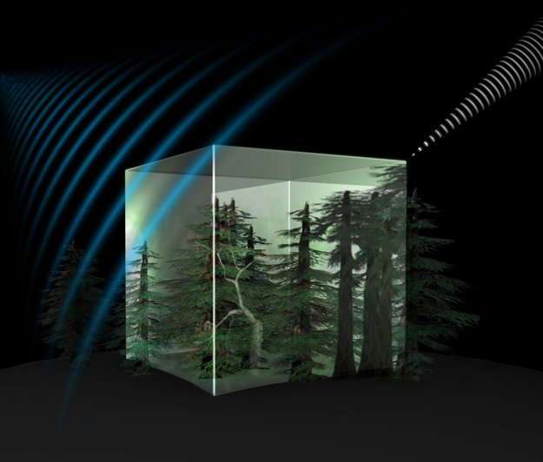
Further Earth Explorer Missions
7th Earth Explorer: Biomass
  Biomass estimates based on global interferometric and polarimetric
  P-Band Radar observations
  launch planned for 2020
8th Earth Explorer:
candidate missions
FLEX and CarbonSat
  User Consultation Meeting
  15/16 Sep 2015, Krakow
  subsequent ESAC recommendation
  decision by PB-EO in November 2015
  FLEX to be launched 2021
Notes:
BIOMASS has the potential to evolve into an operational system. The launch of the mission is foreseen for 2020.
Reopening of phase B1 to account for subscription levels

Slide 12


Thank you for your attention

