Slide 1

Committee on Earth Observation Satellites
Update on
EO Programmes
Italian Space Agency
Plenary Agenda Item #30
29th CEOS Plenary
Kyoto International Conference Center
Kyoto, Japan
5 – 6 November 2015

Slide 2
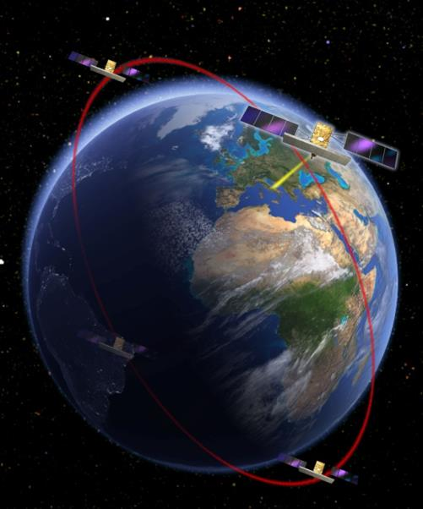
COSMO-SkyMed Current Status
Largest Italian Investment in EO
4 Satellites, X-band SAR
No other 4 SAR satellites constellation today on the EO operational scenario
Fully operative since 2011
COSMO-SkyMed highlights:
  Multiple imaging modes (variable resolution)
  Very High Resolution and High quality images
  Fast response
  Large area collection
  Unmatched revisit
  Worldwide Accessibility
  Interferometric and polarimetric capabilities

Slide 3
COSMO-SkyMed OPEN CALL
for SCIENCE
WHY? Promote R&D on new technologies and algorithms, methods, and applications based on COSMO-SkyMed Constellation data
WHO? International Community
WHAT? R&D Projects on innovative exploitation, synergistic utilization with other missions, methods and algorithms new idea for system exploitation. 100 scenes/Project.
WHEN? Always open
WHERE? On the ASI web site
http://www.asi.it/en/agency/calls-and-opportunities/calls/cosmo-skymed-constellation-data-utilization

Slide 4


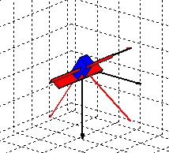
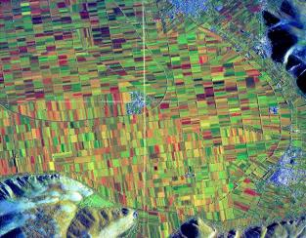
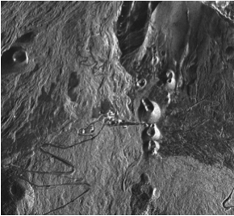
COSMO-SkyMed Second Generation
Robust and innovative planning algorithm
Satellite agility:
Right2Left 6 -> 3 min
Spatial resolution & Geolocation
Up to 2 times better than
COSMO-SkyMed
for specific acquisition mode.
  Full polarimetric capability (QUAD-pol)
  DUAL-pol currently available in Ping-Pong on COSMO-SkyMed.

Slide 5



CSG Deployment Scenario
COSMO-SkyMed
CSK-1 launched 8 June 2007
CSK-3 launched 25 October
2008
CSK-4 launched
6 November 2010
COSMO 2nd Generation
CSK-2 launched
9 December 2007
2007
2008
2009
2010
2011
2012
2013
2014
2015
2016
2017
2018
2019
2024
2025
CSG satellites will replace the CSK satellites that reached the end of life
With the launch of the first CSG satellite planned in 2017 and the second one year later, CSG will provide operational continuity at least until 2025

Slide 6
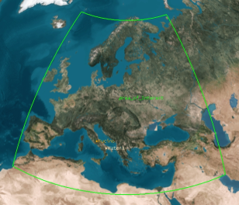
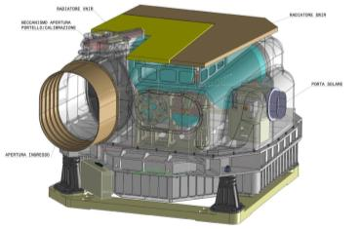
PRISMA
Orbit and lifetime:
  LEO SSO, 620km, 10.30 LTDN
  5 years lifetime
System elements:
  1 “small” Satellite
    Platform
    Pan/Hyp Payload
    PDHT
  Ground Segment
    MCC/SCC/FDS: Fucino
    Image Data Handling System: Matera
  Launch Segment
    VEGA (baseline)

