Slide 1

Committee on Earth Observation Satellites
CEOS Database and EO Handbook
Ivan Petiteville, ESA
Plenary Agenda Item #29
29th CEOS Plenary
Kyoto International Conference Center
Kyoto, Japan
5 – 6 November 2015

Slide 2

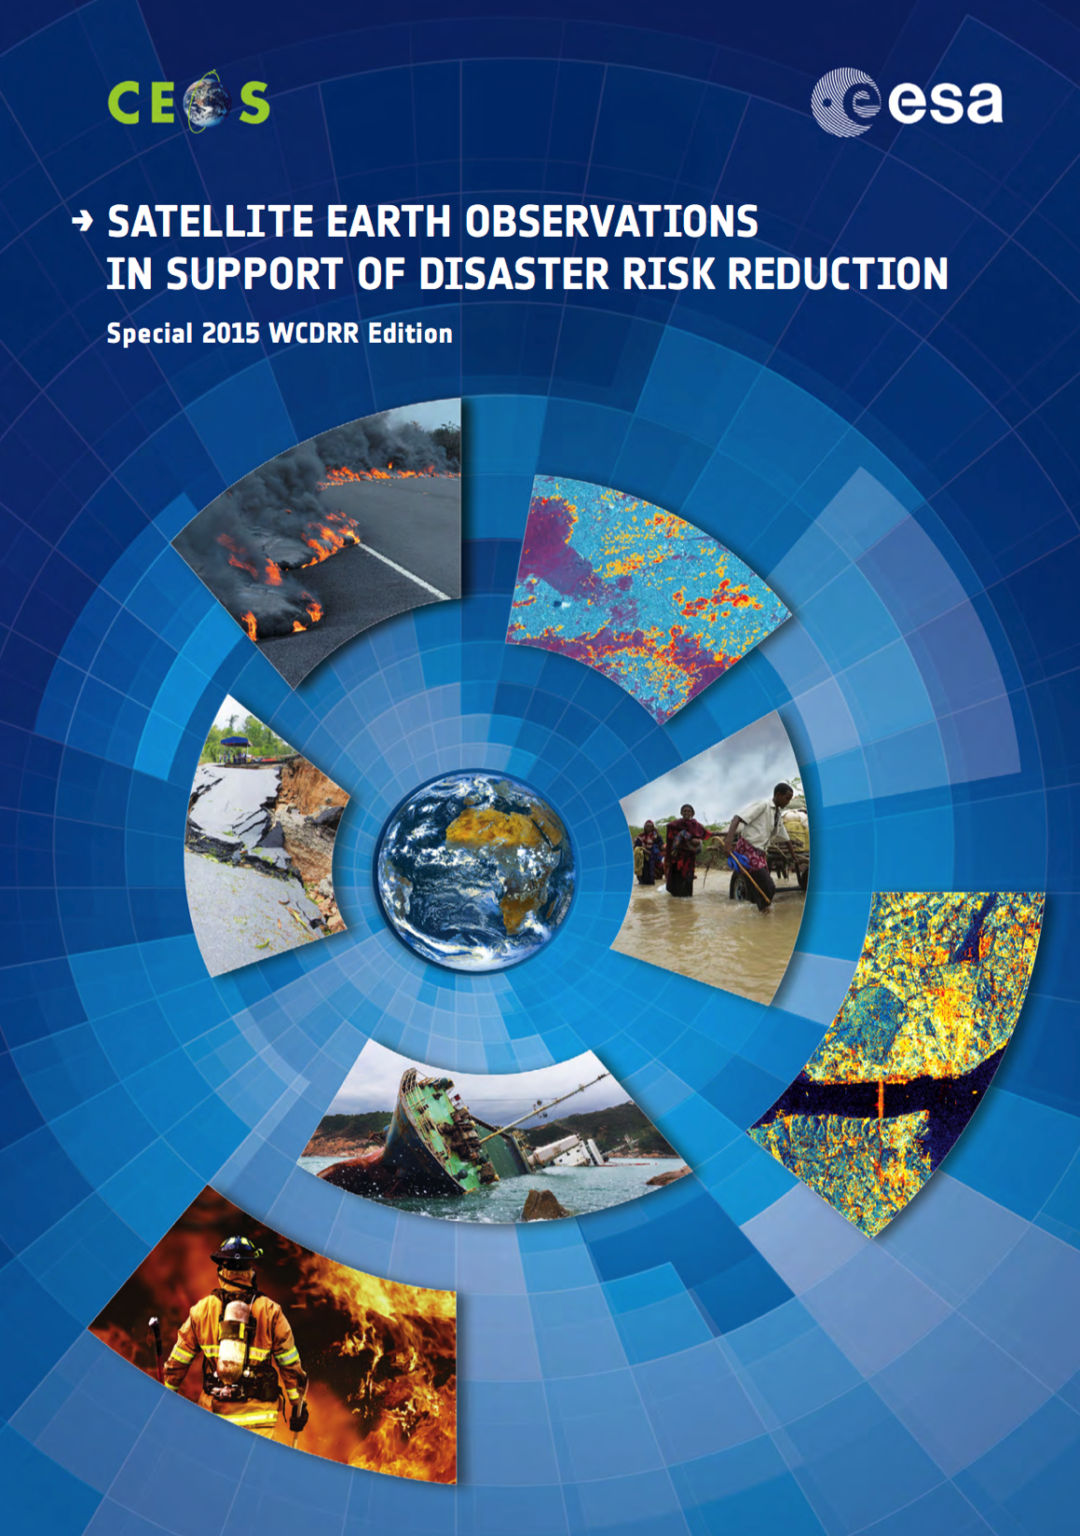

Print editions
Two EO Handbooks were released in 2015, in support of:
    The 3rd UN World Conference on Disaster Risk Reduction
    UNFCCC COP21
The CEOS EOHB presents the main capabilities of EO satellites, their applications, and a systematic overview of present and planned CEOS agency EO satellite missions and their instruments.
Include articles tailored to the target conference themes.
Aimed at raising the awareness of politicians and decision-makers on the benefits satellite EO can bring to society.
Disasters
Climate
1900 copies distributed
3600 copies printed

Slide 3
Disasters
Prepared for the 3rd UN World Conference on Disaster Risk Reduction.
Explores how satellite EO can contribute to the related information challenges, across a range of different countries and addressing varying capacity and infrastructure.
Highlights some of the main capabilities of satellite EO, their applications, and the challenges in converting information collected in space into knowledge for disaster risk reduction.
Multimedia e-book available for tablets
http://www.eohandbook.com/wcdrr/

Slide 4
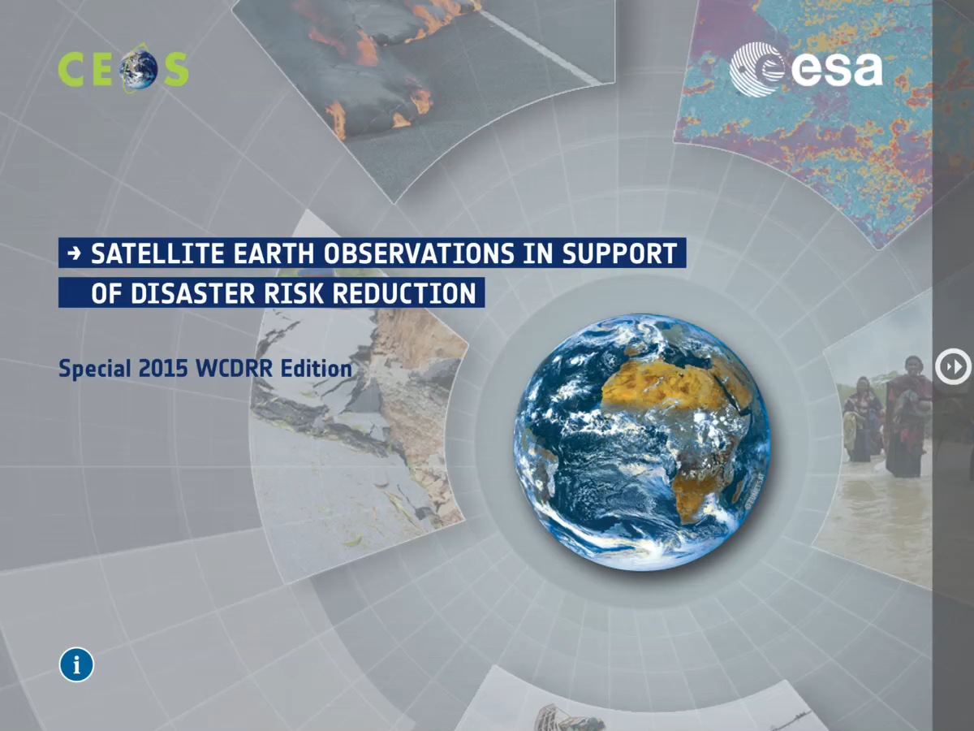

Multimedia E-book

Slide 5

Climate
Prepared for the COP21 meeting in late 2015.
Aims to develop a broader understanding of the fundamental importance of satellite EO to the information needed to inform our climate policies on all scales.
Explores how satellite EO can contribute to the challenges of providing the information that society needs in order to accurately characterise the nature of changes to our climate and to help define the most cost-effective strategies for mitigation and adaptation.
Multimedia e-book in development
http://eohandbook.com/cop21/

Slide 6
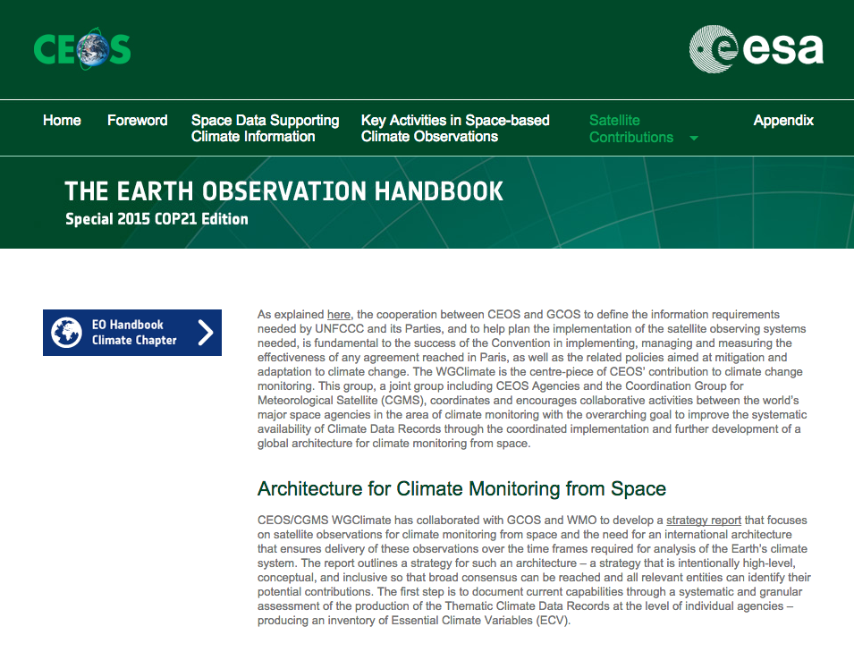
Climate
In addition to CEOS Members and Associates, 100’s of copies are being sent to key delegates and organisations in advance of COP21 to ensure maximum impact. (COP21 is paper-free).
Copies will be distributed at JAXA Data Applications Symposium, CEOS Plenary, GEO Plenary…
Significant work is also being done to include the GCOS IP and CEOS Response to the GCOS IP in expanded EO Handbook climate pages prior to COP21

Slide 7
CEOS MIM Database
COP21 Edition web content will link to the expanded EO Satellite Capabilities content available from the last ‘full-size’ EO Handbook and to the CEOS MIM Database, including:
          Instrument type explanations
          Measurement type explanations
          Detailed supply timelines
          Comprehensive missions and instrument tables
          Powerful query and export tools via the database

Slide 8
CEOS MIM Database
Annual update cycle completed and available online:
          database.eohandbook.com
Responses received from 36 CEOS agencies
37 new mission records added, 144 existing records updated
41 new instrument records added, 164 existing records updated
Currently features operating or planned for launch in next 15 years:
          296 Earth observing satellite missions
          830 instruments
Information on ~170 completed missions included - to be comprehensive and to help users understand and access decades of archived data

Slide 9
Website usage (Year-on-Year)
Most popular content: mission and instrument search tables
September 2014 – October 2015 (compared to previous period)
10.7% boost in visitors - WCDRR and Climate content
60%+ growth in mobile access, but off a small base - still 90%+ desktop
 | CEOS DB | EO HB | Total
Visitors | 11,222 +5% vs. 10,691 previous | 8,819 +19% vs. 7,410 previous | 20,041 +10.7% vs. 18,101 previous
New users | 62% vs. 59% previous | 69% vs. 68% previous
Technology: Desktop | 92.8% vs. 95.2 % previous | 90.8% vs. 93.3% previous

Slide 10
GCIS Linkage - Update
[As presented last Plenary…] Global Change Information System (GCIS) at U.S. Global Change Research Program has created a CEOS DB lexicon (mapping to GCIS): http://data.globalchange.gov/lexicon/ceos
  Can also be mapped via GCIS to the PODAAC
Continuing to regularly pull and update the active CEOS missions into GCIS
GCIS mirroring the identifiers from CEOS
Good example of the kind of interoperability enabled by the CEOS database

Slide 11
2015 Development Activities
Support to the publication of the print versions of the EO Handbook
Inclusion of content from GCOS IP and CEOS Response
          Expanded content for COP21 materials
          Leverages linkages between ECVs and Missions, Instruments, Measurements
          Anticipates future availability of the ECV inventory
Various bug fixes and performance improvements

Slide 12
2016 Activities
Expansion of the Climate content in coordination with WGClimate – including new GCOS documents and ECV inventory when released
Annual update commencing in April
Continued improvements and linkages to maximise accessibility and power of the information for analysis

