Slide 1
Committee on Earth Observation Satellites
Blue Planet Symposium:
Outcomes & Future Plans
Andy Steven, CSIRO, Australia
Plenary Agenda Item 25
29th CEOS Plenary
Kyoto International Conference Center
Kyoto, Japan
5 – 6 November 2015

Slide 2
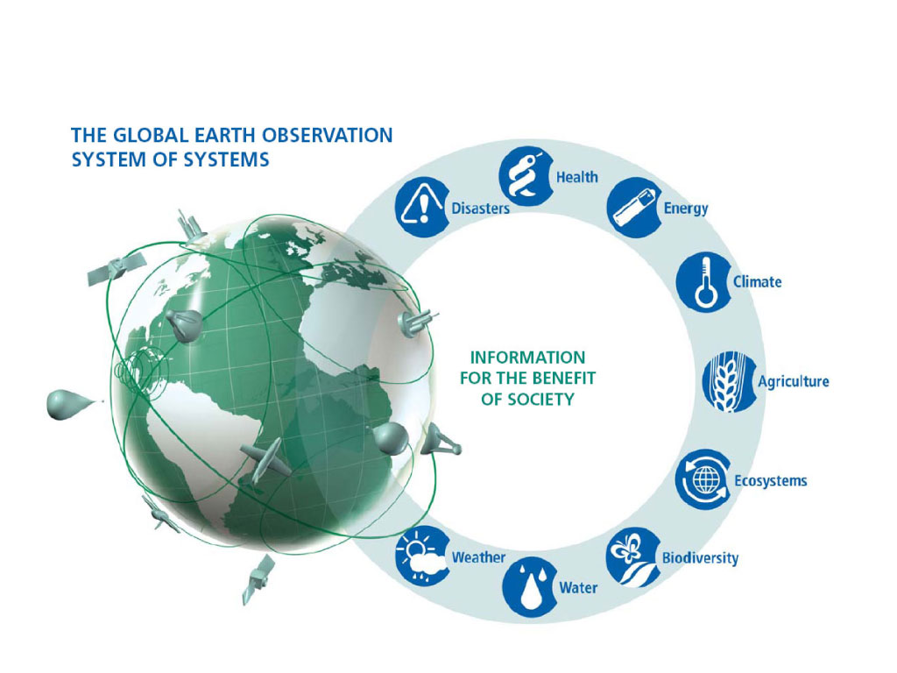
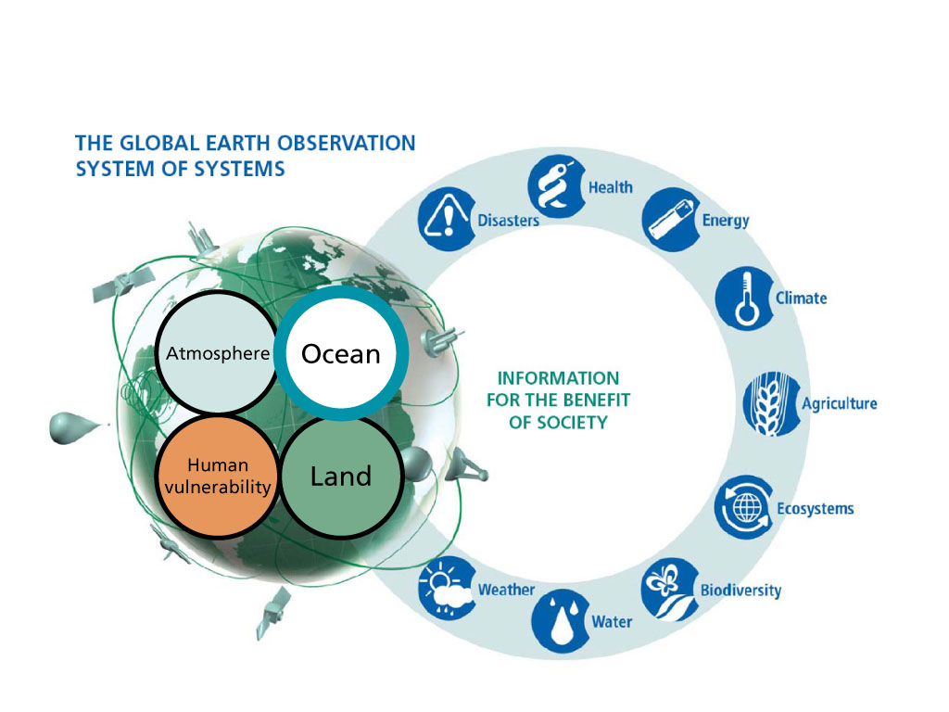
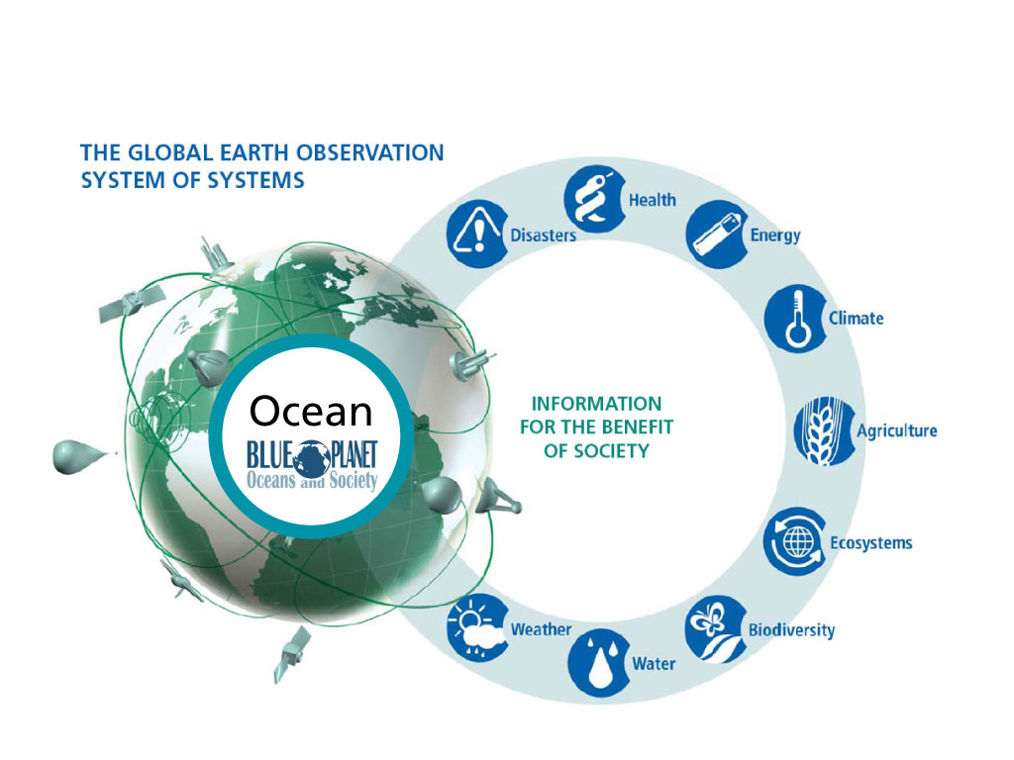
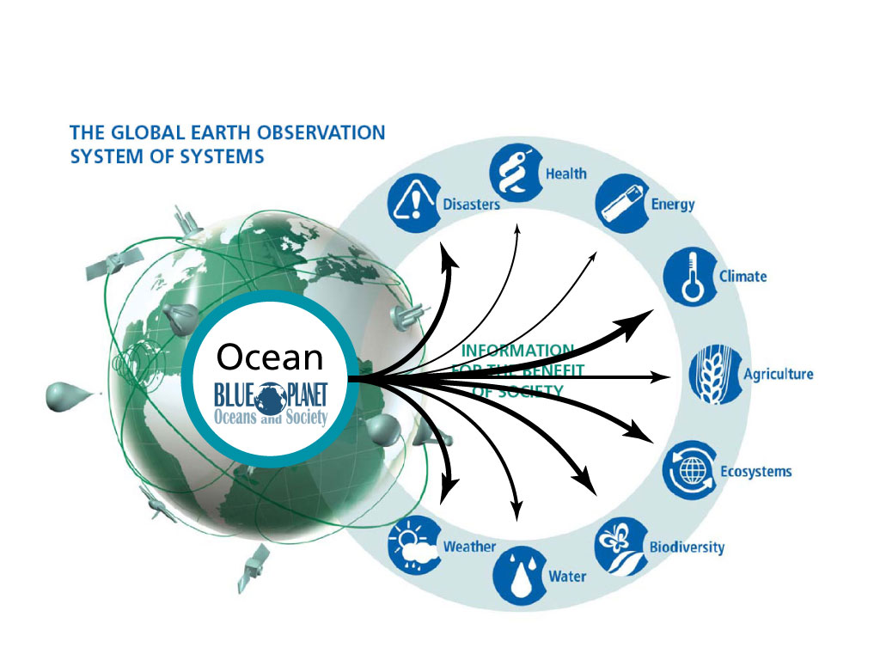
Figure courtesy GEO Secretariat
Notes:
For its first ten-year implementation plan GEO focussed on 9 societal benefit areas impacted/supported by Earth obs. Historically the ocean domain was much less visible than land and atmosphere, despite the fact that Oceans affect all the societal benefit areas of GEO.

Slide 3
Blue Planet: Seeking integration in a complex and crowded scene
WGClimate
TAO
RAMA
Carbon Task Force
PIRATA
GHRSST
GEOHAB
IOCCG
IOC/UNESCO
Virtual Constellations
JCOMM
GCOS
IODE
GCZIS
OBIS
DBCP
CLRCoP
SOT
GLOSS
Coastal Zone Community of Practice
Argo
OceanSITES
IOCCP
GACS
AtlantOS
Antares
GEOWOW
ChloroGIN
GEO Integrated Water
Information Task
IV-TT
IQOE
OSE-TT
Capacity Building
COSS-TT
SAFARI
MEP-TT
Notes:
There is a vast and growing network of existing observing system elements and programmes, governance bodies and data management systems, which are shown here in the outer ring (this is just a subset). This proliferation of acronyms, fondly known as the “Acronym Soup”, is creating confusion within the scientific community and especially outside of it. The role of Blue Planet is to facilitate communication between these programmes, most of which are connected in some way to the 5 main organisations leading Blue Planet. The ultimate goal is to integrate and explore synergies. Blue Planet does not seek to duplicate or compete with work that is already being done. Rather it seeks to raise the visibility of existing programmes and add value to them.

Slide 4
Building on Existing Efforts
Blue Planet builds on existing programmes and coordinating mechanisms addressing ocean observations and their societal applications.
Blue Planet adds value by:
Providing additional exposure and visibility to these programmes
Identifying synergies between programmes, both within Blue Planet and with related activities across the GEO community and beyond
Linking data to products to information to knowledge
Demonstrating societal benefits
Where possible, making a concerted effort to link to relevant policies and policy frameworks

Slide 5
Blue Planet Structure
& Partners
Sustained Ocean Observations
C1
Ocean Forecasting
C3
Sustained Ecosystems & Food Security
C2
Ocean Climate & Carbon
C5
Services for the Coastal Zone
C4
Developing Capacity & Societal Awareness
C6
Notes:
The Blue Planet is currently structured around these 6 Components, which are being led by the organisations shown here.

Slide 6
Societal benefits
Improved human health and safety, Sustainably managed coastal zones,
Climate change adaptation/mitigation,
Improved ecosystem services and food security
Societal applications
Climate forecasts
Tsunami warning
Pollution monitoring
Sustain-able fisheries
Search and rescue
Sea level forecasts
Flood forecasts
Oil spill response
HAB monitoring
Biodiversity monitoring
Data products and services
Ocean forecasting
Data collection
Data/info management
Models
Sustained ocean observations
Developing capacity and societal awareness
Notes:
This shows how capacity building and societal awareness are the foundations on which sustained ocean obs can be implemented globally. Data collection and analysis, data and info management and models provide products and services (such as forecasts) and for a variety of societal applications that ultimately result in societal benefits.

Slide 7
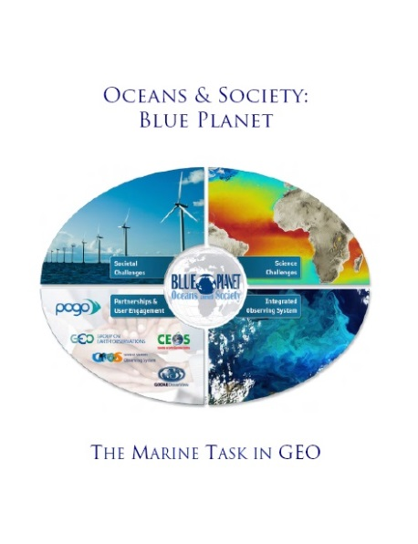
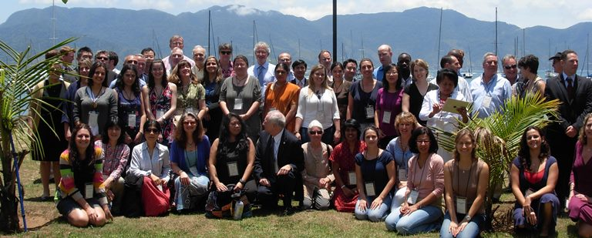
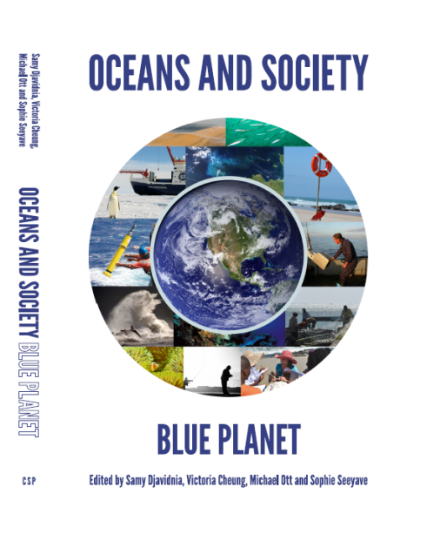
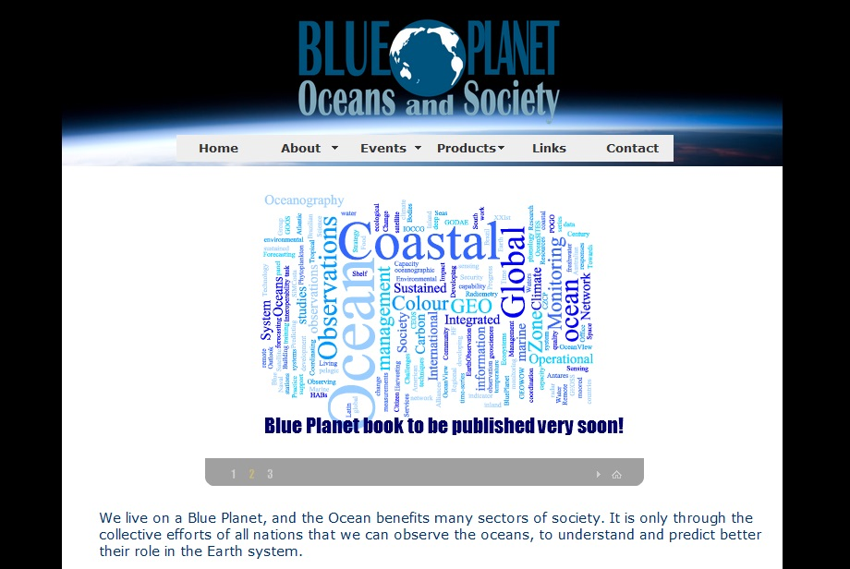
Key Milestones & future plans
White Paper
1st Steering Committee Meeting
Kick-Off Symposium
in Brazil
2nd Symposium in Australia
POGO submits Task proposal to GEO for 2012-2015 Work Plan
2011
2012
2013
2014
2015
2016
Website launched
Book published
Blue Planet Task SB-01 accepted by GEO Plenary and incorporated into 2012-2015 Work Plan
www.oceansandsociety.org
3rd Symposium in USA
Post-2015 GEO Work Program
GEO Ministerial in Mexico
http://www.cambridgescholars.com/
oceans-and-society
Notes:
This shows how capacity building and societal awareness are the foundations on which sustained ocean obs can be implemented globally. Data collection and analysis, data and info management and models provide products and services (such as forecasts) and for a variety of societal applications that ultimately result in societal benefits.

Slide 8
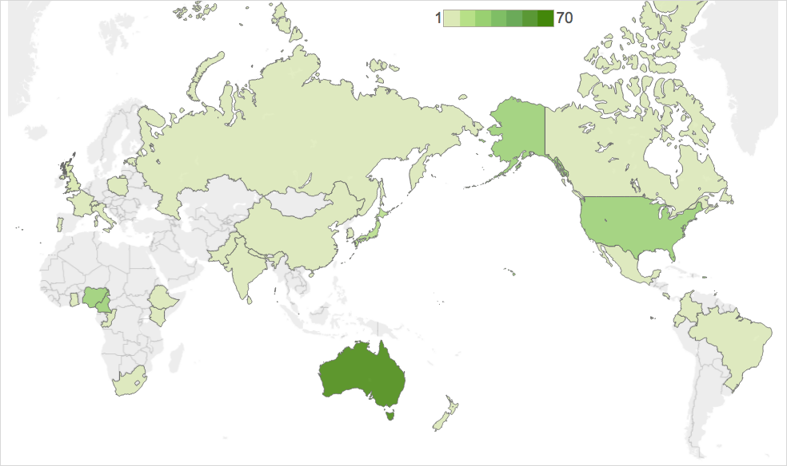
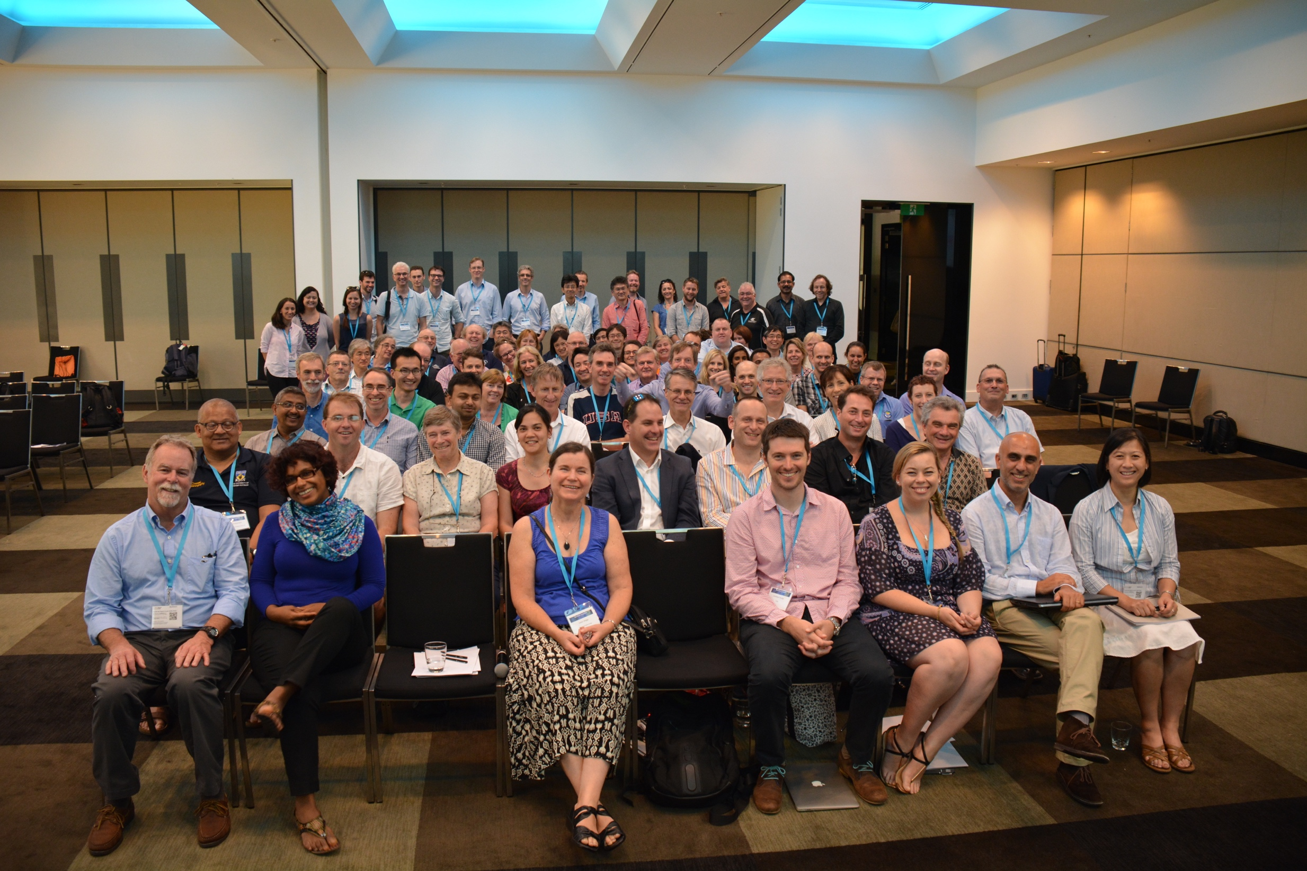
2nd Blue Planet Symposium 2015
67 presentations and 40 posters
162 registered attendees from 36 countries
Notes:
67 presentations
40 posters
104 participants
20 countries
125 tweets on #BluePlanet15 with 225 retweets and 187 favorites
One tweet alone reached >340,000 people
themes

Slide 9
CEOS @ Blue Planet Symp.
CEOS Keynote from Chu Ishida and Alex Held
Key Messages:
CEOS will be best positioned to support Blue Planet when there is a clear understanding and rationale for requirements and priorities
Specific topics keen to explore:
Space-ocean alliance to develop ocean information services in cooperation with related organizations, responding to ocean needs
Opportunities to leverage next-generation GEO satellites, including in combination with LEO missions
Next generation architectures for distribution and analysis of ‘big space data’
Notes:
CEOS provides coordinated Earth observations, products and services, to support Blue Planet

Slide 10
How could CEOS Contribute to
GEO Blue Planet ?
CEOS could contribute to GEO Blue Planet by:
Providing increased coordination on satellite observation data to respond to ocean ECV requirements/priorities.
Providing coordination on missions, calibration/validation, products and services by Virtual Constellations.
Helping coordinate and optimize satellite observations across key communities: Carbon, Climate and Water.
GEO Blue Planet identifies observation requirements/priorities for ocean-related services.

Slide 11
Outcomes from Cairns Symp.
Blue Planet would apply to be an Initiative in the new GEO Work Programme
This will require development of a Strategy and Implementation Plan
Blue Planet Mission updated, to include stronger emphasis on user engagement
Better articulation of the value of Blue Planet
Funding/support for Secretariat
Explored synergies
Notes:
It was agreed at the Cairns Blue Planet Symposium that the Mission should be more focussed on user engagement than it had been previously.
Under the auspices of GEO, Blue Planet envisions an…

Slide 12
Post-2015 GEO Work Programme
Various oceanic programs and communities
Blue Planet Initiative
Pathway to GEO Flagship Implementation
Water quality service
program
Implementation Plan
Resource Plan
Timeline for development
Key partners, participants, stakeholders
Sea level rise service
community
users
Mangrove
service
providers
Potential Flagships
http://www.cambridgescholars.com/
oceans-and-society
Notes:
It was agreed at the 2nd Blue Planet Symposium in Cairns, May 2015, that Blue Planet would apply to be an Initiative in the 2016 GEO Transitional Work Programme (and beyond). This Initiative would then, as it developed, be able to spin off operational services as GEO Flagships.

Slide 13
New Vision and Mission
Vision
An informed society that recognises the oceans’ crucial role in Earth's life-support system and is committed to stewardship of the oceans for a healthy, safe and prosperous future for all.
Mission
To advance and exploit synergies among the many observational programmes devoted to ocean, coastal and inland waters;
to improve engagement with a variety of users for enhancing the timeliness, quality and range of services delivered; and
to raise awareness of the societal benefits of ocean observations at the public and policy levels.
Notes:
It was agreed at the Cairns Blue Planet Symposium that the Mission should be more focussed on user engagement than it had been previously.
Under the auspices of GEO, Blue Planet envisions an…

Slide 14
Value Proposition
...will add value to existing observational programmes by:
Facilitate and encourage collaboration
Provide new platforms to demonstrate the importance of sustained in situ and satellite observations
Build-on and add to GEOSS infrastructure
Build a community where best practices are shared, and new programmes benefit from experience
Coordinate with other GEO elements with marine component
Improve connections with the users of ocean observation-derived products, information and knowledge;
Promote communication with decision makers and with the general public on societal benefits of ocean observations.
Notes:
Providing new platforms to demonstrate the importance of sustained in situ and satellite observations of marine and freshwater environments, and the value of integrating these with models;
Bringing together a wide and diverse community of governmental and academic researchers and providing new platforms for integration of multiple streams of data into products that provide the real value to users;
Provides opportunities to buildon GEOSS infrastructure from other domains (ocean datahave their greatest value when combined with information from other domains, including socio-economic data);
Coordinate with other GEO elements that have a marine component (or not)
Including cross-cutting elements focussing on capacity building, social awareness and user engagement, that have the knowledge and expertise to help the research- and observation-focussed programmes with their training and communication activities;
Bringing the ocean observing community’s efforts to the view of GEO decision-makers and funders;
Building a community where best practices are shared, and new programmes can benefiting from experience of established programmes;
Avoiding duplication and “reinventing the wheel” therefore making more efficient use of limited resources.
There are also a number of benefits to the partners and stakeholders. These include:
Providing an entry point to a vast community of observation programmes for potential data and information users who are not familiar with the ocean observing community and may not know exactly what they want or need;
Providing access to reliable, trustworthy sources of scientific information and advice for decision makers;
Providing clarity on who is doing what within the ocean observing community, for the benefit of all stakeholders;
Providing information to the general public on the importance of oceans and ocean observations.

Slide 15
Components revisited
C1: Developing capacity and societal awareness
C2: Sustained ocean observations
C3: Data access and visualisation
C4: Ocean forecasting and services
C5: Healthy ecosystems and food security
C6: Services for the coastal zone
C7: Ocean climate and carbon
C8: Integrated maritime services
C9: User engagement
Notes:
3 new components (C3, C8, C9) added as a result of Cairns Symposium

Slide 16
Blue Economy & sustainable livelihoods
Ocean stewardship
Human health & safety
Bringing knowledge to users
C5, C6, C7, C8, C9
Transforming data
into information &
knowledge
Data access & visualisation
Ocean forecasting
C3
C4
Sustained ocean observations
C2
Developing capacity and societal awareness
C1
Notes:
This diagram shows how the different Components contribute to the overall Blue Planet vision and mission.

Slide 17
Activities relevant to CEOS
Continue support and development of:
Chlorophyll Global Integrated Network (ChloroGIN )
Societal Applications in Fisheries and Aquaculture (SAFARI)
New Components and Services
Mangrove Mapping and Monitoring Service
Sea Level Service
Maritime services- EO for real-time monitoring, short-term forecasts and climate predictions- in coastal polar and environmentally sensitive regions
Data interoperability and Discovery
Network existing regional and international efforts in improving data interoperability & access (e.g. ODIP, IODE)
A Regional Asia-Pacific My Ocean Portal
Addressing the interface between the relevant Climate and Carbon communities for ocean
Notes:
MBON: It may be envisioned as one of the pillars of GEO BON which requires the observing infrastructure and human ca pacity developed under Blue Planet.

Slide 18
GEO and Other Linkages
Other GEO Initiatives and Community Activities
GEOBON – MBON (GI02)
GEO Water Quality (CA14)
GEO-DARMA (GI16)
Global Carbon Observation and Analysis System (GI05)
Harmful Algal Bloom Early Warning System (CA30)
For Global Mangrove Monitoring (CA31)
Foundational Tasks:
Knowledge Base development (GD-07),
Capacity Building coordination (CD-01)
Determination of user needs and observational gaps (G06)
Other Activities:
Atlantos, TOP, Quiet Ocean
Notes:
MBON: It may be envisioned as one of the pillars of GEO BON which requires the observing infrastructure and human ca pacity developed under Blue Planet.

Slide 19
New Governance Structure for Blue Planet
STRATEGY
IMPLEMENTATION
Advisory Board
Representatives of Endorsing Organisations (e.g. CEOS, CZCP, GEO, GOOS, GODAE OceanView, POGO, etc) + Component/Current leaders
Executive Committee
Representatives of Sponsoring Organisations
Distributed Secretariat
Nodes in Australia, India, UK, USA
Blue Planet community
Developing capacity & societal awareness
Sustained ocean obs
Data access & visualisation
Ocean forecasting & services
Healthy ecosystems & food security
Services for the coastal zone
Ocean climate & carbon
Integrated maritime services
User engagement
C1 leader
C2 leader
C3 leader
C4 leader
C5 leader
C6 leader
C7 leader
C8 leader
C9 leader

Slide 20
Executive Committee Support
POGO Secretariat (Plymouth Marine Laboratories)
continues as liaison with GEO and support with overall coordination/communication, in close cooperation with nodes
Scientific Coordination
full time PhD professional (NOAA NESDIS, Maryland USA)
Masters level professional (ICAR (India) –pending
IT and Support (CSIRO, Australia)
One IT expert and infrastructure for website/databases, communication and outreach services

Slide 21
Third Blue Planet Symposium
Venue: USA
Date: March/April 2017
Theme: “The Role of the Oceans in Earth's Life Support System”:
Sustainable use of ocean resources
Threats from pollution, warming and acidification
The changing oceans
Processes and life at the Interfaces with the oceans
A Program Committee has been formed.
SITWS-2015-12 | SIT Chair | Seek a CEOS representative to serve on the planning committee for the 3rd Blue Planet Symposium to be held September 2016 in Monterey, California | CEOS Plenary

Slide 22
How can/should CEOS
engage with Blue Planet to achieve
increased visibility within
GEO 2016 Framework?

