Slide 1
Committee on Earth Observation Satellites
Data Applications Report
& EO Symposium
Chu Ishida, JAXA
Naoko Matsuo, JAXA
Plenary Agenda Item 24
29th CEOS Plenary
Kyoto International Conference Center
Kyoto, Japan
5 – 6 November 2015

Slide 2
Editorial Committee
Name | Organization
Paul Briand | Canadian Space Agency (CSA)
Marie-Josee Bourassa | Canadian Space Agency (CSA)
Brent Smith | National Oceanic and Atmospheric Administration (NOAA)
Joost Carpay | Netherland Space Office (NSO)
Andre (Alex) Held | Landscape Observation and Simulation Group, The Commonwealth Scientific and Industrial Research Organization (CSIRO)
Cécile Vignolles Ye | Earth Observation Applications, Centre National d’Etudes Spatiales (CNES)
Michael Nyenhuis | German Aerospace Center (DLR)
Chu Ishida | Japan Aerospace Exploration Agency (JAXA)
Kim Holloway | NASA Langley Research Center (LaRC)
Ivan PETITEVILLE | European Space Agency (ESA)
Beth Greenaway | UK SPACE AGENCY (UKSA)
Lawrence Friedl | NASA Headquarters
Jonathon Ross | Geoscience Australia (GA)
Simona Zoffoli | Italian Space Agency (ASI)
Kerry Sawyer | National Oceanic and Atmospheric Administration (NOAA)

Slide 3
Concept
Working Title: Applications of Earth Observations from Space: Serving humanity, society, and industry
Targeted readership
Policymakers in government
International organizations active in key application areas, such as UN
Donors such as World Bank, Asian Development Bank
Purpose
Provide evidence of the importance and necessity of satellite EO to governments and to improve their understanding
Provide support for funding for the next generation of space agency EO programmes through this improved understanding
Highlight approaches that have worked around the world, including the types of partnerships and programmes

Slide 4
DAR Status
The Data Application Report (DAR) is one of the CEOS Chair priorities in 2015.
JAXA and DAR Editorial Committee collected 49 case study articles and 5 background articles (Thank you to all contributors).
The committee selected 11 articles for “Summary Brochure” which is now available as hard copy and to be distributed to GEO and the other international events.
Full Report including all 49 case study articles is available as PDF at CEOS website.
^{http://www.ceos.org/dar2015}

Slide 5
Table of Contents
of the summary report
CHAPTER 1: ABOUT CEOS
A Brief History of CEOS
Evolution in Capabilities
EO Data Policy
Coordination Framework
Current state of the art technology

Slide 6
Table of Contents
of the summary report
CHAPTER 2: APPLICATIONS
Sea-Ice Monitoring Using Rada (incorporating 4 individual articles)
Monitoring Canada’s Geohazard Risks
Early Warning of Infectious Diseases via Global Risk Maps
Public Health and Earth Observation: Risk Assessment of Infectious Diseases in Canada
Planning Pipeline Routes
Enhancing National Carbon Accounting and Reporting Using Remote Sensing Data
Improving Forecasts of Agricultural Crop Yields
Earth Observation for Food Security and Sustainable Agriculture
Enhancing Drought Monitoring in North America
Prevention of Illegal Logging in the Amazon Rainforest
Protecting the Aquaculture Industry from Harmful Algal Blooms

Slide 7
Tokyo Symposium
JAXA Symposium for data applications of earth observation satellites 2015
-Earth observation for decision-making in people's lives-
Date: November 2, 2015 (14:30-17:30)
Venue: Tower Hall, Roppongi Academyhills, Tokyo, Japan
Programme
Opening Remark (JAXA president)
Guest Speech (Ambassador Caroline Kennedy) (Ms.Toyota, Parliamentary Vice-Minister of MEXT) (Cabinet Office)
Keynote Speech “Global social problems that human race has to overcome” (JAMSTEC)
Session 1 : Space Agency Report (2005-2015)
JAXA(Mr.Yamamoto), NASA(Dr.Freilich), ESA(Prof.Briggs)
Session 2: Case Studies for Data Applications of Earth Observation Satellites
○ Outcomes of data applications (JAXA)
○ Public use 1: Dr. Held, CSIRO
Public use 2: Dr. Krishnamurthy, WHO
Public use 3: Mr. Shishido, JICA
Session 3 : Talking Session for Future Choices -Convening Power- (40min)
Speaker: Dr. Hiroki (MILT), Dr. Koike (Tokyo Univ.), Mr. Fukuwatari (Sompo Japan Nipponkoa Insurance Inc.) , Dr. Nakashima (JAXA)

Slide 8
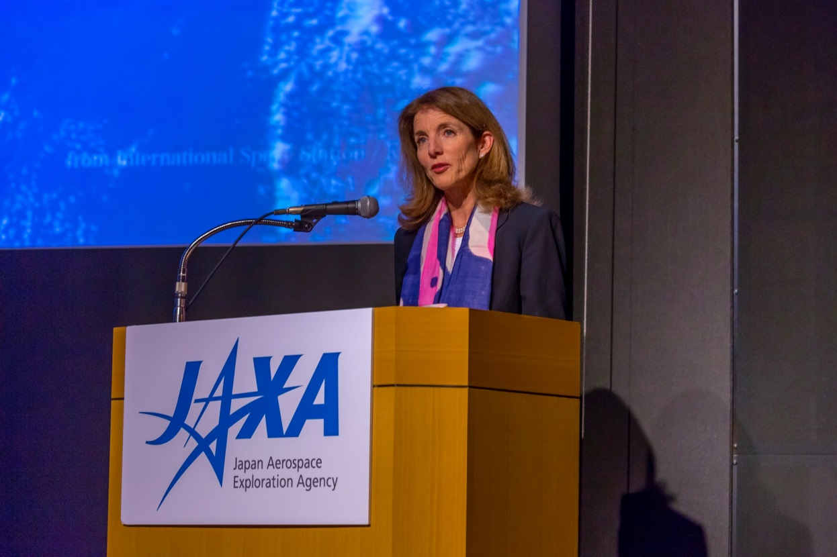
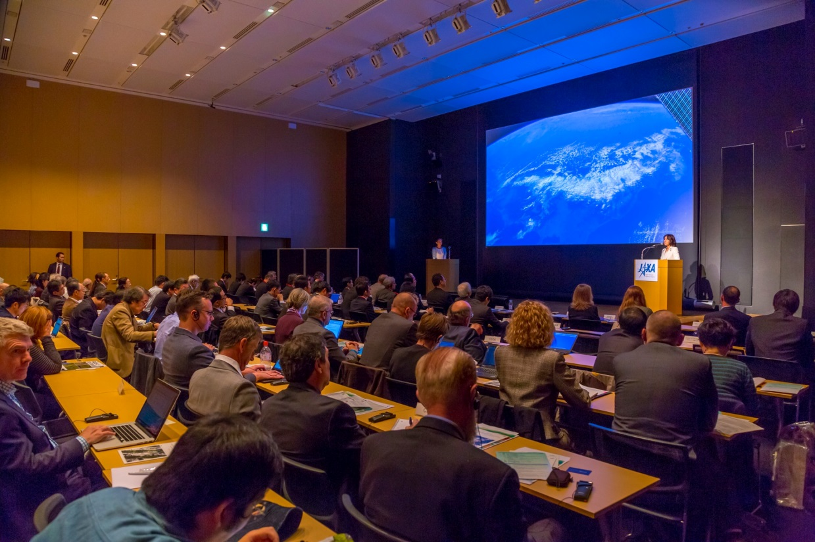
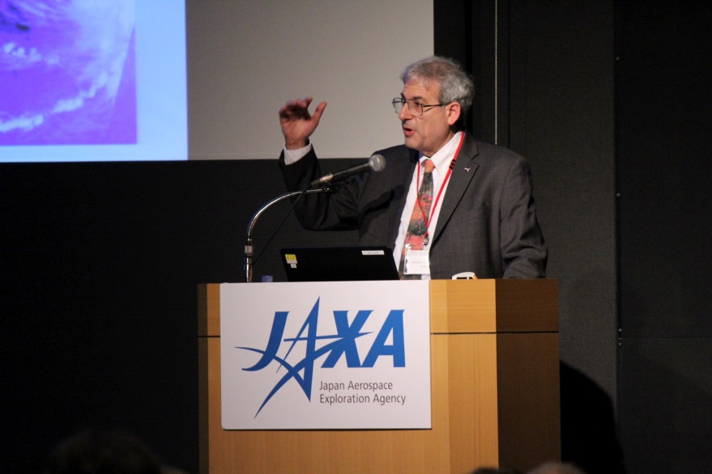
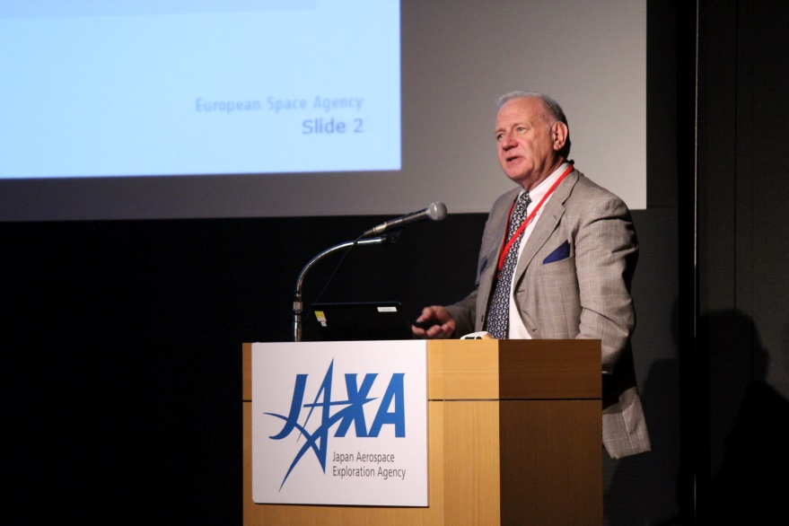
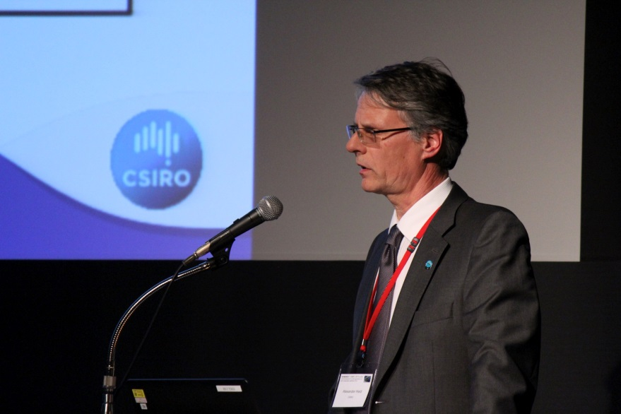
Tokyo Symposium

Slide 9
Outcomes
from Tokyo Symposium
Guest speech
Ambassador Kennedy emphasized the importance of Earth science, Earth observation, and the continuation of the strong international collaborations undertaken by bodies such as the CEOS.
Agency Reports
JAXA : Mr. Yamamoto proposed that we are already gathering, analysing, and using data to understand the status of the Earth, but we must take steps to apply the information to decision-making processes.
NASA: Dr. Freilich promoted the unique perspective provided by space-based Earth observations, stating that no other tool allows us to consistently measure for such long periods of time at a global scale. Space-based observations support applications through monitoring, prediction and response.
ESA: Professor Briggs opened by stating the importance of the services layer built on top of Earth observation data, noting that the majority of economic benefits are derived from services rather than data supply.

Slide 10
Outcomes
from Tokyo Symposium
Case Studies for Data Applications of Earth Observation Satellites
Mr. Ishida reported analysis of DAR case studies. Although, majority of the 49 cases are of public use, but role of private sector as service providers is increasing.
Public Use #1: The Australian Data Cube and Carbon Accounting
Dr. Held (CSIRO) spoke about the unique challenges related to Australia’s large landmass. A large amount of EO data is required for national carbon accounting and new, efficient ways to manage it are necessary.
Public Use #2: Geodata Sets and the Global Health Facility Locator
Dr. Krishnamurthy (WHO) explained that WHO is now working with space agencies to develop a health information platform, which aims to incorporate maps of healthcare facilities, DEMs, satellite imagery and layers with outbreak information to support response efforts.
Public Use #3: Forest Monitoring
Mr. Shishido ( JICA) spoke about JICA’s satellite Earth observation based forest-monitoring efforts, including an early warning system for the Brazilian Amazon (in collaboration with JAXA), and the establishment of a forest monitoring system in Gabon and DRC (optical and SAR based for REDD+ activities).

Slide 11
Outcomes
from Tokyo Symposium
Talking Sessions for Future Choices –Convening Power-
JAXA promote cross-cutting research.
Need satellites to know overall of water-cycle because data of water cycle is still uncertain.
MILT built Water Cycle Master Plan as policy gravity in this year.
Sompo Japan explained the satellite data is very useful for their weather index insurance in East Asia.
Summary
Noted the importance of strong international collaboration undertaken by bodies such as CEOS
Stressed the need to be clear on the value to society of EO and to ensure space agencies understand the value chain
Majority of economic benefits are derived from services rather than data supply – strong support for industry in Europe
Research and refinement of methods/needs necessary to allow non-technical users to make effective use of observations. Technologies such as the Data Cube are expected to help in this direction

Slide 12
49 Articles - Split by Regions

Slide 13
49 Articles - Split by Applications

Slide 14
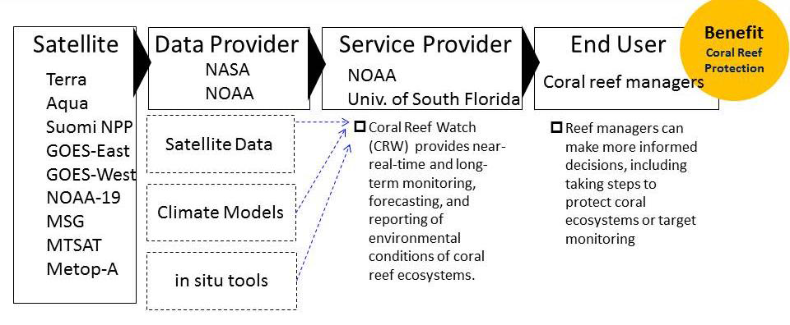
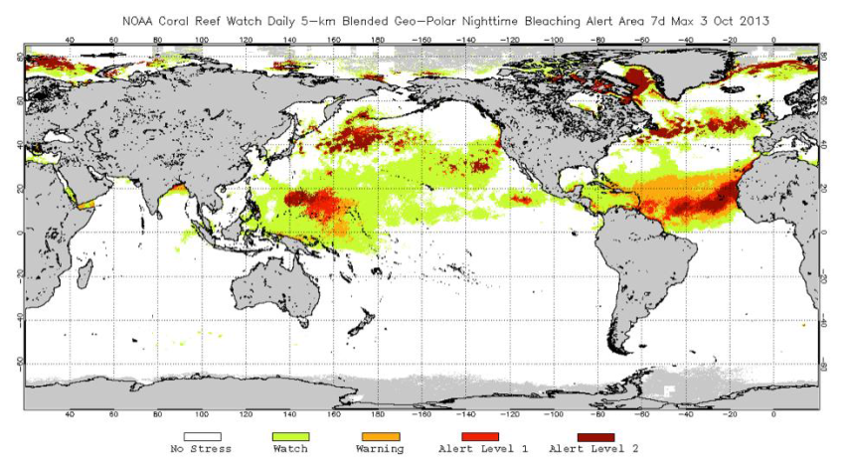
Findings – Data Integration
The value chains indicate that multiple satellites data are integrated with in-situ data, model data and somtimes socio-economic data.
Particular importance are to identify end-users and their requirements and to find a service provider.
Daily coral
bleach alert
3 Oct 2013
14
Notes:
バリューチェーンを良く見ると、ほとんどのケースが複数の衛星データを地上データを統合し、さらにはモデルデータを統合していることが分かります。ここでは、米国におけるサンゴ礁の白化現象のモニターと予測について示していますが、多くの衛星データと現地データ、モデルデータから短期、長期のサンゴ礁の白化現象の予測を行い、それに基づき、各地域で管理が行われていることが分かります。

Slide 15
Public Use vs. Commercial Use
Public use cases dominate applications of the data provided by CEOS space agencies.
But, commercial services to government and other commercial sectors are growing.
Data provider
Service provide
End User
Ground Deformation Monitoring
G-G-B/R
G: Government
B: Business
R: Researcher
C: Citizen
Notes:
４９件のうち、約９割が公共目的で、民間利用は１割と少なくなっています。実際の利用が少ないということではないと思いますが、民間利用の事例を報告するメリットが少ないのだと感じています。
データ提供者、サービス提供者、最終ユーザを政府、民間、市民で分類してみると、

Slide 16
Data Provider - Service Provider - End user
 | Asia/Oceania | Americas | Europe | Africa
1 | G-G-B/C | G-G-G | G-B-G/C | G-R-G
2 | G-G-G | G-G-G | G-G-G/B | G/B-G-G
3 | G-G-G/C | G-G-G | B-B-G/B | G-G/B-C
4 | G-G-G/C | G/C-G-G | B-B-G/B/C | B-B-G/B
5 | G-G-G/B/C | G-G-G/C | G-B-G
6 | G-G-G/C | G/B-B-B | G-G-B/R
7 | G-G-G/B/C | G-B-B | G-G-G/R
8 | G-G-G | G-G-G | B-B-B
9 | G-G-G | G-G-G/C | G-B/R-G/B
10 | G-G-G/B/C | G-G-G/R | G/B-B-G/B
11 | G-G-G/C/R | G-G/R-G | G-G-G
12 | G-B-G/B |  | G-G-B
13 |  |  | G-B-B/C
G: Government
B: Business
R: Researcher
C: Citizen
民間サービス提供者の役割が増大
Role of private sector as service provider is growing.
Notes:
このような結果になりました。
地域別に各事例のステークホルダーの分類になります。
サービス提供者と最終ユーザが民間のケースを黄色で示しました。アジアが圧倒的に公共利用が多いの対して、欧州では民間利用が広がっていることが分かります。

Slide 17
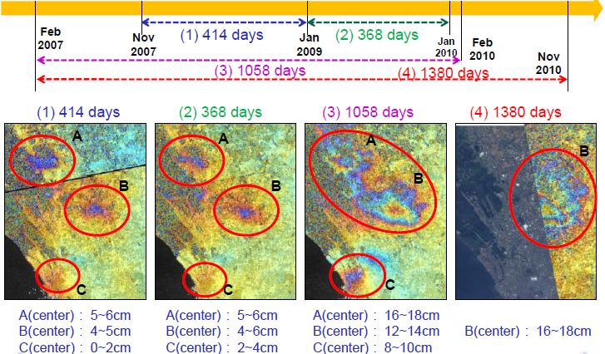
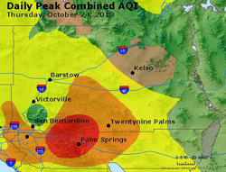
Finding - Risk assessment
Data applications for risk assessment is increasing, with data being used to evaluate risks related to natural disasters, agriculture and public health.
A simple hazard map to complex models are used to provide a new-term to long term risks.
Land subsidence near Manila, Feb 2007- Feb 2010
Upper circle: 12 cm subsidence, lower circle: 4 cm
Air quality map of San Bernardino,
CA, US, Oct 24, 2013
Notes:
データ利用の特徴的な傾向について申し上げます。
事例の約半分がリスク評価に関する事例になっています。
災害に関するリスク評価が多いですが、さらに健康や農業に関するリスク評価が含まれます。
左の図は、ＡＬＯＳによるマニラの地盤沈下の変化を示したものです。右側は、米国カリフォルニア州における大気汚染の予測を示したものです。

Slide 18
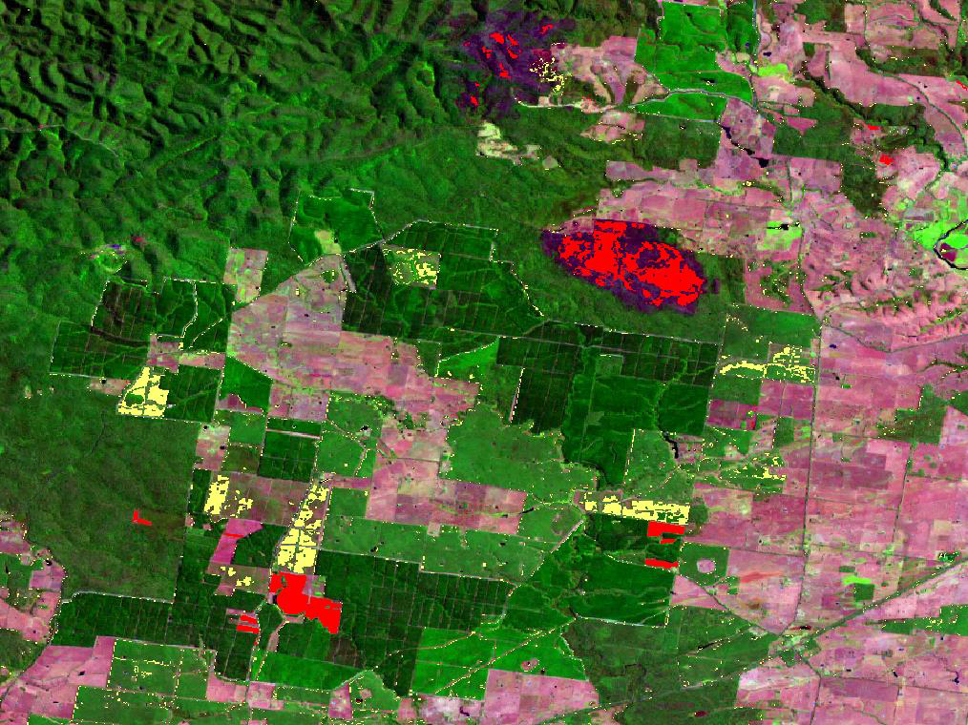
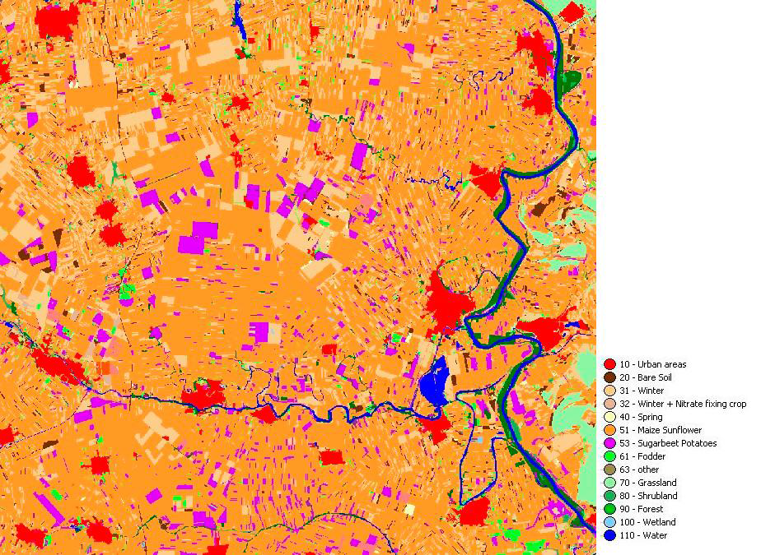
Finding – National accounting/infrastructure use
Australia uses satellite data to monitor and manage water and carbon resources on a national-scale.
Airbus produced national map of Servia with SPOT data.
Land-use changes by Landsat in Australia:
regrowth (yellow), forest fire (red)
Land-use map by SPOT in Serbia:
urban (red), potatoes(purple), sunflower (brown)
Notes:
データ利用には、国全体の環境や資源の管理に利用しようとするものがあり、特に豪州は全国の森林や水のモニタリングに活用しているほか、セルビアにおいては、衛星だけで全国の地図を１年たらずで民間事業者が整備しています。

Slide 19
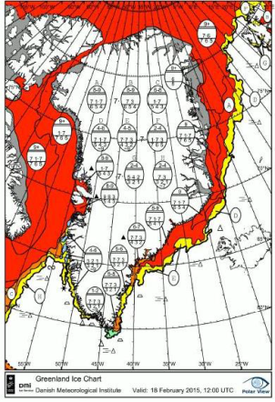
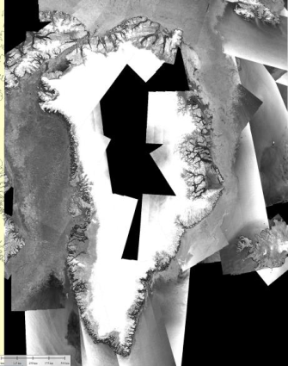
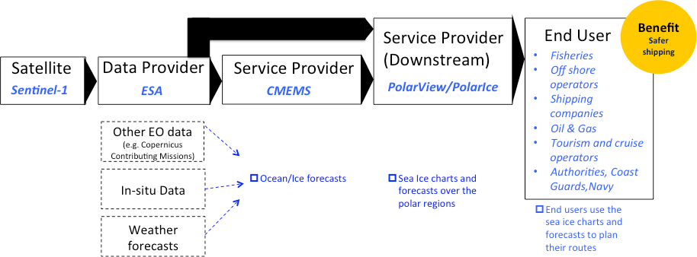
Finding – Copernicus Downstream service
The Copernicus Sentinels downstream service is clearly shown in the value chain.
Copernicus Marine Environmental
Monitoring Services
Notes:
欧州においては、コペルニクスのダウンストリームサービスがバリューチェーンでも示されています。コペルニクスの海洋環境サービスでは、海氷予報データまでがコアサービスとして提供され、ダウンストリームで海氷分布図等が作成され漁船や海運業者等で活用されています。コペルニクスのダウンストリームサービスは他のサービスでも構築されており、新しいデータ利用のモデルとしてその成果が注目されます。

Slide 20
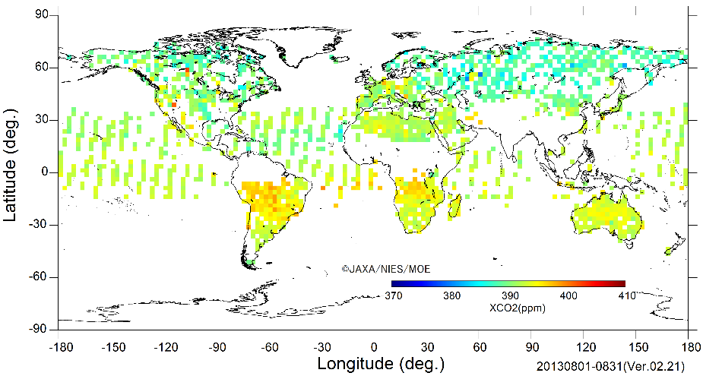
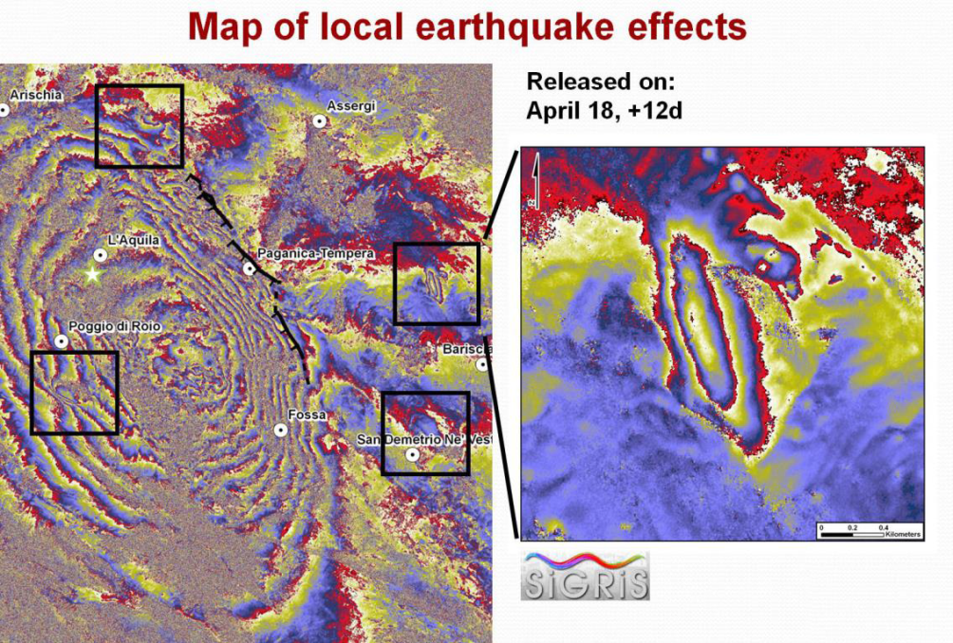
Finding – New EO capabilities
The past decade has seen great innovations in the application of Earth observation technology, including:
Earth surface deformation monitoring using Interferometric SAR
Ground water monitoring using highly-sensitive gravity measurement instruments
GHG monitoring using satellite instruments has filled gaps in ground observations of CO₂ and CH₄.
Monthly Global Map CO2 concentration Aug 2013
Product generated for April 6, 2009 Central
Italy earthquake by COSMO-Skymed
Notes:
この１０年間では、地球観測技術の進展による新たな利用が広がっています。特に、ＳＡＲ干渉技術による地殻変動の監視、重力の計測による地下水の変動の監視、さらには高精度の温室効果ガスの計測等が挙げられます。

Slide 21
Follow-up plan of DAR
JAXA will continue further analysis on the collected applications which are now available on web.
JAXA plans to apply successful application practices to its application program, including:
development of ocean information services in partnership with government, commercial sectors and academia.
contribute to SDGs (Sustainable Development Goals) through global, regional and national indicators.
expand partnership with stakeholders, including private sectors, development banks and development assistance agencies, UN and international organizations.

Slide 22
Summary
2015 CEOS DAR demonstrated the roles of EO satellite are expanding significantly for various applications.
Data Applications Symposium in Tokyo was held successfully with 250 people attendants. The symposium provided latest information and future prospects as to satellite data applications.
JAXA will make further analysis on the collected applications cases and apply to its application projects.

