Slide 1
Committee on Earth Observation Satellites
WGISS report
CNES
Plenary Agenda Item #21
29th CEOS Plenary
Kyoto International Conference Center
Kyoto, Japan
5 – 6 November 2015

Slide 2
What is WGISS ?
Working Group on Information Systems and Services
The overall purpose of WGISS is
to facilitate (CEOS) data and information management,
to support the provision of services for both data providers and data users.
WGISS will address in particular
the description, maintenance, discovery, access, and utilization, including archiving and long-term preservation,
of space borne Earth observation data and supporting ancillary and auxiliary data, enabling improved operability and interconnectivity of information systems and services.

Slide 3
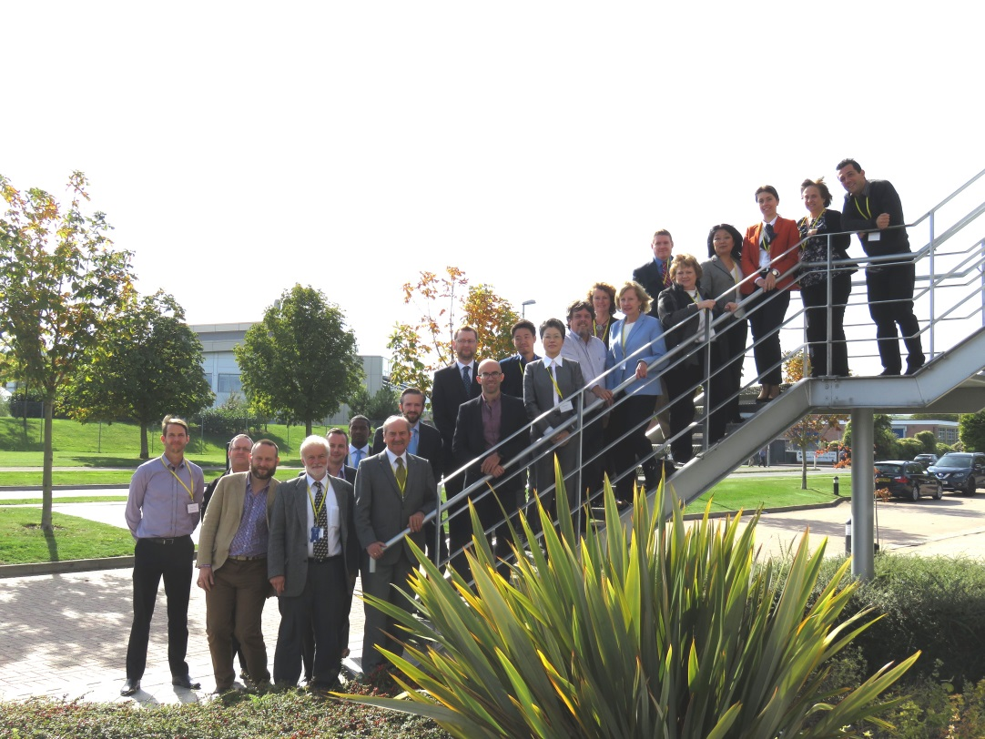
Summary
WGISS40
Hosted last month by UKSA
50+ participant (inc. remote)
20 agencies/organisations
Technology exploration
Recovery Observatory
Interoperability
Data Preservation
Future Architecture for Data

Slide 4
Technology Exploration
WGISS is a forum where new technologies, future architecture are discussed and presented
Distributed architecture
Big data technologies (Hadoop)
Cloud computing
Distribution protocols
GA datacube is a technology which is explored and discussed within WGISS
Collecting use cases from our agencies
Realizing this will not be a solution for all situations
Ground Segment Evolution Workshop
Held in October 2015, in UKSA during last WGISS meeting

Slide 5
Recovery Observatory
Status
Development ended during summer 2015 : on the schedule
Ready for a triggering of Recovery Observatory by Disasters WG
Used operationally by KalHaiti project in CNES
Project still open in WGISS, waiting for an potential triggering
Depending on the event and on the manipulated data, some slight modifications could be done
Video demo
http://ceos.org/ourwork/workinggroups/wgiss/current-activities/recovery-observatory-project/
ACTION DATA-04 - In cooperation with WG Disasters, WGISS will develop and make available the Recovery Observatory infrastructure (see Section 3.5 for details). Version 2 will be available end in Q1 2015 and Version 3 (final) will be available end of Q2 2015. TO BE CLOSED

Slide 6
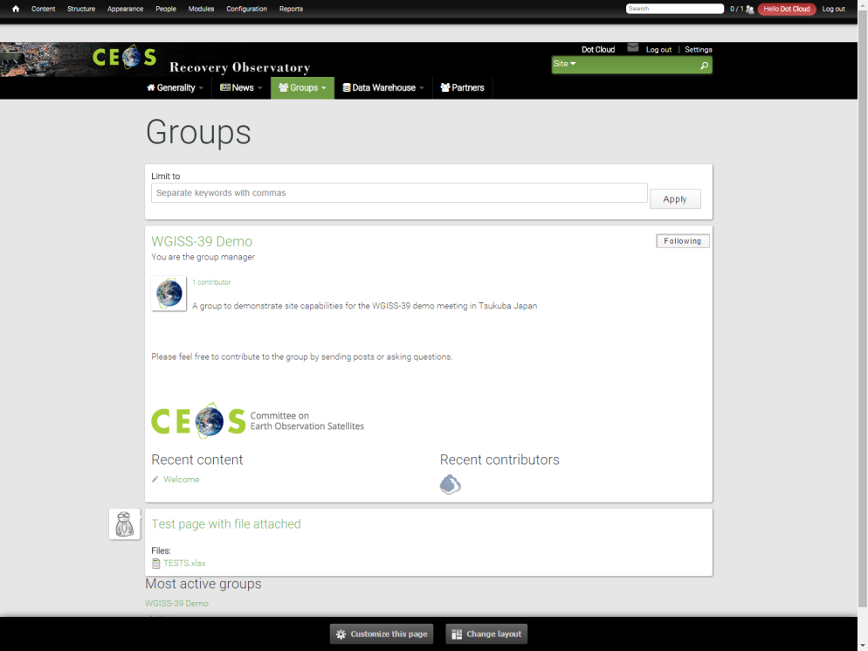
Recovery Observatory
Editorial content
Project presentation
General News & events
Fed by webmaster
Collaborative work
To allow users to post information
& data within groups
To provide security management
Private groups
Semi private groups
Public groups
License management

Slide 7
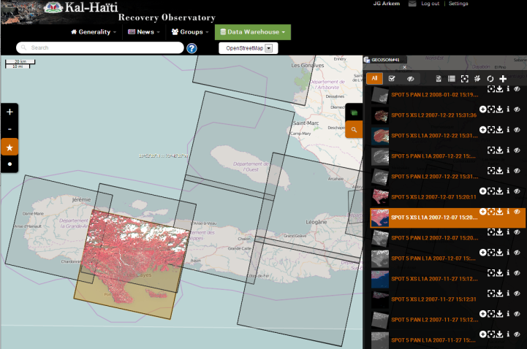
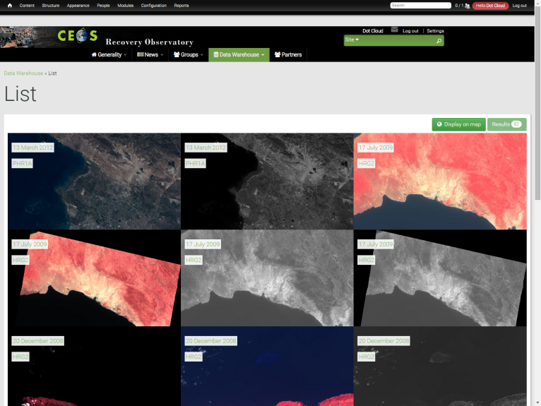
Recovery Observatory
Map with products footprints
Full resolution products displayed on the map
Product download
List of available products
List of products ordered by date of acquisition
Product download
Product details with metadata , quicklook and footprint
Products ingestion
Ability for users to send a geographical product
Multi criteria search form

Slide 8
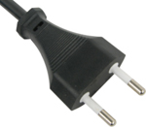
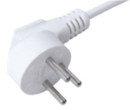
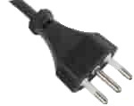
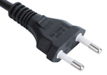
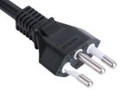
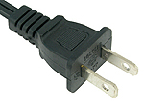
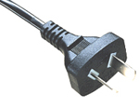
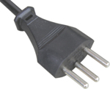
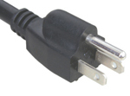
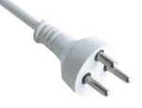
Interoperability
CWIC
FedEO
Opensearch
IDN
Connected data assets
VIDEO

Slide 9
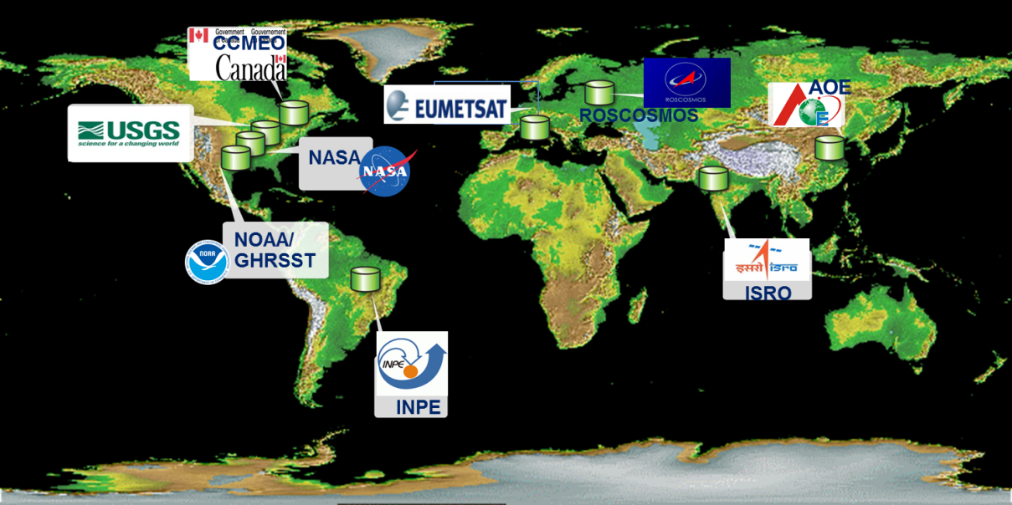
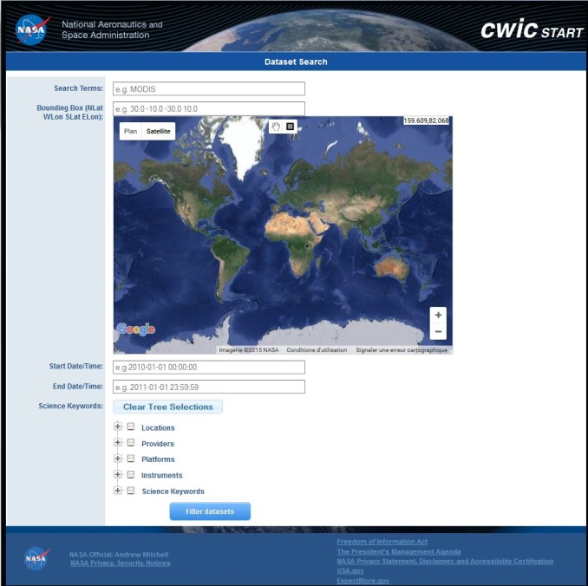
Interoperability - CWIC
Data partners:
NASA, NOAA/GHRSST,
USGS, INPE, CCMEO,
ISRO, EUMETSAT,
AOE, NOAA,
ROSCOSMOS
Implements CEOS opensearch
Access to
Over 1900 collections
70+ millions granules

Slide 10
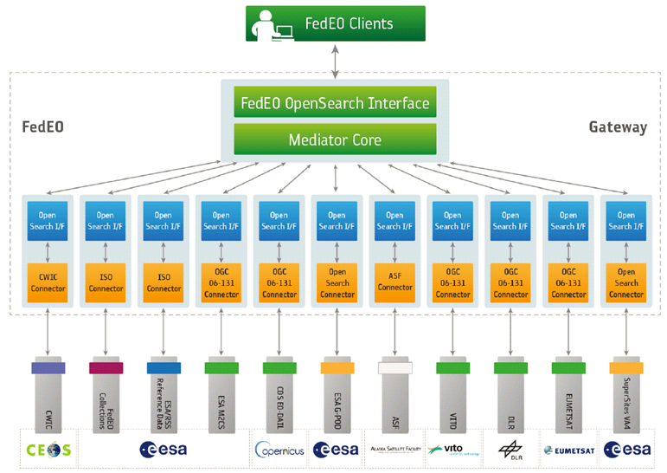
Interoperability - FedEO
Federated Earth Observation Gateway System
Provides brokered discovery, access and ordering capability to European & Canadian EO missions data based on HMA standard interfaces
Implements the CEOS OpenSearch interfaces
Access to
477 collections
6+ millions granules

Slide 11
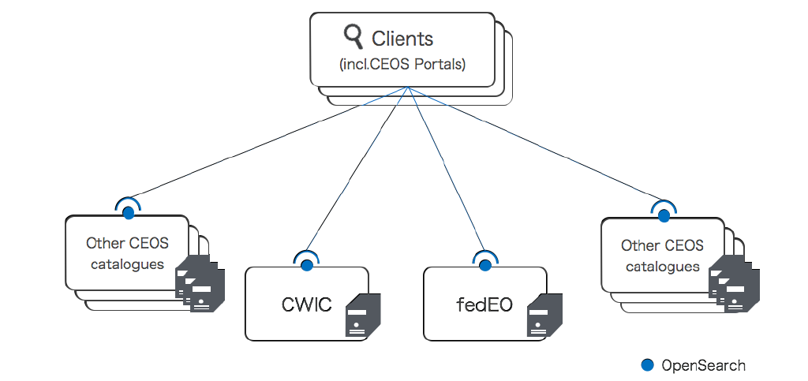
Interoperability - Opensearch
CEOS opensearch ???
Standard for interoperability (discovery and access of data)
Shared by CEOS agencies
Easy to implement
The CEOS opensearch Best practices document was finalized on May 2015

Slide 12
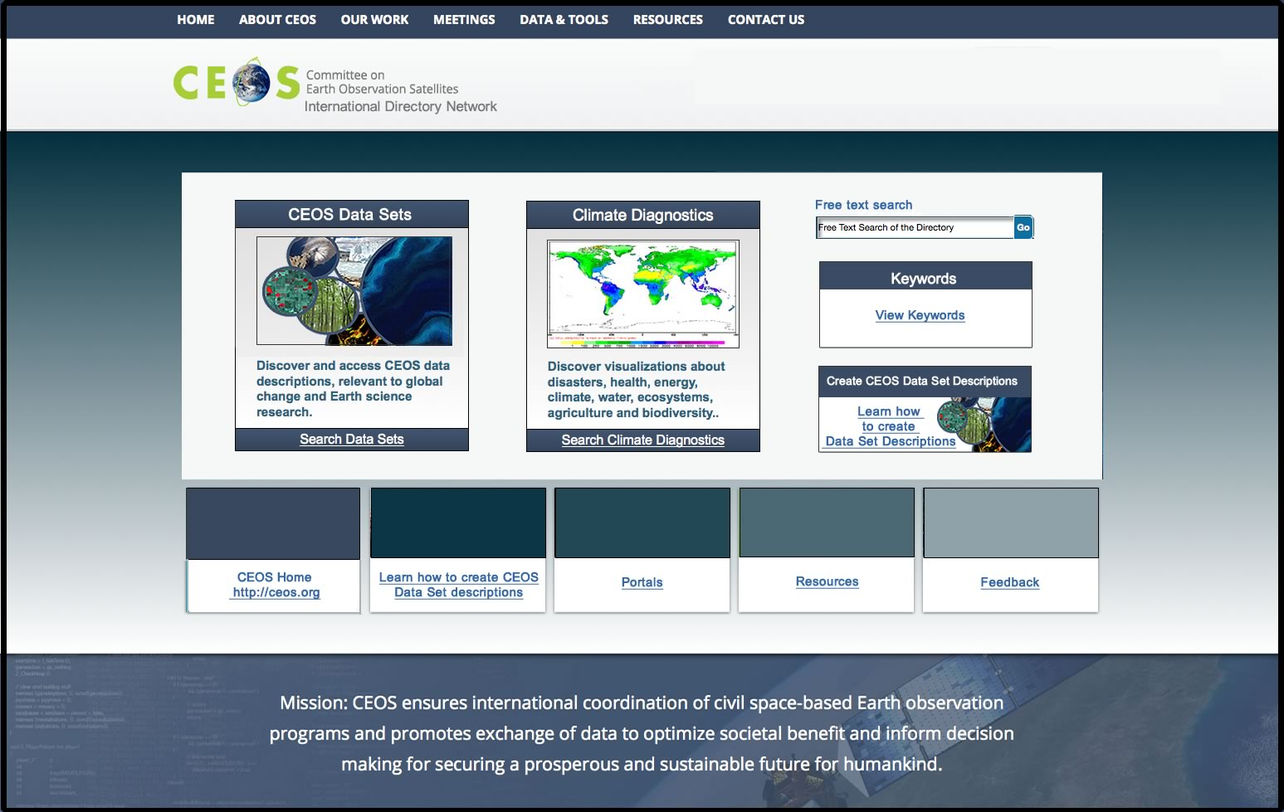
Interoperability - IDN
Upgraded IDN site
Aim: Incorporate current look/feel GCMD search to improve navigation
New data
ROSCOSMOS, EUMETSAT, CNES, ISRO
…
TAGGING : allow portal, VCs, … to directly identify their datasets
ACCESS : address (opensearch, CWIC FEDEO) is provided
Allow to access the data after discovery

Slide 13
Interoperability - IDN
ACTION DATA-02 - Full representation of CEOS Agency datasets in the IDN and accessible via CWIC/OpenSearch : PERMANENT
ACTION VC-01 - Each VC will provide WGISS with a list of relevant datasets that its respective constellation members desire to access. WGISS will work with CEOS data providers to ensure search and accessibility (when possible) of these datasets are available so as to ensure coverage of all datasets required by VCs
These are essential and permanent actions
The access URL endpoint shall be provided to allow access after discovery
Need for better interaction with VCs
Connected data assets :
Up-to-date metrics for IDN, CWIC and FedEO
http://ceos.org/ourwork/workinggroups/wgiss/connected-data-assets/

Slide 14
WGISS Interoperability Video Demonstration
This video demonstrates the search and access of satellite data across multiple CEOS agencies by making use of a common set of commonly defined WGISS interoperability standards.
Science Focus: Borneo deforestation
Technology focus: WGISS Interoperability Standards
All of the search and access tools shown in the video are operational and available for public use
All of the data being accessed have an open data policy (some may require simple user registration)
Video is accessible at http://wgiss.ceos.org

Slide 15
Data Preservation
Documents
Best practice documents
Five new documents have been reviewed and issued :
Data Preservation guidelines
Preservation Workflow
Generic EO Dataset consolidation Process
Persistent Identifiers Best Practices
Preserved Data Set Content (PDSC)
ACTION DATA-05 - Two documents dedicated to CEOS best practices in the domain of Data Stewardship will be issued by WGISS : - Persistent Identifier Best Practice document - EO Data Preservation Workflow document. CLOSED
ACTION DATA-06 - In order to provide a support to the CEOS Working Groups and Virtual Constellations, but also to SEO, WGISS will develop a web page containing a list of best practice documents and opensource software. These will be material directly usable by VCs and WGs for their work related to Information Systems and Services.. CLOSED

Slide 16
Data Preservation
Documents
Policy Documents
Individual organizations' policies (stewardship, access, ...)
EO Data Stewardship Cooperative Framework
Applied to
CEOS EO Space Data Sets
Data Purge Alert Procedure & White Paper
High level framework documents
Applied to
Technical Documents
Preservation Workflow
EO Data Stewardship Definitions
General guidelines and best practices
Support
Guidelines and best practices on specific topics
Persistent Identifiers Best Practice
EO Data Preservation Guidelines
Preserved Data
Set Content
…
Technical implementation procedures
EO Data Set Consolidation Process
…

Slide 17
Data Preservation
Purge Alert
“WGISS realizes that it is a responsibility of all organizations holding EO space data to assess the relative value of their holdings and to preserve them for the long term”
Sometimes an organization must make the decision to Purge* one or more datasets that could be important to help meeting the mission requirements of another organization.
The “Data Purge Alert Procedure” aims at preventing, or at least minimizing, the loss of EO space data:
It replaces the outdated “WGISS Purge Alert Service”.
It should be applied by “Purging organizations” to inform other organizations and trigger a possible transfer of preservation responsibility to another interested entity.
CEOS might support in some cases dialogue initiation between a “Purging organization” and entities interested in taking over data responsibility.
*Data Purge: to permanently and irrecoverably remove all copies of an EO dataset held in an organization.

Slide 18
Future Architecture for Data
New activity, lead by CSIRO, USGS and CNES
Objectives
Study future data access systems
Including datacube
Answer to
2016 CEOS chair initiative : study of Future Data Access and Analysis Architectures
Carbon action
Data03 action with SEO
Support to LSI VC
ACTION CARB-08-35 - The CEOS Carbon Subgroup (recommended in Carbon-Action-38) will develop guidelines for appropriate data use of satellite data and data products.? This will require improved interactions between the carbon cycle community and the satellite community; comprehensive review of the current use of data products, including current data limitations; and reconciliation of methodological differences and spatial compatibility.? Such interactions may include co-sponsorship of joint workshops targeting specific data needs and investment in community product assessments, especially for key intercomparison exercises..

Slide 19
Future Architecture for Data
ACTION DATA-03 - CEOS has made considerable progress in coordinating data acquisition to support important stakeholder initiatives, a number of which have a goal of becoming operational over the coming years. The challenges of routinely processing and analyzing full archives of data to produce operational products are very different to those of producing one-off example products. Traditional ?clip and ship? approaches are proving not to work. This presents a significant ?big data? challenge for both the user communities and the space agencies who wish to support them, but whose programs must also be sustainable. In response to this strategic challenge, WGISS will propose recommendations to SEO for exploring options for how international activities that target an operational state, such as GFOI and GEOGLAM, may be sustainably supported by CEOS and CEOS Agencies into the future. A number of pilot projects are underway that will provide important learnings. These recommendations will be a key input into broader discussions on governance, finance and management.
WGISS, SDCG and SEO are permanently working on this topic
We will be working more closely together to do more real work in common

Slide 20
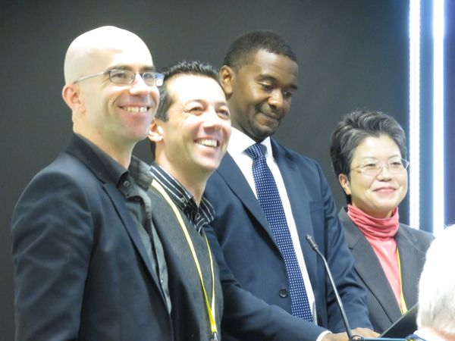
Chair/vice Chair handover
Incoming WGISS chair :
Andrew E. MITCHELL– NASA
Incoming WGISS vice-chair :
Mirko ALBANI – ESA
For endorsement

Slide 21
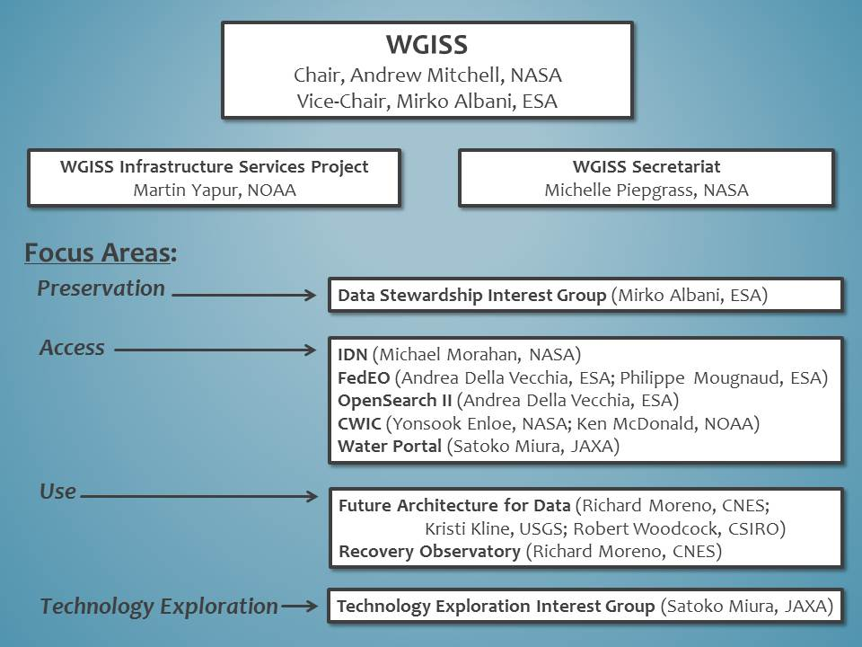
Future WGISS organisation

Slide 22
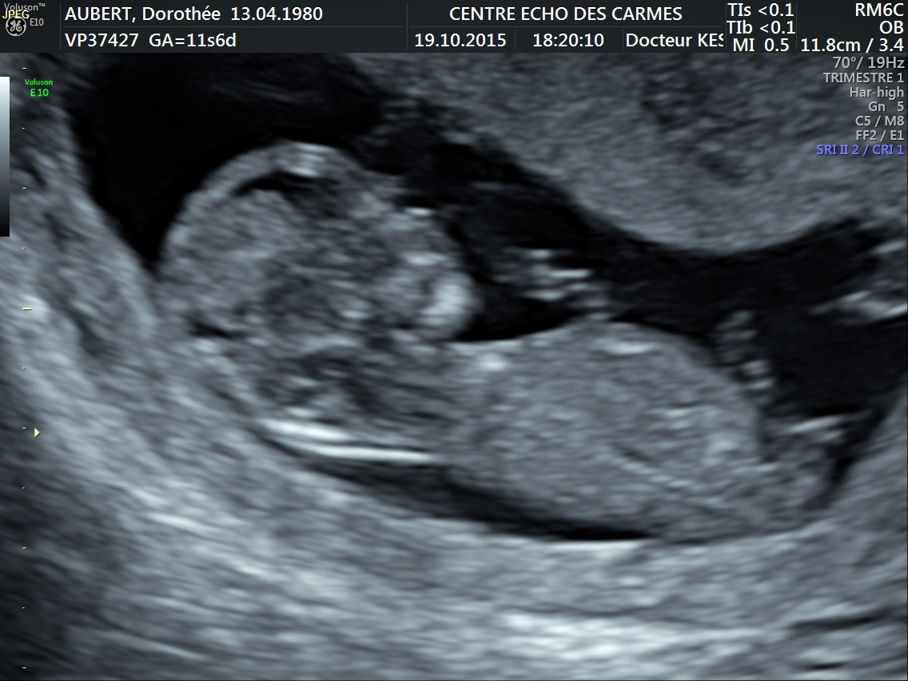
Future big project
Future "BIG" project

