Slide 1
Committee on Earth Observation Satellites
CEOS Ad Hoc Working
Group for GEOGLAM Update
Selma Cherchali, CNES
Brad Doorn, NASA HQ
CEOS Ad Hoc WG for GEOGLAM
Plenary Agenda Item # 20
29th CEOS Plenary
Kyoto International Conference Center
Kyoto, Japan
5 – 6 November 2015

Slide 2
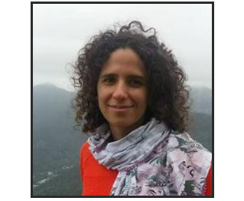
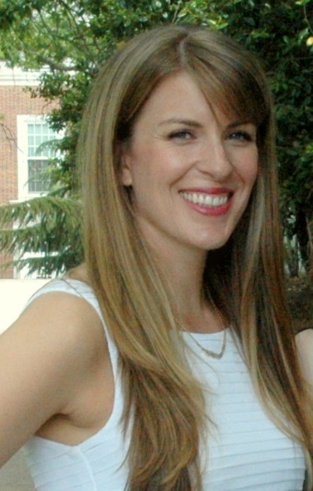
GEOGLAM:
Programmatic Updates
Community Centric Dynamic Implementation
GEOGLAM, as a system of systems, moves at the pace of its activities (communities) – our implementation is dynamic to keep pace with growing community of practice
New “Distributed” Secretariat Staffing
Dr. Michel Deshayes
GEOGLAM Coordinator
(Geneva)
mdeshayes@geosec.org
Dr. Inbal Becker-Reshef
Crop Monitor Coordination
(France)
ireshef@geoglam.org
Dr. Alyssa Whitcraft
EO Data Coordination
(Netherlands)
akwhitcraft@geoglam.org

Slide 3
GEOGLAM:
Programmatic Updates
Preparations for Advisory Committee Meeting, 9 November 2015
Membership from USA, Canada, China, Japan, European Commission, South Africa; AMIS, CEOS, WMO, WFP, GEO, FAO, African Union; BMGF
Formulation of a GEOGLAM Briefing Package
Further growth of GEOGLAM Community of Practice
Revision of GEOGLAM Component Structure:

Slide 4
CEOS Strategic Response
(AGRI-4)
Summary of Main Changes to the Strategy Being Proposed
Updated from a full-length requirements document to one emphasizing CEOS response to the GEOGLAM requirements
2013-14: CEOS Acquisition Strategy for GEOGLAM
2015: CEOS Strategic Response to GEOGLAM Requirements
Up for Endorsement
New accompanying document: “Scope of Work” of the Ad Hoc WG:
Scope of Work is a brief 2-page document which outlines the current and proposed breadth of the Ad Hoc WG.
Encompasses acquisition, strategic relationships, data access, availability, dissemination, and usability.
Up for Endorsement
Discussion of Ad Hoc WG’s “sunset” goals & post-sunset CEOS support to GEOGLAM via existing CEOS entities (i.e. LSI-VC & CEOS SEO)

Slide 5
What has the CEOS Ad Hoc WG
for GEOGLAM accomplished?
Activities below have been accomplished via the Ad Hoc Working Group for GEOGLAM:
Identified and evaluated missions that meet GEOGLAM’s Earth Observation (EO) data requirements, including detailed assessments of global coverage, measurement gaps, and cloud cover impacts
Organized GEOGLAM’s long-term acquisition requirements
Coordinated EO data for core GEOGLAM requirement, e.g. JECAM (GEOGLAM R&D project), for Asia-RiCE, and for GEOGLAM activities (e.g. Sentinel-1A data)
Provided a cloud-based space data management system for Asia-RiCE testing of radar data
Initiated a cloud-based data management system for a radar intercomparison study
Added features to the COVE (CEOS Visualization Environment) tool to support agriculture data acquisition and applications.
Developed, with GEOGLAM, a multi-user, multi-site user agreement to utilize Radarsat-2 restricted data for JECAM
Engaged commercial satellite agencies to contribute data to JECAM (e.g. RapidEye)
Notes:
COVE tool support includes links to past acquisition metadata, addition of a coverage analyzer tool, land cover classification overlays, and revisit analyses overlays with cloud cover constraints.

Slide 6
Asia-RiCE
From Sites to Wall-to-Wall
Key Challenge: Sustained observations & easy data access (especially for wall-to-wall)
Asia-RiCE is ready to scale up to wall-to-wall for Vietnam and Thailand
 | Vietnam |  | Thailand
PoC | Shin-Ichi Sobue, VAST or HCMC** |  | Shin-Ichi Sobue, GISTDA**
Purpose? | Planted area, crop growth monitoring, yield estimation, damage assessment
When? | May – October 2016 (Wet) November 2016 - April 2017 (Dry) |  | May – October 2016 (Wet) November 2016 - April 2017 (Dry)
What? | C&L band SAR Dual Polarization (VV/VH or HH/HV) | Optical | C&L band SAR Dual Polarization (VV/VH or HH/HV) | Optical
How often? | 14 days (min. 30) | 14 days (reasonably cloud free!)* | 14 days (min. 30) | 14 days (reasonably cloud free!)*
Spatial Resolution? | 20-100 m | 20-500 m | 20-100 m | 20-500m
**institutional PoC pending
Evaluation of CEOS capacity to meet requirements is pending…
*particularly for cloudy areas

Slide 7
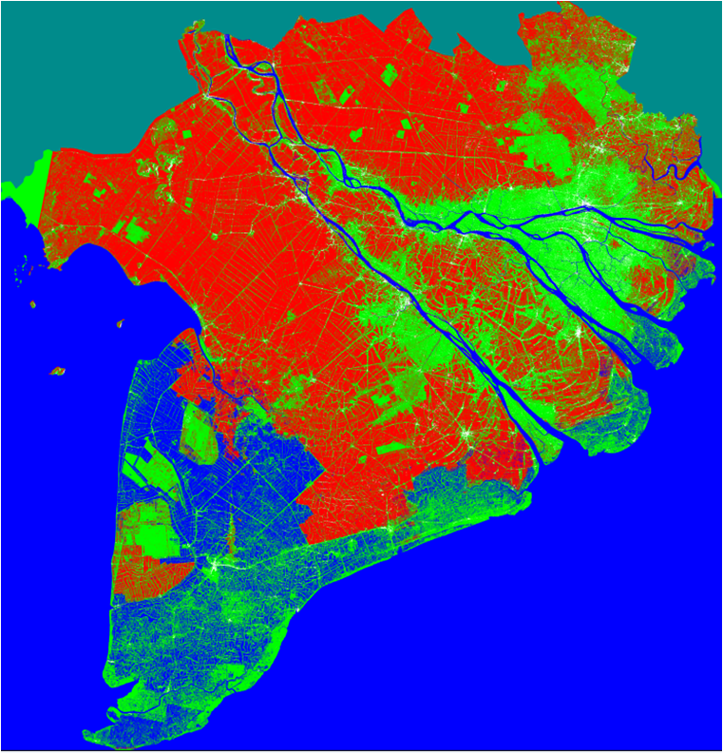
Rice monitoring using Sentinel-1A data
Area estimate and map of Spring-Summer Rice (April-July) 2015
Mapping result obtained by 21 July 2015
IW S1 Data: 28 April, 10 May, 16 May,
15 June, 9 July, 21 July 2015
Estimated Spring-Summer planted area in 2015:
2.14 Mha
Rice (Winter-Spring)
Non rice (forest, other LULC)
Water (ocean, river, aquaculture)
Land outside the Vietnam Mekong delta
The Mekong Delta, Vietnam
300 km x 300 km
20 m resolution

Slide 8
Rangelands and Pasture
Productivity (RAPP)
Rangelands are different from croplands – larger, less heterogeneous, reliant upon surveys of livestock numbers to complete analysis
3rd Workshop held in Campinas, Brazil, 20-22 July 2015
Agreement to form an internal working group to develop requirements for pasture monitoring – adapted from GEOGLAM’s cropland example
Generally, needs will be for moderate to coarse spatial resolution data. No fee-based or commercial data anticipated
Assess the requirements development and evaluation process.
New lead / Point of Contact for RAPP: Juan Guerschman (CSIRO)
More info: http://www.geo-rapp.org/
Notes:
Introduce to CEOS that we have a RAPP activity (which they have heard of – but don’t know much about it, or how it is different from cropland monitoring)
Alex Held asked to show the requirements development and evaluation

Slide 9
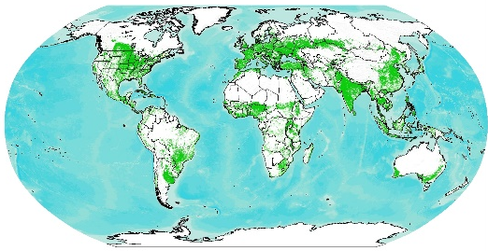
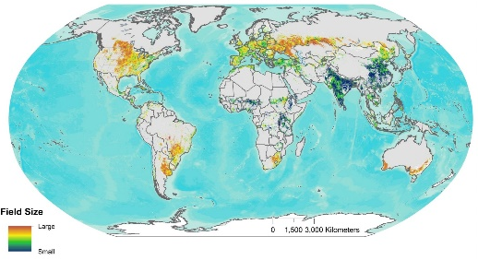
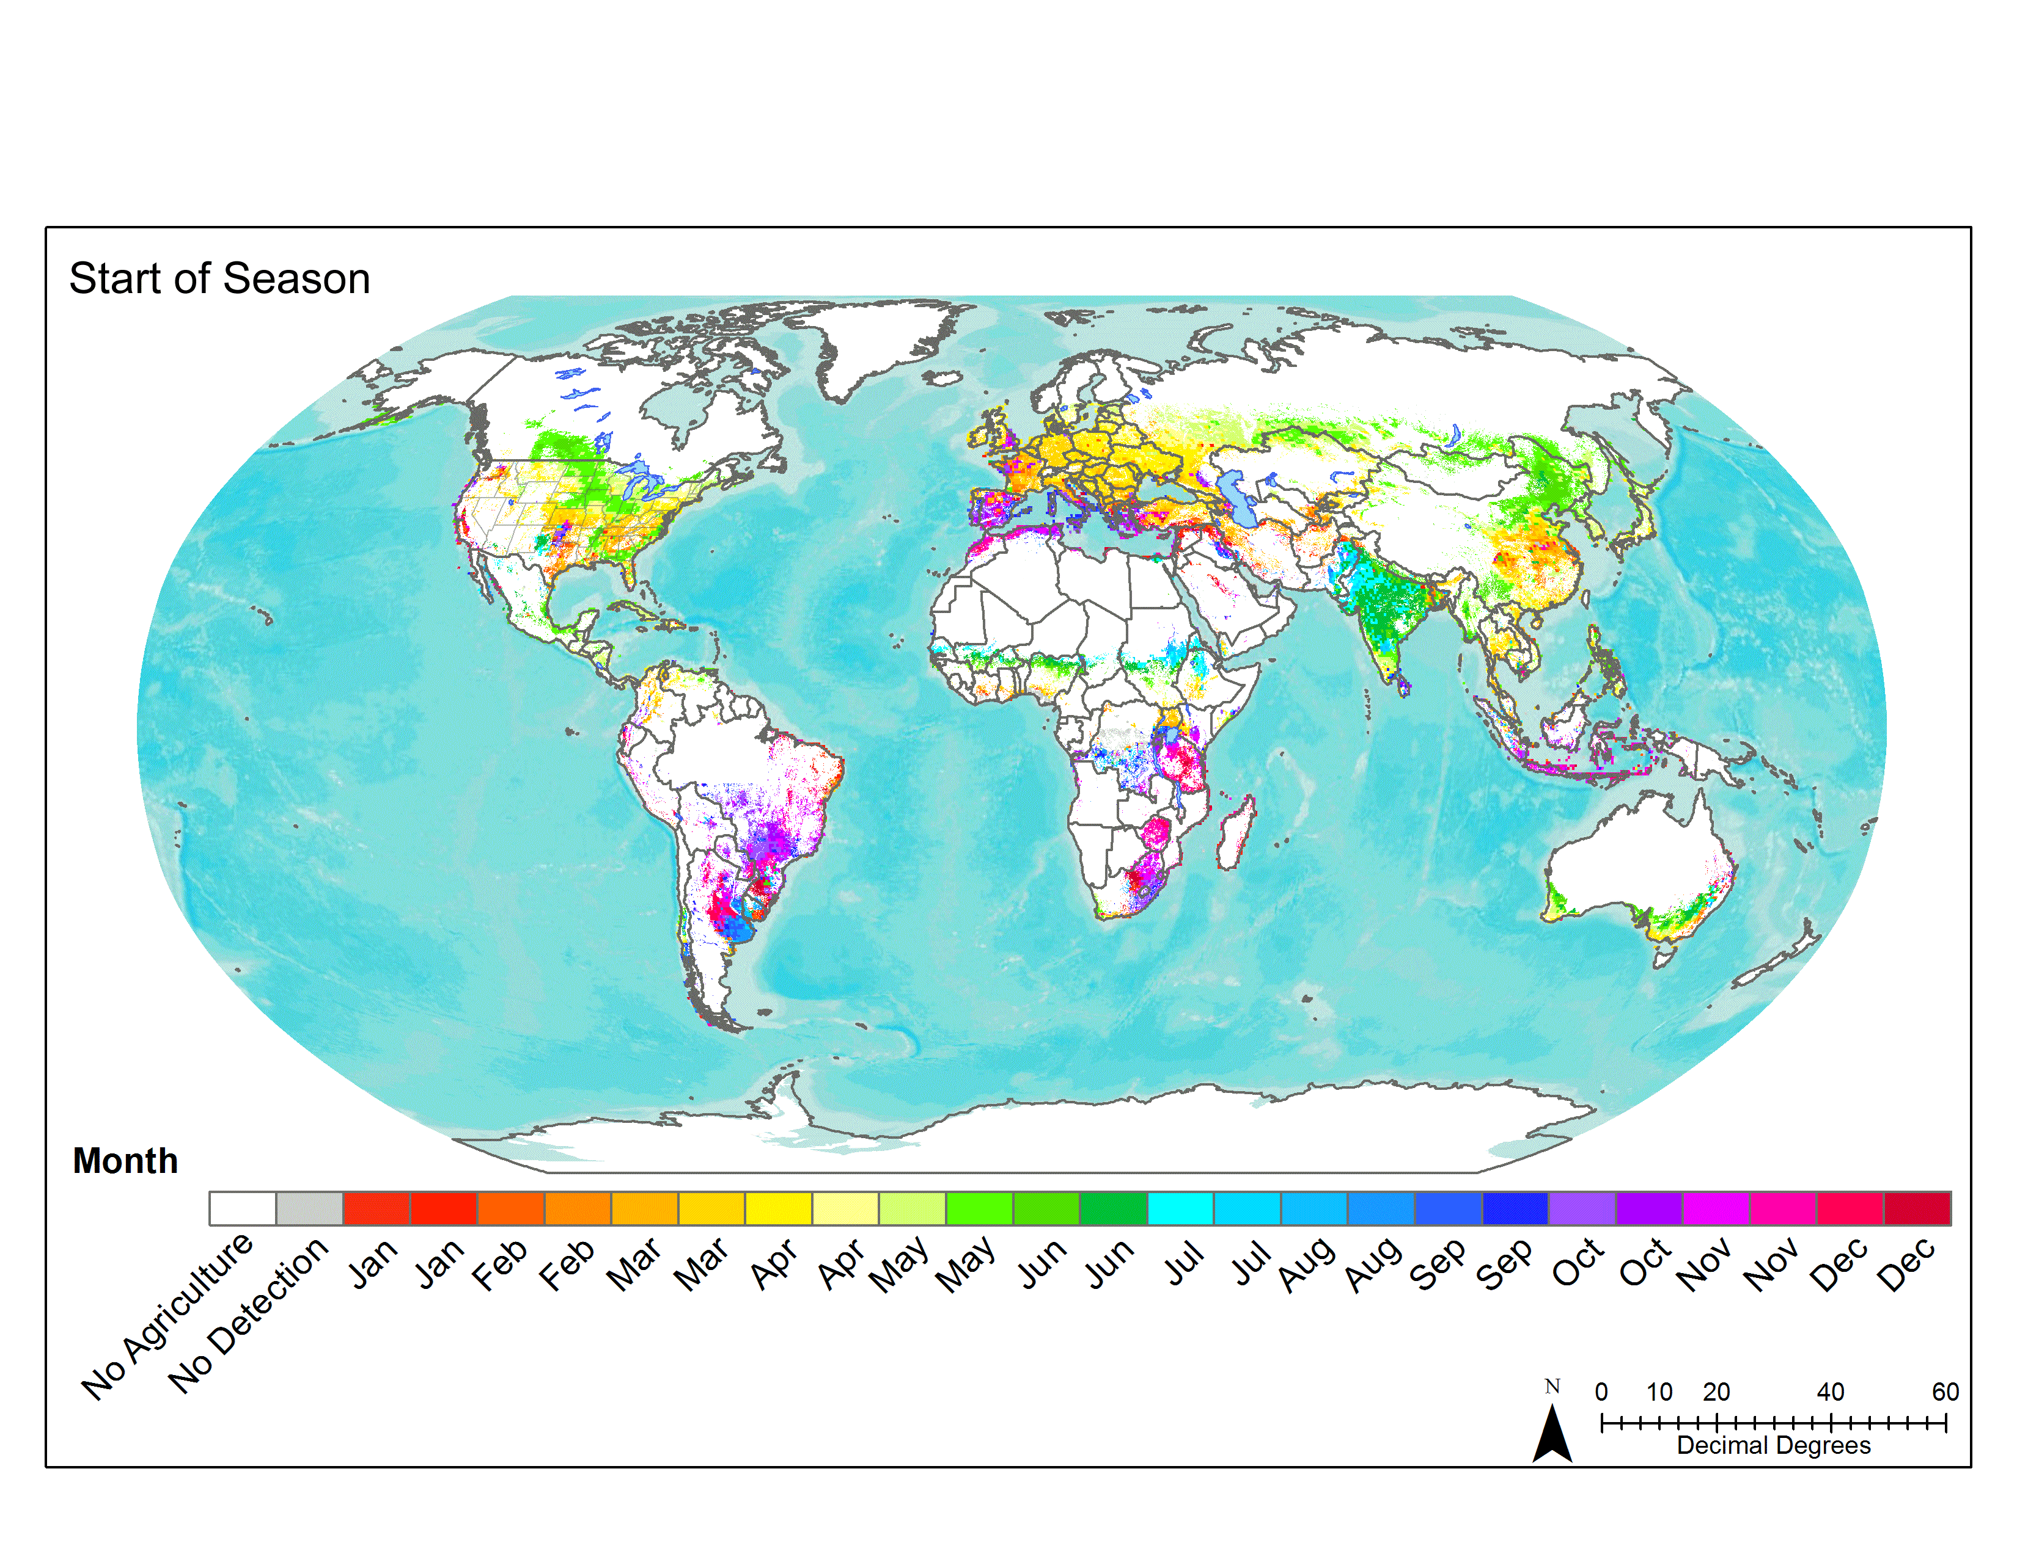
Key Components of Spatially Explicit EO Requirements
Evaluating Requirements
GEOGLAM Case
Where to image?
When to image?
How frequently to image?
At what spatial & spectral resolution [instrument type] to image?
‘best-available’ cropland mask + field size distribution (Fritz et al., 2015) [rangeland mask]
Agricultural growing season calendars (Whitcraft et al., 2014) – [rangeland calendar]
Cloud cover info (Whitcraft et al., 2015a)
+
‘best-practices’ from agricultural monitoring community of practice [RAPP developing now]
(How) can we meet these requirements? → CEOS!
Notes:
The key components of EO requirements include where to image (as in where the crops of interest are – as indicated by information on crop location and field size distribution), when to image (clarified by when crops are growing), and how frequently/at what spatial resolution to image – determined by the applications of these data (such as crop type and crop condition) and the methods used to derive that information.
RAPP will need to produce the relevant baseline datasets for their analysis

Slide 10
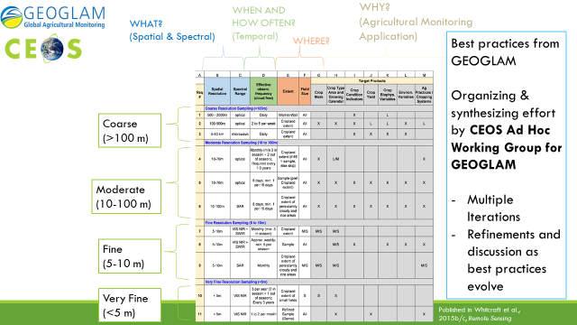
CEOS Ad Hoc Working Group worked with GEOGLAM to organize agriculture information requirements

Slide 11
CEOS Ad Hoc Working Group identified candidate missions to meet requirements
 | How ? |  |  |  | Where ? | When ? |  | What ? Information Products and Applications
Req# | Core Missions (future) | Contributing Missions (future) | Spatial Resolution | Spectral Range | Sample Type | Effective observ. frequency (cloud free)* | Growing Season Calendar | Crop Mask | Crop Type Area and Growing Calendar | Crop Condition | Crop Yield | Crop Biophysical Variables | Environ. Variables | Ag Practices / Cropping Systems
 | Coarse Resolution Sampling (>100m)
1 | Aqua/Terra (1000m) | Suomi-NPP (750m) Proba-V (1000m) SPOT-5 (1150m) | >500-2000 m | optical | Wall-to-Wall | Daily | all year |  |  | X |  | L
2 | Aqua/Terra (250/500m) Sentinel-3A (500m) | Suomi-NPP (375m) Proba-V (100/333m) | 100-500 m | optical | Cropland Extent | 2 to 5 per week | all year | X | X | X | L | L | X | L
3 | Aqua GCOM-W1/W2 | SMOS SMAP | 5-50 km | microwave | Cropland Extent | Daily | all year |  |  | X | X | X | X
 | Moderate Resolution Sampling (10 to 100m)
4 | Landsat 7/8 (30m) Sentinel-2A/2B (10-20m) | ResourceSat-2 (56m) CBERS-4 (20-40m) | 10-70m | optical | Cropland Extent | Monthly (min 2 out of season + 3 in season). Required every 1-3 years. | all year | X | L/M |  |  |  |  | X
5 | Landsat 7/8 (30m) Sentinel-2A/2B (10-20m) | ResourceSat-2 (56m) CBERS-4 (20-40m) | 10-70m | optical | Sample | ~Weekly (8 days; min. 1 per 16 days) | growing season | X | X | X | X | X | X | X
6 | Sentinel-1A/1B (C) Radarsat-2 (C), RCM (C) ALOS-2 (L) | RISAT-1/1A (C) RISAT-3 (L) | 10-100m | SAR Dual Polarization | Cropland Extent or Sample | ~Weekly (8 days; min. 1 per 16 days) | growing season | X | X | X | X | X | X | X
 | Fine Resolution Sampling (5 to 10m)
7 | RapidEye | SPOT-5/6, SPOT-7 CBERS-4 | 5-10 m | VIS, NIR, SWIR | Cropland Extent | Monthly (min. 3 in season) | growing season | M/S | M/S
8 | RapidEye | SPOT-5/6, SPOT-7 CBERS-4 | 5-10 m | VIS, NIR, SWIR | Sample | ~Weekly (8 days; min. 1 per 16 days) | growing season |  | M/S | X |  | X | X | X
9 | Sentinel-1A/1B (C) Radarsat-2 (C), RCM (C) ALOS-2 (L) | RISAT-1/1A (C) RISAT-3 (L) | 5-10 m | SAR Dual Polarization | Cropland Extent or Sample | Monthly | growing season | M/S | M/S |  |  |  |  | M/S
 | Very Fine Resolution Sampling (<5m)
10 |  | Pleiades, SPOT-6, SPOT-7 | < 5 m | VIS, NIR | Cropland Extent | 3 per year (2 in season + 1 out of season); Required every 3 years | all year | S | S
11 |  | Pleiades, SPOT-6, SPOT-7 | < 5 m | VIS, NIR | Refined Sample | 1 to 2 per month | growing season |  | X |  | X |  |  | X
Notes:
CEOS was instrumental in helping us organize our requirements, with identifying missions to meeting the requirements, and with evaluating our ability to meet the requirements (to be shown later)
The specific focus from here forward will be on Requirement #5 – 10-70m optical data required every 8 days (ideally)… minimum every 16 days… for croplands of all sizes (so we won’t be using the field size map for this specific requirement, but it is there for the future). This is useful for all of these above “target products” or monitoring applications
- Keep in mind this is a req. for reasonably clear views – which is where the earlier cloud data came in.

Slide 12
CEOS Ad Hoc Working Group identified candidate missions to meet requirements:
Requirement #5
 | How ? |  | When ? | Where ? |  | What ? Information Products and Applications
Req# | Spatial Resolution | Spectral Range | Effective observ. frequency (cloud free)* | Sample Type | Field Size | Crop Mask | Crop Type Area and Growing Calendar | Crop Condition | Crop Yield | Crop Biophysical Variables | Environ. Variables | Ag Practices / Cropping Systems
5 | 10-70m | optical | ~Weekly (8 days; min. 1 per 16 days) | Sample | All | X | X | X | X | X | X | X
5 | Landsat 7/8 (30m) Sentinel-2A/2B (10-20m) | ResourceSat-2 (56m) CBERS-4 (20-40m)
Identified Existing Missions
Potential Future Missions
What ? Information Products and Applications
Categories derived from existing GEOGLAM tasks

Slide 13
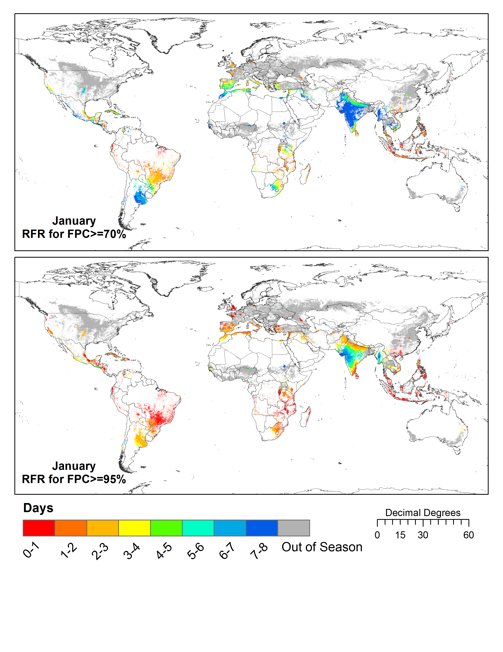
Requirement #5
How frequently do we have to image (required revisit frequency – RFR)…
for a view at least
70% (top) cloud free
or
95% (bottom) cloud free…
every 8 days…
...over in-season global croplands?
Whitcraft et al., 2015b, Rem. Sens.
Notes:
The maps show what revisit frequency would be required to yield a view at least 70% (top) or 95% (bottom) cloud free within 8 days over in season croplands. For 70% clear, 8 days is sometimes sufficient, but generally most areas are in the 3-5 day range. For 95% clear, a much more frequent revisit is required.
- Determining acceptable cloud cover thresholds is a priority research area

Slide 14
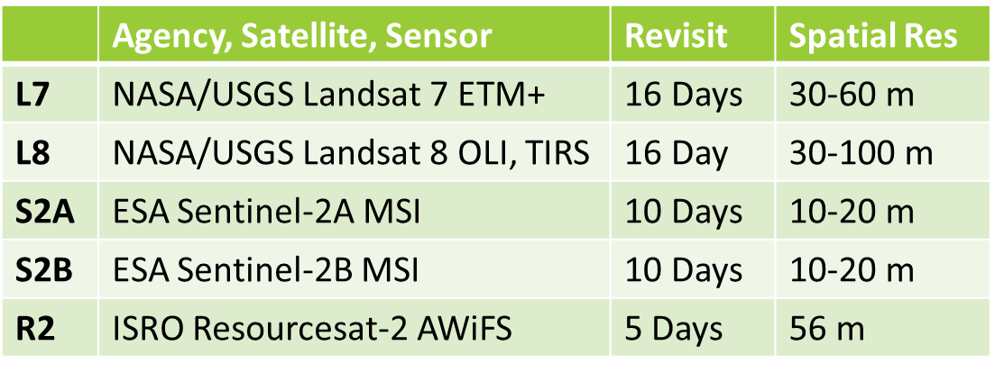
Can we meet these requirements for
optical, moderate resolution (10-70m)
data within 8 days during the growing
season with current & planned missions?
Overpass Analysis: CEOS SEO
Revisit Capabilities
of 7 Hypothetical Constellations
Whitcraft, Killough et al., 2015c, Rem. Sens.
Notes:
Constructed 7 hypothetical constellations from 5 missions

Slide 15
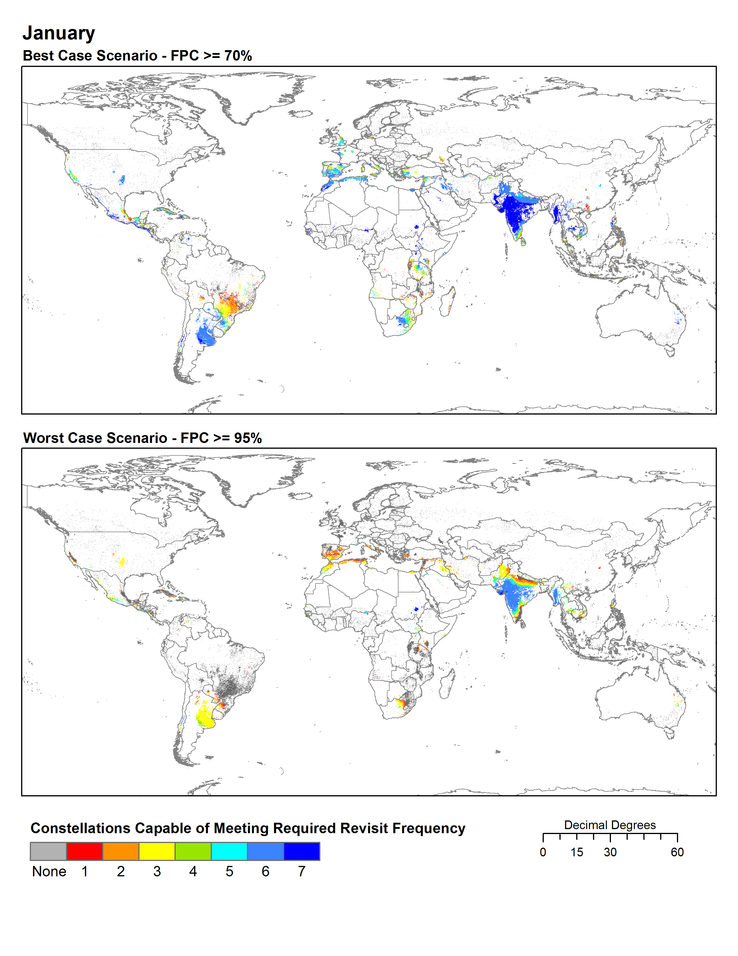
Meeting the Requirement for a view
≥ 70% Cloud Free within 8 days
(over global in season croplands)
Meeting the Requirement for a view
≥ 95% Cloud Free within 8 days
(over global in season croplands)
# | Satellites
1 | L8, S2A, S2B, R2
2 | L7, L8, S2A, R2
3 | L7, L8, R2
4 | L7, L8, S2A, S2B
5 | L8, S2A, S2B
6 | L7, L8, S2A
7 | L7, L8
Whitcraft, Killough et al., 2015c, Rem. Sens.
Notes:
Note from AKW to Brad/Brian – to tie this back into the presentation, you could say “we can now evaluate specific requests, like the one from asia-rice for wall to wall, or future ones from RAPP, following this same basic framework.”
HERE’S A DESCRIPTION OF WHAT ACTUALLY HAPPENED… and the figure:
We compared these overpass capabilities with the revisit frequency requirements for moderate spatial resolution within 8 days during the growing season.
Where you see any color, one or more of these constellations can meet the revisit frequency required to meet a 70% clear view (top) or 95% clear view (bottom)
Constellations are ranked – 1 is best performing, can meet everything 2-7 can
Where you see dark blue, all of the constellations can meet it, because 7 has the least frequent revisit
Where you see red, only that constellation (#1 – L8, S2A, S2B, R2) can meet
Where you see gray… none of these constellations can meet. Obviously, because the bottom is a more stringent requirement, you see more gray there.
The plots show you global success rates (where the hypothetical constellations can meet the revisit frequency requirements), and regional success rates for southeast Asia – the point being during certain times, obtaining at least 70% clear is not even possible with these constellations.
The last map shows you the number of months where these revisit frequencies exceed the capabilities of the hypothetical constellations – this is where we will have gaps and need to consider alternative data types (like SAR).

Slide 16
What can CEOS do for
GEOGLAM in the future?
Respond to GEOGLAM requirements as they evolve.
Help develop, with GEOGLAM, a data request process.
Evaluate new datasets relevant to GEOGLAM EO requirements, including the European Sentinel missions, other CEOS missions, small satellites, and commercial space assets.
Further develop and test the data management system prototypes to support JECAM, Asia-RiCE, and other GEOGLAM activities.
Expand the use of multi-user, multi-site user agreements for the distribution and use of restricted-use datasets from multiple space agencies.
Maintain flexibility within the Ad Hoc Working Group to address challenges related to data acquisition and dissemination as they evolve and grow.
Provide input to the GEOGLAM Advisory Committee.
ONGOING
Notes:
New lines are in RED

Slide 17
What can CEOS do for
GEOGLAM in the future?
Begin wall-to-wall acquisitions for Asia-RiCE – Thailand-Vietnam
Evaluate acquisition metadata archives using the COVE tool and request archival data for GEOGLAM production of improved baseline datasets (e.g. crop area/type, and crop calendars).
Support space agency rapid processing of archival data (open and restricted) and delivery to GEOGLAM for baseline datasets.
Support space agency provision of analysis-ready data products.
Collaborate with GEOGLAM on the development of standardized preprocessing requirements for analysis-ready data for agriculture monitoring.
Complete and test a prototype national Data Cube and user interface to support agriculture applications. Space Agency support to ingest analysis-ready data layers.
Evaluate EO requirements for emerging agriculture activities and initiatives (e.g. Rangelands and Pasture Productivity-RAPP, Early Warning Crop Monitor).
NEW
Notes:
New lines are in RED

Slide 18
Future of CEOS Ad Hoc WG
for GEOGLAM
Annually, the group reviews whether it has met these goals ...
EO monitoring requirements are satisfied
Baseline datasets are available and CEOS-coordinated EO can support 3-5 year updates
Storage, processing, and analysis solutions are feasible and planned
User agreement allows sharing of restricted data for R&D
Once these goals are complete, we propose ....
Future support, including the coordination of data acquisition, provided through the Land Surface Imaging Virtual Constellation (LSI-VC) and Systems Engineering Office (SEO)
The LSI-VC will evaluate new EO requirements and missions, communicate availability of new EO datasets, and facilitate access to datasets
GEOGLAM will appoint a POC to sit on the LSI-VC
The SEO will maintain open source tools to support data management including the provision for Data Cubes and will conduct systems analyses, as needed

Slide 19
Background Materials

Slide 20
Scope of Work
It Addresses These Questions
What is GEOGLAM and with whom are its key relationships?
What are the goals and activities of the Ad Hoc WG?
What has CEOS done for GEOGLAM in the past?
What can CEOS continue to do for GEOGLAM in the future? (ONGOING)
What new activities can CEOS do for GEOGLAM in the future? (NEW)

Slide 21
Presenter Guidance
Presenters are requested to name their files according to the agenda item number, their last name, and the version number.
(e.g.) 18_Holloway_v3.ppt
Presentation materials should be sent to Z-JAXA-CEOS-SEC@jaxa.jp with a CC to kim.e.holloway@nasa.gov, no later than 23th (Friday) October.

Slide 22
Way Forward
Actions from SIT (April 2015)
Endorse a CEOS candidate for the GEOGLAM Advisory Committee - COMPLETE
Test data services prototypes and report lessons learned – ONGOING
Define JECAM data requests to CEOS Agencies – ONGOING
Report on the progress of new missions (Sentinel) and new programs/partnerships (EWCM, RAPP, SIGMA, Sen2Agri) and the impact to GEOGLAM – ONGOING
Proposed synergy between AgMIP test sites and JECAM sites
Press on with archival data connections, query, and data requests – ONGOING
New or Upcoming Actions
Review GEOGLAM CapDev ⬅➔ CEOS WGCapD
Get space agency support for rapid processing of archival data
Get space agency support for production of “analysis-ready” data
Evaluate options to meet requirements for new activities (EWCM, RAPP, AgMIP)
Endorse CEOS Strategic Response to GEOGLAM Requirements
Endorse Scope of Work of CEOS Ad Hoc WG for GEOGLAM
Notes:
OPTIONAL SLIDE
Establish guidelines & system for communicating specific GEOGLAM data requests to Space Agencies through CEOS
Improve coverage; improve access to data including early access to new mission datasets
GEOGLAM works with Space Agencies to open up data licensing to community
Form Working Group to develop and implement cross-site SAR experiment

Slide 23
GEOGLAM: Crop Monitor
Activities Since March 2015
Continued Success of GEOGLAM Crop Monitor for AMIS
AMIS request to formalize relationship with GEOGLAM
Regular improvement of information products (crop calendars, crop type mask; pie charts by production & export…)
GEOGLAM internal survey carried out on Crop Monitor to guide improvements
Prototyping of National Crop Monitors
Interest from Ministry in Tanzania to develop a monthly Crop Monitor bulletin as part of the STARS project
Similar interest from South Africa and SA Development Community
Prototyping of the Early Warning Crop Monitor
Based off of success & experience of CM for AMIS
First full run → September 2015

Slide 24
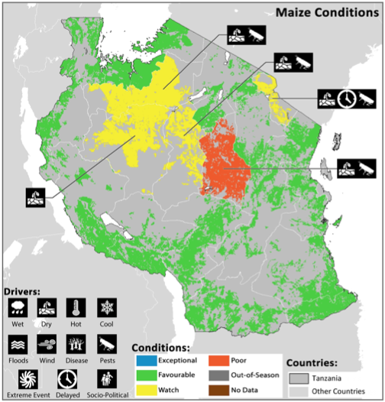
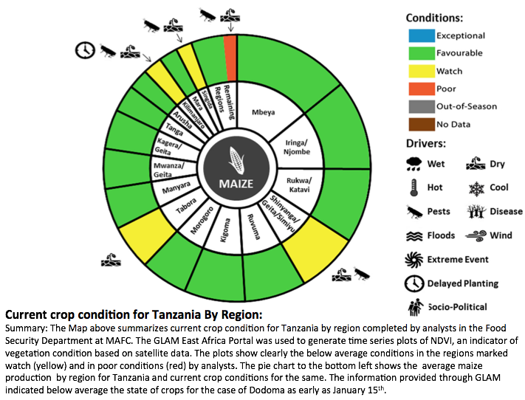
GEOGLAM:
National Crop Monitor for Tanzania
Interest from Ministry in Tanzania to develop a monthly Crop Monitor bulletin as part of the STARS project
Similar interest from South Africa and SADC

Slide 25
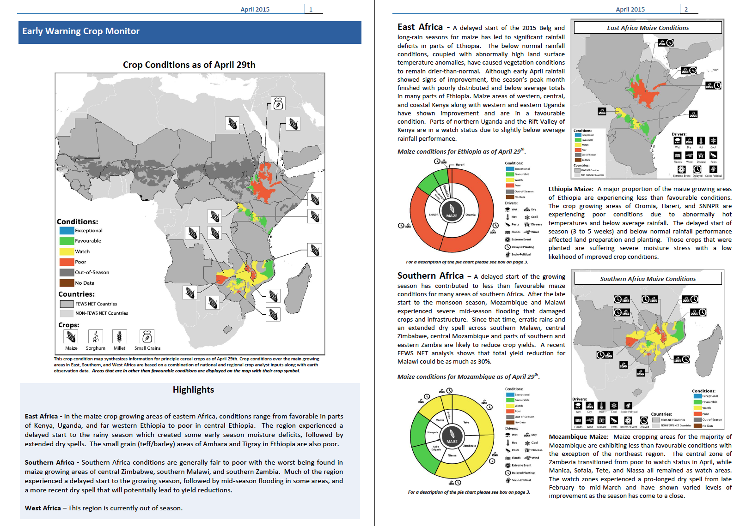
GEOGLAM:
Early Warning Crop Monitor
Full prototype will be run at the end of September, open to EW community
Notes:
The prototype for FEWSNET, from April 2015

Slide 26
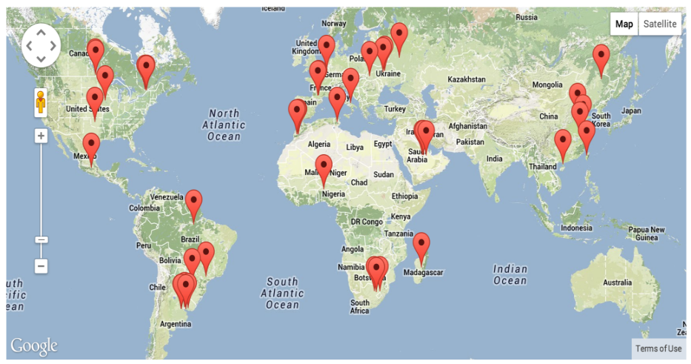
JECAM: Joint Experiment for Crop Assessment & Monitoring
R&D for operational agricultural monitoring systems
A global network of 33 sites
2014 Annual report on the JECAM website
Annual meeting November 16-17, Brussels
Minimum Dataset Guide Documents
Guidelines for site definition & minimum EO data
Guidelines for in-situ data collection
Multi-User Agreement for Radarsat 2 Data
To support multi-site inter-comparison studies
Proposed - Dedicated cloud-computing storage & tools and processing capabilities
Next 2 years:
Multi-site SAR experiment building on Minimum Dataset exercise & NASA prototype and support for SIGMA optical inter-comparison research
Optical inter-comparisons, tools and computing capacity (Sen2-Agri and SIGMA Project)
Proposal (AAFC and CSA) – JECAM/Commercial Data Providers Workshop
www.jecam.org
Notes:
26

Slide 27
Asia-RiCE Team Highlights 2015 Achievements
CEOS agencies data acquisitions
X/C/L SAR data from CSA/MDA, ESA, ASI, DLR, ISRO and JAXA
High resolution optical data utilization (CNES)
2. Data analysis
Time series SAR data from multiple sources to estimate rice planted area, growing status, etc.
Provision agro-meteorological information derived from satellites
Worked with ASEAN food security information system (AFSIS) to provide crop condition overview information and outlooks for FAO AMIS through GEOGLAM
Test bed
The JAXA/RESTEC teams developed the INAHOR (rice crop planted area estimation software) and JASMIN (agro-met information provision system for outlook) tools
NASA/CEOS SEO developed and tested a cloud computing SAR processing (INAHOR) platform for Indonesia
Rice Phenological Stages Classification using Radarsat-2 Data (VH_VV)
29 July 2014 (Subang Area, West Java) by MOA, LAPAN with JAXA

Slide 28
Asia-RiCE Team Highlights 2016 Plans & Anticipated Challenges
1. 2016 Plans
Continue working with Phase 1A/1B TDS to generate target products using Radarsat-2, Sentinel-1, ALOS-2, CSK, TerraSAR-X , RISAT, etc. (Continue working closely with CSA, ESA, JAXA, ISRO and other CEOS agencies to ensure continuity of data supply for the TDS)
Continue Sentinel-1 reference site coordination with ESA/IRRI/RIICE/NCU, and work with ESA to explore the possibility of further expansion to other SE Asian sites during the ramp-up phase of the mission.
Continue working with CESBIO to maximize the potential outcomes from the ESA DUE Innovator III program.
Initiate integrated usage of HR optical instruments with SAR for crop analyses through SPOT 5 Take 5 in 2015 and Venus in 2016 with Landsat and Sentinel-2, and with coarse resolution satellites such as MODIS and GCOM-C in 2016.
2. Challenges
Sustained observations & easy data access: Share observation / acquisition plan of multiple satellites at one site to conduct information validation for rice growing and production estimation (especially for wall-to-wall (whole country))
Support ICT environment with applications; Expand SDMS for end users such as Min of Ag.
Promote EO data and related information sharing (especially ground data and base line datasets)
Promote cross validation for outlook and rice crop growing and production estimation

Slide 29
CESBIO: Research organisation linked to CNES.
1. Rice monitoring
1.1 GeoRice ESA Innovator Project
pre-operational method development using Sentinel-1 data 2015-2018

Slide 30
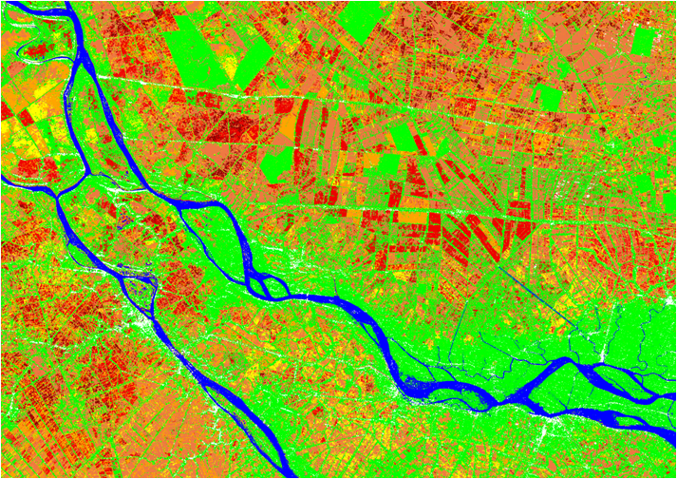
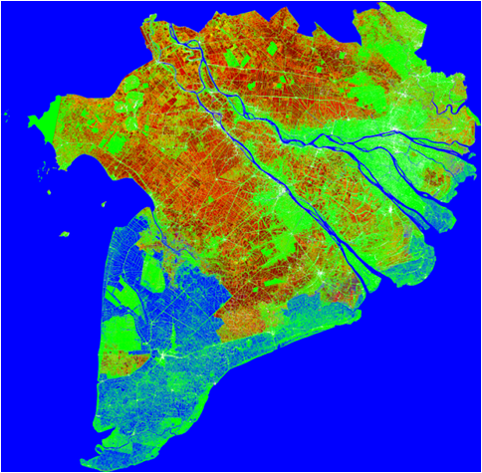
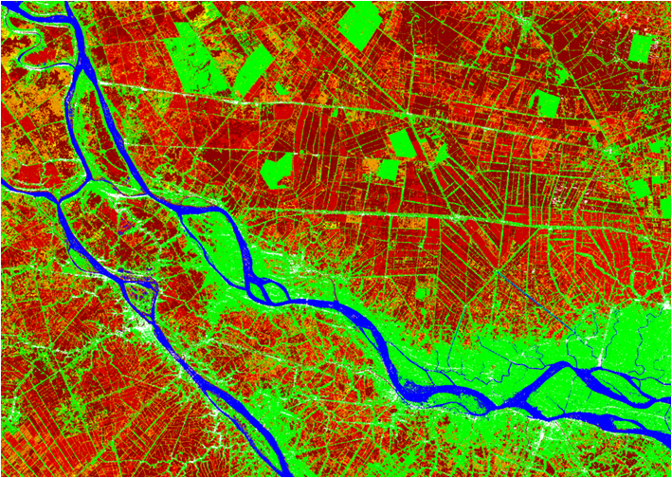
23 March 2015
125 km x 90 km. Pixel size 20 m
Rice monitoring using Sentinel-1A data
04 April 2015
The Mekong Delta, Vietnam
360 km x 360 km. Pixel size 20 m
Thap Muoi
Rice: early stage
Rice: tillering stage
Rice: reproductive stage
Rice: maturity stage
Non rice (forest, other LULC)
Long Xuyen
Land water/ sea / land outside the Vietnam
Mekong river delta
Can Tho
Vinh Long

Slide 31
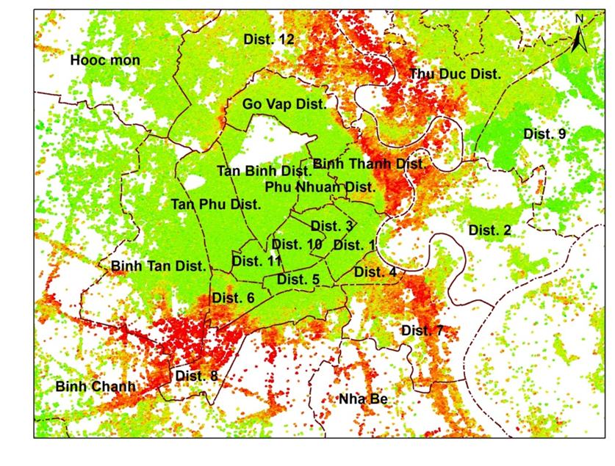
Subsidence in Ho Chi Minh City
Average vertical velocity 2006-2010
Comparison with velocity obtained by levelling
10
RMSE = 4.6 (mm/yr)
0
2
R
= 0.86
48
33
7
-10
29
Estimated velocity (mm/yr)
35
-20
43
15
-30
28
-40
-40
-30
-20
-10
0
10
Reference velocity (mm/yr)
Rate of deformation in mm/year.
Ho Tong M.D., Le Van Trung, and Thuy Le Toan. "Mapping Ground Subsidence Phenomena in Ho Chi Minh City through the Radar Interferometry Technique Using ALOS PALSAR Data." Remote Sensing 7.7 (2015): 8543-8562.
mm/yr
-40
-30
-20
-10
0
10

Slide 32
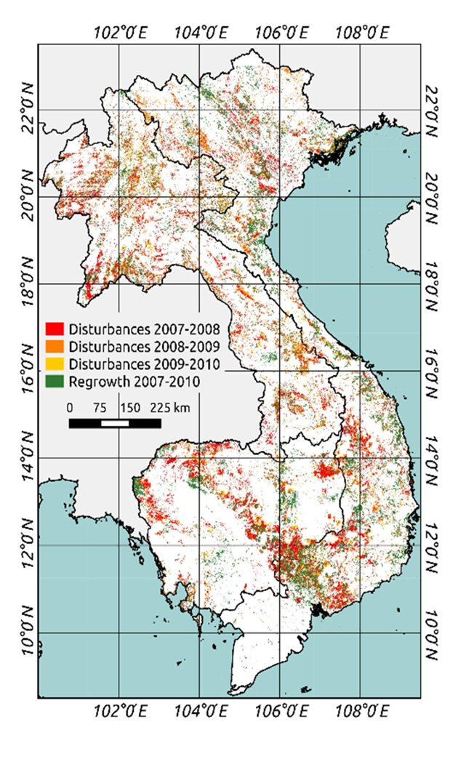
Forest monitoring in Vietnam, Cambodia and Lao PDR using ALOS PALSAR
Map of Forest Disturbances and
Regrowth between 2007 and 2010
 | Vietnam | Cambodia | Lao PDR
Disturbances rate (% /year) | -1.09 | -1.24 | -0.89
Biomass loss ( M. tons) | 61.4 | 58.8 | 77.7
Regrowth rate (% / year) | 0.82 | 0.49 | 0.32

Slide 33
Data Services Prototypes:
Status & Lessons Learned
JECAM Data Services Project
Sites: Ukraine, Belgium, South Africa, Argentina, Germany, Canada
Datasets: Radarsat-2, TerraSAR-X, and other optical datasets.
Dedicated and cloud-based storage and SAR processing capabilities
Secure access and data sharing within guidelines of license agreements
STATUS: Under planning with Agri-Food Canada. Exploring the use of Amazon Web Services for hosting.
LESSONS: Hosting of restricted datasets (Radarsat-2) requires careful planning and understanding. Users should pay for hosting.
Asia-RiCE Data Services Project for Indonesia.
Secure access for JAXA and Indonesia Asia-RiCE science users.
Dedicated storage for up to 35 Radarsat-2 images (provided by CSA) and cloud processing of SAR datasets using INAHOR tool.
STATUS: Data Services tool functioning well. No issues.
LESSONS: Cloud-based services operate better when they are close to the user. Moving server to Singapore helped performance.

Slide 34
Archival Data Links Update
Archive Data for Baseline Product Generation
The accuracy of baseline datasets (e.g. crop type & calendars) could be improved through the use of fine to moderate resolution (<100 meter) archive data.
Benefits for progress toward implementation:
Establishes data request process
Facilitates evaluation of new data streams
Supports future data acquisition planning.
Current Growing Season Calendars
How?
Obtain direct access to archive metadata (via COVE tool) STATUS: Ongoing; Links to Landsat, SPOT, Radarsat, Pleaides already in place; Sentinel-1, RapidEye (late 2015) upcoming
Request access to those which comprise a sufficient data record for baseline dataset generation (e.g., crop maps, crop calendars)
STATUS: Upcoming once archive links are complete & once we have support from space agencies for rapid processing of archival data

Slide 35
