Slide 1

Committee on Earth Observation Satellites
Update on GFOI and the CEOS
Space Data Coordination Group
Stephen Briggs & SDCG EXEC
(Ake Rosenqvist, Frank Martin Seifert, Gene Fosnight,
George Dyke, Stephen Ward)
Plenary Agenda Item #19
29th CEOS Plenary
Kyoto International Conference Center
Kyoto, Japan
5 – 6 November 2015

Slide 2




Global Forest Observation Initiative (GFOI)
GFOI Objectives:
to foster sustained availability of satellite and ground observation in support of national forest information systems
to support countries in the use of observations for their national forest information systems
2008 Establishment of GEO FCT task
2009+ FCT demonstration based on NDs
2010 GFOI Concept plan
2011 GFOI Implementation plan
2012 GFOI Start-Up Phase
2013-15 Incrementing coverage
2016+ Full Operations Phase
Co-leads:
➔ www.gfoi.org
Notes:
Co-leads:
Australia (DOTE) - Department of the Environment
Norway (NICFI) - Ministry of Climate and the Environment
USA (USGS) ➔ SilvaCarbon
FAO
CEOS (ESA, USGS)

Slide 3
GFOI Components
Space Data
GFOI works with space agencies through CEOS to ensure the long-term, global acquisition of core satellite data
Capacity Building
GFOI provides capacity building in cordination with others such as UN-REDD. It supports the use of satellite and ground data to monitor forests, and estimate GHG emissions.
Methods and Guidance
Guidance on integrating remote-sensing and ground-based observations for estimation of emissions and removals of greenhouse gases in forests.
Research and Development
Identifying and promoting R&D needed for improved practical, global implementation of National Forest Monitoring
GFOI Office
Coordination and Management
helps countries meet their individual data needs
Notes:
Coordination of satellite data supply (CEOS lead) => Space Data Coordination Group (SDCG) – ESA, USGS
Capacity Building (US lead)
Methods and Guidance Documentation (Australia lead)
R&D on technical challenges (GOFC-GOLD lead)
GFOI office in transit from GEO to Rome via Australia

Slide 4

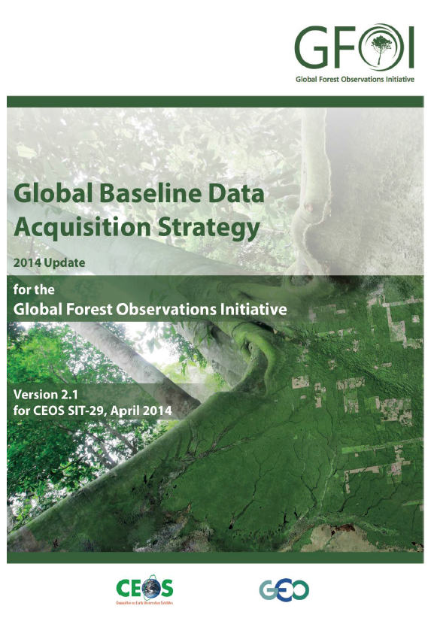
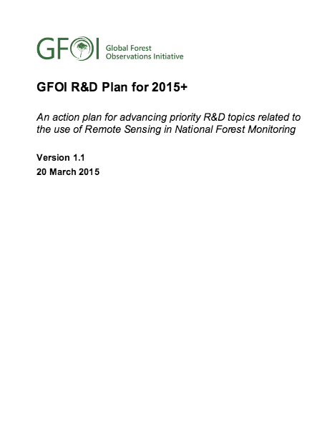
2015 Overview
Version 1 of the GFOI Methods and Guidance Documentation (MGD) available in English, French and Spanish
  Key GFOI deliverable to governments, next to space data
  Defines how to apply space data for IPCC-compliant MRV
  V2 and interactive MGD portal under development
Global Baseline Acquisitions going to plan
  Landsat-7/-8 running well
  Sentinel-1A operational since June 2015
  Sentinel-2A launched 23 June 2015
  ALOS-2 operational
  CBERS-4 regional
R&D Element under new lead by
GOFC-GOLD, supported by ESA
Coordination of capacity building between
GFOI (SilvaCarbon), UN-REDD and FCPF

Slide 5
Outlook
GFOI office to relocate to UN FAO, Rome 2016 (until 2015 alongside GEOSEC; 2015 interim support by Australia DOTE)
Baseline mapping with global acquisitions from Landsat-7/-8, Sentinel-1A and Sentinel-2A in good shape ➔ multiple global coverages in 2016
MGD version 2 (including interactive portal) due June 2016
Updated R&D programme (GFOI / GOFC GOLD) with two expert workshops in 2016
3rd GFOI Plenary meeting
  ESRIN - Frascati, February 2016
  SDCG-9
  Component coordination
Emphasis on outreach & country engagement

Slide 6




SDCG & GFOI Space Data Component Update
29th CEOS Plenary
Kyoto, 4-6 November 2015

Slide 7
The Role of SDCG in GFOI
Coordination of satellite data acquisition and supply is fundamental to GFOI objectives and supports all countries’ reporting
Satellite data can provide substantial input for MRV
  Measurements of forest extent, status and characteristics
  Support to countries in GHG Reporting
  Independent Verification
2011 plenary endorsed the set-up of the Ad-hoc CEOS Space Data Coordination Group to support GFOI

Slide 8
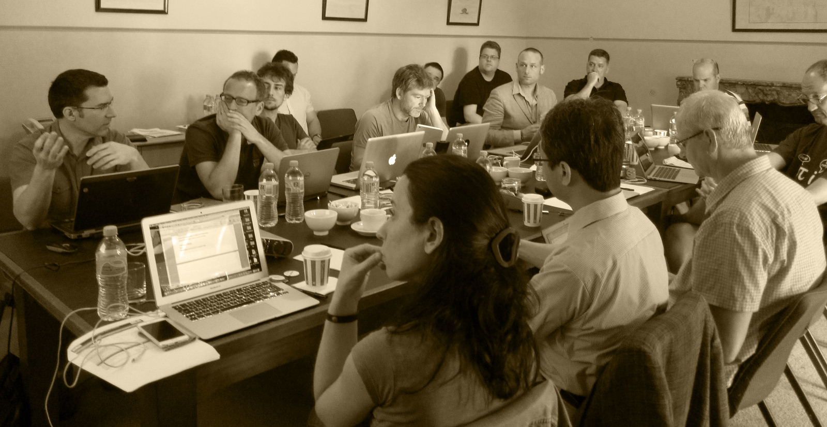
SDCG Set-up
SDCG Co-chairs: ESA, USGS
SDCG Secretariat: DOTE
SDCG Members: ASI, CNES, CONAE, CRESDA, CSA, DLR, INPE, ISRO, JAXA, NASA
Convene biannual meetings of SDCG
  CSA hosted SDCG-1 in March 2012
  USGS hosted SDCG-2 in Sep 2012
  Australia hosted SDCG-3 in Feb 2013
  NASA hosted SDCG-4 in Sep 2013
  ESA hosted SDCG-5 in Feb 2014
  NSC hosted SDCG-6 in Oct 2014
  Australia hosted SDCG-7 in Mar 2015
  DLR hosted SDCG-8 in Sep 2015
  ESA will host SDCG-9 in Feb 2016
Notes:
.

Slide 9
CEOS Space Data Strategy for GFOI: 3 Elements
Implementation of Baseline Global Data Acquisition Strategy
Space Data Services Available
Data Supply in Support of GFOI R&D Activities
Publicly open (“core”) satellite data, phased implementation – multiple full global coverage by 2016.
A coordinated strategy for national data acquisitions accommodating countries’ specific technical requirements, heritage, and experience.
Covers a wider range of satellite data sources, including commercial.
Includes support for science studies assisting the development and evolution of the MGD for GFOI and addressing specific country needs.
At least one annual national cloud-free optical coverage over each country.
Innovative country data uptake by novel computing and database technologies
Assuring the availability of consistent time-series of optical and radar (SAR) satellite data over global forest cover.

Slide 10
Global annual coverages by 2016
of the world’s forested areas
In 2016, full (127 country) global coverage
  Coverage by Landsat-7/-8, Sentinel-1 and -2,
  Regional coverage by CBERS-4
  Annual 25 m mosaic by ALOS-2
  On request coverage by non-core tasking missions
Encourage non-core data providers to release older data to serve as baseline (generally 1990+)

Slide 11
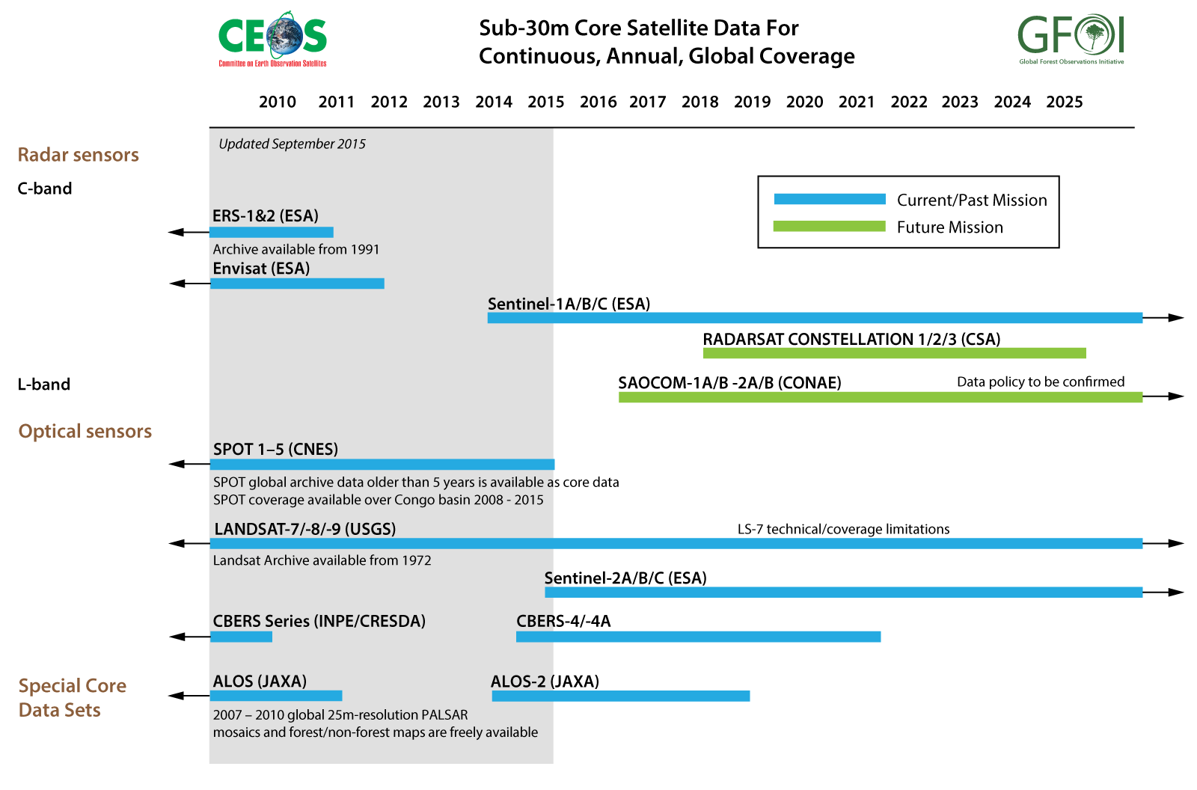
Core Data

Slide 12
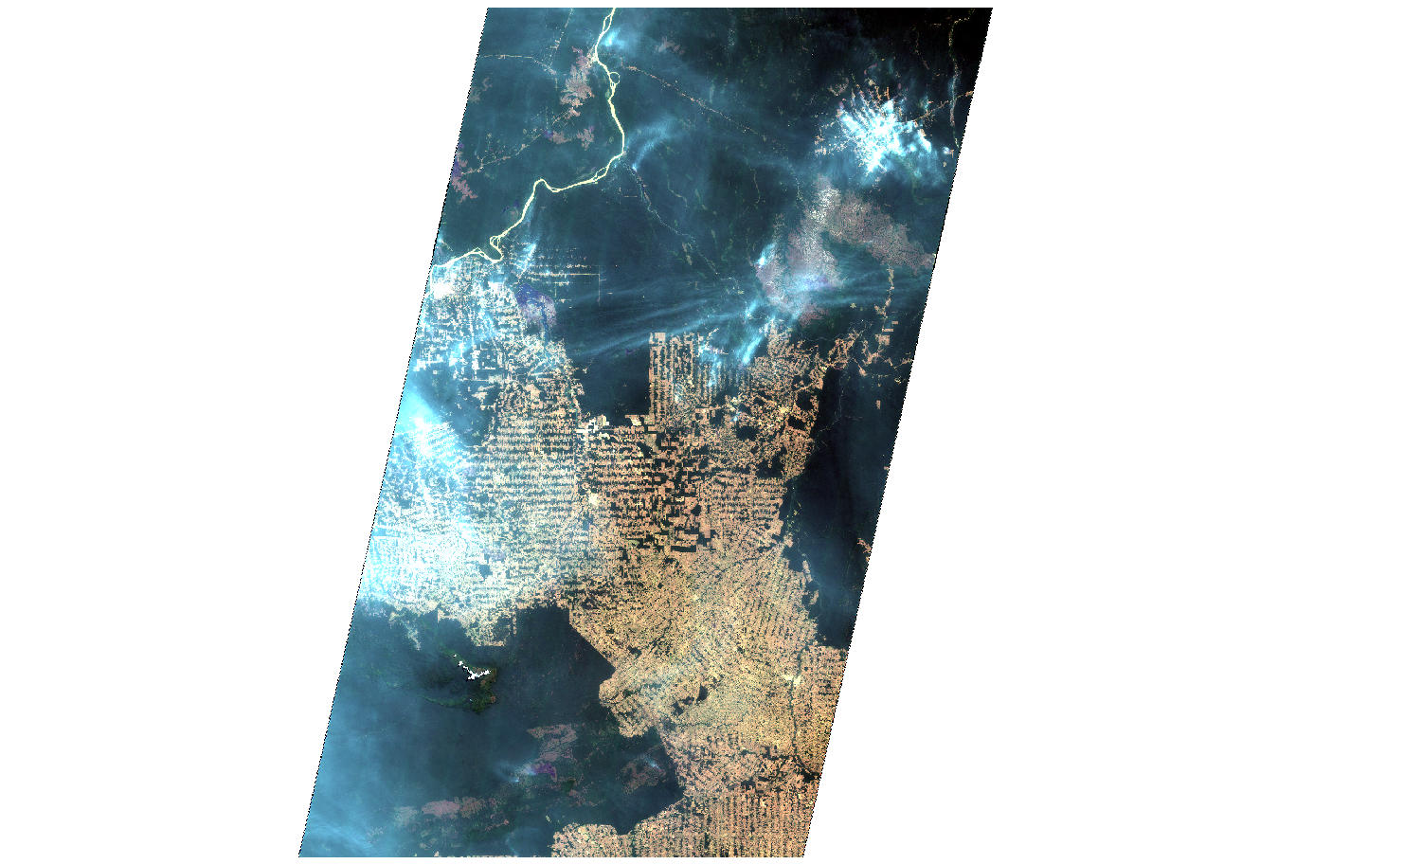
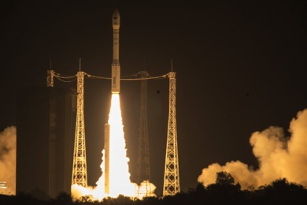


New Core Data: Sentinel-2
Sentinel-2A launched on 23 June 2015
Data available publicly after end of
commissioning phase in Oct. 2015
➔ https://sentinel.esa.int/
⬅ 290 km ➔
Notes:
S-2 Example over Amazon forest in Brazil over Rondonia in on 25 August 2015
➔ zoom to full resolution

Slide 13
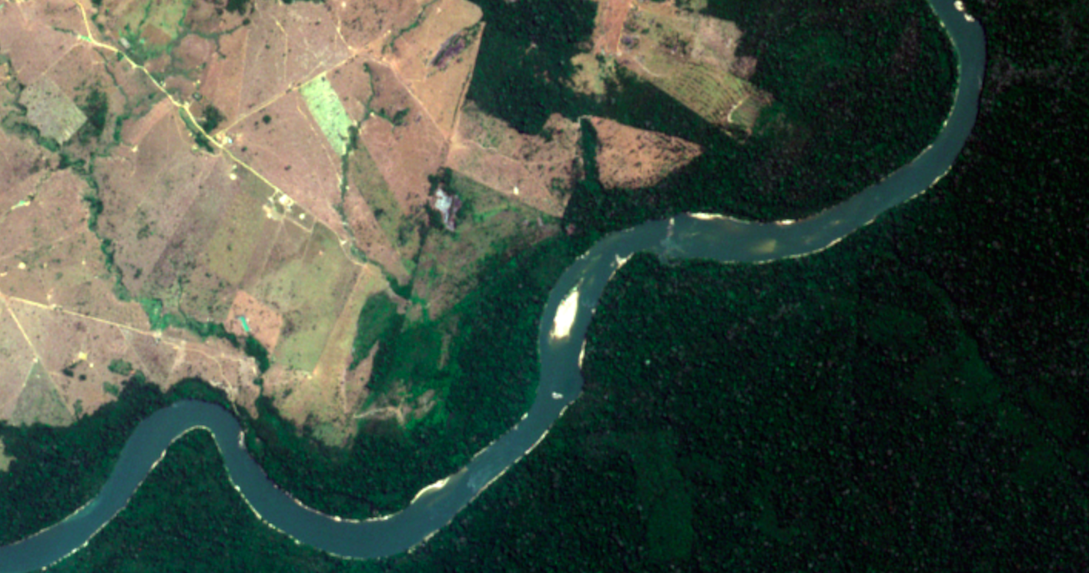
Sentinel-2 in full resolution over the Amazon
13 spectral bands in VIS/NIR/SWIR
Spatial resolution: 10m / 20m / 60 m
Swath: 290 km
5 days revisit at the Equator (with 2 spacecraft)
Systematic coverage between 84°N and 56°S
Notes:
S-2 data take over Rondonia in Brazil on 25 August 2015

Slide 14
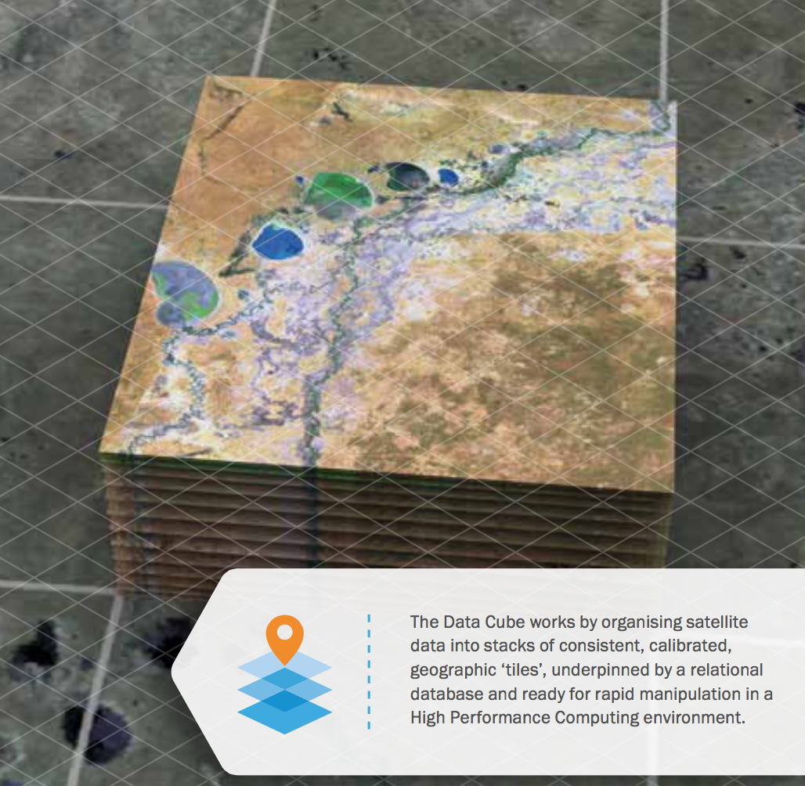
Space Data Services
Strategy endorsed at SIT-29, Toulouse
Removing obstacles to country uptake of satellite data through cloud computing, storage, novel computing and database technology
Countries can focus on data
applications and not handling
Pilot projects underway, e.g.
  Kenya Cube in support of their
  NFMS - Colombia Cube will follow
  SEPAL by FAO
  ESA’s Thematic Exploitation
  Platform on Forestry
New GFOI Space Data Portal
for all countries is being
developed.
Notes:
We see broader potential for CEOS

Slide 15
GFOI R&D Programme
Methods and Guidance only includes operational methods and approaches.
Component aims to stimulate R&D on developing approaches that are not operational but could become widely available and useful
R&D Workshops to discuss major topics, on-going work and how to promote further development, in cooperation with GOFC-GOLD
Identifying and provision of space data to meet R&D (SDCG R&D Element)
Identification of new approaches that can be included in future versions of the Methods and Guidance
Identifying funding opportunities
GOFC-GOLD: http://www.gofcgold.wur.nl/ GFOI: http://www.gfoi.org/rd
Notes:
GOFC GOLD: New lead for R&D Component

Slide 16
SDCG 3-Year Work Plan
Aligns Space Data Component with new GFOI Strategy document
Intended to take the Space Data Component through the next phase of GFOI in a well-structured and managed way
First presented at SIT-30 in Paris, March 2015
Update discussed at SDCG-8 for 29th CEOS Plenary

Slide 17
Issues & Concerns
SDCG seeks confirmation from GFOI Leads of the model of in-country delivery by GFOI, FAO and WB
  What is the best modus operandi for cooperation?
Continuity of Leadership Capacity
  CEOS GFOI Lead will step down in March 2016
  No replacement of third SDCG co-chair (was NSC)
  Current USGS SDCG Co-Chair retires 2016
  SDCG SEC funding expires Jun 2016
COP-21 in Paris is a global Milestone
  GFOI side event (ESA, Australia, Cameroon, RESTEC) –
  opening by Greg Hunt, Australian Minister for the Environment
SDCG willing and able to continue as an Ad-hoc CEOS Group for another year!

Slide 18
For Plenary
Acquisition Strategy Implementation Report for 2014 – for reference and endorsement
Updated 3-year Work Plan (per SIT-30 action) – for reference
Request renewal as CEOS Ad-hoc Group

Slide 19

Thanks
www.gfoi.org
www.ceos.org/sdcg

