Slide 1
Committee on Earth Observation Satellites
SIT Accomplishments
2014-2015
SIT Chair
Plenary Agenda Item 15
29th CEOS Plenary
Kyoto International Conference Center
Kyoto, Japan
5 – 6 November 2015

Slide 2
Context
Let’s think back to November 2013 …
Steered by the NASA SIT team, CEOS had just completed its most comprehensive operations review ever …
Evolution not revolution!

Slide 3
SIT team focus (as presented at Plenary 2013)
CNES will endeavour to balance these two requirements: managing change while continuing to deliver on CEOS “core business”
Two main themes :
Implementation of CSSII recommendations
Manage the evolution of CEOS as described in the recoms passed at Montréal plenary 2013
Implement the processes agreed on
Tidy up any “loose ends” …
Support GEO in showing concrete progress
Continuity in the development of programmes (GFOI, GEOGLAM, Disasters)
Improve access to space based EO data

Slide 4
Major focus of CSSII
Internal organisation (TORs, group interactions, decision making)
Steering of CEOS operations
Management of new activities (responsiveness, guidance)
“Use of CEOS guiding documents critical. SIT Team referenced these often”
“I found the SIT team very reactive over the past two years”
“ … it should be noted which functions are inherently CEOS and which are "work-throughs" or transitional”
98% of survey respondents either satisfied or very satisfied on SIT team steering

Slide 5
Major focus of CSSII
Formalised and regular interactions with the Virtual Constellations and Working Groups
Maintaining VC and WG teleconferences twice annually
Creation of a “VC/WG day” prior to the SIT Technical Workshop in September
“These teleconferences were focused and efficient. They were summarized in a concise and timely manner.”
“Very useful meetings providing an opportunity for VCs/WGs to discuss progress and issues, and for the SIT Chair and Team to offer guidance and support”
“perhaps what we really want/need is not a "VC/WG" day, but rather a "VC" day”
“Should be with less people around the table, which would allow a smaller room and less formal interaction”
“I'm not totally convinced by the process”
98% of survey respondents either satisfied or very satisfied on VC/WG teleconferences and VC/WG day

Slide 6
Major focus of CSSII
Generally on implementation of CSSII recommendations and stabilizing CEOS operations
“… focused on strategic priorities and struck an appropriate balance between this and excessive focus on process”
100% of survey respondents either satisfied or very satisfied

Slide 7
Support to GEO
Support GEO to show concrete progress
CEOS-GEO interactions
VC and WG progress
Ad-hoc activities (GFOI, GEOGLAM)
“The SIT Team also … worked to ensure that ad-hoc activities continued to advance and were well led”
“Support was satisfactory, especially given some of the changes going on within GEO”
97% of survey respondents either satisfied or very satisfied on Support to GEO

Slide 8
CNES priorities
Climate
Disasters
Access to EO data
“CNES worked very hard to implement its objectives. But despite all these efforts, it is not always easy to move people forward”
82% of survey respondents agree that SIT Chair has contributed on these priority areas and 97% agree or partially agree

Slide 9
Some major CEOS achievements in 2014 and 2015
Internal organisational issues
Consolidated regular interactions with VCs and WGs – six-monthly teleconferences and VC/WG day
Revival of Land Surface Imaging Virtual Constellation
Disasters
Creation and build up of Disaster WG (including the Recovery Observatory)
Successful participation at World Conference on Disaster Risk Reduction – Earth Observation cited explicitly 3 times in Post-2015 Framework for DRR

Slide 10
Some major CEOS achievements in 2014 and 2015
Climate
Promoting space for better understanding Climate trends in the build up to the COP-21
CEOS Climate roundtable at the Paris Airshow Le Bourget
IAA Head of Agencies declaration on space’s contribution to Climate Change and Disaster management
Improved access to Earth Observation data
Consolidation of IDN
CEOS Opensearch
SPOT World Heritage programme

Slide 11
General feedback
“work of the SIT chair over the past two years has been very useful and CEOS certainly moved forward under this leadership”
“SIT Chair, and SIT Chair Team, were very responsive and offered sound opinions and guidance on important strategic issues”
“Many thanks to CNES and the SIT Team for their hard work during these two years”
“Bravo to CNES on its SIT Chairmanship!”

Slide 12
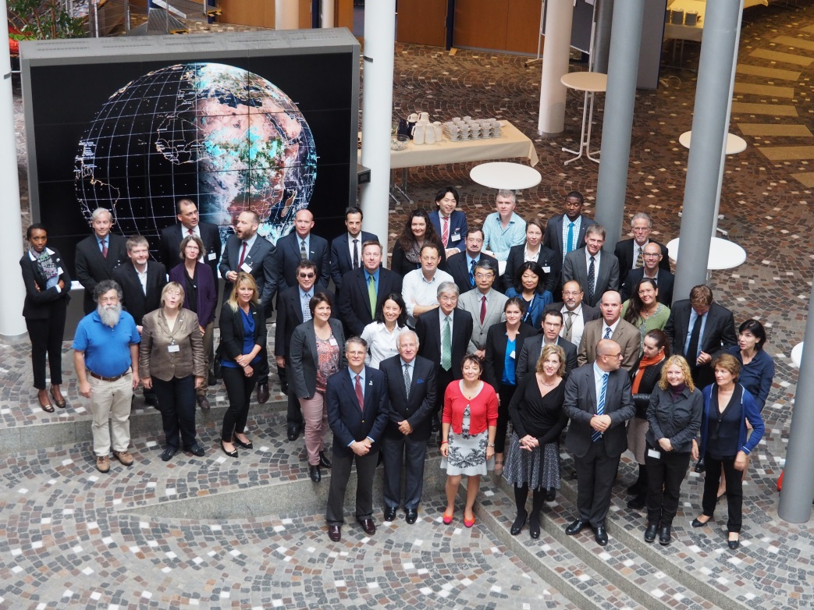
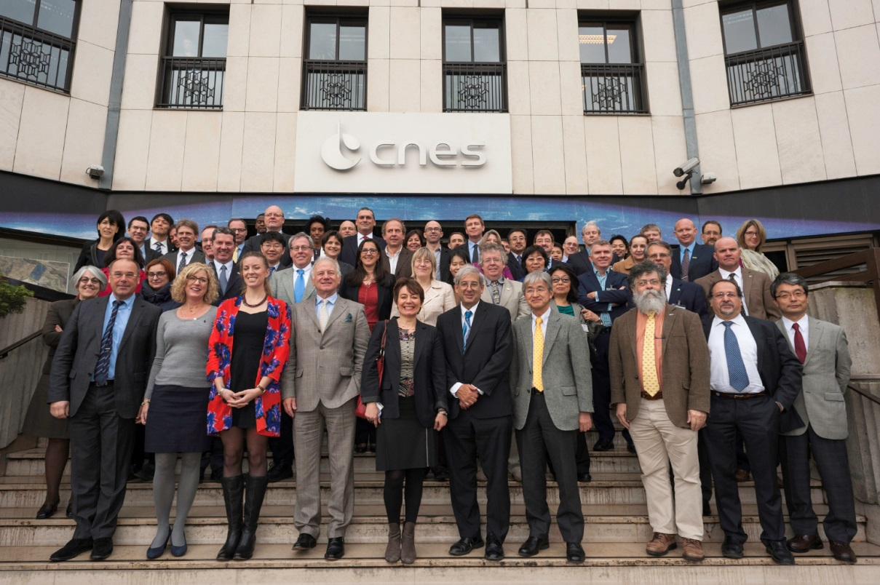
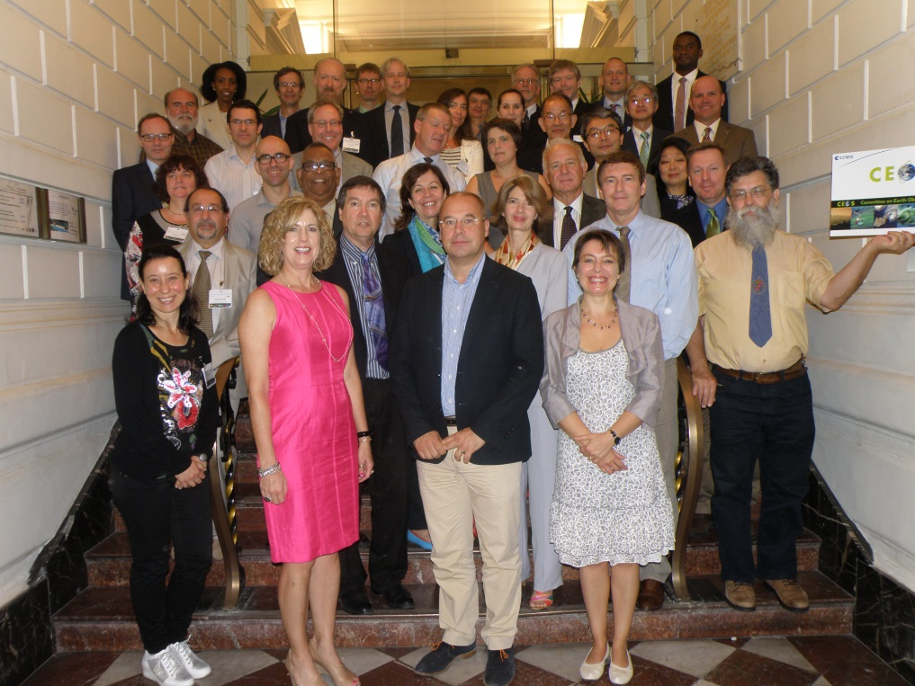
TEAM WORK !!!

Slide 13
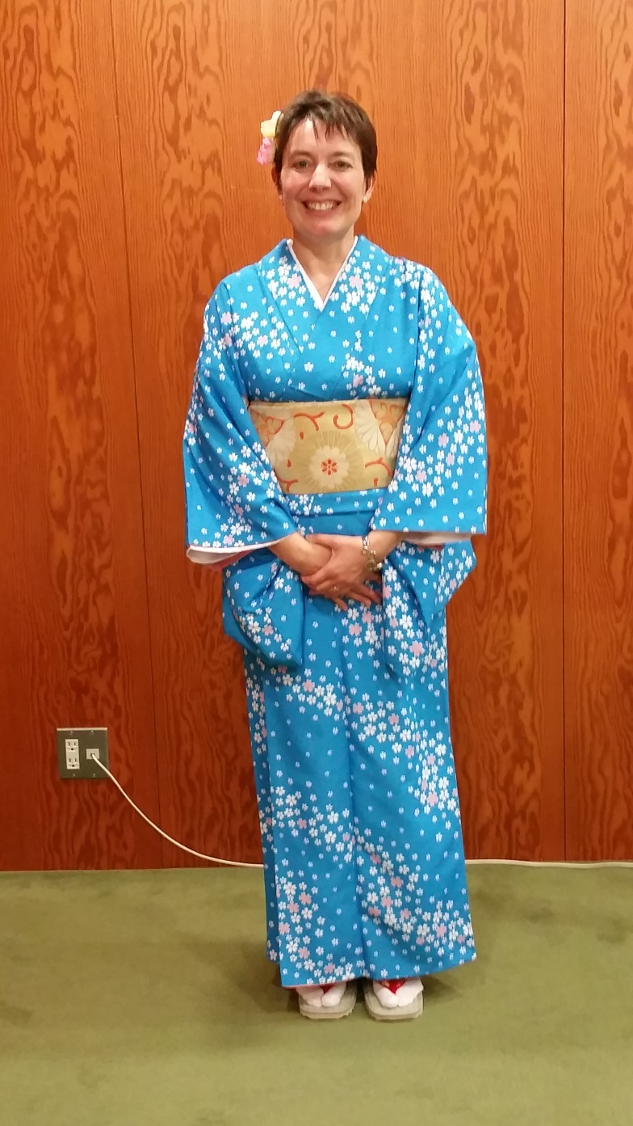
Thank you!
Merci!
Arigato!

