Slide 1
Committee on Earth Observation Satellites
CEOS Contribution to
GEO 2012-2015 Work Plan
SIT Chair, Brian Killough
Plenary Agenda Item #12
29th CEOS Plenary
Kyoto International Conference Center
Kyoto, Japan
5 – 6 November 2015

Slide 2
Outline
Part 1: CEOS contributions to GEO Work Plan
GEO-related actions are tracked within the CEOS workplan
Status of actions was presented on agenda item 6
Part 2: Focus on CEOS leadership of GEO Infrastructure task IN-01-C2
Part 3: Report on CEOS Virtual Constellations
To be presented during agenda item 16

Slide 3
2 components
63 Task Components
5 components
6 components
1 component
3 components
Point of Contact: 11
5 components
Lead: 7
Contributor: 10
5 components
Involved in 44%
of Task Components
3 Members serving on Boards
3 components
1 component
Societal
Benefits
14 components
Institution & Development
7 components
Infrastructure
11 components

Slide 4
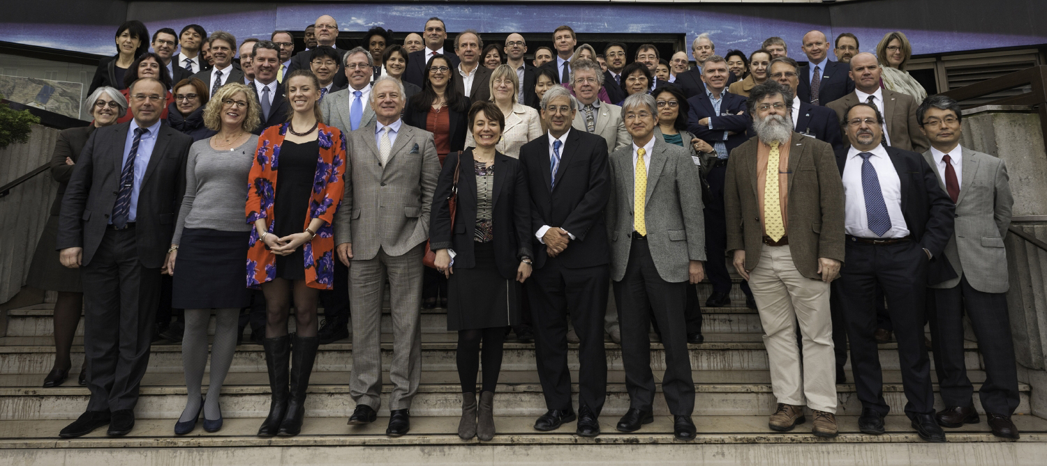
CEOS, the Space Arm of GEO
CEOS Response to the GEOSS Water Strategy Recommendations

Slide 5
Task Coordinator: Brian Killough (CEOS)
GEO Task IN-01 Status Report

Slide 6
New GEO Workplan – Changes to IN-01
IN-01-C2 task now called GD-5 (GEOSS Satellite Earth Observations Resources). This new task, dedicated to space-based observations is a perfect fit for CEOS and clearly matches our goals and work plan.
Old IN-01-C1 (surface networks, in-situ) now removed and the focus of GD-6 (GEOSS non Space-based Earth Observations Resources). Brian Killough will lead an in-situ side meeting at the GEO Plenary to support the transition for this group and provide guidance for future coordination of this community.
Old IN-01-C3 (coordination of satellite and in-situ measurements) is now a general role of GEO and not found in any particular task.
Old IN-01-C4 (Radio Frequency Protection) is now moved to GD-09.

Slide 7
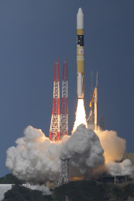
IN-01-C2 Accomplishments
CEOS currently operates 135 missions!
12 successful CEOS launches in 2014
5 successful CEOS launches in 2015 CATS-ISS (NASA), SMAP (NASA), KOMPSAT-3A (Astrium,DLR,KARI), Sentinel-2A (ESA, EC), Meteosat-11 (EUMETSAT).
4 new CEOS launches planned for the rest of 2015 Sentinel-3A (ESA/EC), Jason-3 (NASA, NOAA, CNES, EUMETSAT), Ingenio (CDTI), ELECTRO-L2+RESURS-P3 (Russia)
NO ISSUES

